Slide 1
University Astronomy
Professor Don Figer
Dark Matter

Slide 2
Aims and outline for this lecture
define dark matter
review evidence of dark matter
describe potential sources of dark matter
discuss dark matter probes

Slide 3
what is dark matter?

Slide 4
Dark Matter
The term “dark matter” describes an unseen source that appears to affect measurements of the Universe just as does the matter that we can see.
For instance, matter that we can see, such as the Sun, affects the orbits of planets (that we can see).
Imagine that we could not see the Sun (but it was still there), but we could watch the planets orbit it. We might say that there is some mysterious “dark matter” that is causing the planets to orbit a common point.
We cannot explain some measurements in the Universe just on the basis of what we can see and our knowledge of gravity.

Slide 5
What Does “Dark” Mean?
In the context of the term “dark matter,” the word “dark” means that we do not see it.
What does “see” mean?
“See” means that we have not detected photons from it.
It could be that we aren’t looking in the right wavebands.
Maybe dark matter doesn’t emit many photons.
Maybe the effects of dark matter actually aren’t due to any kind of matter at all.
That is, maybe the effects are just an artifact of the fact that we do not understand gravity (“oh, there goes gravity”).

Slide 6
dark matter and Galactic
Rotation curves

Slide 7
Galactic Rotation Curves
One way to estimate the mass of a point object is to measure the velocities of objects orbiting it.
In a system in which the point mass dominates the whole mass of the system, like the Sun and planets, we expect the orbital velocities to decrease by 1/r^{1/2}. This is called the Keplerian case.
The mass distribution in the Galaxy is a bit different.
Its mass is extended, not just in a point.
We observe that the orbital velocities do NOT decrease at all. They are roughly constant as a function of distance from the Galactic center.
The “visible” distribution of matter falls as a function of distance.
Therefore, their appears to be some “dark” matter.

Slide 8
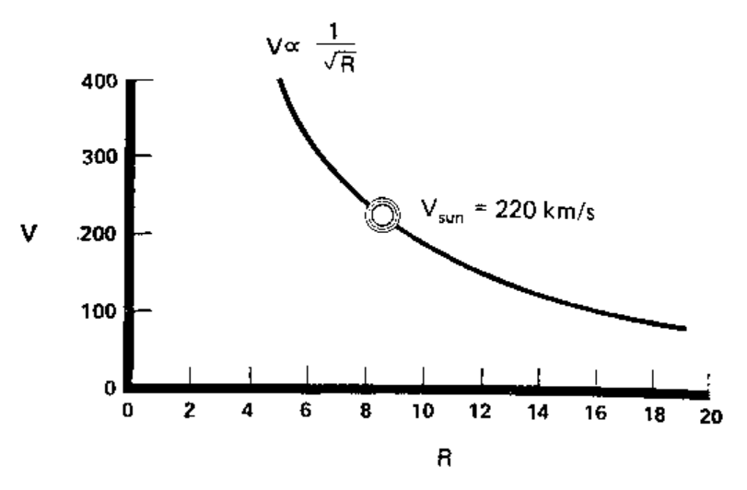
What Is Velocity Around Point Mass?

Slide 9
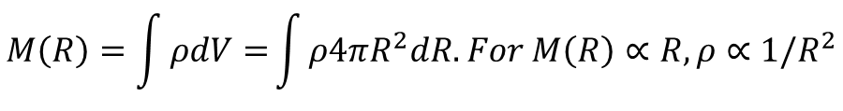

Stellar Velocities and Dark Matter
The average rotational velocity does not fall as 1/r^{1/2}, as one would expect around a point mass, e.g. as in the Keplerian case.
Instead, it appears to be constant.
$$F=G\frac{M\left(R\right)m}{R^{2}}=ma=m\frac{{v(R)}^{2}}{R}, so G\frac{M\left(R\right)}{R}={v(R)}^{2}$$
$$M\left(R\right)=\frac{{v(R)}^{2}R}{G}→{v(R)}^{2}=G\frac{M\left(R\right)}{R}. For v=constant, M\left(R\right)∝R.$$
$$M\left(R\right)=\int{ρdV=}\int{ρ4πR^{2}dR. For M\left(R\right)∝R, ρ∝1/R^{2}}$$
The stellar number density is falling at a much higher rate.
Therefore, there must be some sort of matter that we cannot see in order to explain the velocities.

Slide 10
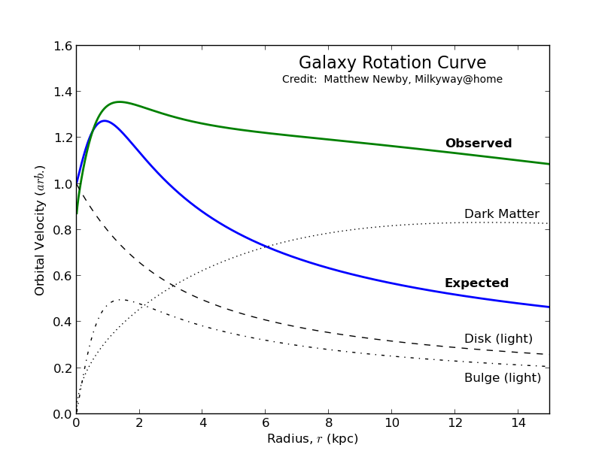
Rotation Curve

Slide 11
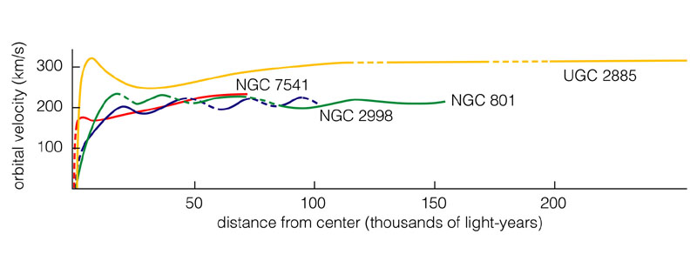
Other Spiral Galaxies
These rotation curves are flat, just like for our Milky Way.
Other galaxies also contain a lot of dark matter.

Slide 12
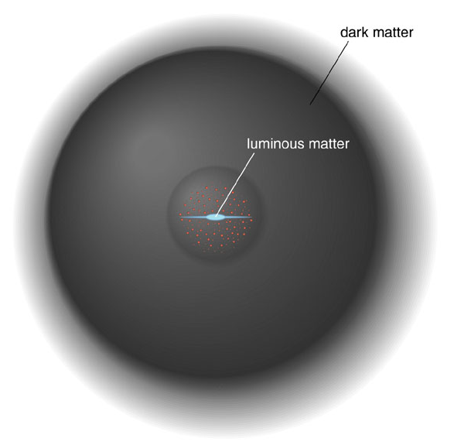
Dark Matter in the Halo

Slide 13
dark matter and Galaxy clusters

Slide 14
Galaxies in Clusters
Galaxy clusters are particularly important for dark matter studies since their masses can be estimated in three independent ways:
  From the scatter in radial velocities of the galaxies within clusters.
  From X-rays emitted by hot gas in the clusters. From the X-ray energy spectrum and flux, the gas temperature and density can be estimated, hence giving the pressure; assuming pressure and gravity balance determines the cluster's mass profile.
  Gravitational lensing (usually of more distant galaxies) can measure cluster masses without relying on observations of dynamics (e.g., velocity).
These three methods are in reasonable agreement that dark matter outweighs visible matter by approximately 5 to 1.

Slide 15
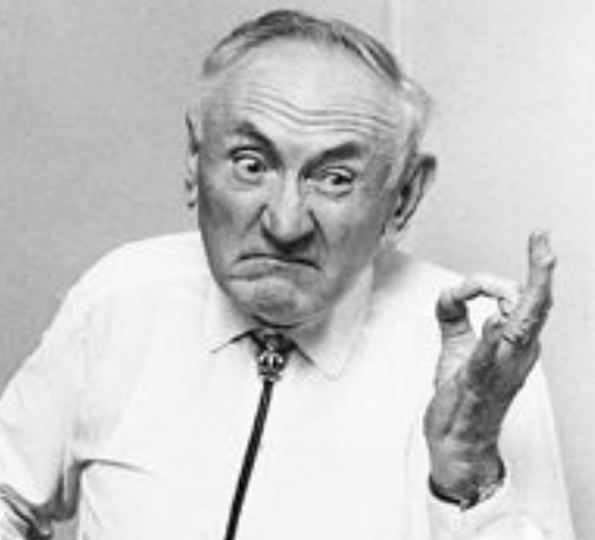
Coma Cluster
Fritz Zwicky (1930s) noted large radial velocities Coma Cluster galaxies.
It took 30 years to confirm the existence of dark matter.
Modern x-ray telescopes find a halo of hot gas (~10⁸ K), implying matter ~5 times more than the visible mass.

Slide 16
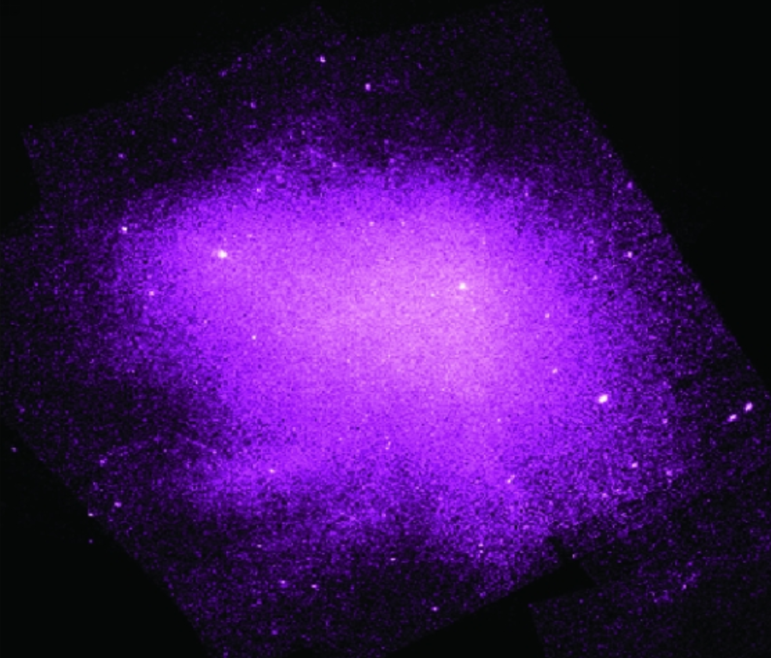
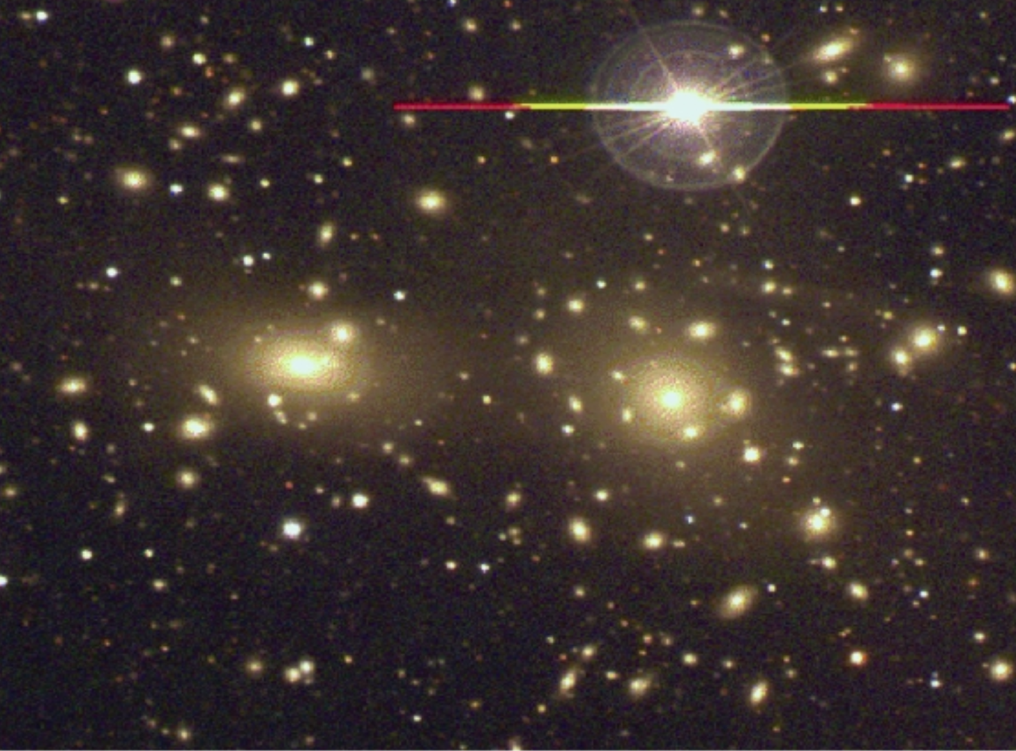
Coma Cluster
Visible
X-ray

Slide 17
dark matter and hot gas around elliptical galaxies

Slide 18
M87
M87 is a giant elliptical galaxy with an extended corona of X-ray emitting hot gas and two opposing jets projecting out from a giant black hole at the center.
The mass of M87’s giant central black hole is 3(10⁹) M_{Sun}, small compared to the visible mass in M87.
X-ray measurements can be translated into pressure and temperature gradients.
Assuming hydrostatic equilibrium, one can relate the gradients into a mass distribution.
The mass far exceeds what would be expected from the observed light.
Globular cluster motions around M87 confirm the presence of dark matter.

Slide 19
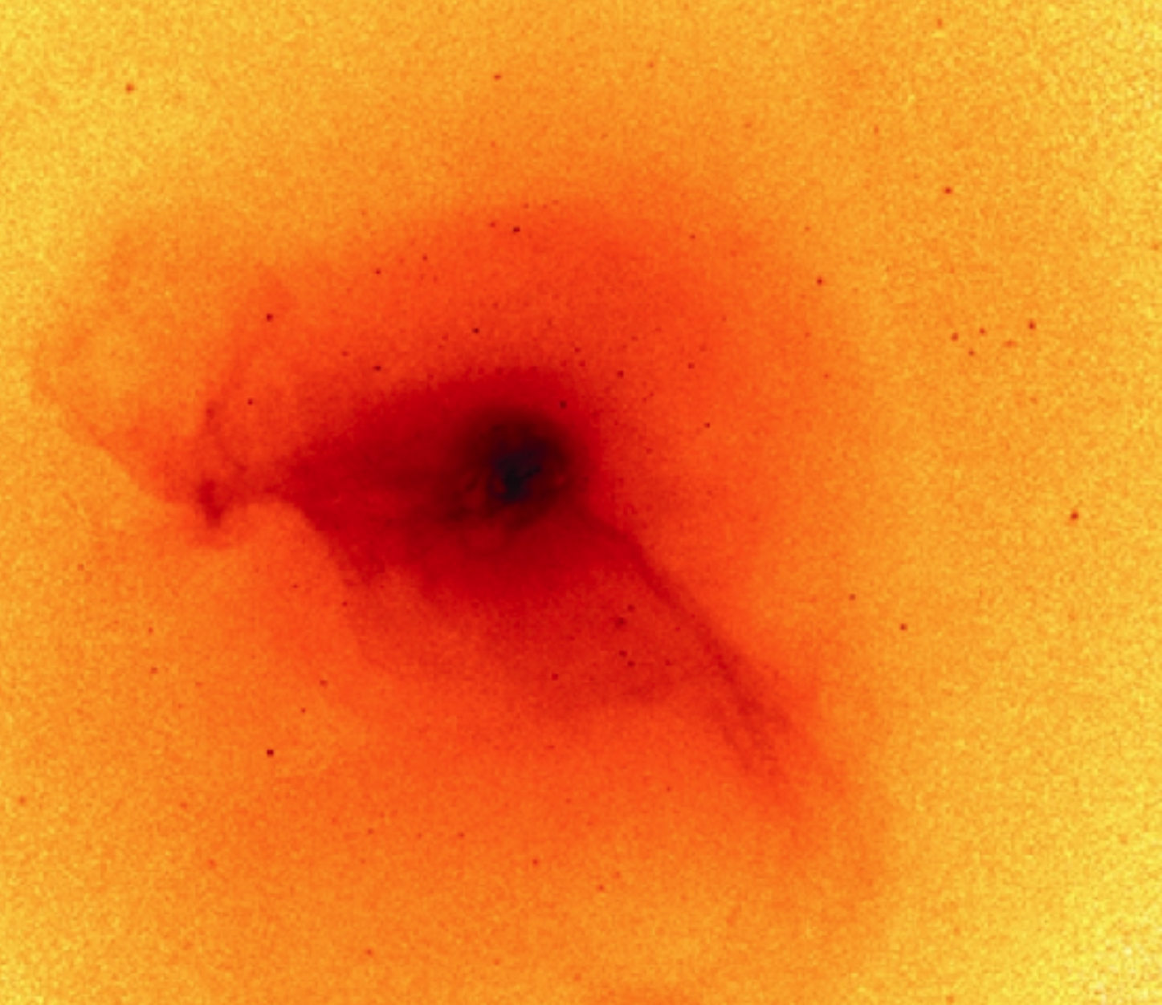
M87 (x-ray)

Slide 20
dark matter and gravitational lensing

Slide 21
Gravitational Lensing
Massive objects (such as a cluster of galaxies) lying between a more distant source (such as a quasar) and an observer should act as a lens to bend the light from this source.
The more massive an object, the more lensing is observed.
Gravitational lensing is often categorized as strong or weak.

Slide 22
Strong Lensing
Strong lensing is the observed distortion of background galaxies into arcs when their light passes through such a gravitational lens. By measuring the distortion geometry, the mass of the intervening cluster can be obtained.
In the dozens of cases where this has been done, the mass-to-light ratios obtained correspond to the dynamical (from velocities) dark matter measurements of clusters.
Lensing can lead to multiple copies of an image. By analyzing the distribution of multiple image copies, scientists are able to deduce and map the distribution of dark matter around galaxy clusters.

Slide 23
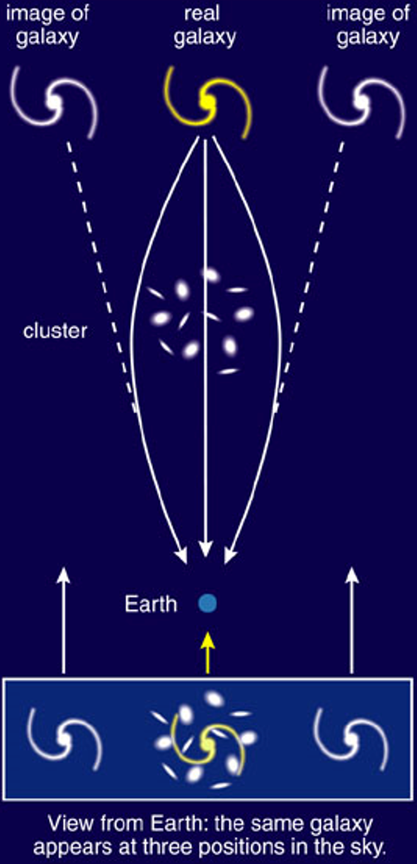
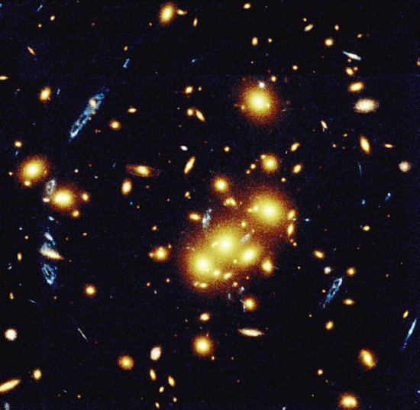
Gravitational Lensing

Slide 24
Weak Lensing
Weak gravitational lensing describes very small perturbations in the images of galaxies that are far far away….
Perturbations are small, so the effects are studied using statistical analyses from vast galaxy surveys.
By examining the apparent shear deformation of the adjacent background galaxies, the mean distribution of dark matter can be characterized.
This is the primary method that LSST will use to map dark matter in the Universe.

Slide 25
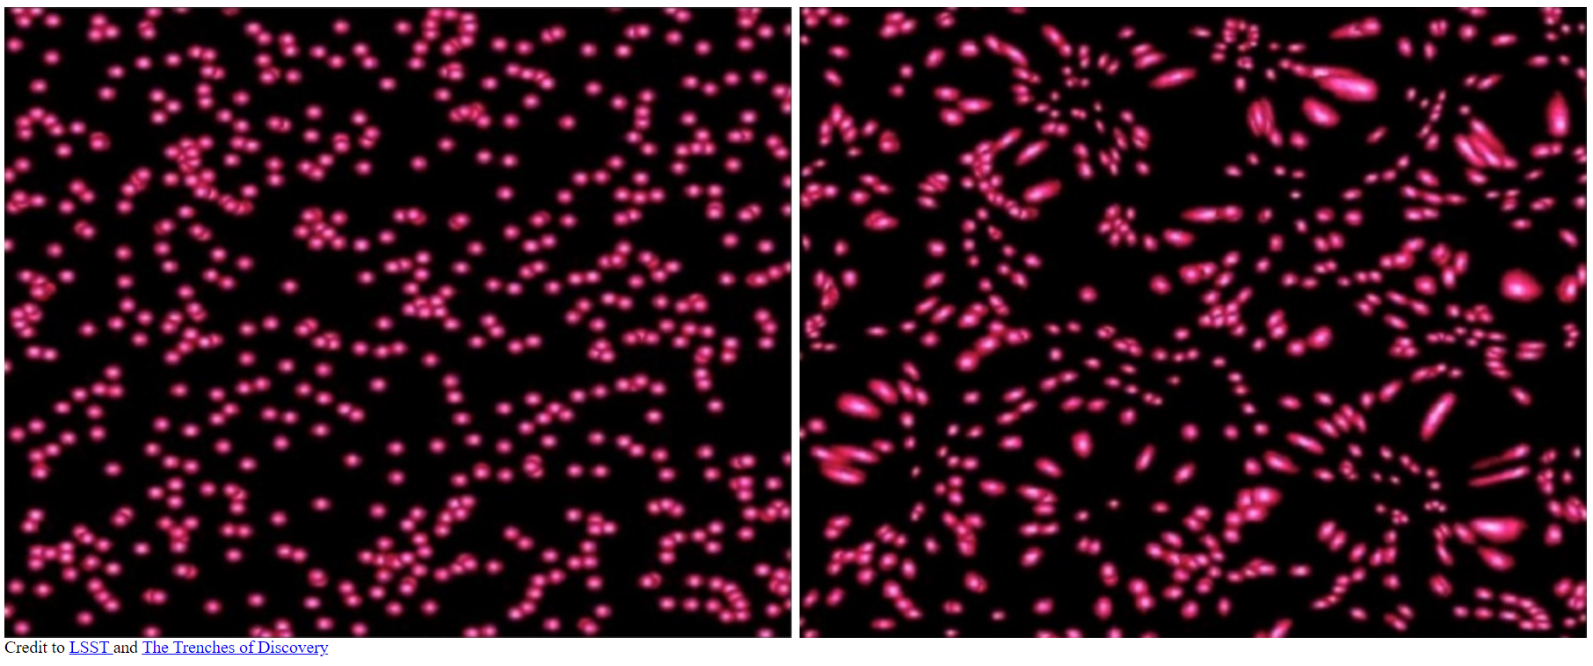
Weak Lensing

Slide 26
LSST
LSST is the Large Synoptic Survey Telescope in the Vera Rubin Observatory.
It will image the sky every few days for five years.
The primary goal is to map dark matter in the Universe through weak lensing.
It is located in Chile.
RIT involvement started ~2006 when the Center for Detectors contributed to development of the detectors and then leading management of the guider system. RIT was first to get the LSST prototype detectors.
RIT continued to be involved in LSST through Center for Detectors involvement in the stellar populations science group.

Slide 27
dark matter candidates

Slide 28
Dark Matter
stellar dark matter
  black holes, rare but could make up some of dark matter
  brown dwarfs, low-mass prestellar objects, never stars
  white dwarfs, relic low mass stellar objects, no longer generating energy
  faint, low-mass red dwarfs, Hubble Space Telescope examined a globular cluster with extreme sensitivity and did not see the red dwarfs, so they are ruled out
  MAssive Compact Halo Objects (MACHOs)
exotic subatomic particles
  WIMPs (Weakly Interacting Massive Particles)
  Axions
modified law of gravity at large distances

Slide 29
dark matter probes

Slide 30
Detecting Dark Matter
If dark matter is made up of sub-atomic particles, then millions, possibly billions, of such particles must pass through every square centimeter of the Earth each second.
Many experiments aim to test this hypothesis. Although WIMPs are popular search candidates, the Axion Dark Matter Experiment (ADMX) searches for axions.
These experiments can be divided into two classes:
  direct detection experiments, which search for the scattering of dark matter particles off atomic nuclei within a detector; and
  indirect detection, which look for the products of dark matter particle annihilations or decays.

Slide 31
dark matter summary

Slide 32
Dark Matter Summary
Dark matter evidence includes
  galactic rotation curves
  velocities of objects in the halo
  velocities of galaxies in cluster
  x-ray emitting gas around ellipticals
  x-ray emitting gas in clusters
  gravitational lensing (weak and strong)
Dark matter could be
  regular matter that does not emit much light
  exotic matter of an unknown nature
  nothing (effects due to misunderstanding of gravity)
We are searching for the source of dark matter.

