Slide 1
University Astronomy
Professor Don Figer
Star Formation

Slide 2
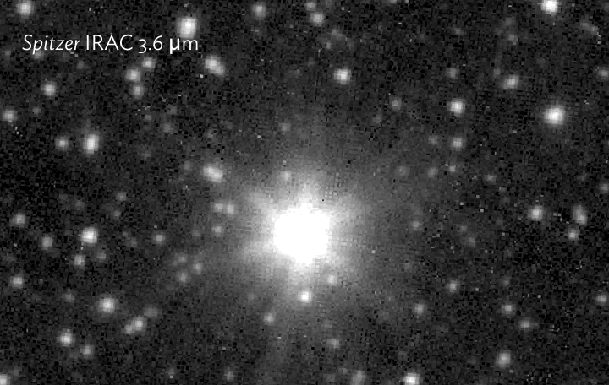
JWST vs. Spitzer!

Slide 3
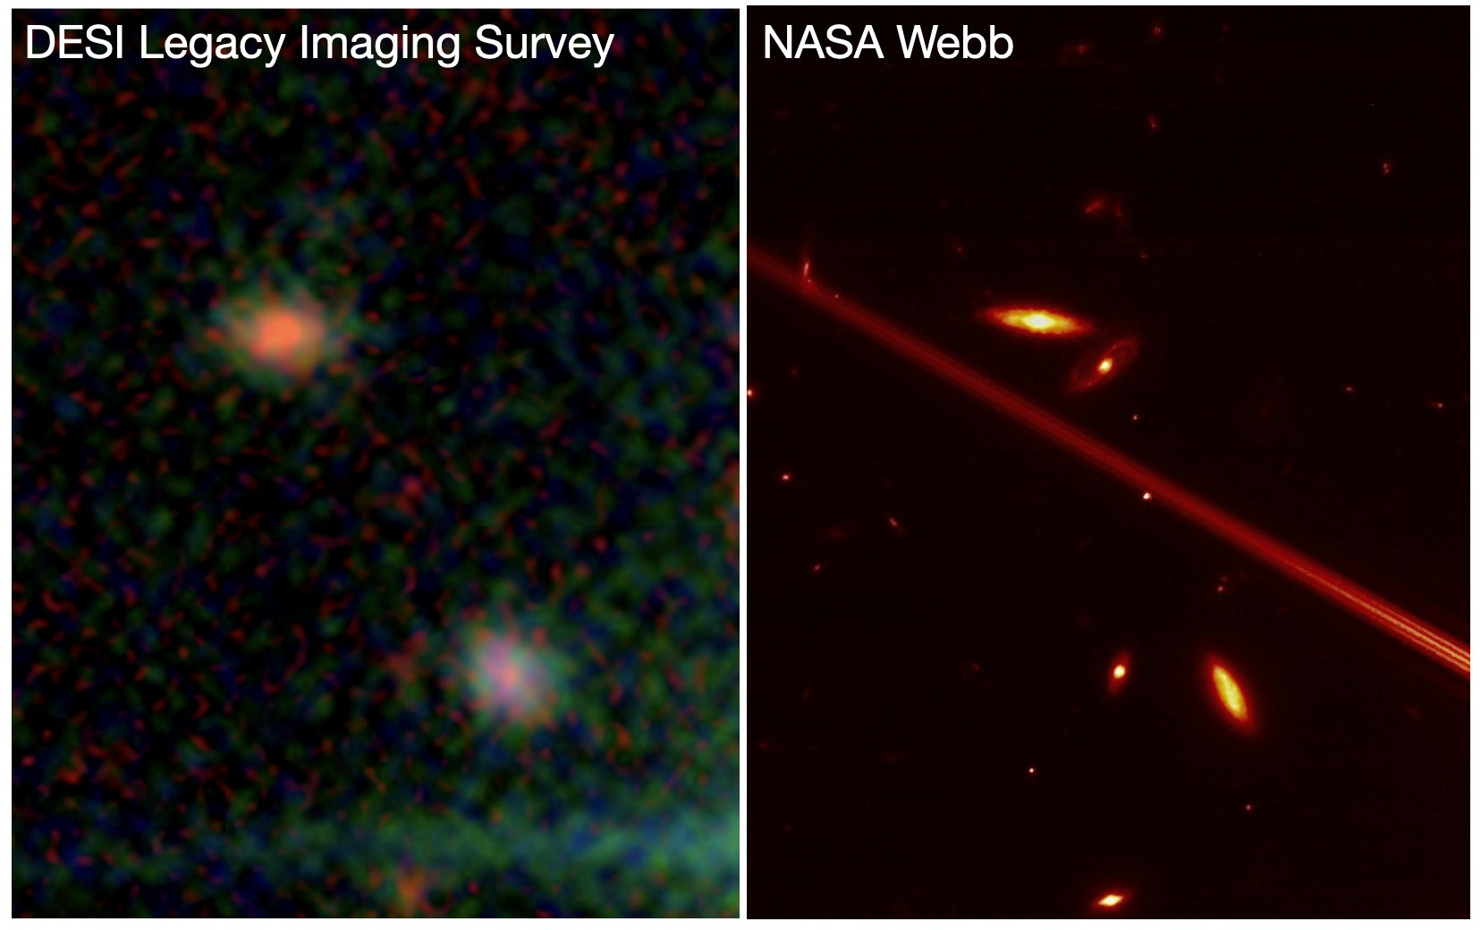
JWST vs. Ground-based!

Slide 4
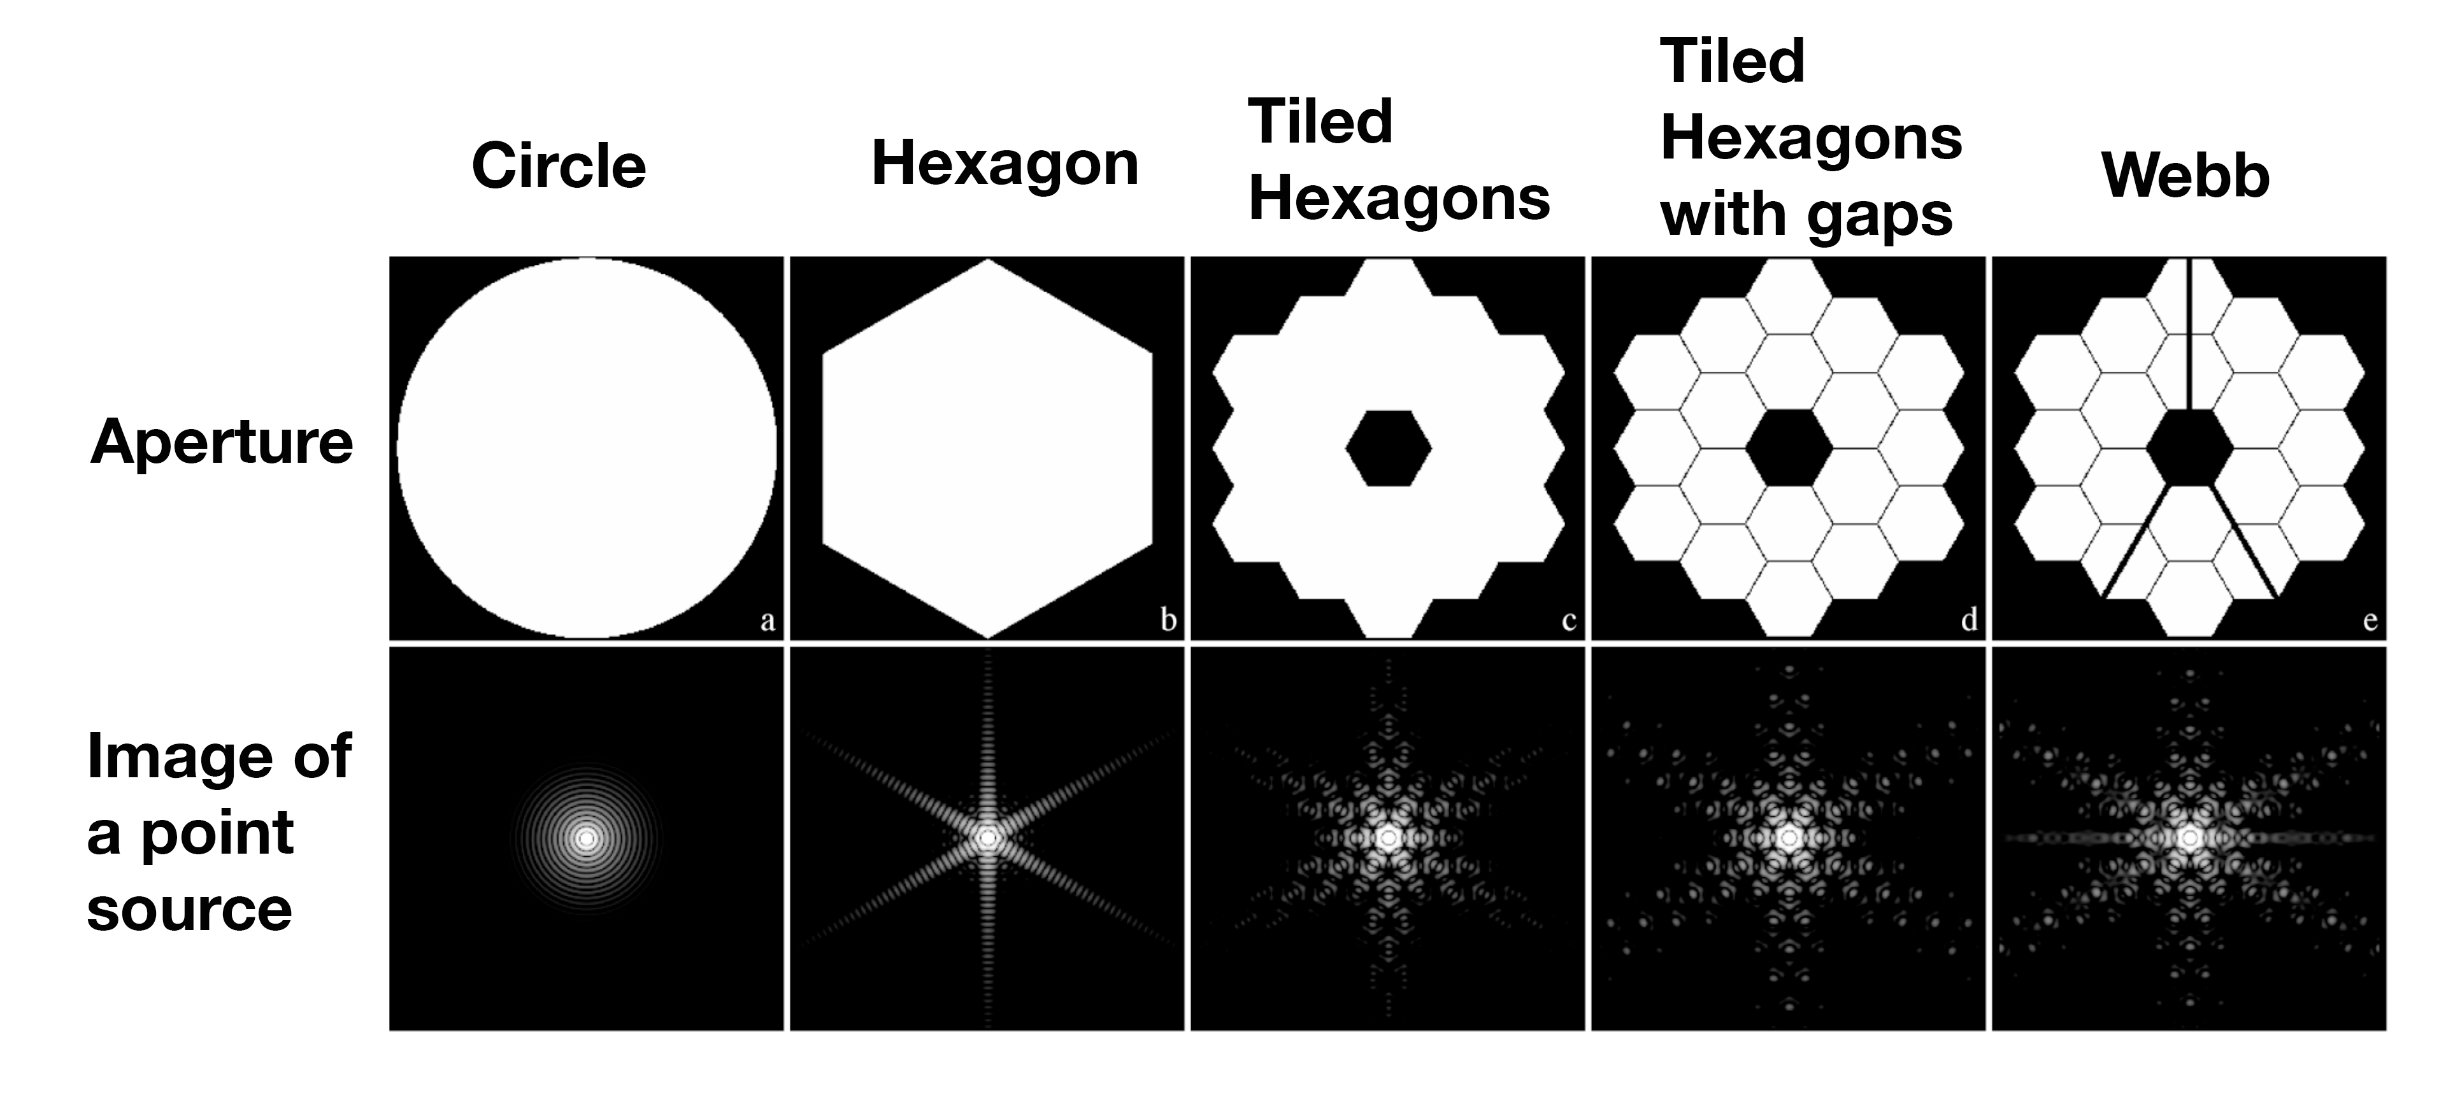
Webb Diffraction Pattern

Slide 5
Aims and outline for this lecture
describe the star formation process
introduce the stages of star formation
discuss the challenges of star formation models
show where stars fall on the HR diagram when they are forming

Slide 6
star formation process

Slide 7
Star Formation Process
Stars form in molecular clouds.
A typical cloud might have a mass of hundreds to millions of solar masses in gas.
Initially, an overly-dense region of the cloud collapses under gravitational influence.
The region begins to collapse at “free-fall” speeds, meaning as fast as gravity will take it without any impediments.
As the density grows, gas pressure builds.
Half of the change in potential energy will be radiated like a blackbody. The other half will be retained, resulting in higher and higher temperatures as the gas collapses.

Slide 8
Star Formation Process (cont.)
The clump contracts to hydrostatic equilibrium on the Kelvin-Helmholtz timescale.
As the gas collapses, the orbital speed increases because angular momentum is conserved.
Gas along the rotation axis falls on to a disk. Planets form.
The hydrogen core ignites, stabilizing the star and beginning its life on the main sequence.
Because the molecular cloud usually has more mass than what is necessary to make one star, stars form in clusters.
When a sufficient number of stars in a star formation event turn on, their winds could disrupt further star formation, especially if they are massive stars.
Star formation might trigger nearby star formation.

Slide 9
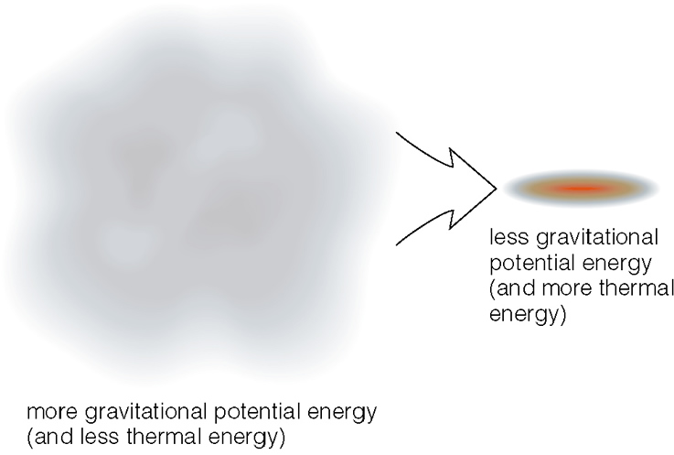
Cloud Collapse

Slide 10
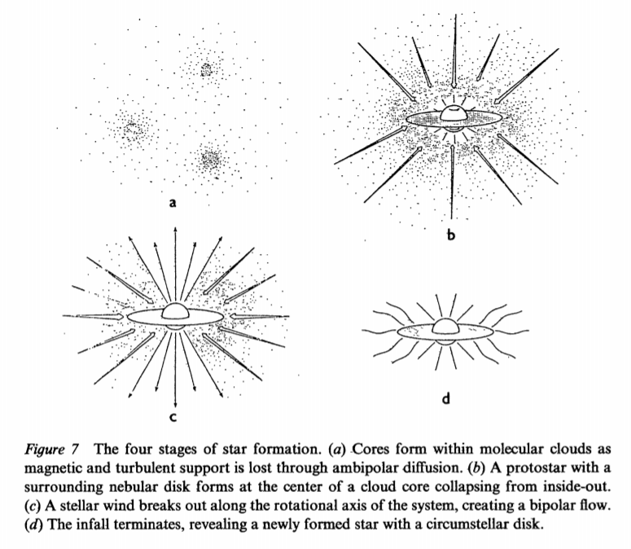
Shu, Lizano, Adams

Slide 11
star formation on the hr diagram

Slide 12
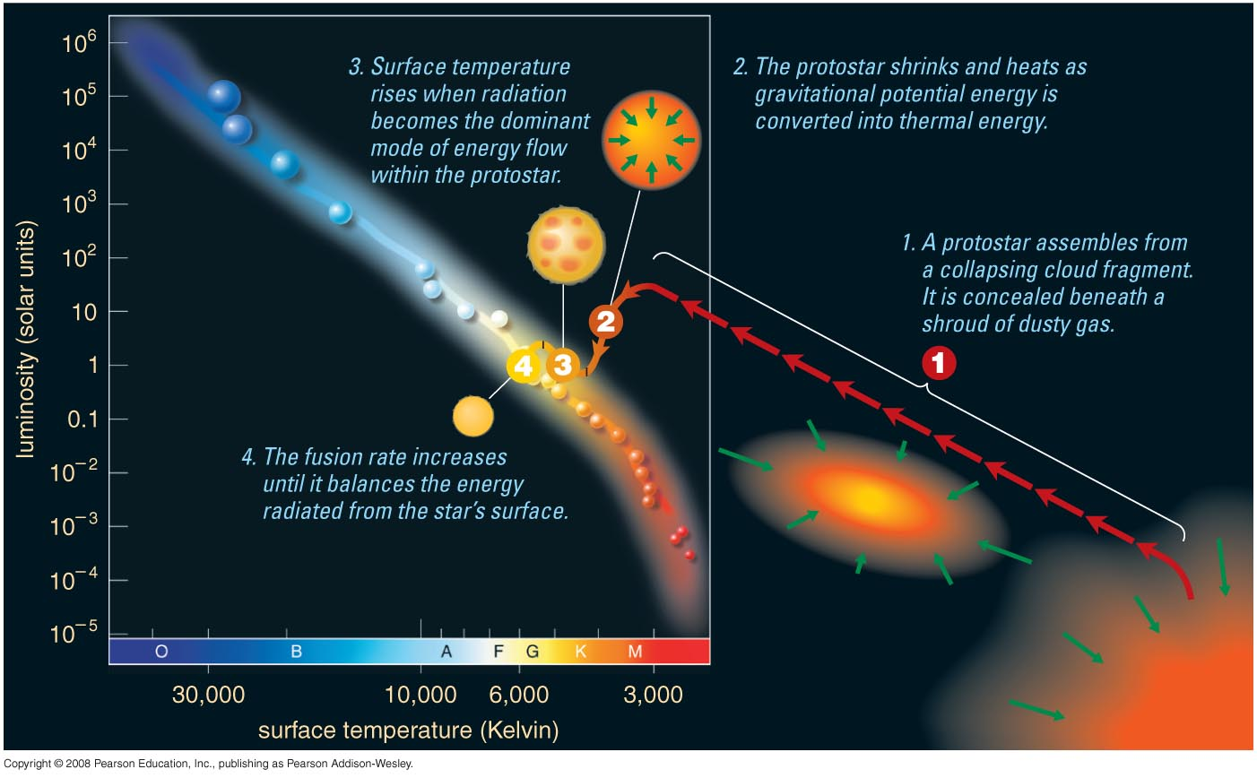
Protostars on the HR Diagram

Slide 13
Protostars on the HR Diagram
Convection Dominant

Slide 14
Protostars on the HR Diagram
Radiation
Dominant

Slide 15
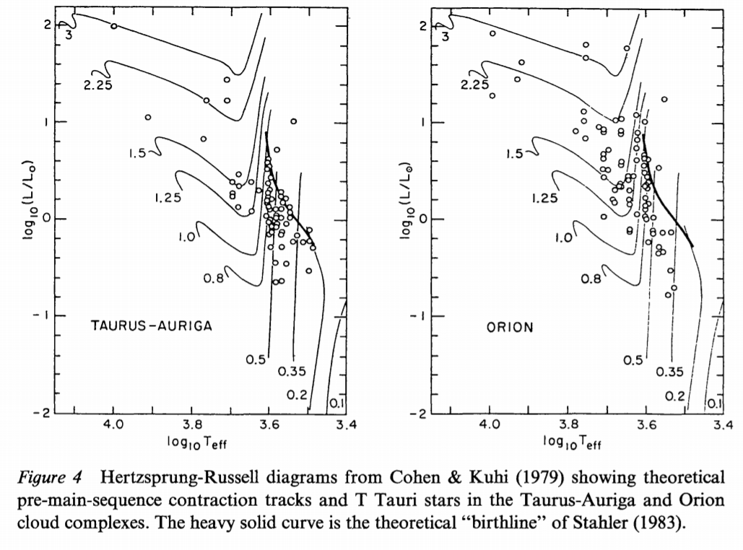
Observed HR Diagram

Slide 16
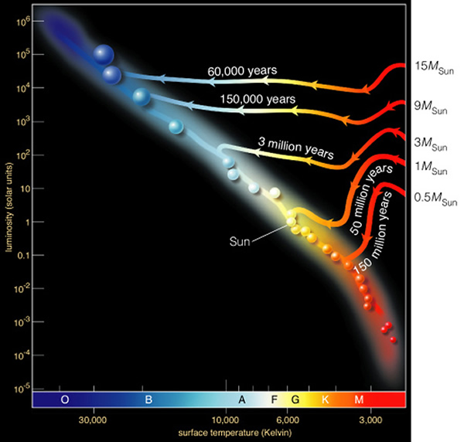
Protostars on the HR Diagram
Labels show the time it takes to reach the MS
depends on mass.
Shape of track
depends on mass
and composition.
Low mass stars take a long time to contract.

Slide 17
molecular clouds

Slide 18
Molecular Clouds
Stars are made of hydrogen (mostly).
Space is filled with hydrogen.
Molecular clouds contain hydrogen atoms and molecules in relatively high densities.
Gas temperatures are:
  10,000 K for warm gas
  100 K for cool gas
  10 K for cold gas

Slide 19
Molecular Cloud Support
Some gas can resist the pull of gravity.
Material is supported by ideal gas pressure.
Magnetic force resists the motion of ions (but neutrals can move against the field, presuming that they do not bump into too many ions).
Gravitational force is weak, so not much pressure is needed to resist it.

Slide 20
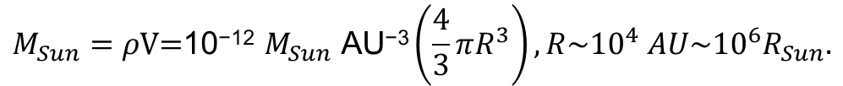
Densities
Molecular clouds have an average density of about a few hundred to thousand times the average density in “empty” space.
The average density in “empty” space is ~1 particle per cubic centimeter, or 10⁶ particles per cubic meter.
So, molecular clouds have an average density of ~10⁹ m⁻³.
A core/fragment has densities that are yet again a thousand times higher.
The mass density in a clump is ~10⁻¹² M_{Sun} AU⁻³.
Evidently, then, matter must come from a relatively large volume in order to have enough mass to make a star.
$$M_{Sun}=ρ\text{V}\text{=}\text{10}\text{−}\text{1}\text{2} M_{Sun} \text{AU}\text{−}\text{3}\left(\frac{4}{3}πR^{3}\right), R\sim {10}^{4} AU\sim {10}^{6}R_{Sun}.$$

Slide 21
Collapse Timescale
The time it would take for a cloud to collapse to a star is called the Kelvin-Helmholtz timescale.
It is a rough estimate for how long it would take for a collapsing system of gas to radiate its potential energy, given its luminosity.
One can use it to get a rough idea for how long it would take for a collapsing proto-star to collapse on to the main sequence.

Slide 22
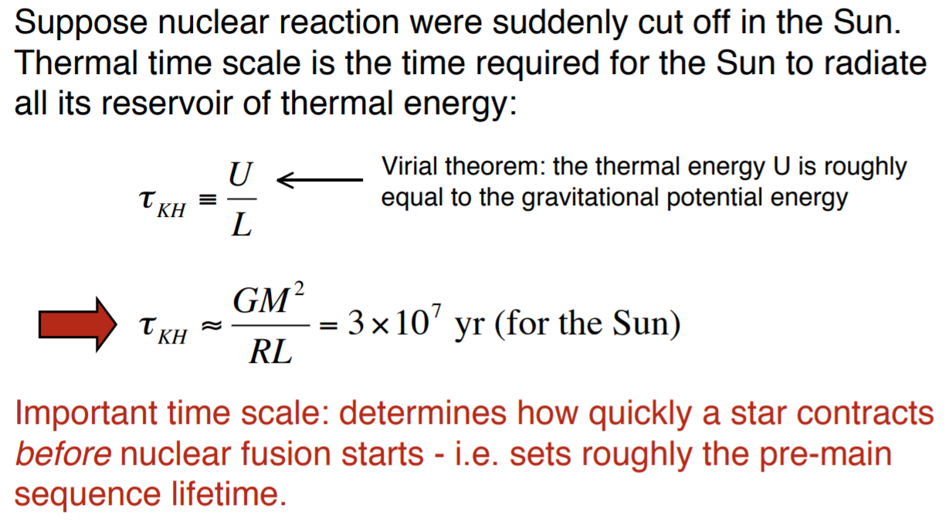
Kelvin-Helmholtz Timescale

Slide 23
The Jean’s Mass

Slide 24
Jean’s Mass Examples
For a globular cluster, M~10⁶ M_{Sun}~10³⁶ kg. Assuming an ionized gas state during the epoch of the early Galaxy, T~10⁴ K. So, ρ~10⁻¹⁸ kg/m³=10⁻²¹ g/cm³, or about a thousand times the density of the present-day ISM.
For the Sun, the density needs to be about a million times greater still, assuming T~50 K.
For Jupiter, the density needs to be ~10⁻⁷ kg/m³, or 10¹⁴ particles cm⁻³, assuming T~30 K.
Note that this Jean’s mass analysis is relatively simplistic, and there can be other factors that come into play, such as angular momentum and magnetic fields.

Slide 25

Angular Momentum
From physics, we know that angular momentum is conserved in an isolated system with no forces other than the centripetal force, i.e. no torques.
$$\frac{dL}{dt}=0, L=r×p, L=rmv$$
where, L is the angular momentum, r is the distance from the rotation axis to the particle, and p is the linear momentum (mv).

Slide 26
Angular Momentum of Sphere
For a constant-density sphere, the angular momentum is given by the moment of inertia, I, multiplied by the angular velocity, ω.
$L=Iω=\left(\frac{2}{5}MR^{2}\right)ω=\left(\frac{2}{5}MR^{2}\right)2πν$=$\left(\frac{2}{5}MR^{2}\right)\frac{2π}{P}∝\frac{R^{2}}{P}$
If angular momentum is conserved as a spherical distribution of particles collapses, then the period will decrease as the radius of the sphere decreases.
At some point, the velocity will be too high to permit further infall.
There must be some way to dissipate the angular momentum for the material to collapse further, such as frictional loss for particles in a spinning disk, magnetic braking, and formation of binaries.

Slide 27
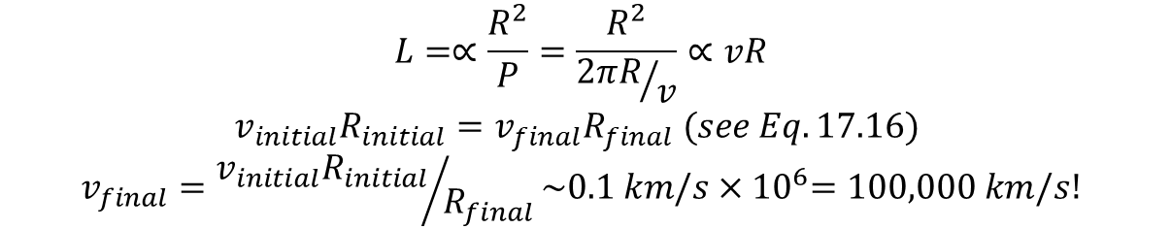
Angular Momentum Example
Consider a collapsing cloud that starts with a radius of 10⁴ AU and a rotational velocity of ~0.1 km/s. How fast would it be spinning after collapsing into a Sun-like star?
Recall that the cloud would have to contract by a factor of approximately 10⁶ times.
Conservation of angular momentum would suggest that the final velocity is ~30% the speed of light!
$$L=∝\frac{R^{2}}{P}=\frac{R^{2}}{{2πR}/v}∝vR$$
$$v_{initial}R_{initial}=v_{final}R_{final} (see Eq. 17.16)$$
$$v_{final}={v_{initial}R_{initial}}/{R_{final}}\sim 0.1 km/s{×10}^{6}=100,000 km/s!$$

Slide 28

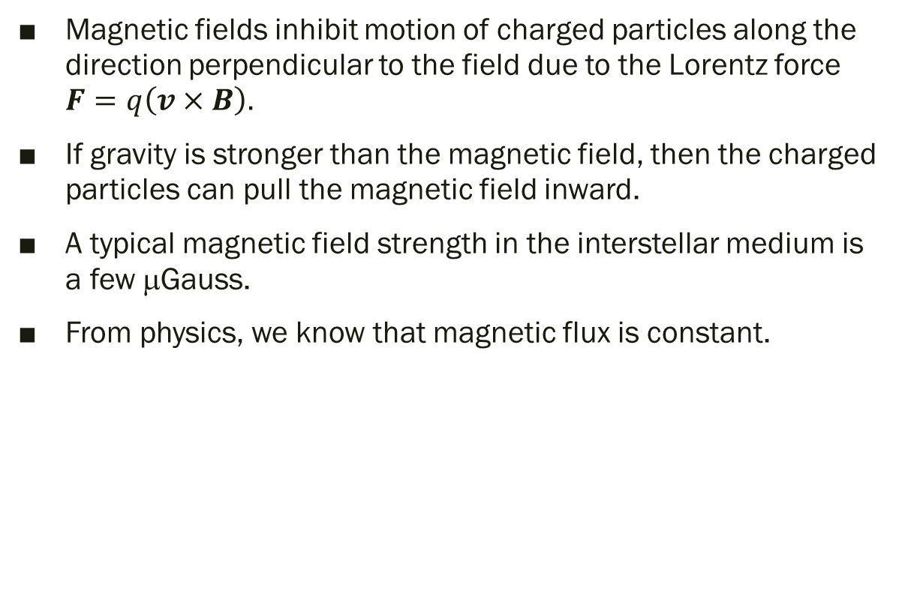
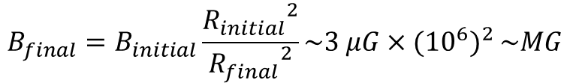

Magnetic Fields
Magnetic fields inhibit motion of charged particles along the direction perpendicular to the field due to the Lorentz force $F=q\left(v×B\right).$
If gravity is stronger than the magnetic field, then the charged particles can pull the magnetic field inward.
A typical magnetic field strength in the interstellar medium is a few μGauss.
From physics, we know that magnetic flux is constant.
$$\frac{dΦ_{B}}{dt}=0{, Φ}_{B}=B∙dA.$$
$$B_{initial}{R_{initial}}^{2}=B_{final}{R_{final}}^{2}$$
$${B_{final}=B}_{initial}\frac{{R_{initial}}^{2}}{{R_{final}}^{2}}\sim 3 μG{×({10}^{6})}^{2}\sim MG$$
But Sun has a magnetic field of ~G.

Slide 29
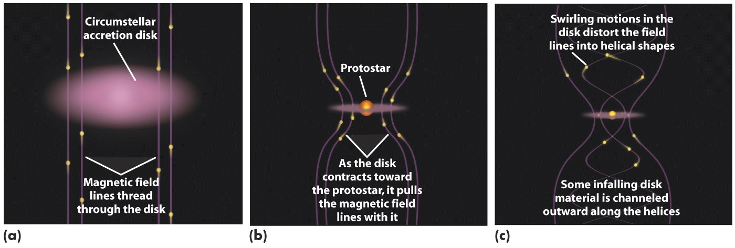
Getting Rid of Magnetic Field and Angular Momentum
How do protostars get rid of excess angular momentum and magnetic flux?
They form planets, magnetized disks, and bi-polar outflows. See Section 17.1.
Magnetized disks confine outflow of hot gas along rotation axis.
Jets carry away excess angular momentum.

Slide 30
evidence of disks and jets

Slide 31
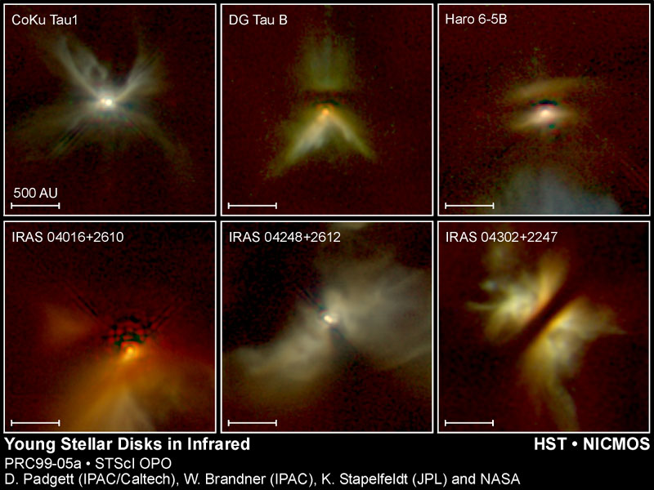
Evidence of Disks
Star hidden behind
dusty disk

Slide 32
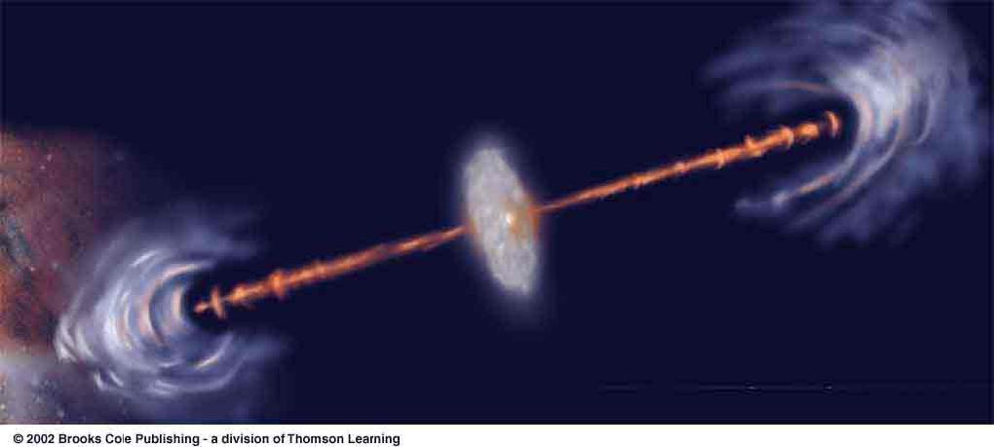
T Tauri Stars Herbig-Haro Objects
Disks and jets are often associated with T Tauri stars, which are solar mass pre-main sequence stars (named after prototype T Tauri)
Where the jets encounter the ISM, Herbig-Haro objects are formed, producing compact emission nebulae.

Slide 33
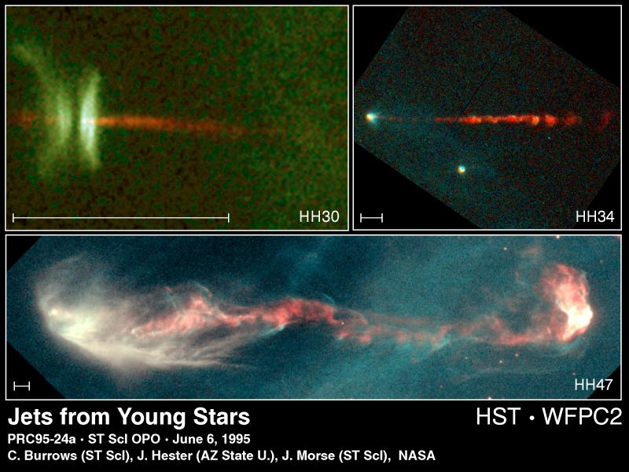
Protostellar Jets

Slide 34
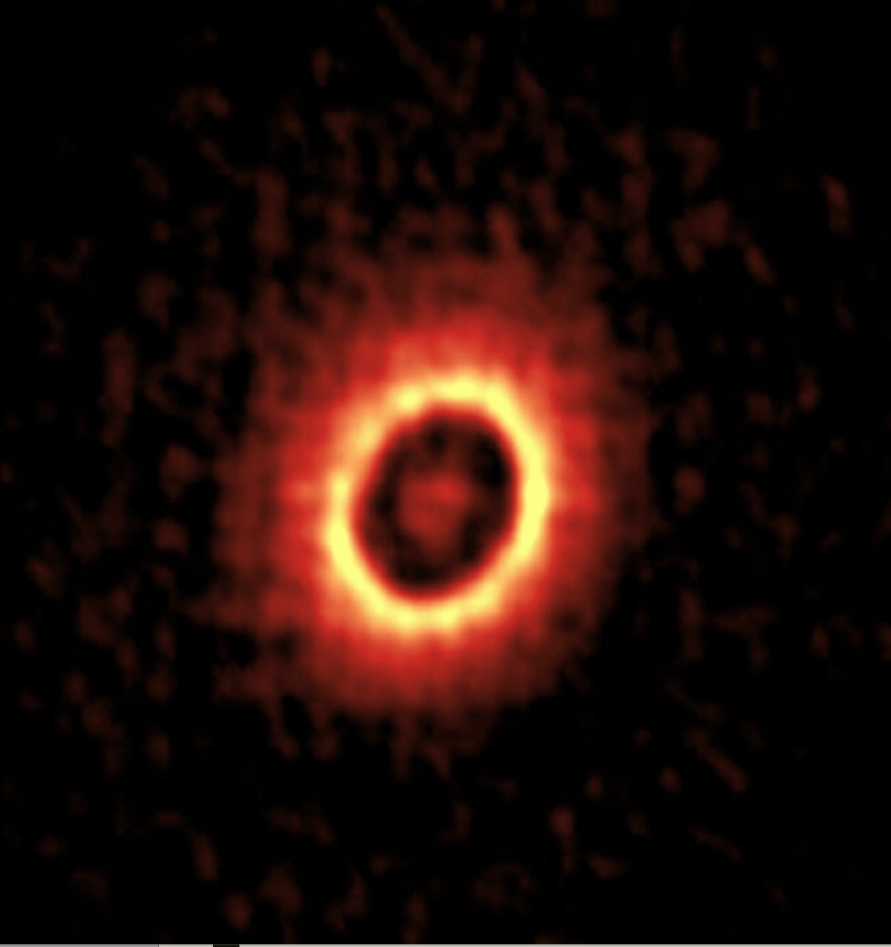
Protoplanetary Disk
ALMA has found several planetary disks.
Gaps are where planets have formed.
Rings are where planets might be forming.
DM Tau is shown on the right.
Inner ring is at orbit of asteroid belt. Outer ring is at orbit of Neptune.
Star is one half mass of Sun.

Slide 35
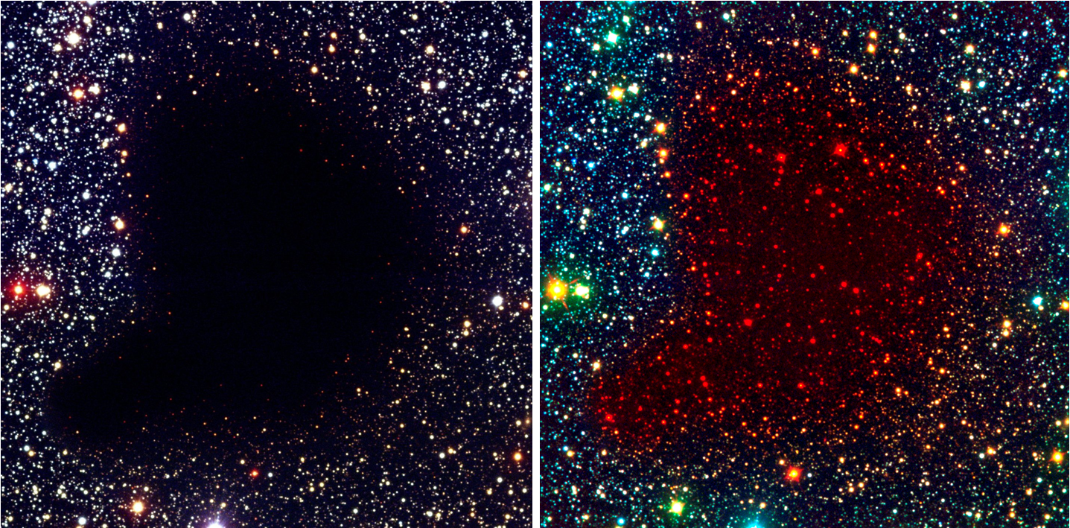
Molecular Cloud Example B68

Slide 36
star-forming region

Slide 37
Star Formation Example M17

Slide 38
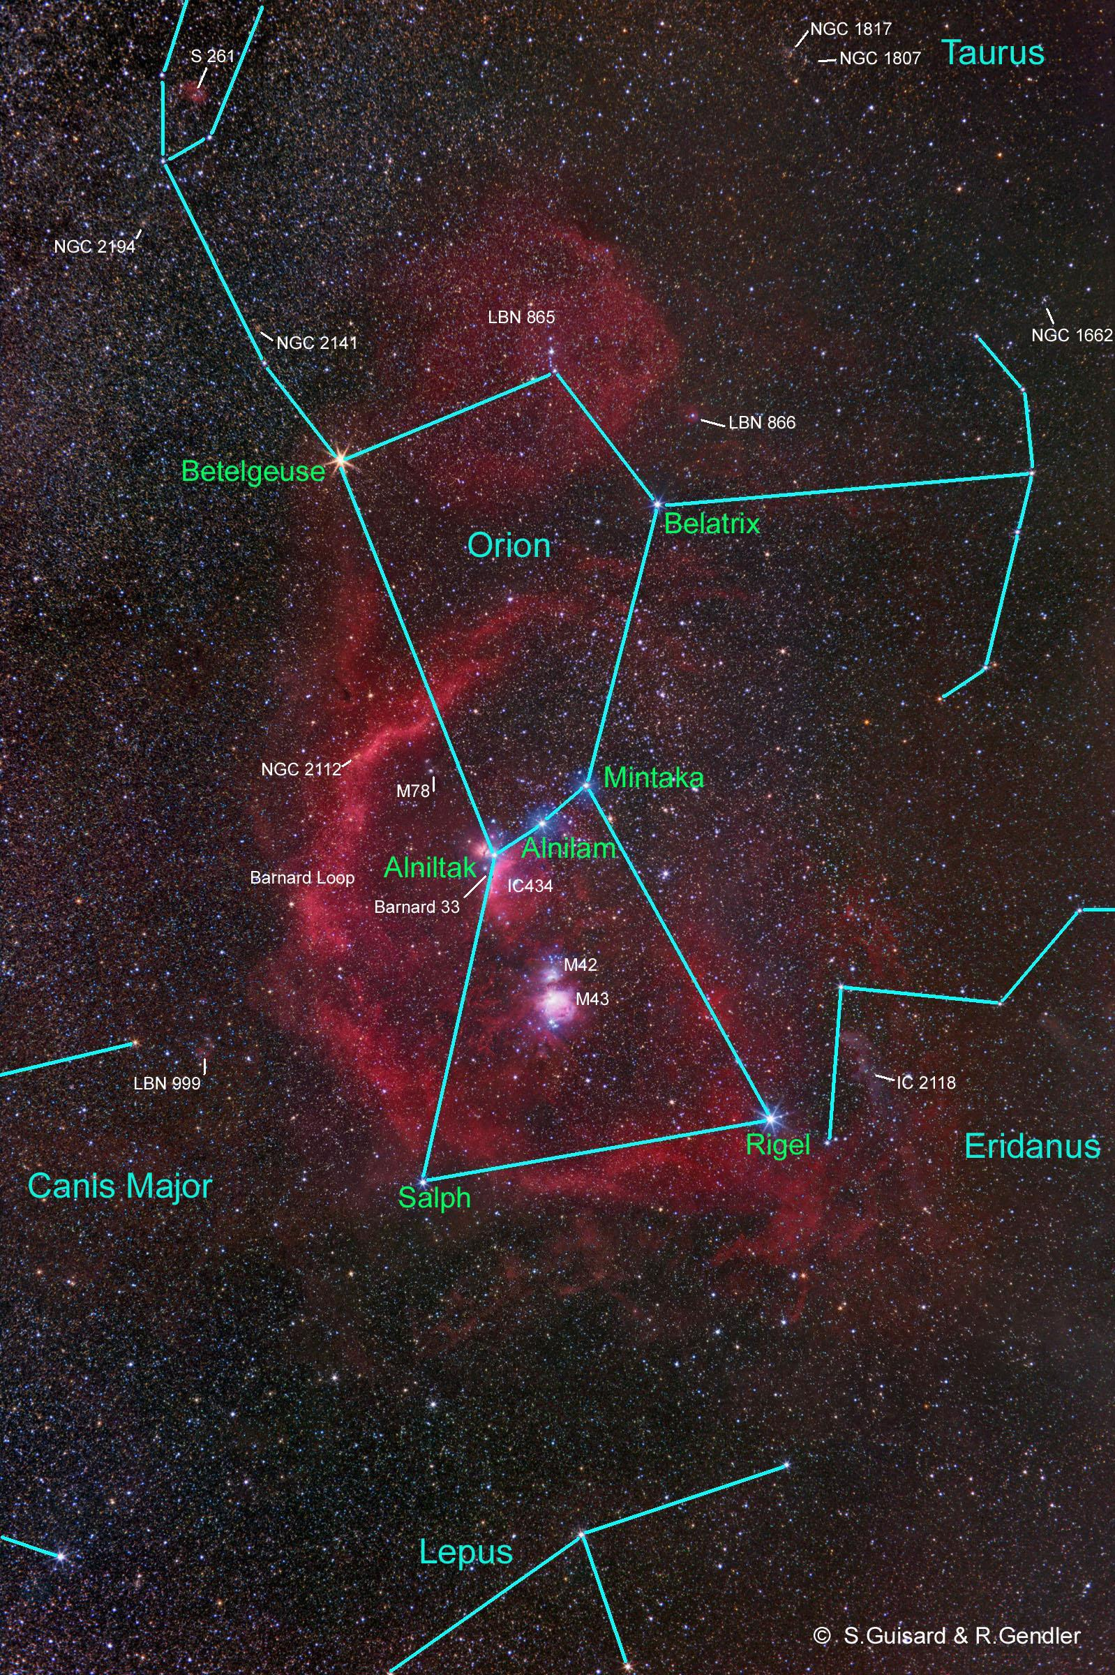
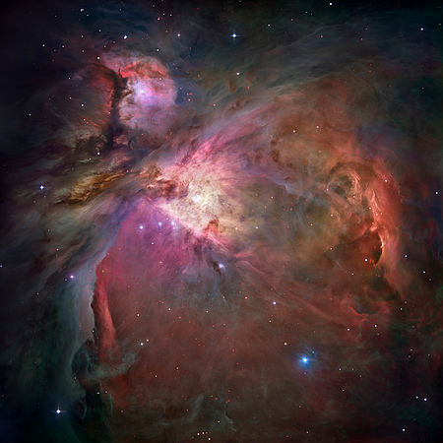
Star Formation Example M42

Slide 39
What is a HII Region?

Slide 40
HII Regions
HII regions are usually indicators of star formation.
Given sufficient mass, a star formation event will produce some massive stars (O and B stars).
Massive stars are hot, thus they produce ionizing radiation.

Slide 41
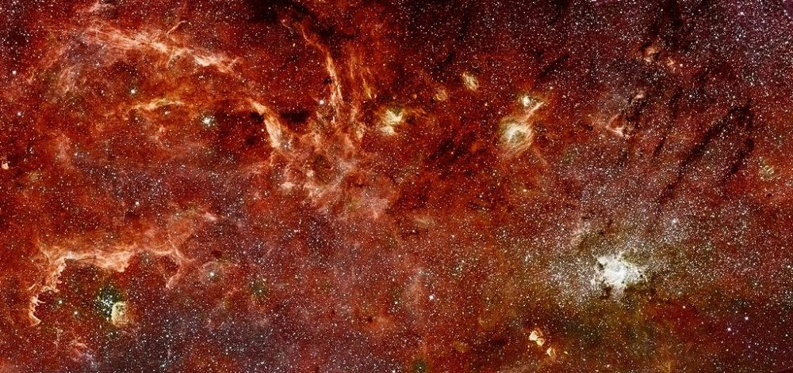
HII Regions in The GC

Slide 42
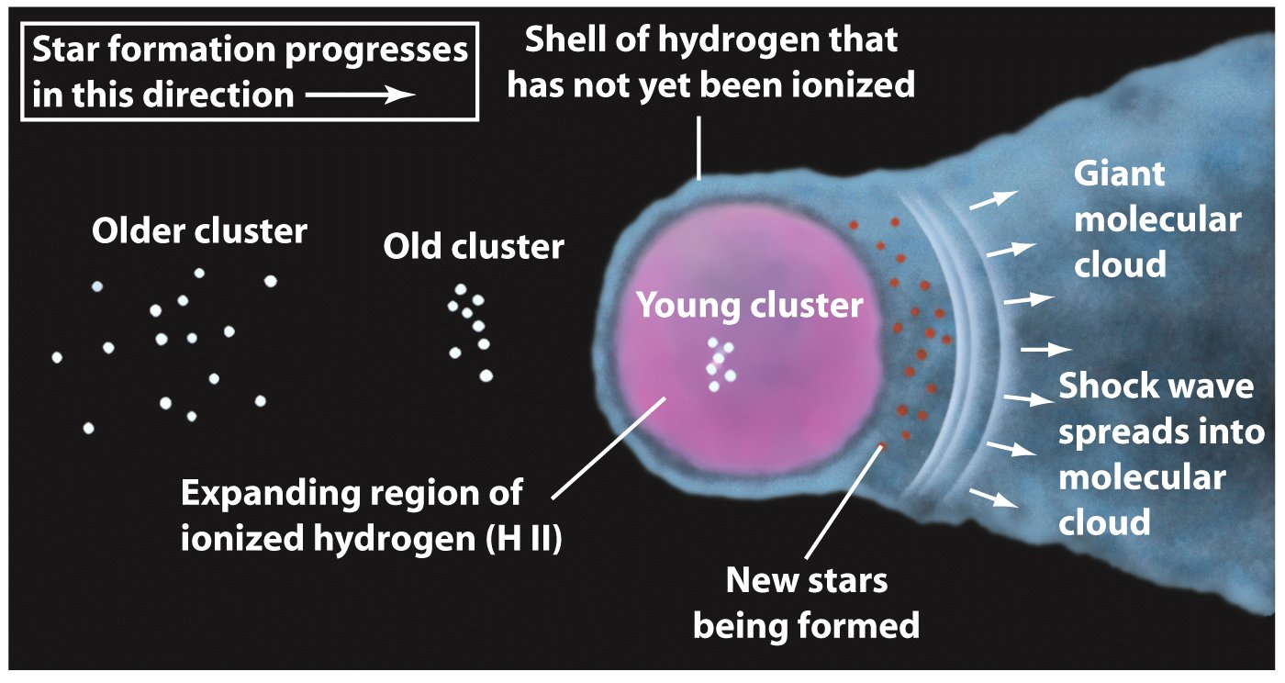
Triggered Star Formation

Slide 43
initial mass function

Slide 44
How Do We Learn About Star Formation
We cannot observe the whole formation process for a single star.
But we can learn a lot from observations of protostars and pre-main sequence stars in different stages of formation.
We can learn both what they look like, and, from the number that we see, an idea of how long the various stages last.
We can also observe the final “products” of the star formation process. Those products are the stars!

Slide 45
Star Formation Output
Initial Mass Function (IMF)
Minimum stellar mass
Maximum stellar mass

Slide 46
Initial Mass Function
There are many more low mass stars than high mass stars.
Nobody really knows why.
Typically, it is observed that for every star with a mass between 10 and 100 M, there are:
  10 stars with 2-10 M
  50 stars with 0.5-2 M
  Few hundred with less than 0.5 M
This distribution is called the Salpeter Initial Mass Function.

Slide 47
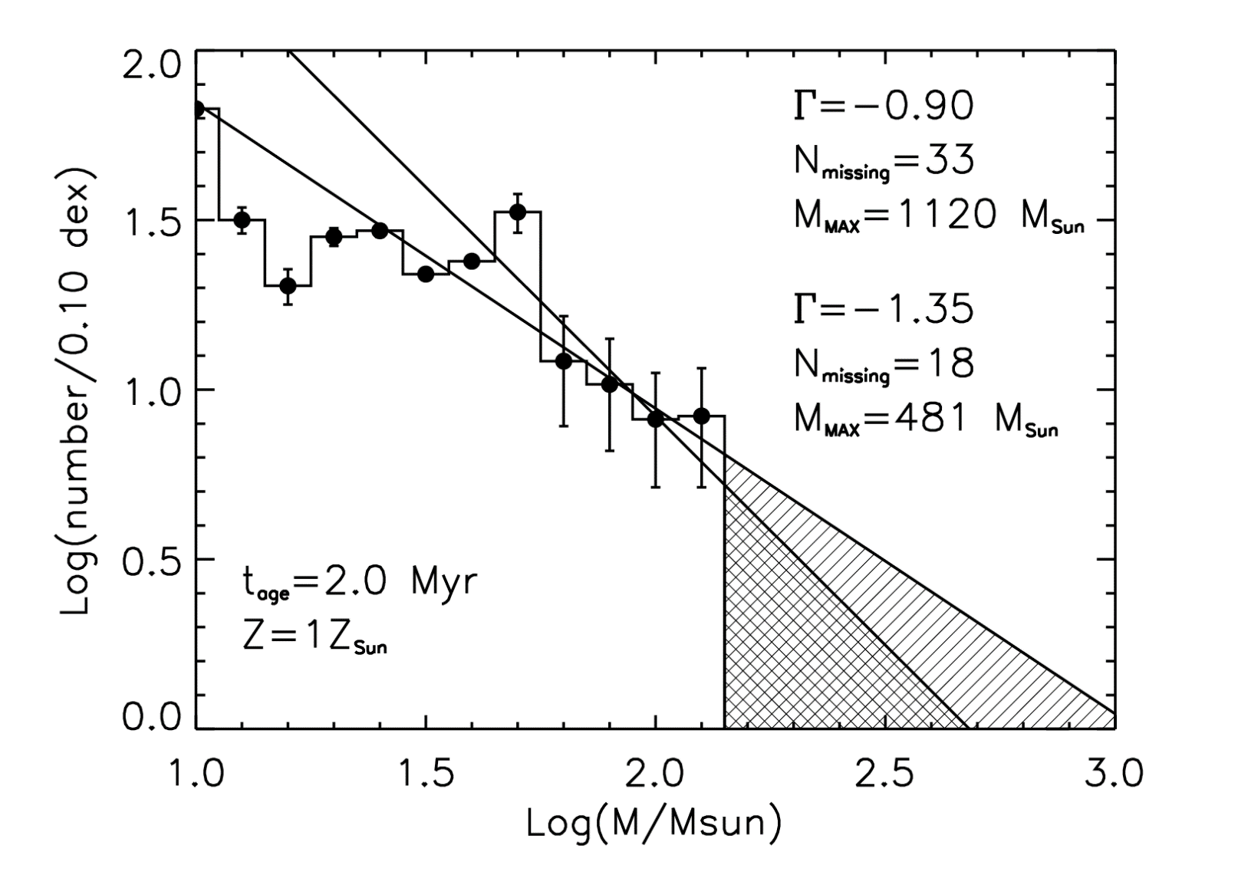
Arches IMF

