Slide 1
University Astronomy
Professor Don Figer
Stellar Classification

Slide 2
Aims and outline for this lecture
introduce stellar classification system
  spectral type
  luminosity class
describe some stars that are not on the main sequence

Slide 3
Stellar Classification
Stars are classified by the spectral characteristics of their light.
The spectral characteristics are primarily a function of temperature and composition in their photospheres and winds (for most massive stars).
The temperature influences the ionization state of the gas, and thus the relative strengths of spectral lines.
Astronomers developed the spectral classification system during a time when they did not even know the underlying physics that produced the spectral characteristics
Notes:
2

Slide 4
Spectral Classification
Spectral classification includes nomenclature for temperature and luminosity.
The temperature classification is based on spectral features: OBAFGKM (from hot to cool). The “sub-type” is designed by a number, from 0 to 9 in order of decreasing temperature.
The luminosity classification is determined using luminosity: I, II, III, IV, V, in order of decreasing luminosity.
As an example, the Sun has a spectral classification of G2V.
“G” means that the Sun has roughly an average temperature.
“2” means that it is hotter than most “G” stars.
“V” means that the luminosity is on the low side.
Notes:
2

Slide 5
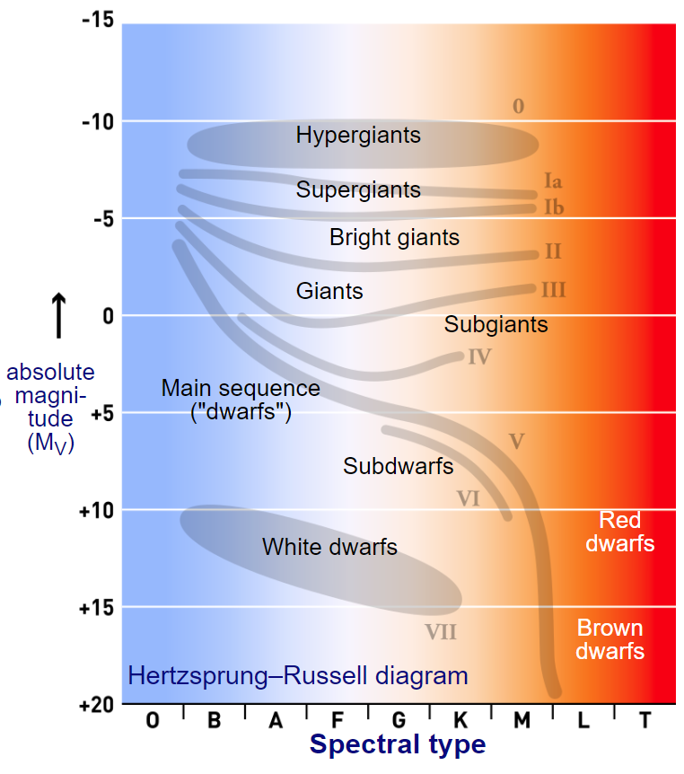
Spectral Class in HR Diagram
Notes:
2

Slide 6
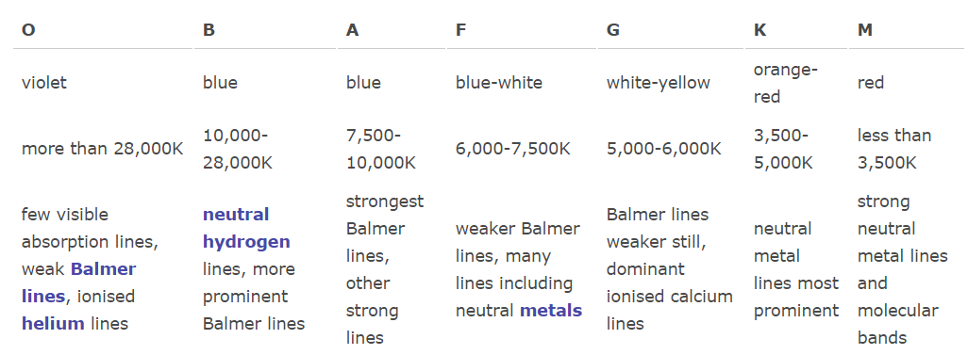
Spectral Type
The spectral type system was developed at Harvard and was originally based on spectral features generated in the photospheres and winds of stars.
The letters were originally in sequential and alphabetic order from A to Q, but many were eliminated due to redundancy and some were reordered.
Notes:
2

Slide 7
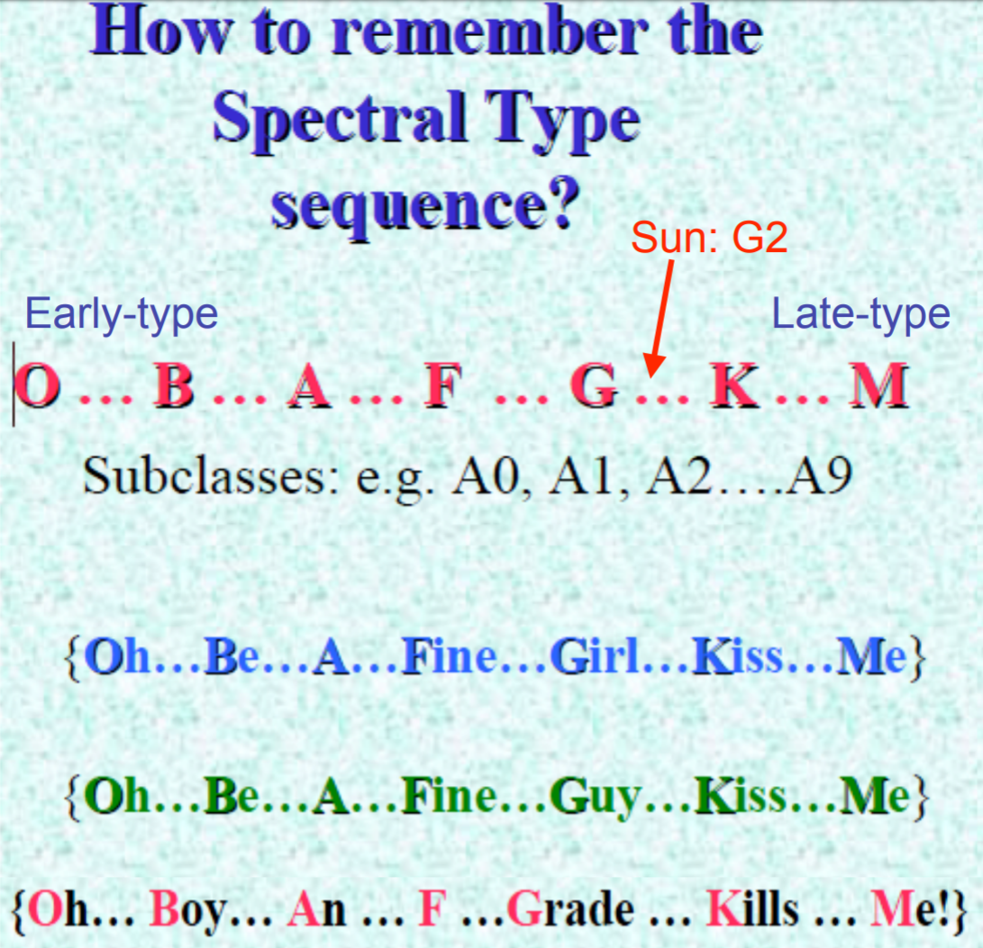
Remember!
Notes:
2

Slide 8
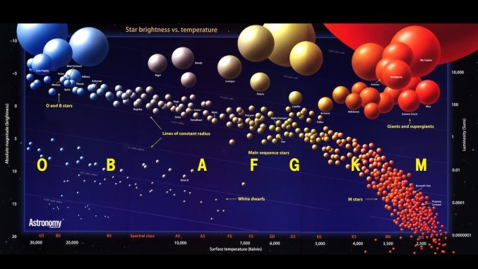
Star Sizes
Notes:
2

Slide 9
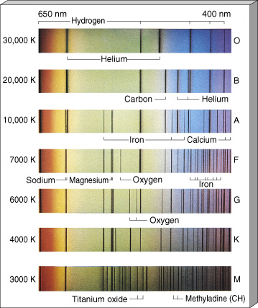
Stellar Spectroscopy
Spectra for the hottest stars, at the top, have lines of helium and multiply ionized heavy elements.
For the coolest stars, at the bottom, helium lines are not seen, but lines of neutral atoms and molecules are plentiful.
At intermediate temperatures, hydrogen lines are strongest.
The actual compositions of all seven stars are about the same.
Notes:
2

Slide 10
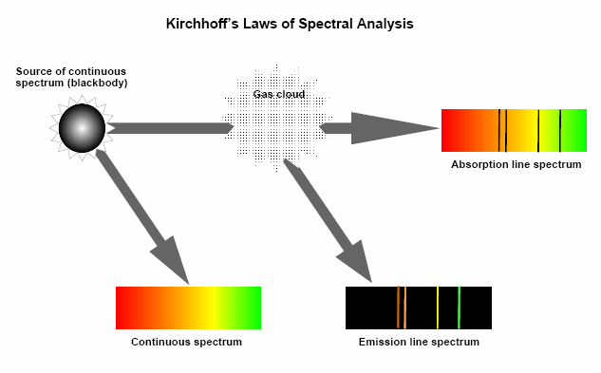
Emission/Absorption Lines

Slide 11
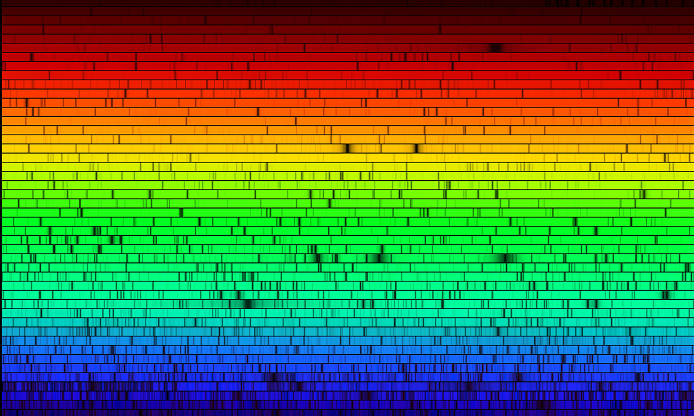
Spectrum of Sun
Notes:
2

Slide 12
Absorption Lines and Temperature
Absorption lines are a sign that atoms are absorbing photons.
The wavelength of an absorption line is related to the energy of the photon that is absorbed, i.e., λ=hc/E.
For electronic transitions, that energy is equal to the different between the energies of the two levels between which the electron transitions.
In order for an electron to transition from a lower to higher energy state, it first needs to be in the lower state.
The population of states is related to temperature (atoms bumping into each other and sharing energy).
If the temperature is high, electrons can collisionally receive energy and occupy higher energy states.
Notes:
2

Slide 13
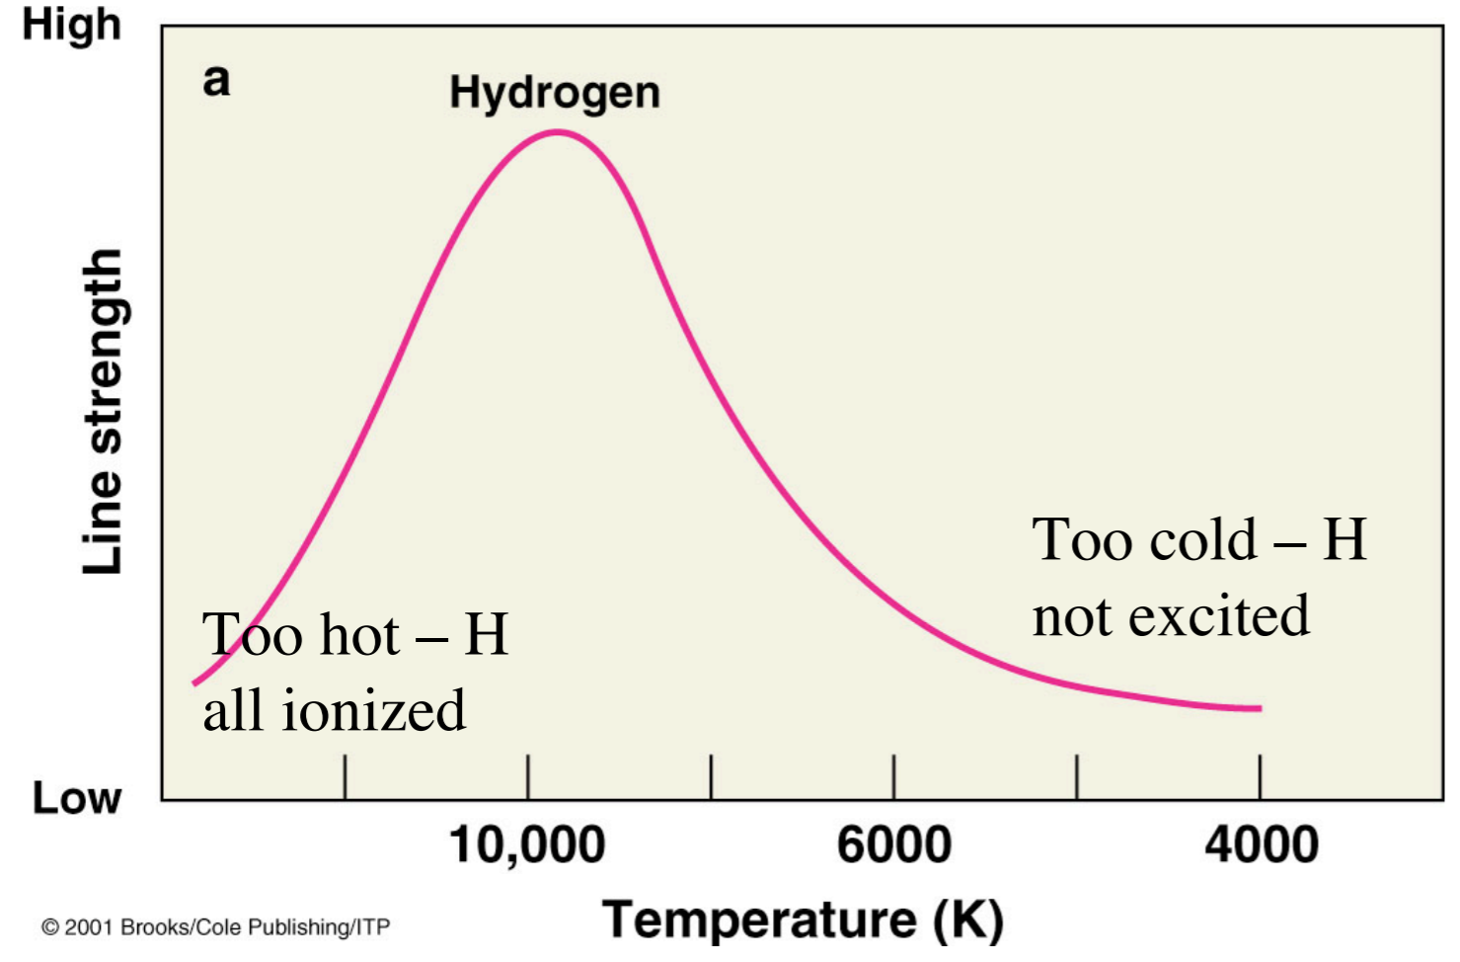
Balmer Lines Peak at A0
Balmer absorption lines correspond to transitions from the n=2 level of hydrogen. Cold gas populates n=1. Hot gas is ionized. So, the peak is at intermediate temperatures.
Notes:
2

Slide 14
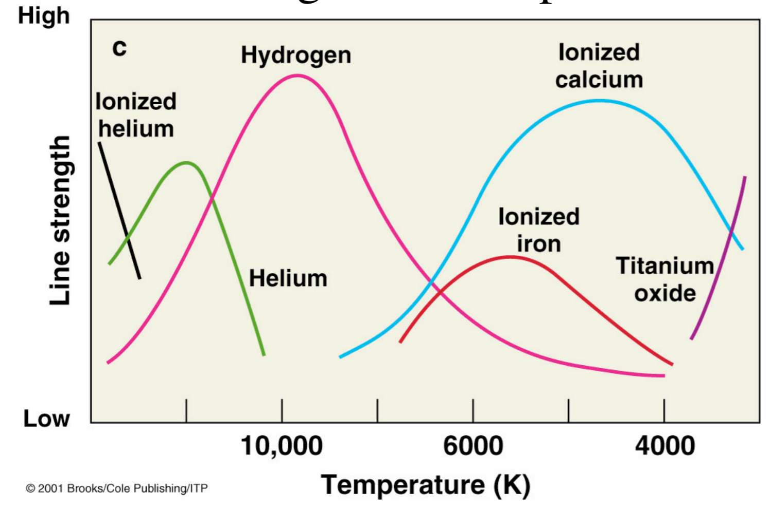
Lines vs. Temperature
The plot shows strengths for absorption lines from various ions. The peaks correspond to the temperature of the gas that most efficiently populates the lower energy states.
Notes:
2

Slide 15
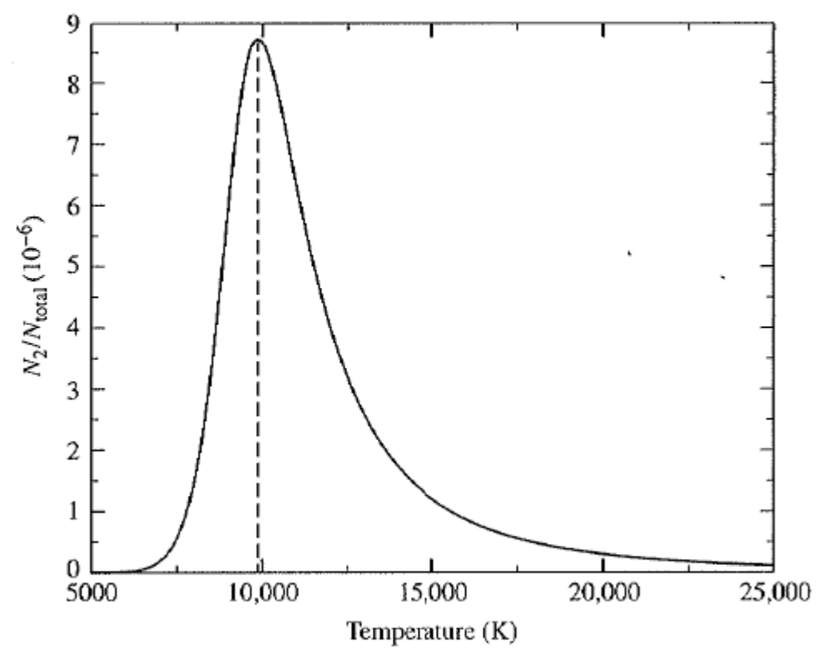
Number vs. Level
The plot shows the relative number of electrons in the n=2 state of hydrogen versus all levels. Notice that the peak is around 10,000 K, where Balmer lines peak.
Notes:
2

Slide 16
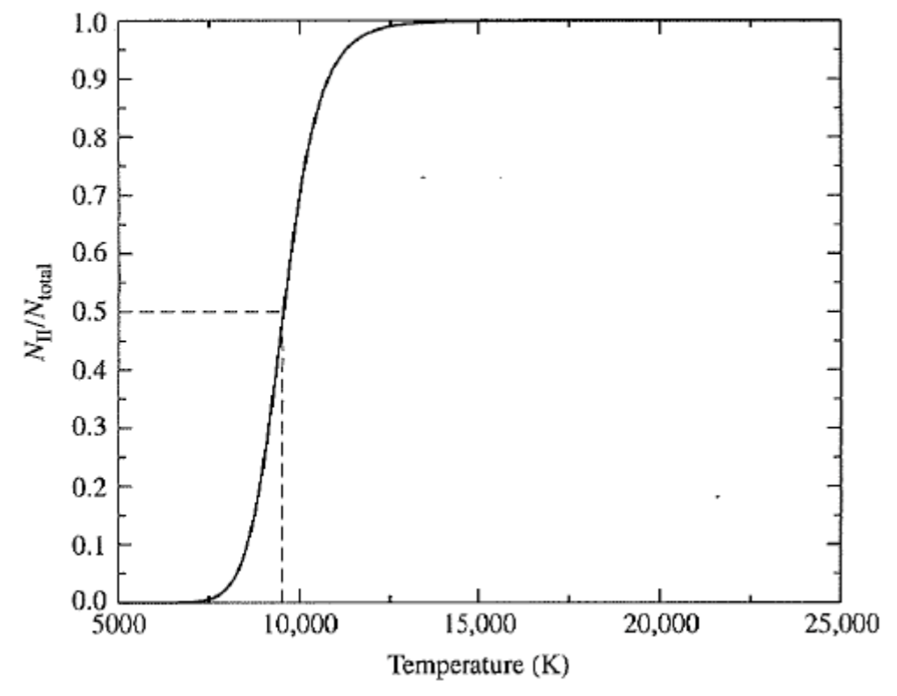
Number vs. Ionization State
The plot shows the relative number of ionized hydrogen atoms in a gas versus all atoms as a function of temperature. Note that almost all hydrogen is ionized beyond T~12,000 K.
Notes:
2

Slide 17
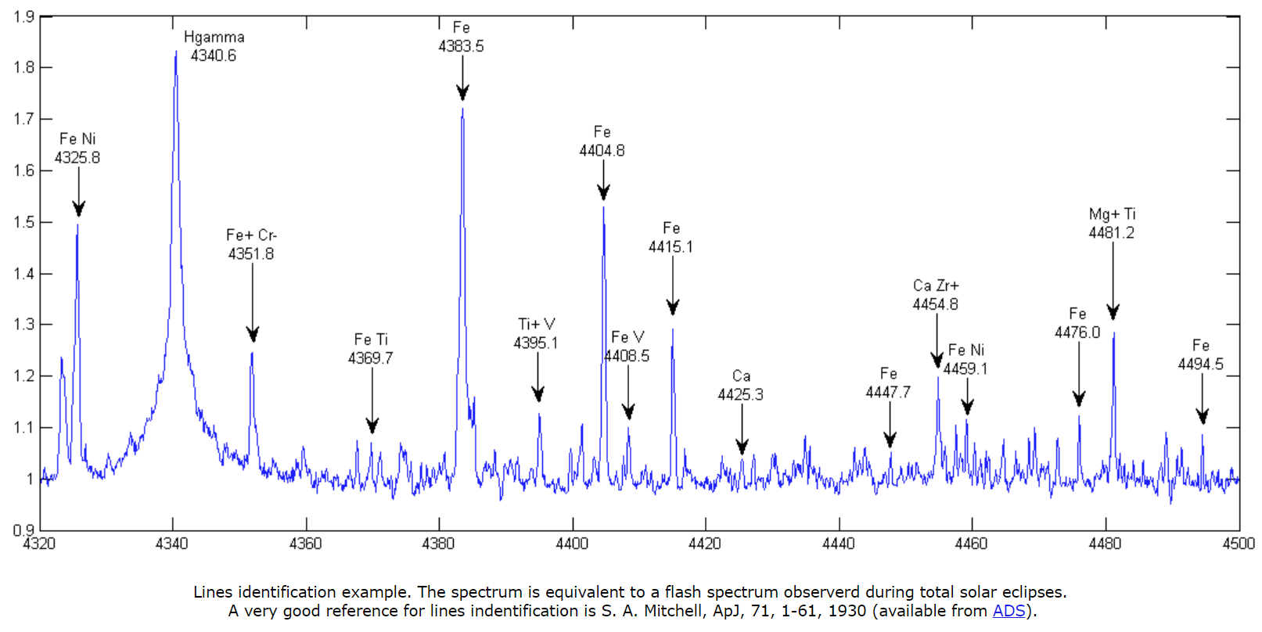
Spectrum of Chromosphere
The chromosphere must be quite hot, according to this spectrum. Note the present of high ionization states, i.e., FeV at 441 nm.
Notes:
2

Slide 18
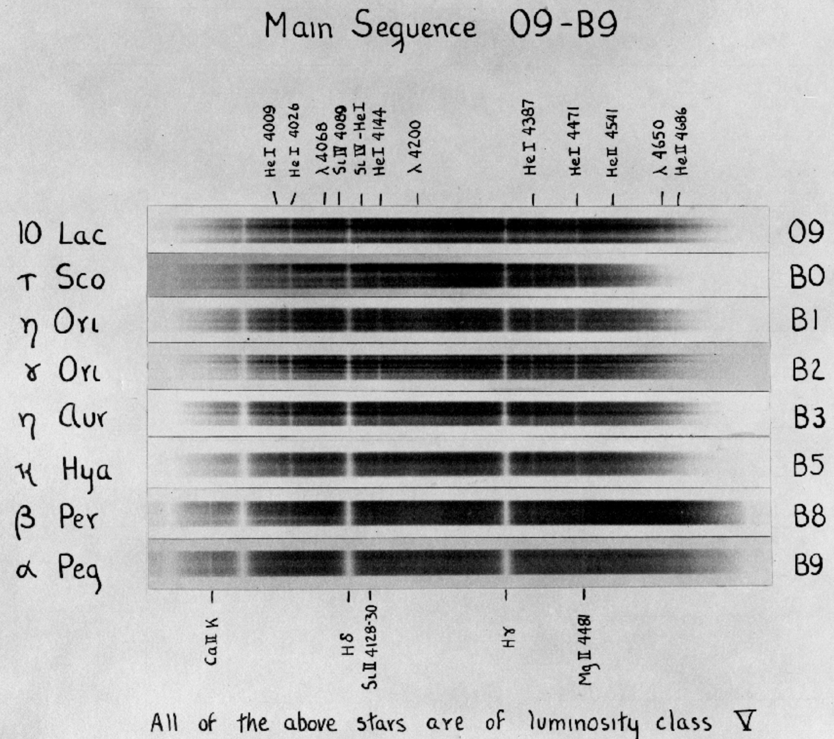
Original Spectra from Harvard
Notes:
2

Slide 19
Luminosity Class
William Wilson Morgan and Philip C Keenan established a luminosity classification system to distinguish between stars with the same temperature but very different luminosity.
While the Sun is a G2V star (a dwarf), a supergiant of the same temperature would be classified as a G2I star.
Luminosity class can change as the star ages.
For instance, the Sun will become an MIII star (a red giant) eventually when it expands to be roughly 2 AU in diameter, or a few hundred times its current size.
Notes:
2

Slide 20
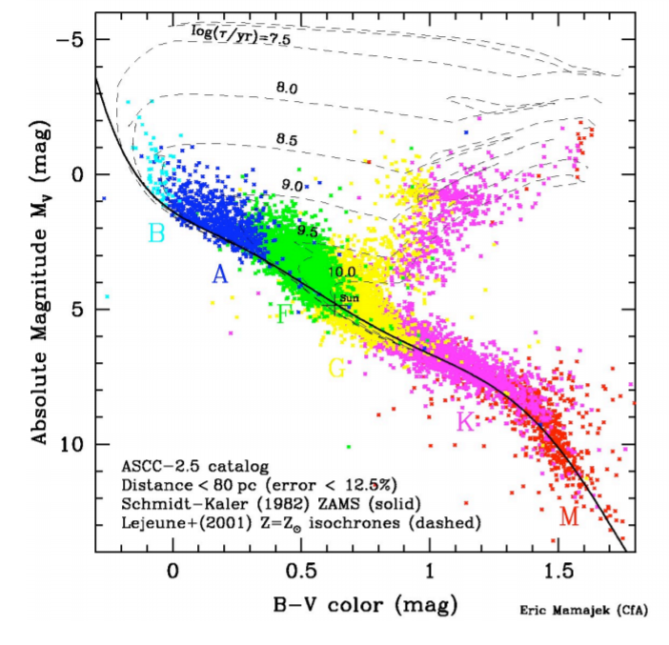
Hertzsprung-Russel (HR) Diagram
Notes:
2

Slide 21
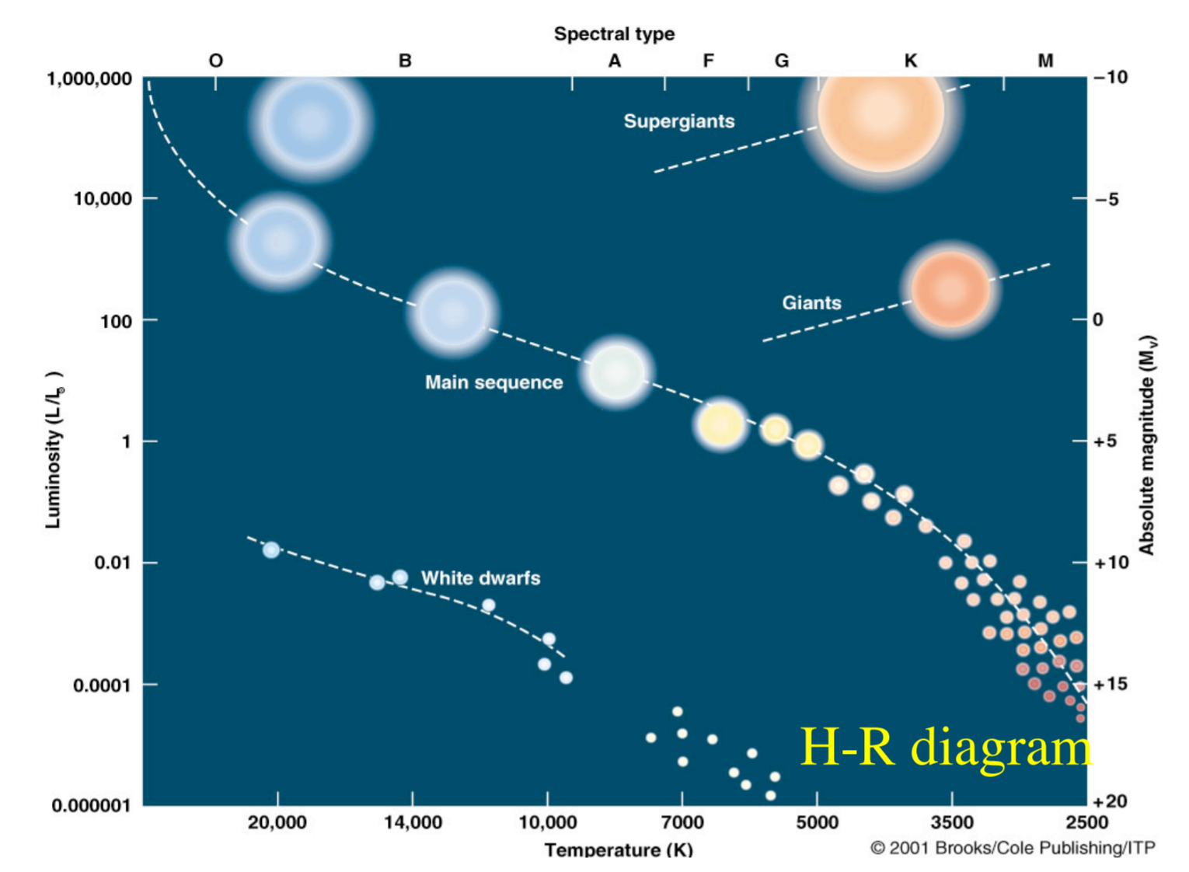
HR Diagram Schematic
Notes:
2

Slide 22
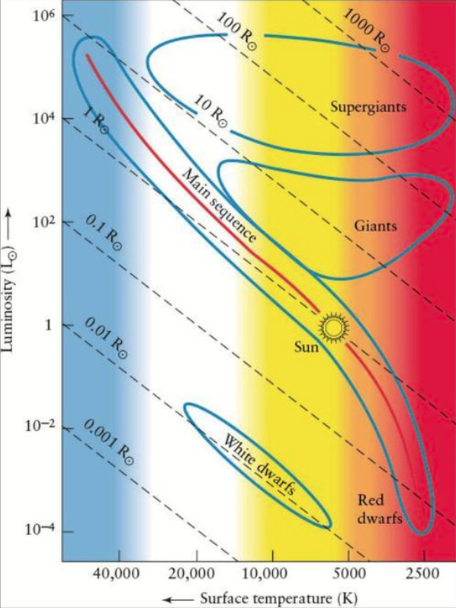
HR Diagram Star Size
Stellar radius is a function of luminosity and temperature. Remember, L=4πR²σT⁴.
Radii increase to the upper right of the HRD.
The radii on the MS do not vary by much.
Giants and supergiants have very large radii, but notice the radius is not the only variable that distinguish them (also luminosity).
Notes:
2

Slide 23
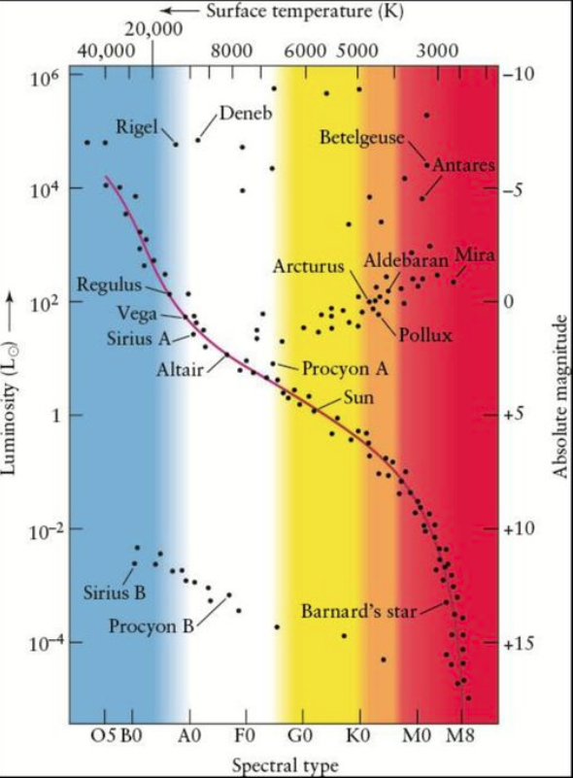
HR Diagram Common Stars
Notes:
2

Slide 24
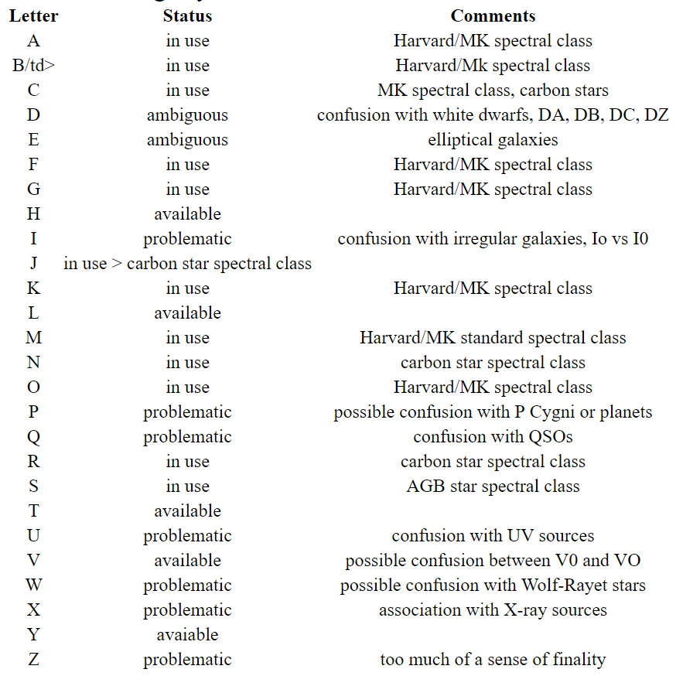
Extensions to Cooler Stars
L Dwarfs are cooler than M stars with T~1300-2500 K.
They are “brown dwarfs.”
They have too little mass for fusion (below 0.08 Msun limit).
M~15 to 75 times the mass of Jupiter.
Why use “L?”
It was an available letter near M.
Notes:
2

Slide 25
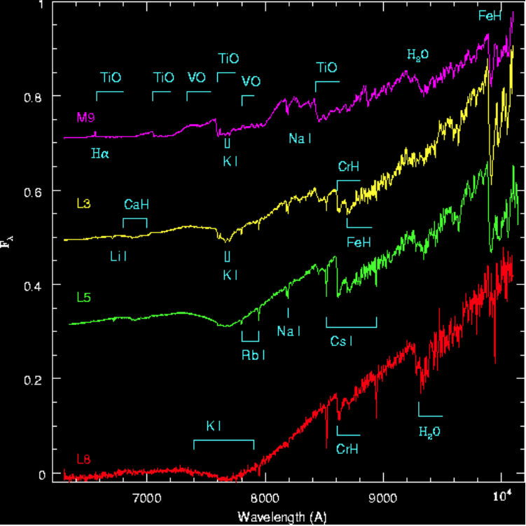
L Dwarfs
Notes:
2

Slide 26
Other Types of Stars
Some stars do not have spectra like those of stars in the MK spectral system.
For example, a Wolf-Rayet star might have a temperature like that of O5 and be in a luminosity class of I, but it has an emission-line spectrum.
The emission lines are formed in the wind of the star.
For this reason, their spectral type is usually referred to as WN (WR star with nitrogen emission lines), WC (WR star with carbon emission lines), or WO (WR star with oxygen emission lines).
Notes:
2

Slide 27
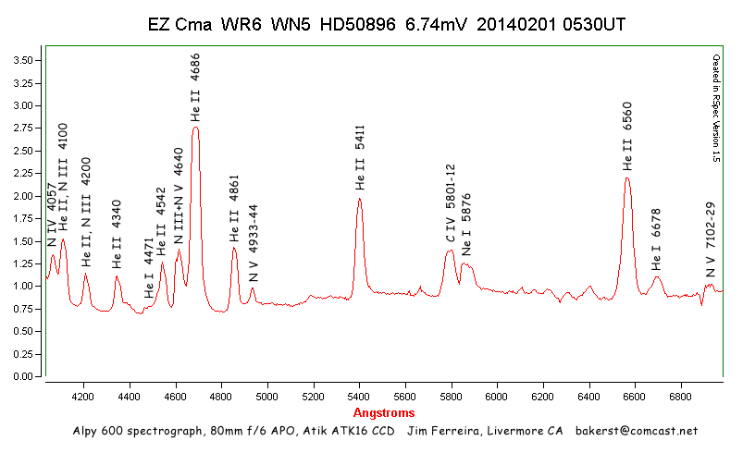
WR Star Spectrum (WN6)
Notes:
2

Slide 28

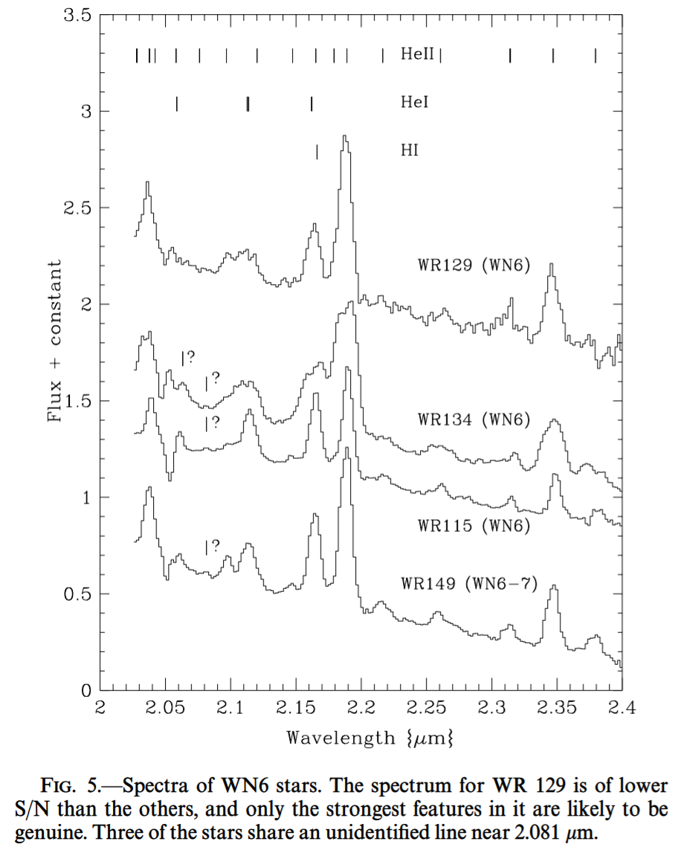
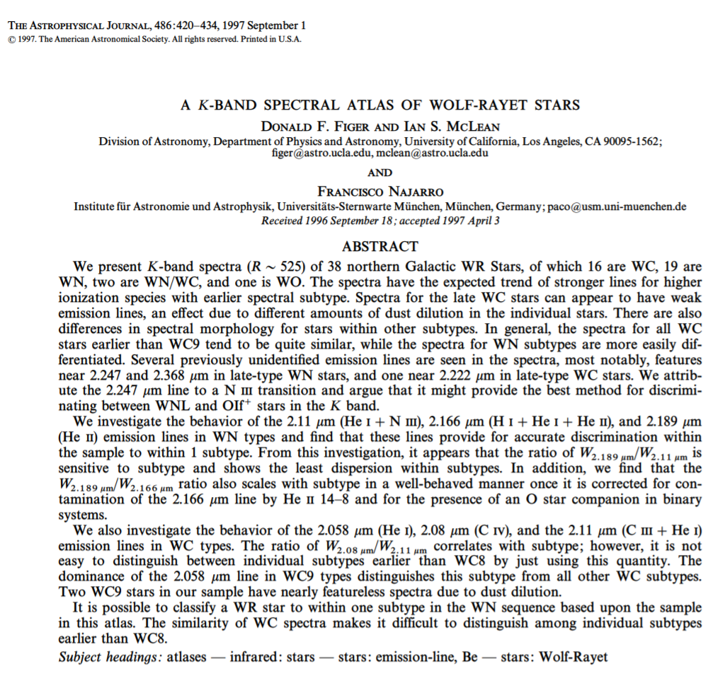
No Atlas? No Problem!
Notes:
2

Slide 29
“Slash” Stars (Slash=“/”)
Some stars do not have spectra that are easily recognizable.
Sometimes, they seem to be a combination of spectra, even though they are single stars.
In these fringe cases, astronomers create ever more refined spectral classifications.
One example are the OfpeI/WN9 stars that seem to be intermediate between the O supergiant phase and the WN9 WR phase.
There are at least a few dozen of these types of stars in the Galactic center clusters (Quintuplet, Arches, Central).
To make things simpler, sometimes people suggest that these complex spectral types be simplified, such as calling the slash stars “WN11” types.
Notes:
2

Slide 30
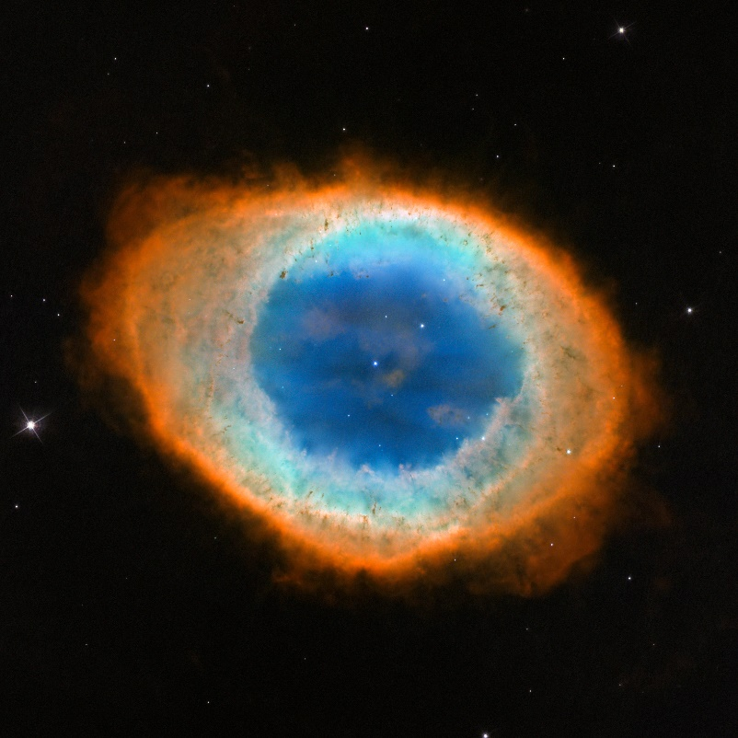
Central Stars of PN
The central stars of planetary nebulae are very hot, comparable to the temperatures of O-stars.
They are much fainter than main sequence O-stars because they are much smaller.
Notes:
2

Slide 31
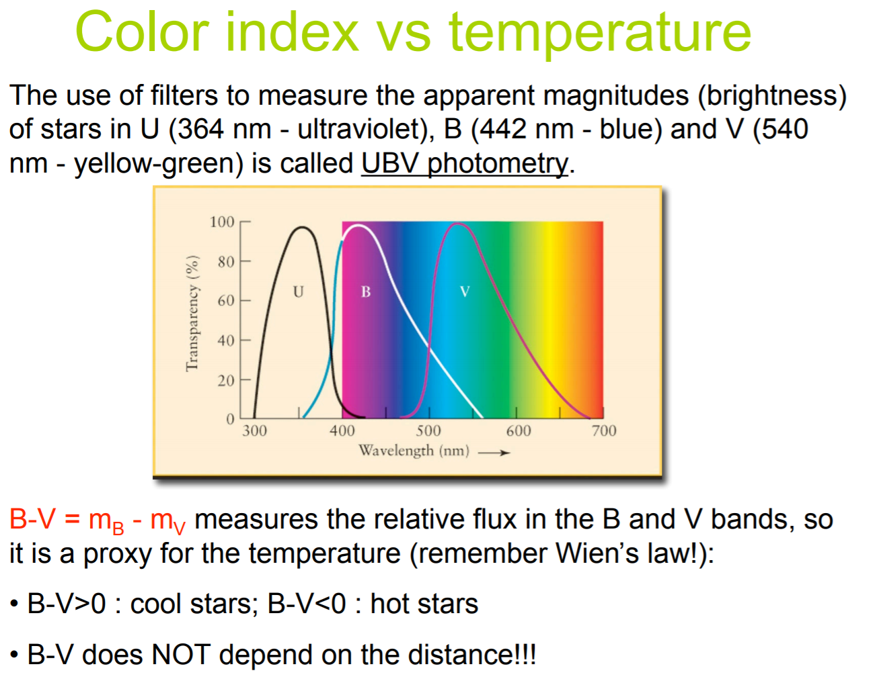
Color Index
Notes:
2

Slide 32
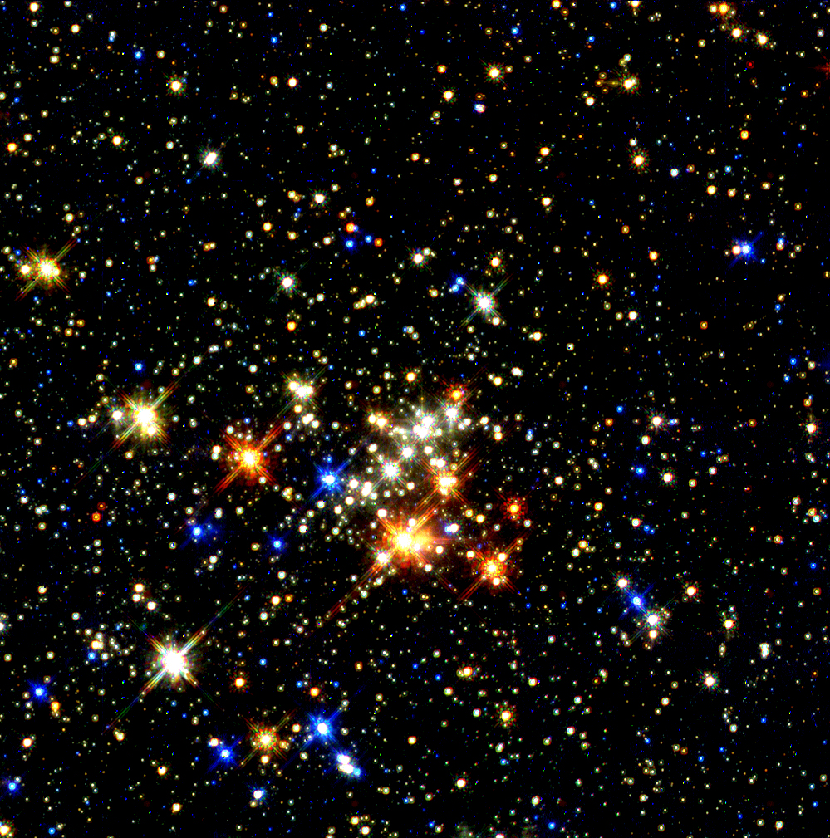
Quintuplet Cluster Puzzle
Notes:
2

Slide 33
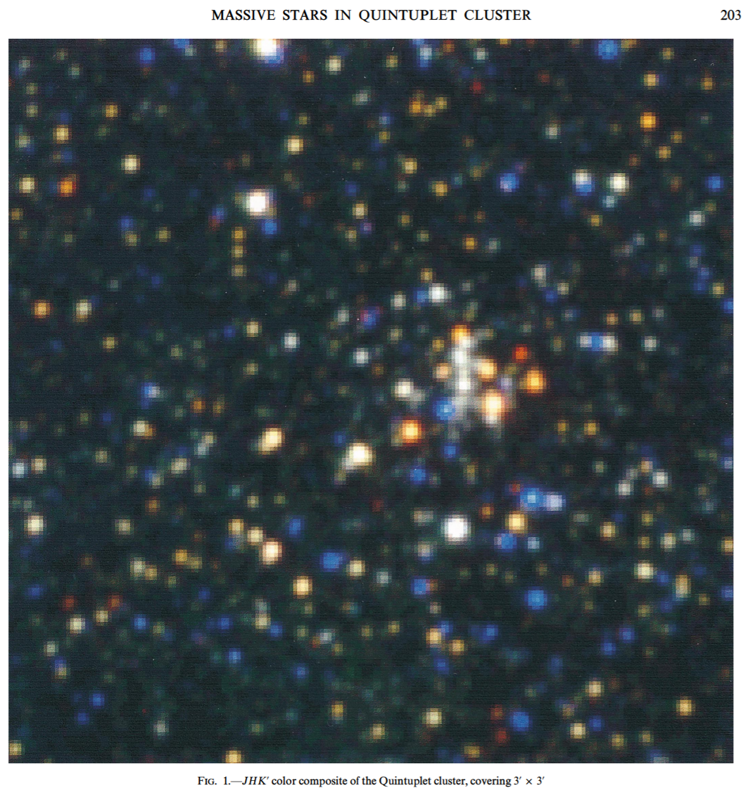
Compare to Old Data! (1999)
Notes:
2

Slide 34
Quintuplet Puzzle
Astronomers first observed the five bright red stars in the Quintuplet cluster around 1990.
Their luminosities are high (10⁵ L_{sun}).
Their temperatures are very low (1000 K).
Their sizes are huge (250 AU).
Their spectra are featureless.
Some suggested that the stars are just forming and hidden by dust in their natal cocoon.
My team predicted (1999) that they are dust-enshrouded Wolf-Rayet stars but could not prove it until 2017.
I can now see that our old spectra had some WR features. They are too weak for me to publish a conclusion in 1998.
Notes:
2

Slide 35
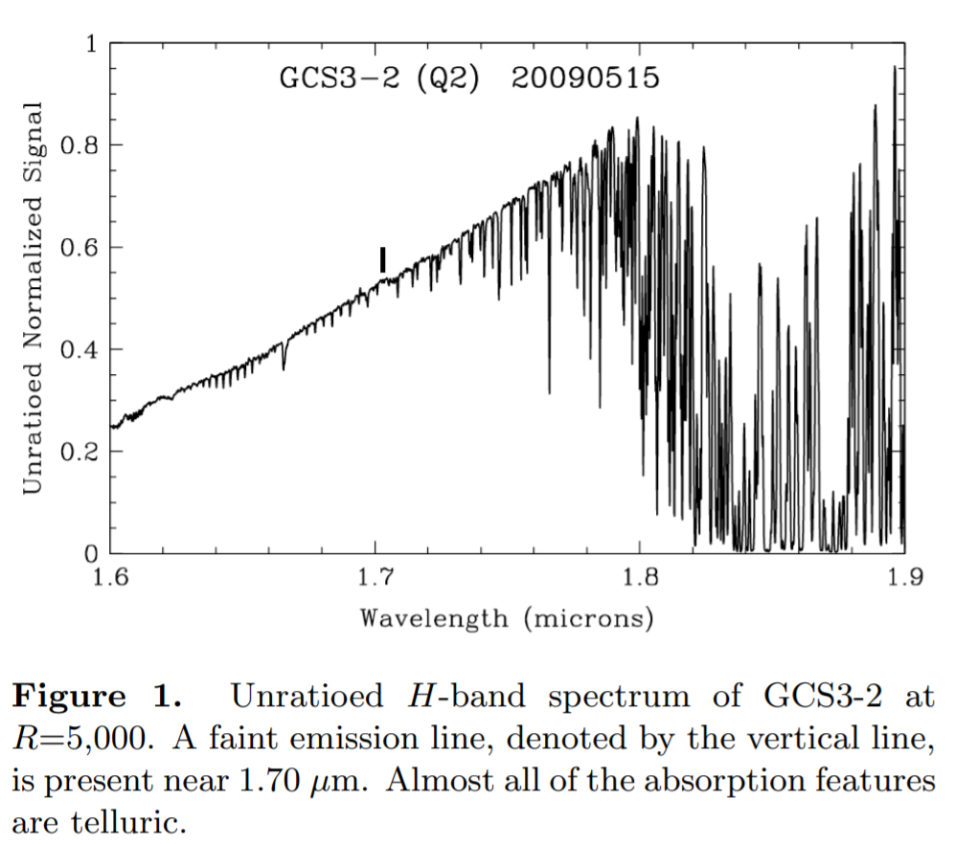
Quintuplet Star Spectrum
Notes:
2

