Slide 1



Silicon Single Photon Imaging Detectors
Don Figer¹ and Brian Aull²
¹Director, Center for Detectors, Rochester Imaging Detector Laboratory
Professor, College of Science, Astrophysical Sciences and Technology PhD Program, Microsystems PhD Program, Imaging Science
²Staff, MIT Lincoln Laboratory
CfD
Notes:
This paper summarizes progress of a project to develop photon-counting detectors for NASA exoplanet missions through a radiation testing program. The project, funded by NASA ROSES TDEM, uses a 256x256 pixel silicon Geiger-Mode Avalanche Photodiode (GM-APD) per pixel, each individually bump-bonded to a silicon readout circuit. Each pixel independently registers the arrival of a photon and can be reset and ready for another photon within 100 ns. The pixel has built-in circuitry for independently counting photo-generated events. The readout circuit is multiplexed to read out the photon arrival events. The signal chain is inherently digital, allowing for noiseless transmission over long distances. The detector always operates in photon counting mode and is thus not susceptible to excess noise factor that afflicts other technologies. It continues operating with shot-noise limited performance up to extremely high flux levels, >10^6 photons/second/pixel, and delivers signal-to-noise ratios on the order of thousands for higher fluxes. Its performance is expected to be maintained at a high level throughout mission lifetime in the presence of the expected radiation dose.

Slide 2
Outline
Motivation for Single Photon Detectors
Applications
  Inner Space: Biophotonics
  Outer Space: the Universe
Status of Current Projects
  photon-counting detector for astrophysics
  imaging LIDAR detector for planetary missions
  technology demonstration for exoplanet missions
Future Directions
Notes:
This slide gives the outline of the whole talk.

Slide 3
Motivation for Single Photon Detectors
Notes:
This section motivates the desire for single photon detectors.

Slide 4
Detector Properties and SNR
Notes:
Signal to noise ratio depends on detector properties. By reducing detector read noise, SNR increases. Also, the time to achieve a fixed SNR decreases. For photon-starved applications, zero read noise is very important.
4

Slide 5
Quantum-Limited Imaging Detectors
limited by the information carried by a photon
  existence in time and space (x, y, z, t)
  wavelength (λ)
  polarization
“easier said than done…..”
Notes:
Quantum-limited detectors produce signal-to-noise ratio that is dominated by the inherent uncertainty in the photon stream.
5

Slide 6
Outer Space Applications
Notes:
Outer space applications correspond to “Astrophysics”

Slide 7
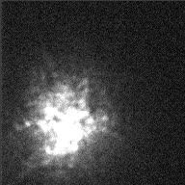
Blurring Effects of Atmosphere
Notes:
The atmosphere is turbulent, and it has a blurring effect on starlight. This movie shows the image of Alpha Orionis as seen through the atmosphere.
7

Slide 8
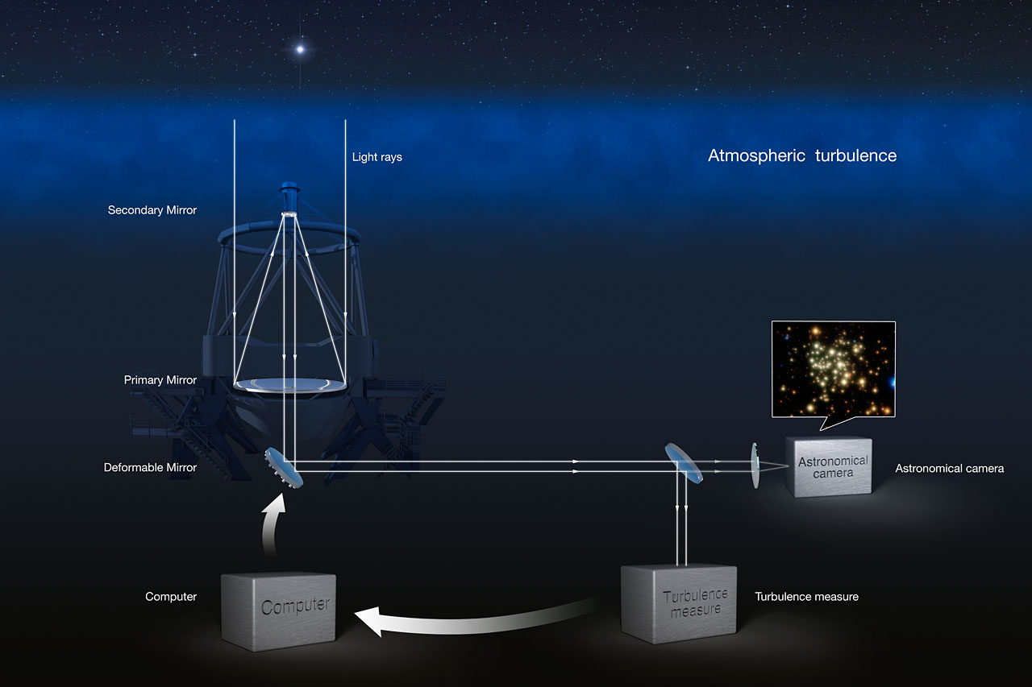
Adaptive Optics System
Notes:
An adaptive optics system removes the blurring effects of the turbulent atmosphere. A deformable mirror adds aberrations to the beam that perfectly remove the aberrations from the atmosphere.
8

Slide 9
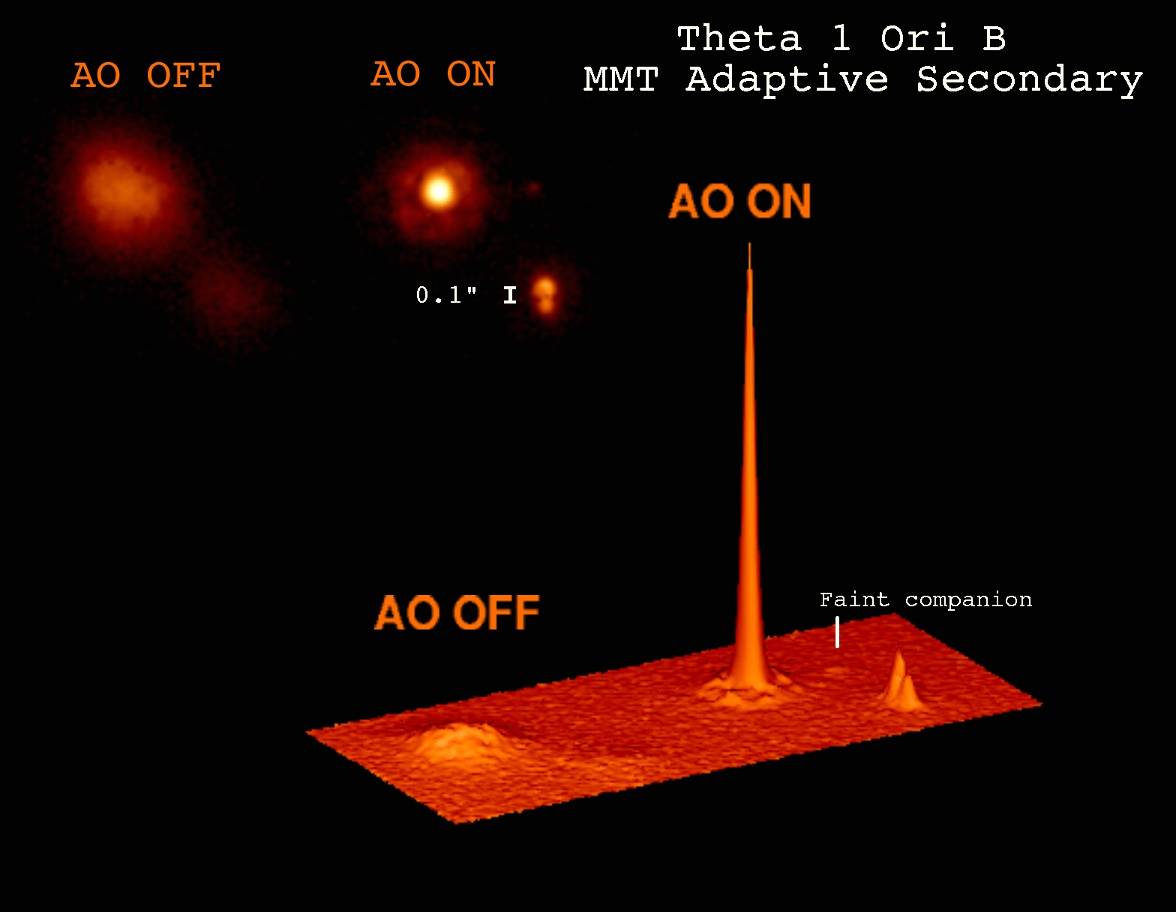
Adaptive Optics Performance
Notes:
A typical AO system will produce a much sharper point spread function, but only if the sampling frequency is much faster than the atmospheric perturbation frequency.
9

Slide 10
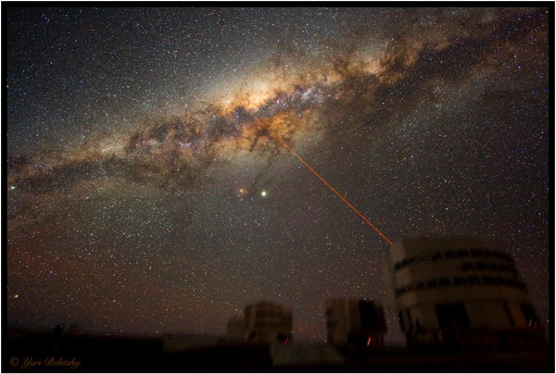
Adaptive Optics Laser Guide Star
Notes:
PARSEC, a joint project by MPE (Garching) and MPIA (Heidelberg), is a sodium line laser which can produce a high quality 12W continuous wave output beam. It is currently installed on Yepun, the fourth 8.2-m unit telescope of the VLT in Chile, as part of the Laser Guide Star Facility. The aim of the LGSF is to substantially increase the sky coverage available to, and hence the scientific potential of, the adaptive optics cameras CONICA (with NAOS) and SPIFFI (as part of SINFONI). This has been achieved as a collaborative effort between the Max Planck Institutes and the European Southern Observatory (who were responsible for the laser clean room, the beam relay, and the launch telescope).
10

Slide 11
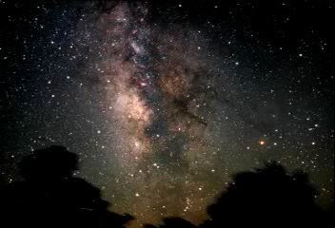
Notes:
The movie shows a “journey” into the Galactic Center, starting with optical wavelengths and then transitioning to IR wavelengths. The supermassive black hole, and surrounding young population of blue stars, can be seen at the end of the movie.

Slide 12

Lick 3-m (1994)
Notes:
This series of images shows the Arches cluster at progressively better spatial resolution.

Slide 13
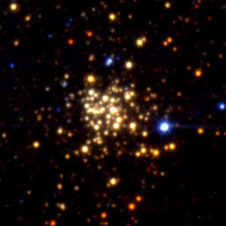
Keck 10-m (1997)

Slide 14
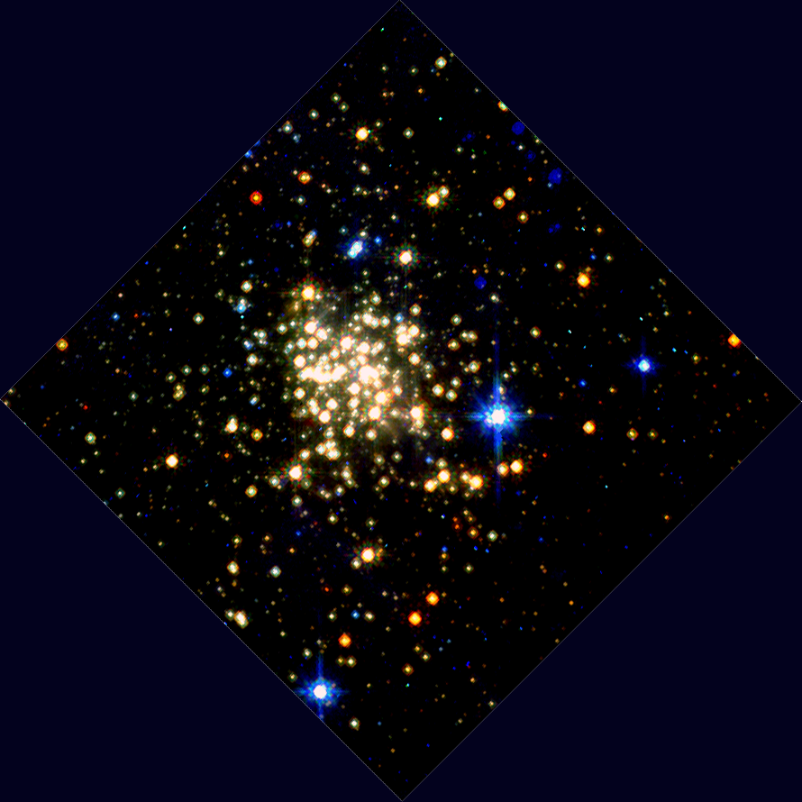
HST/NICMOS (1997)

Slide 15
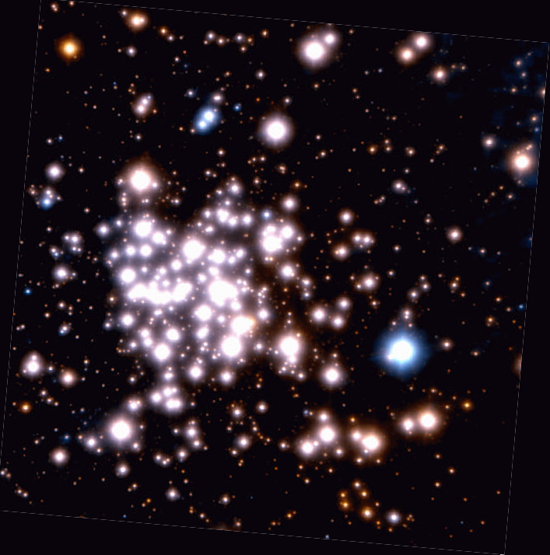
VLT/AO (2002)

Slide 16
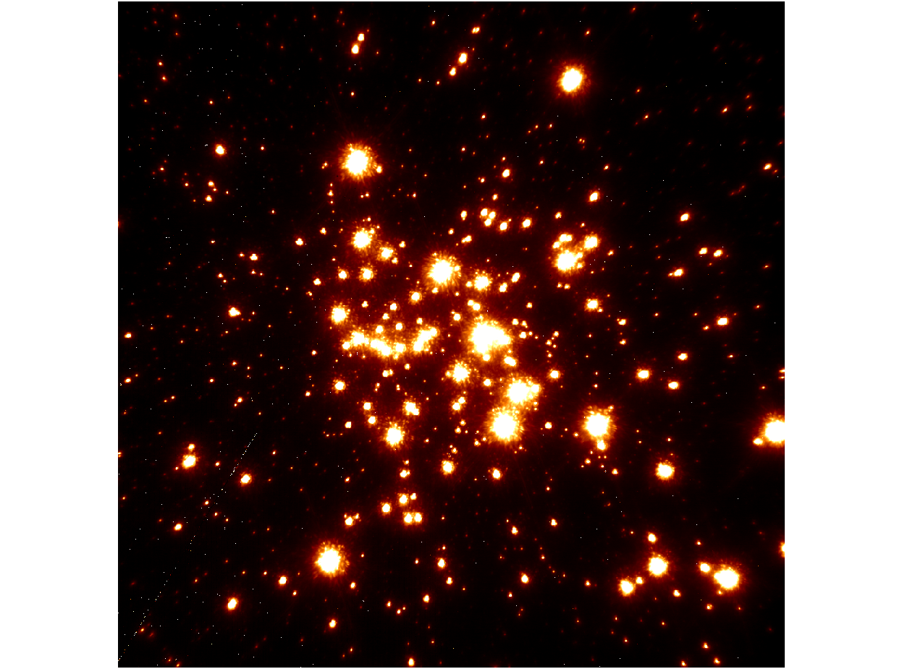
Keck/LGSAO (2006)

Slide 17
Spatial Resolution
Notes:
This figure shows the dramatic improvement in the spatial resolution of one of the most massive young star clusters in the Galaxy obtained over a ten year period, leading to the determination of the full mass function from 130 Msun down to 2 Msun.
17

Slide 18
IR Wavefront Sensor Sensitivity
Notes:
This table gives the limiting magnitude for a wavefront sensing star as a function of read noise and quantum efficiency. A typical detector that is available today has properties that correspond to the red box. The green box shows that a zero noise detector will be able to probe the sky by more than 3 magnitudes fainter, even if it has much less QE.

Slide 19
IR Wavefront Sensor Goals
Notes:
This table shows reasonable goals for a fast IR wavefront sensor that uses GM-APDs.

Slide 20
Read Noise
Notes:
Lower read noise enables observation of fainter objects, like solar mass stars in the Arches cluster near the Galactic Center.
20

Slide 21
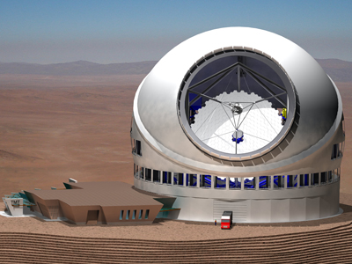
Aperture vs. Read Noise
Notes:
A zero read noise detector would effectively quadruple the collecting power of a telescope in photon-starved applications.
21

Slide 22
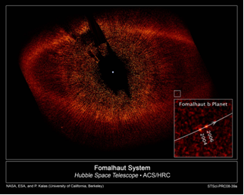
Finding an “Earth”
Notes:
Direct imaging is the method that will be used in a future terrestrial planet finder mission.

Slide 23
Very Low Light Level - ExoPlanet Imaging
The exposure time required to achieve SNR=1 is dramatically reduced for a zero read noise detector, as compared to detectors with state of the art read noise.
Notes:
The table gives exposures times to produce SNR=1 for a typical planet detection space mission. Note the dramatic reduction in time required for a zero noise detector. R=100 is assumed, and the effective planet flux is about 10 photons/hour per pixel. The nearby starlight is suppressed at the 10^-10 level by optical nulling. Zodiacal light contributes about 0.0015 electrons/s/pixel.

Slide 24
Hunt for Dark Energy
Brown 2007, PhD Thesis
Notes:
These plots show the error in estimating brightness of supernovae as a function of detector characteristics, i.e. read noise, dark current, and quantum efficiency. Ultimately, these errors map into our understanding of the nature of the Universe, including whether it will expand forever.
24

Slide 25
Inner Space Applications
Notes:
Inner space corresponds to inside the body.

Slide 26
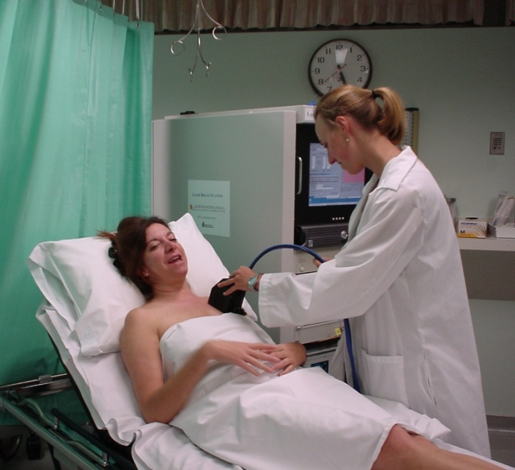
Some Inner Space Applications
breast cancer detection
Notes:
Bio applications include, transillumination, single molecule fluorescence, bioluminescence, breast cancer detection and monitoring, and infant cognitive functioning studies.
26

Slide 27
Biophotonics
Using (~optical) photons for biomedical purposes
Applications
  cognitive functioning
  brain hematoma
  breast cancer
  neuron action potential
Hardware systems
Notes:
In general, biophotonics refers to using optical light to probe biology. Principle applications covered in this talk include cognitive function, brain hematoma, breast cancer, and neuron action potential imaging.
27

Slide 28

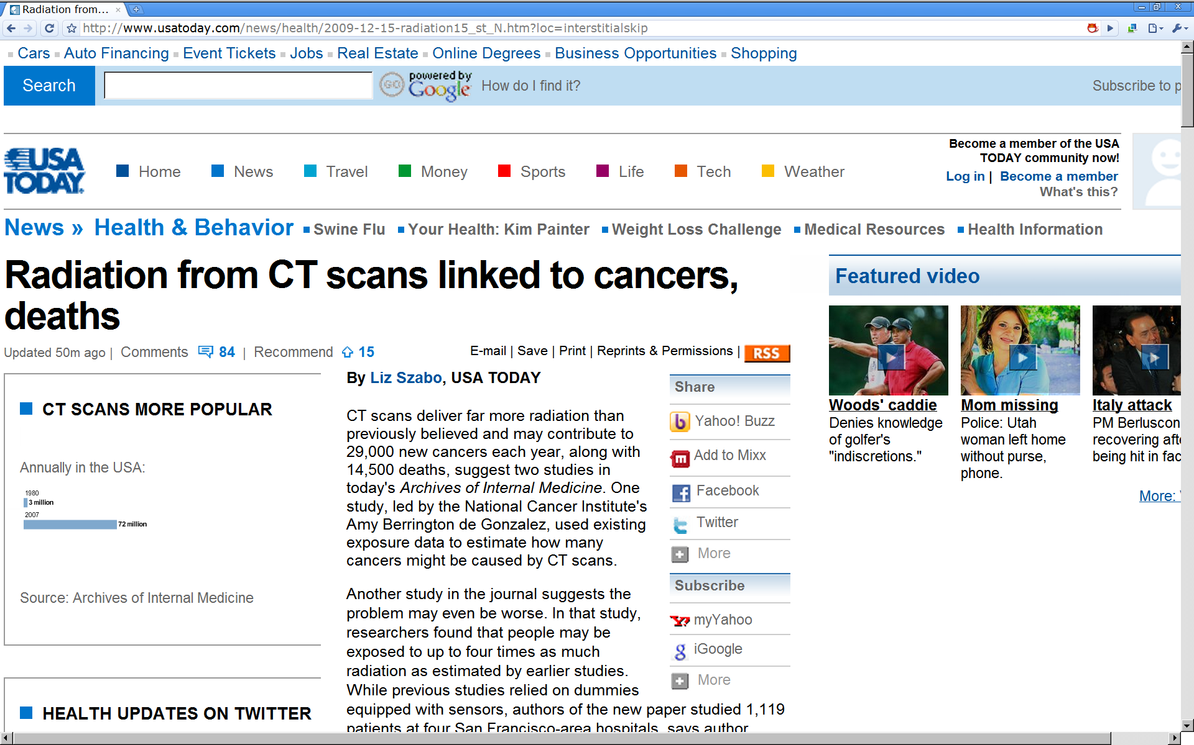
Motivation for Optical Biophotonics
Alternate modalities
Low mass, cost, power, volume
Safe
Notes:
Of many motivations for optical biophotonics, safety is key. Dominant modalities at the present time use high energy photons which can cause tissue damage and cancer. Optical light is safe.
28

Slide 29
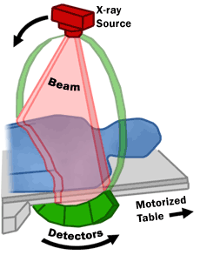
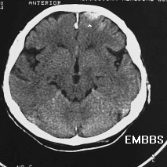
Ballistic Photons
CT-scan (x-ray)
numerical
reconstruction
sources
detectors
scattering << absorption ⇒ paths = straight lines
(courtesy F. Bevilacqua)
Notes:
29
High energy photons are ballistic, and they are used to produce “shadow” images.

Slide 30
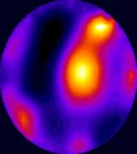
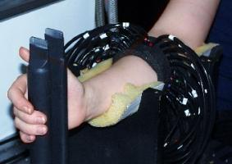
Scattered Photons
near-infrared light
sources
detectors
scattering >> absorption ⇒ broad probability of paths
(courtesy F. Bevilacqua)
http://www.medphys.ucl.ac.uk/research/borg/index.htm
Notes:
30
Optical light is heavily scattered in the turbid medium of the human body. Mathematical reconstruction techniques are important in this case.

Slide 31
Diffuse Optical Imaging (Phantom)
Konecky et al. 2008, Optics Express
Notes:
Despite the strong optical scattering in tissue, it is possible reconstruct an image from the light emerging from tissue. This figure shows reconstructed images of light travelling through phantom sources that mimic the optical scattering and absorption properties of human tissue.
31

Slide 32
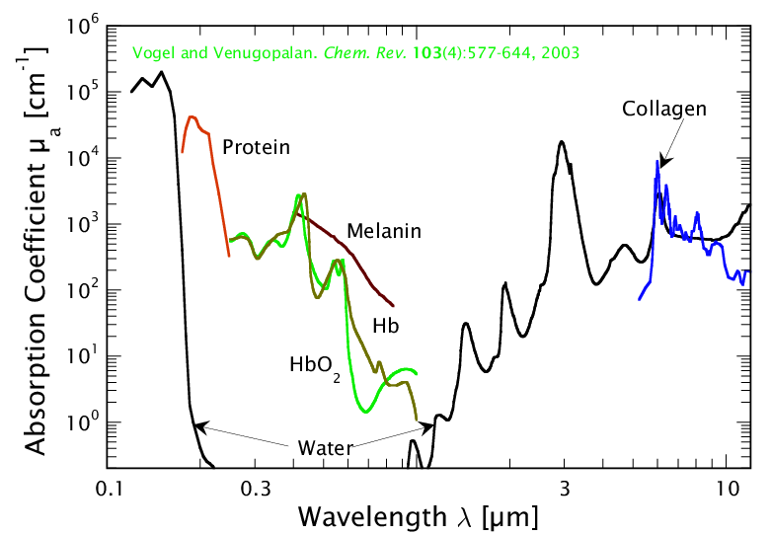
Spectroscopy in Biological Tissue
DNA
biological
window
courtesy V. Venugopalan, http://www.osa.org/meetings/archives/2004/BIOMED/program/#educ
Notes:
32
Melanin may not really be "asborbing". Also, remember its small physical distance. Some additional points: in biological window, fat (lipid) is another important absorber, at its body concentration. Also, in vibrational regime, if you dry out the sample you can get a lot of analytes to contribute.

Slide 33
Important Near-IR Absorbers
19 M
water
32 mM HbO₂
11mM Hb
0.3 g/cm³
fat
Notes:
33
By observing light at contrasting wavelengths, it is possible to make images that highlight variations in the matter being probed. For instance, an image taken at 890 nm would have lower signal than one taken at 720 nm in the case that the target has more oxygenated hemoglobin.

Slide 34
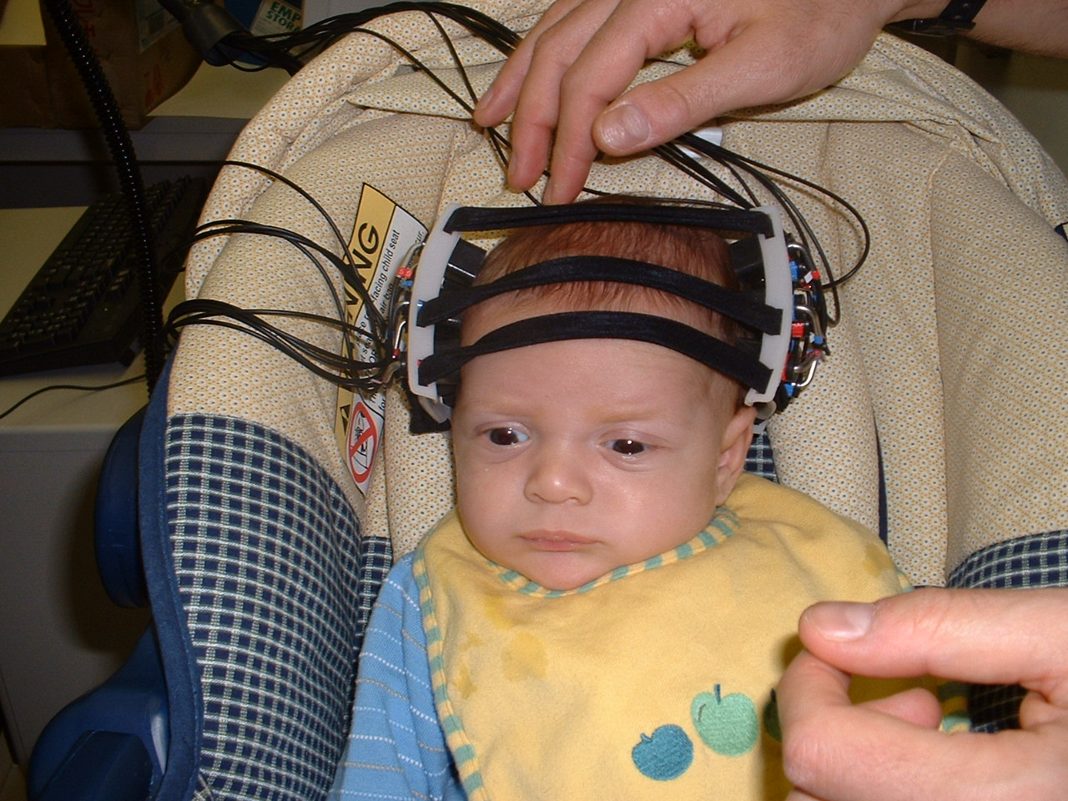
What is He Thinking?
Notes:
34
discuss motivation here: infants are small, uncommunicative, lots of good questions, can’t hold still…

Slide 35
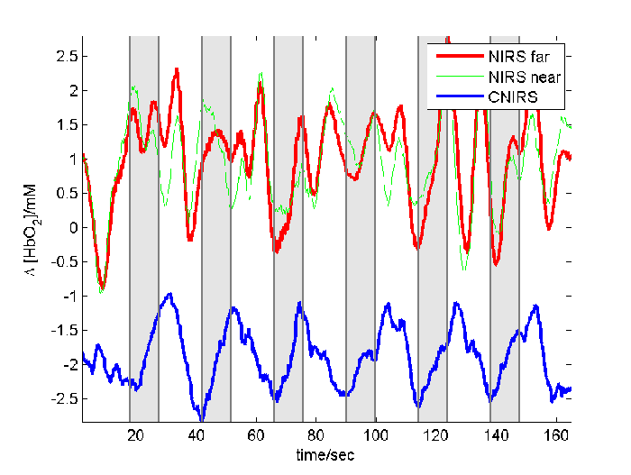
Response to Visual Stimulation
Notes:
35
This figure shows oxygenation level versus time as a baby’s eyes are being stimulated with a flashing light.

Slide 36
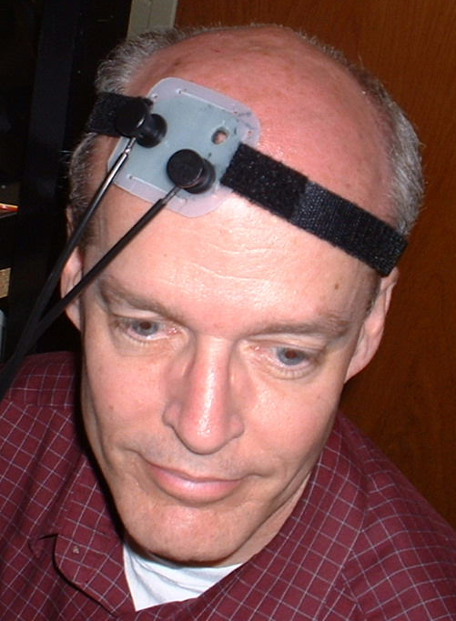
Cerebral Blood Monitoring
light in (690, 830 nm)
light out
Notes:
36
In an adult brain, the absorption is too high for light to traverse the whole target, so one can do the experiment in reflection where the source and detector are on the same side of the brain.

Slide 37

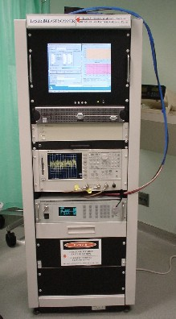
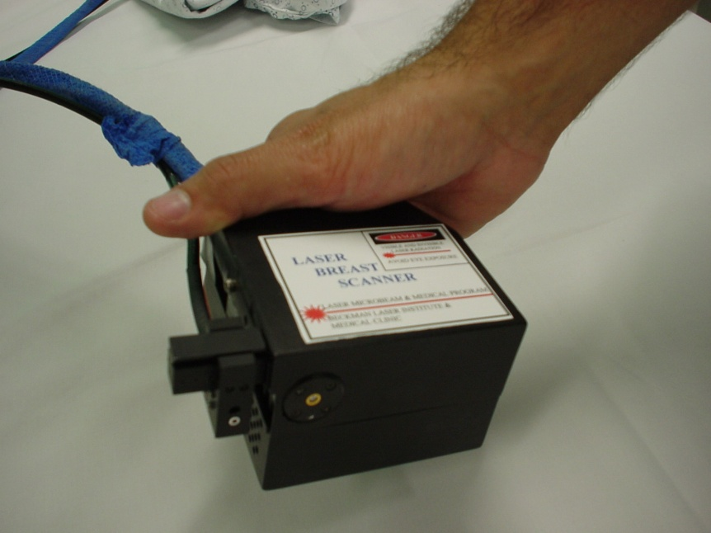
Hand-Held Optical Breast Scanner
Pham, TH., et al. Review of Scientific Instruments, 71 , 1 – 14, (2000).
Bevilacqua, F., et al. Applied Optics, 39, 6498-6507, (2000).
Jakobowski et al., J. Biomed. Opt., 9(1), 230-238 (2004).
(courtesy F. Bevilacqua)
Notes:
37
Beckman Laser Institute have developed a hand-held optical breast scanner.

Slide 38
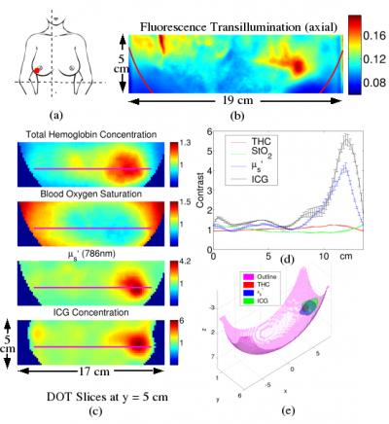
Breast Cancer Detection
Tromberg et al., 2009
Notes:
The optical breast cancer can be used to reveal the presence of extraordinary amounts of oxygenation and blood. By analyzing this information, it is possible to identify and monitor breast cancer.
38

Slide 39
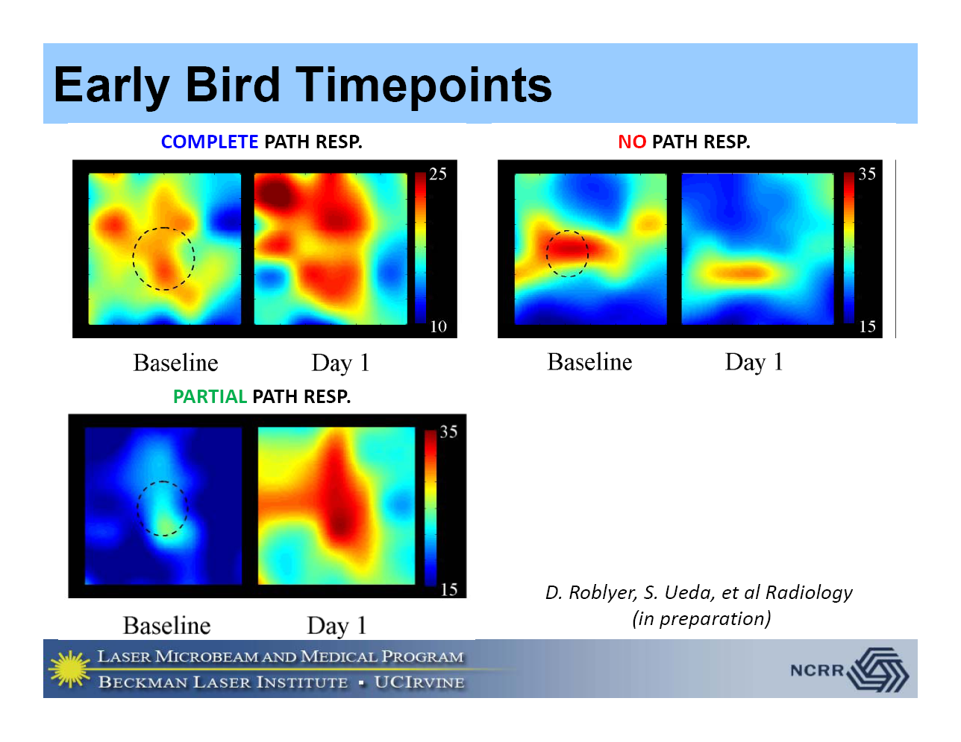
DOSI: Rapid Monitoring
Notes:
39
In some cases, it can even be important to get a picture of response to therapy even one day after treatment.

Slide 40
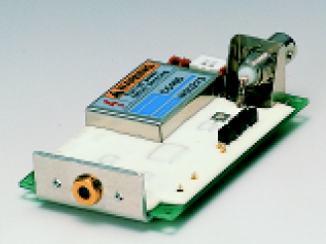
Typical Detector
Hamamatsu ~few element silicon avalanche photodiode modules
Frequency rolloff in low MHz to GHz
Spectral response out to 1000 nm
Notes:
40
A typical detector is shown in this picture.

Slide 41
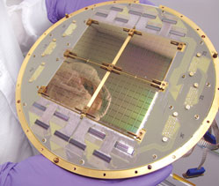
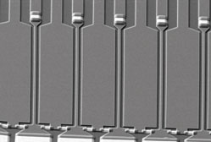
Single Photon Technologies
Table 1. Quantum-limited Detector Technologies.
Superconductors |  | Semiconductors
Transition Edge Sensor (TES) energy resolution operating temperature of tens of mK |  | Electron Multiplying CCD (EMCCD) commercially available excess noise factor
Superconducting Tunnel Junction (STJ) energy resolution operating temperature of mK, leakage current |  | Linear Mode Avalance Photodiode (LM-APD) ns time constant excess noise factor (although MCT has ~no excess noise)
Kinetic Inductance Detector (KID) energy resolution ms time constant |  | Geiger Mode Avalance Photodiode (GM-APD) large pulse per photon afterpulsing
Superconducting Single Photon Detectors (SSPD) ns time constant low fill-factor (?), polarized, few K
Notes:
These plots show the error in estimating brightness of supernovae as a function of detector characteristics, i.e. read noise, dark current, and quantum efficiency. Ultimately, these errors map into our understanding of the nature of the Universe, including whether it will expand forever.
41

Slide 42
Photon-Counting Detector
Notes:
This section describes the photon counting detector being developed by LL and RIT.

Slide 43
Introduction to Photon-Counting Detectors
Photon-counting detectors detect individual photons.
They typically use an amplification process to produce a large pulse for each absorbed photon.
Current devices typically have one element (pixel).
These types of detectors would be useful in low-light and high dynamic range applications
  nighttime surveillance
  daytime imaging
  faint object astrophysics
  high time resolution biophotonics
  real-time hyperspectral monitoring of urban/battlefield environments
  orbital debris identification and tracking
Notes:
This slide gives the reasons why we use Geiger-Mode Avalanche Photodiodes (GM-APDs) for photon counting.

Slide 44
Avalanche Diode Architecture
Notes:
44
This cartoon is a schematic cross-section of a GM-APD. It shows the low field region where photons are converted into electron-hole pairs and the high field region where electrons are accelerated.

Slide 45
Operation of Avalanche Diode
Linear
on
Geiger
mode
mode
on
Linear
Geiger
quench
mode
mode
Current
avalanche
Current
Current
Current
off
off
arm
V_{dc} + ΔV
V
V
br
br
Voltage
Voltage
Notes:
45
The GM-APD is held above breakdown. An avalanche occurs when a free charge enters the high field region. The avalanche is quenched by a circuit that brings the voltage below breakdown.

Slide 46
Performance Parameters
Photon detection efficiency (PDE)
  The probability that a single incident photon initiates a current pulse that registers in a digital counter
Dark count Rate (DCR)
  The probability that a count is triggered by dark current
Single photon input
APD output
time
Discriminator
level
time
Digital comparator output
time
time
time
Successful
single photon
detection
Photon absorbed but insufficient gain – missed count
Dark count – from dark current
Notes:
46
PDE and DCR are two of the most important characterization parameters for GM-APDs.

Slide 47
Zero Read Noise Detector Project
Goals | To design, fabricate, develop, and test a large scale, operational, megapixel array detector that has zero read noise.
Schedule | October 2008 – October 2012
Sponsor | Gordon and Betty Moore Foundation
Notes:
The Moore project is a 2-phase project that will develop large scale detector arrays for the Thirty Meter Telescope. It is a 4 year program in collaboration with MIT LL.
47

Slide 48
Zero Read Noise Detector ROIC
48
Notes:
This is a floorplan and picture of the 256x256 ROIC for the Moore project.
48

Slide 49
Zero Noise Detector Project Goals
Operational
  Photon-counting
  Wide dynamic range: flux limit to >10⁸ photons/pixel/s
  Time delay and integrate
Technical
  Backside illumination for high fill factor
  Moderate-sized pixels (25 μm)
  Megapixel array
Notes:
The Moore detector will have extraordinary capabilities in a competitive device and pixel size format. It will be capable of delivering high dynamic range and ultra-fast imaging.

Slide 50
Zero Noise Detector Specifications
Optical (Silicon) Detector Performance
Parameter | Phase 1 Goal | Phase 2 Goal
Format | 256x256 | 1024x1024
Pixel Size | 25 µm | 20 µm
Read Noise | zero | zero
Dark Current (@140 K) | <10⁻³ e⁻/s/pixel | <10⁻³ e⁻/s/pixel
QEª Silicon (350nm,650nm,1000nm) | 30%,50%,25% | 55%,70%,35%
Operating Temperature | 90 K – 293 K | 90 K – 293 K
Fill Factor | 100% | 100%
ªProduct of internal QE and probability of initiating an event. Assumes antireflection coating match for wavelength region.
Notes:
The proposed performance for the optical (silicon) Moore detector is shown in the table. In Phase 1, we will fabricate and test a moderate-size detector, and in Phase2, we will do the same for a large detector.

Slide 51
Zero Noise Detector Specifications
Infrared (InGaAs) Detector Performance
Parameter | Phase 1 Goal | Phase 2 Goal
Format | Single pixel | 1024x1024
Pixel Size | 25 µm | 20 µm
Read Noise | zero | zero
Dark Current (@140 K) | TBD | <10⁻³ e⁻/s/pixel
QEª (1500nm) | 50% | 60%
Operating Temperature | 90 K – 293 K | 90 K – 293 K
Fill Factor | NA | 100% w/o μlens
ªProduct of internal QE and probability of initiating an event. Assumes antireflection coating match for wavelength region.
Notes:
The proposed performance for the infrared (InGaAs) Moore detector is shown in the table. In Phase 1, we will fabricate and test a single test structure, and in Phase2, we will do the same for a large detector. Note that we will likely only pursue an optical OR infrared detector in Phase 2, depending on the maturity of both paths.

Slide 52
Zero Noise Detector Project Status
A 256x256x25μm diode array has been bonded to a ROIC.
An InGaAs array has been hybridized and tested.
Testing is underway.
Depending on results, megapixel silicon or InGaAs arrays will be developed.
Notes:
The slide describes the status of the Moore project.

Slide 53
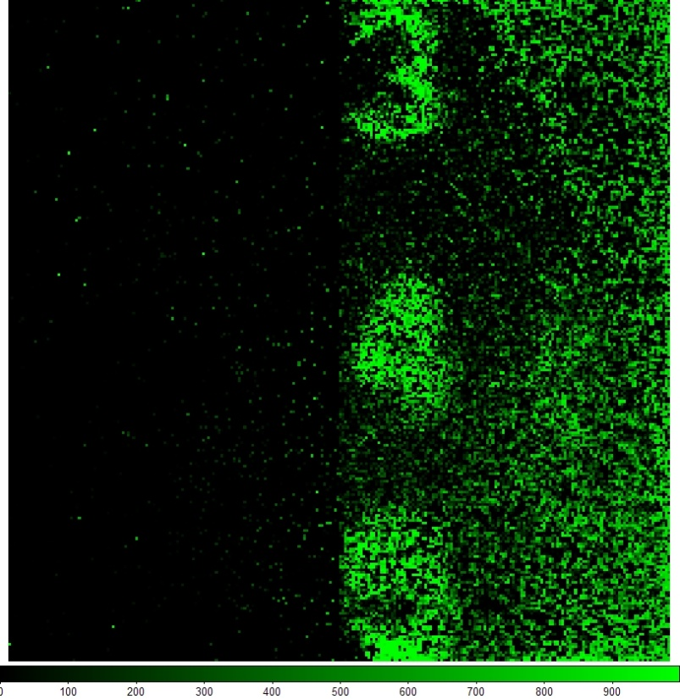
Air Force Target Image
Notes:
This is an image taken with a GM APD biased above breakdown. The image is created by placing an air force target on top of the detector and illuminating with a light source. The image was taken with the detector at room temperature and exposed to ambient light levels. It was formed by summing 1000 expose sequences in which only one photon can be counted per sequence. The event flip-flop for each pixel is read out after each expose sequence and saved for later processing. The events generated by dark current are mitigated by setting a small exposure time in which the APDs are above breakdown and able to achieve a GM avalanche.

Slide 54
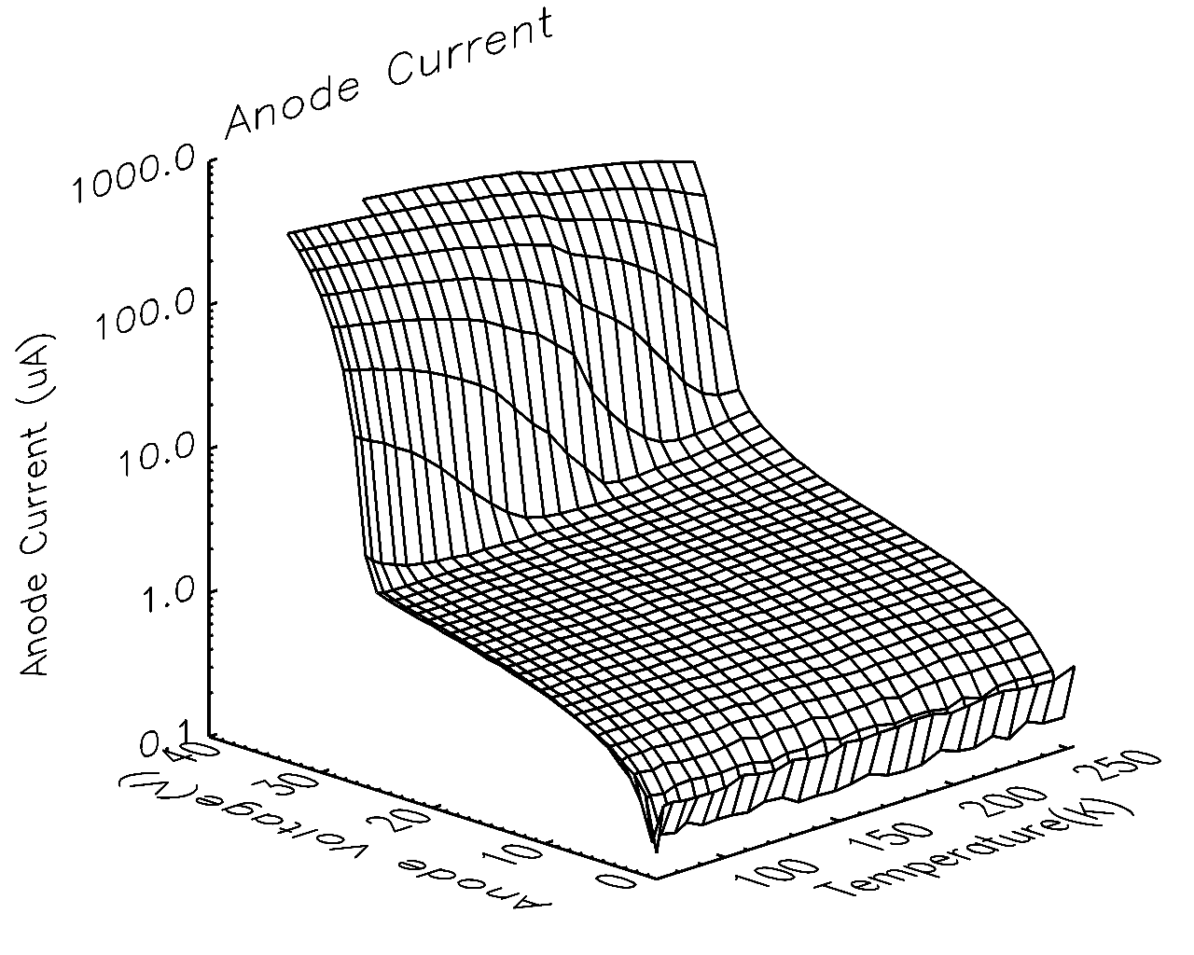
Anode Current vs. V_{bias} and T
Notes:
This is a plot of the anode current vs anode voltage and temperature. It shows the breakdown voltage of the GM APDs and how that breakdown voltage changes vs temperature. Breakdown happens when the anode current sharply increases denoting when the electric field is large enough to accelerate the electron hole pair to the point that they can achieve impact ionization.

Slide 55
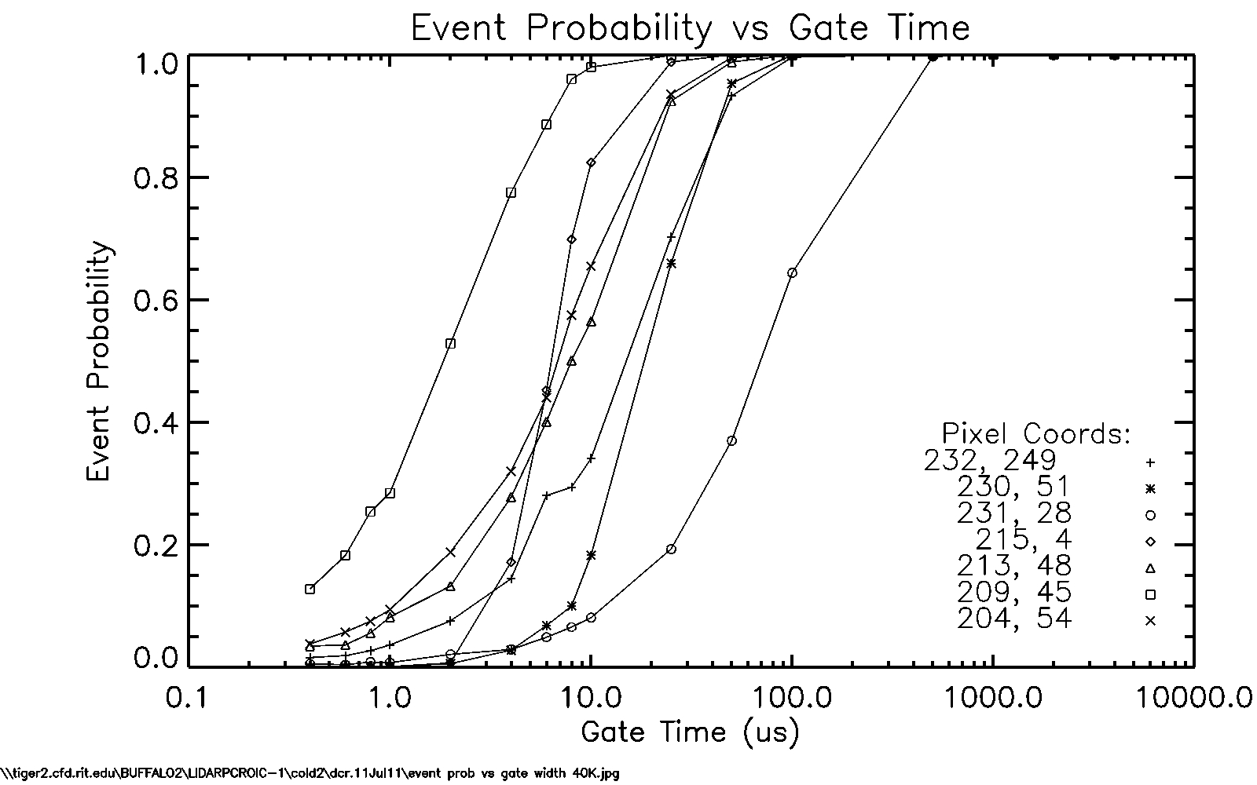
Dark Current
Notes:
This plot shows the event probability vs increasing gate time for a number of pixels. Gate time is defined as the time in which the APDs are able to initiate an avalanche great enough to register and event in the readout circuit. Essentially it is the exposure time. We expect the event probability (i.e. the probability that an event will be generated in a given exposure time) to increase with gate time until the gate time is long enough that either the photon flux or dark current will always generate an event. At this point the pixel is saturated. The event probability due to dark current can be reduced by cooling the detector so that the photon flux has a much greater probability to generate an event. We have identified pixels with what looks like leakage current induced events. This behavior causes the event probability to sharply rise to 1 after a particular gate time. This is because the leakage current is linear, reproducible and will trigger an event when the accumulated charge passes the threshold point of the CMOS trigger circuit.

Slide 56
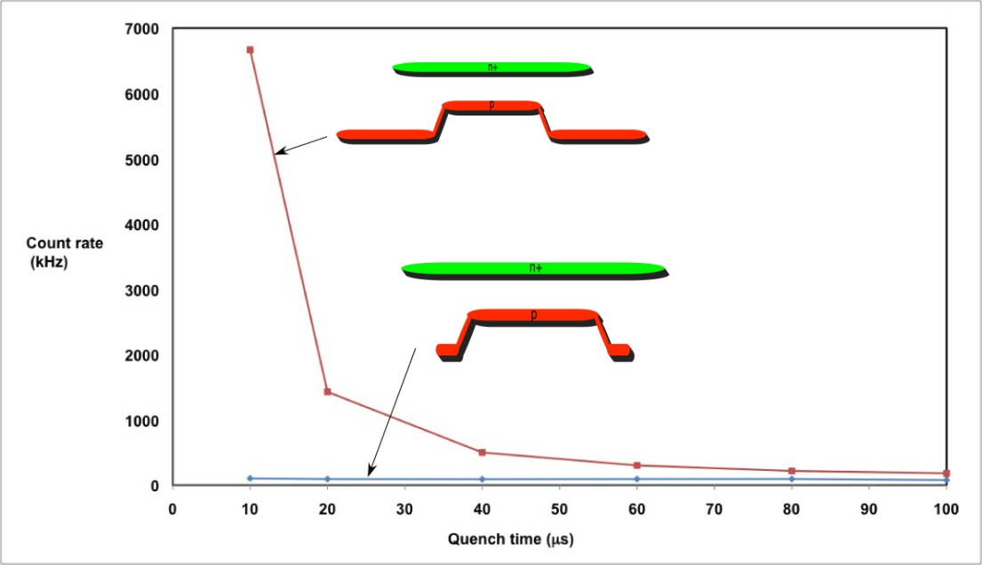
GM APD High/Low Fill Factor
Notes:
Previous testing results for HFF vs. LFF device dark count rate as a function of quench time.

Slide 57
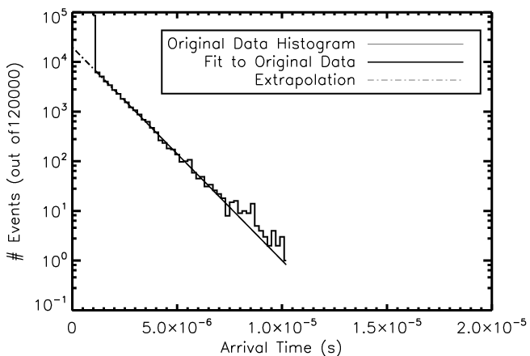
GM APD Self-Retriggering
Simulated Histogram of Avalanche Arrival Times
Notes:
Self-retriggering occurs when photons are generated by the recombination of carriers in an avalanche and are absorbed in the device. This absorption liberates a carrier that induces another avalanche when the device is reset. These carriers have a high probability of causing immediate avalanches.
The number of events in the first bin represents all the cases in which the avalanche occurred while the arm pulse was held high.
Using a fit of the histogram (excluding the first bin), the fit is extrapolated back to the beginning of the arm pulse.
The discrepancy between the expected and actual counts represents the first-bin avalanches caused by self-retriggering.

Slide 58
Imaging LIDAR Detector
Notes:
This section of the talk describes the imaging LIDAR detector project.

Slide 59
Introduction to LIDAR
LIght Detection And Ranging (LIDAR) measures photon time-of-flight, and thus distance to a target.
LIDAR detectors typically have one element and are scanned.
A LIDAR “imaging” detector is pixellated and can be used to produce a 3D data set.
Notes:
This slide gives an introduction to LIDAR.

Slide 60
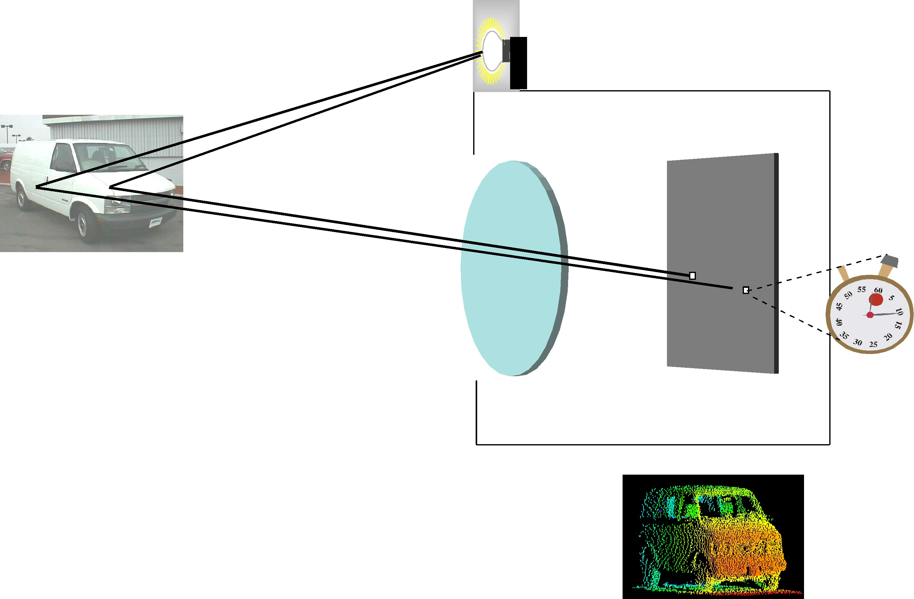
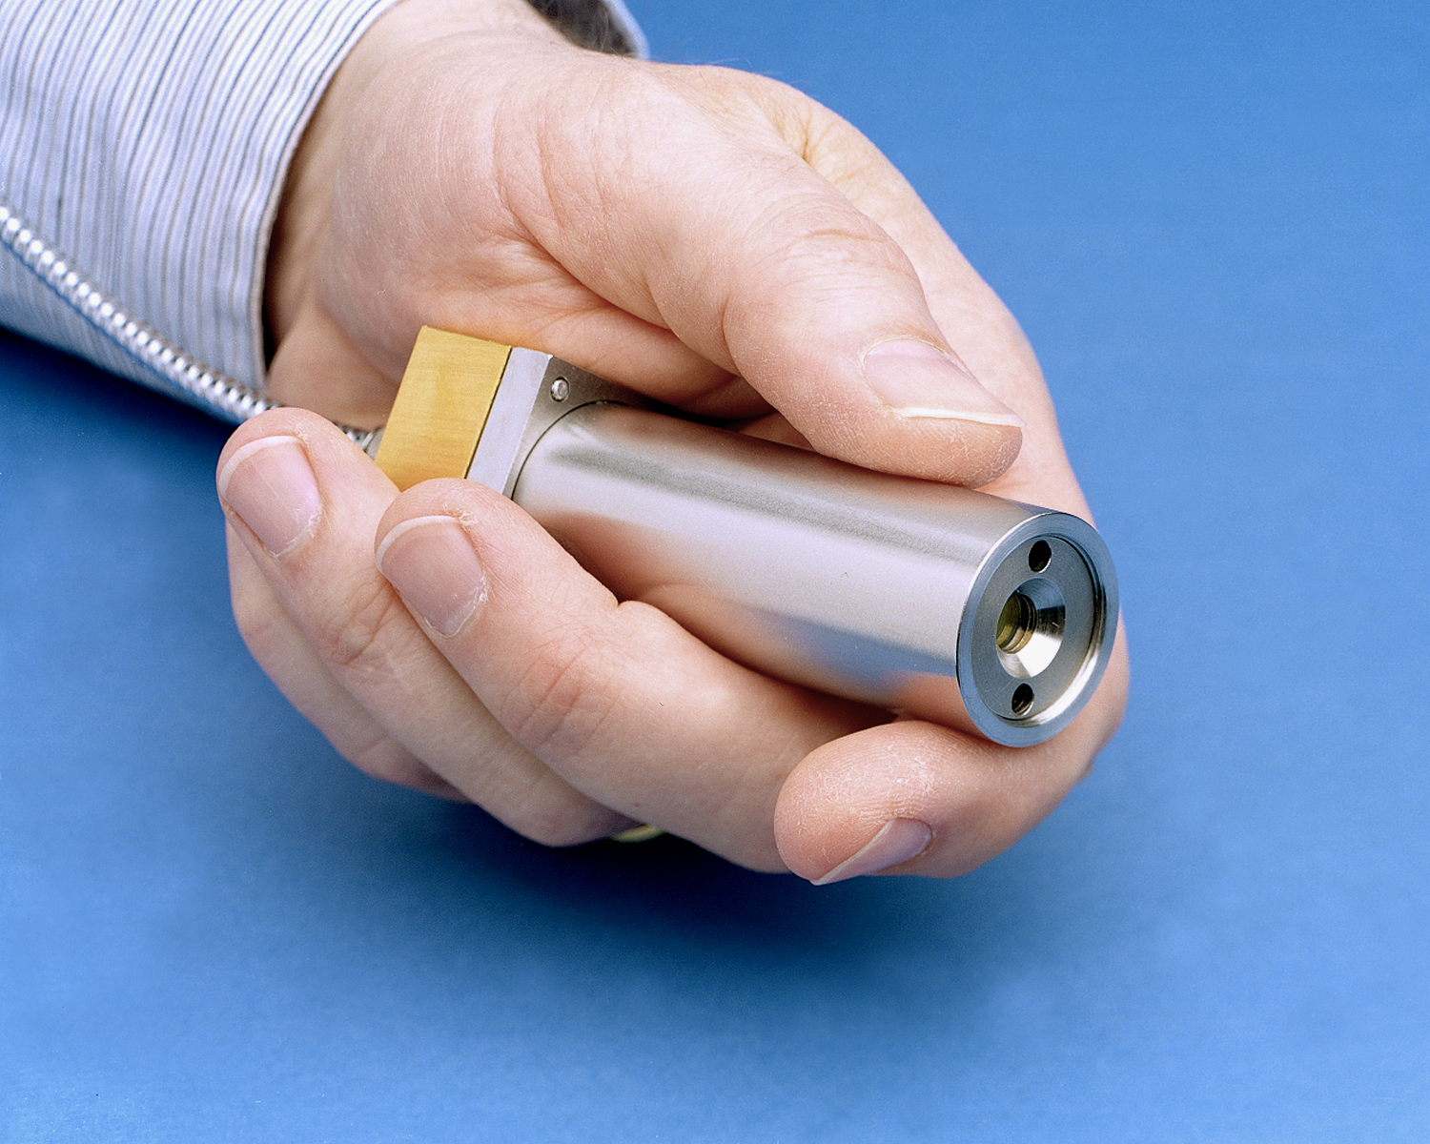
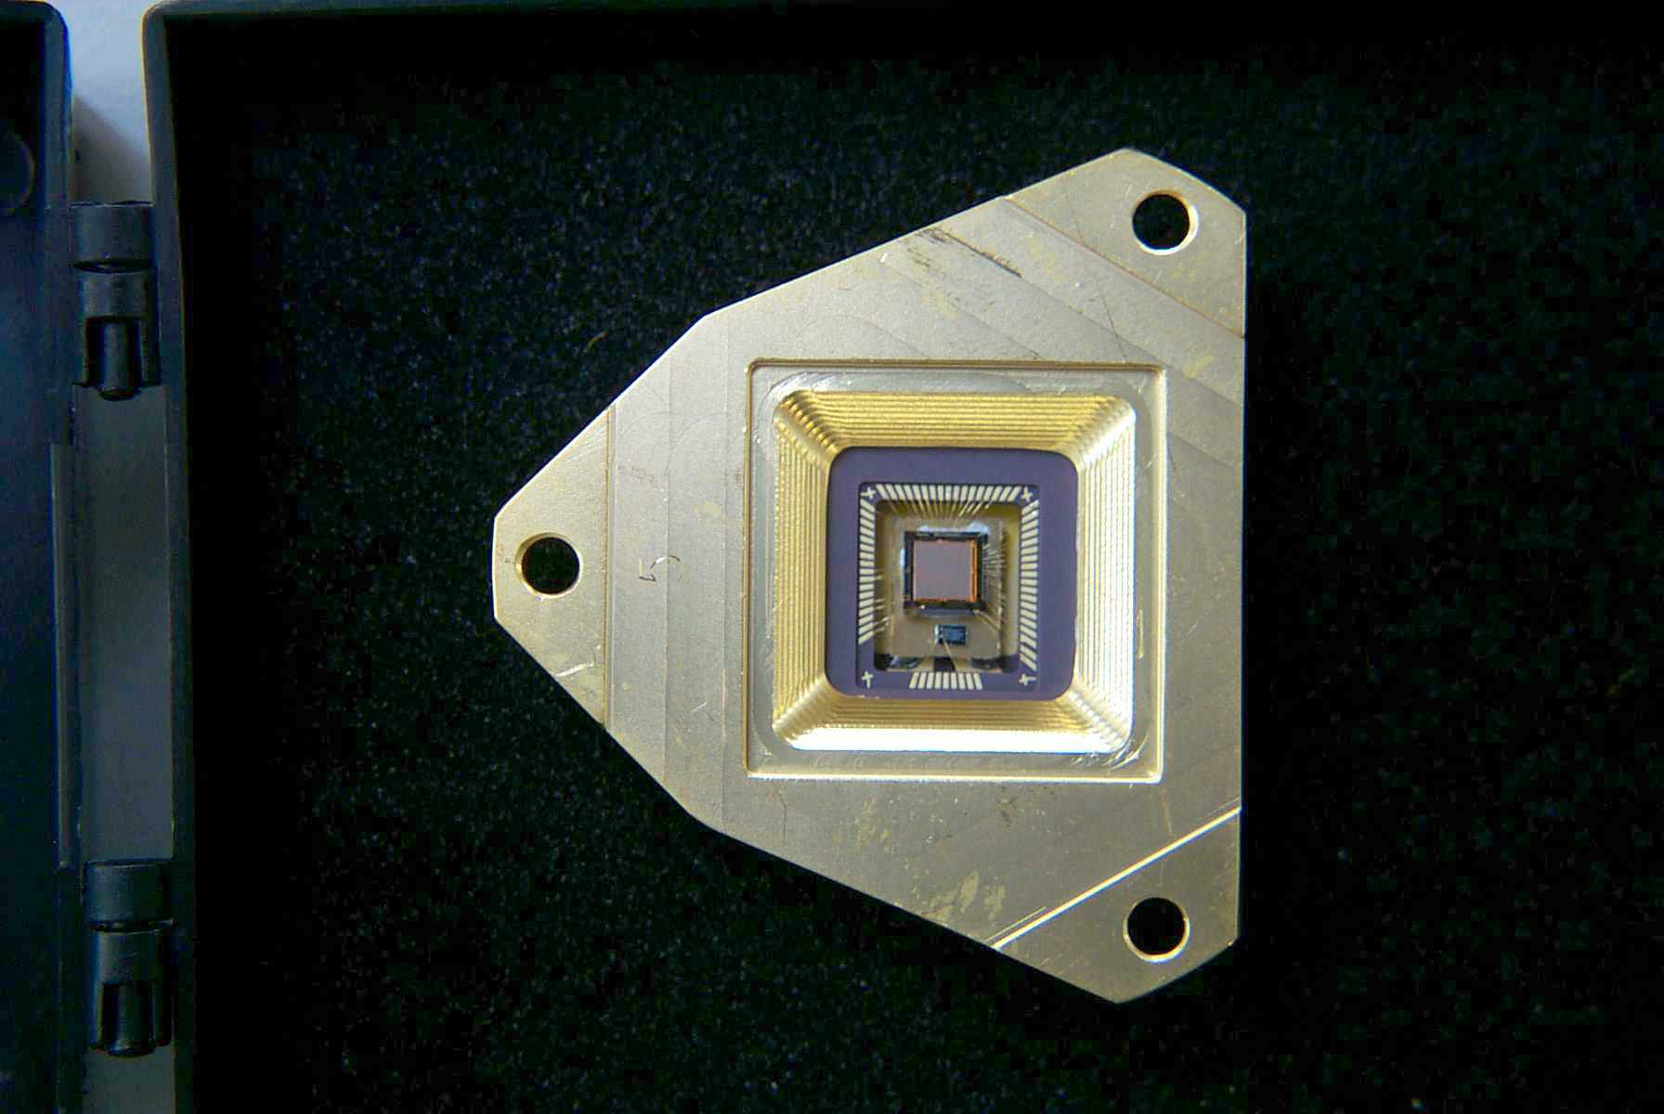
LIDAR Imaging System
Microchip laser
Geiger-mode APD array
Imaging system photon starved. Each detector must precisely time a weak optical pulse.
Color-coded
range image
Notes:
A flash ladar system is like a flash camera, except the flash bulb is a laser that puts out short light pulses, and the pixel measures the arrival time of the light rather than its intensity.

Slide 61
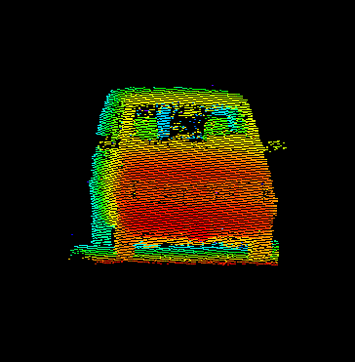
LIDAR 3D Imaging
Taken at noontime on a sunny day
Notes:
1
1
This slide shows a photo of the Gen I ladar system, and a 3D image of a Chevy van taken by the Gen I at noontime on a sunny day.

Slide 62
A LIDAR Imaging Detector for NASA Planetary Missions
Parameter | Current | Goal
Space-Qualifiable | NO | YES
Scalable to Large Format | NO | YES
CMOS ROIC Timing Resolution | 250 ps | 250 ps
Pixel Size | 50 μm | 50 μm
Multiplied Dark Current (@140 K) | unknown | <10⁻³ e⁻/s/pixel
QE (350nm,650nm,1000nm)ª | 45%,65%,5% | 45%,65%,10%
Operating Temperature | 293 K | 90 K – 293 K
Radiation Limit | unknown | 50 Krad(Si)^{b}
Technology Readiness Level^{c} | 2 | 4
Notes:
RIT and LL are funded to develop a LIDAR imaging detector for planetary missions. “QE” is a product of internal QE and probability of initiating Geiger mode avalanche; it does not assume anti-reflection coatings.

Slide 63
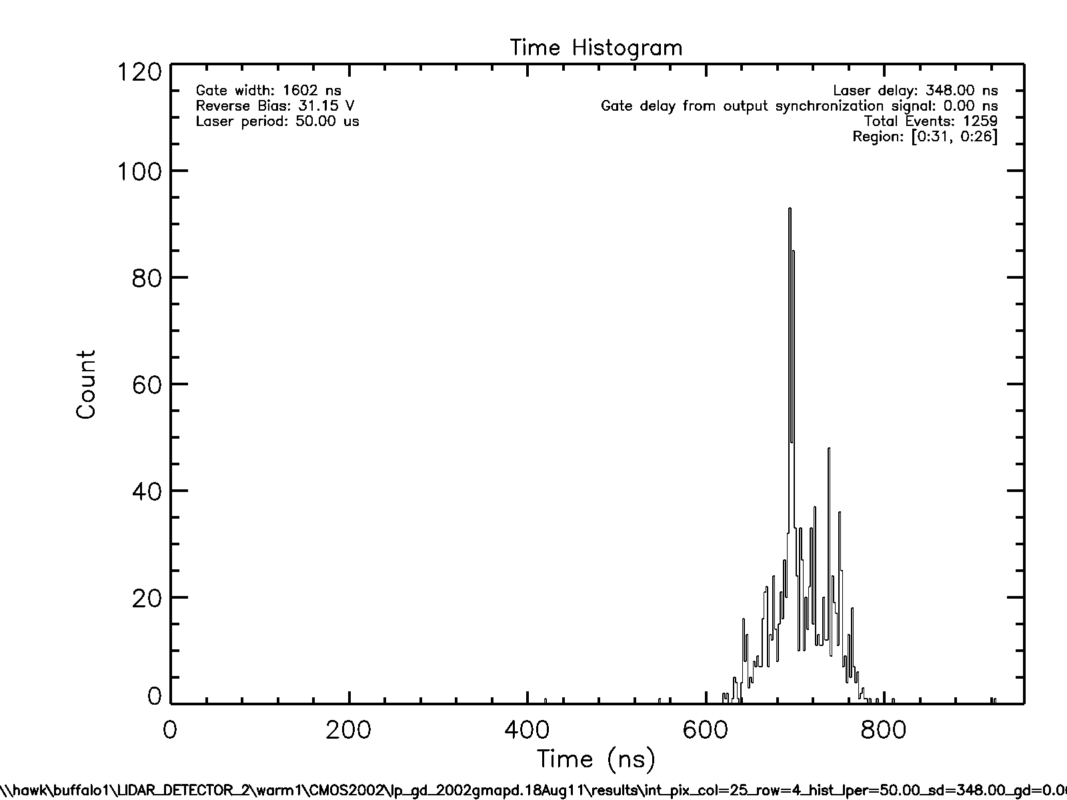
LIDAR 3D Imaging
Notes:
1
1
This slide shows a photo of the Gen I ladar system, and a 3D image of a Chevy van taken by the Gen I at noontime on a sunny day.

Slide 64
Conclusions
We have developed, and are testing, a 256x256 photon-counting imaging array detector.
After lab characterization, we will expose four devices to radiation beam and then re-test.
Notes:
To simulate the radiation flux on the detector, relevant mission parameters need to chosen first. The 4 types of orbits are chosen based on the orbits for the proposed missions.
Based on the mission parameters, the trajectory over the life mission can be calculated. Using that information, radiation models can be used to calculate the flux on the detector.

Slide 65
Future Directions
Notes:
This concluding section summarizes future directions.

Slide 66
Future Directions
In the short term, we plan to develop GM-APD detectors
  final fabrication
  lab testing
  field testing
  radiation testing
In the medium term, we plan to deploy detectors for
  astrophysics, planetary science
  biophotonics
In the long term, we plan to develop multi-mode quantum-limited detectors.
Notes:
In the near term, we want to make a working zero noise detector. In the medium term, we want to deploy them into systems. In the long term, we want to exploit all properties of a photon.

Slide 67
Detector Virtual Workshop
Year-long speaker series dedicated to future advanced detectors
Talks streamed and archived
Email if interested in being on distribution list:
figer@cfd.rit.edu
Notes:
To simulate the radiation flux on the detector, relevant mission parameters need to chosen first. The 4 types of orbits are chosen based on the orbits for the proposed missions.
Based on the mission parameters, the trajectory over the life mission can be calculated. Using that information, radiation models can be used to calculate the flux on the detector.

Slide 68
Center for Single Photon Detectors
NSF Science and Technology Center
“The Center will fuse breakthroughs in nano and quantum science to establish the knowledge needed to create devices that exploit all the properties of every single photon.”
10 year lifetime, $50M
RIT, UofR, UNM, UCI, US Labs, Industry, 12 countries
Notes:
We are proposing an NSF center for single photon detectors.

Slide 69
Center for Single Photon Detectors
Notes:
These are the partner organizations for the proposed center.

