Slide 1



Diagnostic tools and
CCD readout optimization in the first rafts of LSST
Claire Juramy

Slide 2
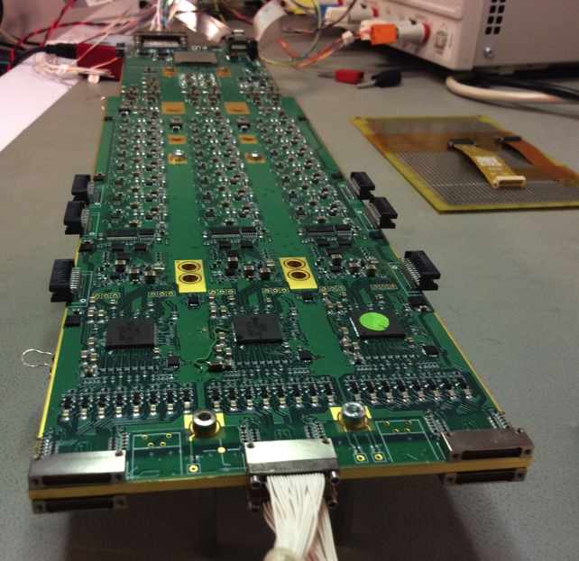
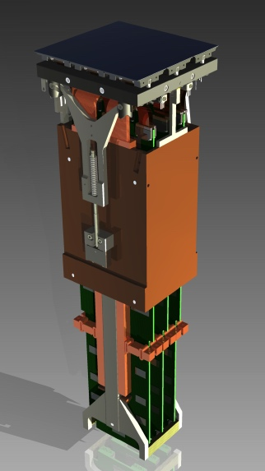
Monitoring and diagnostic challenges
LSST Focal Plane: 21 Camera Science Rafts: 9 CCDs, 12x12 cm footprint
Control and readout of CCDs: Raft Electronics Board (REB): 3 CCDs, 48 video channels, 1 FPGA
All in-cryostat
On-board monitoring of DC values
Diagnostic of video channels: ?
Raft Tower Module (BNL)

Slide 3
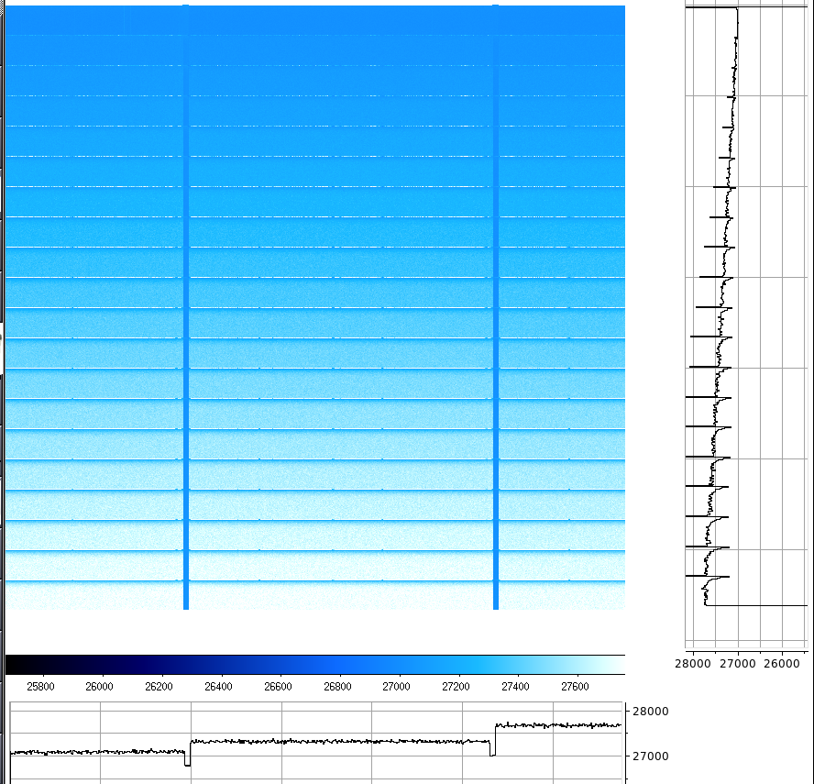
CCD readout: FPGA sequencer
Sequencer block in firmware of FPGA (Stefano Russo): controls parallel clocks, serial clocks, readout clocks, including sampling trigger for ADC
  functions: linear sequence of clock states
  program memory: subroutines, calls to functions and other subroutines
  pointers: storing constants and addresses in dedicated registers
Scan mode / scope mode: the ADC sampling trigger is delayed by increments of 10 ns each time it is sent, up to 2550 ns.
[functions]
ReadPixel: # Single pixel read
clocks: RG, S1, S2, S3, CL,RST, RD, RU,TRG
slices:
TimeS = 1, 0, 1, 0, 0, 0, 0, 0, 1
BufferS = 1, 0, 1, 1, 0, 1, 0, 0, 0
BufferS = 0, 0, 0, 1, 0, 1, 0, 0, 0
220 ns = 0, 0, 0, 1, 1, 1, 0, 0, 0
ISO1 = 0, 0, 0, 1, 0, 0, 0, 0, 0
RampTime = 0, 0, 0, 1, 0, 0, 1, 0, 0
BufferS = 0, 1, 0, 1, 0, 0, 0, 0, 0
ISO2 = 0, 1, 0, 0, 0, 0, 0, 0, 0
RampTime = 0, 1, 0, 0, 0, 0, 0, 1, 0
BufferS = 0, 1, 1, 0, 0, 0, 0, 0, 0
constants: P2=1, P3=1
[subroutines]
WindowLine: # Line readout
CALL TransferLine
CALL SerialFlush repeat(@PreCols)
CALL ReadPixel repeat(@ReadCols)
CALL SerialFlush repeat(@PostCols)
RTS
ReadFrame: # Readout and acquisition of a CCD frame
JSR FlushLine repeat(@PreRows)
CALL StartOfImage
JSR WindowLine repeat(@ReadRows)
CALL EndOfImage
JSR FlushLine repeat(@PostRows)
RTS

Slide 4
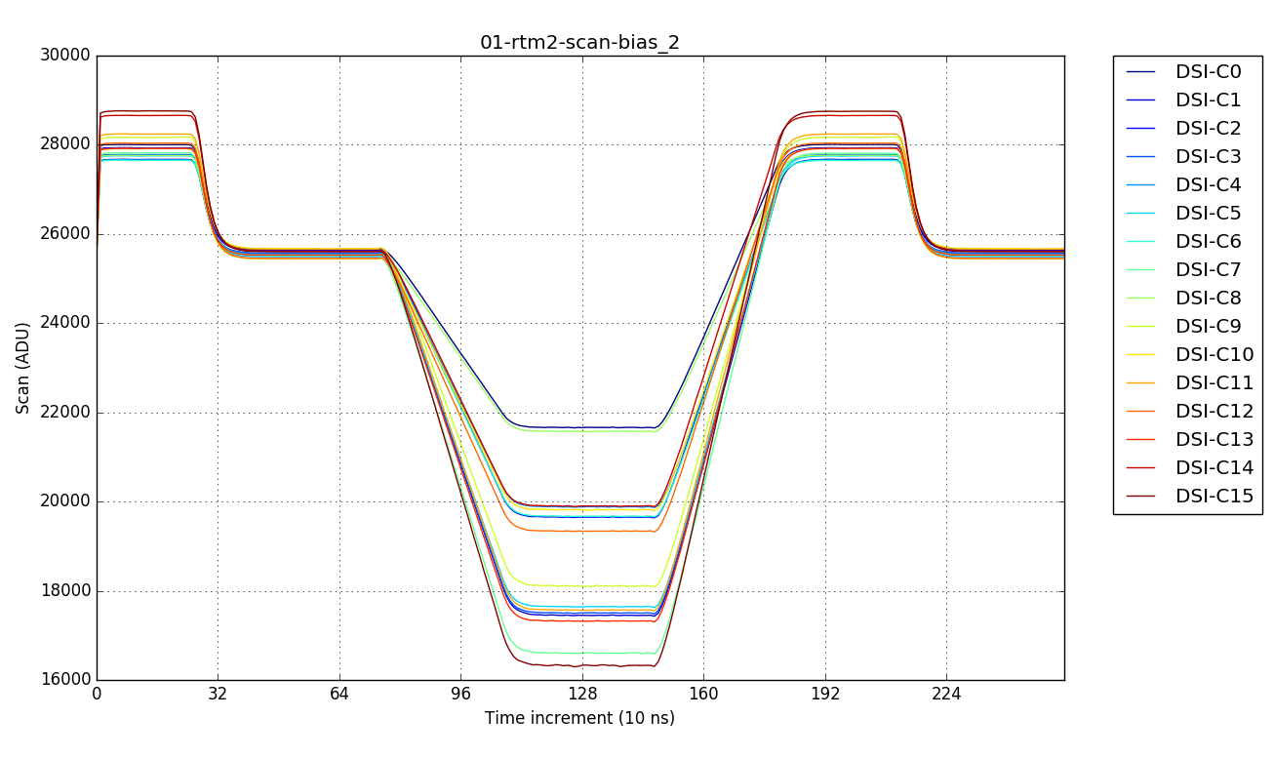
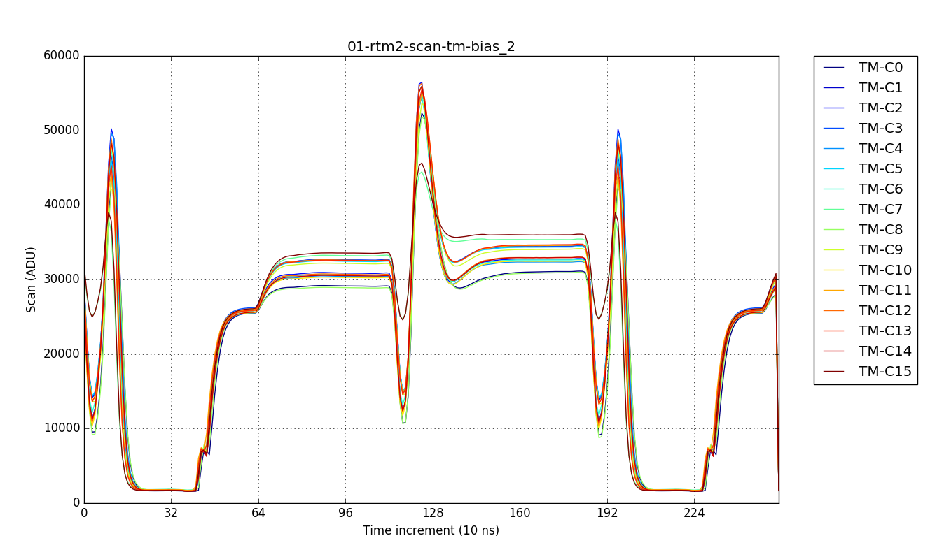
CCD readout: REB video chain
OD
ASPIC
CCD
18-bit ADC
||
G
∫
ASPIC: Analog Signal Processing IC: amplification (x1.9), differential signal, and Dual Slope Integration
“Transparent Mode” bypasses the integrator stage: the ASPIC output becomes a replica of the CCD output
Acquired through the video pipeline, with 18-bit resolution and low noise
Note: ADU value increases when OS voltage decreases
normal mode: dual slope integration
transparent mode

Slide 5
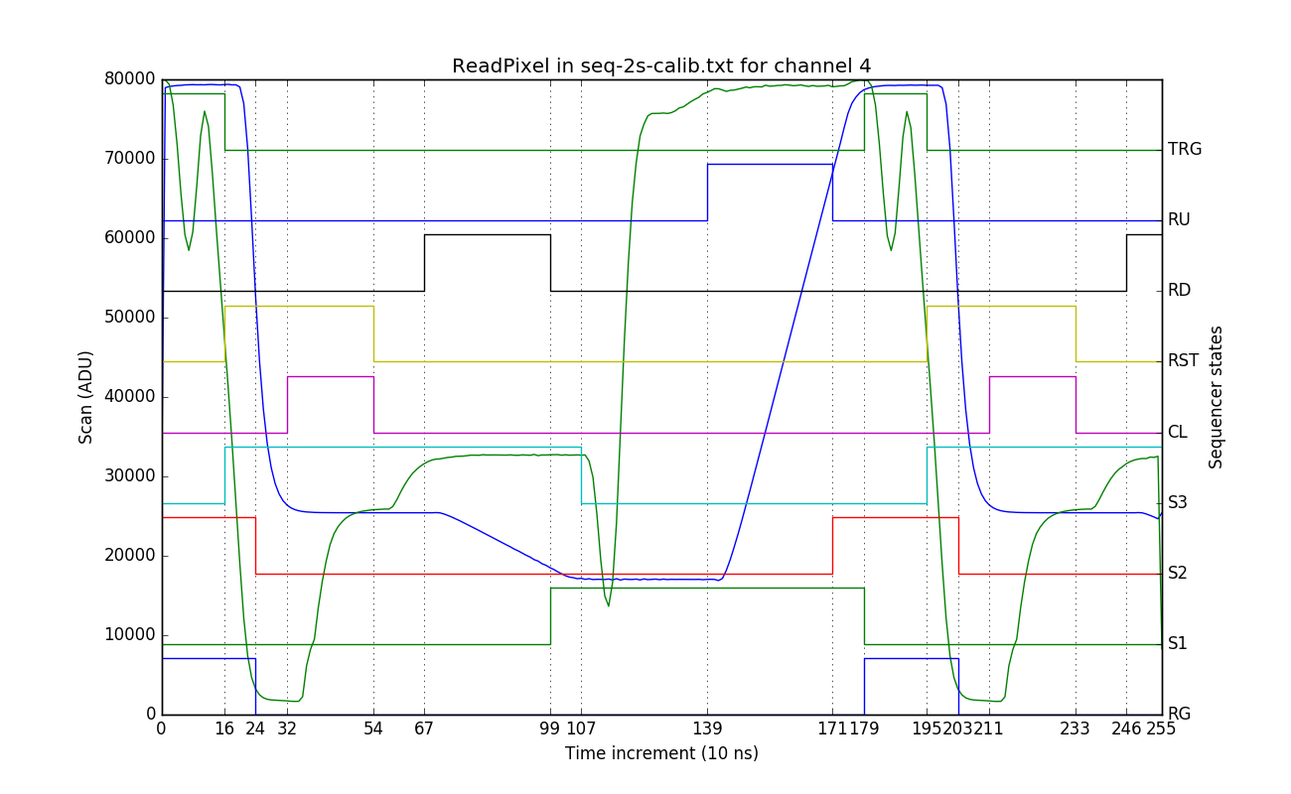
Pixel scan and clocks: Transparent Mode
Raw OS
Integrated
Baseline level
Pixel content
ADC trigger
ASPIC signals
CCD Reset
ASPIC clamp
CCD Reset
CCD serial clocks

Slide 6
Pixel scan and clocks: Dual Slope Integration
Raw OS
Integrated
ASPIC integrator reset
ASPIC integrator reset
ADC trigger
ASPIC Ramp Up
ASPIC Ramp Down
ASPIC signals
CCD serial clocks

Slide 7
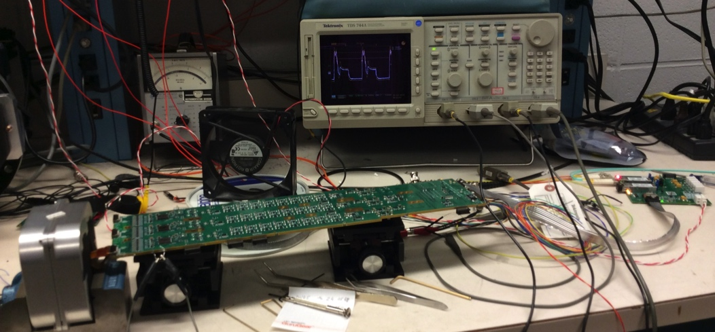
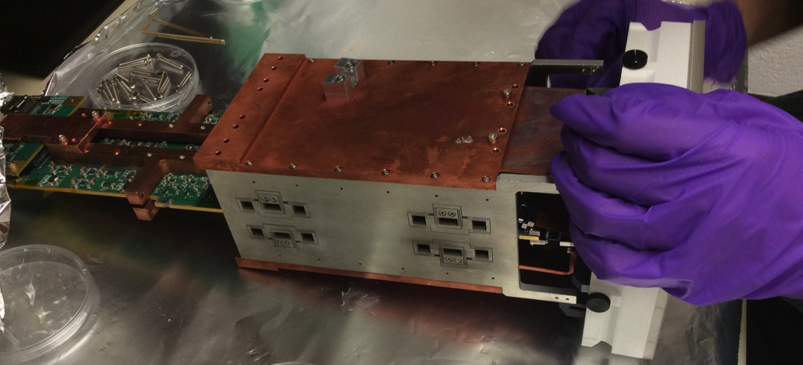
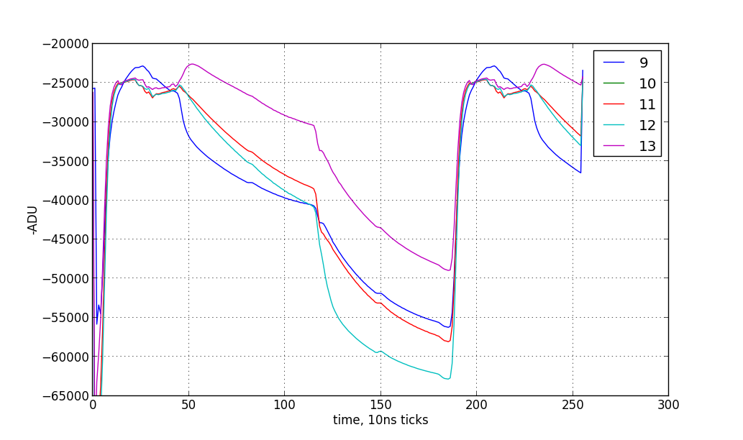
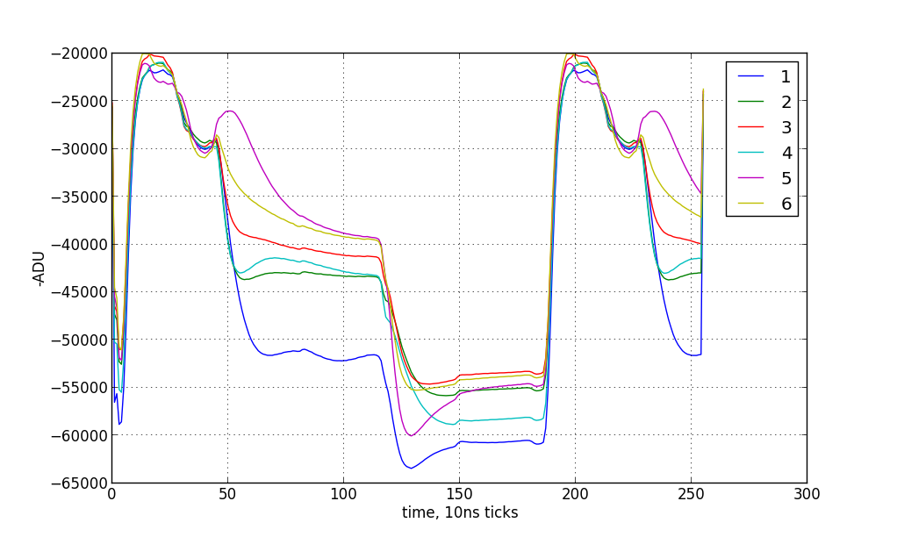
Deployment in prototype test stands
1-CCD ROAR (BNL)
3-CCD ROAR (BNL)
Early adjustments on readout sequences with prototype LSST electronics
Evaluation of the “active flex cable” solution for ITL sensors
Channels with passive cable
Channels with active cable

Slide 8
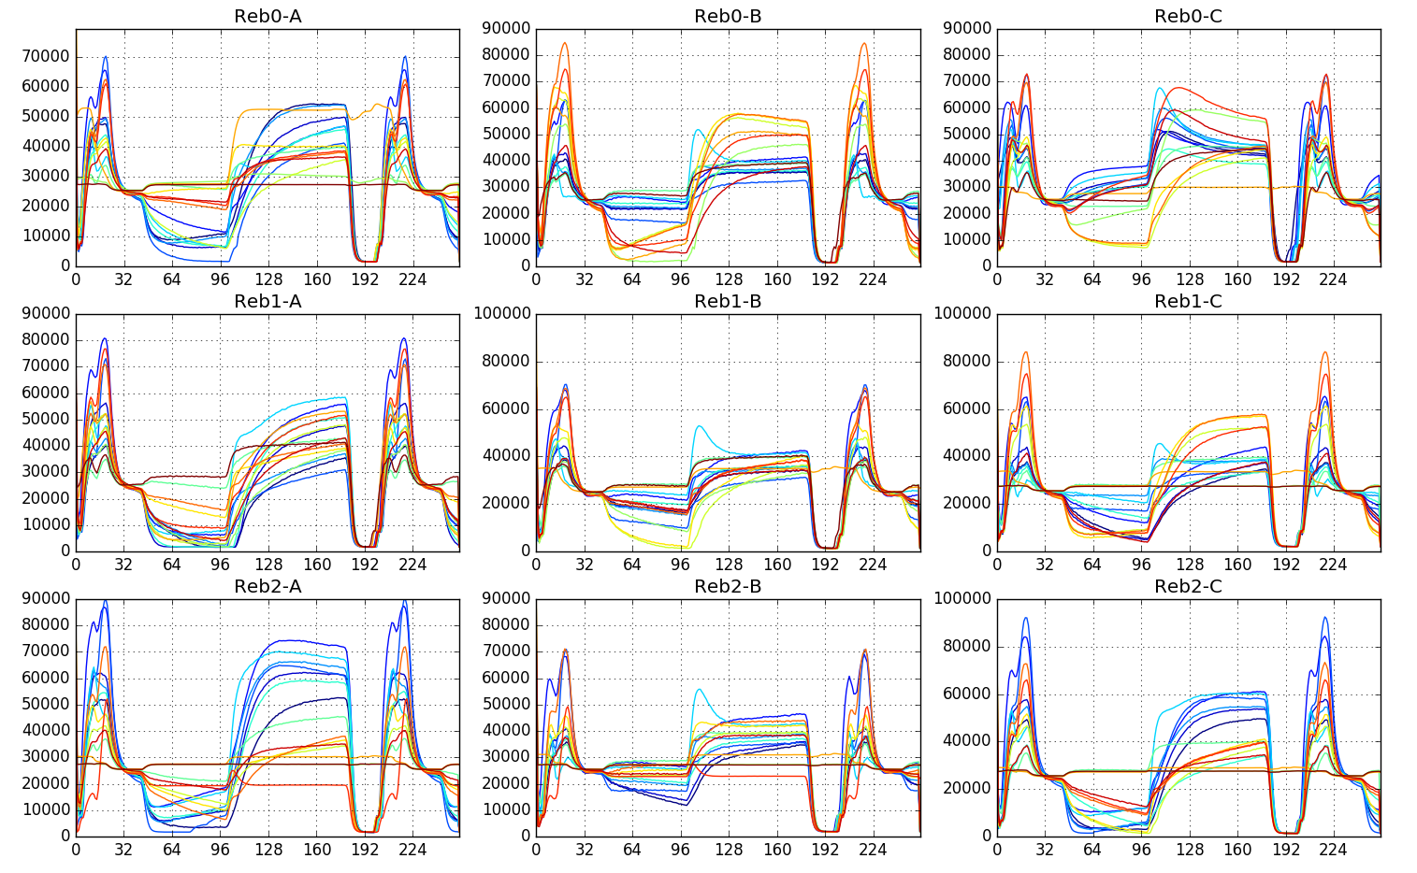
Diagnostic on Engineering Test Unit #2
Issues with excess noise and very high bias levels
Original readout sequence: similar to CCD test stands
Scan mode showed origin of bias: very strong crosstalk from serial clocks (quantified with “single-clock” scans)

Slide 9
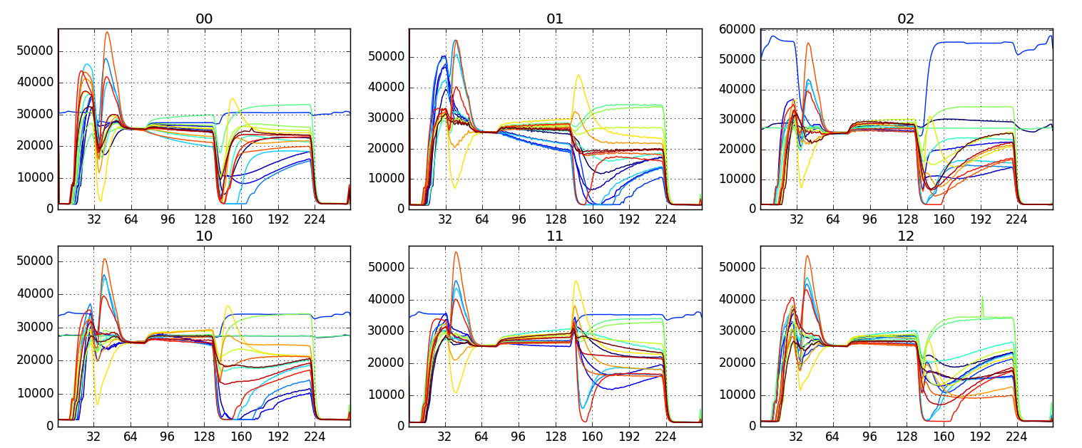
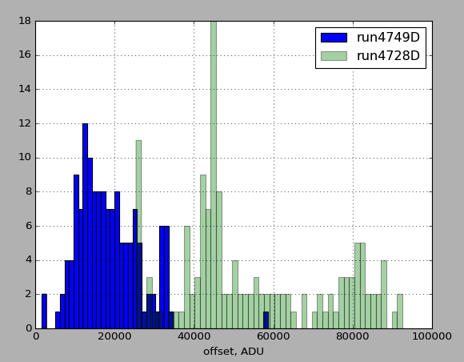
ETU2 with modified sequence
Moved serial clock to have clock crosstalks neutralize each other
Lowered biases and spread of values
Brought noise in line with expectations

Slide 10
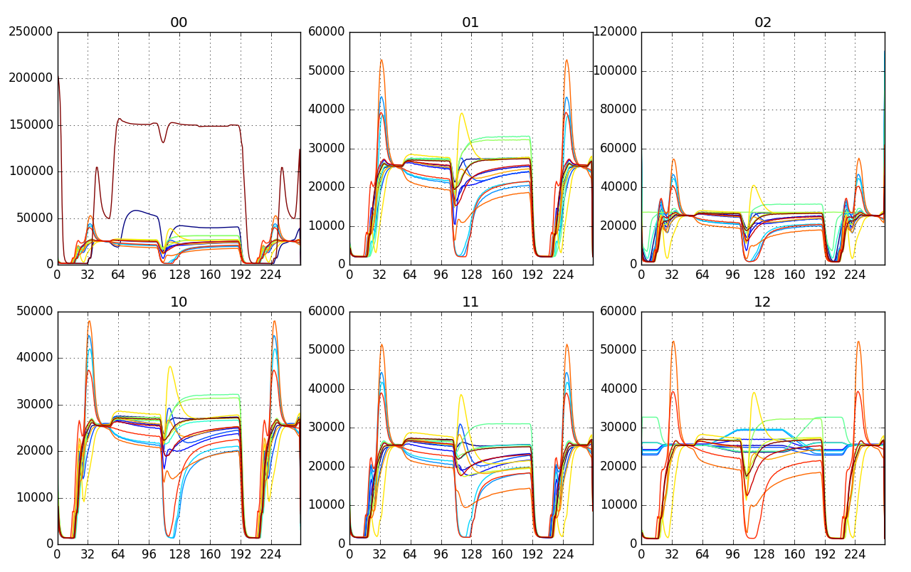
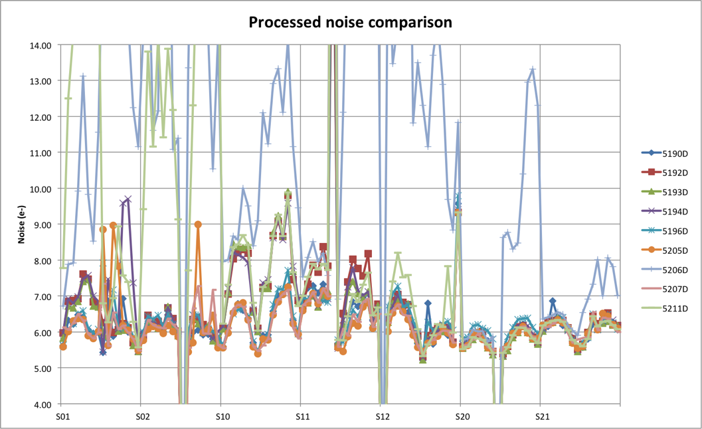
Raft Tower Module #1: the road to 2s
Sequence from ETU2 optimization was 2.39 µs/pixel, for a median noise of 5.9 e- on RTM1
Target to read the nominal frame size in 2s: 1.81 µs/pixel
Iterative tests over noise + checks on gain, CTI
Reached 1.79 µs/pixel for a median noise of 6.0 e-

Slide 11
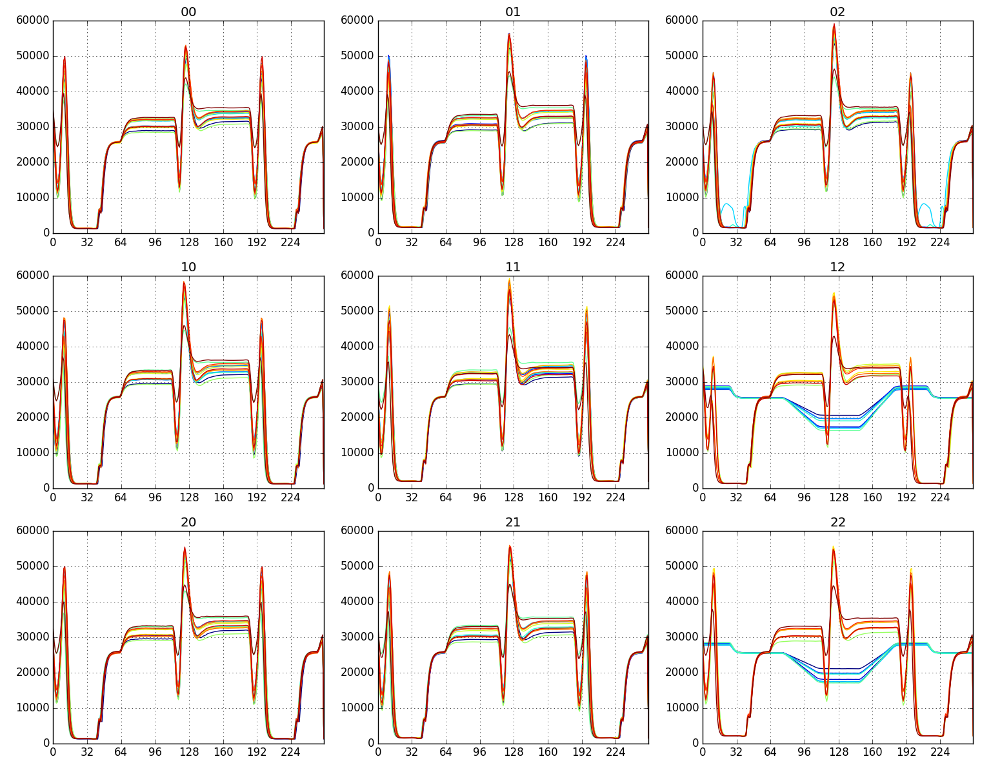
Raft Tower Module #2
First raft with E2V sensors
Readout tested at LPNHE with REB + single CCD
Reached 4.7 e- median noise at 1.79 µs/pixel

Slide 12
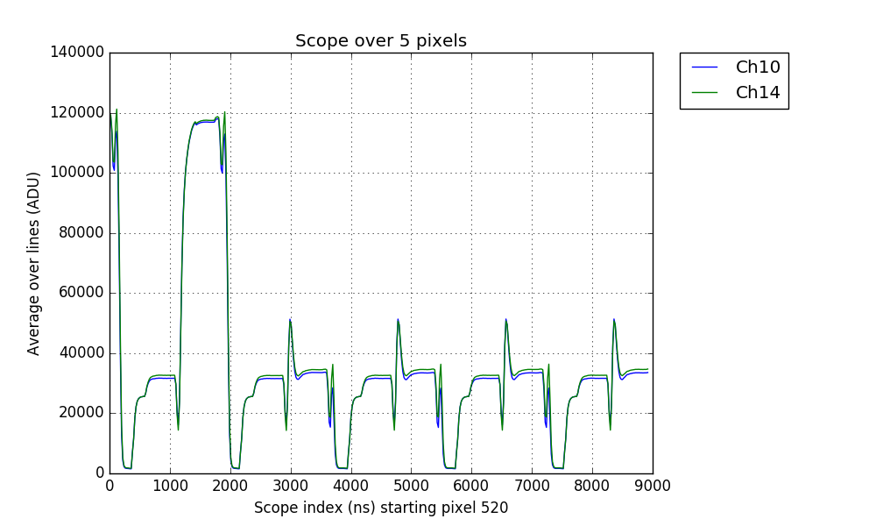
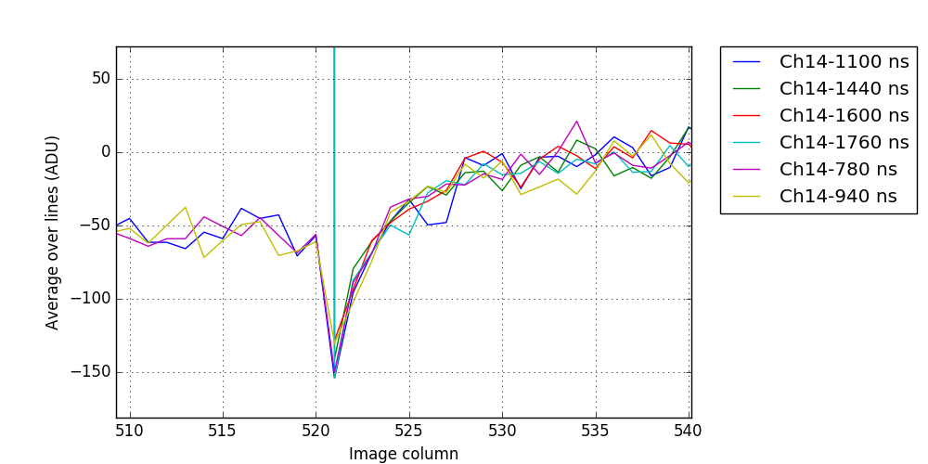
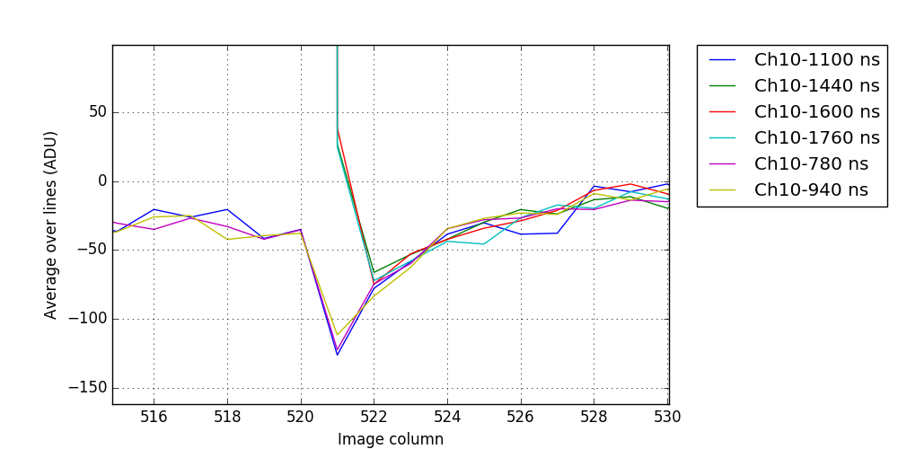
Super-scan
Limitation of scan mode: time index = pixel
Super-scan: stack of frames with 1 time index per frame + ASPIC Transparent Mode
Super-scans combine spatial and temporal information: Charge Transfer Inefficiency, drifts over time
overscan pixels
Full scope
Selected time indexes: baseline and signal levels

Slide 13
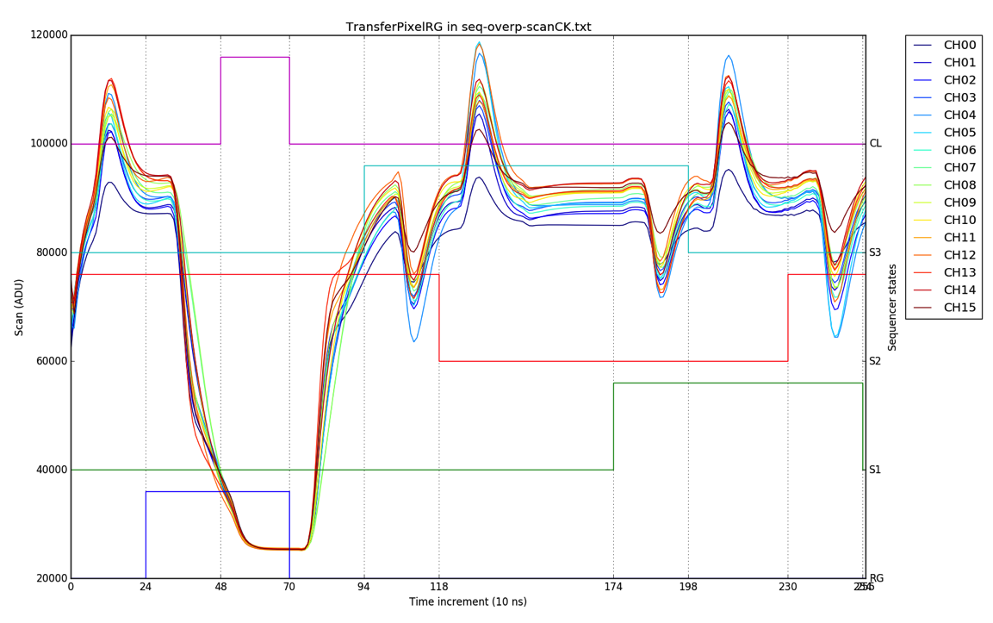
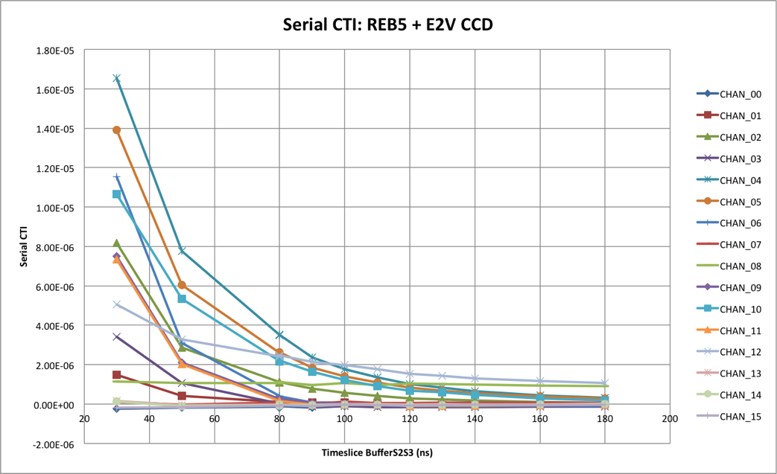
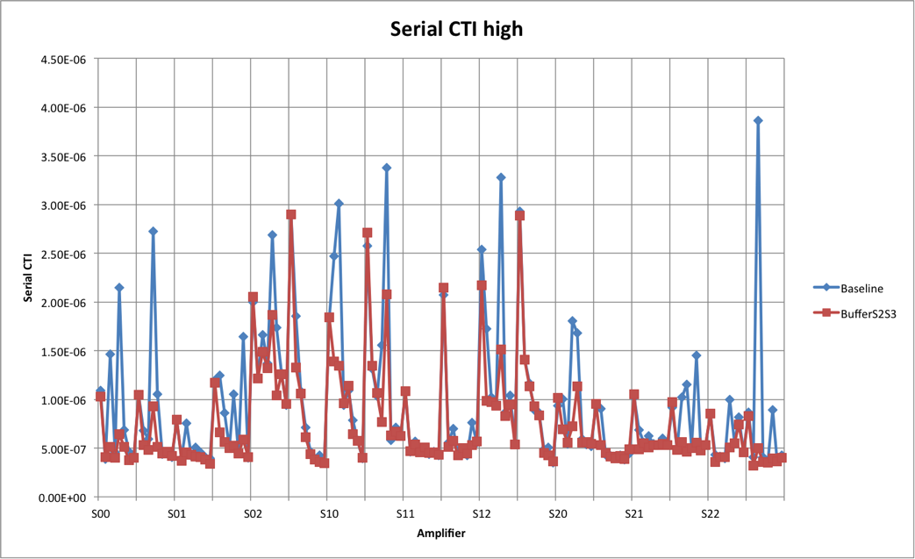
Serial transfer: high flux
Serial CTI at high flux ~5ppm on some channels
Dependent on readout timing
Scan mode: timing of actual clock transitions vs sequencer state transitions
baseline timing
modified timing
bench test
RTM3

Slide 14
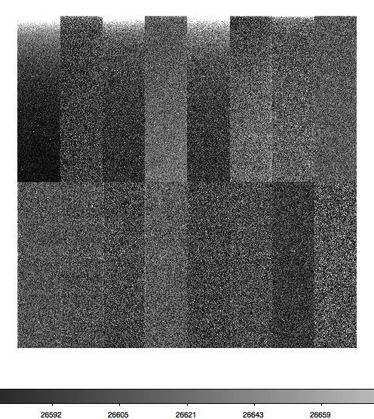
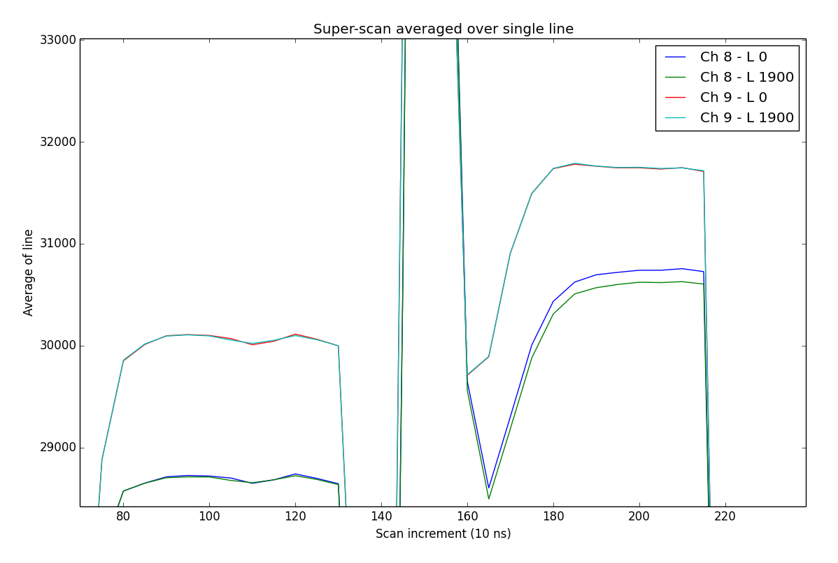
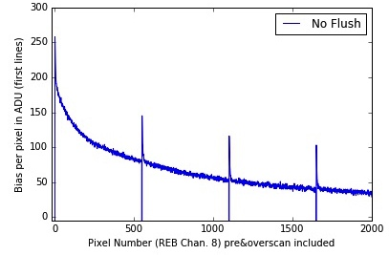
Study of the “bias drift”
Bias in some channels is continuously decreasing over the 100 first lines
Suppressed by flushing the serial register before readout (50,000 + pixels)
Not actually a bias drift, but an injection of charges
pixel content
No effect
Line 1 Line 2 Line 3 Line 4
baseline
Charge excess in first line

Slide 15
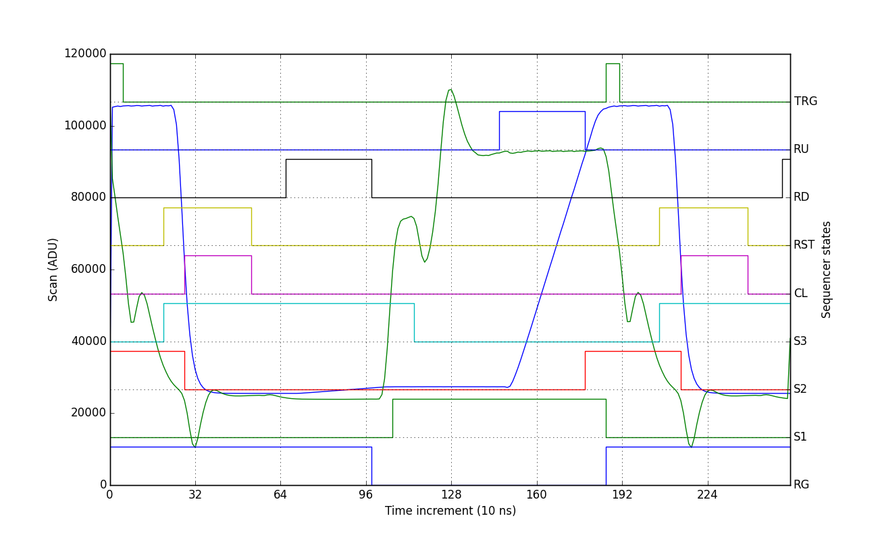
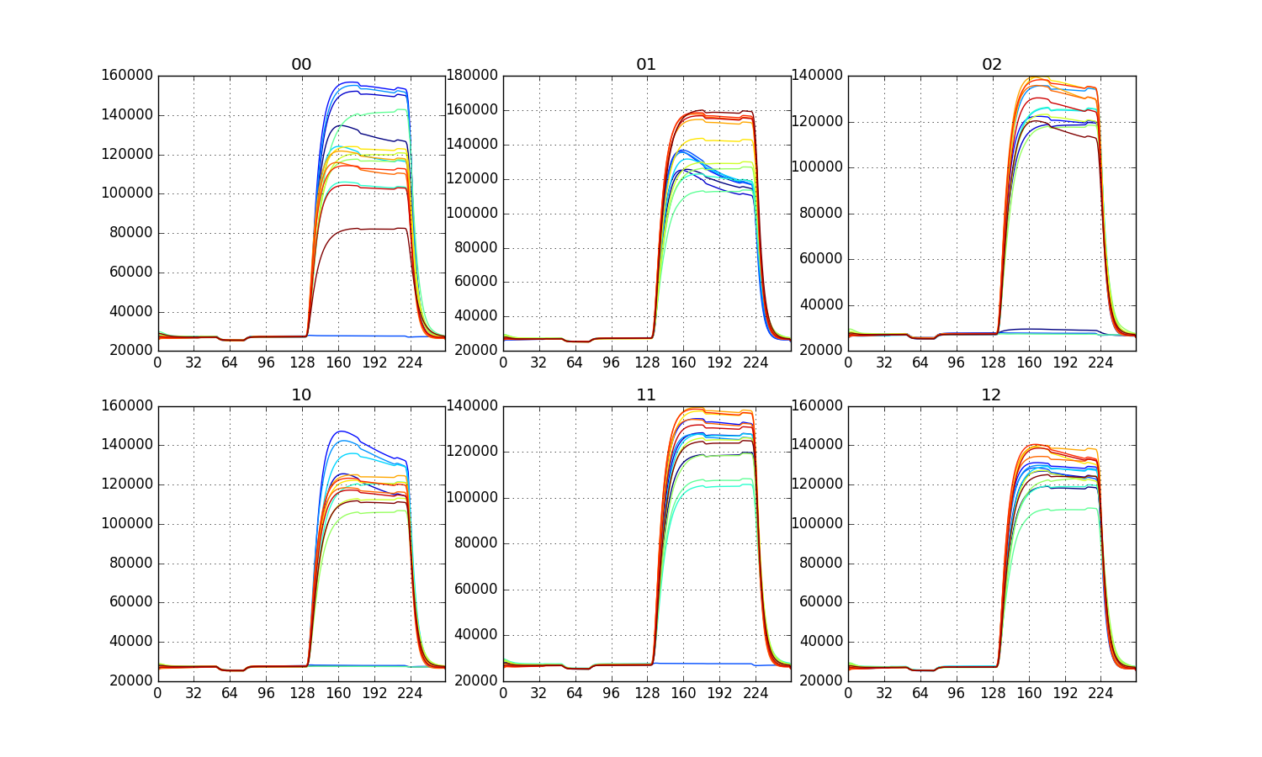
Injecting the CCD reset level
Reset of pixel content with CCD Reset Gate clock: (positive) voltage jump on the CCD output
RG high as baseline, RG low as “pixel content”
Simulates a pixel with signal ~ 55,000 e- (3% dispersion on E2V sensor), kTC reset noise (~ 40 e-)
Fake pixel readout
RG only, ETU2

