Slide 1
Flat Field Forensics
Timothee Greffe
28 of September. 2017

Slide 2
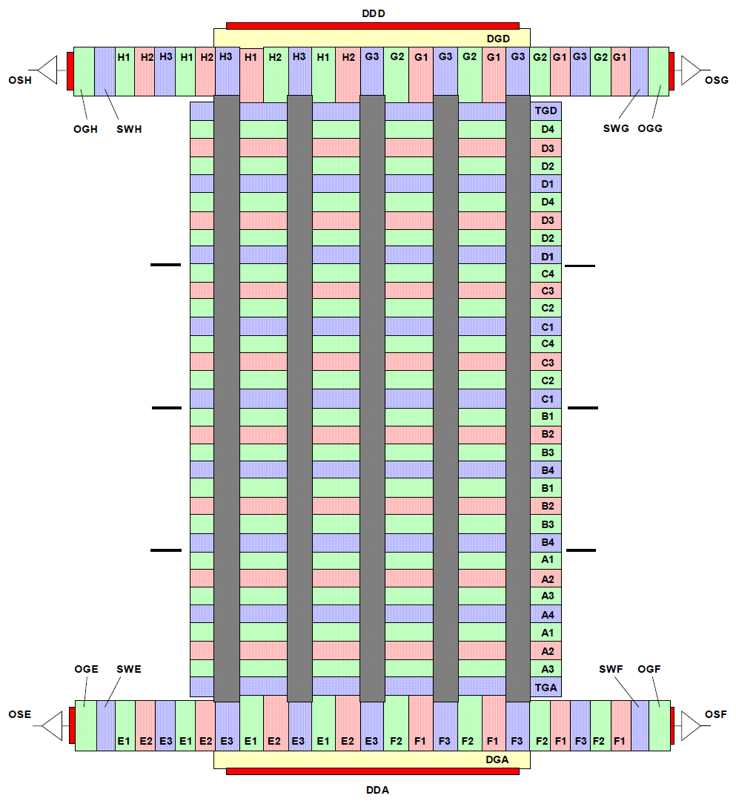
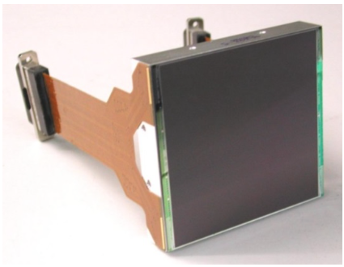
e2v 231 CCD 6k*6k
Intro | Parallel Transfer | Surface Well | PRNU | Conclusion
4 x 4 array on Zwicky Transient Facility
  4 outputs:
    only the two upper ones are used on the following work.
  4 phase parallel clocking.
  800kHz pixel clock

Slide 3
Outline
Intro | Parallel Transfer | Surface Well | PRNU | Conclusion
Parallel Transfer
  Photon Transfer Curve Dip and pixel shifting
  Transfer inefficiency
Surface Well
  Analysis and improvement
Pixel Response Non Uniformity
  From 2 phases to 3 phases
  Lithographic mask
Conclusion
NGC7331 @ Palomar Observatory – P200 using the e2v ccd-231

Slide 4
Parallel Transfer
Intro | Parallel Transfer | Surface Well | PRNU | Conclusion
Parallel Transfer

Slide 5
Photon Transfer Curve
Intro | Parallel Transfer | Surface Well | PRNU | Conclusion
Flattening of the PTC for high levels
  Surface Well effect?
  Lateral diffusion (Brighter-Fatter effect)?
          … maybe both?
Voltage
Voltage
Surface Well
10V
15V
0V
distance
0V
-5V
distance
-5V
  Surface Well occurs when charges are hitting the Si-SiO2 surface

Slide 6
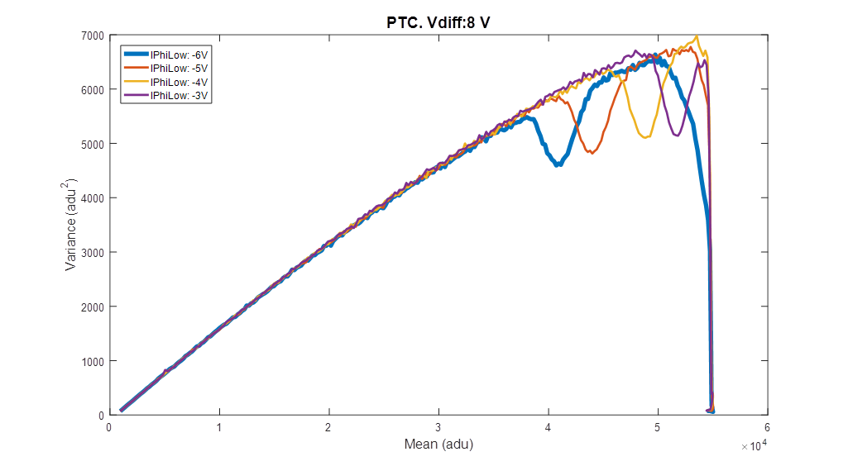
Photon Transfer Curve - Tuning
Intro | Parallel Transfer | Surface Well | PRNU | Conclusion
A broad range of voltages is explored to find the best setting.
  => more than 90 PTCs!
A class of PTC with unexplained dip appears
Dip

Slide 7
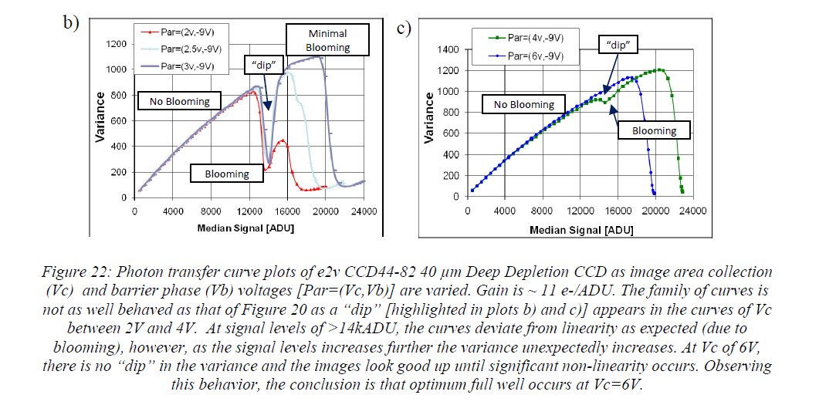
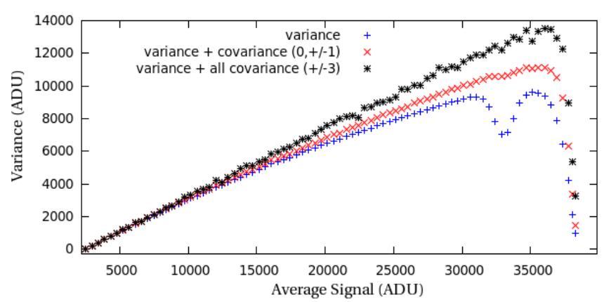
“Downing Dip”
Intro | Parallel Transfer | Surface Well | PRNU | Conclusion
A look-alike dip was first described in a paper from Mark Downing.
We decided to focus on this strange behavior:
  It may lead to interesting discovery.
  It improves our understanding of the CCD.
Dip
Dip
Extract from “Bulk Silicon CCDs, Point Spread Function and Photon Transfer Curves: CCD testing activities at ESO”
Mark Downing et al.
Dip
Extract from “Electro-Optical Testing of Fully Depleted CCD Image sensors for the Large Synoptic Survey Telescope Camera”
Peter E. Doherty et al.

Slide 8
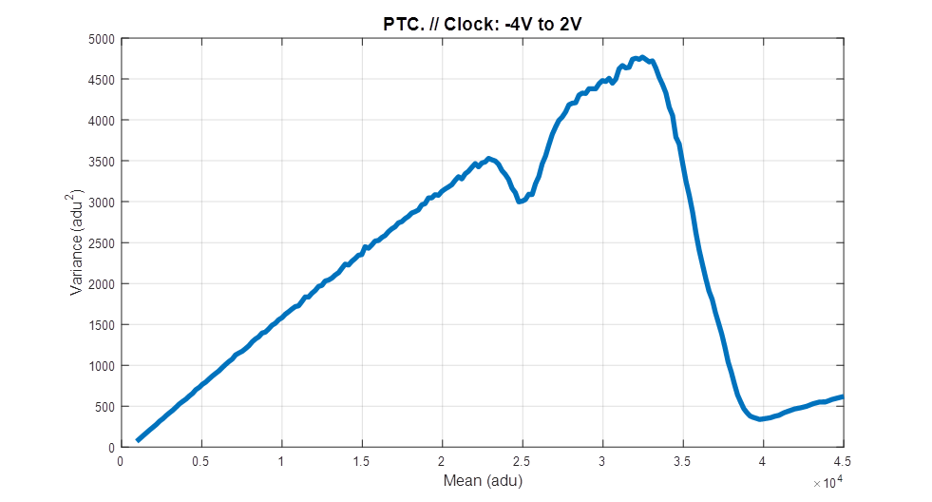



Hypothesis: Image shifting
Intro | Parallel Transfer | Surface Well | PRNU | Conclusion
What if the whole image area drifts when the level increases?
1 pixel
What is the resulting noise of a frame C made of two equivalent frames A and B partially summed?
C,σC
$$C=\left(1−η\right)A+ηB$$
$$η∈ \left[0;1\right]$$
If some correlated noise
Additive term null in 0 and 1
No drift
Half drifted
Fully drifted
1
0.5
Voltage Swing on parallel clocks: -4V to 2V
0
0.5
1
$$η$$

Slide 9
Cross-Correlation
Intro | Parallel Transfer | Surface Well | PRNU | Conclusion
Cross correlation frame to frame is computed to spot the drift
  It relies on the FPN on the Image Area.
Reference level for Cross-Correlation
There is indeed a drift of the whole image area during the “Downing Dip”

Slide 10
Cross-Correlation
Intro | Parallel Transfer | Surface Well | PRNU | Conclusion
Cross correlation frame to frame is computed to spot the drift
  It relies on the FPN on the Image Area.
But HOW is this happening?
Reference level for Cross-Correlation
There is indeed a drift of the whole image area during the “Downing Dip”

Slide 11
Mechanism: How it should work.
Intro | Parallel Transfer | Surface Well | PRNU | Conclusion
Pixel 1
Pixel 2
Transfer Gate and IPHI1 tied together
TGD | IPHI4 | IPHI3 | IPHI2 | IPHI1 | IPHI4 | IPHI3 | IPHI2 | IPHI1
Serial Register
Time

Slide 12
Mechanism: What if the last node is missing?
Intro | Parallel Transfer | Surface Well | PRNU | Conclusion
Pixel 1
Pixel 2
TGD | IPHI4 | IPHI3 | IPHI2 | IPHI1 | IPHI4 | IPHI3 | IPHI2 | IPHI1
Serial Register
Time

Slide 13
Mechanism: When the charges are spilling into the serial register?
Intro | Parallel Transfer | Surface Well | PRNU | Conclusion
Pixel 1
Pixel 2
TGD | IPHI3 | IPHI2 | IPHI1 | IPHI4 | IPHI3 | IPHI2 | IPHI1
?
?
?
Serial Register
?
?
Time

Slide 14
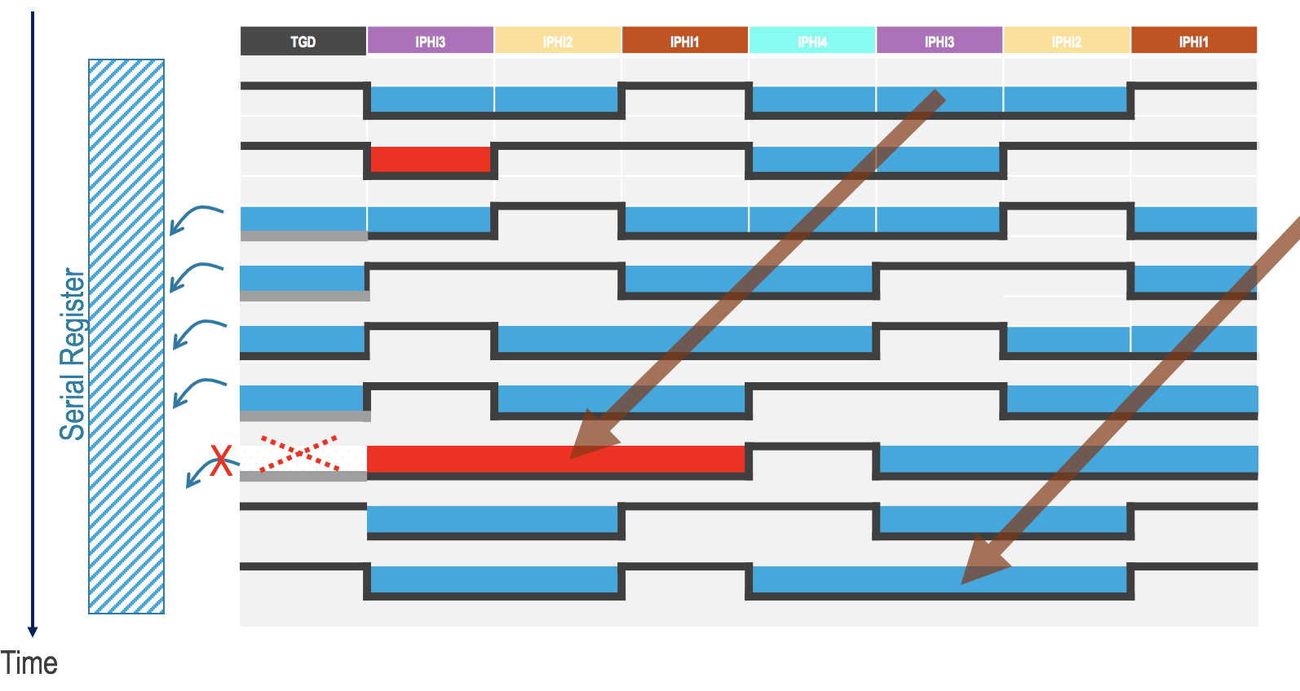
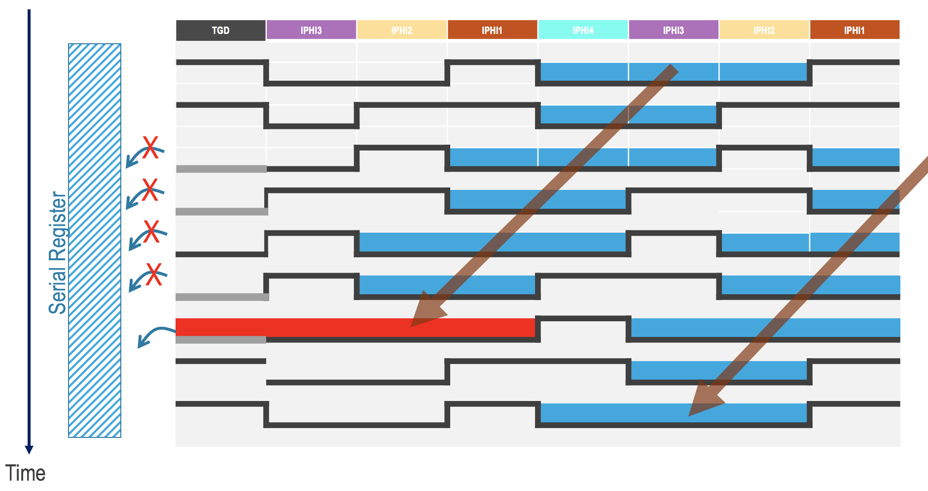
Mechanism: 2 cases
Intro | Parallel Transfer | Surface Well | PRNU | Conclusion
Pixel 1
Pixel 2
Pixel 1
Pixel 2
Lower light levels: Pixel 1 is read
Higher light levels: Pixel 2 is read
=> Translation

Slide 15
Electric field shaping
Intro | Parallel Transfer | Surface Well | PRNU | Conclusion
Reason why charges are flowing or not for a given level into the serial register is still unexplained.
Hypothesis: Charges shape the electric field.
    potential wall could appear or disappear at the edge between image area and serial register.
    Phenomenon with a threshold effect.
Wall
charges
No more Wall: every charges flow to the serial register
Potential
Potential
Serial Register
Transfer Gate
Serial Register
Transfer Gate
I Phi 3
I Phi 2
I Phi 1
I Phi 4
I Phi 3
I Phi 2
I Phi 1
I Phi 4

Slide 16
Mechanism: New clocking scheme
Intro | Parallel Transfer | Surface Well | PRNU | Conclusion
Pixel 1
Pixel 2
TGD | IPHI3 | IPHI2 | IPHI1 | IPHI4 | IPHI3 | IPHI2 | IPHI1
Transfer Gate rises and falls earlier than previously.
=> Concurrent clocking presented by Pavan Bigli during Poster session auto-solves this issue.
Serial Register
Time

Slide 17
New Clocking
Intro | Parallel Transfer | Surface Well | PRNU | Conclusion
New Clocking
No more dip or pixel shifting!

Slide 18
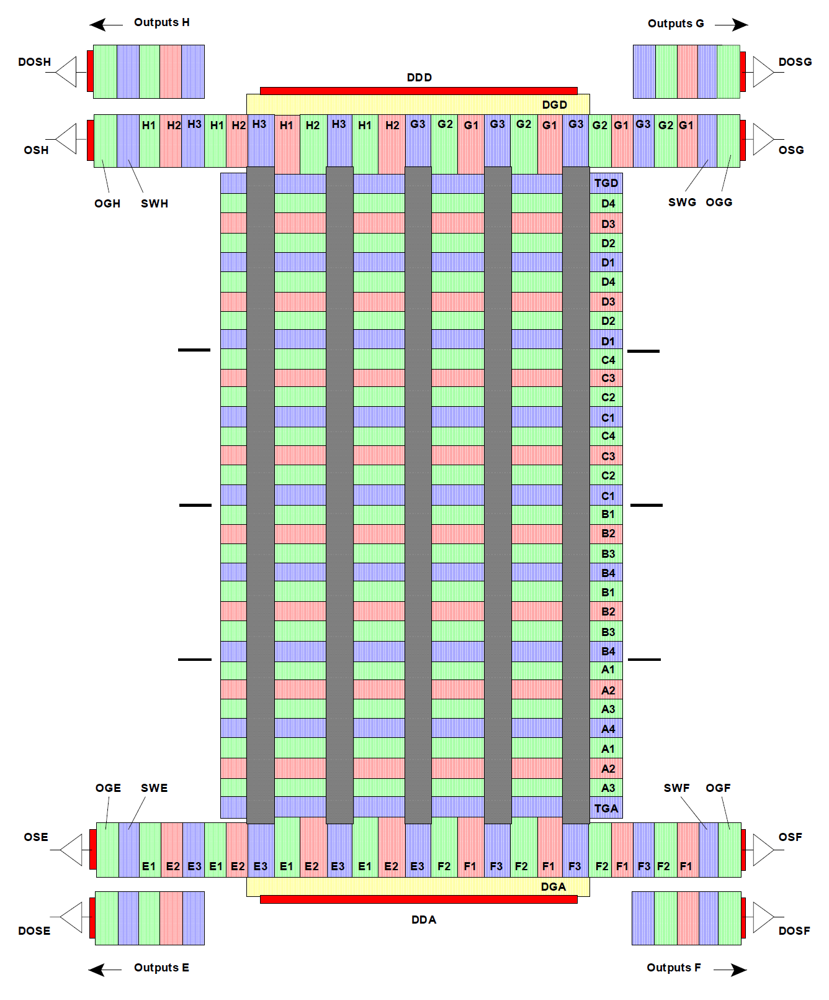
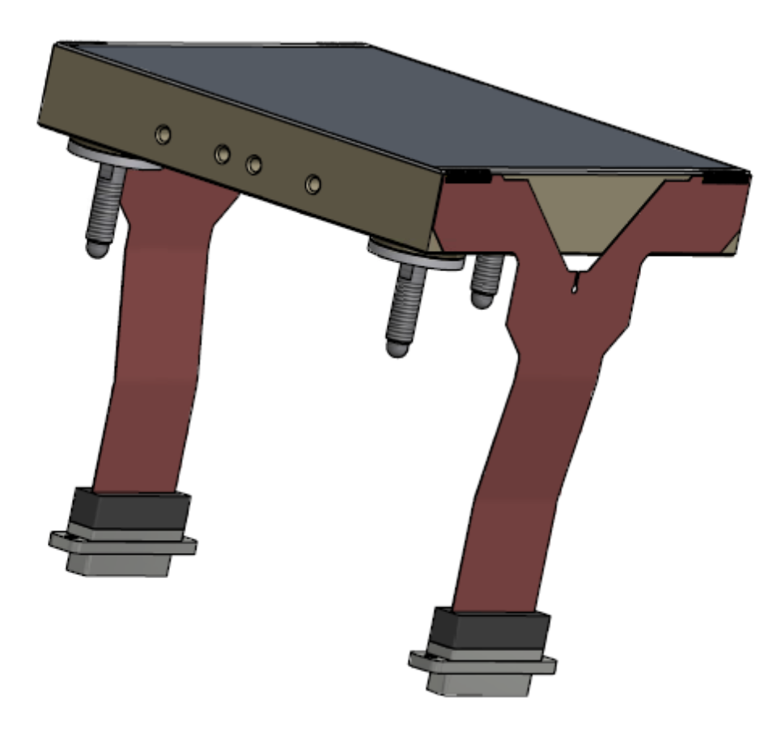
Possible explanation
Intro | Parallel Transfer | Surface Well | PRNU | Conclusion
Not symmetric node mapping of the CCD.
Mislabeling of nodes?
    Either on the datasheet or on our camera…
Pinout strictly symmetric but package is oriented.
Transfer Gate
3 Collecting Phases
Barrier Phase
Collecting Phase
2 Collecting Phases
Transfer Gate

Slide 19
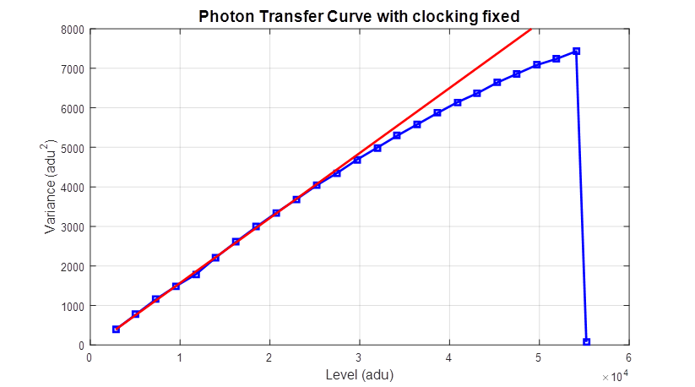
Another transfer issue
Intro | Parallel Transfer | Surface Well | PRNU | Conclusion
Closer look at the Photon Transfer Curve
Recommended voltage from e2v’s datasheet
VERY subtle dip

Slide 20
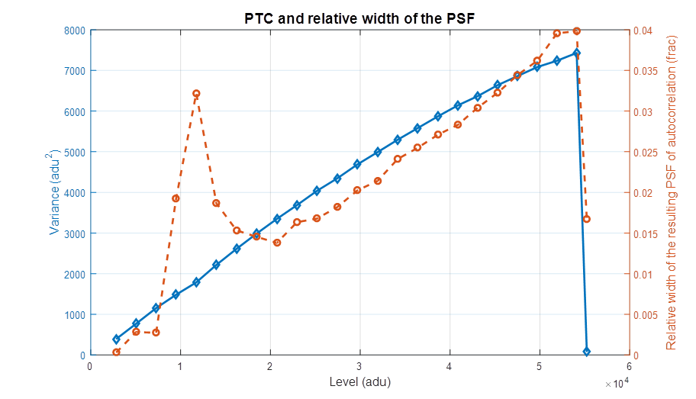
Another transfer issue - autocorrelation
Intro | Parallel Transfer | Surface Well | PRNU | Conclusion
Autocorrelation of each frame shows excess correlation only in the vertical direction for this exact level.
VERY subtle dip

Slide 21
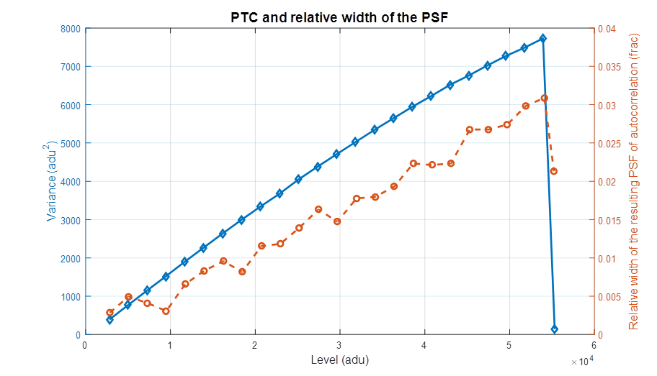
Another transfer issue - Fix
Intro | Parallel Transfer | Surface Well | PRNU | Conclusion
Problem fixed increasing the voltage on the serial register to “help” electrons falling from the transfer gate.
Autocorrelation increase with signal is due to Brighter-Fatter effect discussed by Antilogus et al.
Increase of the serial register’s voltage

Slide 22
Conclusion
Intro | Parallel Transfer | Surface Well | PRNU | Conclusion
Exact shape of the electric field over the nodes is complex, especially at the edges.
  1-D representation is simplistic.
We should not assume that a same voltage applied on a node results on a same shape of electric field everywhere.
=> Keep some margin, increase delta.
Voltage
10V
0V
distance
-5V

Slide 23
InfraRed Inspection
Intro | Parallel Transfer | Surface Well | PRNU | Conclusion
Zoom : 10x
We do know that the 8 lasts rows of the sensor and the transfer gate aren’t made with the same lithographic mask than the image area.
  Maybe some discrepancies?
Optical microscope with SWIR Camera + narrow IR filter
  Lack of contrast and Magnification
We can’t explore further the CCD itself.
  => Call for help and ideas.
Pixel size
Transfer Gate
Parallel Phases
Image Area
Serial register
Serial Phases

Slide 24
Surface Full Well
Intro | Parallel Transfer | Surface Well | PRNU | Conclusion
Surface Full Well

Slide 25
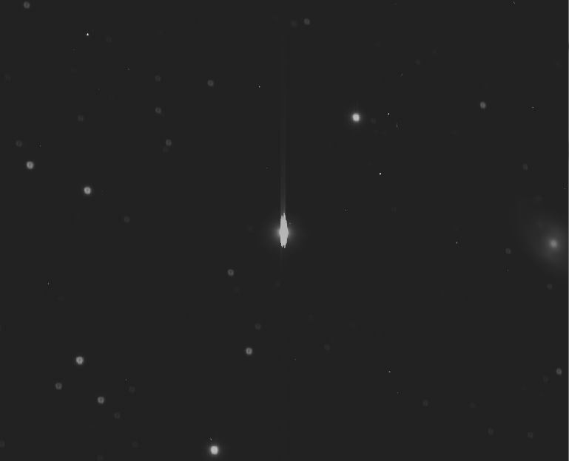
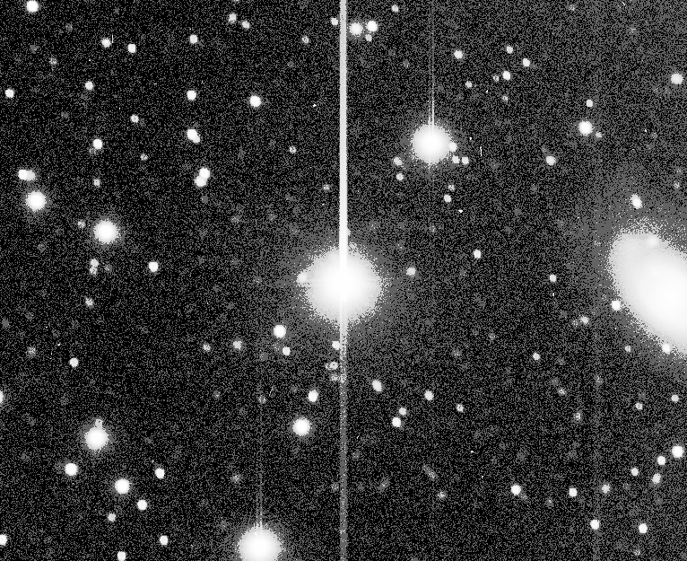
Surface Full Well – On Sky
Intro | Parallel Transfer | Surface Well | PRNU | Conclusion
Long tail forward and backward of an over-illuminated star on the Field of View
  The forward tail is caused by the charges left beyond during the previous frame reading. (persistence)
“LOG” scale
“Histogram” scale
Even worse than blooming.

Slide 26
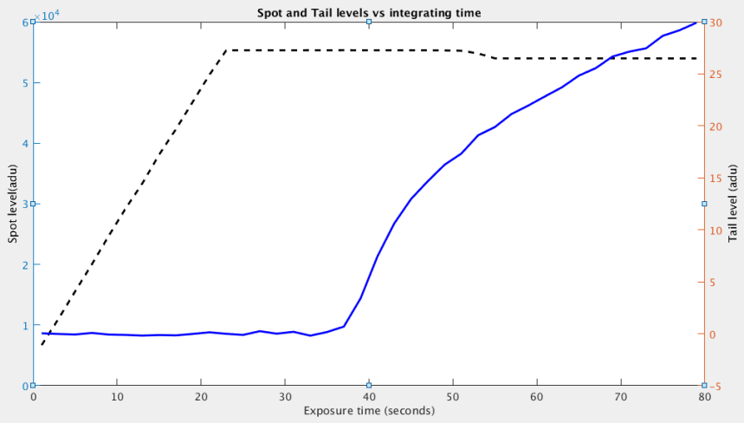
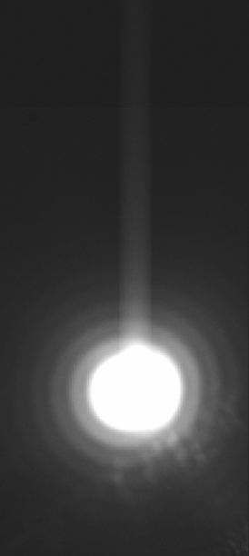
Surface Full Well – Pin Hole setup
Intro | Parallel Transfer | Surface Well | PRNU | Conclusion
A pin hole allows to characterize in lab the levels of both spot and tail.
Saturation is occurring before the tail appears.
~340ke-
Fake Star
Reference
Tail level on the overscan
~510ke-
Spot level
Blooming Well
or ADC saturation
Surface Well

Slide 27
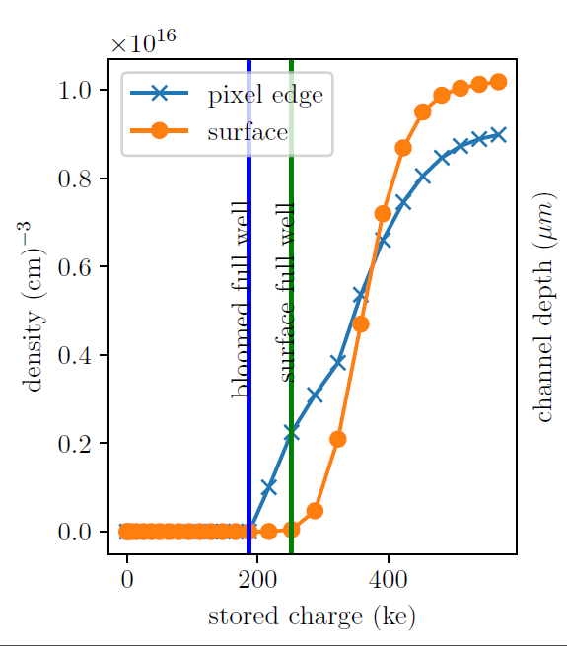
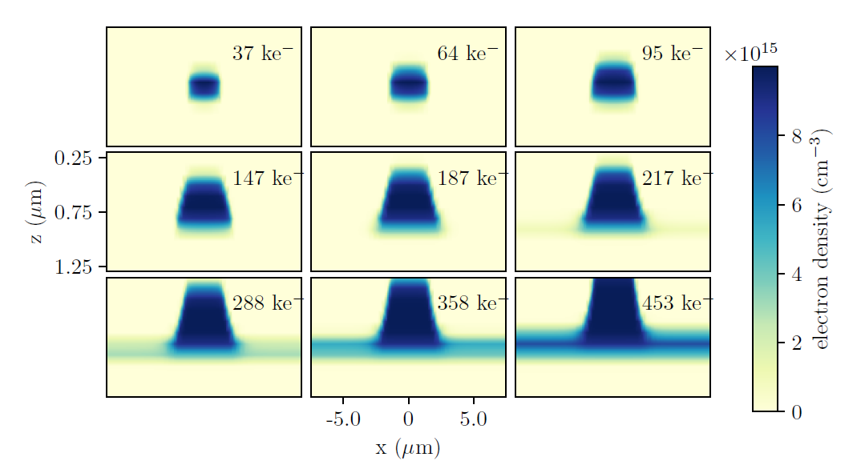
Surface Well and Blooming
Intro | Parallel Transfer | Surface Well | PRNU | Conclusion
Surface Well can occur after blooming.
SiO2 interface
Blooming
Surface Well
D.P. Weatherill, R. Plackett, K.Arndt and I.P.J. Shipsey
“Modelling charge storage near full well in CCDs”
Journal of Instrumentation. May,17. 2017

Slide 28
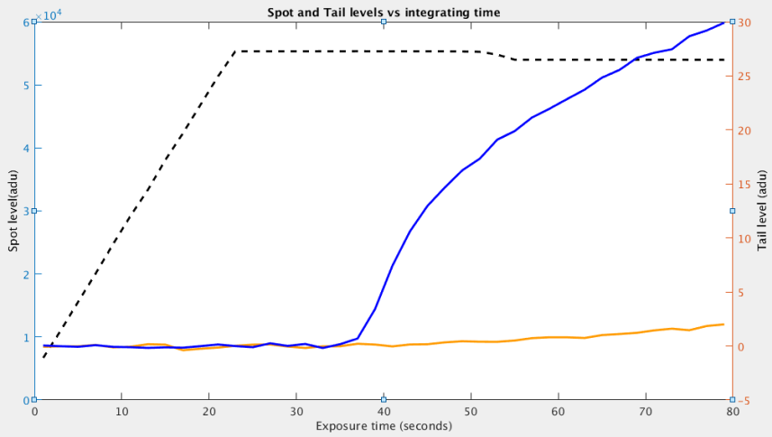
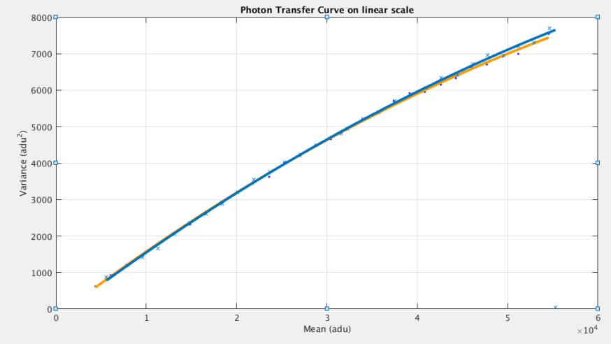
Surface Full Well – Pin Hole setup
Intro | Parallel Transfer | Surface Well | PRNU | Conclusion
Decrease of the common mode voltage moves charges away from the surface.
Classical detraping fix.
0V to 10V
-5V to 5V
0V to 10V
-5V to 5V
No more tails on the brightest stars
Drawback: Increase of the lateral charge diffusion

Slide 29
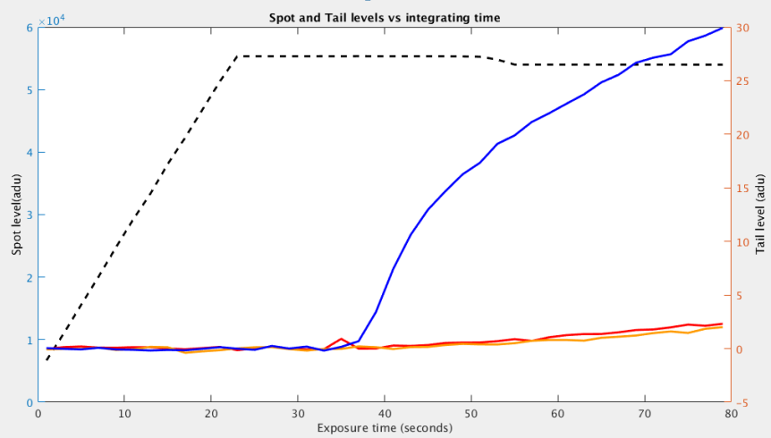
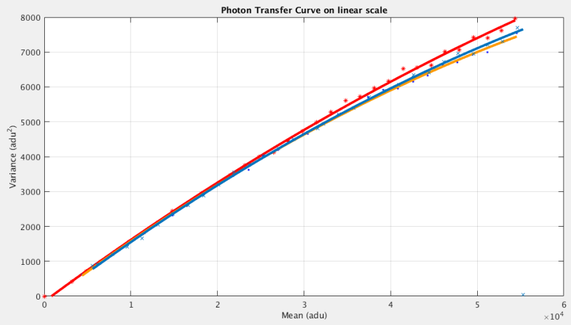
Surface Full Well – Optimization
Intro | Parallel Transfer | Surface Well | PRNU | Conclusion
Two successive states:
  Exposure: High common mode voltage to Reduce Lateral Diffusion
  ReadOut: Low common mode voltage to suppress Surface Well
0V to 10V
-5V to 5V
0V to 10V during Exposure
-5V to 5V during ReadOut
Even Steeper PTC !
Surface Well suppressed
No more tails on the brightest stars
Less lateral diffusion

Slide 30
Pixel Response Non Uniformity
Intro | Parallel Transfer | Surface Well | PRNU | Conclusion
Pixel Response Non Uniformity

Slide 31
Pixel Response Non Uniformity
Intro | Parallel Transfer | Surface Well | PRNU | Conclusion
Co addition of 15 flats of ~43ke- (Shot noise well below PRNU)
Normalization by a filtered version of itself (To get rid of flat field gradient)
=
9x9 BoxCar filtering

Slide 32
Pixel Response Non Uniformity
Intro | Parallel Transfer | Surface Well | PRNU | Conclusion
2 Collecting phases (datasheet standard clocking)
  PRNU = 0.38%
3 Collecting phases
  PRNU = 0.28%

Slide 33
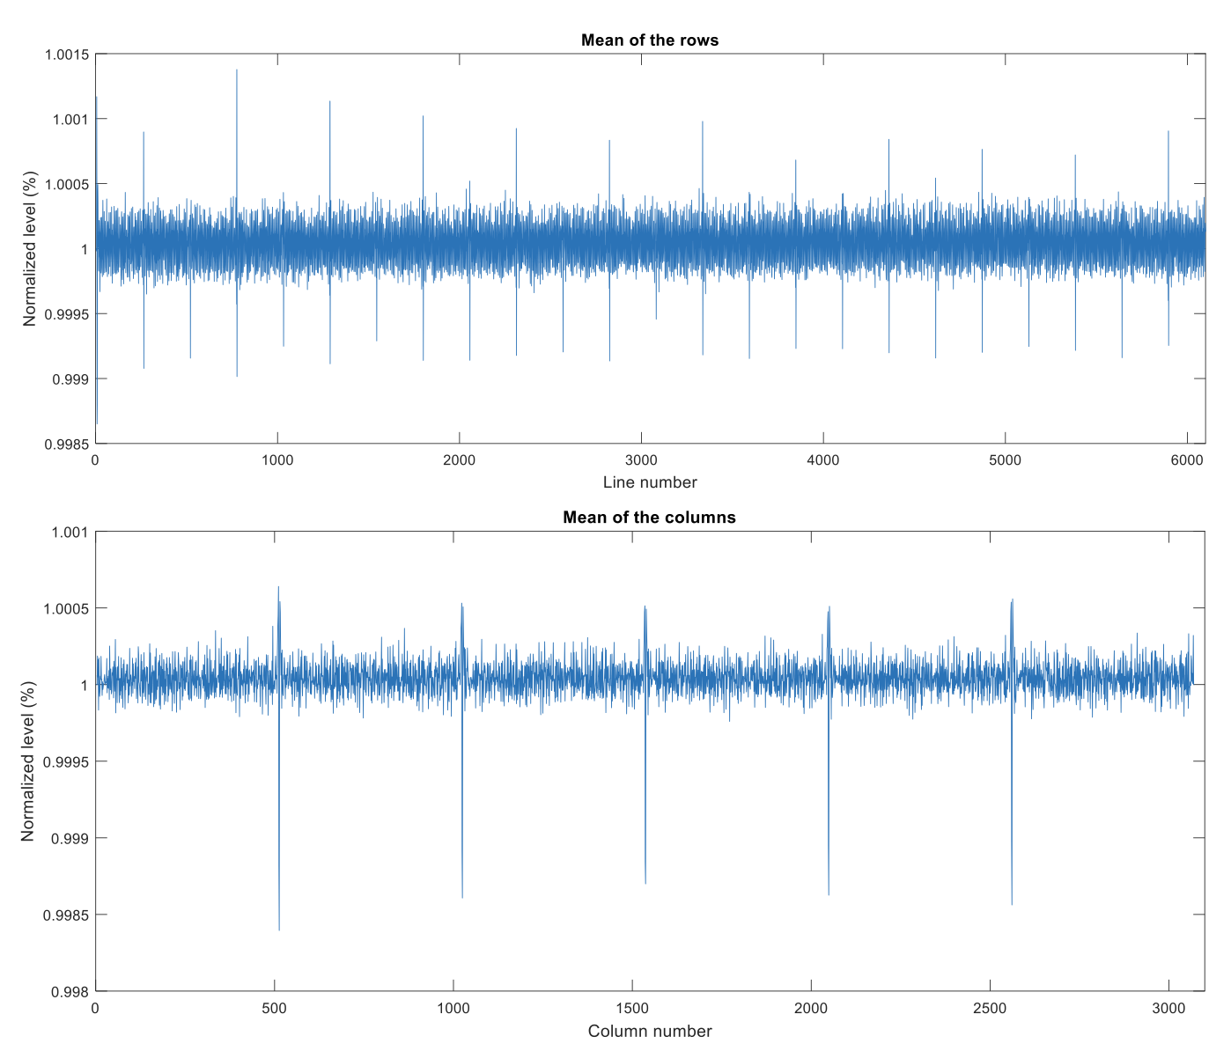
Pixel Response Non Uniformity
Intro | Parallel Transfer | Surface Well | PRNU | Conclusion
Lithographic mask stitching is visible on high-intensity frames.
Masks of 512x256 pixels
12*512=6144 pixels
8 extra pixels
24*256=6144 pixels
E2v-231
6144(H) x 6160 (V)
Figure: average on vertical and horizontal directions
8 extra pixels

Slide 34
Summary
Intro | Parallel Transfer | Surface Well | PRNU | Conclusion
Benefits of new clocking and new voltages:
  No more strange dip on the PTC. (both pixel shifting and defective line transfer).
  No more catastrophic Surface Well effect on bright objects.
  Improvement of the PSF with high levels (less lateral diffusion or “brighter-fatter” effect).
  Improvement of the PRNU using 3 storage phases instead of two.

Slide 35
Thank your for your attention.

Slide 36
Extra Slide: Best setup
0V to 10V
-5V to 5V
0V to 10V during Exposure
-5V to 5V during ReadOut
3V to 13V during Exposure
-8V to 2V during ReadOut
Tail level: 2 adu with saturation of about 1.8Me-

Slide 37
Extra Slide: Down side
Photon Transfer curve using the new clocking on the down side of the sensor.
Assuming one extra node.
-4V to 2V on // clock
0V to 10V on // clock
No ”Downing Dip”

Slide 38
Extra Slide: Inverted Clocking
15V
0V
distance
-5V
15V
0V
distance
-10V

Slide 39
Mechanism: Case 1
Intro | Parallel Transfer | Surface Well | PRNU | Conclusion
TGD | IPHI3 | IPHI2 | IPHI1 | IPHI4 | IPHI3 | IPHI2 | IPHI1
X
X
X
Serial Register
X
Time

Slide 40
Mechanism: Case 2
Intro | Parallel Transfer | Surface Well | PRNU | Conclusion
TGD | IPHI3 | IPHI2 | IPHI1 | IPHI4 | IPHI3 | IPHI2 | IPHI1
Serial Register
X
Time

