Slide 1
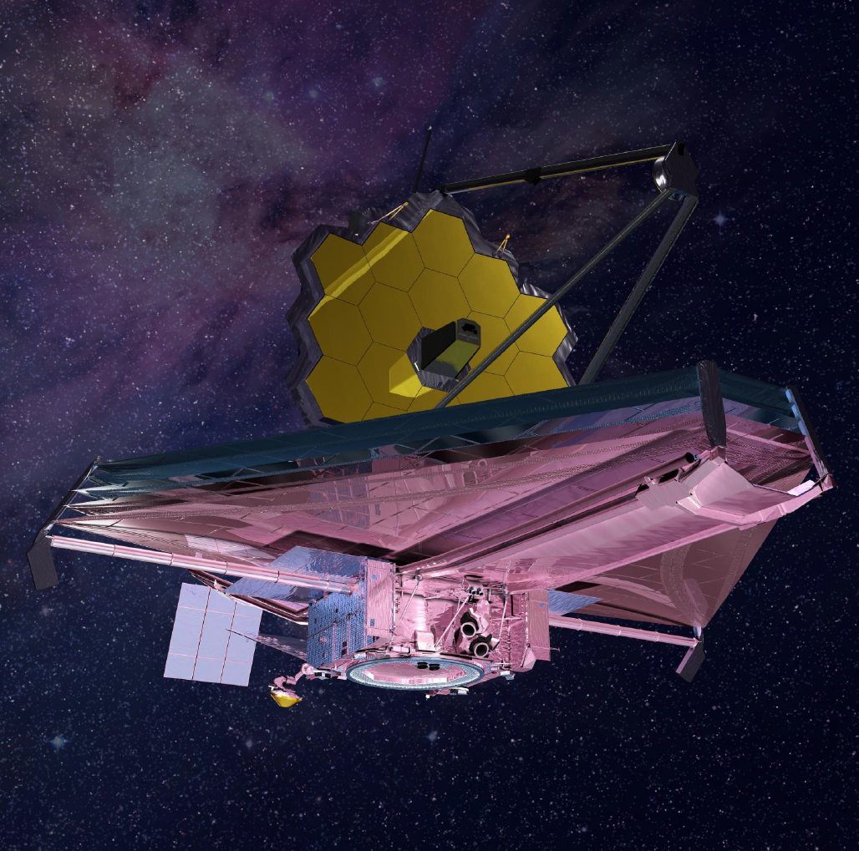




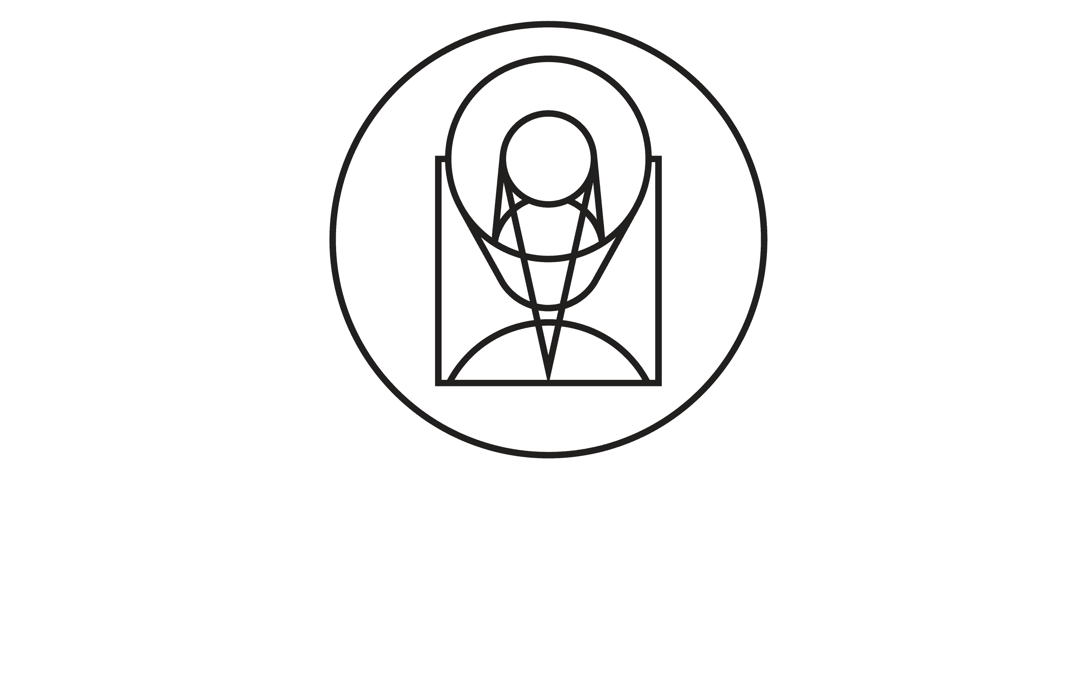
Performance and Scientific Capabilities of the
JWST MIRI Detectors
Ori Fox
@Fox_Ori
Space Telescope Science Institute
Scientific Detector Workshop- Baltimore, MD, Sep 24-29
Talk includes significant contribution from M. Ressler, D. Dicken, and T. Temim
Notes:
Note twitter. Come follow me.

Slide 2
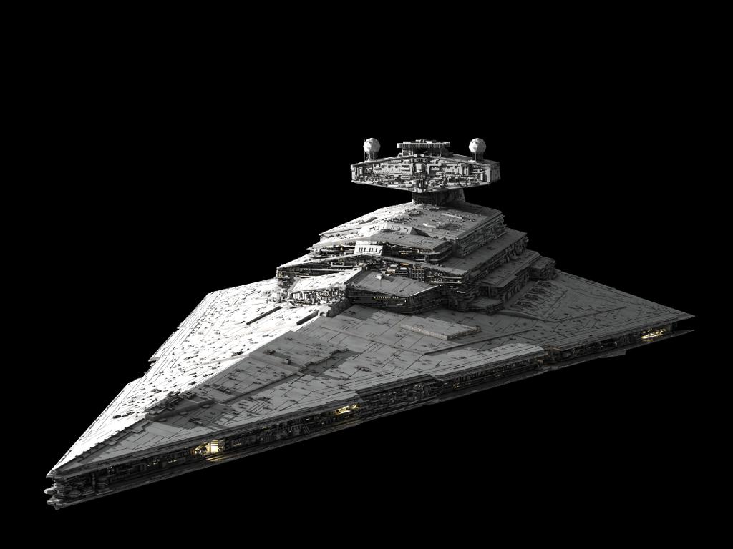
JWST Is …
Notes:
Or is it really a Destroyer?

Slide 3
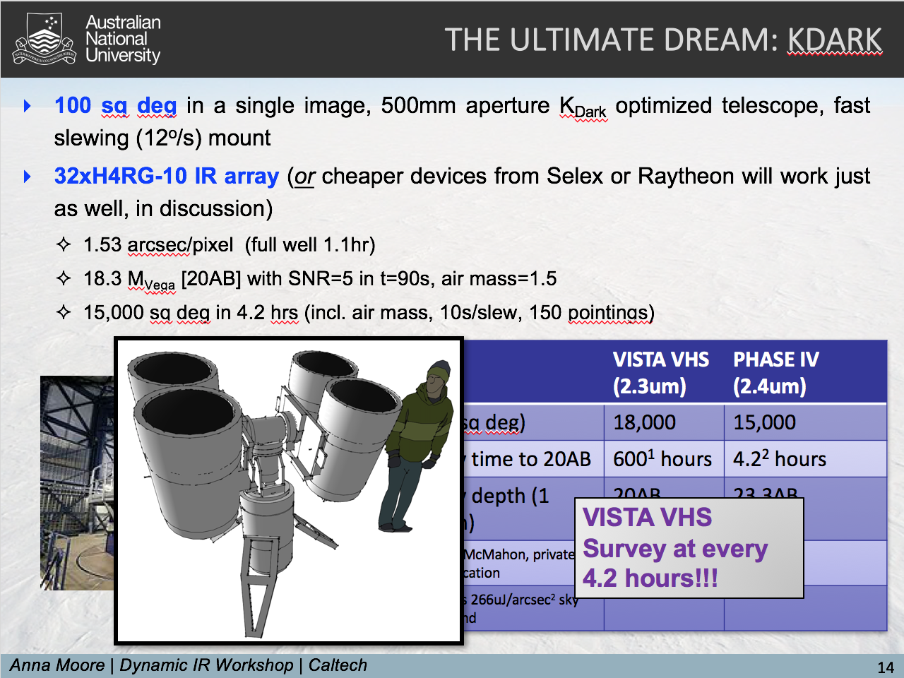
Advertisement
Notes:
If you’re not following things on Twitter, you should do so. Lots of fun things happening, including testing at OTIS.

Slide 4
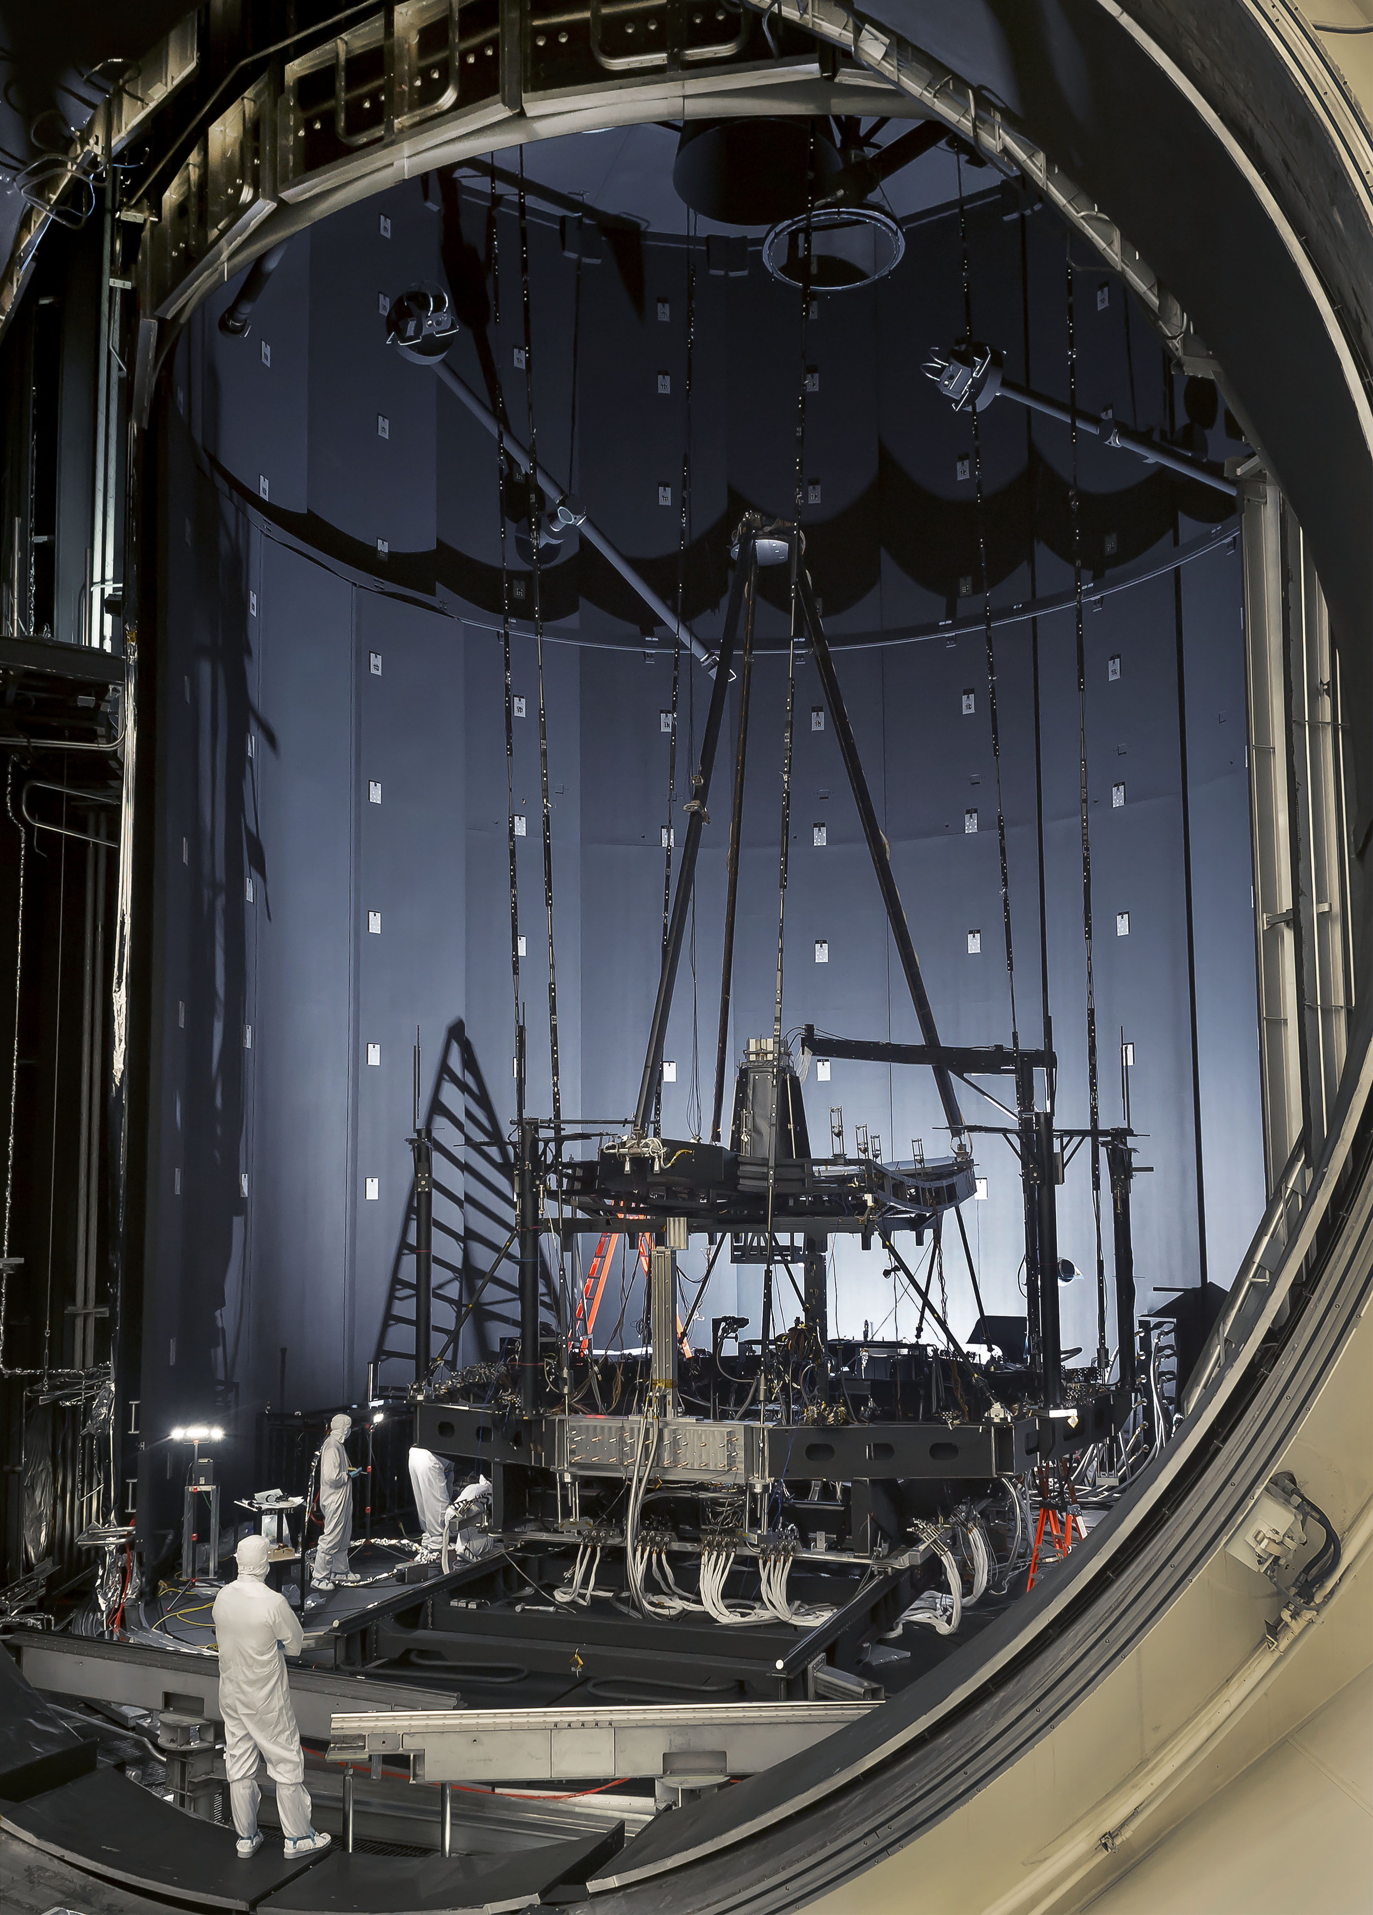
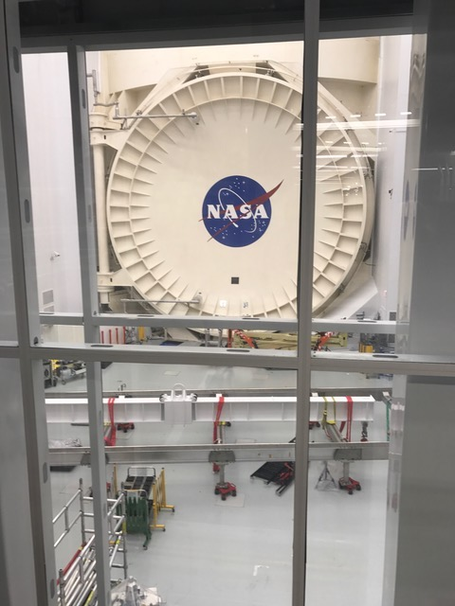
OTIS Testing at Johnson
Notes:
If you’re not following things on Twitter, you should do so. Lots of fun things happening, including testing at OTIS.

Slide 5
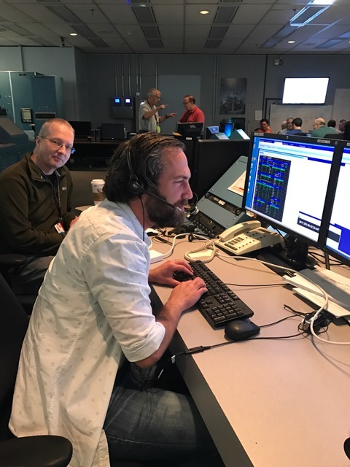
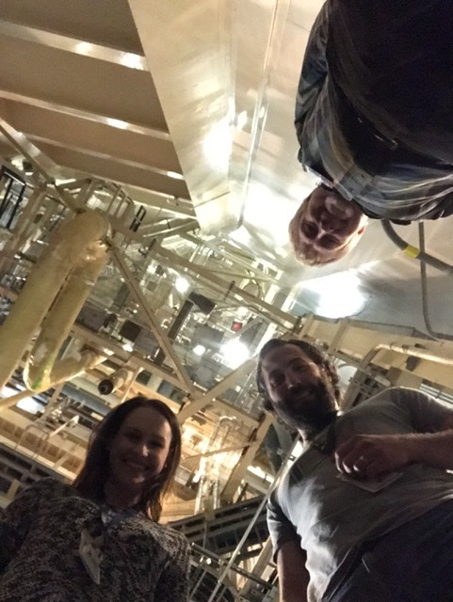
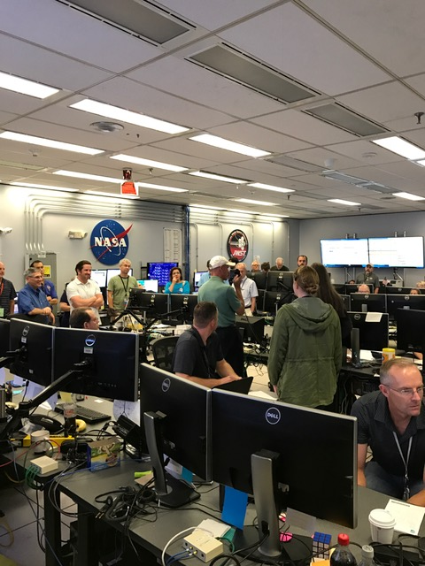
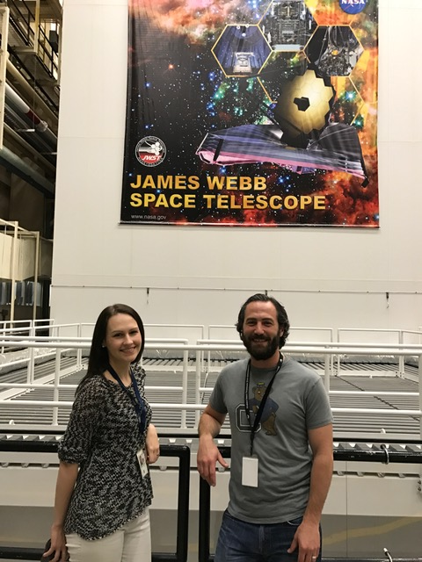
OTIS Testing at Johnson

Slide 6
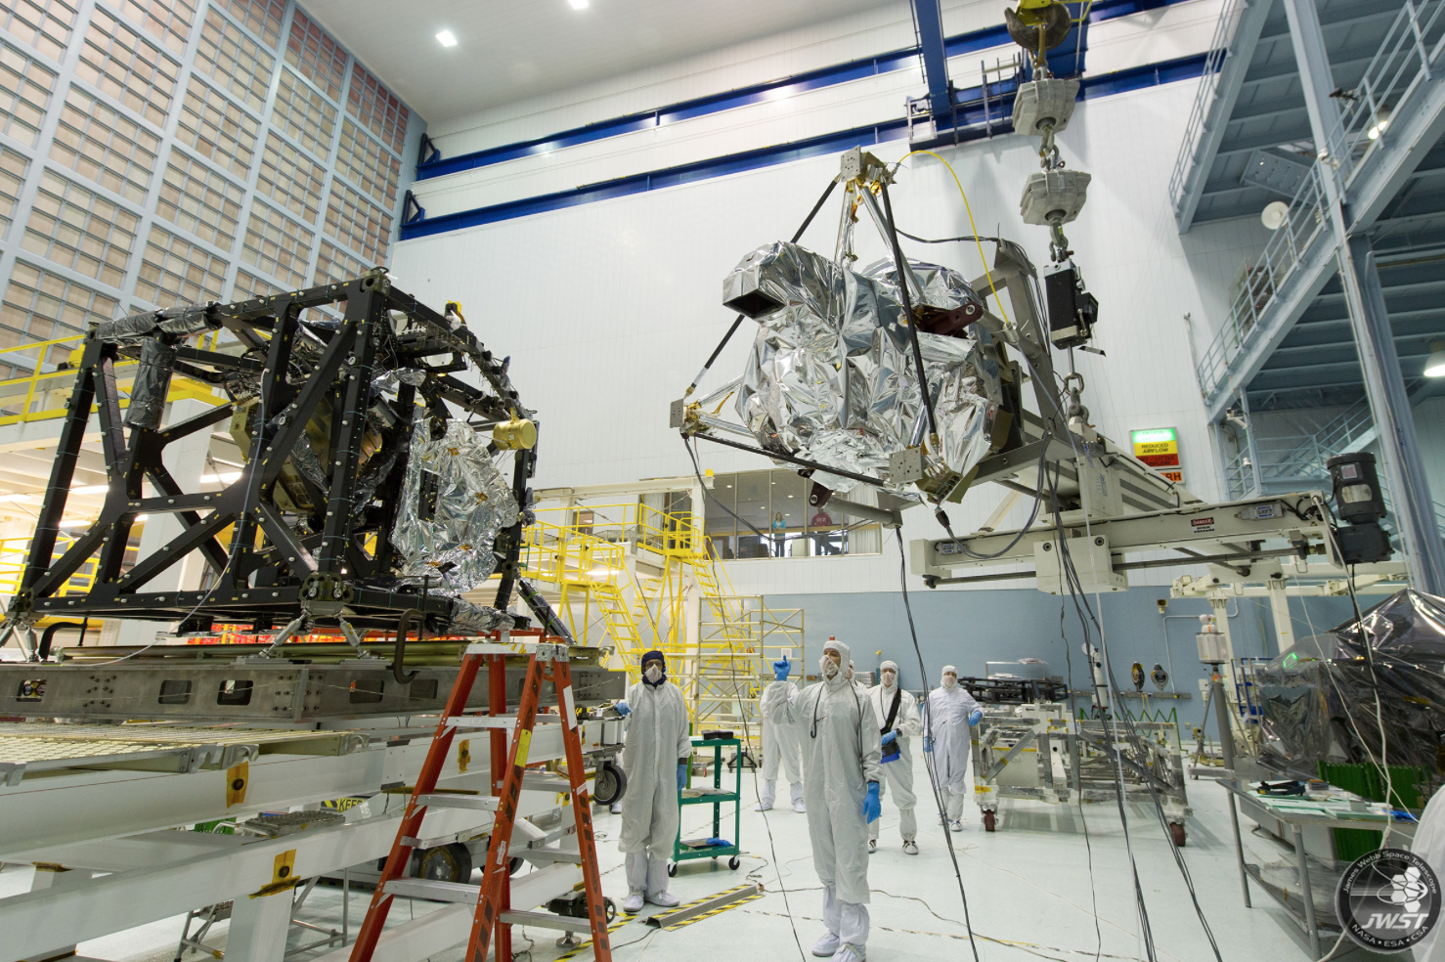
The Mid-Infrared Instrument (MIRI)

Slide 7
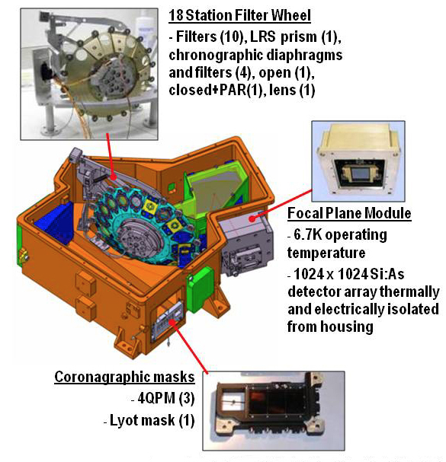
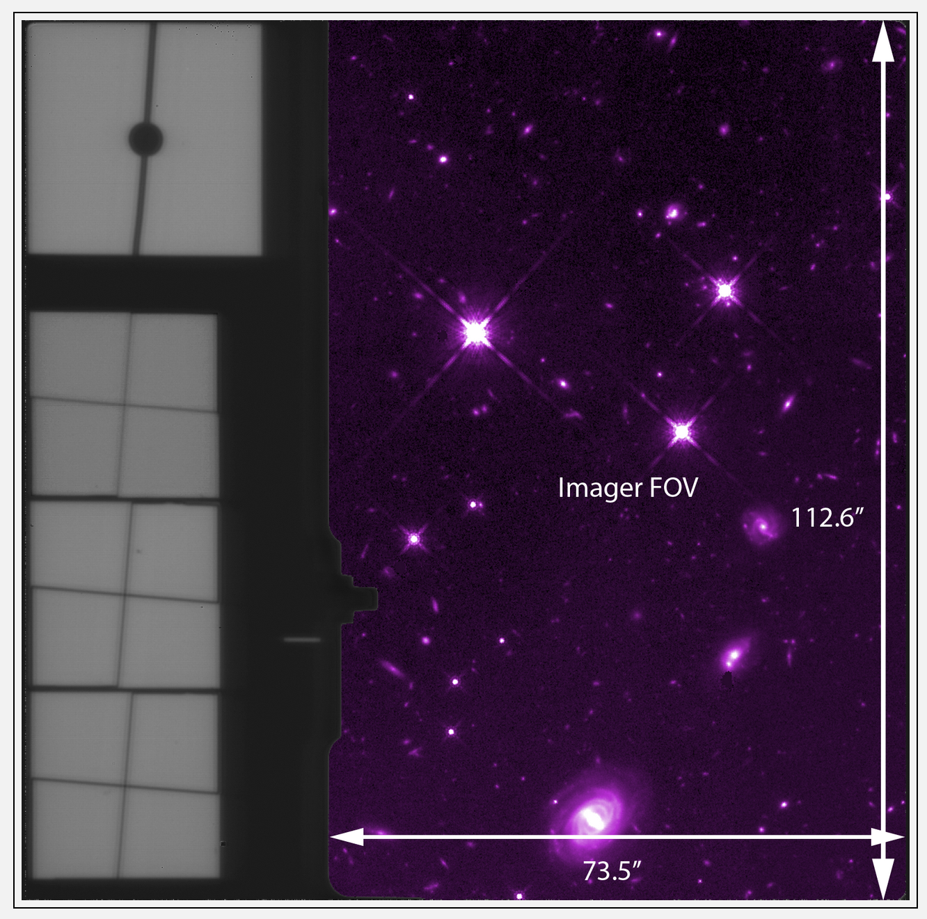
The Mid-Infrared Instrument (MIRI)
Wavelength range: 5 - 28 μm
50 times more sensitive than Spitzer
Sub-arcsec resolution
Observing modes:
Imaging
Coronagraphs
Low Resolution Spectrometer
Medium Resolution Spectrometer
Notes:
MIRI is the only mid-infrared instrument aboard JWST covering the wavelength range from 5 to 28 microns. It is 50 times more sensitive than Spitzer and about a 1000 times more than ground-based observations. It has sub arcsecond resolution which is something that we’ve never had at these wavelengths until now.
MIRI basically has almost all capabilities of the other three near IR instruments rolled into one. It offers imaging capabilities, 4 different coronagraph modules, low resolution spectroscopy in both slit and slitless modes, and an Integral field unit (IFU), which is the medium resolution spectrometer.
A diagram of MIRI: It has an 18 station filter wheel that includes ten imaging filters, the prism for the low resolution spectrometer and the coronagraph filters. It has a total of three arsenic doped silicon detectors, 1024 by 1024 pixels each. MIRI is the only instrument aboard James Webb that is actively cooled by a cryocooler to a temperature of 6 kelvin in order to reduce the noise from the infrared background
*********************************************************************************************************************************************************
Being a refrigerator and a "closed" system, the cryocooler does not consume coolant like an ice chest full of ice or a big container (a.k.a. dewar) of liquid helium does, and so its life is limited only by wear in its moving parts (the pumps) or the longevity of its electronics, all of which should last for many years.

Slide 8
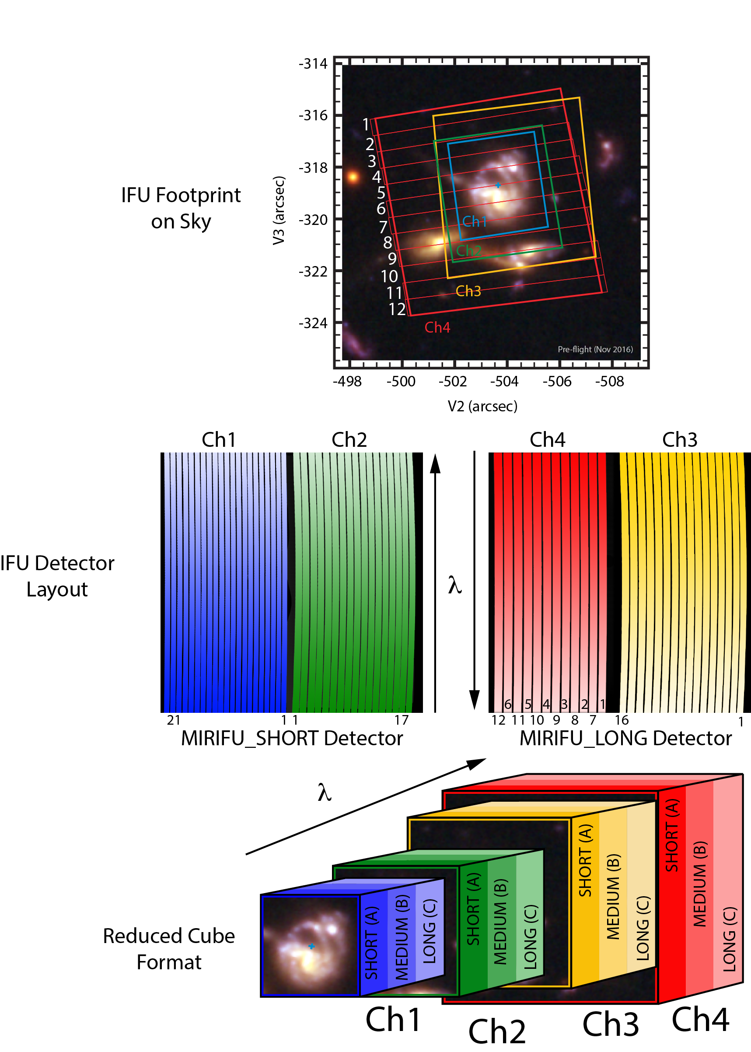
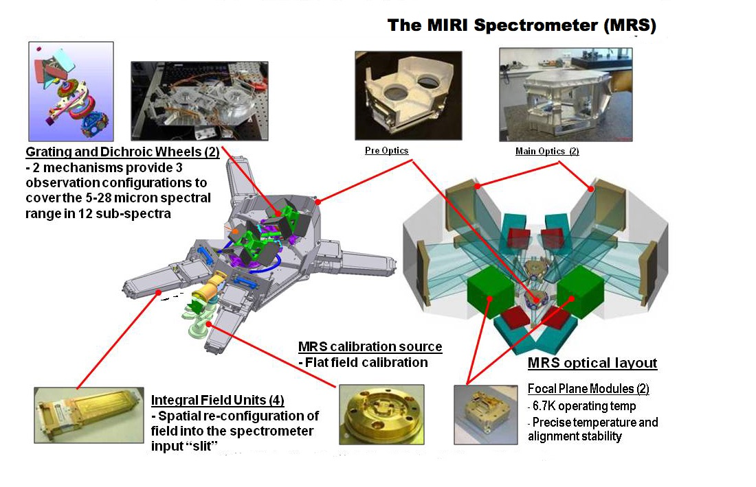
The Mid-Infrared Instrument (MIRI)
Wavelength range: 5 - 28 μm
50 times more sensitive than Spitzer
Sub-arcsec resolution
Observing modes:
Imaging
Coronagraphs
Low Resolution Spectrometer
Medium Resolution Spectrometer
Notes:
MIRI is the only mid-infrared instrument aboard JWST covering the wavelength range from 5 to 28 microns. It is 50 times more sensitive than Spitzer and about a 1000 times more than ground-based observations. It has sub arcsecond resolution which is something that we’ve never had at these wavelengths until now.
MIRI basically has almost all capabilities of the other three near IR instruments rolled into one. It offers imaging capabilities, 4 different coronagraph modules, low resolution spectroscopy in both slit and slitless modes, and an Integral field unit (IFU), which is the medium resolution spectrometer.
A diagram of MIRI: It has an 18 station filter wheel that includes ten imaging filters, the prism for the low resolution spectrometer and the coronagraph filters. It has a total of three arsenic doped silicon detectors, 1024 by 1024 pixels each. MIRI is the only instrument aboard James Webb that is actively cooled by a cryocooler to a temperature of 6 kelvin in order to reduce the noise from the infrared background
*********************************************************************************************************************************************************
Being a refrigerator and a "closed" system, the cryocooler does not consume coolant like an ice chest full of ice or a big container (a.k.a. dewar) of liquid helium does, and so its life is limited only by wear in its moving parts (the pumps) or the longevity of its electronics, all of which should last for many years.

Slide 9
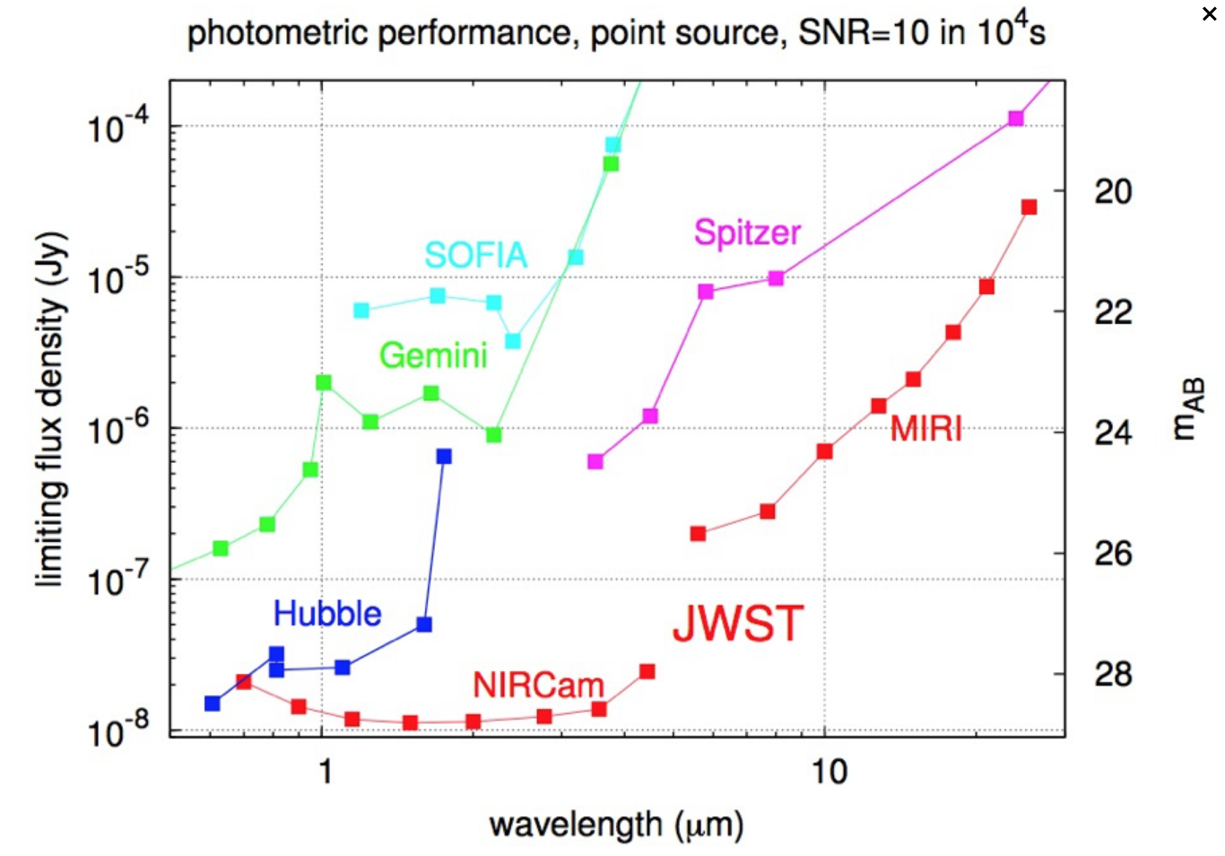
JWST Sensitivity
F560W = 1 DN/s
F1280 = 19 DN/s
F1800W = 80 DN/s
F2100W = 380 DN/s
F2550W = 790 DN/s
Notes:
plot shows the MIRI photometric sensitivity for achieving a signal to noise of 10 in 10,000 seconds. MIRI is about 50 times for sensitive than Spitzer.

Slide 10
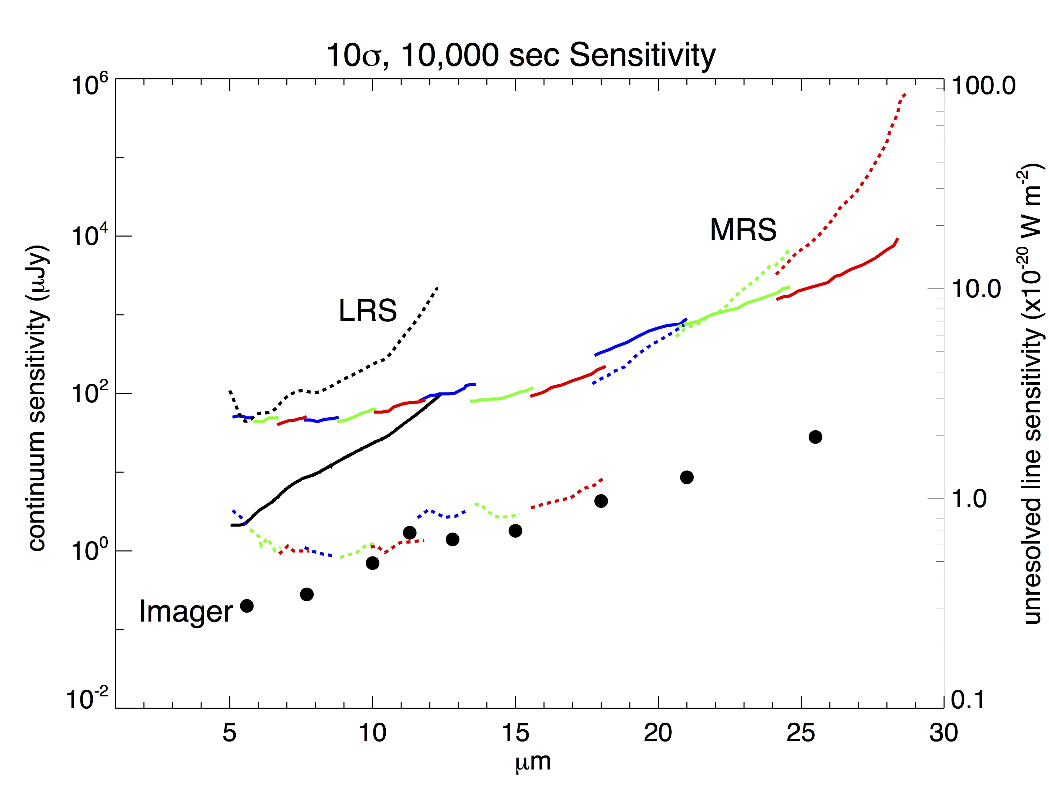
MIRI Sensitivity
F560W = 1 DN/s
F1280 = 19 DN/s
F1800W = 80 DN/s
F2100W = 380 DN/s
F2550W = 790 DN/s
Notes:
MIRI sensitivity plot for MRS (in colors), low-resolution spectrometer (LRS) (in black), and imager (in circles) configurations, corresponding to S/N=10, 1E4 seconds on-source integration time. Solid lines and dots correspond to continuum sensitivity for a spatially unresolved target (units of μJy), while dotted lines correspond to the sensitivity for the detection of an unresolved spectral line in a spatially unresolved target (units of 10^{–20}Watt m⁻²).
250,000 e- full well.

Slide 11
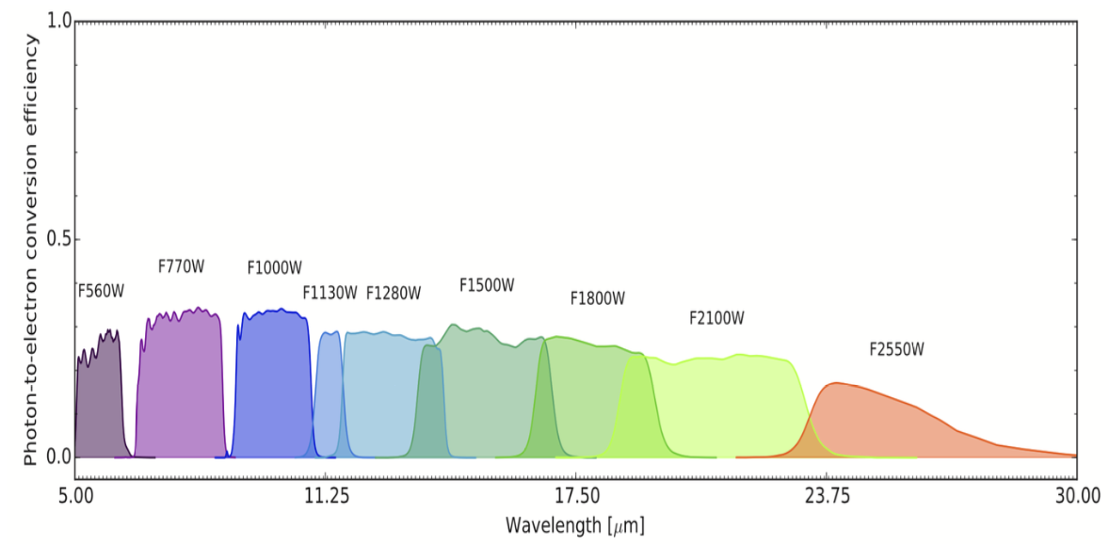
MIRI Imager
Imaging
FOV: 74” x 113”
Plate scale: 0.11”/pix
9 broad filters from 5.6 to 25.5 µm
PSF: 0.22”-0.82”
Subarrays
  BRIGHTSKY
  SUB256
  SUB128
  SUB64
Coronagraphy
3 4QPM (no central spot)
10.65, 11.4, & 15.5 µm
1 Lyot (central spot) 23 µm
FOV: 74” x 113”
Plate scale: 0.11”/pix
Notes:
This the field of view of the MIRI detector. This 74 by 113 arcsecond area is reserved for the MIRI imager. The low resolution slit and the coronagraph modules are in the same field of view. The plate scale is 0.11” per pixel. There are 9 filters available for the imager from 5.6 to 25.5 microns. The corresponding PSF sizes range from 0.22 to 0.82 arcseconds. The imager filter bands are shown in the figure on the bottom.
***********************************************************************************************

Slide 12
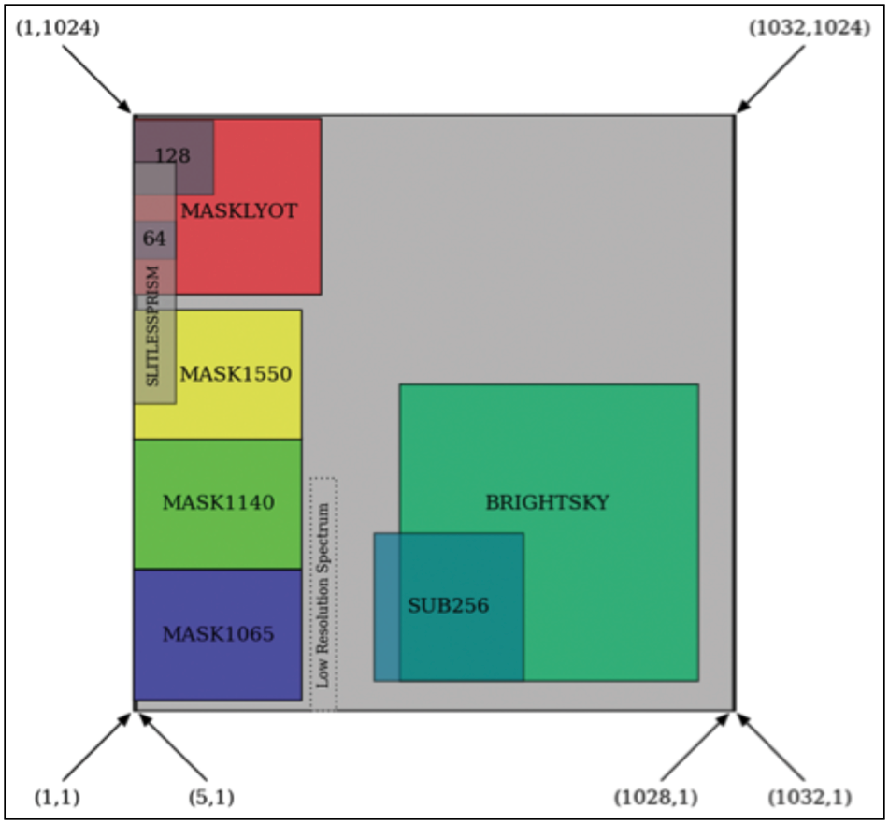
MIRI Imager
Imaging
FOV: 74” x 113”
Plate scale: 0.11”/pix
9 broad filters from 5.6 to 25.5 µm
PSF: 0.22”-0.82”
Subarrays
  BRIGHTSKY
  SUB256
  SUB128
  SUB64
Coronagraphy
3 4QPM (no central spot)
10.65, 11.4, & 15.5 µm
1 Lyot (central spot) 23 µm
Notes:
The imager can also be operated in subarray modes. There are BRIGHTSKY and sub256 subarrays useful for high background cases so as not to saturate the detector. The 128 and 64 subarray (or slitlessprism subarray) reserved for slitless spectroscopy can be read out on much faster timescales than required for the full array which is about 3 seconds.
3 four quadrant phase mask coronagraph filters at 10.65, 11.4, and 15.5 microns, and one lyot coronagraph with a central occulting spot at 23 microns.
*************************************************************************************************************************************************

Slide 13
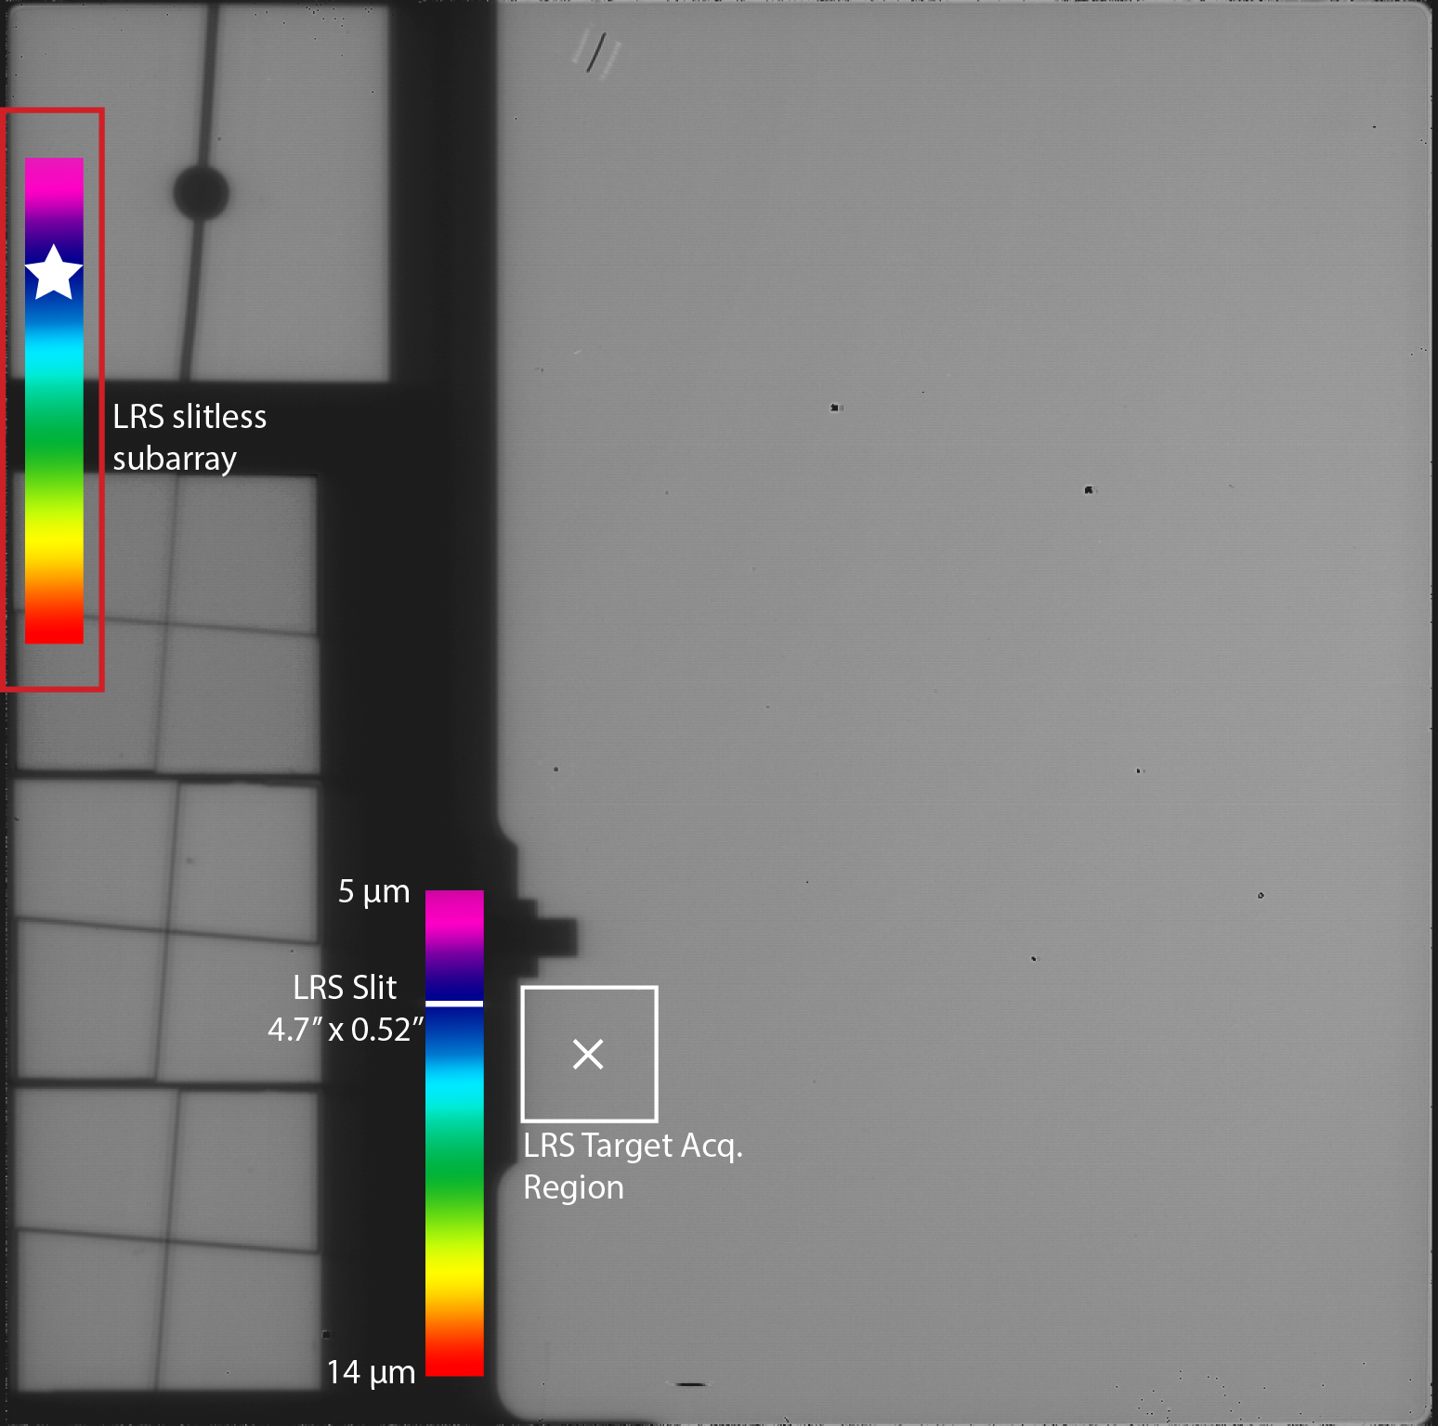
MIRI Low Resolution Spectrometer (LRS)
Spectroscopy of compact sources from 5-12 µm
R = 40 – 160
Operated with 4.7” x 0.51” slit
Dispersion via double prism in filter wheel
Slitless mode
Non-dithered high precision variable source observations (e.g. transiting exoplanets)
Notes:
MIRI has a low resolution spectrometer that can be operated in slit and slitless modes. It is designed for spectroscopy of compact sources from 5-12 microns and has a resolving power that varies from 40 to 160 across that wavelength rage. As I mentioned before, the LRS shares the focal plane with the imager and the coronagraphs. The is 4.7” by 0.51” arcseconds in size and the spectrum is dispersed across this region here. The area for the Target Acquisition region is also shown as the white square.
The LRS can be operated in the slitless mode but this mode is optimized for high precision spectrophotometric observations of variable sources, such as planetary transits.
***********************************************************************************************************************************************************

Slide 14
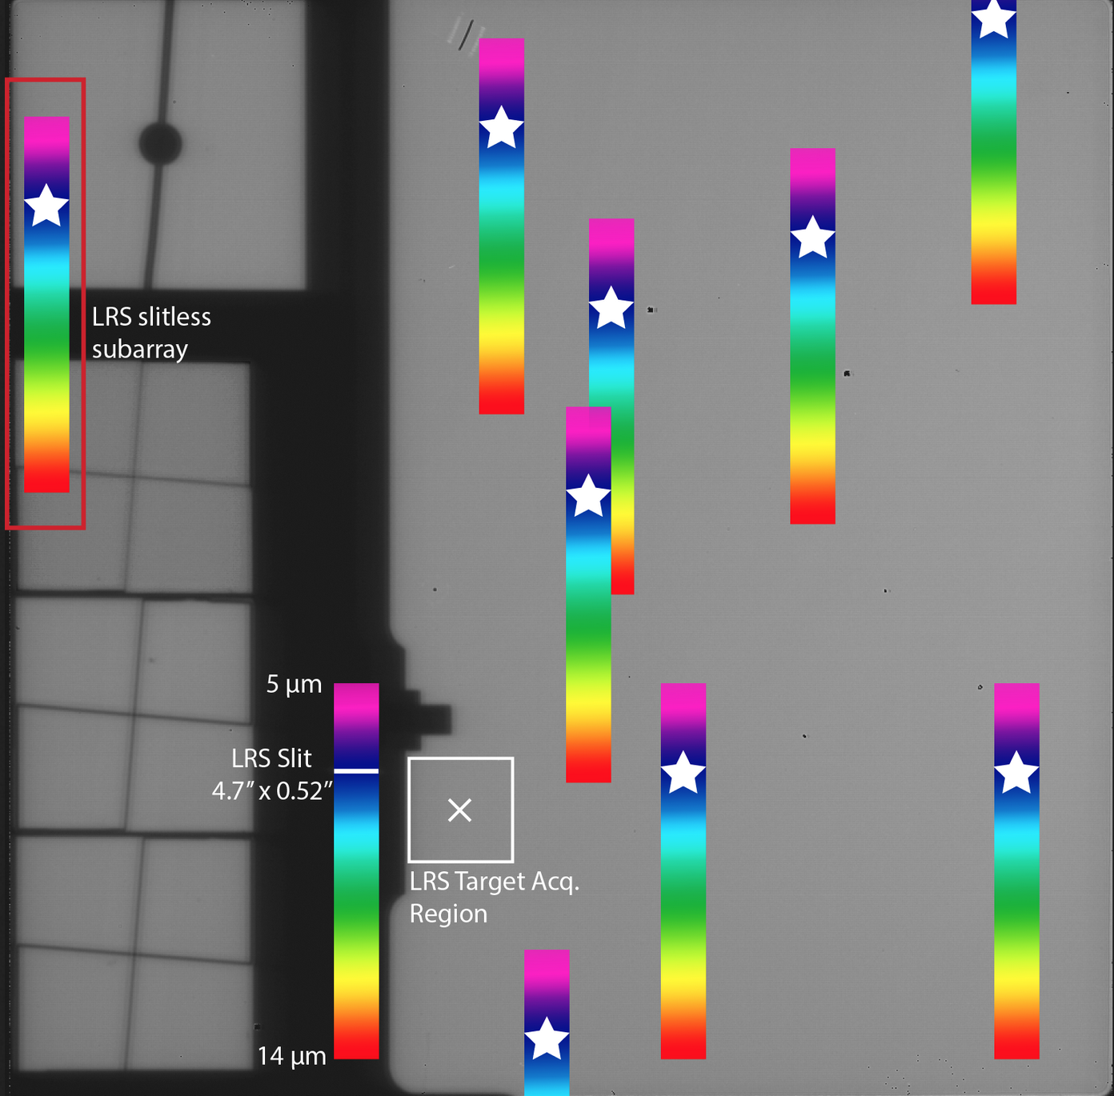
MIRI Low Resolution Spectrometer (LRS)
R = 40 – 160
Spectroscopy of compact sources from 5-12 µm
Operated with 4.7” x 0.51” slit
Shares focal plane with the imager and coronagraph modes
Dispersion via double prism in filter wheel
Slitless mode
Non-dithered high precision variable source observations (e.g. transiting exoplanets)
Notes:
since the prism that disperses the spectrum is in the filter wheel, everything that is in the imager’s filed of view will be dispersed, as I show on the next image. However, these slitless observations are not meant for general use. The thermal infrared background rises steeply in the mid-infrared, so there will be a very high background across the whole spectrum in slitless mode. It is important for planetary transits so it can be read out as fast as possible and there are no slit losses and guiding jitter
***********************************************************************************************************************************************************

Slide 15
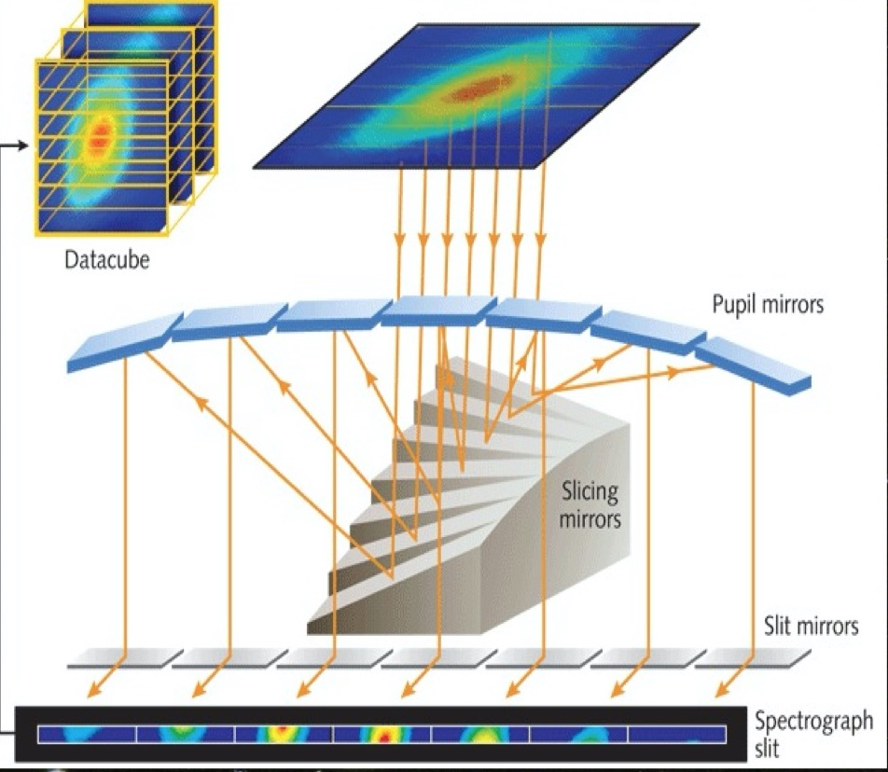
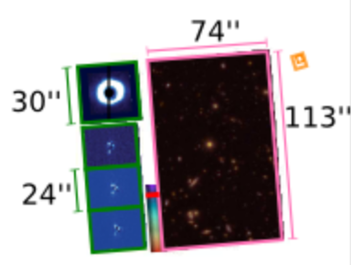
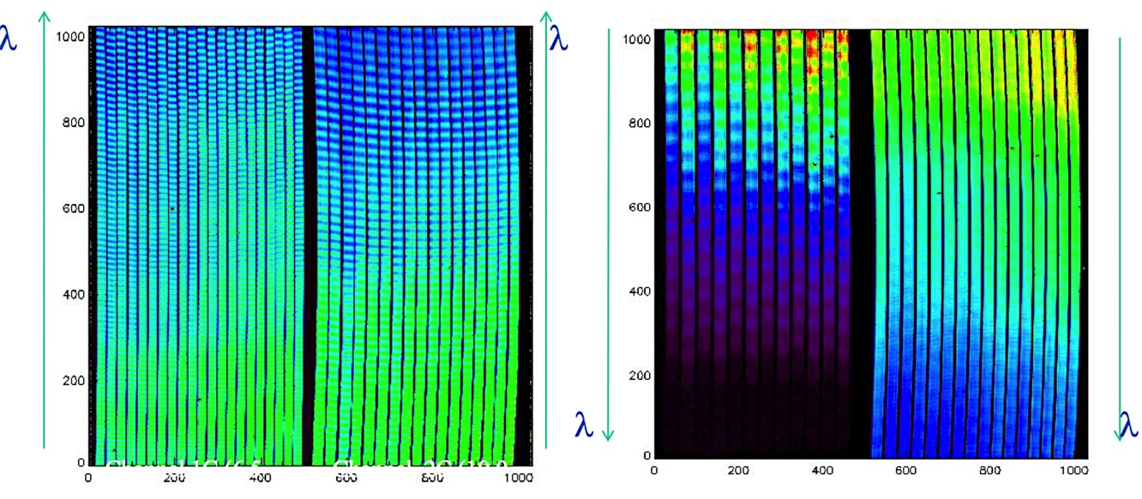
MIRI Medium Resolution Spectrometer (MRS)
R ~ 3000, 4 nested IFUs
(4 channels)
3.44” x 3.64” to 7.7” x 8.0” FOVs
2 detectors
3 grating settings to get full
5-28 µm spectra
Notes:
MIRI also has integral field unit capabilities. The Medium resolution spectrometer is actually 4 different IFUs, each slicing images in 4 different channels. It has a resolving power of about 3000. The little orange square is the field of view of the MRS, and how it compares in size with the MIRI imaging region.
This diagram shows the basics of how an IFU works. Here we have an image of a galaxy. An image slicing mirror slices this image into strips and each slice is sent through a slit that disperses the spectrum. For the MIRI IFUs, the slices for each channel are dispersed onto two detectors. You can see the dispersed slices for the four channels on the detectors here. **
**********************************************************************************************************************************
MIRI uses four image slicers to produce dispersed images of the sky on two 1024x1024 pixel detectors to provide R~3000 spectroscopy over its full wavelength range. The spectral window of each IFU channel is covered using three separate gratings. The IFUs are designed with different pixel scales, providing roughly optimal sampling of the PSF at the central wavelengths of each spectral window. The fields of view of the channels are thus different, ranging from 3.6″x3.6″ to ~7.6″x7.6″ with increasing wavelength. The number of slices decreases from 30 to 12 with increasing wavelength.

Slide 16
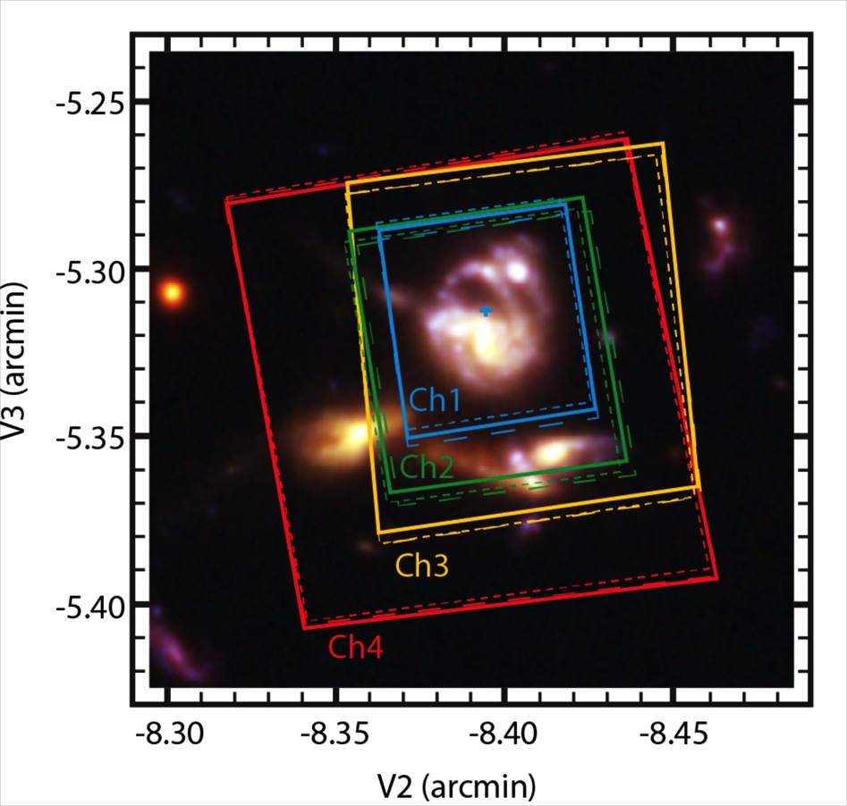
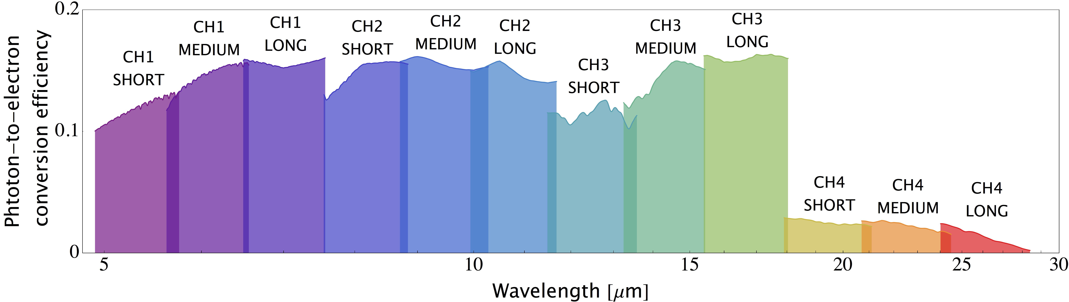
MIRI Medium Resolution Spectrometer (MRS)
R ~ 3000, 4 nested IFUs
(4 channels)
3.44” x 3.64” to 7.7” x 8.0” FOVs
2 detectors
3 grating settings to get full
5-28 µm spectra
Notes:
The FOV ranges from 3” to about 8” arcsecond in the long wavelength channels. Their footprints are shown here. For each channel, there are three grating settings that are used to get the full wavelength range from 5-28 microns.
The bottom figure shows the wavelength coverage for the 4 channels, each has a short, medium, and long wavelength grating setting, so observations can be acquired using only one of the three, or the entire wavelength range depending on the science goals.
These spectra are then used to construct a three dimensional data cube that gives both spatial and spectral information for the given field of view.
**********************************************************************************************************************************

Slide 17
Why the Mid-Infrared?
The Mid-IR (~ 5-28 µm) probes astrophysics that is not accessible at other wavelengths
Enables observations of objects deeply imbedded in dusty environments
Probes molecular species (organics & PAHs), solid state features (Mg₂SiO₄), and thermal continuum emission
Enables detailed investigations of the very high redshift universe

Slide 18
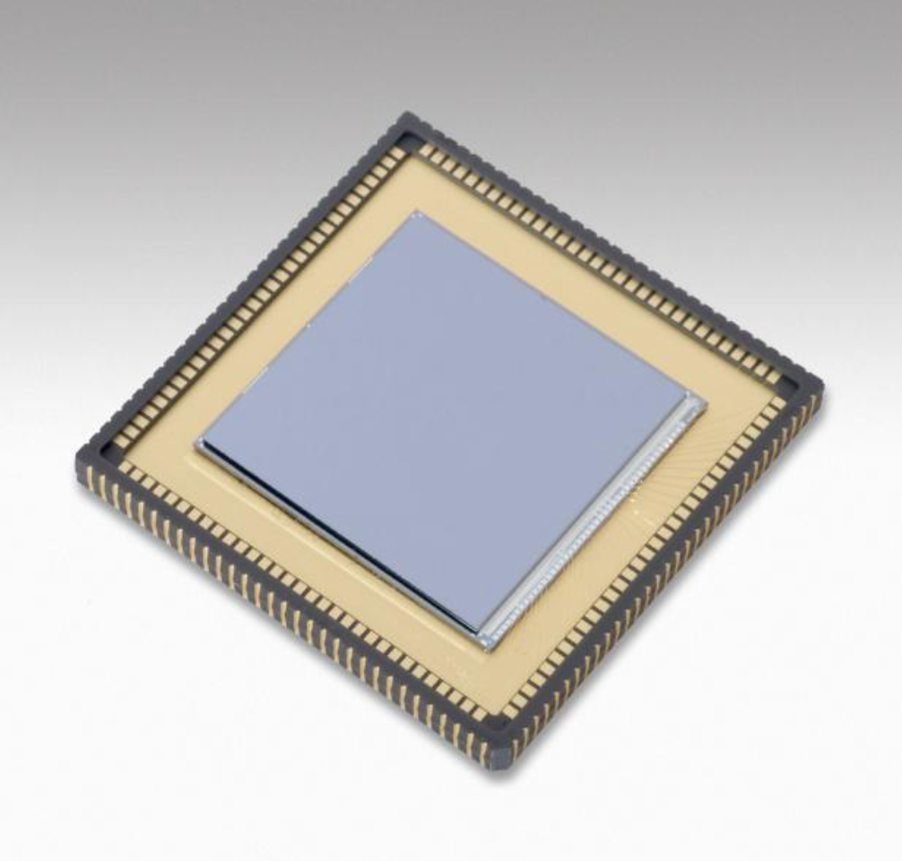
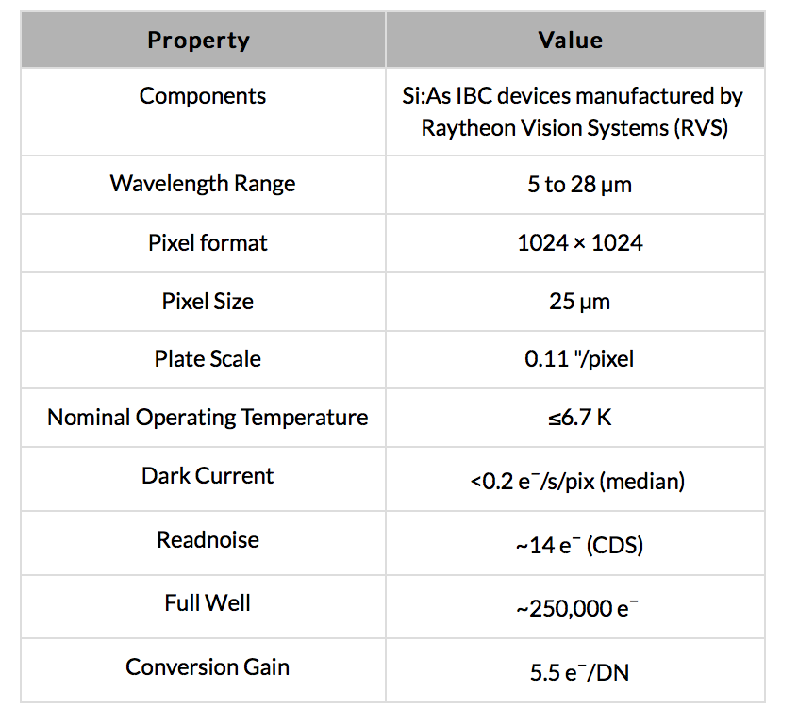
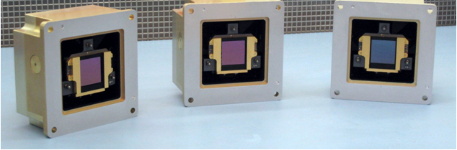
The MIRI Sensor Chip Assembly

Slide 19
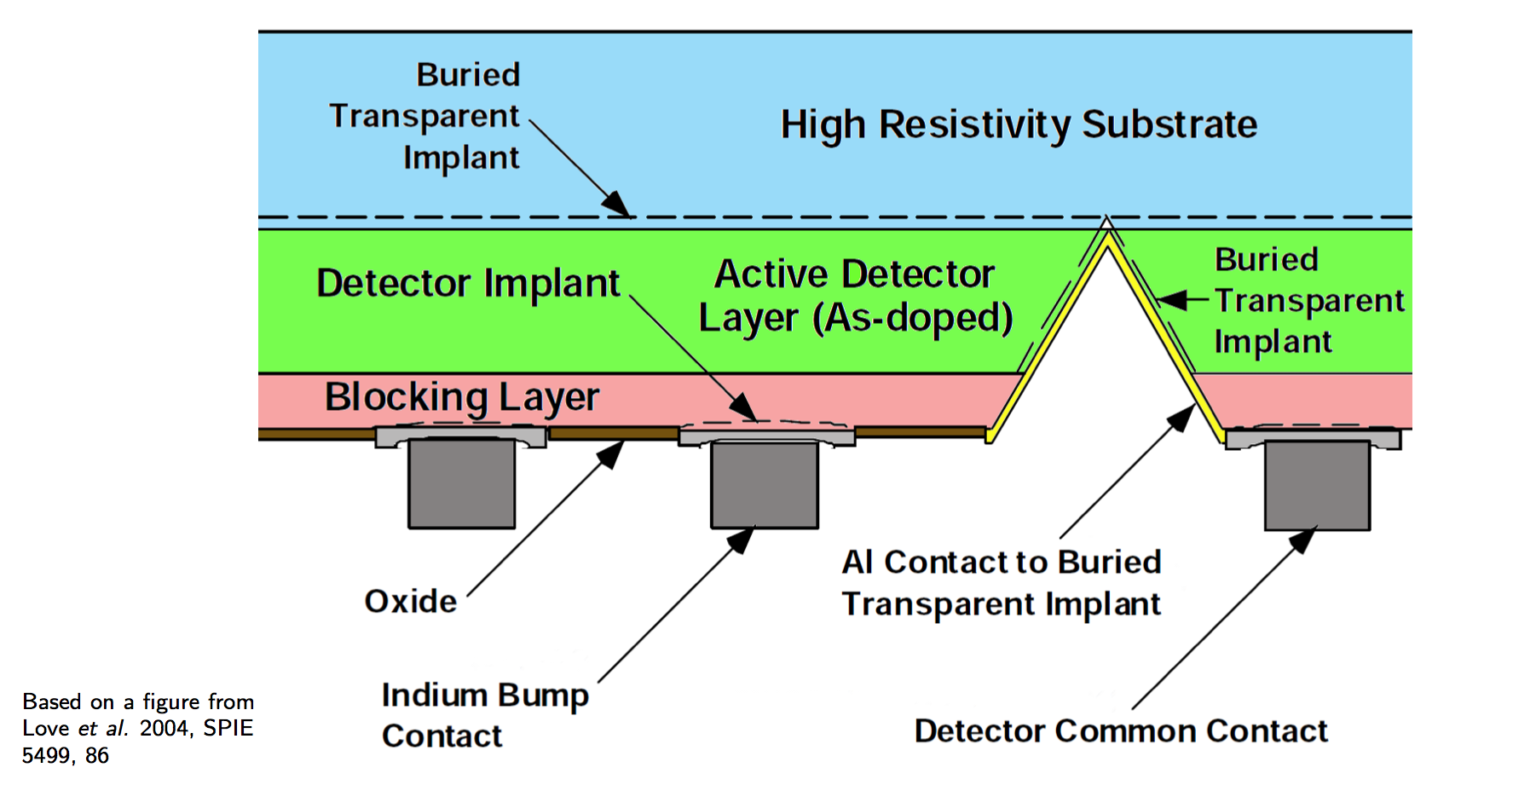
Detector Layer Schematic

Slide 20
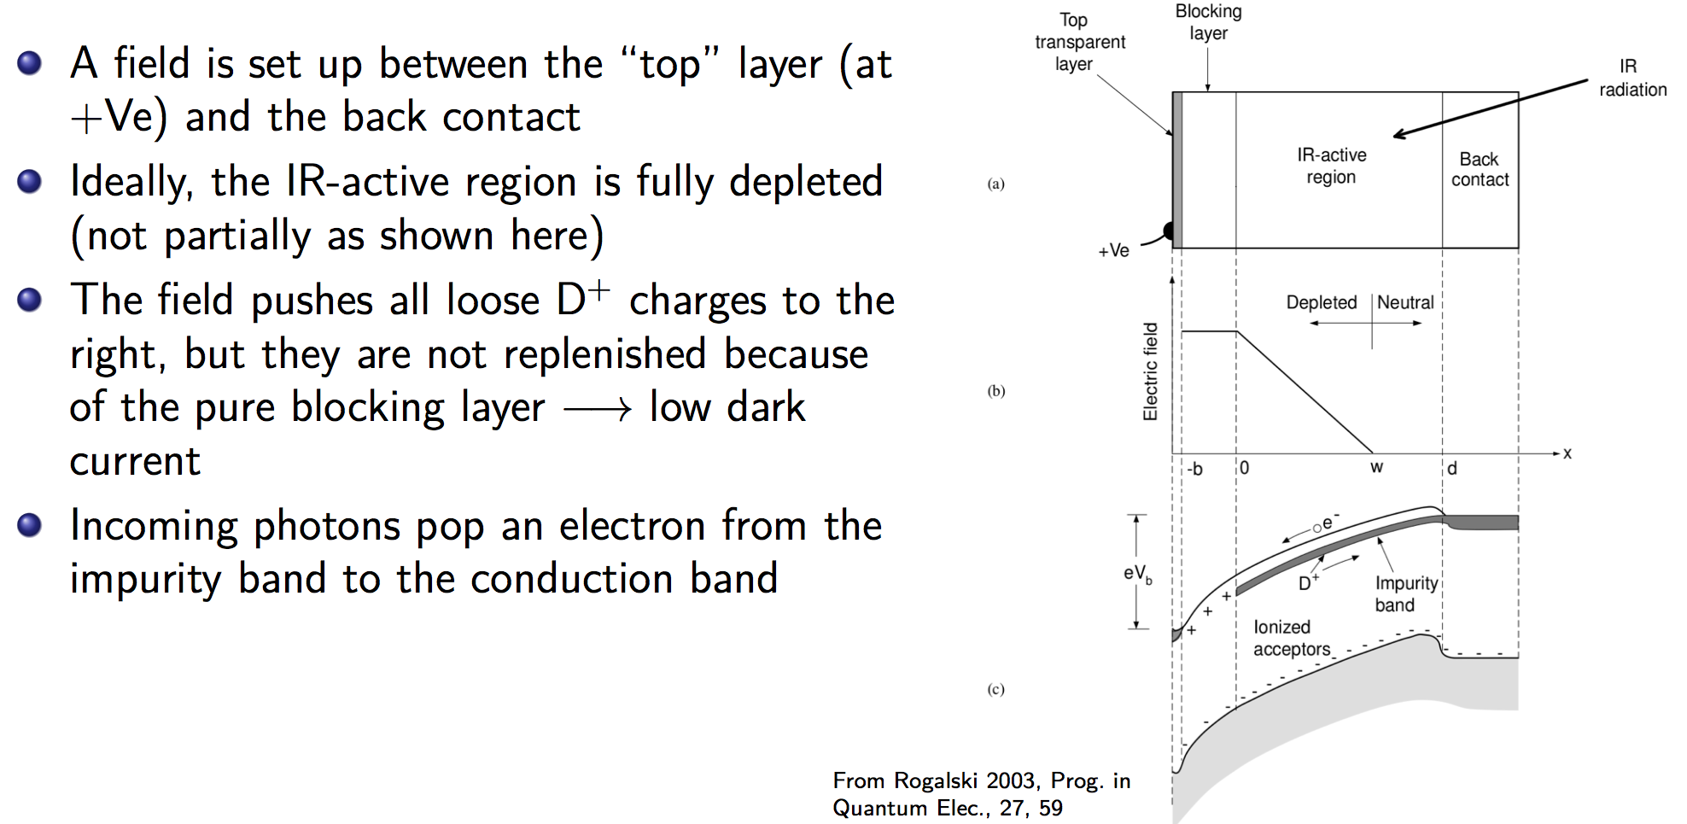
Energy Diagram

Slide 21
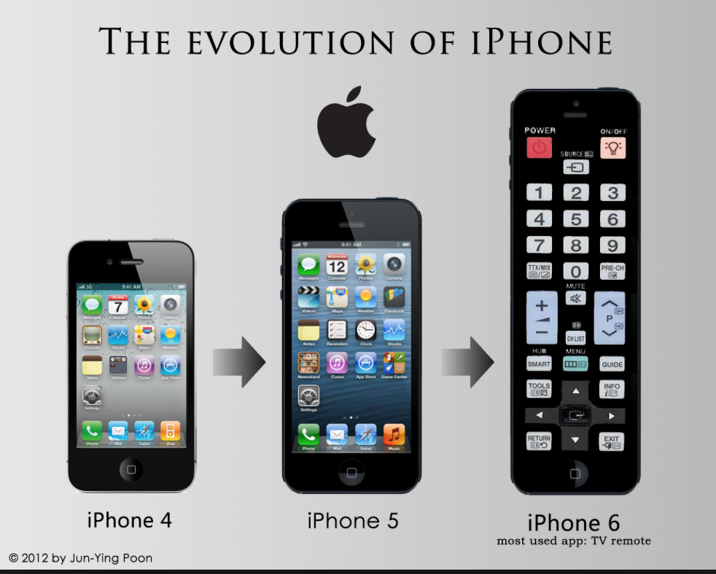
The MIRI Sensor Chip Assembly
The MIRI arrays are the direct descendants of the long wavelength IRAC arrays:
  Same four science outputs and interleaving
  Same readout procession
  Same fundamental noise/power performance
  Similar detector layer recipes (thicker IR layer)
Chief differences:
  Larger format, 1024² vs 256²
  Smaller pixel size, 25 um vs 30 um
  Added reference pixels and output
  Added odd/even row circuitry

Slide 22
The MIRI Sensor Chip Assembly
MIRI has 3 detectors
  1 x imager
  2 x medium-resolution spectrometer –MRS)
Redundancy in electronics – side A or B
Two slightly different detector architectures:
  Short wavelength MRS trades lower absorption efficiency for reduced dark current (contingency array)
Uniform response
  Pixel-to-pixel variation no more than 3% RMS
Small proportion of inoperative pixels
  Either hot or dead <200 (0.1%)
Usable level of response out to 28.22 um
  Allows detection of e.g. molecular hydrogen 0-0 S(0) rotation line

Slide 23
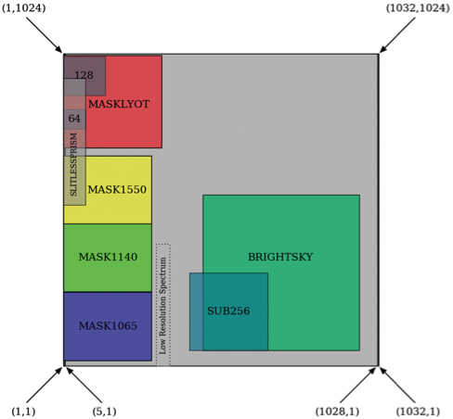
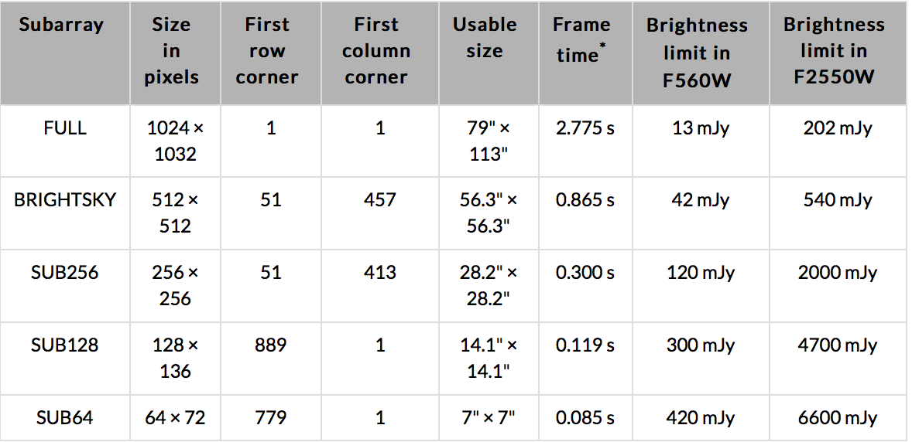
Subarrays
1024x1024 active pixels divided into 4 outputs
  4 columns of reference pixels on each side
  5th output that is read out simultaneously as another reference
9 predefined subarrays to simplify operations and calibration

Slide 24
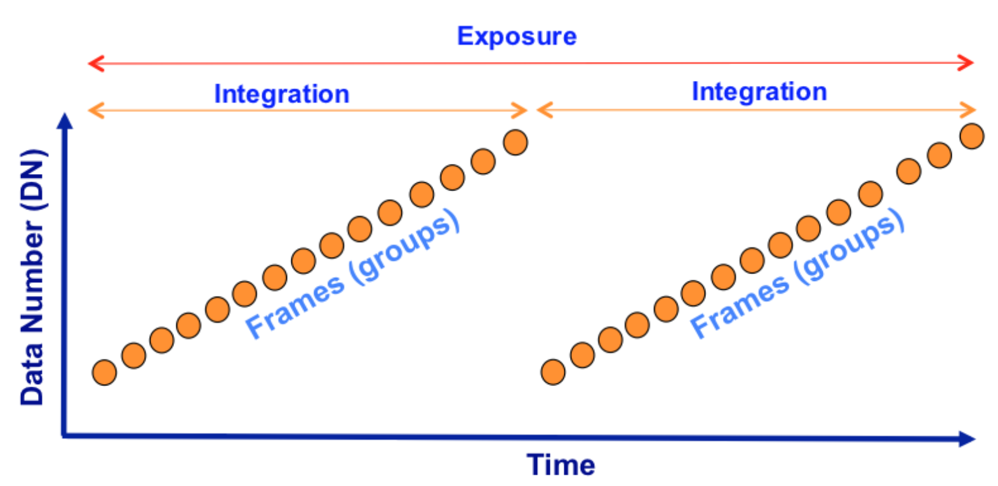
MultiACCUM Data
Possible frames per integration = 1 to 65535
And possible Integrations per Exposure = 1 to 65535
Longest possible single exposure = 8525 years
Mission configuration max = 3352 years
However observers will be restricted to 3 hour maximum exposures except for time series observations.
Frame = single clocking scan through array
Integration = a number of non-destructive readout frames where photons are allowed to integrate
Exposure = a number of sequential integrations within a single command
MIRI does not explicitly have “groups” – By definition, MIRI has one frame per group

Slide 25
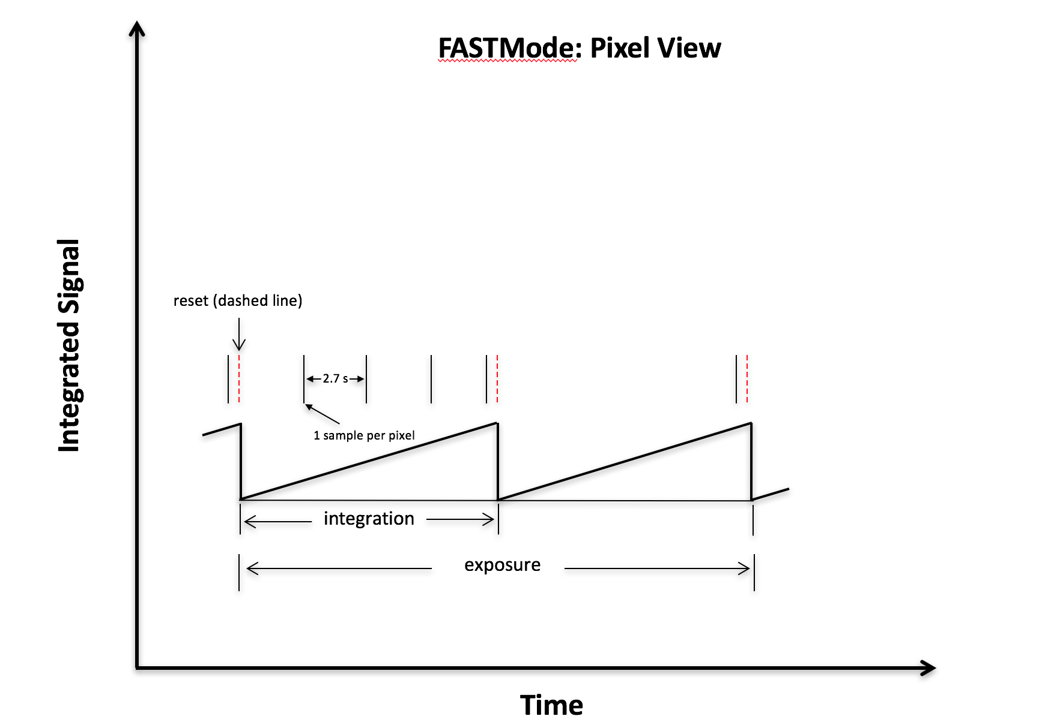
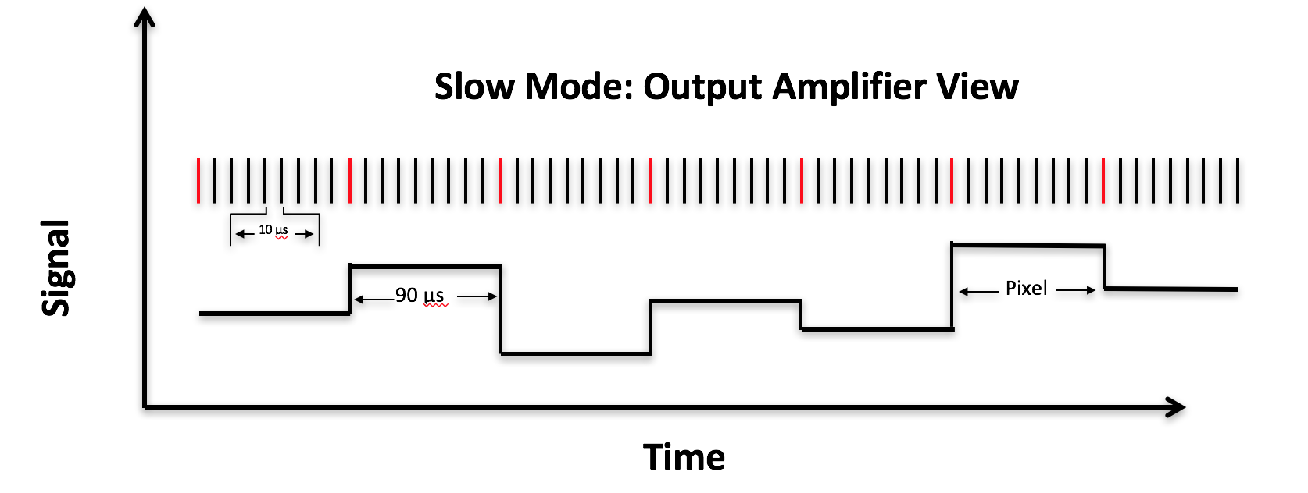
Fast vs. Slow
Readout ~ 3 sec
Readout ~ 24 sec
The electronics have the ability to sample a pixel multiple times before moving on to the next pixel
In FAST mode, MIRI samples a pixel once during a single clock cycle
In SLOW mode, many samples of a pixel are obtained in a clock cycle and a subset of them can be averaged to output a single result
Notes:
Silicon Arsenic doped Impurity Band Conduction detectors.
Non destructive.
Fast vs. Slow
FAST modes readout the detector every ~3 seconds in full array mode, vs. ~24 seconds in SLOW mode. That means better time sampling that allows better characterisation of the detector effects.
SLOW mode provides about 10 times less data volume.
FAST mode is better suited for imager observations, being hence the default (not mandatory) mode offered by APT.
SLOW mode has shown to deliver slightly lower noise in MRS observations, and for this reason is offered as default (not mandatory) readout mode by APT.

Slide 26
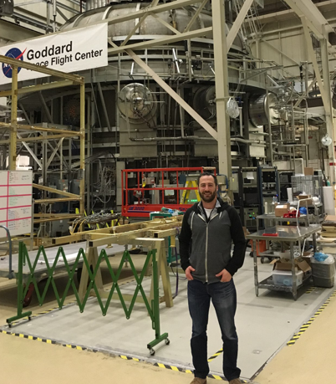
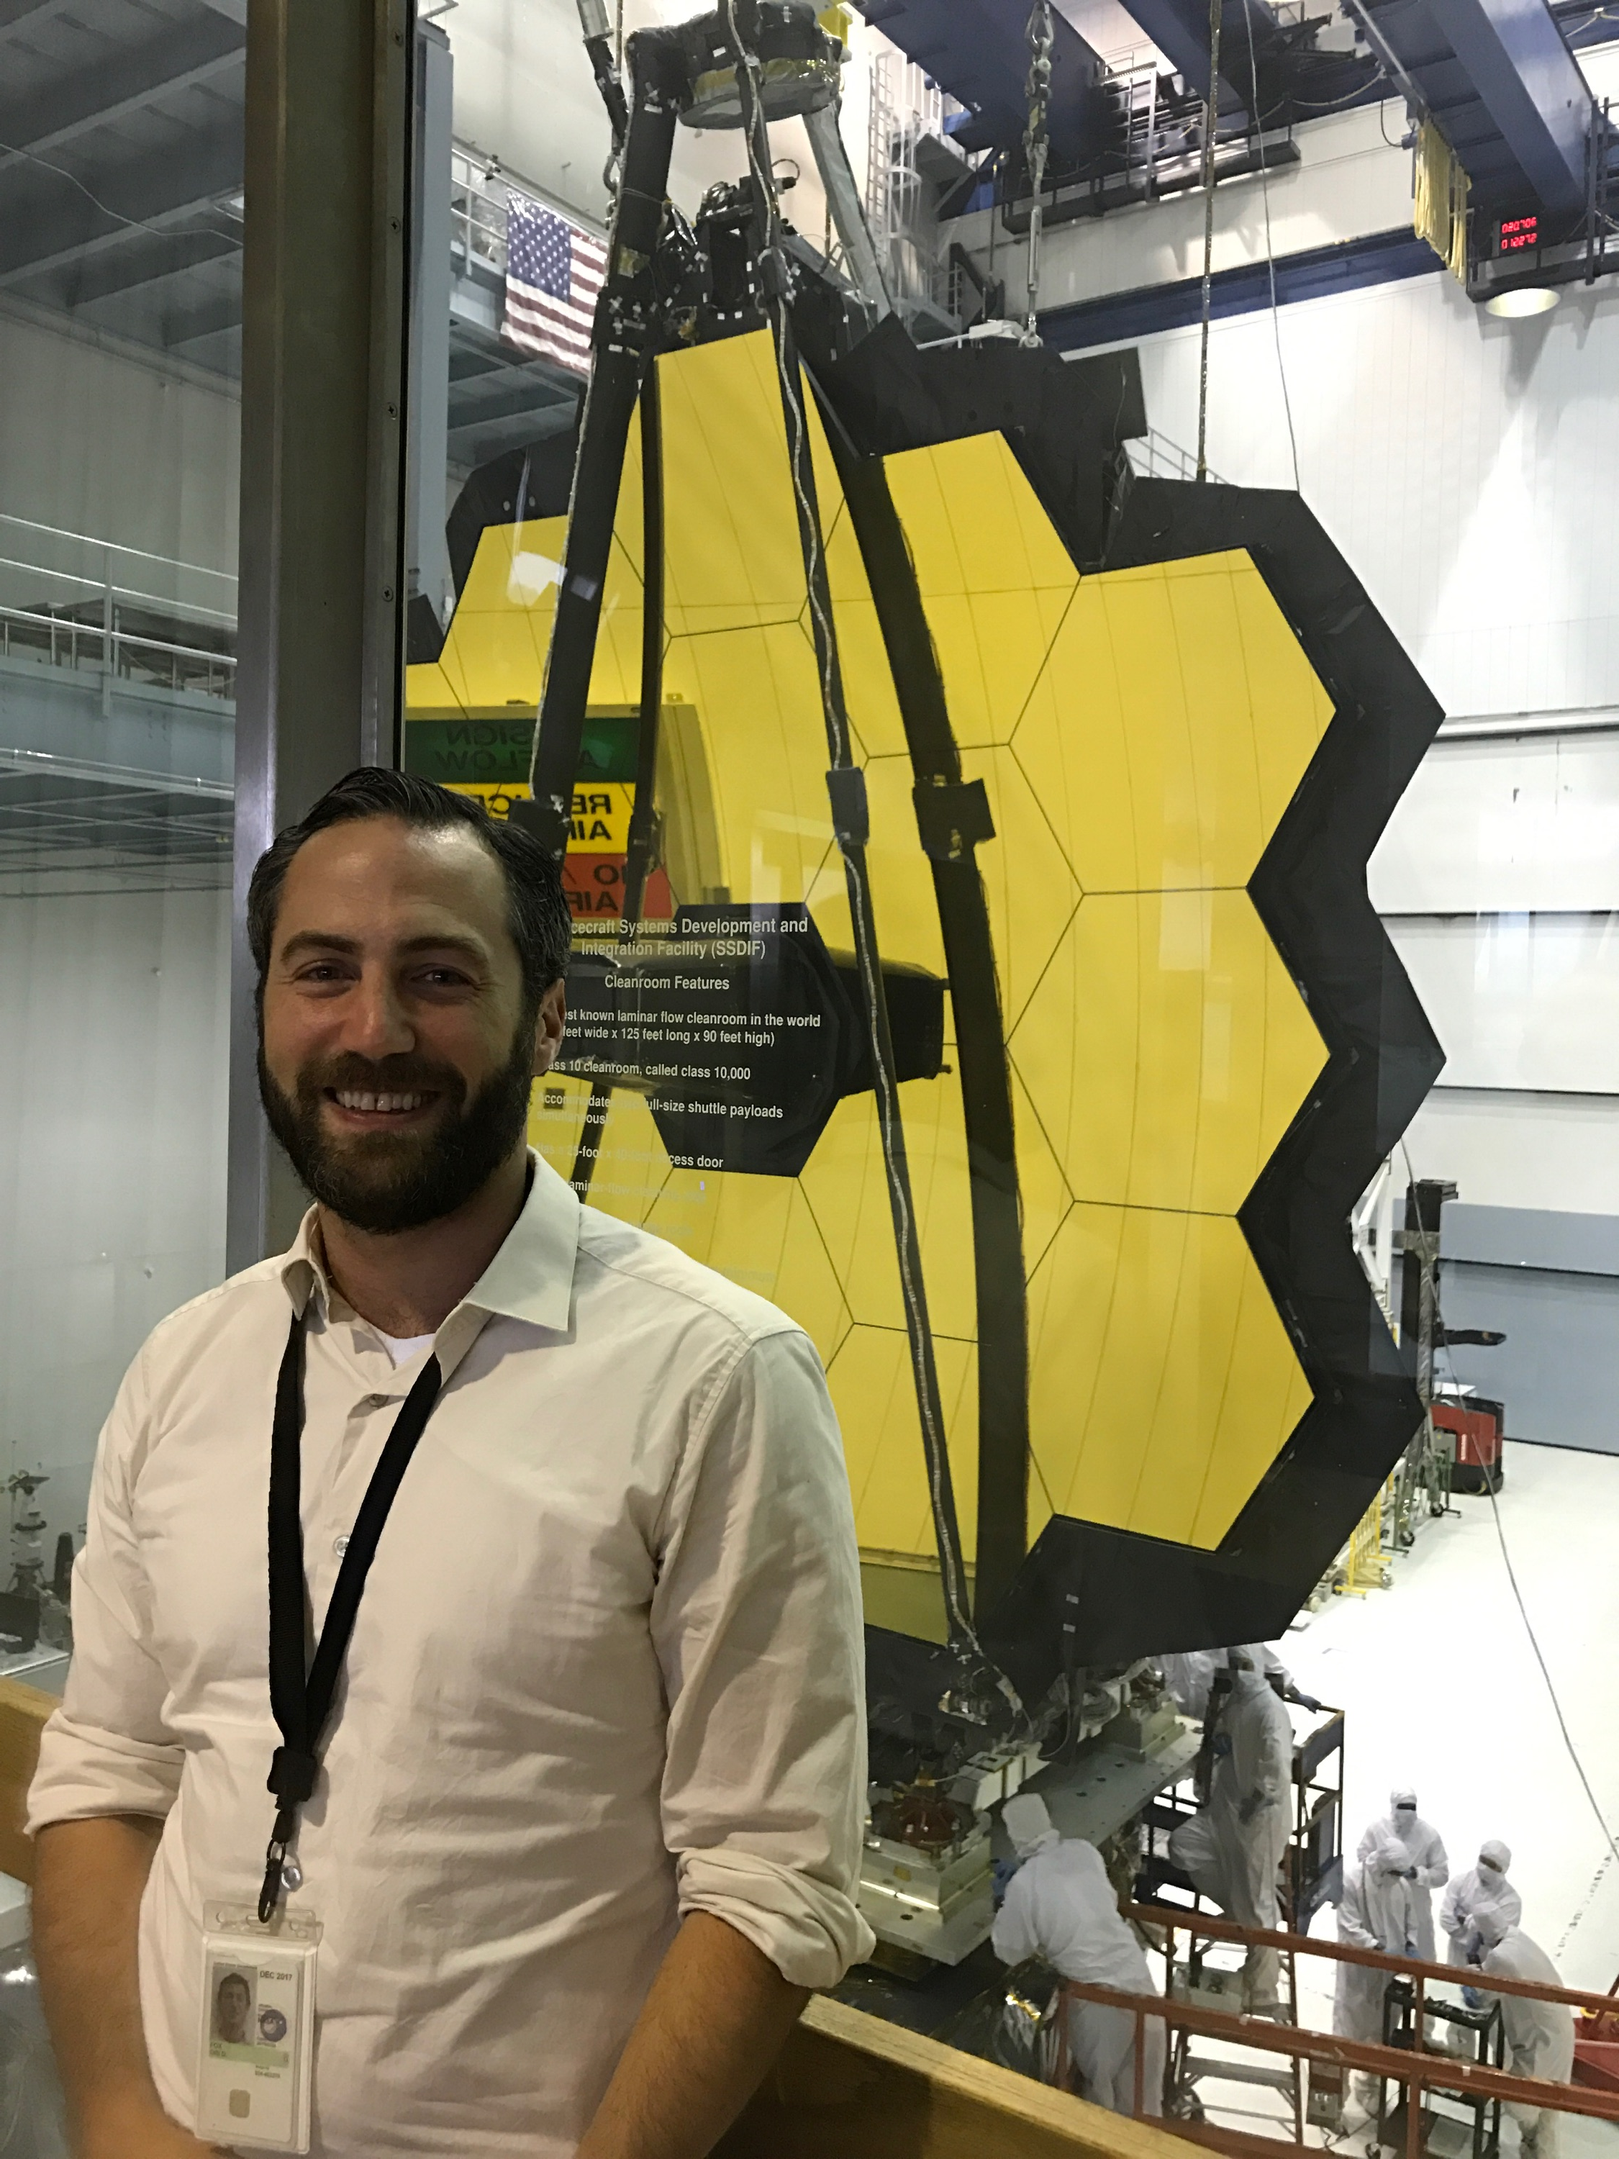
Testing (NASA Goddard)

Slide 27
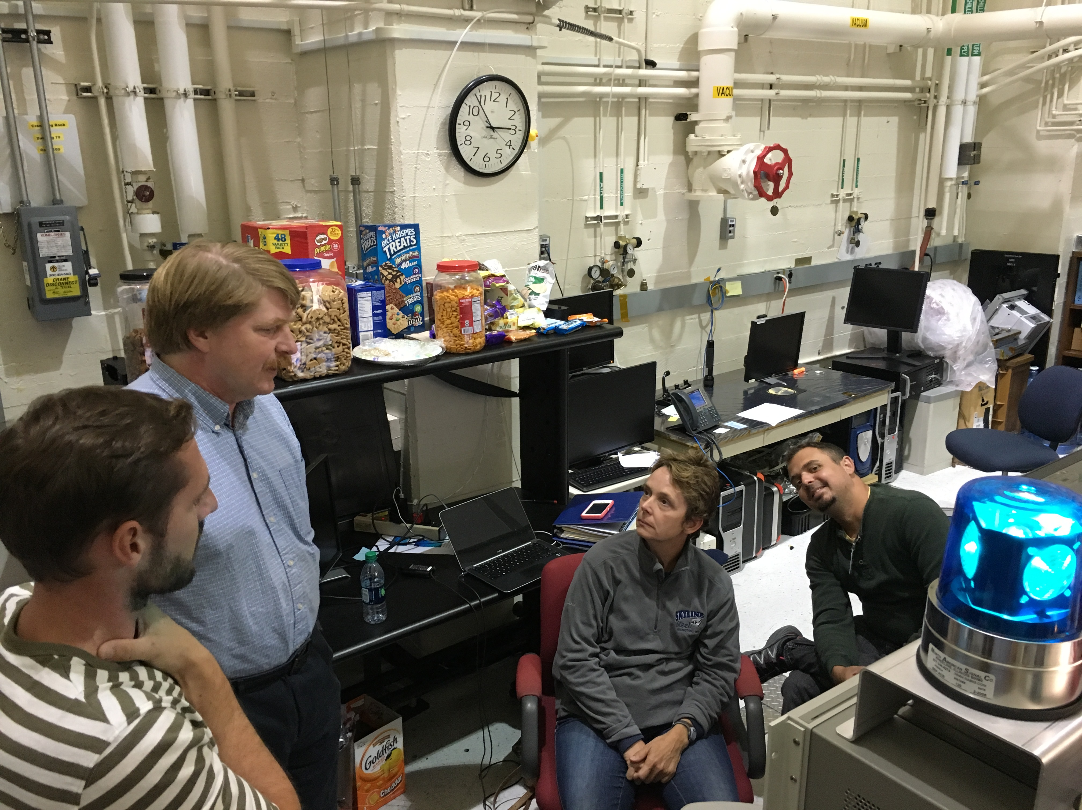
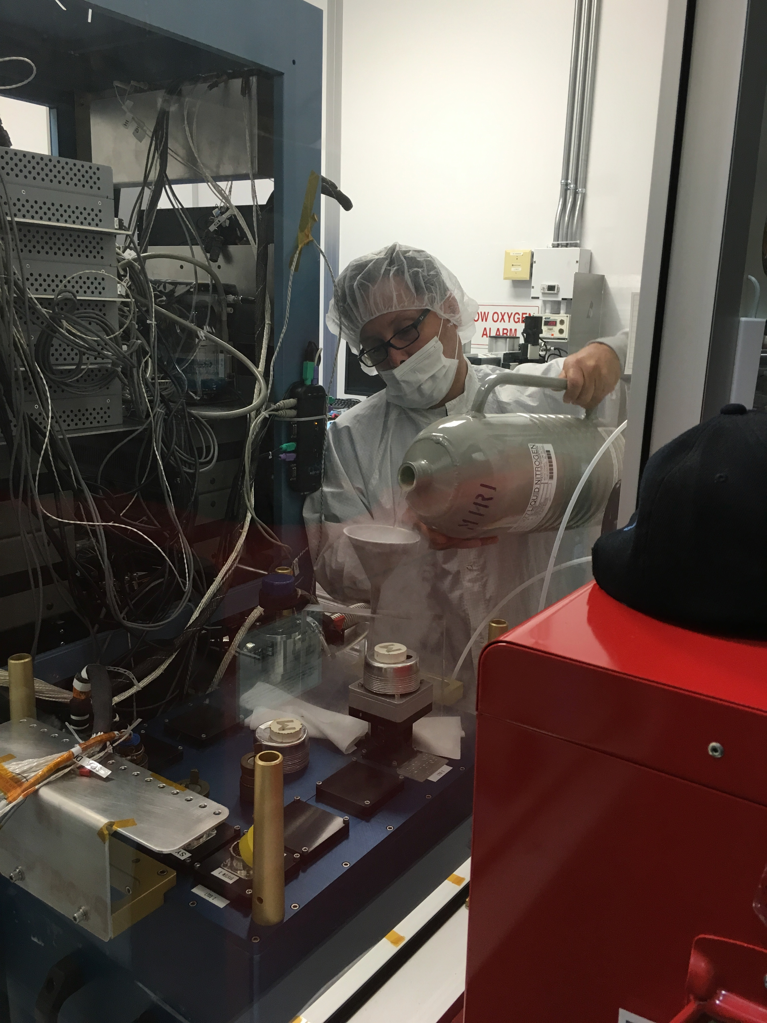
Testing (JPL)

Slide 28
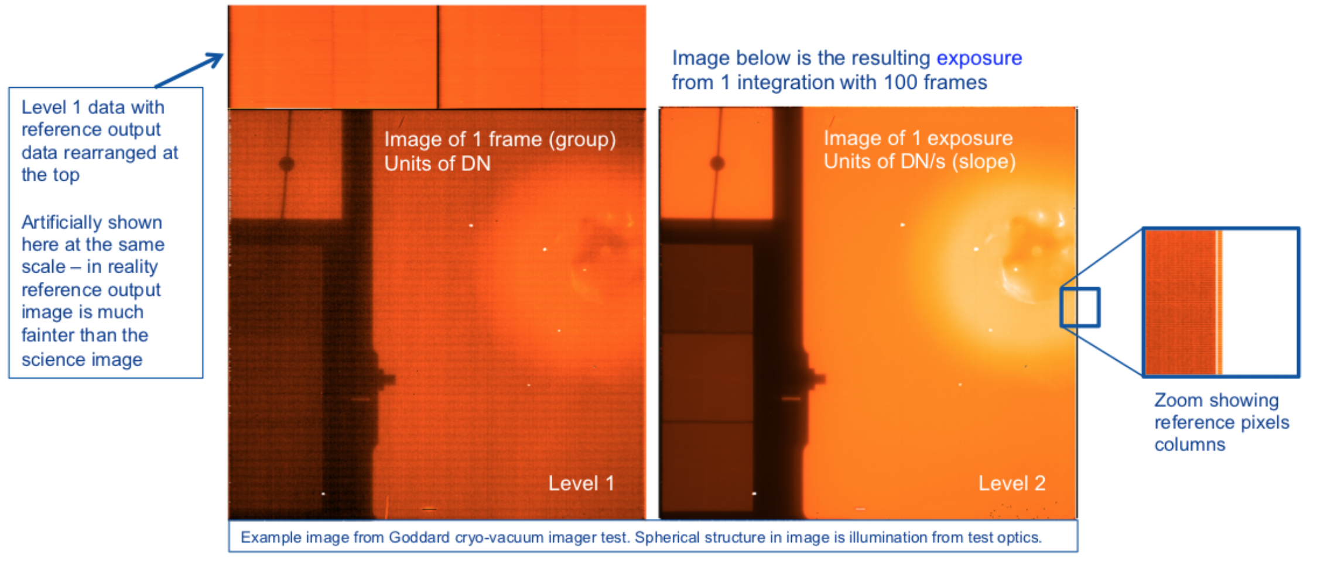
Data!

Slide 29
Ramps-to-Slopes
Level 2 data (“ramps-to-slopes”) will be generated for all data
  Will take care of all the usual and not-so-usual effects when converting raw data to electron rates
  Non-linearity, reset anomaly, cosmic ray strikes, pull-up/pull-down, darks, references, e-/DN, etc.

Slide 30
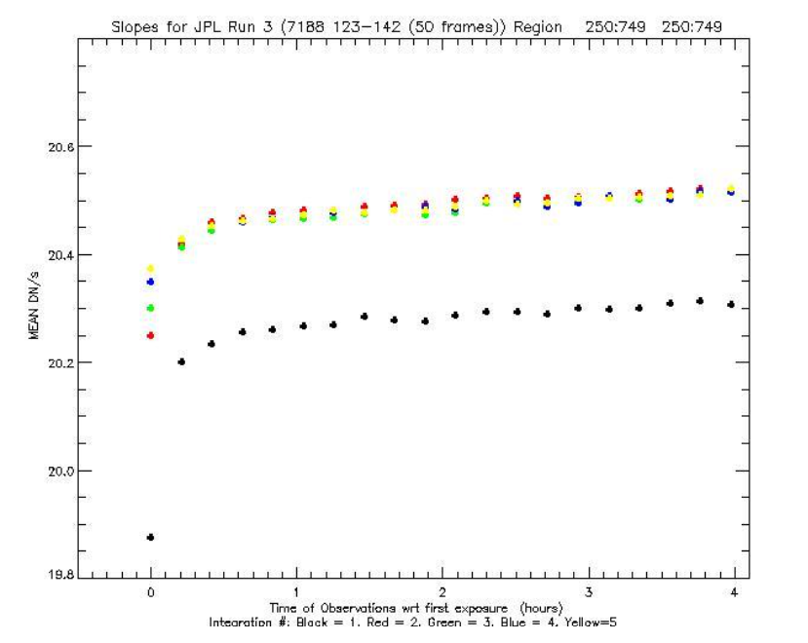
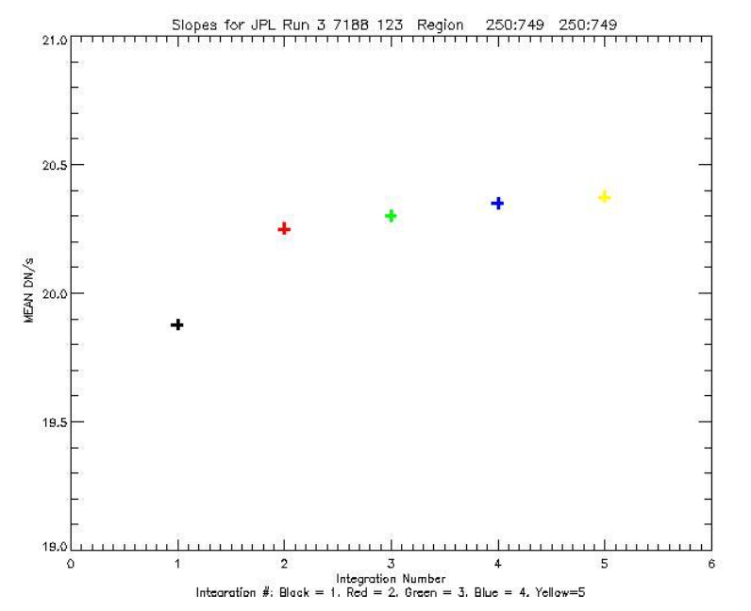
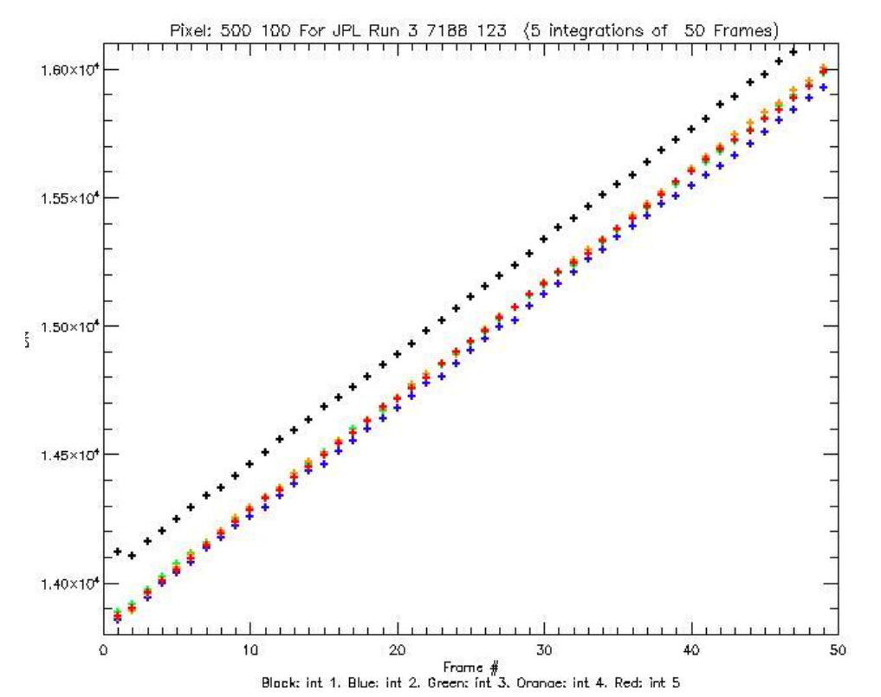
Ramps-to-Slopes

Slide 31
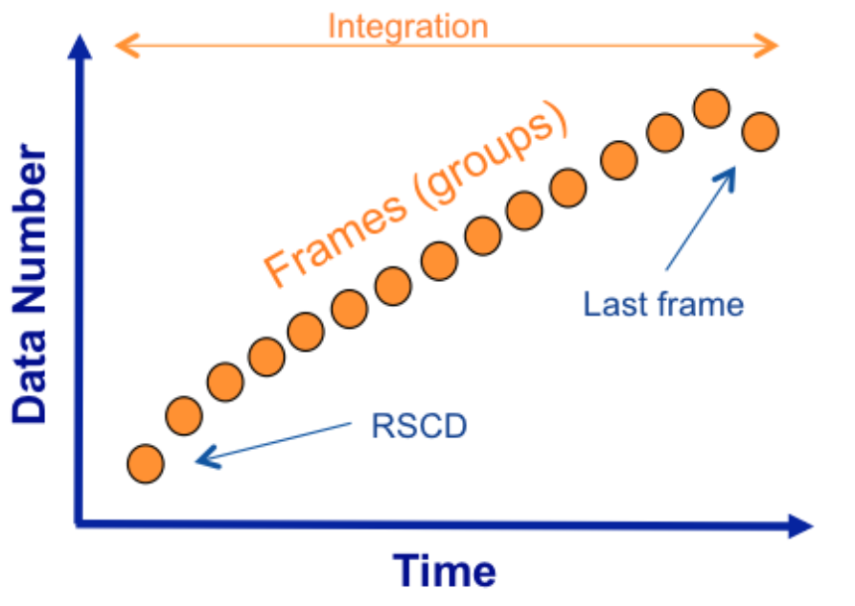
“Features”
First Integration Effect
First Exposure Effect
Last Frame Effect – The array is reset sequentially by row pairs. The last frame of an integration ramp on a given pixel is influenced by signal coupled through the reset of the adjacent row pair. Corrected by pipeline.
Reset Switch Charge Decay (RCSD) – seen as a non-linear hook in the first frames of the ramp in the second and subsequent integrations. Product of charge injection – very predictable. Corrected by pipeline.
First integration effect
First Exposure Effect

Slide 32
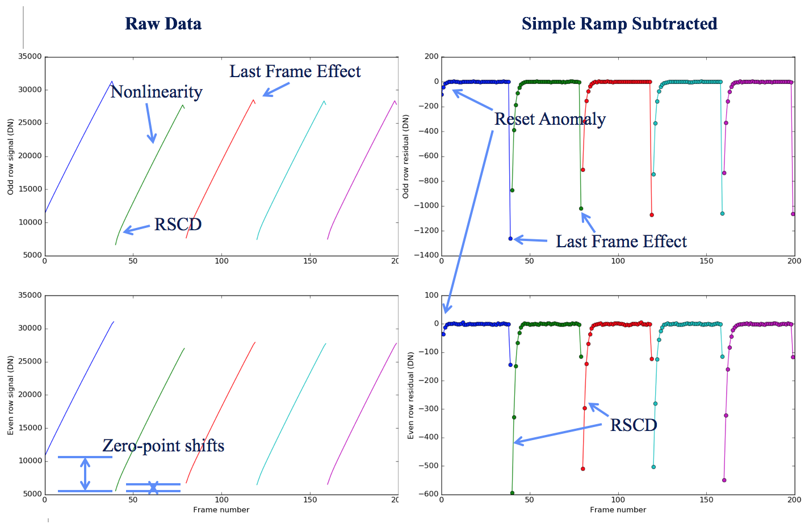
“Features”
First Integration/Exposure Effect - In multi-integration exposures the measured slope of the first integration is always lower than the other integrations. [This is due to charge traps being filled]
Last Frame Effect – The array is reset sequentially by pairs of rows. The last frame of an integration on a given pixel is influenced by signal coupled with the reset of the previous row pair. Planned to be corrected by the pipeline.
Reset Switch Charge Decay (RCSD) – seen as a non-linear hook in the first frames of the ramp in the second and subsequent integrations. Product of charge injection from the reset MOSFET – very predictable. Corrected by pipeline.

Slide 33
“Features”
First Integration/Exposure Effect - In multi-integration exposures the measured slope of the first integration is always lower than the other integrations. [This is due to charge traps being filled]
Last Frame Effect – The array is reset sequentially by pairs of rows. The last frame of an integration on a given pixel is influenced by signal coupled with the reset of the previous row pair. Planned to be corrected by the pipeline.
Reset Switch Charge Decay (RCSD) – seen as a non-linear hook in the first frames of the ramp in the second and subsequent integrations. Product of charge injection from the reset MOSFET – very predictable. Corrected by pipeline.

Slide 34
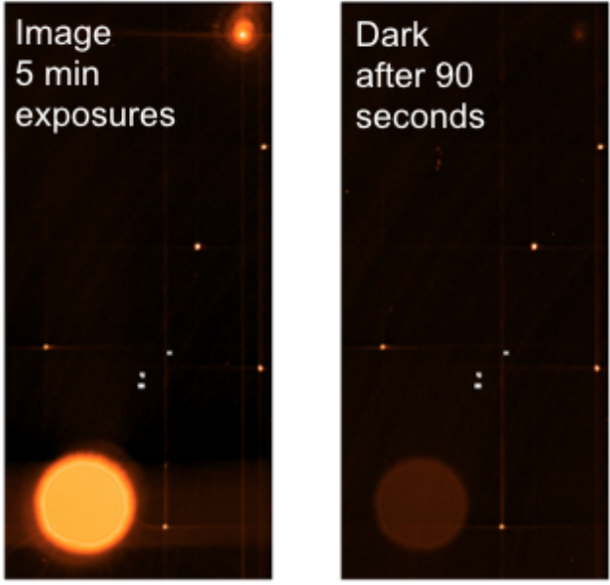
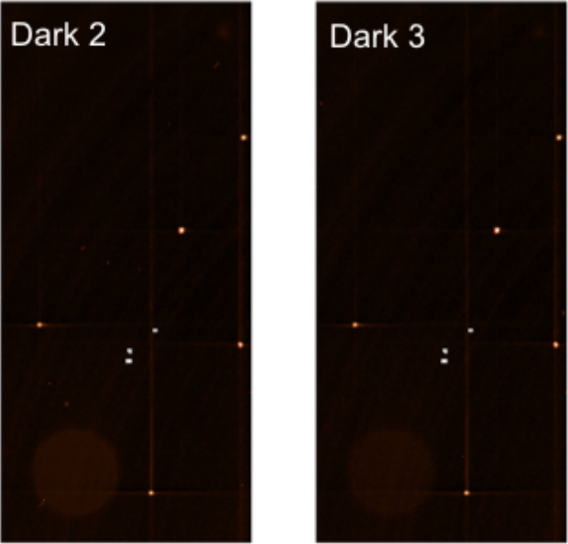
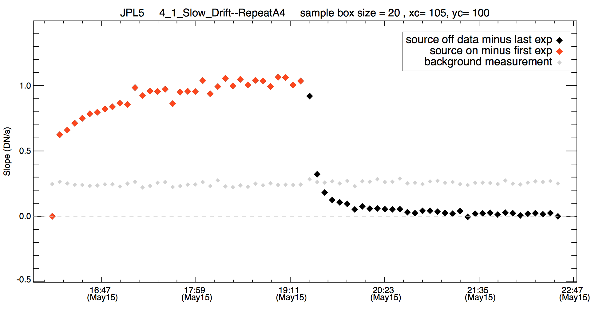

“Features”
Latents/Persistence – all types of memory effects where the origin is not assumed. This includes localized, large scale and array wide latent like structure (e.g., subarrays and anneal recovery)
Imprint – A memory effect that does not change with time (or on a very long timescale) – such effects were seen in Spitzer IRAC and removed by anneal
Drifts – signal drifts with amplitudes roughly proportional to signal level. <<1%.
Latent
Drift
Imprint
These are the best examples of this type of detector ever flown - impact of memory effects thought to need correction only at the extreme end of luminosity and integration time
Notes:
<< 0.5% of previous signal after a few minutes
Memory effects are common to these type of detectors
These are the best examples of this type of detector ever flown - impact of memory effects thought to need correction only at the extreme end of luminosity and integration time

Slide 35

Cosmic Rays

Slide 36
Science Operations
Slow vs. Fast Mode
Ideal ramp length (Full Well; Persistence vs. Noise)
Min/Max Exposure Time
Number of integrations
Background correction strategies
Anneal frequency
Target Acq
jwst-docs.stsci.edu
Notes:
Ultimately, there’s nothing to worry about. Calibration will be done in space.

Slide 37
Why we’re still testing
Trap Mechanism
Transit Simulations
Exoplanets
Subarray Latents
Mode Switching
Anneals
One vs. Multiple Integrations

Slide 38
Summary
MIRI detector performance meets and exceeds design requirements
Known non-ideal behaviors are well characteried and should be mitigated or corrected during the mission
MIRI instrument team are very confident about performance
References:
MIRI performance – Ressler et al (2008, Proc. Of SPIE Vol. 7021)
MIRI detectors – Rieke et al. (2015, PASP 127, 665)
MIRI Focal Plane System – Ressler et al. (2015, PASP 127, 675)
MIRI predicted sensitivity – Glasse et al. (2015, PASP 127, 686)
jwst-docs.stsci.edu

Slide 39

12 Bad Habits

Slide 40

3. Drifts in Apparent Response

Slide 41

3. Drifts in Apparent Response

Slide 42

4. Reset Anomaly

Slide 43

5. Persistence Recovery

Slide 44

6. Anneal Recovery

Slide 45

Responsitivity

Slide 46

Quantum Yield (Efficiency)

Slide 47

Dark Current

Slide 48

Non-Ideal Behavior

