Slide 1
Empirically Modeling CTE for HST
Jay Anderson
STScI
2017 Detector Workshop
Baltimore

Slide 2
CTE = Charge-Transfer Efficiency
Radiation damage
Impact on science
  Photometry
  Astrometry
  Shape
  Makes CRs worse
Initial corrections
  Empirical corrections:
  Δm ~ 10ª × SKY^{b} × FLUX^{c} × (y/2000)
Worst part: not knowing what to trust
UP TO 60 PIXELS

Slide 3
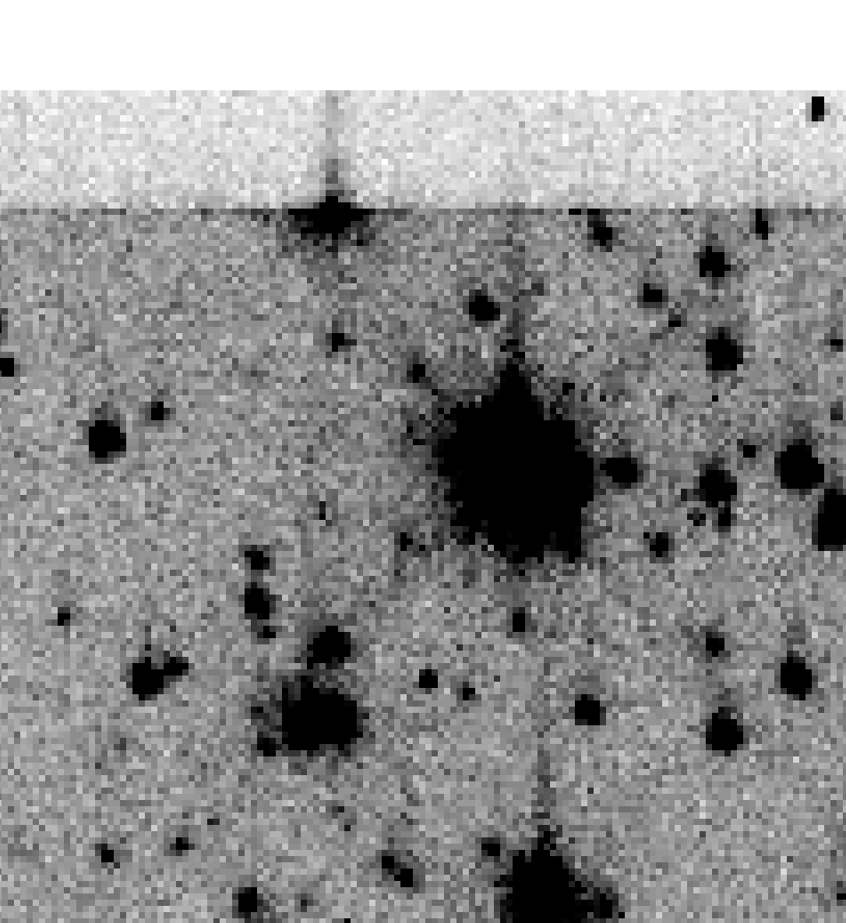
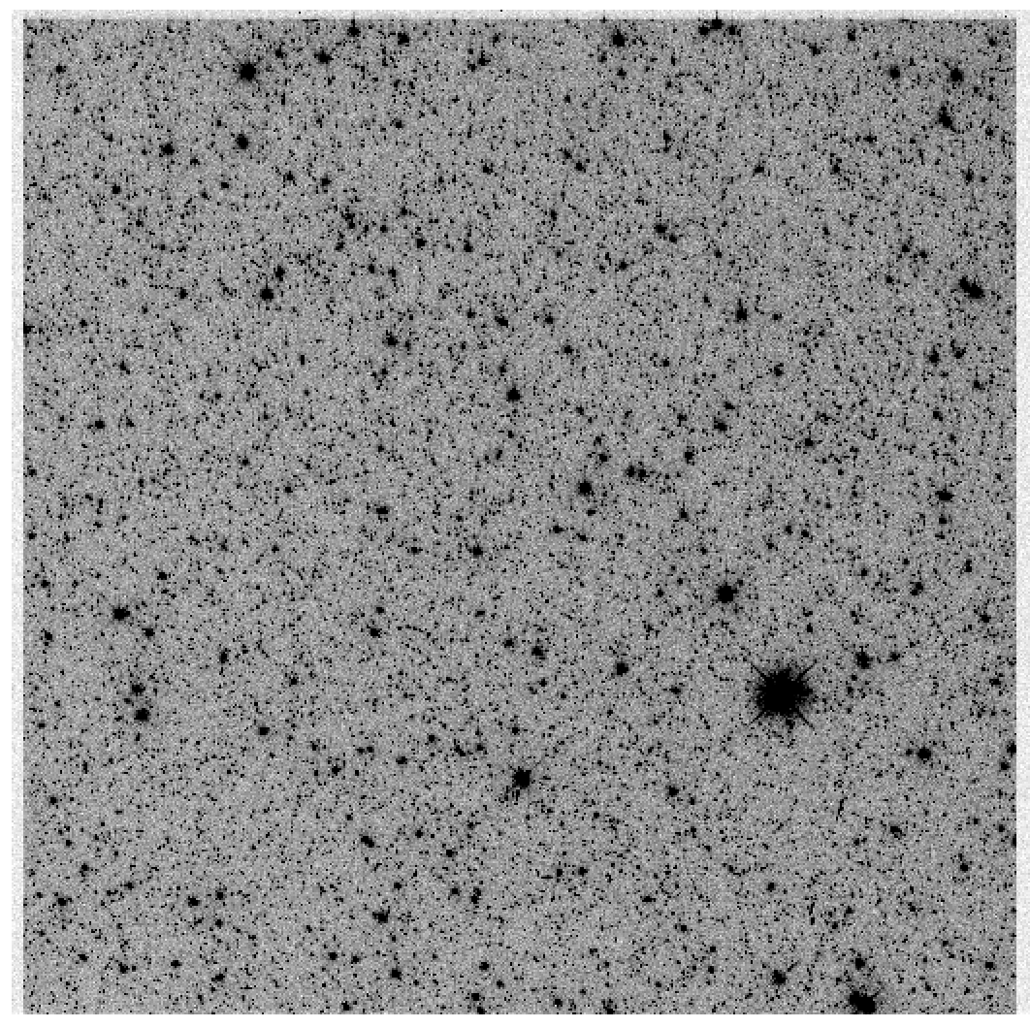
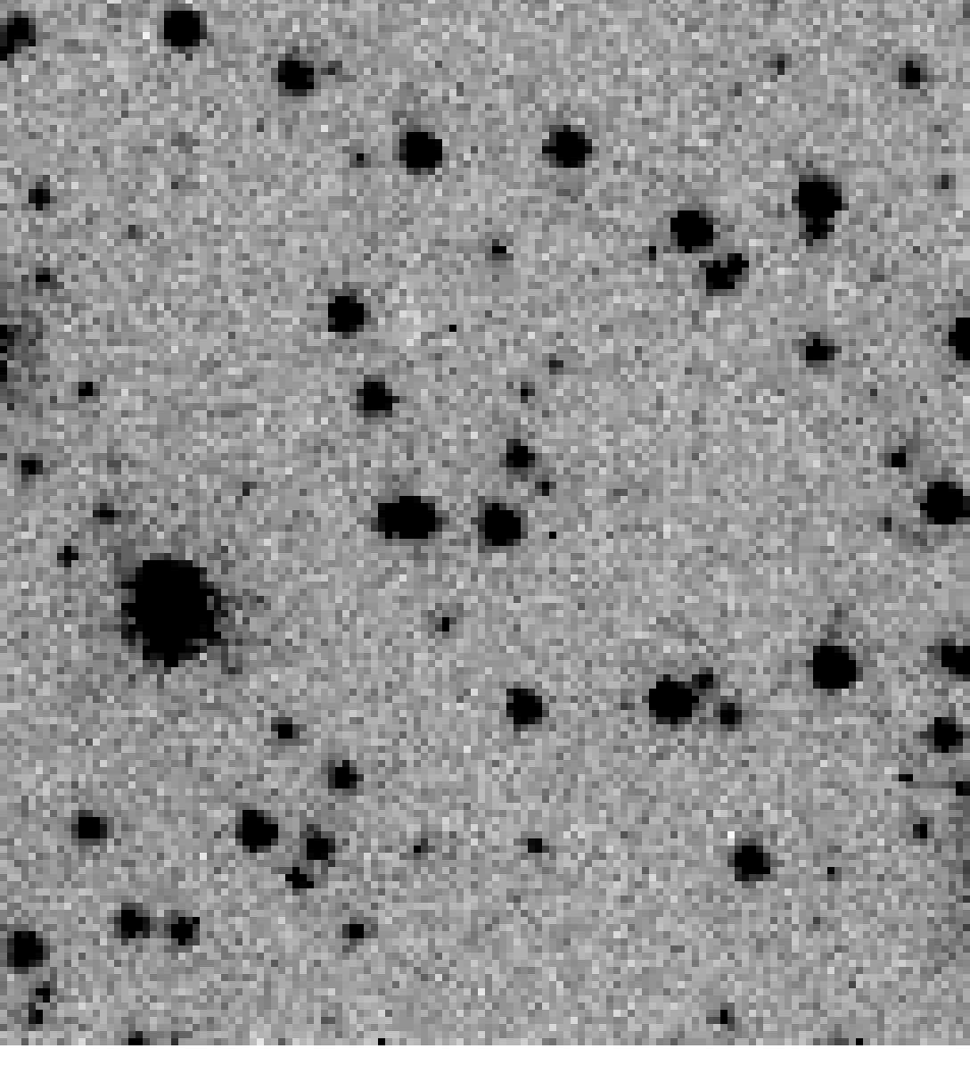
PARALLEL READOUT
SERIAL READOUT

Slide 4
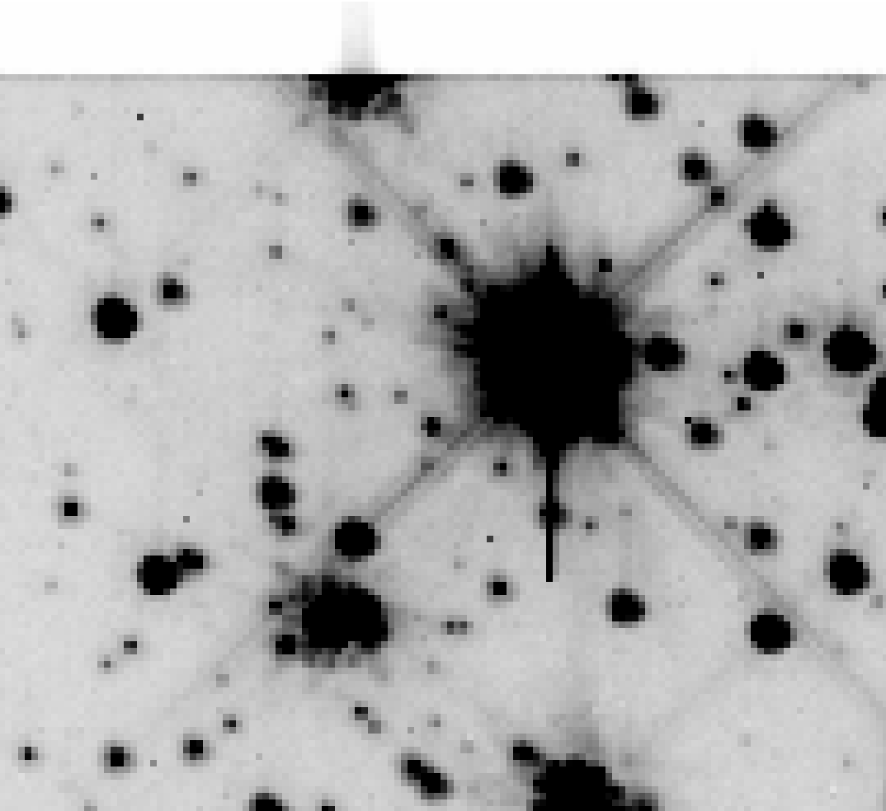
DEEPER
PARALLEL READOUT
SERIAL READOUT

Slide 5
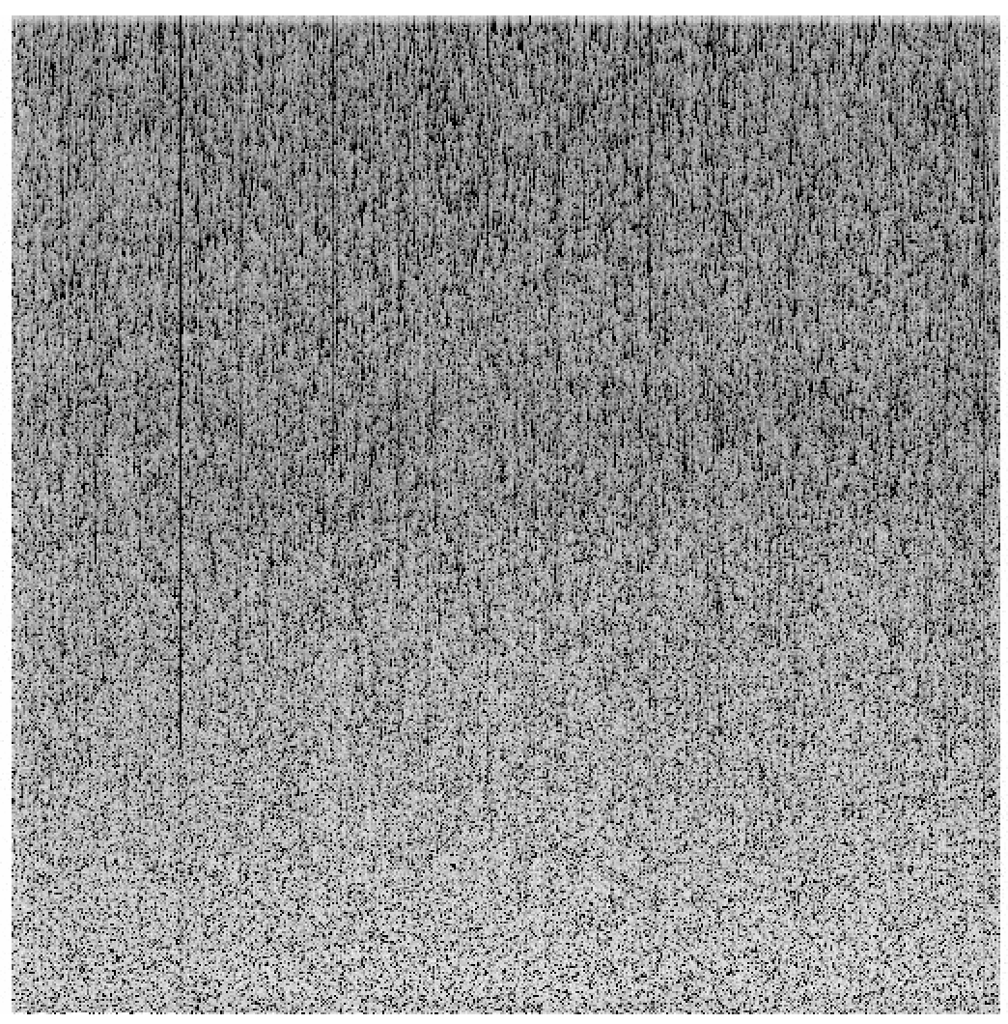

CURRENT
DEEP
DARKS
PARALLEL READOUT
ACS/WFC
WFC3/UVIS

Slide 6
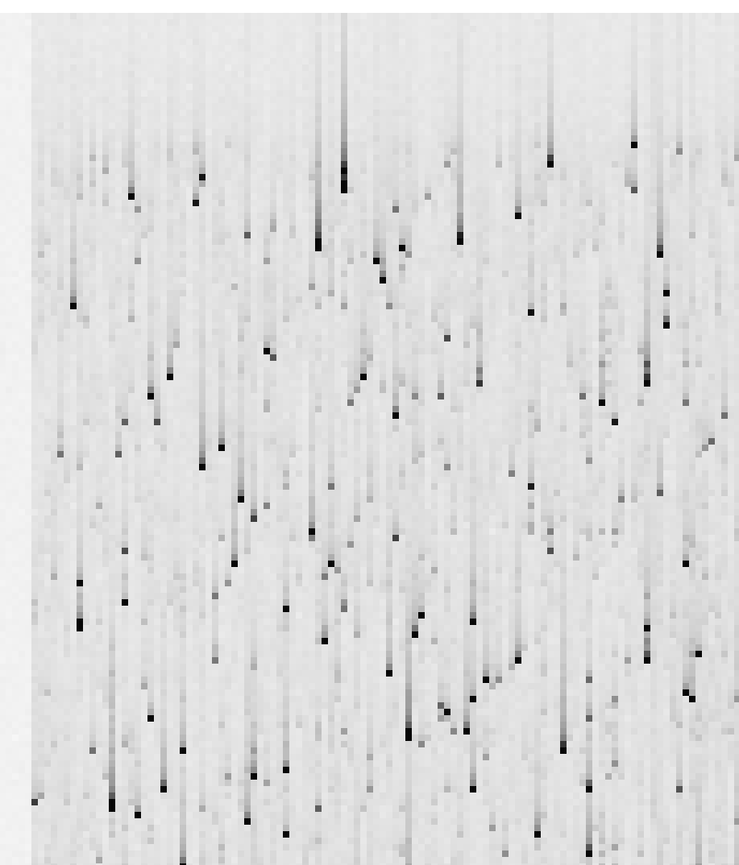
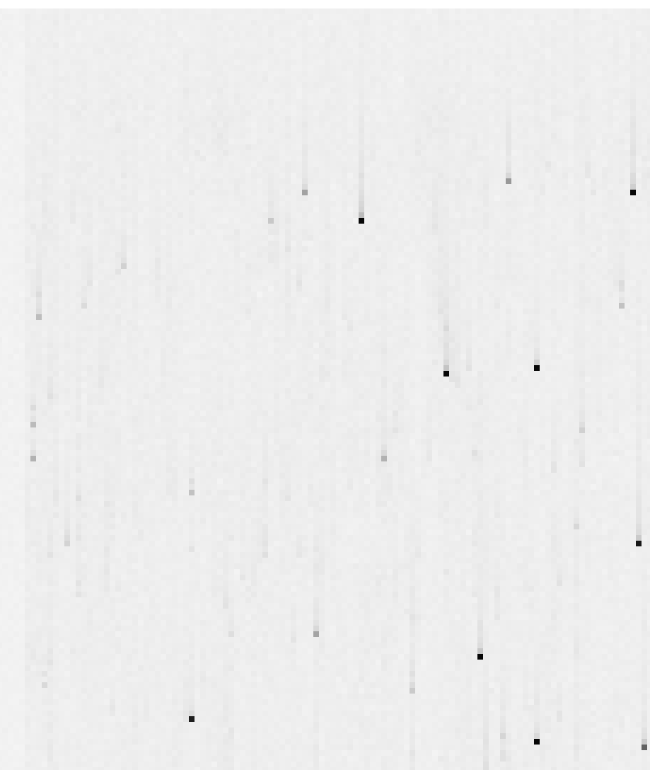
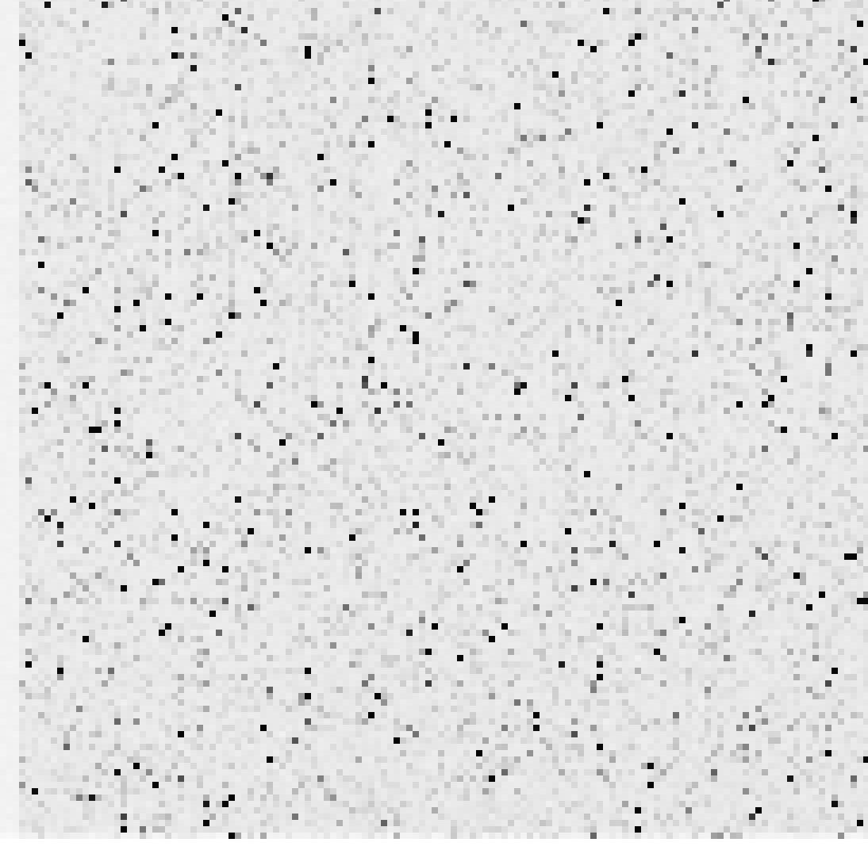

CURRENT
DEEP
DARKS
PARALLEL READOUT
ACS/WFC
WFC3/UVIS

Slide 7
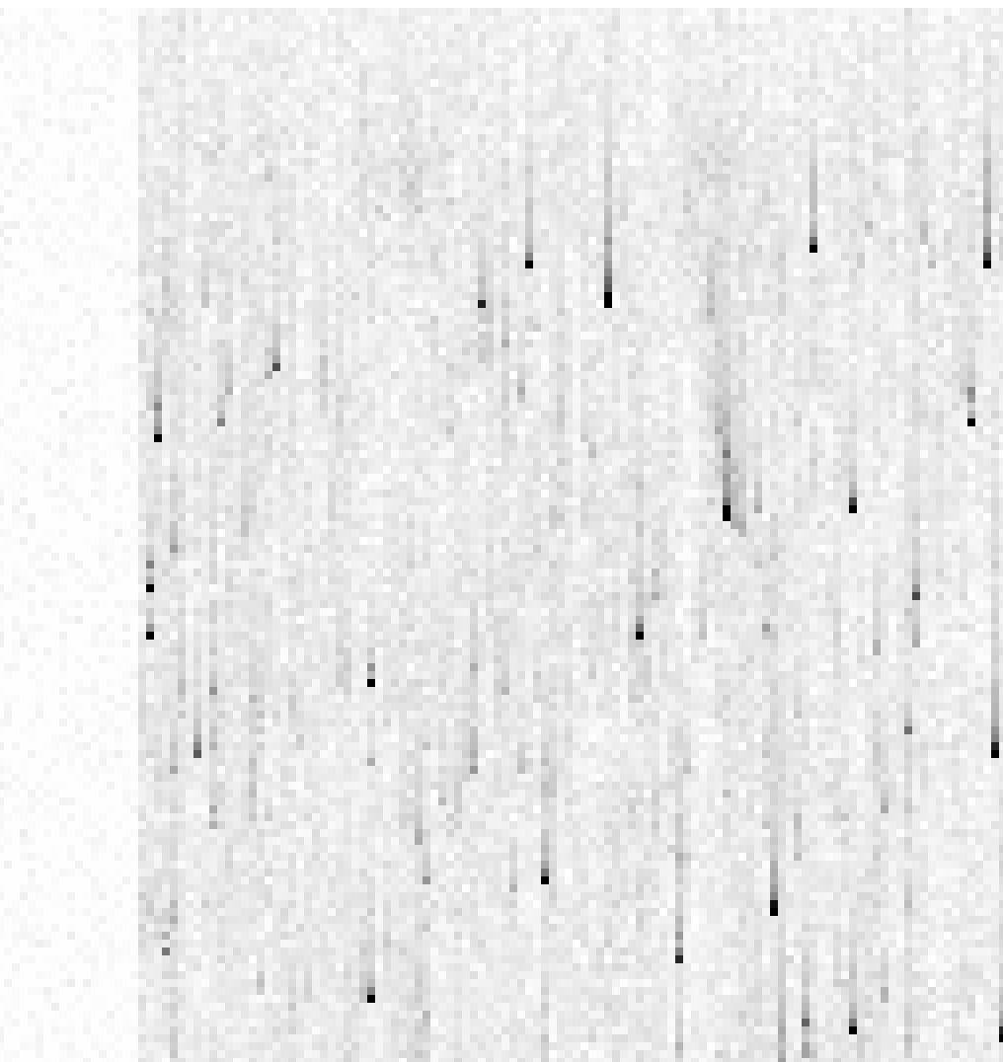
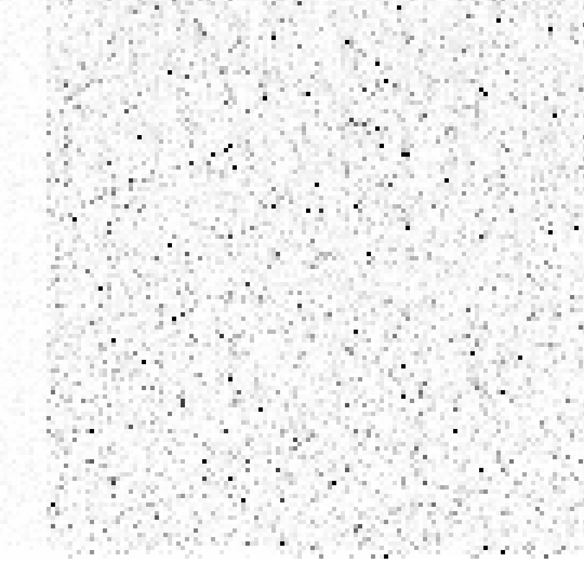
CURRENT
DEEP
DARKS
PARALLEL READOUT
ACS/WFC
WFC3/UVIS

Slide 8
Pixel-Based Models
Historical efforts
  WFPC2: Riess, Bristow, Alexov (2000-2003)
  Wisdom
    We can’t know where the traps are, use average/random dist
    Time-consuming computation:
      ACS: 8196 × 2048 × 1024 = 1.7 × 10¹⁰ calculations
      multiple traps
      Reconstruction is a deconvolution (iterative forward modeling)
More recently
  Massey et al (2010) modeled CTE in COSMOS field
    Traps with two exponentials (from lab)
    Specific field (50e⁻ background), random traps
  Success stimulated 2009 Anderson & Bedin ACS correction

Slide 9
My Pixel-Based Model
1) Parameterization
2) Algorithm
  Running model
  Read-noise mitigation
  Reconstruction
3) Pinning the parameters
  Long darks
  Clever use of Long+Short darks
  Trails
4) ACS/UVIS Comparison
5) Evaluating on-sky

Slide 10
1) Model Parameters
Trapping:
  Trap density: φ(q):
  number of traps between q and q+1
  Cumulative distribution:
  q(n): the n^{th} trap affects the q^{th} electron
Release profile:
  T(j) = % of trap released in j^{th} upstream pix
    Half released by j ~ 8
    Trails go out to j ~ 60
    T(j) can be a function of q: T(j;q)
20%
10%
7%

Slide 11
2) Algorithm
When it grabs an electron,
  fill trap, remove f electrons
With clocking, deposit f × T(Δj) in upstream pixels
  Keep track of how full the trap is at each shift
  After 60 shifts, trap empty again
  If you encounter upstream pixel with > 37, flush trap, then refill
Forward model
Deal with one trap at a time
  A “trap” affects one particular electron (i.e., the 37th)
PARALLEL READOUT

Slide 12
PARALLEL READOUT

Slide 13
PARALLEL READOUT

Slide 14
PARALLEL READOUT

Slide 15
PARALLEL READOUT

Slide 16
PARALLEL READOUT

Slide 17
PARALLEL READOUT

Slide 18
PARALLEL READOUT

Slide 19
PARALLEL READOUT

Slide 20
PARALLEL READOUT

Slide 21
PARALLEL READOUT

Slide 22
PARALLEL READOUT

Slide 23
NET CHANGE:
−
+
+
+
+
PARALLEL READOUT

Slide 24
ORIG:
PARALLEL READOUT

Slide 25
POST READOUT:
PARALLEL READOUT

Slide 26
Reality:
“SINK” PIXEL
PARALLEL READOUT

Slide 27
The model:
PARALLEL READOUT

Slide 28
NATURAL CTE MITIGATION
BY MODERATE BACKGROUND
The model:
PARALLEL READOUT

Slide 29
Traps grow in impact
linearly with distance
from the readout register
The model:
Fewer transfers to model
PARALLEL READOUT

Slide 30
My Pixel-Based Model
1) Parameterization
2) Algorithm
  Running model
  Reconstruction
  Read-noise mitigation
3) Pinning the parameters
  Long darks
  Clever use of Long+Short darks
  Trails
4) ACS/UVIS Comparison
5) Evaluating on-sky

Slide 31
Reconstruction
READOUT
?
?
?
?
?
?
?
ORIGINAL
REAL OBSERVATION

Slide 32
Reconstruction
READOUT
?
?
?
?
?
?
?
ORIGINAL
REAL OBSERVATION
ESTIMATE OF ORIGINAL

Slide 33
Reconstruction
READOUT
?
?
?
?
?
?
?
ORIGINAL
REAL OBSERVATION
ESTIMATE OF ORIGINAL

Slide 34
Reconstruction
READOUT
?
?
?
?
?
?
?
ORIGINAL
REAL OBSERVATION
READOUT
ESTIMATE OF ORIGINAL
ESTIMATE OF OBSERVATION

Slide 35
Reconstruction
READOUT
?
?
?
?
?
?
?
ORIGINAL
REAL OBSERVATION
EST-REAL
READOUT
ESTIMATE OF ORIGINAL
ESTIMATE OF OBSERVATION

Slide 36
Reconstruction
READOUT
?
?
?
?
?
?
?
ORIGINAL
REAL OBSERVATION
ADJUST
EST-REAL
EST-REAL
READOUT
ESTIMATE OF ORIGINAL
MODEL OF OBSERVATION

Slide 37
Reconstruction
READOUT
?
?
?
?
?
?
?
ORIGINAL
REAL OBSERVATION
EST-REAL
READOUT
ESTIMATE OF ORIGINAL

Slide 38
Reconstruction
READOUT
?
?
?
?
?
?
?
ORIGINAL
REAL OBSERVATION
EST-REAL
READOUT
ESTIMATE OF ORIGINAL
ESTIMATE OF OBSERVATION

Slide 39
Reconstruction
READOUT
?
?
?
?
?
?
?
ORIGINAL
REAL OBSERVATION
EST-REAL
READOUT
ESTIMATE OF ORIGINAL
MODEL OF OBSERVATION

Slide 40
Reconstruction
READOUT
?
?
?
?
?
?
?
ORIGINAL
REAL OBSERVATION
EST-REAL
EST-REAL
READOUT
ESTIMATE OF ORIGINAL
MODEL OF OBSERVATION

Slide 41
Reconstruction
READOUT
?
?
?
?
?
?
?
ORIGINAL
REAL OBSERVATION
ADJUST
EST-REAL
EST-REAL
ESTIMATE OF ORIGINAL
MODEL OF OBSERVATION

Slide 42
Reconstruction
READOUT
?
?
?
?
?
?
?
ORIGINAL
REAL OBSERVATION
EST-REAL
READOUT
ESTIMATE OF ORIGINAL
MODEL OF OBSERVATION

Slide 43
Reconstruction
READOUT
?
?
?
?
?
?
?
ORIGINAL
REAL OBSERVATION
USUALLY TAKES
~7 ITERATIONS
EST-REAL
READOUT
ESTIMATE OF ORIGINAL
MODEL OF OBSERVATION

Slide 44
My Pixel-Based Model
1) Parameterization
2) Algorithm
  Running model
  Reconstruction
  Read-noise mitigation
3) Pinning the parameters
  Long darks
  Clever use of Long+Short darks
  Trails
4) ACS/UVIS Comparison
5) Evaluating on-sky

Slide 45
Readnoise Mitigation
Reconstruction formally a deconvolution
  Readnoise added after CTE blurring
  RN did not participate in the shuffle
    WFC3/UVIS ~3.00 e⁻
    ACS/WFC ~4.25 e⁻
  Artificial amplification of noise
How to prevent this?
  Operate on RN-free image
Conservative reconstruction
  Find smoothest possible image consistent with being
  R(i,j) = S(i,j) + N(i,j)
  N consistent with being pure readnoise
  Associate as much pix-to-pix variation as possible to N
    Σ N(i,j)² ~ RN²
    Σ_{3x3} N(i,j)² ~ 9 RN²

Slide 46
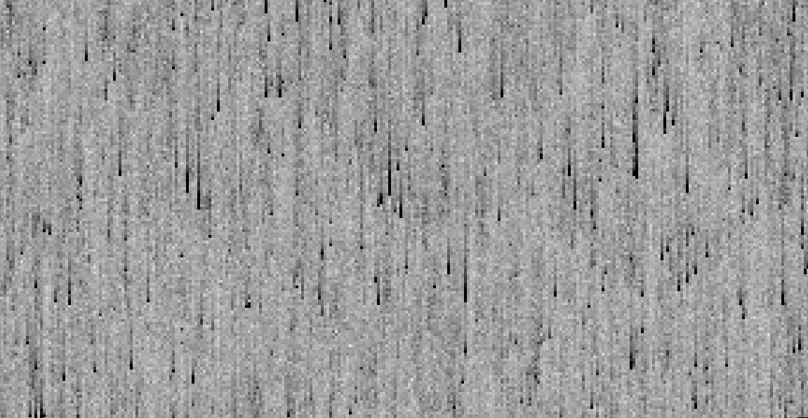
RAW Dark

Slide 47

Pure Noise

Slide 48
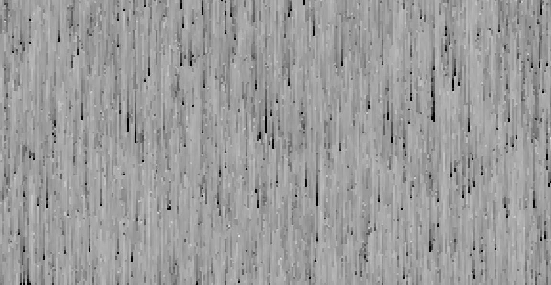
Smooth

Slide 49
RAW Dark

Slide 50
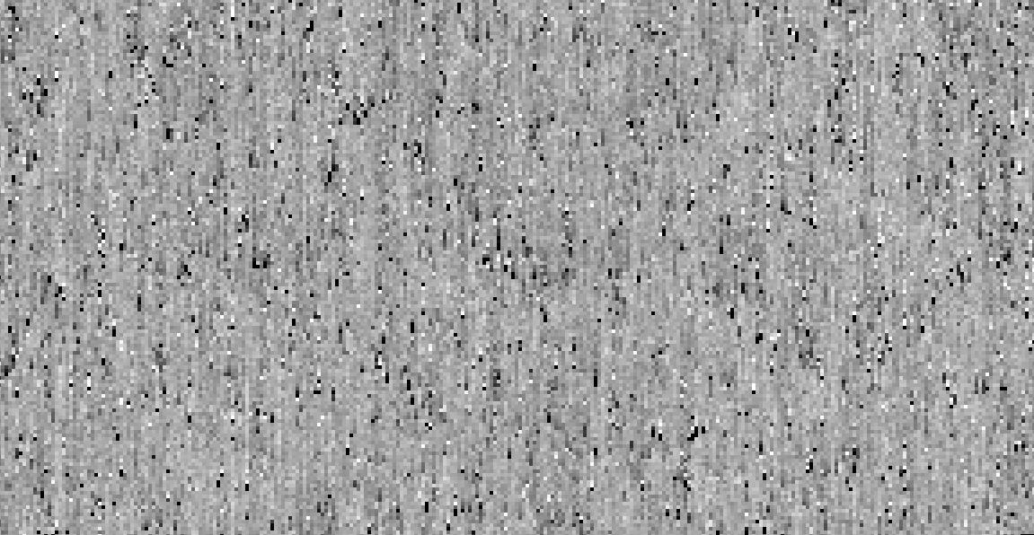
Corrected Dark

Slide 51
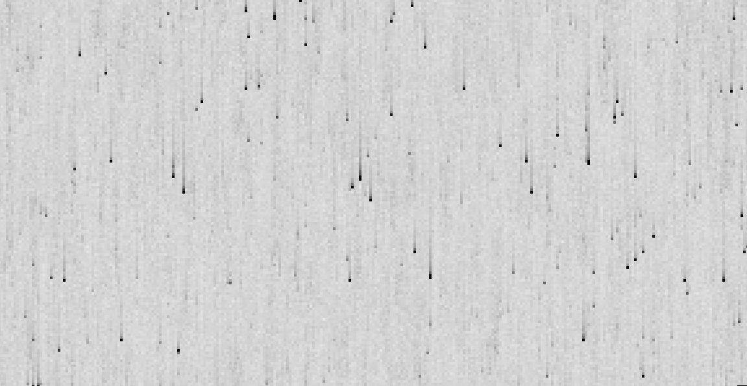
RAW Dark

Slide 52

Corrected Dark

Slide 53
My Pixel-Based Model
1) Parameterization
2) Algorithm
  Running model
  Reconstruction
  Read-noise mitigation
3) Pinning the parameters
  Long darks (bright end)
  Clever use of Long+Short darks
  Trails
4) ACS/UVIS Comparison
5) Evaluating on-sky

Slide 54
Pinning Down the Model
READ OFF
CTE LOSSES
Two functions to solve for:
q(n) and T(j)
Easier to solve for with WPs in the darks:
CLOSE TO PARALLEL READOUT
FAR FROM PARALLEL READOUT

Slide 55
Pinning Down the Model
READ OFF
CTE LOSSES
Two functions to solve for:
q(n) and T(j)
Easier to solve for with WPs in the darks:
CLOSE TO PARALLEL READOUT
FAR FROM PARALLEL READOUT

Slide 56
Pinning Down the Model
Two functions to solve for:
q(n) and T(Δj)
Easier to solve for with WPs
in the darks:
READ OFF
APPARENT
CTE LOSSES
n
n^{th} trap affects
q electrons
q(n)
T(Δj)
CLOSE TO PARALLEL READOUT
FAR FROM PARALLEL READOUT

Slide 57
Pinning Down the Model
Two functions to solve for:
q(n) and T(Δj)
Easier to solve for with WPs
in the darks:
READ OFF
APPARENT
CTE LOSSES
n
n^{th} trap affects
q electrons
CHALLENGES
q(n)
T(Δj)
CLOSE TO PARALLEL READOUT
FAR FROM PARALLEL READOUT

Slide 58
Pinning Down the Model
#1: FAINT TRAIL
?
Two functions to solve for:
q(n) and T(Δj)
Easier to solve for with WPs
in the darks:
READ OFF
APPARENT
CTE LOSSES
n
n^{th} trap affects
q electrons
CHALLENGES
q(n)
T(Δj)
CLOSE TO PARALLEL READOUT
FAR FROM PARALLEL READOUT

Slide 59
Pinning Down the Model
#1: FAINT TRAIL
?
Two functions to solve for:
q(n) and T(Δj)
Easier to solve for with WPs
in the darks:
READ OFF
APPARENT
CTE LOSSES
n
n^{th} trap affects
q electrons
CHALLENGES
#2: BACKGROUND
q(n+n_{B})
q(n)
T(Δj)
CLOSE TO PARALLEL READOUT
FAR FROM PARALLEL READOUT

Slide 60
Pinning Down the Model
#1: FAINT TRAIL
?
Two functions to solve for:
q(n) and T(Δj)
Easier to solve for with WPs
in the darks:
READ OFF
APPARENT
CTE LOSSES
n
n^{th} trap affects
q electrons
CHALLENGES
#2: BACKGROUND
q(n+n_{B})
q(n)
#3: FAINT WPs
where n ~ q(n)
T(Δj)
CLOSE TO PARALLEL READOUT
FAR FROM PARALLEL READOUT

Slide 61
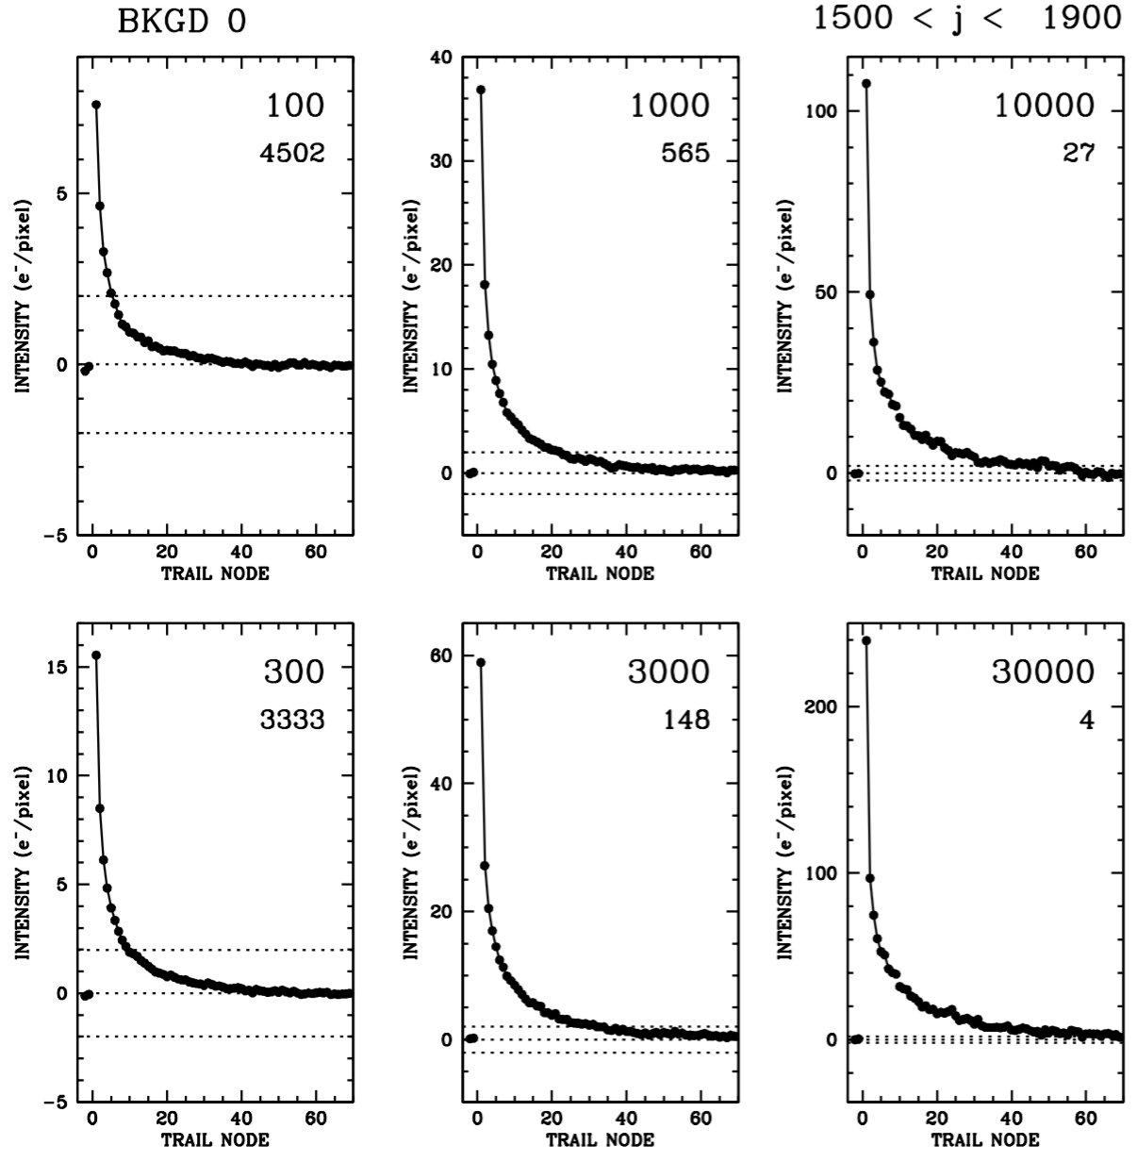
Pinning the model
1) Long Darks

Slide 62
Pinning the model
1) Long Darks
area ~35
area ~190
area ~550
AREA ➔ q(n)
q( 35) = 100
q( 75) = 300
q( 190) = 1,000
q( 300) = 3,000
q( 550) = 10,000
q(1100) = 30,000
area ~75
area ~300
area ~1100
PROFILE➔ T(j)
t( 1) = 0.250
t( 2) = 0.100
t( 3) = 0.073
t(10) = 0.020
t(50) = 0.002

Slide 63
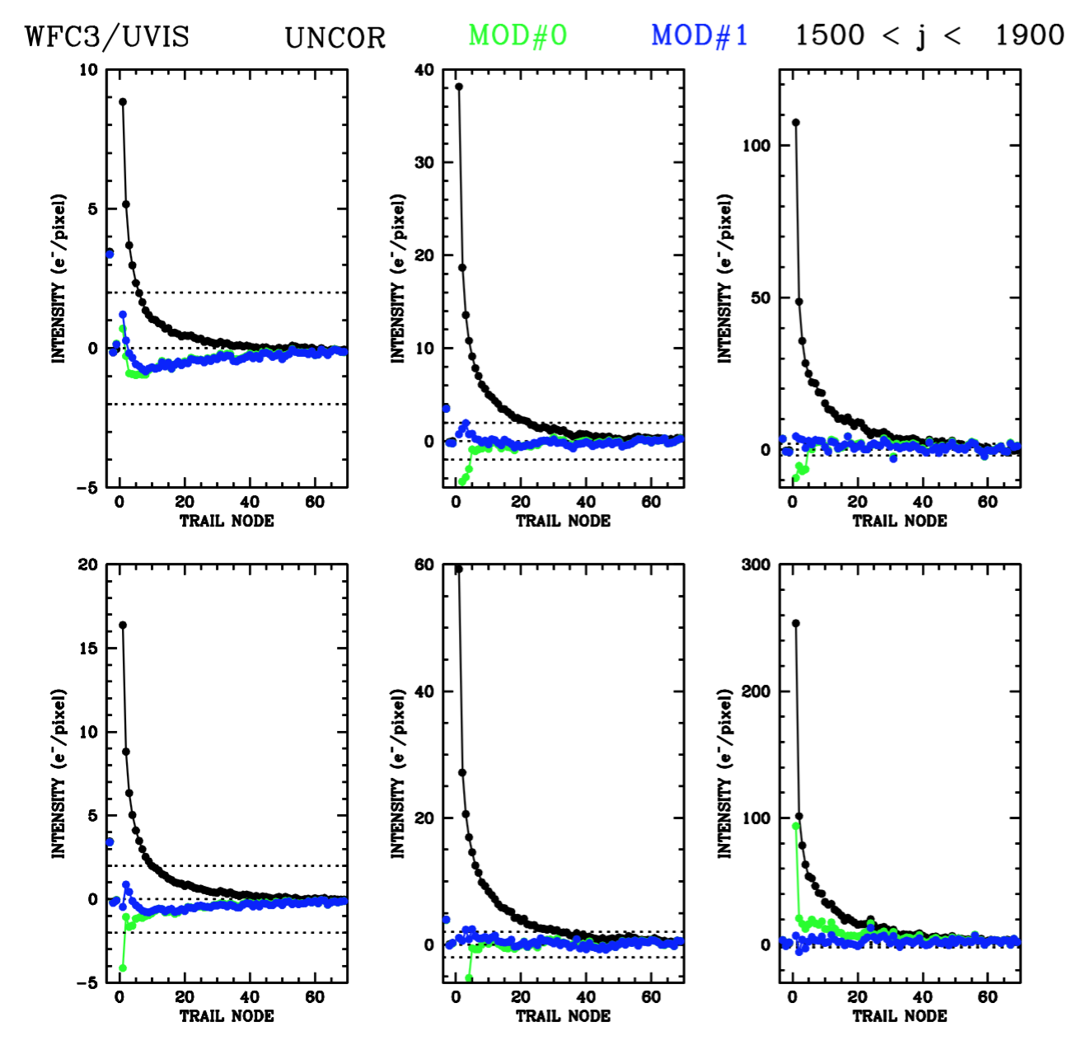
Iterate to turn WPs into delta functions

Slide 64
My Pixel-Based Model
1) Parameterization
2) Algorithm
  Running model
  Reconstruction
  Read-noise mitigation
3) Pinning the parameters
  Long darks (bright end)
  Clever use of Long+Short darks
  Trails
4) ACS/UVIS Comparison
5) Evaluating on-sky

Slide 65
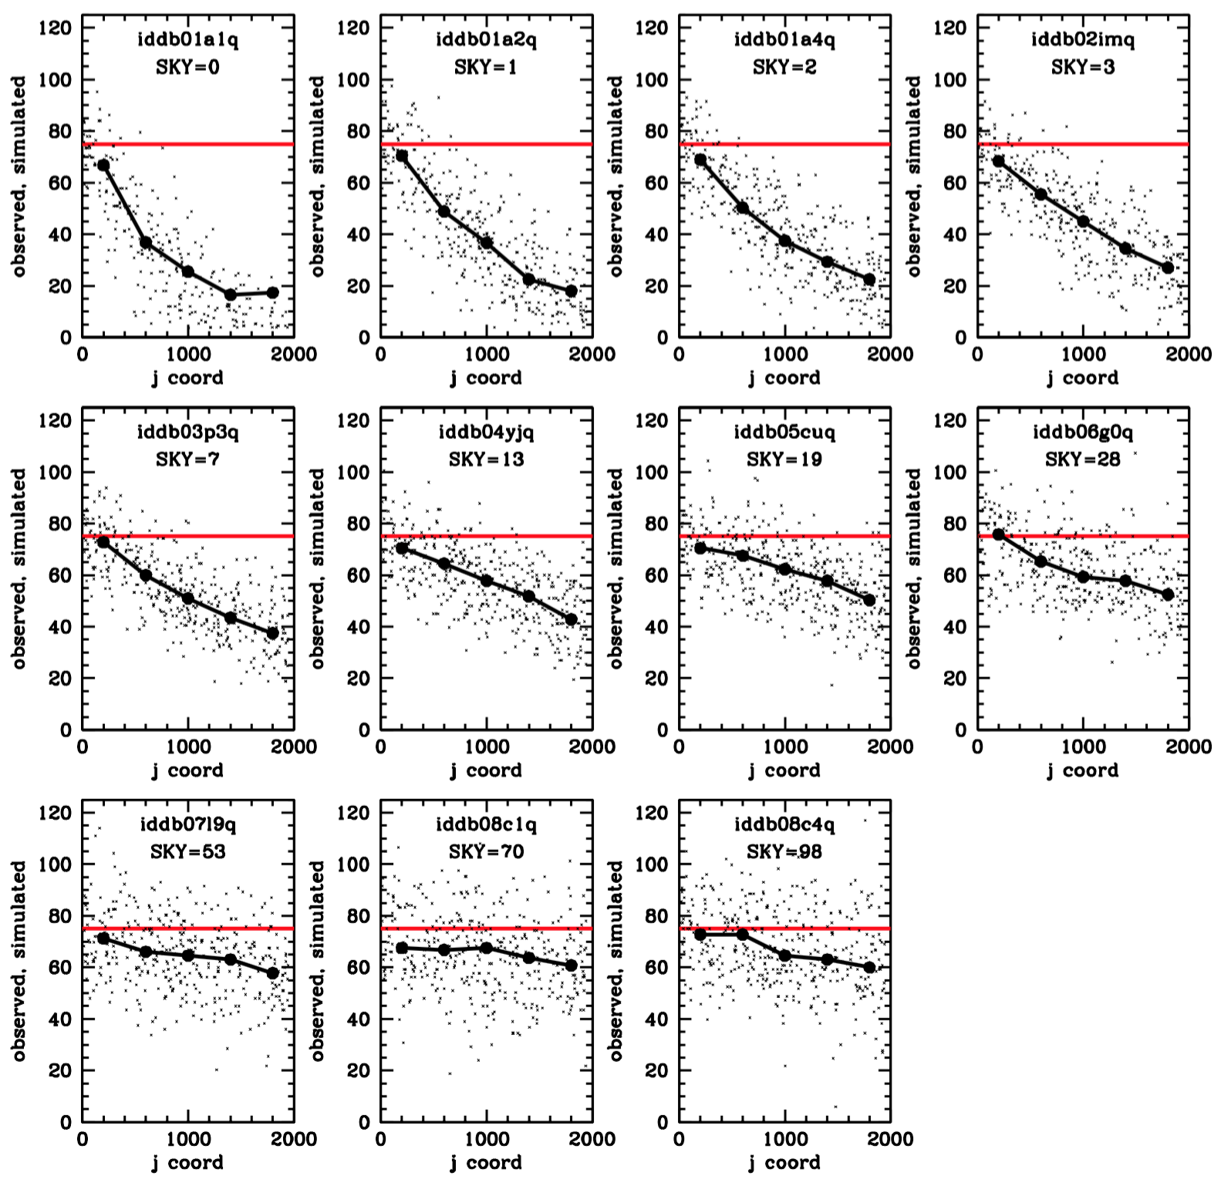
Pinning down the low end…
Take:
  1) 800s long darks
  2) 40s short darks
  w/postflash
Scale down long darks
  Know truth in shorts
  Start with 75 e⁻
  See what survives
FIXED SIGNAL-vs-SKY

Slide 66
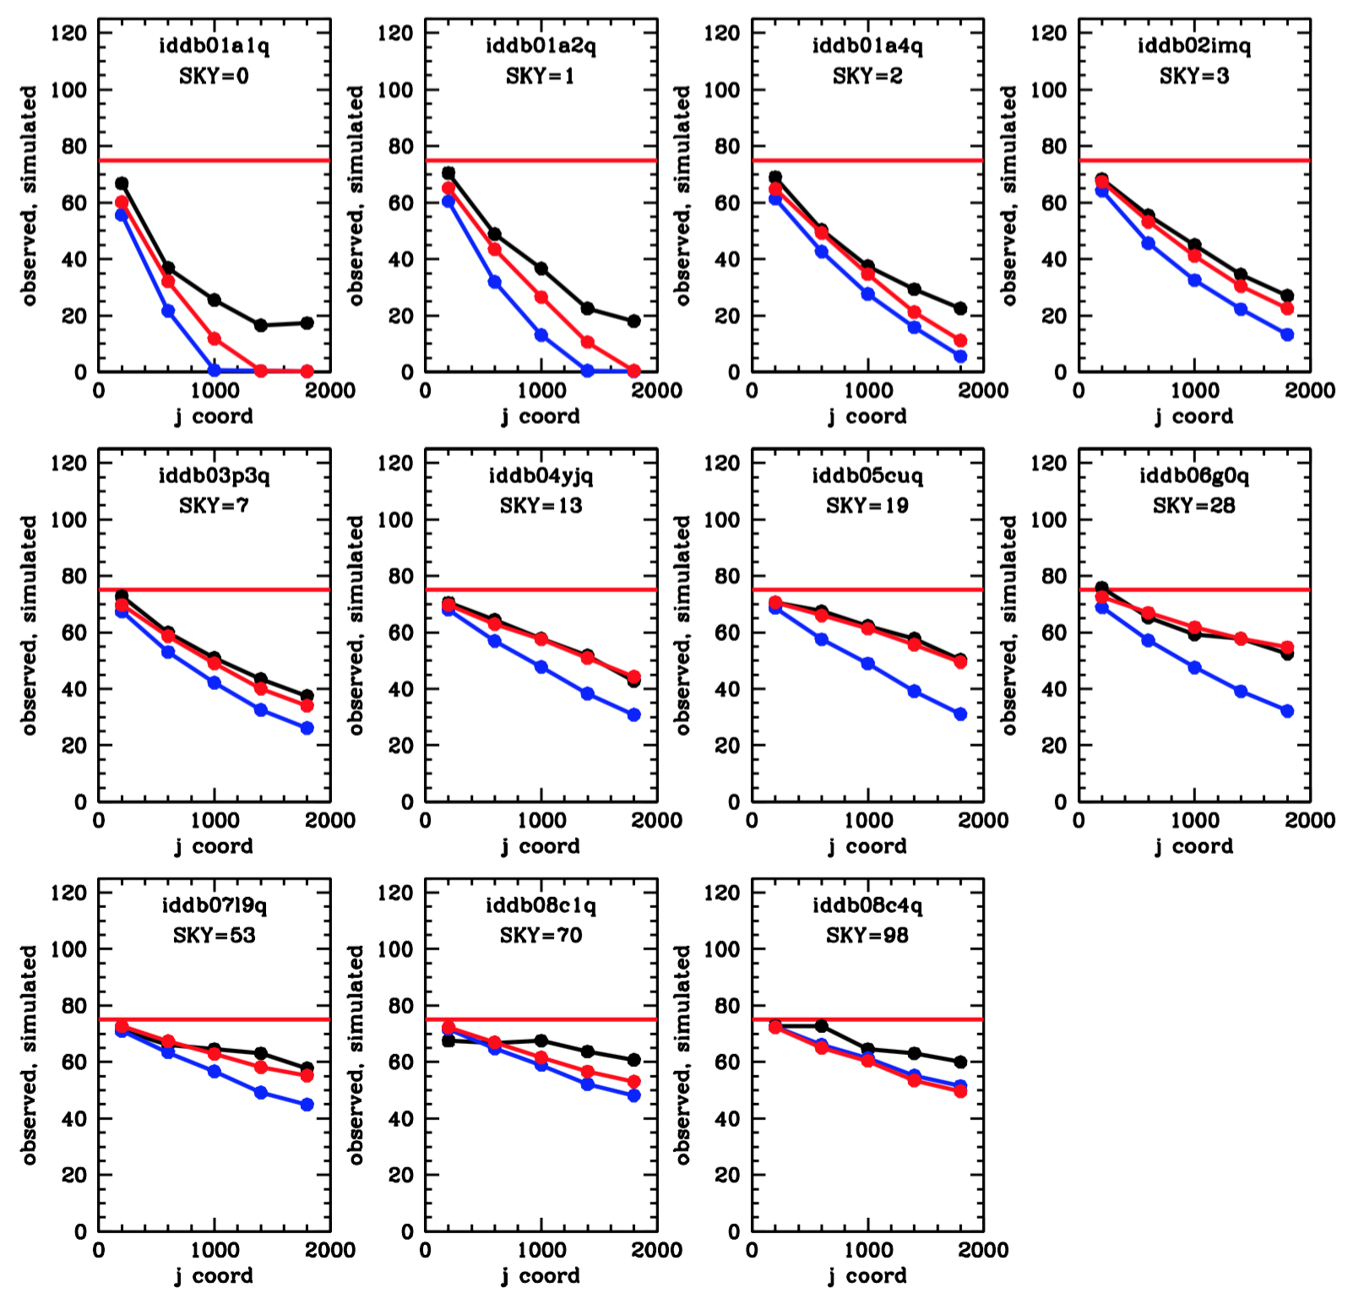
Pinning down the low end…
Take 800s long darks and 40s short darks
Scale down long darks
Know truth in shorts
  Start with 75 e⁻
  See what survives
FIXED SIGNAL-vs-SKY

Slide 67
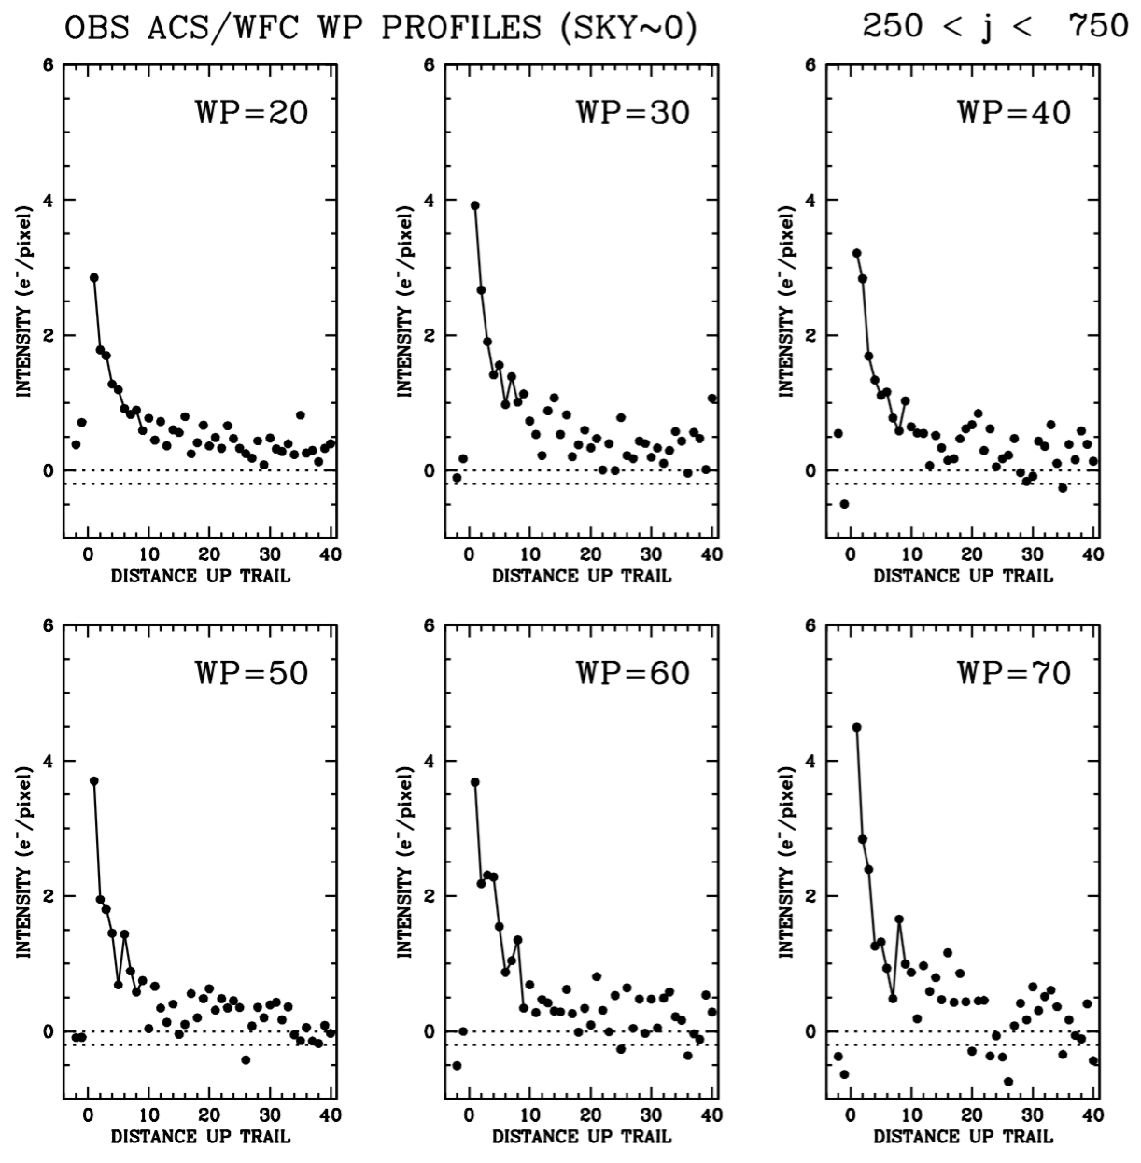
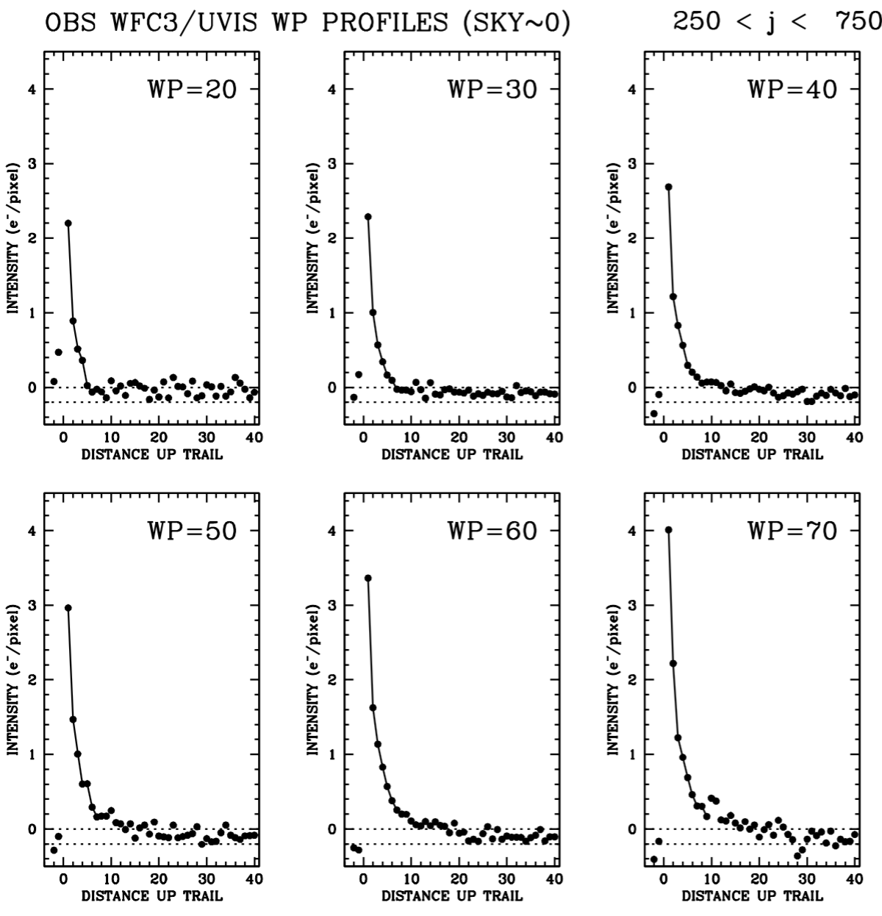
Is the trail profile constant?
ACS/WFC
WFC3/UVIS
SAME PROFILE
PROFILE BROADENS

Slide 68
My Pixel-Based Model
1) Parameterization
2) Algorithm
  Running model
  Reconstruction
  Read-noise mitigation
3) Pinning the parameters
  Long darks
  Clever use of Long+Short darks
  Trails
4) ACS/UVIS Comparison
5) Evaluating on-sky

Slide 69
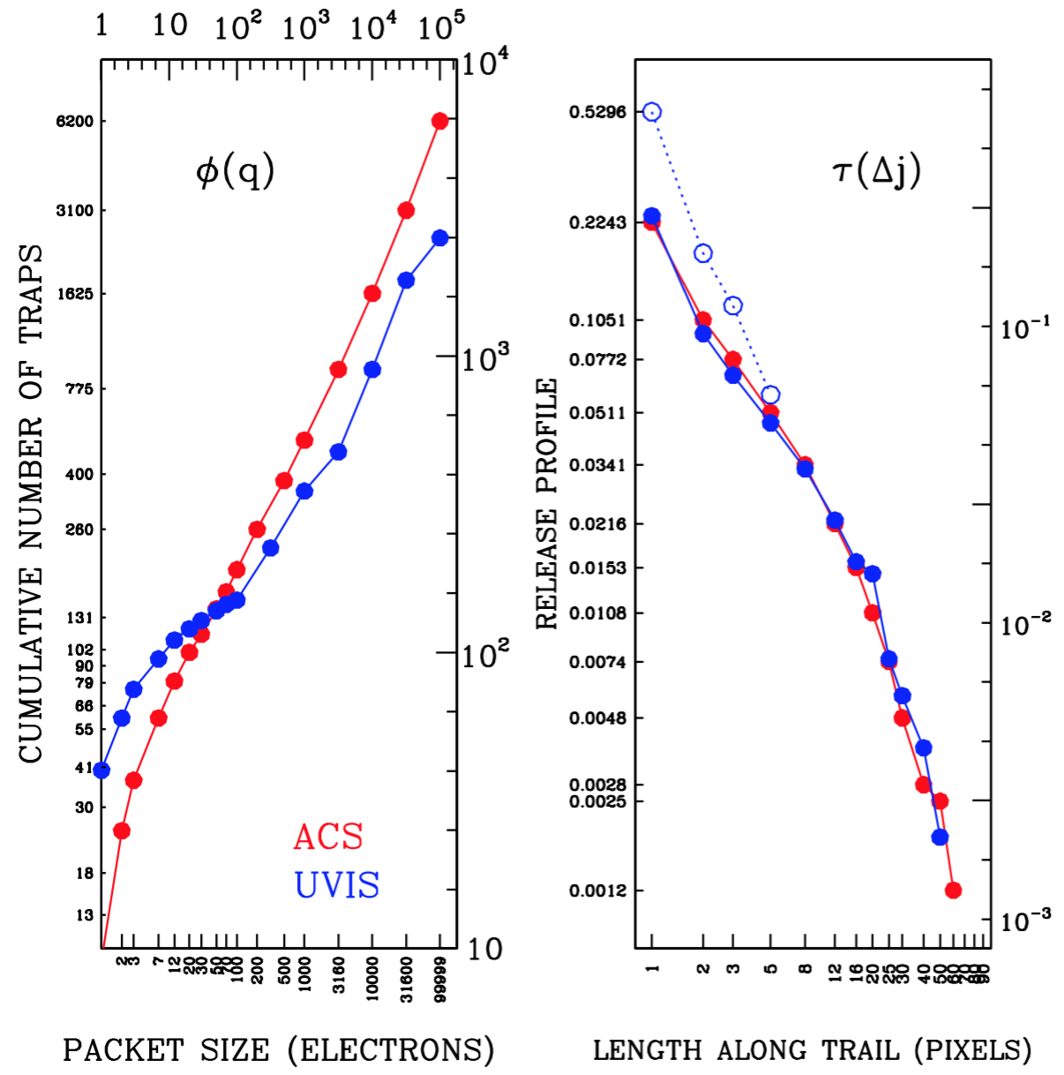
Current
Models
ACS-vs-UVIS
N(q)
N(q)
Similar high-end slopes
Different low-end behavior
Trails similar

Slide 70
My Pixel-Based Model
1) Parameterization
2) Algorithm
  Running model
  Reconstruction
  Read-noise mitigation
3) Pinning the parameters
  Long darks
  Clever use of Long+Short darks
  Trails
4) ACS/UVIS Comparison
5) Evaluating on-sky

Slide 71
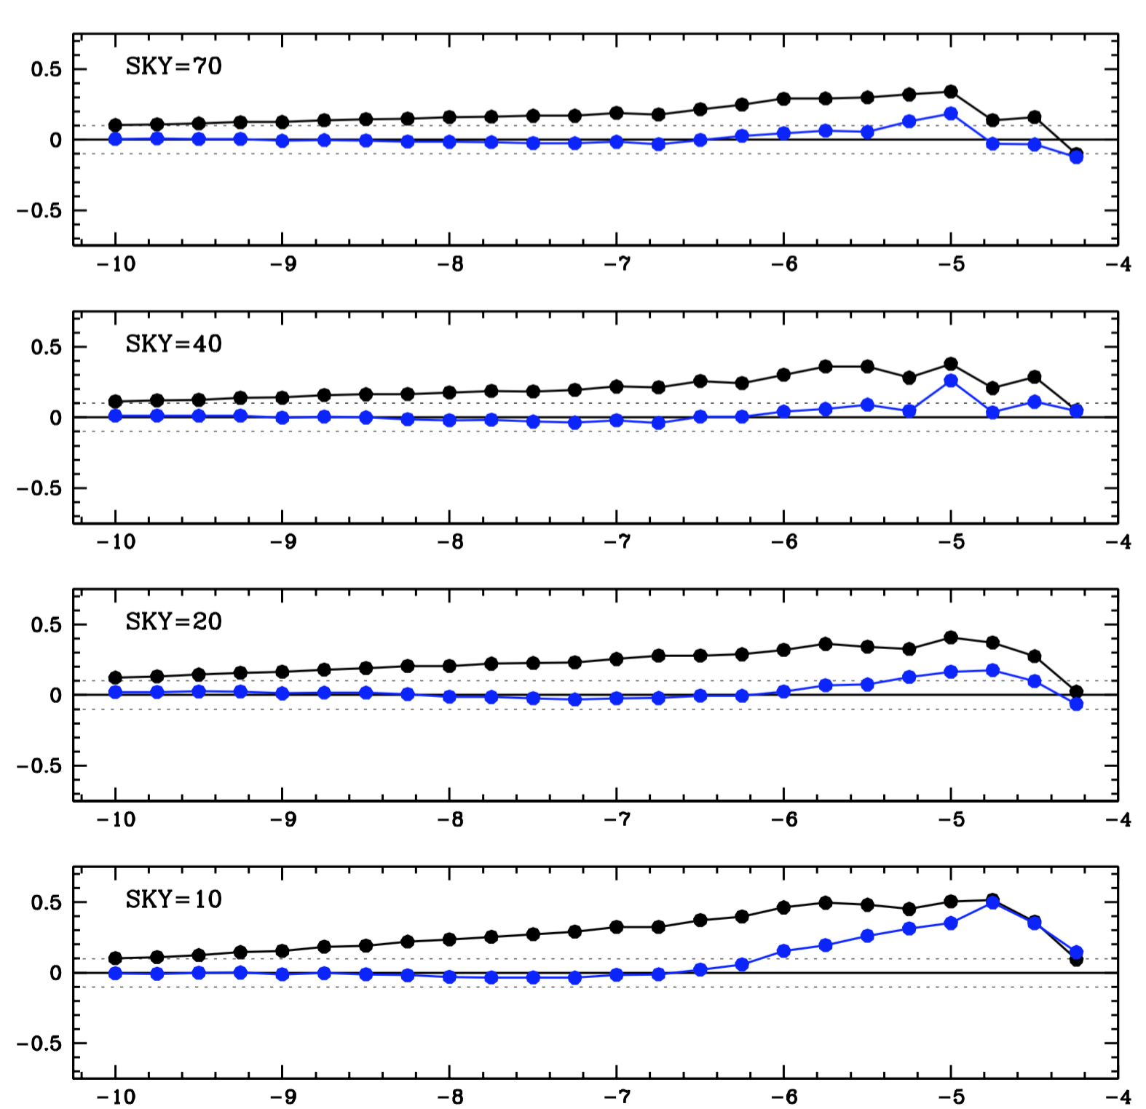
Magnitude residuals
(farthest 25%)
(ACS)
S/N ~ 100
S/N ~ 30
S/N ~ 10

Slide 72
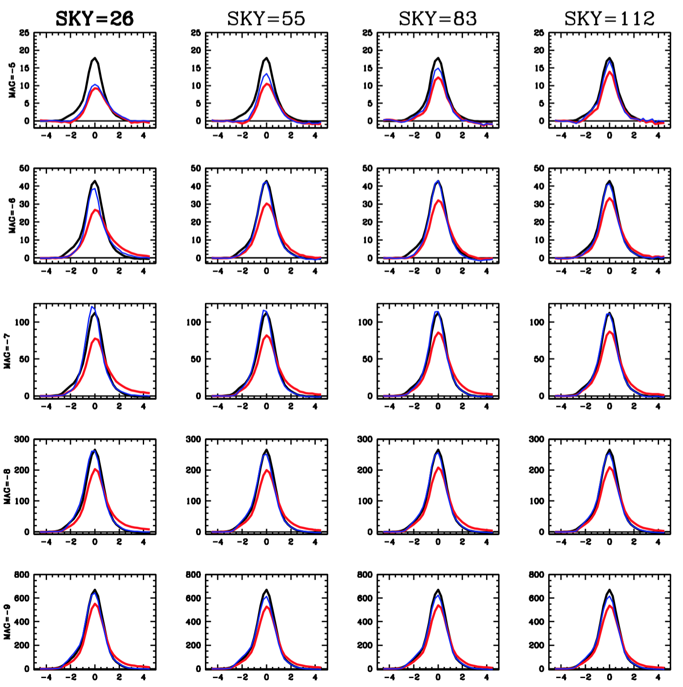
Star Profiles
(farthest third)
(ACS)

Slide 73
Summary
Model
  Trap and release
  Pinning to long/short/flashed darks
Pixel-based reconstruction effective if CTE losses are not too severe

