Slide 2

a SDW2017 production
supported by:
BMBF grant 03Z22AN11
and

Slide 3

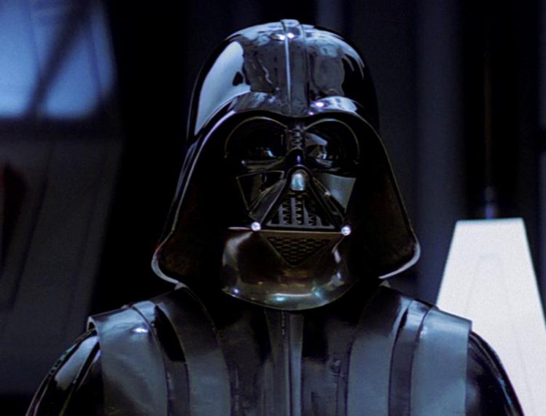
Into the darkness…
with:
F. Pedichini
G. Li Causi
M. Stangalini
S. Antoniucci
M. Mattioli
V. Testa
how to exploit the dark side of photons by taming sCMOS imagers

Slide 4
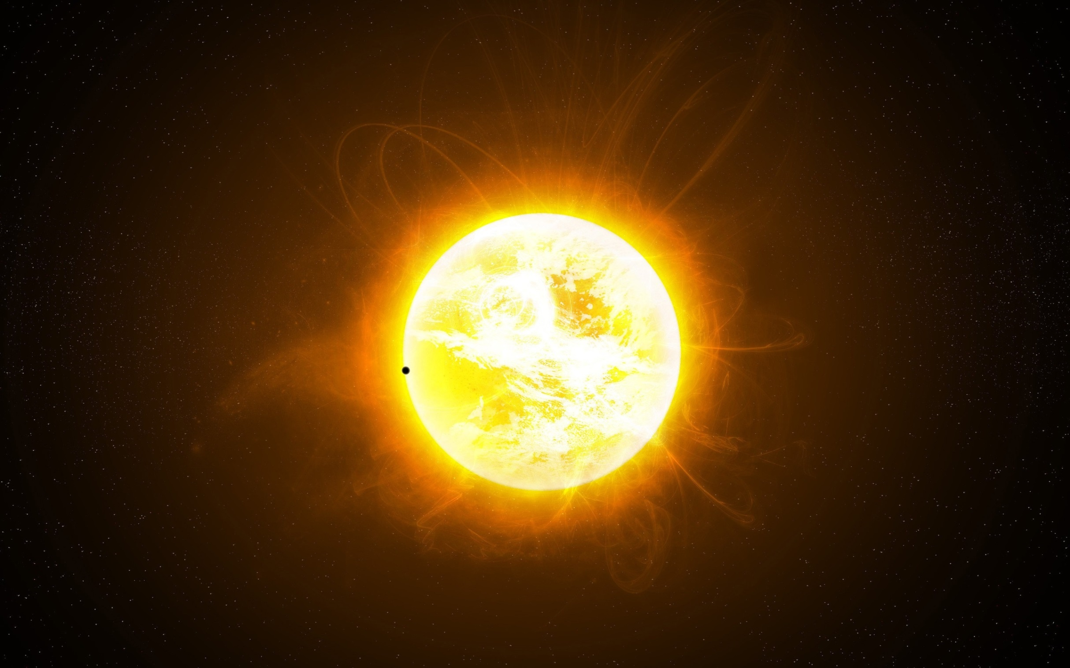
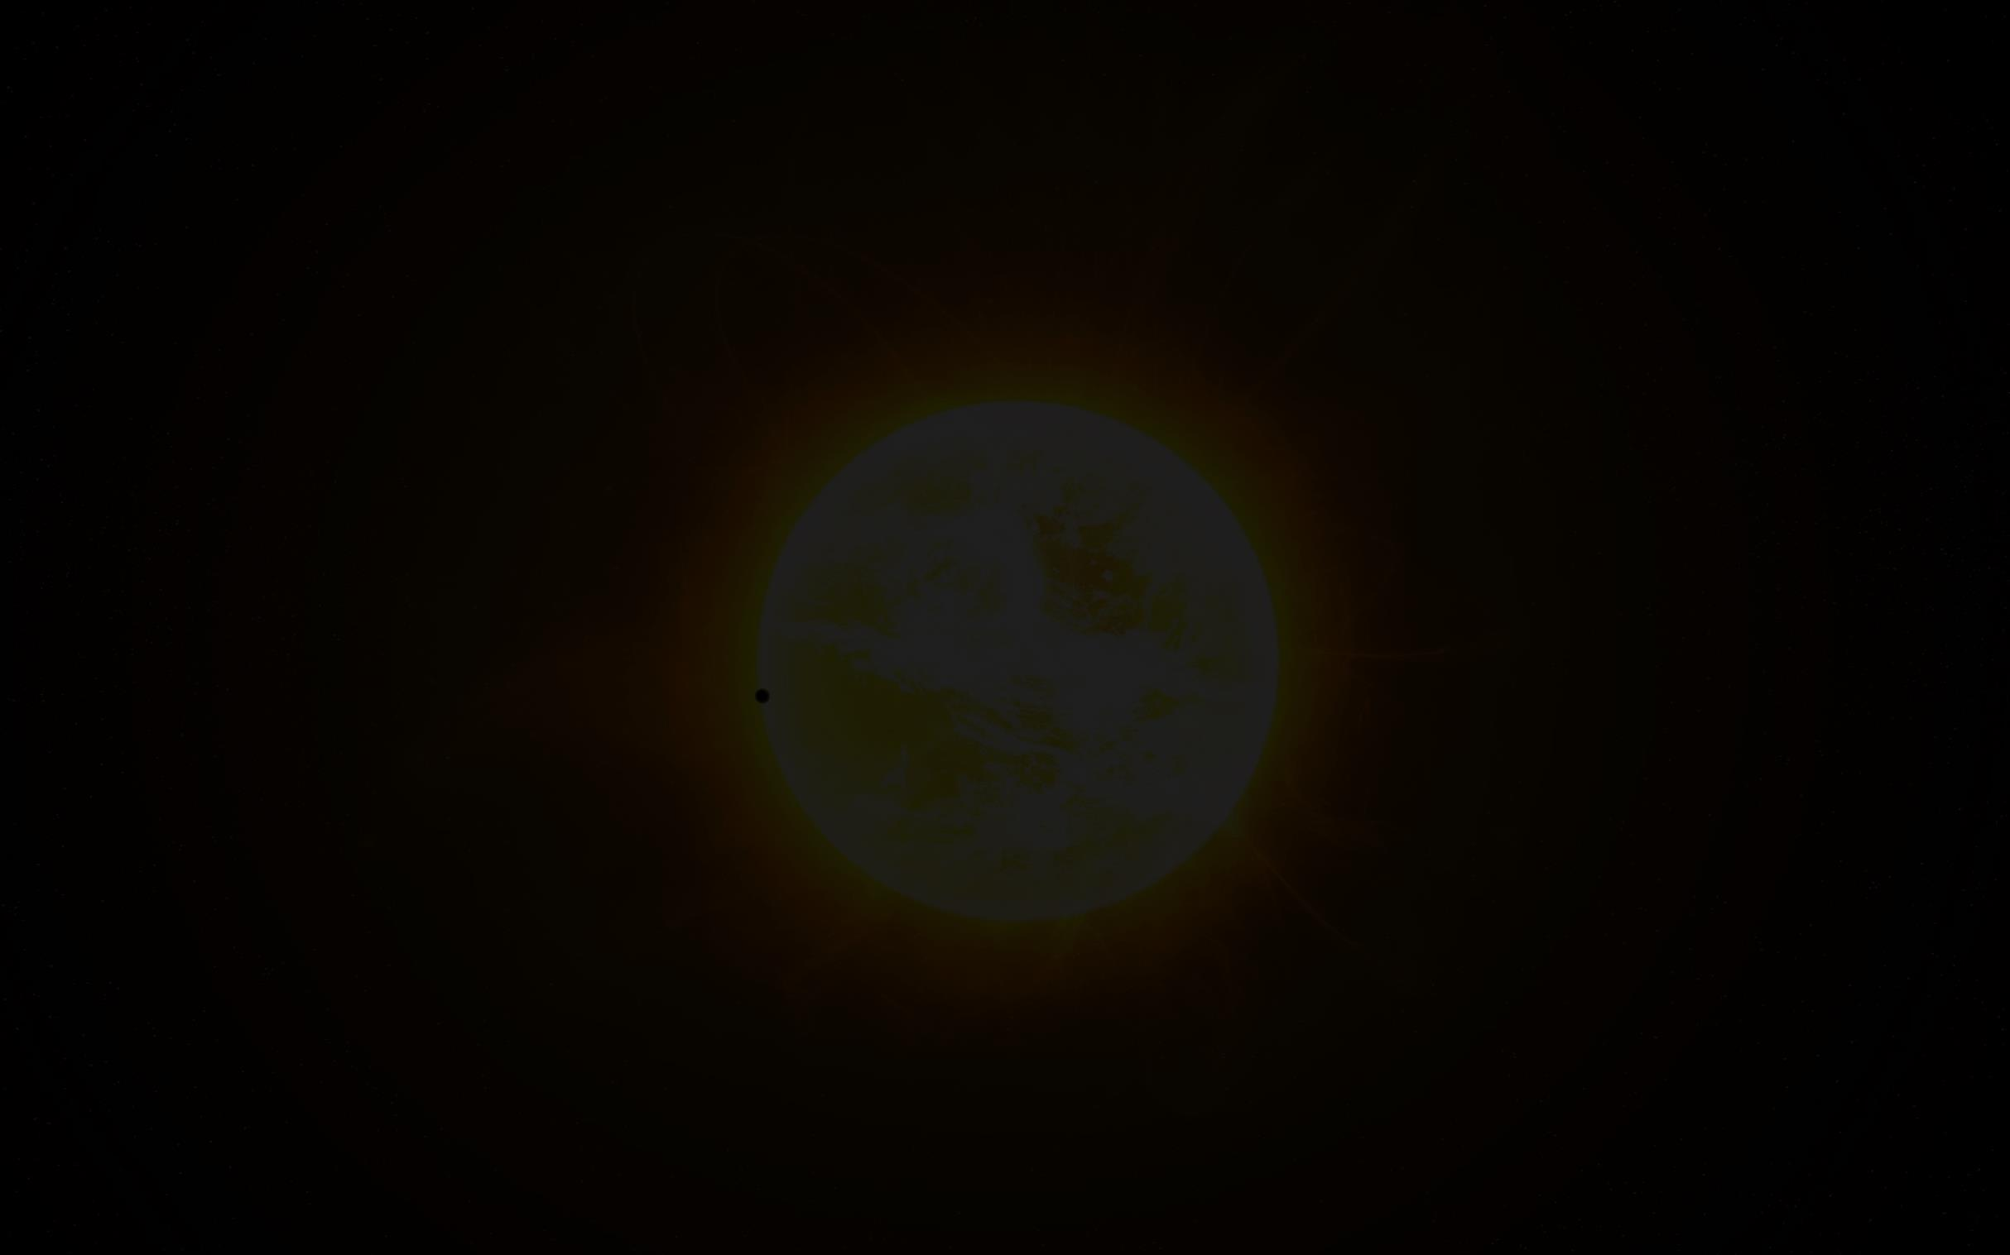
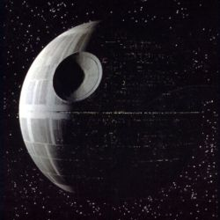
at present time
in a cluttered laboratory
will our heroes, blinded by a bright sun,
reveal the menace of the next DEATH STAR..?

Slide 5
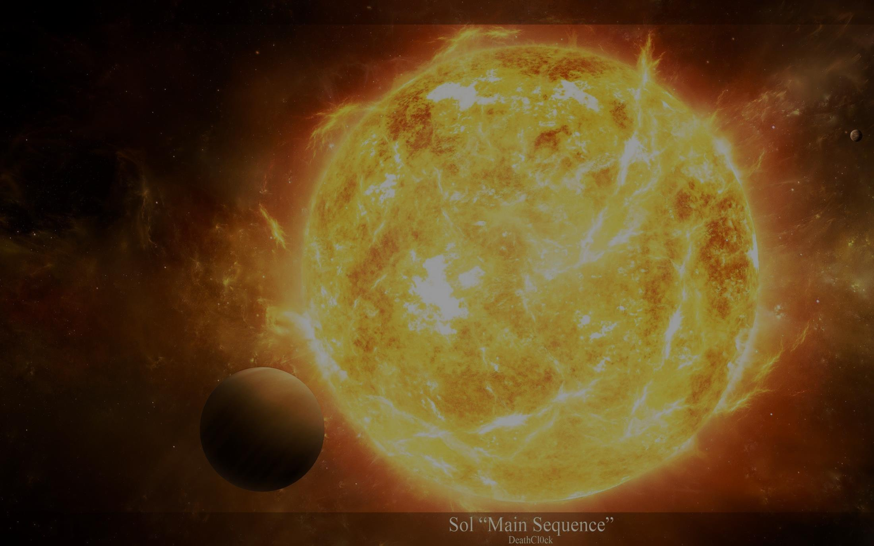
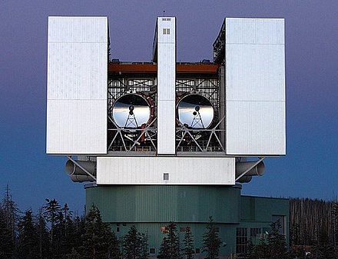
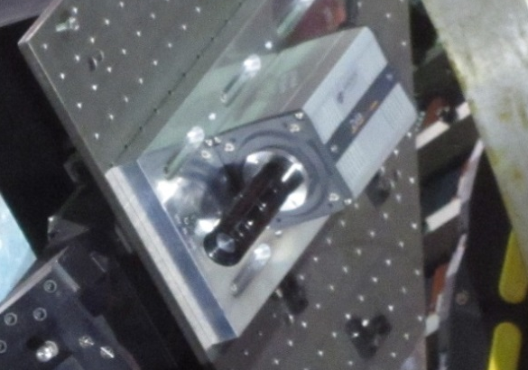
also starring:
XAO at LargeBinocularTelescope
S. Esposito et al SPIE 2012
Zyla sCMOS and
Forerunner experiment
F. Pedichini+ AJ 2016- M. Stangalini+ JATIS 2017

Slide 6
guest star:
S.F.A.D.I.
G. Licausi+ ApJ 2017 in press

Slide 7
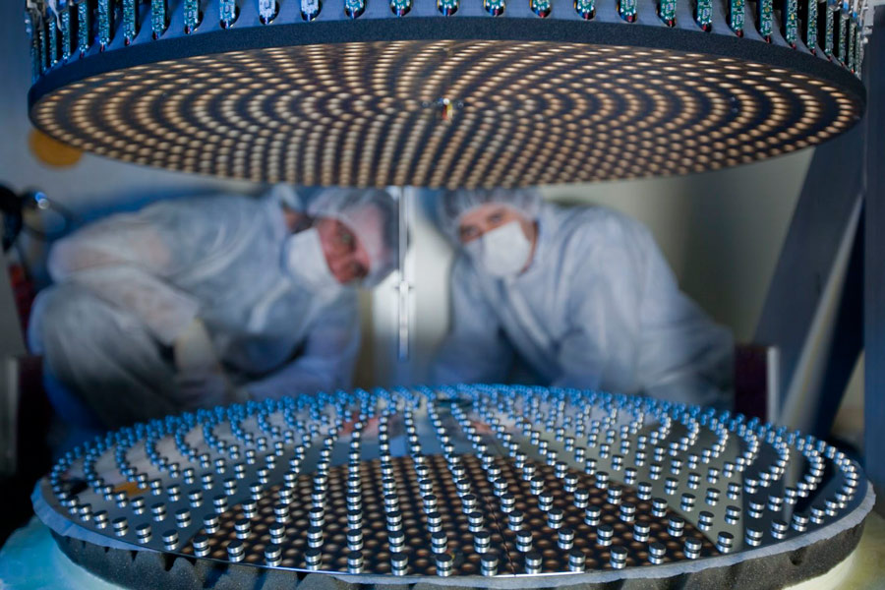
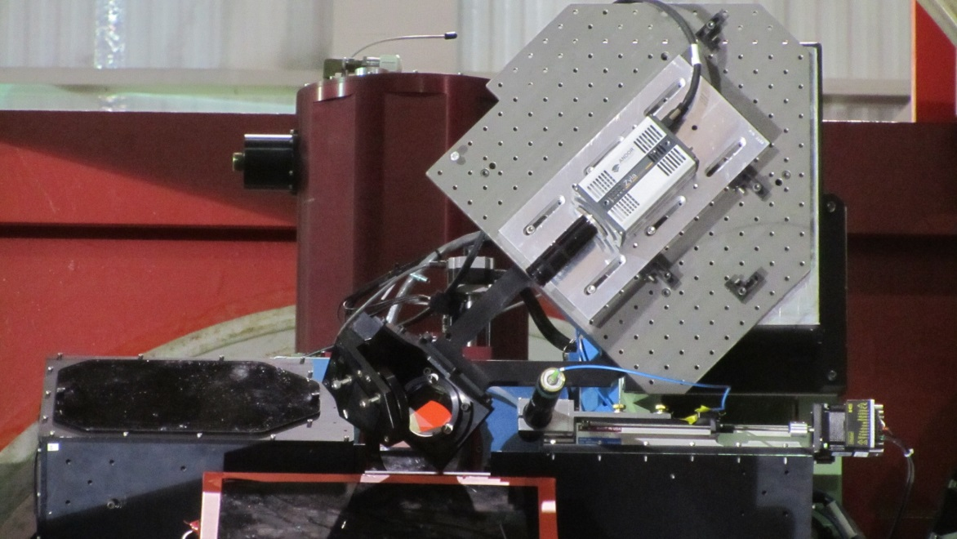
episode 1:
the Forerunner experiment

Slide 8
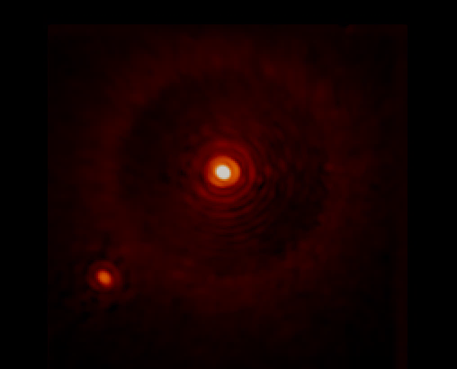
a few minutes of observation on bright stars to asses the XAO performances at 630nm when the seeing FWHM was
0.8 – 1.5 arcsec
pixel scale 3.73 mas
300mas
Diffractive core
β - Cygni (Albireo) R 2.5
and its companion R 6.0
FWHM 17mas
peak 35000 adu/ms, faint features 2-3 adu/ms
Control radius halo

Slide 9
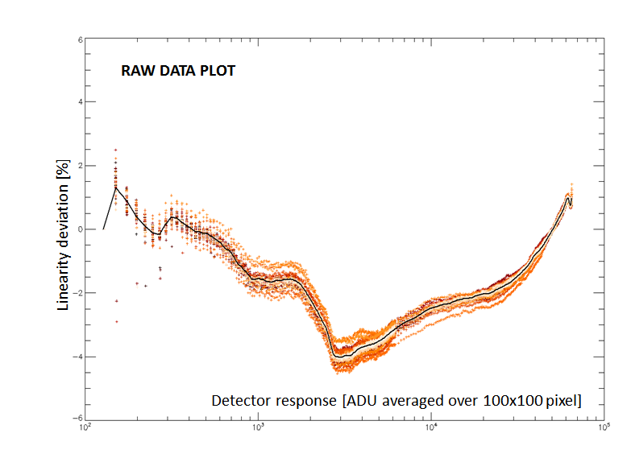
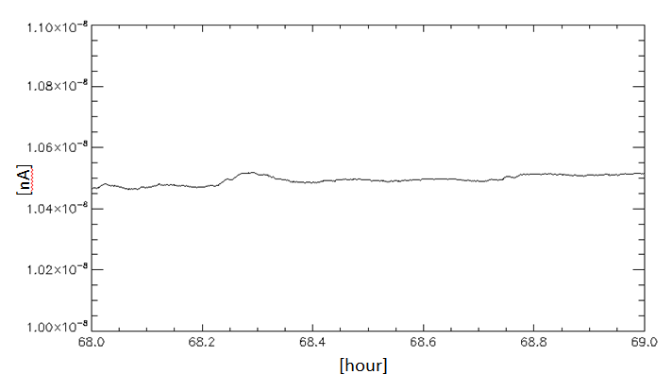
half dynamic point
average
Source stability in 1 hour
RON ≈ 1.2 e- (2γ)
episode 2:
calibrating the sCMOS

Slide 10
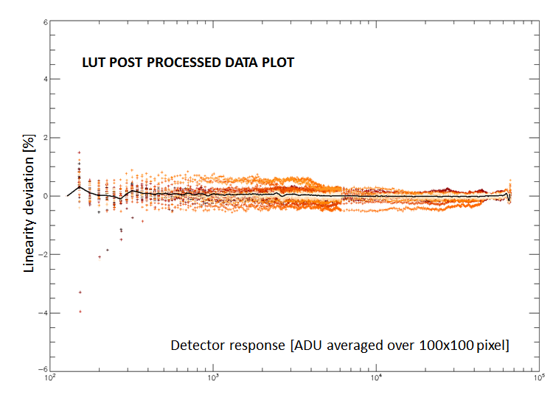
cal_{i} = adu_{i} + LUT(adu_{i}) * (adu_{i}-bias)

Slide 11
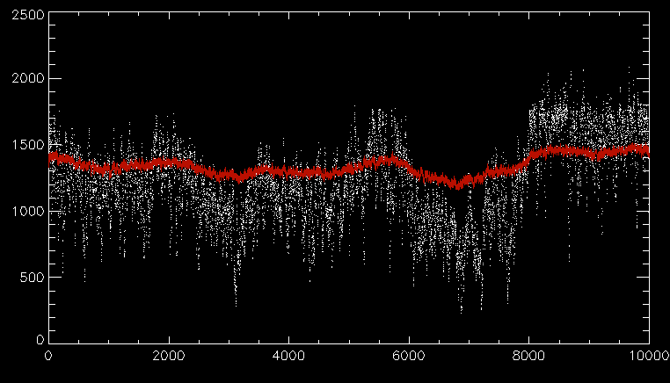
Stangalini + JATIS 2017
---- PSF peak
---- PSF flux-1e6
episode 3:
GLIESE 777 PSF at milliseconds

Slide 12
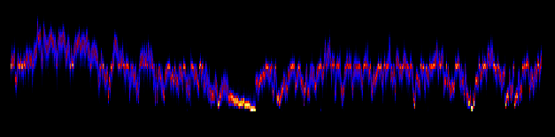
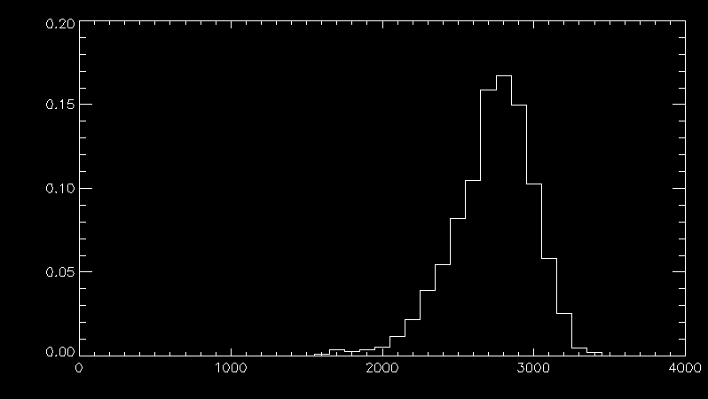
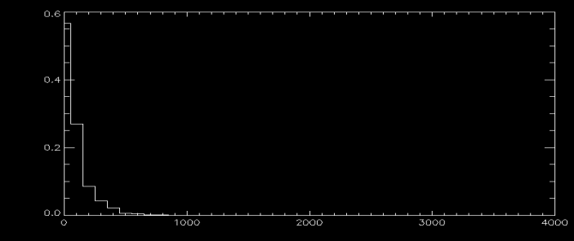
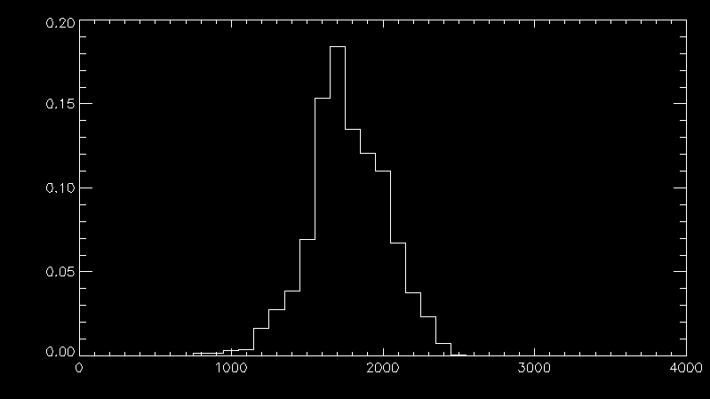
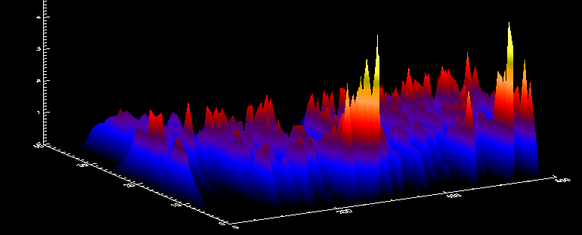
>>> 1140 seconds of data at 1kHz >>>
frame 0
frame 1.2e6
Psf peak distribution vs time (2sec. Bins)
BEST
BAD
AVERAGE

Slide 13
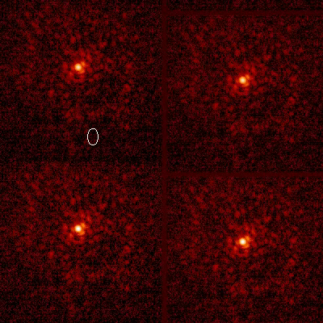
RAW
STABILIZED
REGISTERED
CO-ADD
CO-ADD

Slide 14
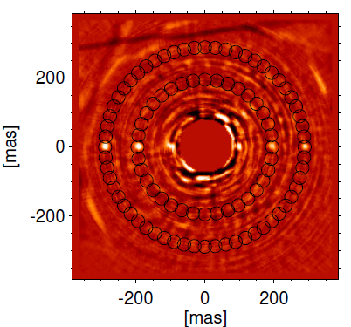
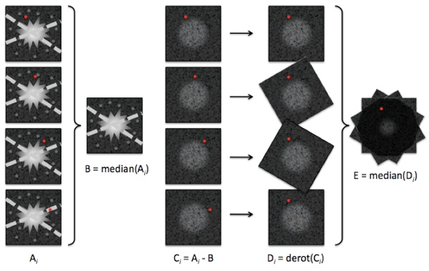
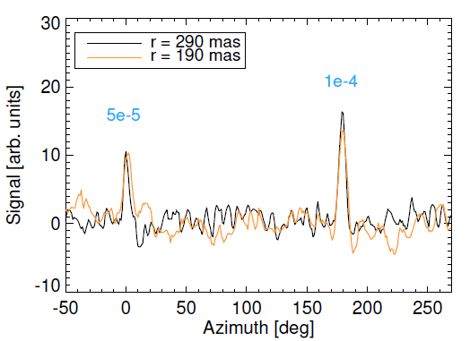
ADI (Marois+ 2005)
Take images at different field angles (not derotated)
Estimate by median the PSF to subtract to every frame…median on the final registered stack
Pedichini +
AJ 2016
Detection level is
≈ 10 times
the photon limit
episode 4:
a new hope A.D.I.

Slide 15
Despite the Forerunner experiment reached in only 20 minutes of exposure a detection contrast of 5e-5 at 100 mas the scientific community is aware that breaking the contrast barrier of 1e-5 or better 1e-6⁽¹⁾ it is really hard and the photon limit detection, especially close to the PSF core, still remain far far away. Uncontrolled variation of NOISE as:
      PRNU
      RON
      PSF instability
almost vanish the effort of very long integration.
PROXIMA b exp. contrast 5e-7 at 40 mas
GJ 876b 1e-6 at 50 mas… (Lovis et al. 2016)
episode 5:
NOISE strikes back

Slide 16
episode 6:
the return of the (Specle Free) ADI

Slide 17
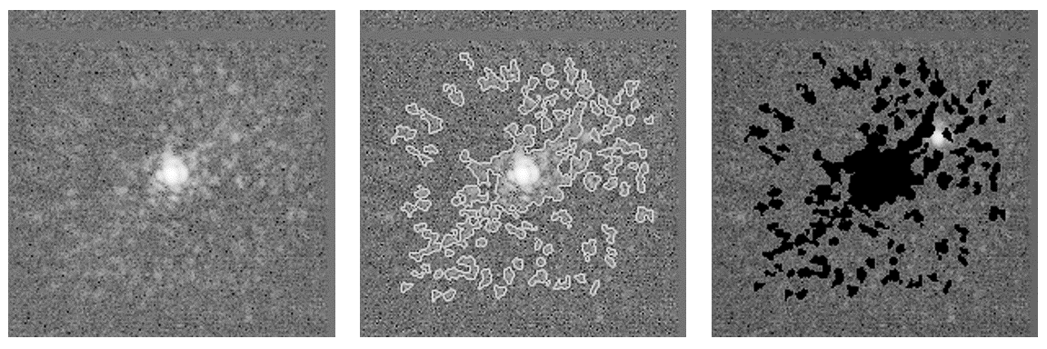
SFADI ( Speckle-Free ADI )
Li Causi et al. 2017, ApJ, in press (http://arxiv.org/abs/1709.03181)
SFADI concept (10⁻¹ contrast planet for clarity):
KHz frames acquisition
Speckles identification
D: ADI using un-masked pixels only and average combination
Speckles suppression

Slide 18
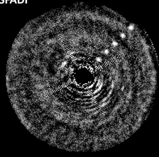
SFADI vs ADI for 2 10⁻⁵ contrast planets on real 1.2 million frames with Forerunner@LBT
2e-5
The barrier is closer, now detection limit is 3 times the photon limit.
What else?

Slide 19
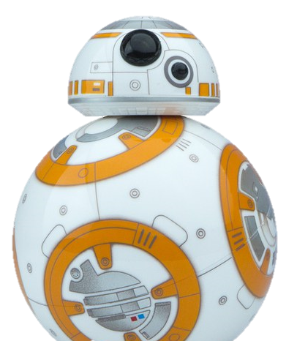
SFADI takes care of pixels with 1e-3 γ/frame → RON ≈ 0…
Format > 512 x 512 pixel (2x2 arcsec Nyquist sampled at 600nm)
256 x 256 pixel still acceptable
Pixel size 6 micron to minimize fore optics at f#15 focal planes
1ms typical exposure with no PSF smearing
Dynamic range…?
AOB (QE > 70%)
episode 7:
new detector architectures for
SFADI at 8 meters XAO telescopes

Slide 20
INTERLINE TRANSFER
LENSLET
EM-CCD
PHOTON COUNTING
10μs resolution
SMART CMOS
…and then they were falling again into the darkness of the next tradeoff

Slide 21
The Forerunner team
thanks for your attention
with the contribution of
ADONI
LBTO, UoA, INAF
SDW2017 BMBF grant 03Z22AN11

