Slide 1

A CMOS Image Sensor with Non-Destructive Readout Capability: Performance and Operational Considerations for Ground-Based Astronomy
Presented by: Gary Sims, Spectral Instruments
At Imager Labs: Gene Atlas
At Spectral Instruments: Roger Cover, Dan Gilmore, Hans Meyer

Slide 2
Evaluating CMOS Image Sensors for Low Light, “Long Stare” Applications
Ground based astronomy imaging and spectroscopy
Bioluminescence and fluorescence

Slide 3
Why use a CMOS part when a CCD will do the job?
1) In principle, CMOS sensors can do some things better than a CCD:
      Anti blooming
      Lower noise readout
      Larger size possible from 8” - 12” wafers
      ????
2) Future availability of CCDs

Slide 5
There are things that current CMOS sensors do not do:
Binning.
2) TDI readout, nod and shuffle readout.

Slide 6
GPixel G400
2K x 2K 11 micron pixels
available backside illuminated
2-3 e- readout noise
fully integrated sensor with A/D converters

Slide 7
GPixel G400 at -60C

Slide 8
Imager Labs “DaVinci” 2K and 4K
2K x 2K or 4K x 4K 15 micron pixel
3T pixel with cascode amplifier
Simple “rolling shutter” architecture (no A/D converters)
Non-destructive readout
High gain (112 uV/e-), resulting in low noise
Limited output capacity (about 14 ke-)
QE 60% peak, 40% at 400 nm, 37% at 800 nm (12 micron epi)
8+8 or 16+16 analog outputs

Slide 9
Cascode Amplifier

Slide 10
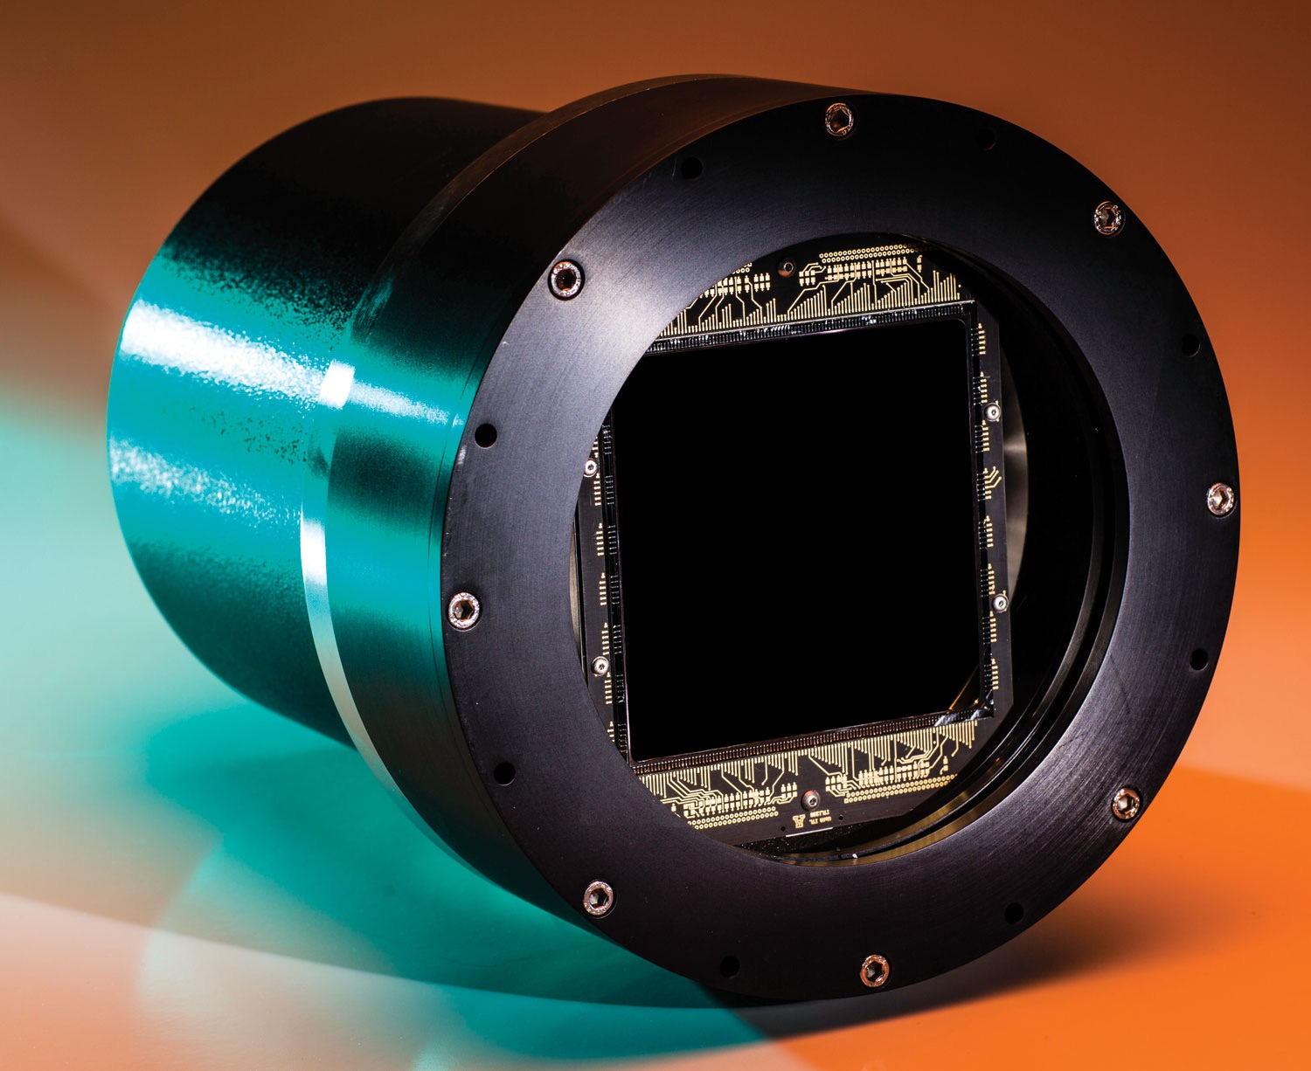
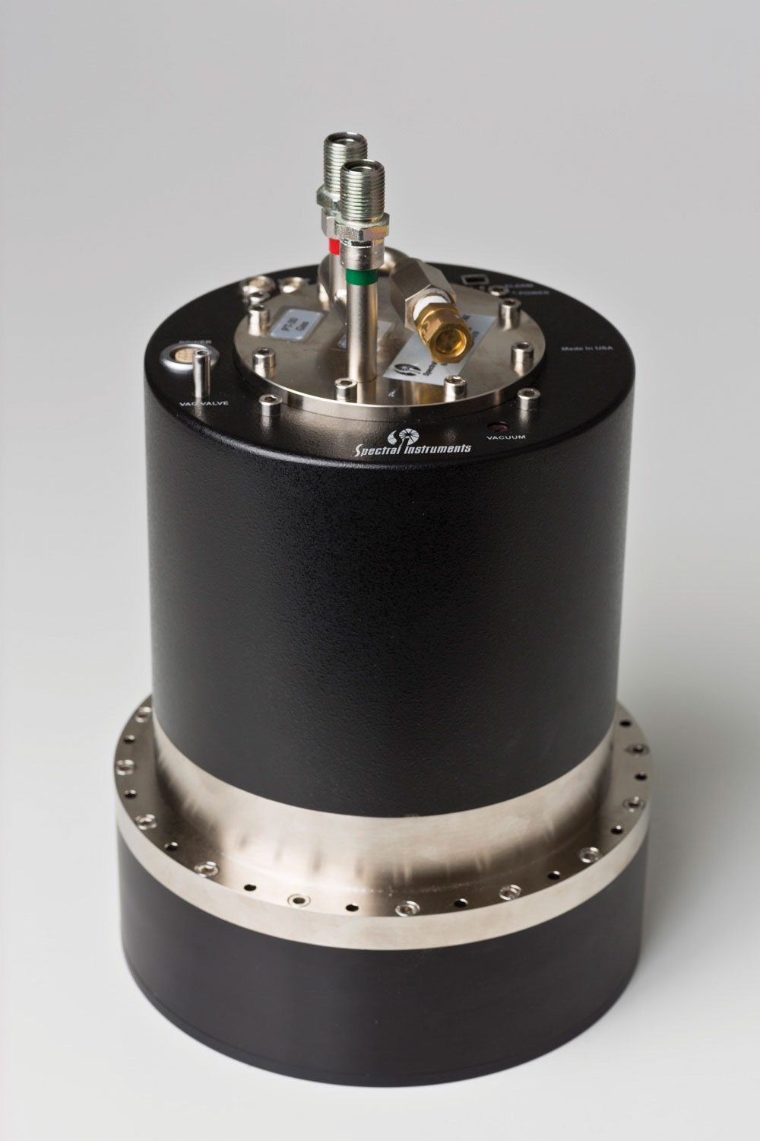
1110S Camera Platform
16 port 100 MHz 16 bit full digital sampling
Cryo-Cooled
Used with large-area 4 to 16 port CCDs

Slide 11
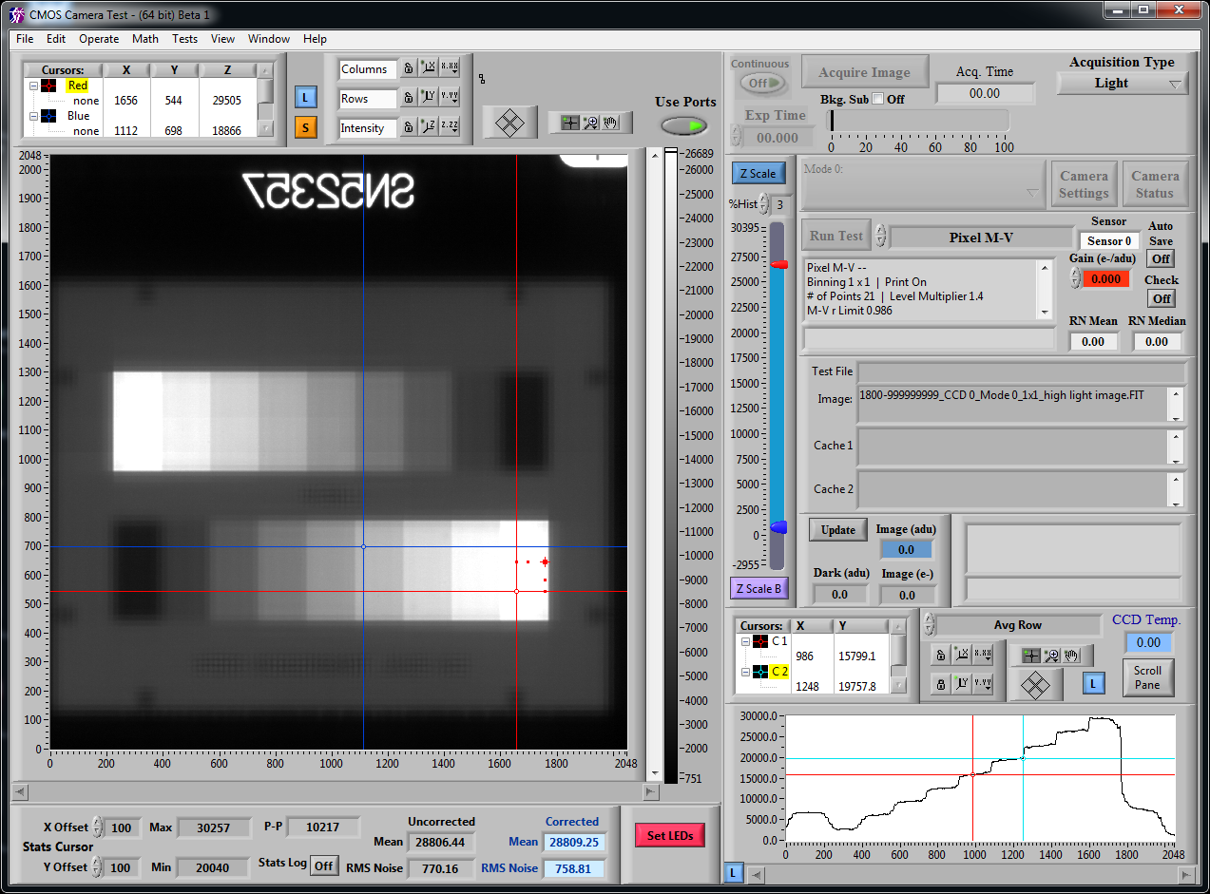
EIA Transmission Chart - High Light

Slide 12

EIA Transmission Chart - Low Light

Slide 13
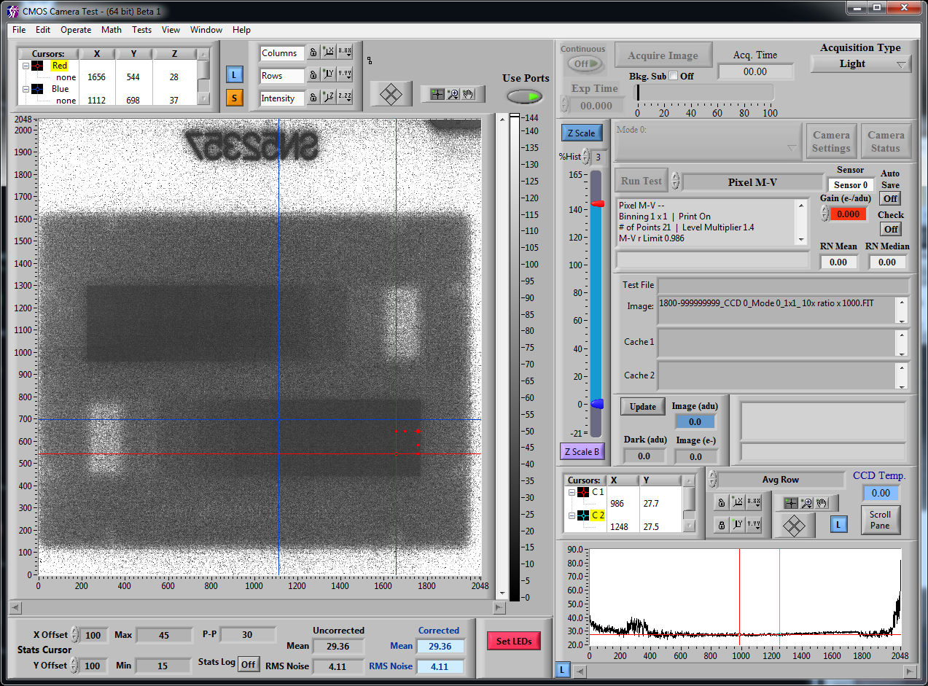
EIA Transmission Chart - Ratio X 1000

Slide 14
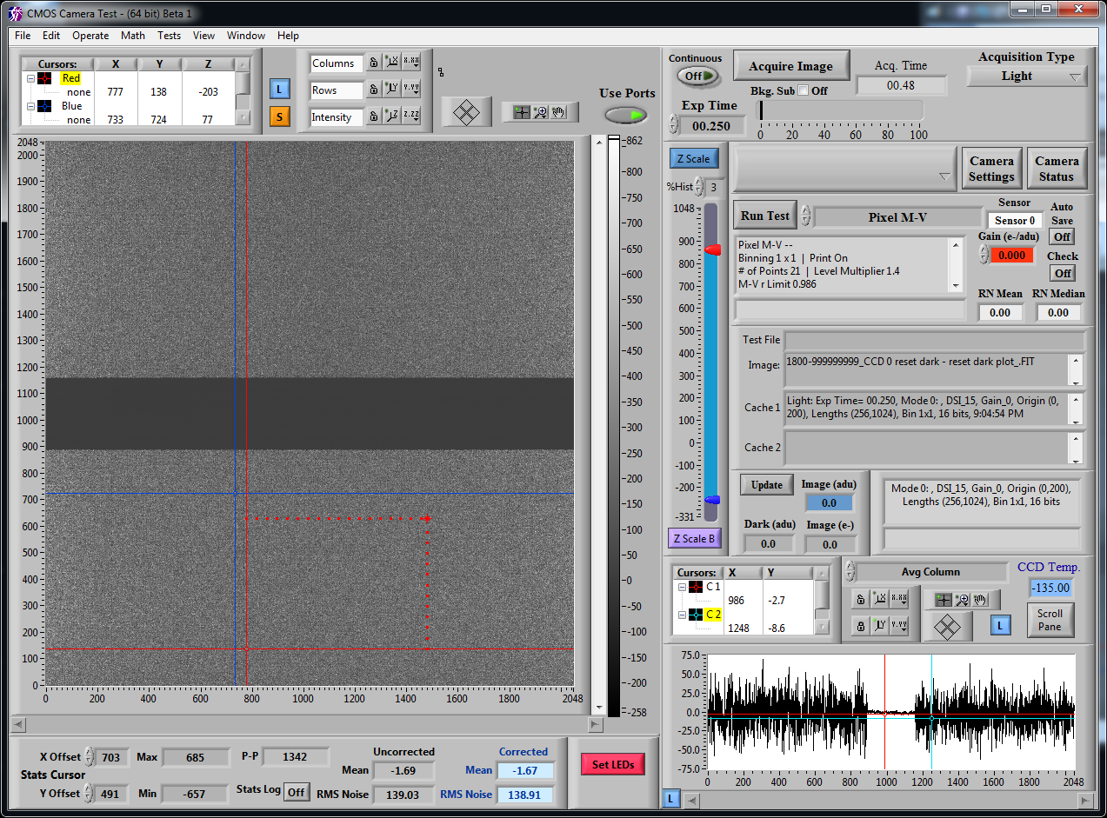
Reset/Dark - Reset/Dark
40 e- noise dominated by kTC

Slide 15
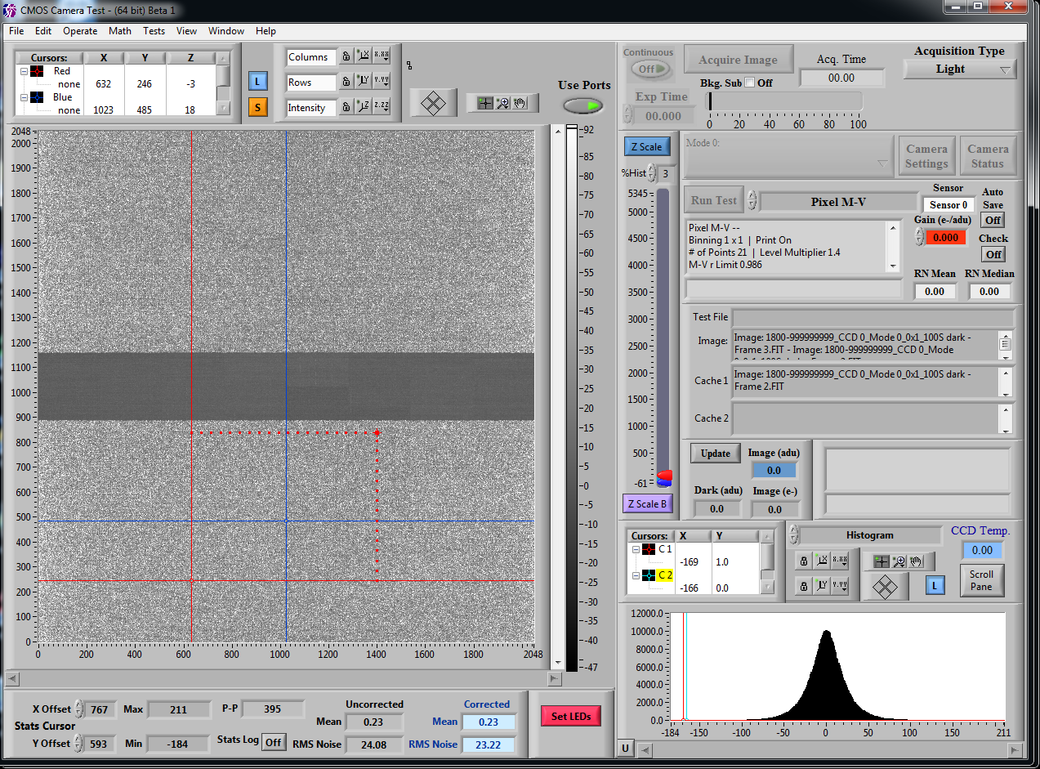
Reset/Dark - Dark
6.8 e- noise with no optimization

Slide 16
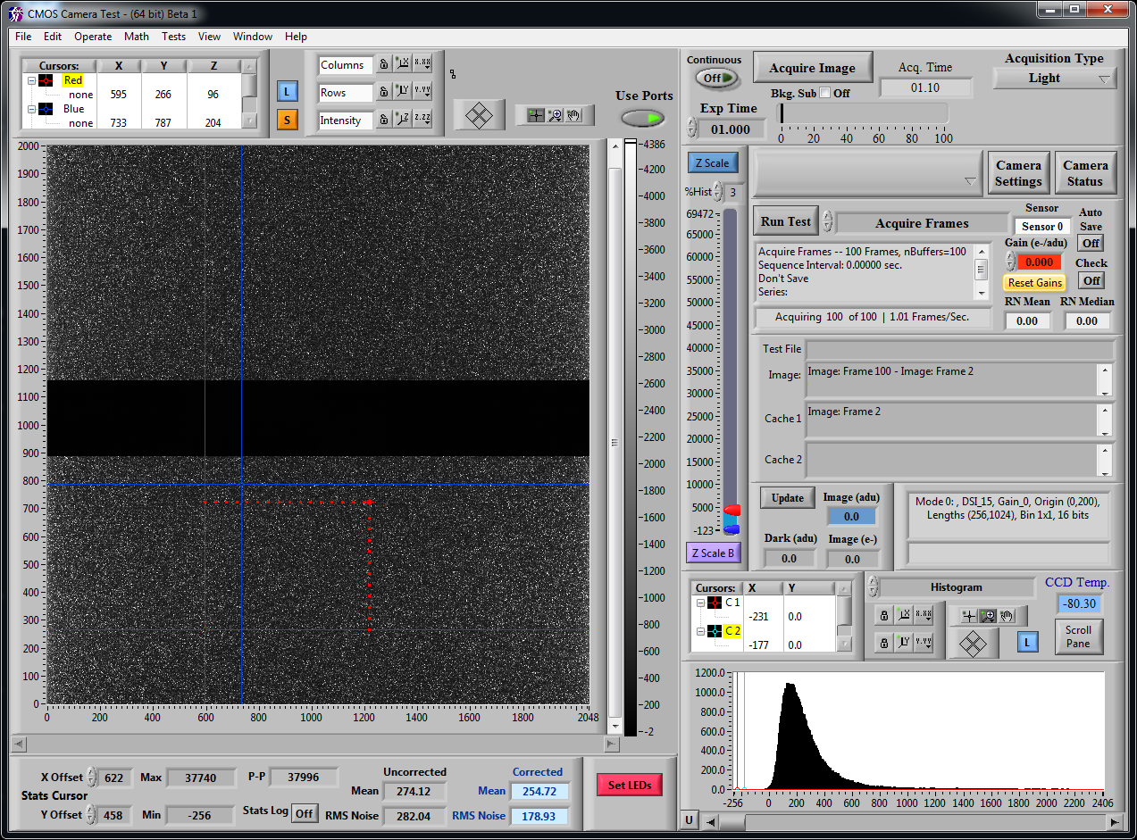
Reset/Dark - 100th Dark (100 seconds) at -80C

Slide 17
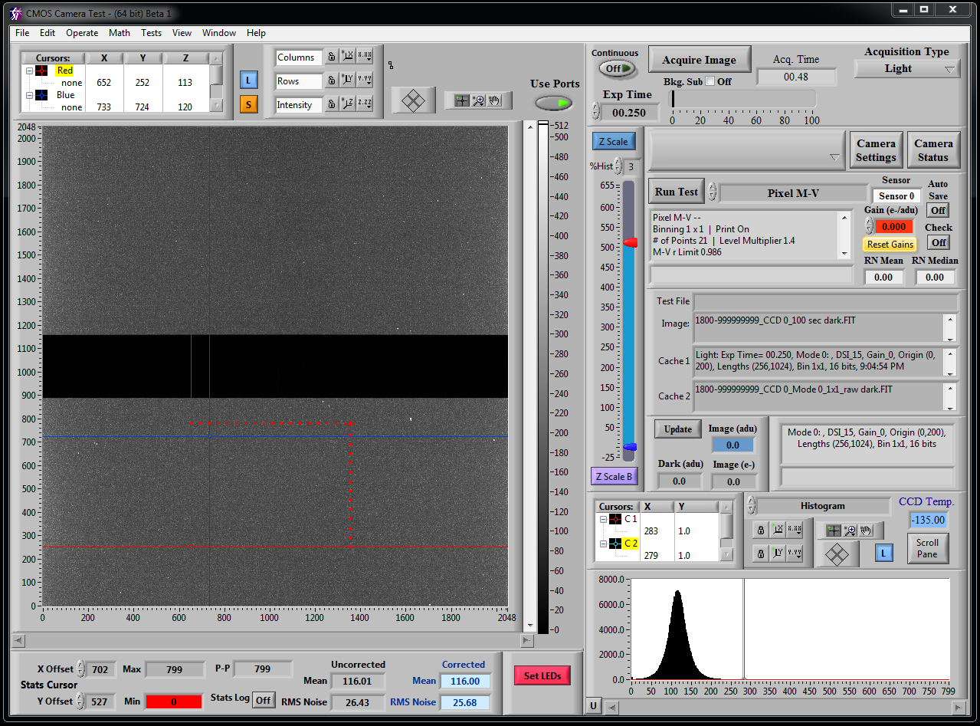
Reset/Dark - 100th Dark (100 seconds) at -135C

Slide 18
Initial Results are Promising
Noise O.K, and probably excellent once optimized
Linearity good
No readout lag, or other obvious issues when NDRO used
No change in characteristics when cooled
High dark current in preliminary measurements

Slide 19
Operational Considerations
Well capacity severely limits dynamic range. Do not operate
like a CCD, use it like an IR sensor.
Read at 1-5 frames/second using NDRO “up the ramp” sampling to:
    synthetically expand dynamic range 10X to 100X
    discriminate and remove “cosmic rays”
    decrease read noise - hopefully to << 1e-
    throw away the mechanical shutter
    If read noise is sufficiently low, binning is no longer necessary

Slide 20
Operational Considerations (continued)
Any row can be read either destructively, or non-destructively.
Use destructive readout on selected rows at top and bottom
of the array for guiding.
Do not try to force a CMOS sensor to be a CCD!

Slide 21
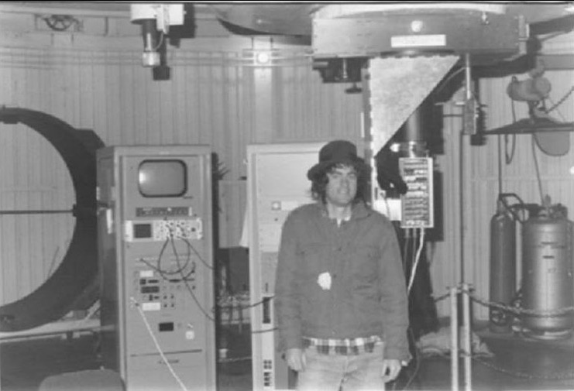
Next Up

Slide 22
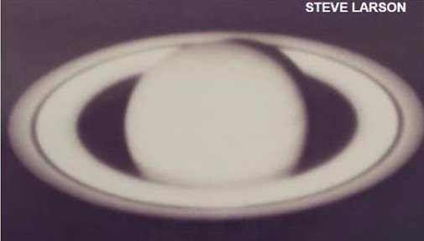
Next Up

