Slide 1


STA CCD Detector, Controller, and System Developments
Scientific Detector Workshop
Baltimore, Maryland
26 September, 2017
Greg Bredthauer, Kasey Boggs, Joe Tufts
greg.bredthauer@sta-inc.net
http://www.sta-inc.net

Slide 2

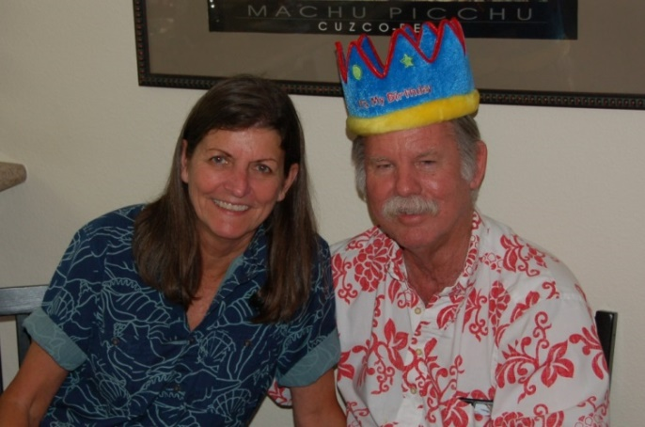
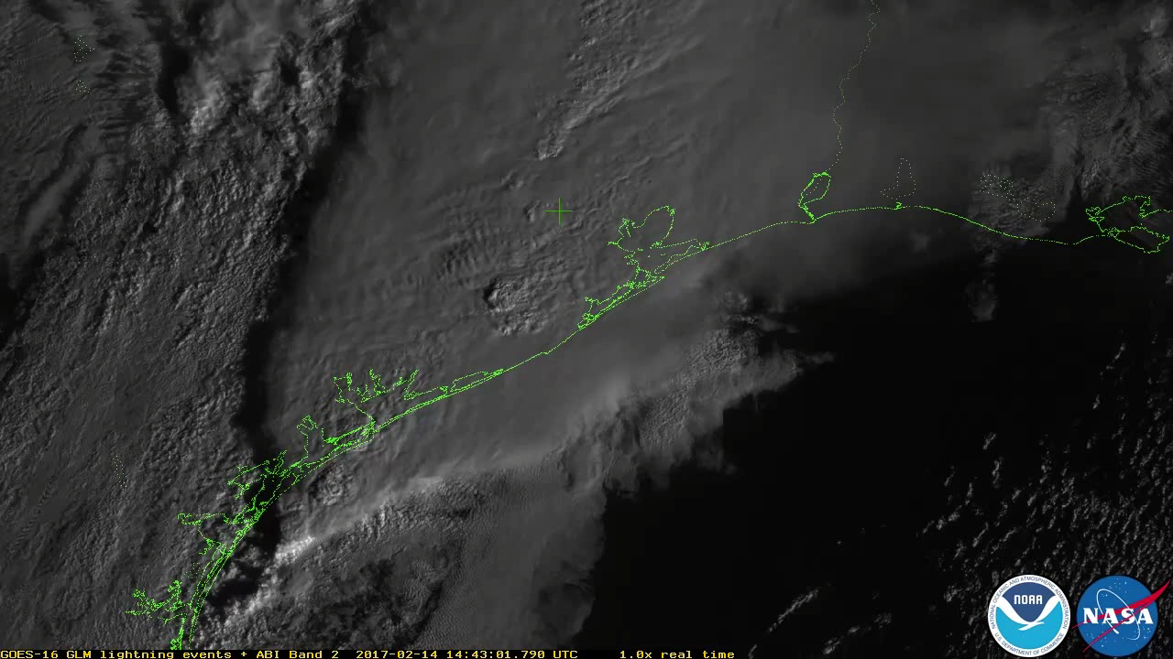
STA
Richard Bredthauer, 1975:
“A 50-bit charge coupled device with AC coupled inputs”
Hubble WFPC2
Mars Pathfinder
Stereo Imager
All Cassini CCDs
STA founded 1999
GLM

Slide 3
Changes at STA
Dick and Ginny retired in 2016, sold STA
Still 5 full time employees
We moved from a 5000 sq. ft. leased building to a 7000 sq. ft. building we own on Friday
Cleanroom upgraded from 180 sq. ft. to 480 sq. ft. (independent AC and humidity control)
Move took 1 semi, 4 large box trucks, 4 small box trucks, countless car/minivan/pickup trips

Slide 4
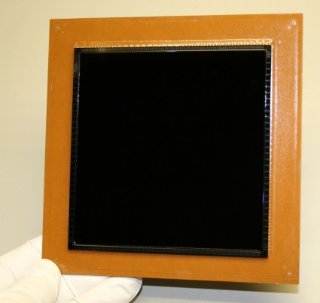


Custom CCDs
STA4600 (Metrology)
4032 x 4032 22.5um
32 outputs split frame
4.6 Hz frame rate
STA4500 wafer scale
6k x 6k 15um

Slide 5
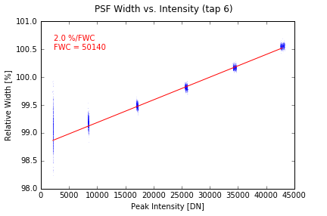
PSF vs. Intensity

Slide 6
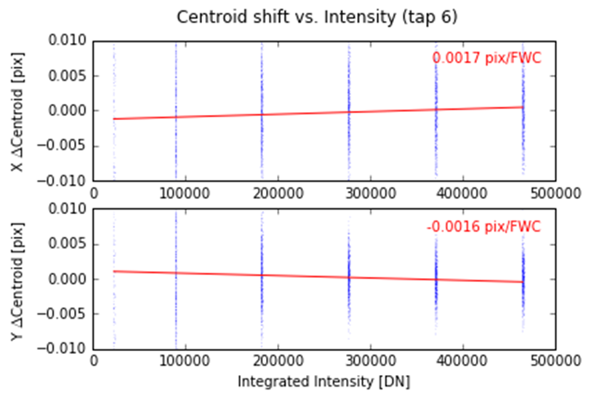
Centroid vs. Intensity

Slide 7
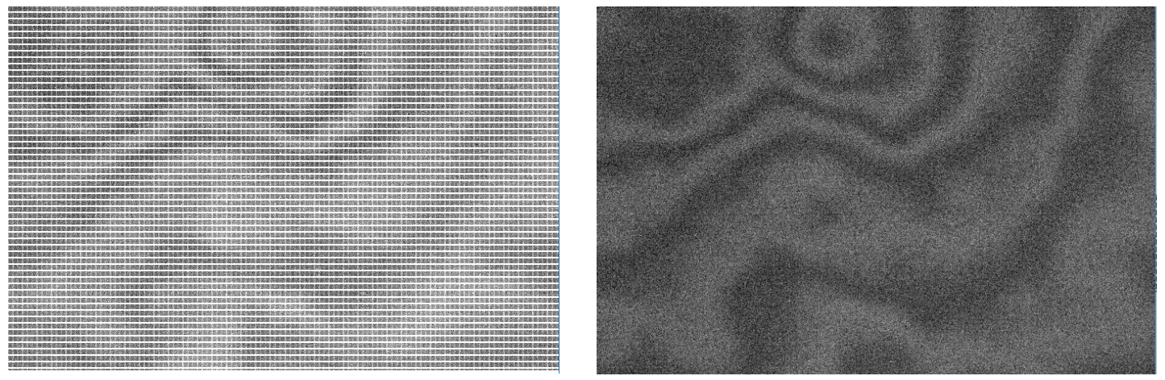
Etalon
Challenge: Measure etalon in the presence of fixed patterns
Solution: Calculate 2nd derivative imagery from flats taken at 3 wavelengths (930±5nm)

Slide 8
High(er) Resolution 1X Masks
STA3800 Revisions
(Data courtesy of Mike Lesser at
the U of A Imaging Technology
Laboratory)

Slide 9
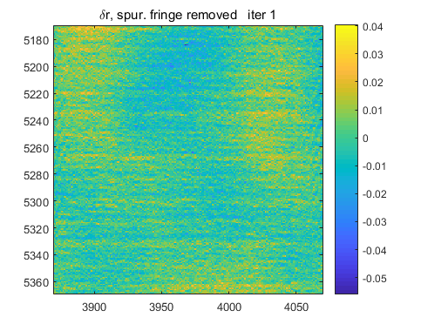
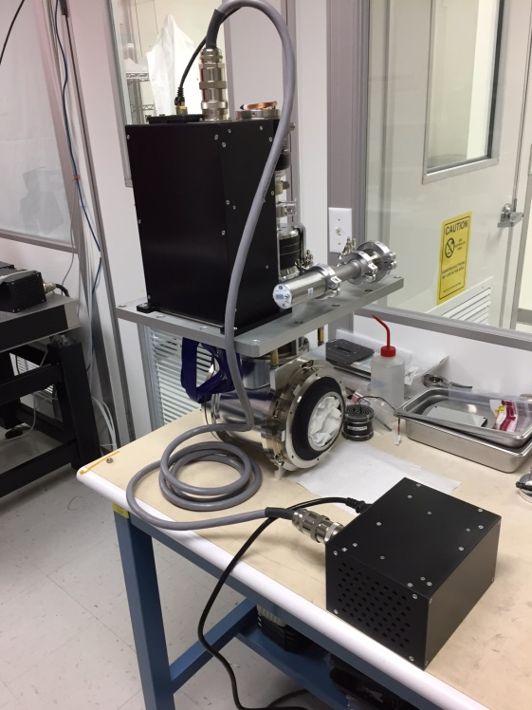
High Resolution Pixel Mapping
STA1600 pixel centroids measured using a projected fringe pattern (courtesy of Dave Sawyer and Mike Shao) for the EXPRES spectrometer

Slide 10
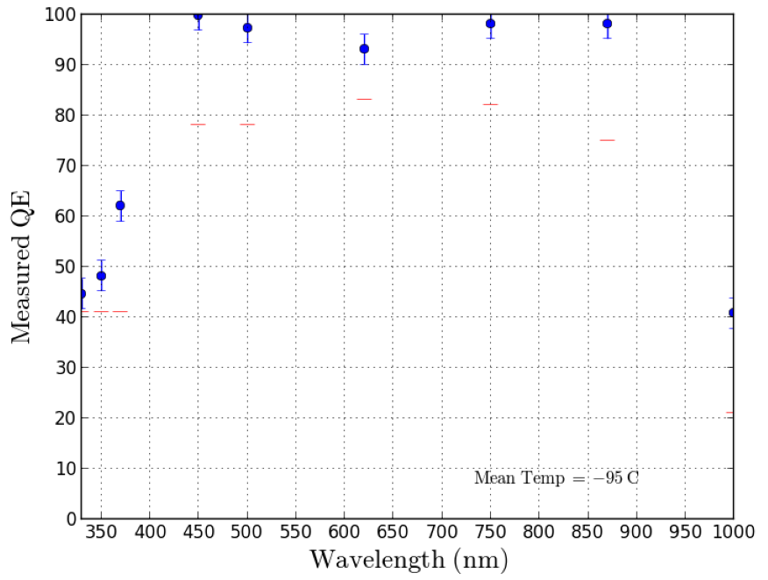
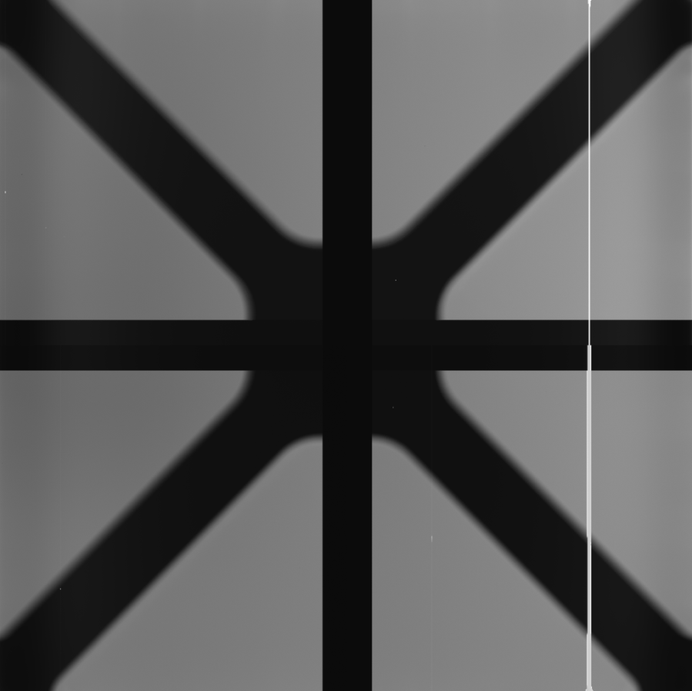
STA4850
Improved 4k x 4k quad output with 15um pixels
30um 1kOhm epi or 100um 10kOhm deep depletion

Slide 11
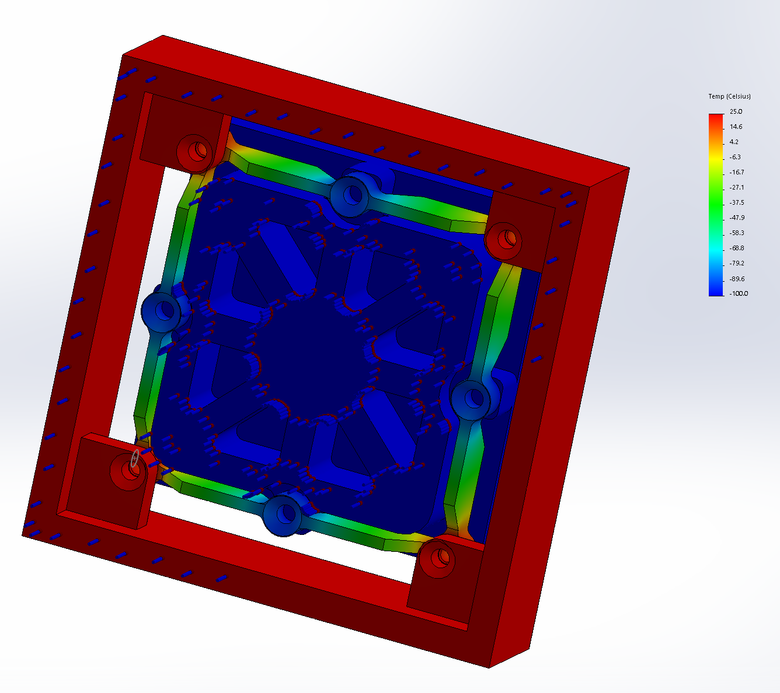
STA4850
New package isolates thermal and mechanical support
Package fits in the sensor footprint
Symmetric thermally and
mechanically
Designed for tight thermal
control (SiC or AlSi or not invar)
Z stiffness 1um/N, X/Y stiffness
<=0.3um/N, compliant in R
Integrated JFET buffers, temp
sensors, dump drain

Slide 12
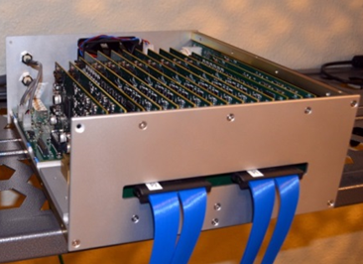
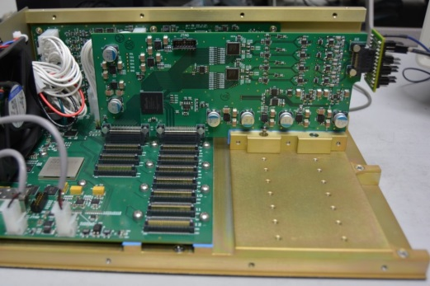
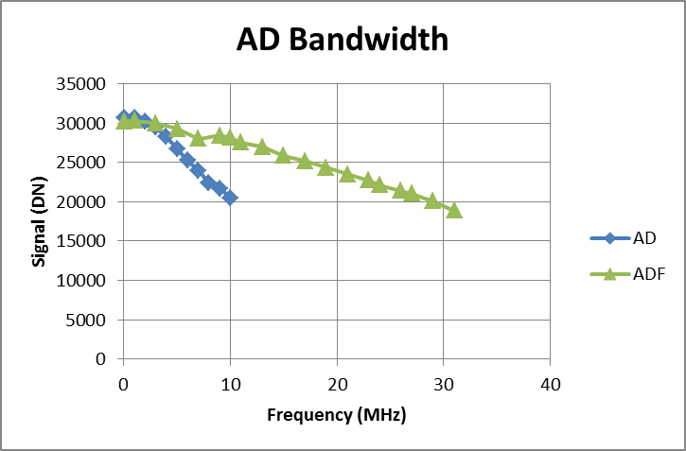
Custom Electronics
Custom 32
channel Archon
Custom higher
bandwidth, fast
settling ADF module

Slide 13
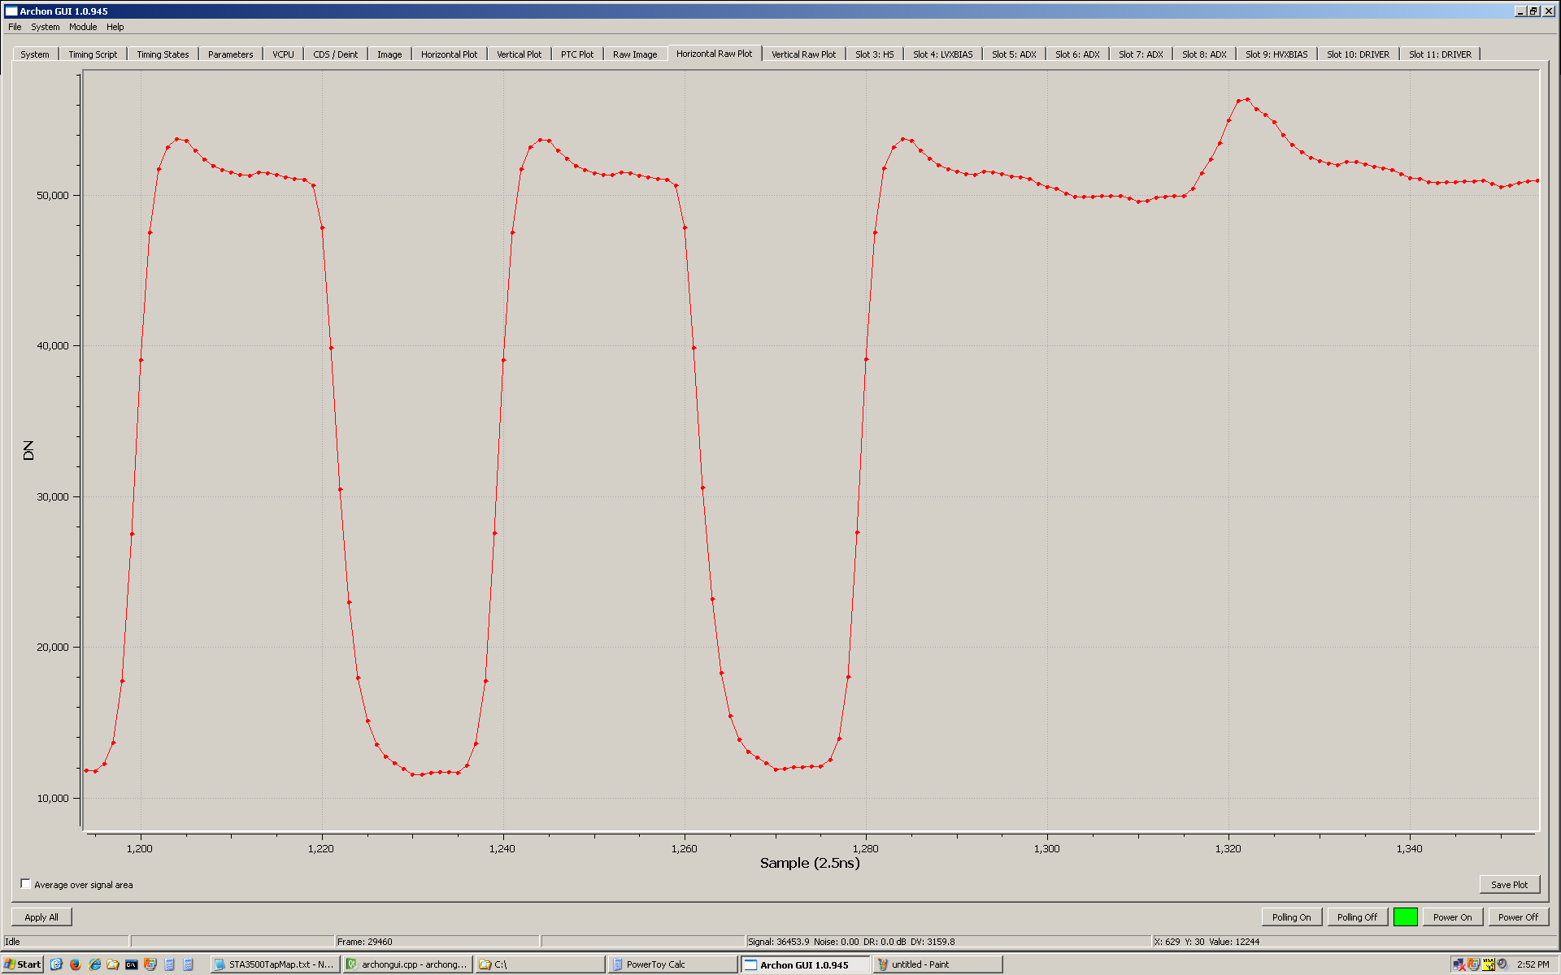
400MHz 14-bit Archon ADX

Slide 14
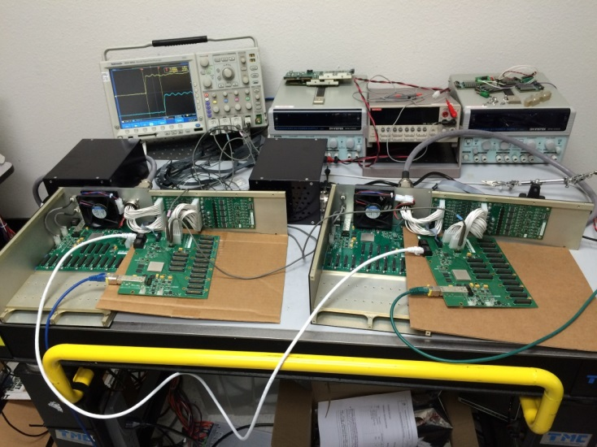
Archon Developments
Daisy-chain
synchronization
XV options: +/-95V biases for deep depletion
VCPU for general purposes (vacuum gauges, motion control, I2C, RS232, etc)
AC power

Slide 15
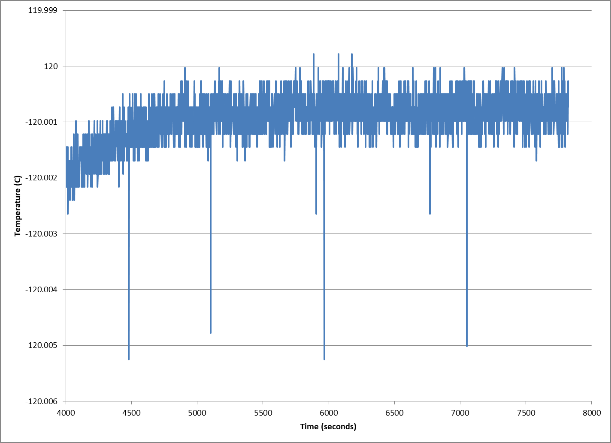
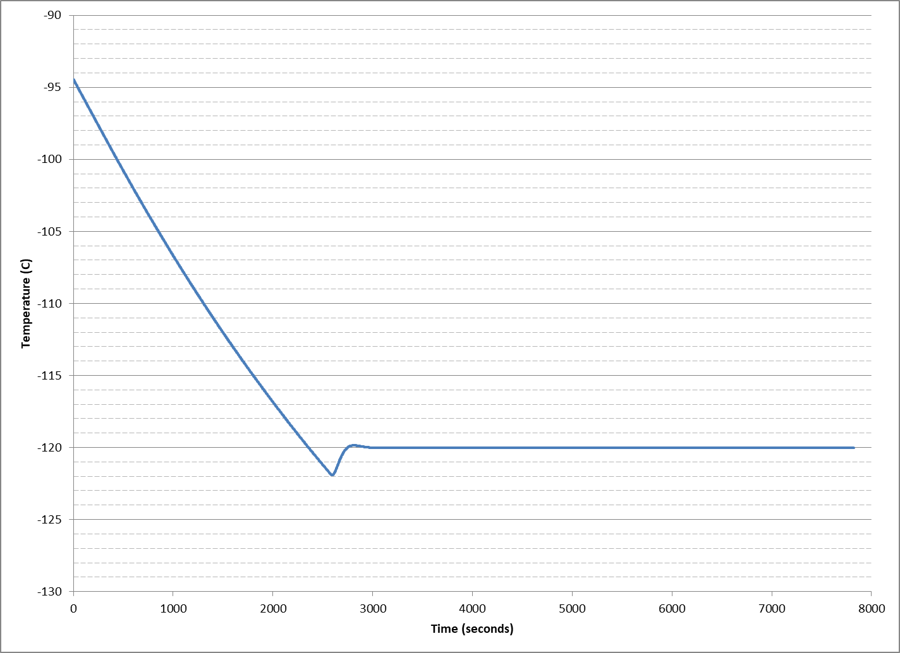
Archon Temperature Control
HeaterX:
0.3mK RMS
stability with
1000 Ohm RTD

Slide 16
CCD Simulations
Comprehensive simulations of deep depletion CCDs that properly model fields, doping, mobility, interfaces, etc., are hard…

Slide 17

Dark Current, +25C

Slide 18
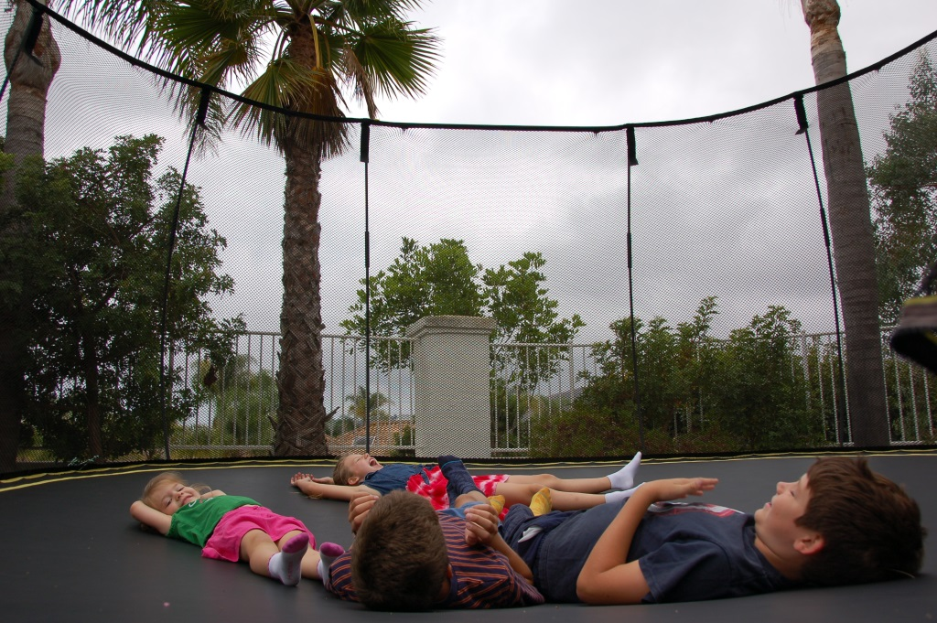
Dark Current, -120C

