Slide 1
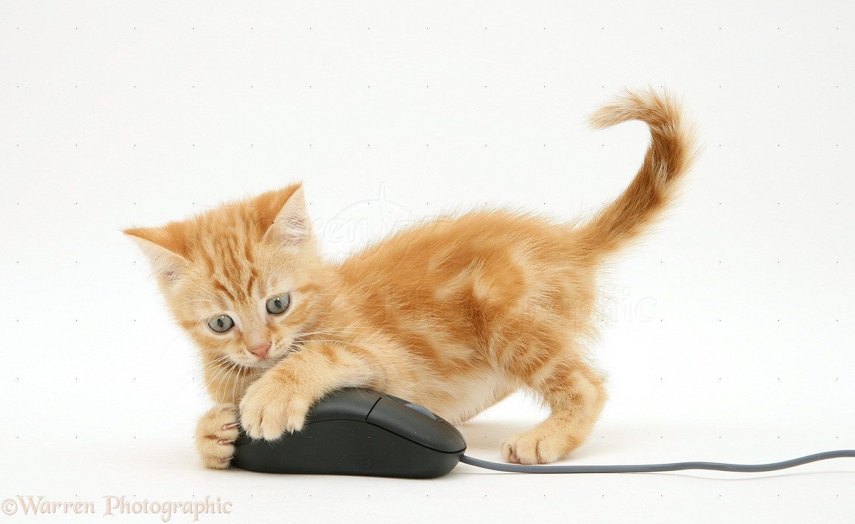
May Mice help scientists to develop a
Smart Wave Front Sensor Detector?
a mouse Story
by:
F. Pedichini, M. Mattioli, M. Stangalini, G. Li Causi and V.Testa

Slide 2
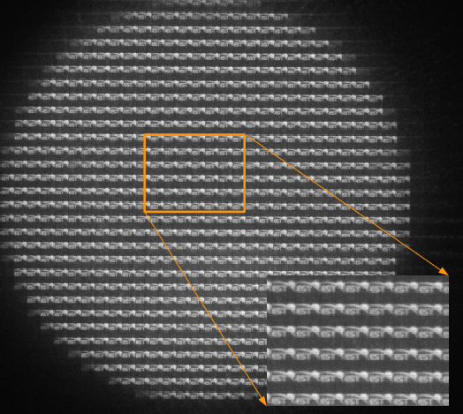
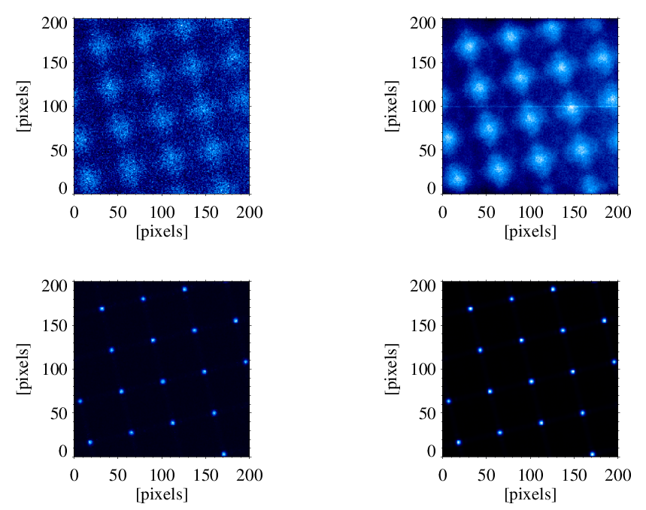
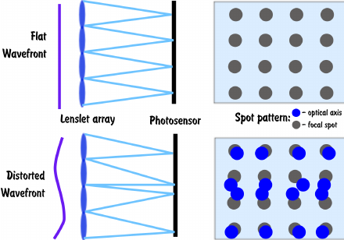
Overview of a Shack Hartmann Wave Front Sensor
the work-horse of many Adaptive Optics System

Slide 3
 | NGS | LGS | DAY/SUN
Cell format | 5 x 5 = 25pix | 25 x 25 = 625 | 32 x 32 = 1024
N actuators | 1K | 1K | 1K
Loop time | 1ms | 1-2ms | 0.5-1ms
Data rate (8 bit A/D) | 20 MB USB - ETH | 500-250MB ETH | > GB CamLink+
1
2
3
..
..
..
..
N-2
N-1
N
We cannot stop AO evolution
AO WFC input is 2 x N slopes (N∝D²)
Not Billion of pixel/s
Best result are for LGS and DAY/SUN

Slide 4
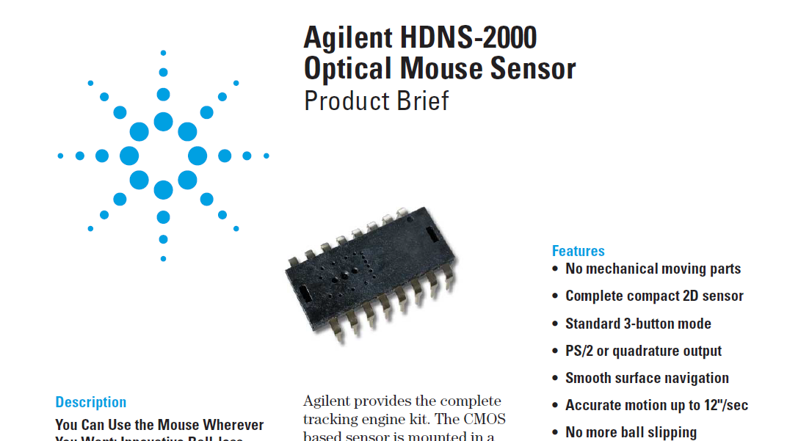
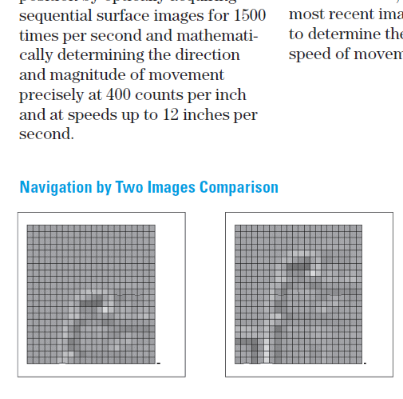

Slide 5
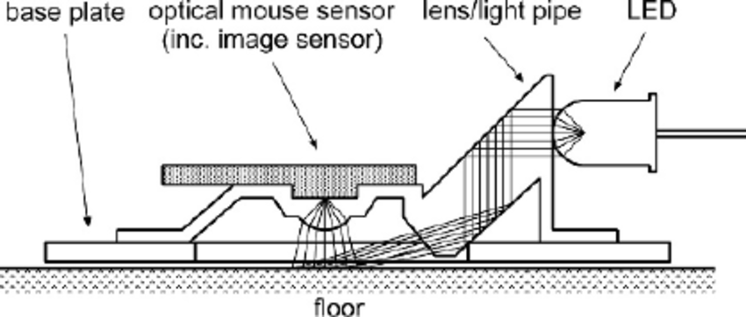
Hacking Optical Mouse (do it at Home!)
S/H lenslet
focus

Slide 6
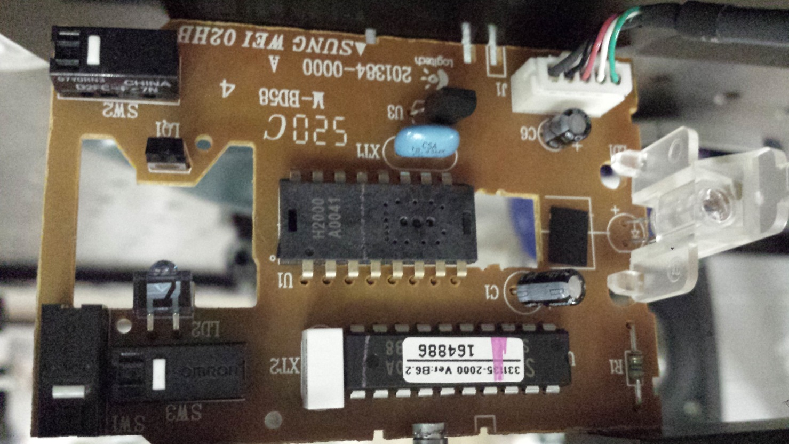
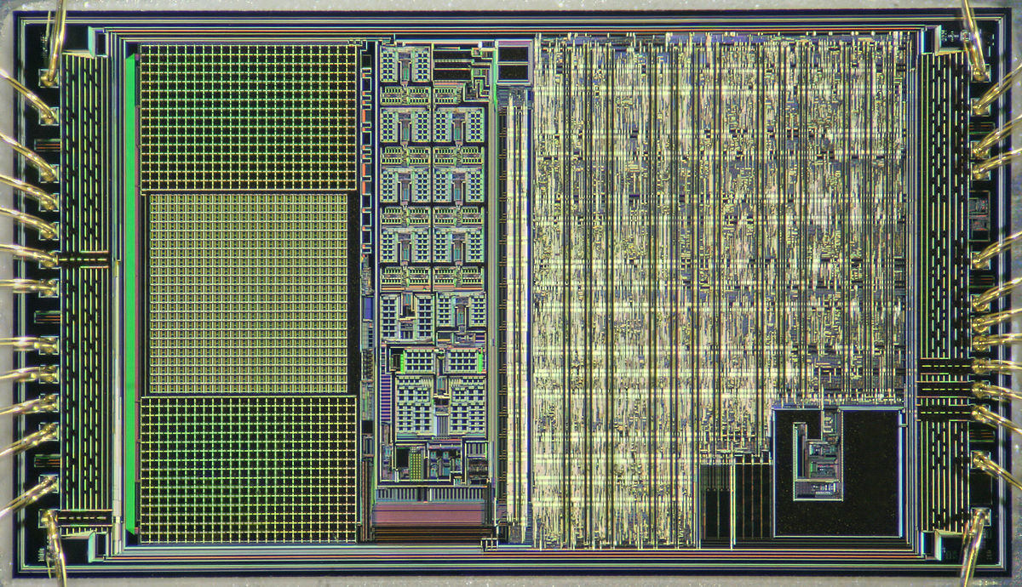
18 x 18 pixel array
read out electronic
data processing

Slide 7
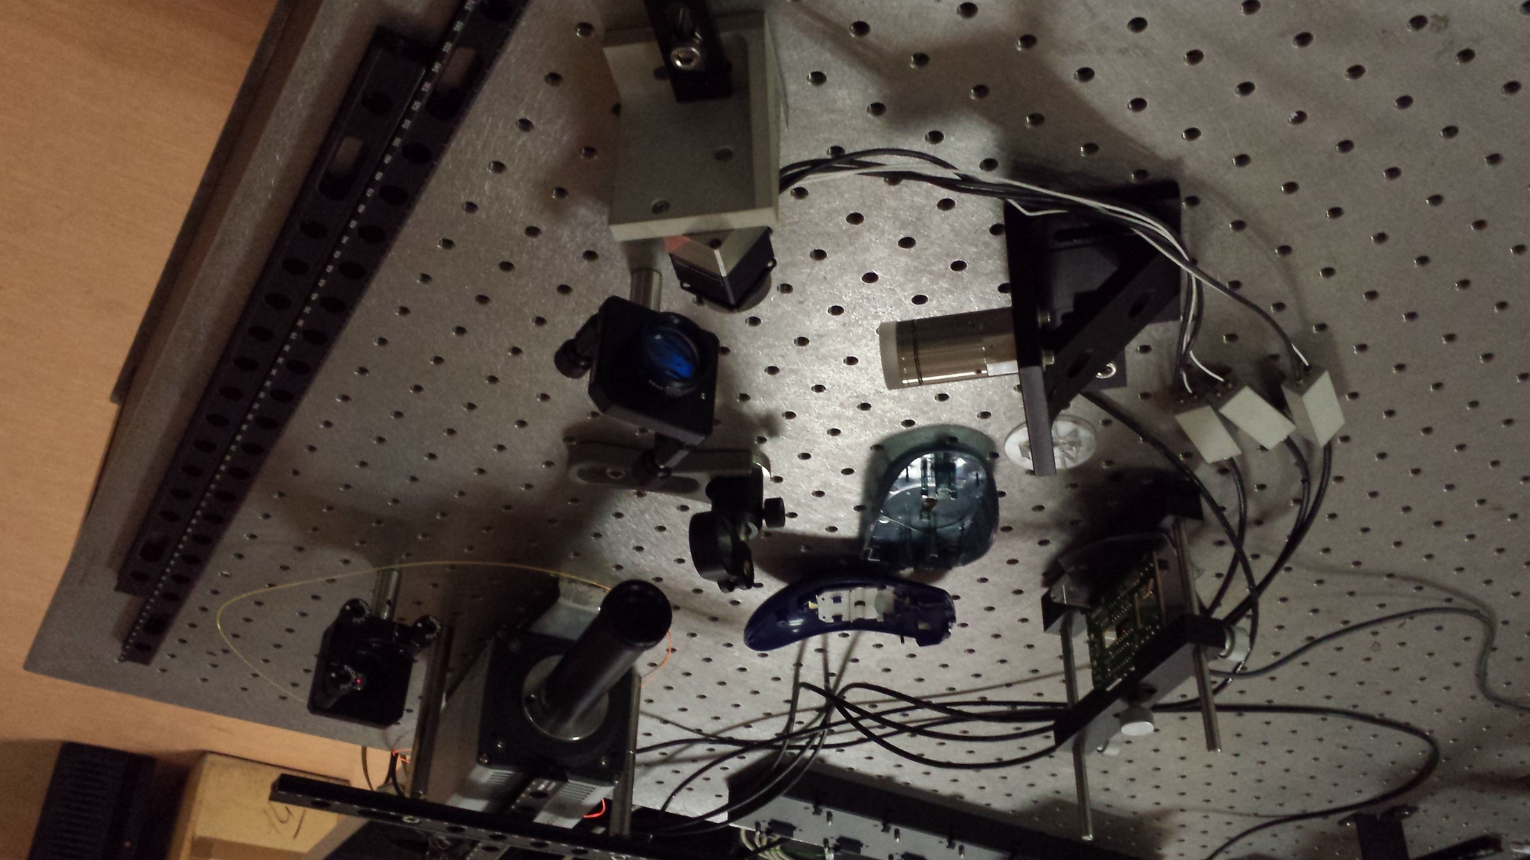
source
living
mouse
f#15
relay lens
Piezo
tip/tilt

Slide 8
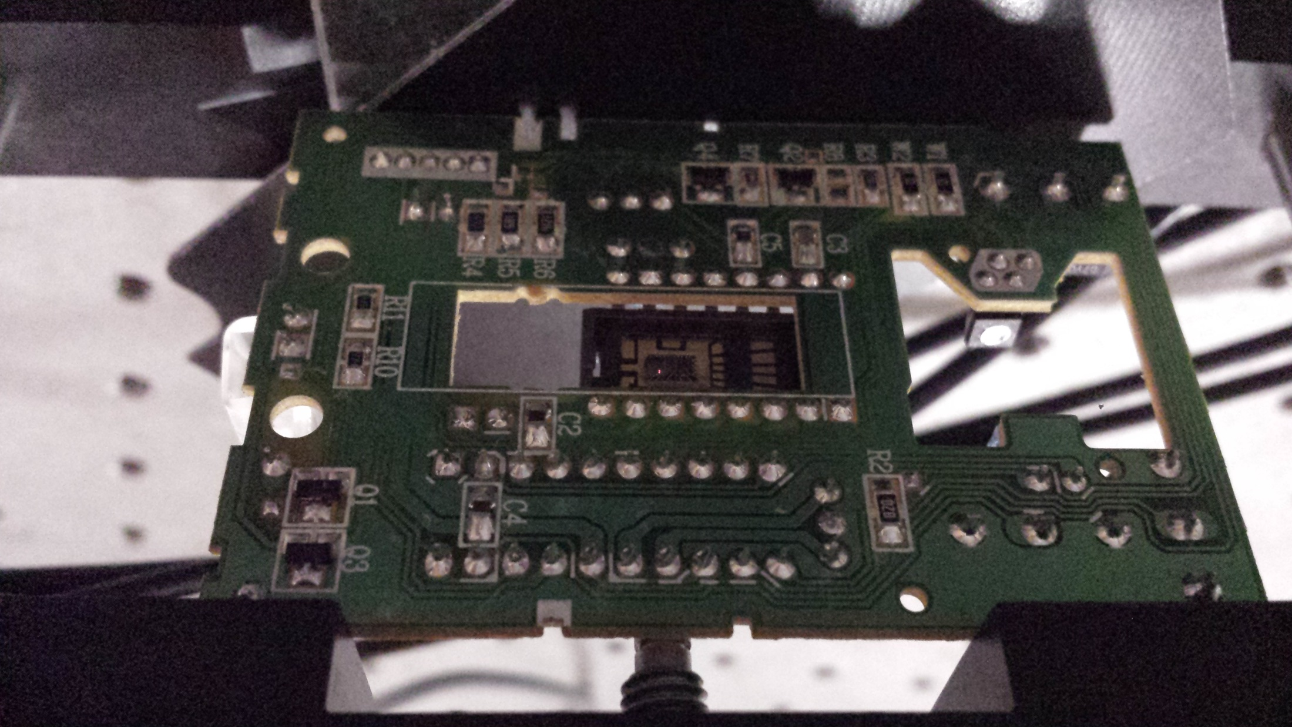
1Hz 1mRad

Slide 9
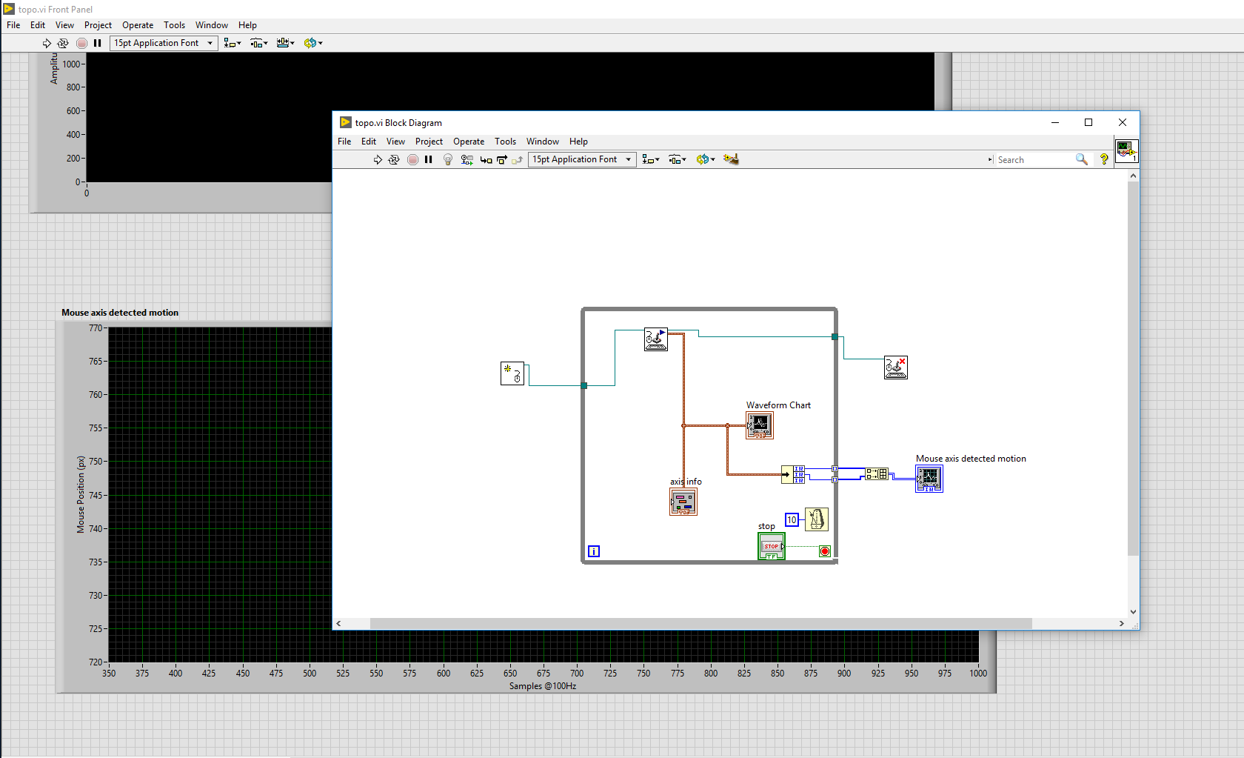

Slide 10
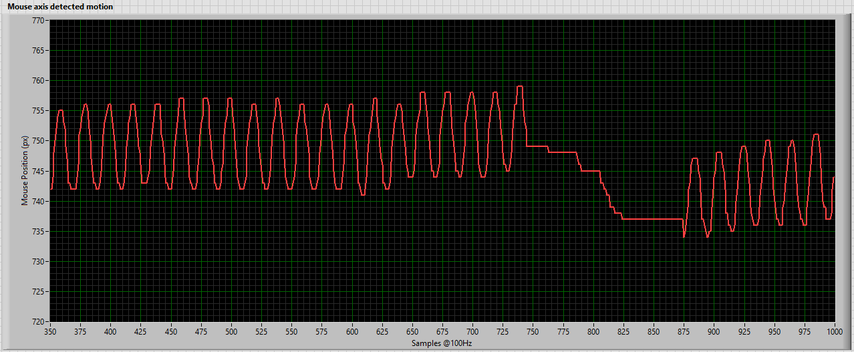
It works…!

Slide 11
This contribution was developed with the support of SDW2017 – BMBF grant 03Z22AN11
The authors declare that a full
working Logitech mouse was sacrificed to
the glory of AO science.
Mouse remnants are still half-alive
in our optical Lab and they take part in
our nightmares…

Slide 13
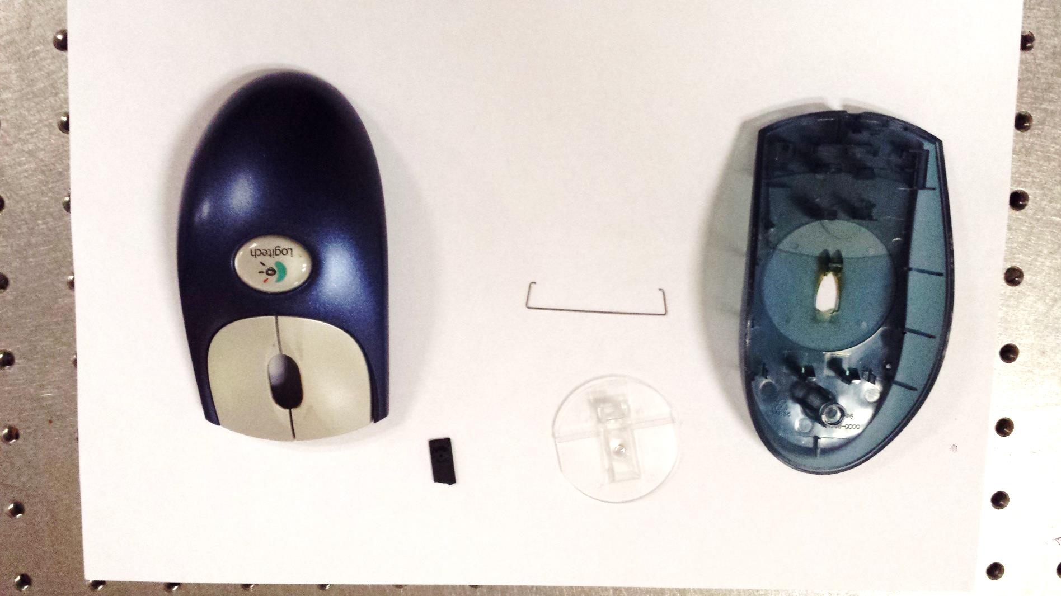

Slide 14
Thank you !

