Slide 1



Efficiency and Stability of
2D-doped Silicon Detectors
National Aeronautics and
Space Administration
Jet Propulsion Laboratory
California Institute of Technology
Pasadena, California
M.E. Hoenk, A. D. Jewell, J. J. Hennessy, T. J. Jones,
T. M. Goodsall, S. R. Cheng, S. Nikzad
Jet Propulsion Laboratory, California Institute of Technology, Pasadena, CA 91109
Doug Trotter, Quinn Looker, Gideon Robertson
Sandia National Laboratories, Albuquerque, NM 87123
Scientific Detectors Workshop
Baltimore, Maryland
September 25–29, 2017
Reference herein to any specific commercial product, process, or service by trade name, trademark, manufacturer, or otherwise, does not constitute or imply its endorsement by the United States Government or the Jet Propulsion Laboratory, California Institute of Technology.
The research described in this paper was carried out at the Jet Propulsion Laboratory, California Institute of Technology, under a contract with the National Aeronautics and Space Administration, and at Sandia National Laboratories, under a contract with the Department of Energy.
Copyright 2017 California Institute of Technology. U.S. Government sponsorship acknowledged.

Slide 2
Efficiency and Stability of 2D-doped Silicon Detectors
Outline
Overview of 2D doping
Surface and bulk recombination in ion-implanted detectors
Efficiency and stability of 2D-doped detectors
AR and UV bandpass coatings
2D-doping on a large scale

Slide 3
Overview of 2D-doping
Quantum Efficiency and Stability of Delta-doped detectors
Hoenk et al., “Growth of a delta-doped silicon layer by MBE on a CCD for reflection-limited UV QE,”
Applied Physics Letters, 61: 1084, 1992
Delta-doped layer
(dopant in single atomic layer)
original Si
CCD
frontside
circuitry
Native oxide
1 nm
MBE growth
3 nm
Silicon detector
(CCDs, CMOS, PIN arrays)
S. Nikzad et al., “Ultrastable and uniform EUV and UV detectors,” SPIE Proc., Vol. 4139, pp. 250-258, 2000.
No measurable hysteresis in delta-doped CCDs

Slide 4
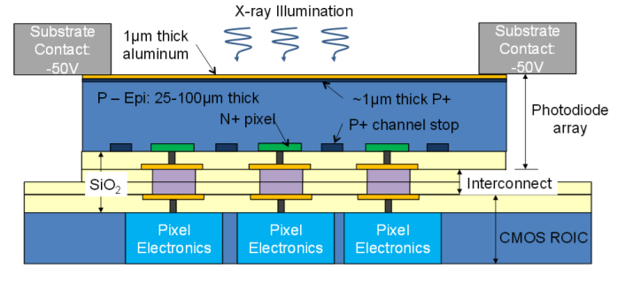
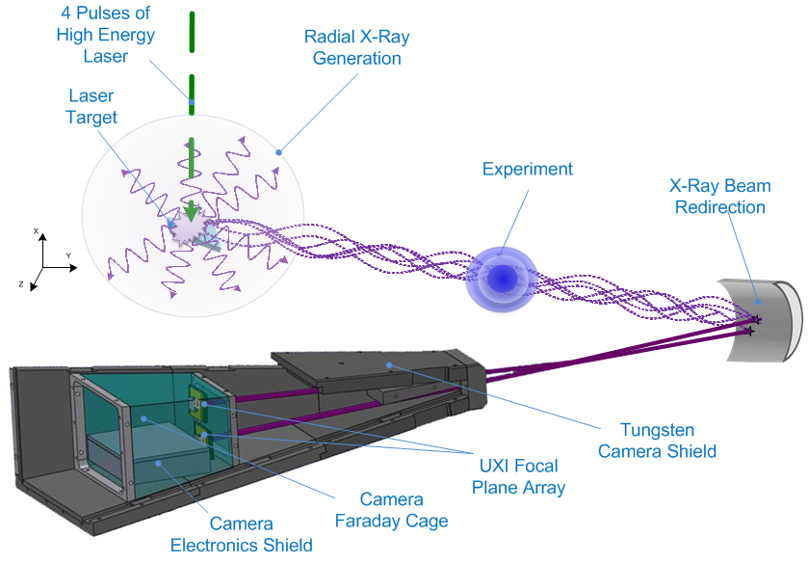
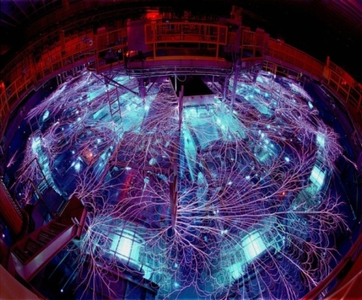
Sandia Ultrafast X-ray Imager (UXI) Program
Superlattice-doped Detectors for Pulsed Power Experiments
Z-Machine Experiment
Time-gated hybrid CMOS detector
Capable of capturing 1 ns frames at 2 ns intervals
Pulsed-power detector requirements:
Radiation-hard surface passivation
High QE for soft X-rays and low energy electrons
Notes:
Sandia Z-Machine
Used for inertial confinement fusion and weapon physics experiments in support of the Stockpile Stewardship Program
Magnetic fields are used to implode BB sized targets (implosion collisions occur along Z-axis, thus called the “Z-Pinch” )
Z-Pinch Imaging
Z-Beamlet (ZBL) is a laser used to generate 6KeV X-rays that act as a “flash bulb” in order to image the Z-Pinch
Dual crystal imager system splits the X-Rays spatially and temporally thus allowing for two images to be captured

Slide 5
Superlattice-doped SARS Diodes
Stable, high efficiency detection of soft X-rays and low energy electrons
SARS diode with JPL superlattice + p+ implant
SARS diode with JPL superlattice
SARS diode with p+ implant
MBE superlattice
MBE superlattice
Oxide/Pad Opening
Oxide/Pad open
Oxide/Pad open
Metal
Metal
Metal
Oxide/Contact
Oxide/Contact
Oxide/Contact
n-type epilayer
10 µm
n-type epilayer
10 µm
n-type epilayer
10 µm
p+ implant
p+ implant
n⁺ substrate
n⁺ substrate
n⁺ substrate

Slide 6

Sandia Pulsed Power Experiments
Superlattice-doped photodiode response to X-ray pulses
Response to 7keV (Cobalt) X-ray pulse
Pulsed power experiments
X-ray pulses generated using lasers
Exceptionally high current densities:
  ~10⁸ to 10⁹ electron-hole pairs per pulse
  Timescale ~ns
  Diode size 200µm x 200µm
Sandia SARS diodes
Front-illuminated pn diodes operated at 50V bias
Ion-implantation to form pn junction
  Boron (BF₂) implant: 10¹⁵cm⁻² at 20keV, 30nm mask
  Arsenic implant: 10¹⁵cm⁻² at 5keV, no mask
P- and N- type superlattice-doped detectors have been fabricated and tested
Superlattice-doped photodiodes are sufficiently stable for pulsed power experiments
Notes:
Roughly equivalent to 0.5 – 5x10^6 photons hitting a 15µm pixel

Slide 7
Superlattice-doped vs Ion-implanted detectors
Low-Energy Electron Responsivity
P-type photodiodes
N-type photodiodes
Superlattice-doped photodiodes show significant improvement over ion-implanted photodiodes, best tested to date

Slide 8
Superlattice-doped vs Ion-implanted detectors
Ultraviolet Quantum Efficiency
Recombination losses in silicon
  Surface recombination
    Surface depletion layer caused by charge trapping at Si-SiO₂ interface
    Detector QE and stability depend on surface doping and Si-SiO₂ interface trap density
  Bulk recombination
    Auger recombination in degenerately doped, ion-implanted surface: 𝛕 ~ (Na)⁻²
    Detector QE depends on surface dopant profile and electric field
Superlattice doping virtually eliminates both surface and bulk recombination
Notes:
Blouke model 1991: Formal model, depends on surface recombination velocity and near surface electric field. Blouke assumes a Gaussian dopant density.
Surface may be either accumulated or depleted, modeled by Blouke as positive or negative surface electric field.
Model calculates excess carrier concentration, and uses continuity equation to calculate currents, with the surface recombination velocity as a boundary condition for x=0.
Surface recombination is one loss mechanism, as a non-zero surface recombination velocity reduces the excess carrier concentration (thereby reducing the signal).
Bulk recombination is the second important loss mechanism, modeled in terms of a recombination rate that depends on the minority carrier lifetime. Rn(x) = delta n(x)/tau
Stern et al. 1994: The formal model is solved numerically, and the results of this model are compared to a “semiempirical” model that assumes a linear relationship between CCE and depth, up to some layer thickness t.
Jerram et al. 2010: Uses “semiempirical” model from Stern 1994 (with slight variation in the equation, possibly to correct an error in the Stern equation).
There are only two parameters in the semiempirical model, which are the thickness of the doped layer and a parameter “P₀”. The latter corresponds to the probability that an electron generated at the surface will be collected. Because charge generated near the surface interacts with both the surface and the bulk, P₀ is affected by both surface and Auger recombination.
A comparison of ion implantation alone with ion implantation + SL doping gives some insight into the relative importance of surface and bulk recombination. From the data, it appears that the two are roughly comparable.

Slide 9
Ion-implanted detectors
Surface and Bulk Recombination
UV-visible detectors
Electron detectors
High surface and bulk recombination in ion-implanted detectors

Slide 10
Bulk Recombination
Minority carrier lifetime and electric field strength
𝛕 ~ 20ns
Auger lifetime
𝛕 ~ (N_{a})⁻²
Superlattice doping virtually eliminates Auger recombination in the detector surface
Superlattice doping isolates the surface from the detector

Slide 11
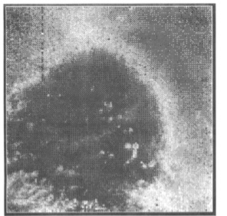
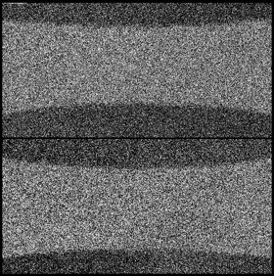
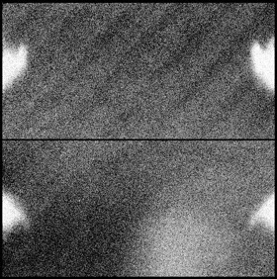
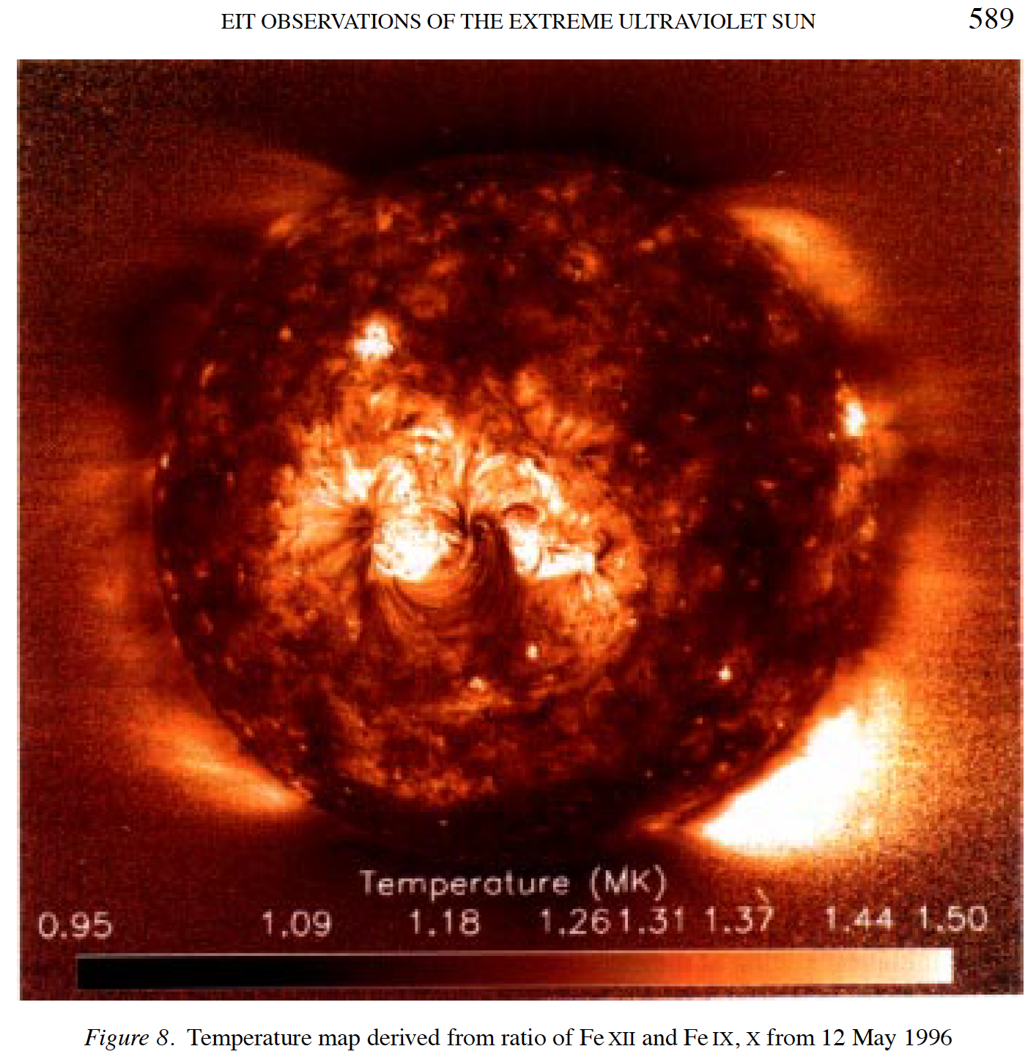
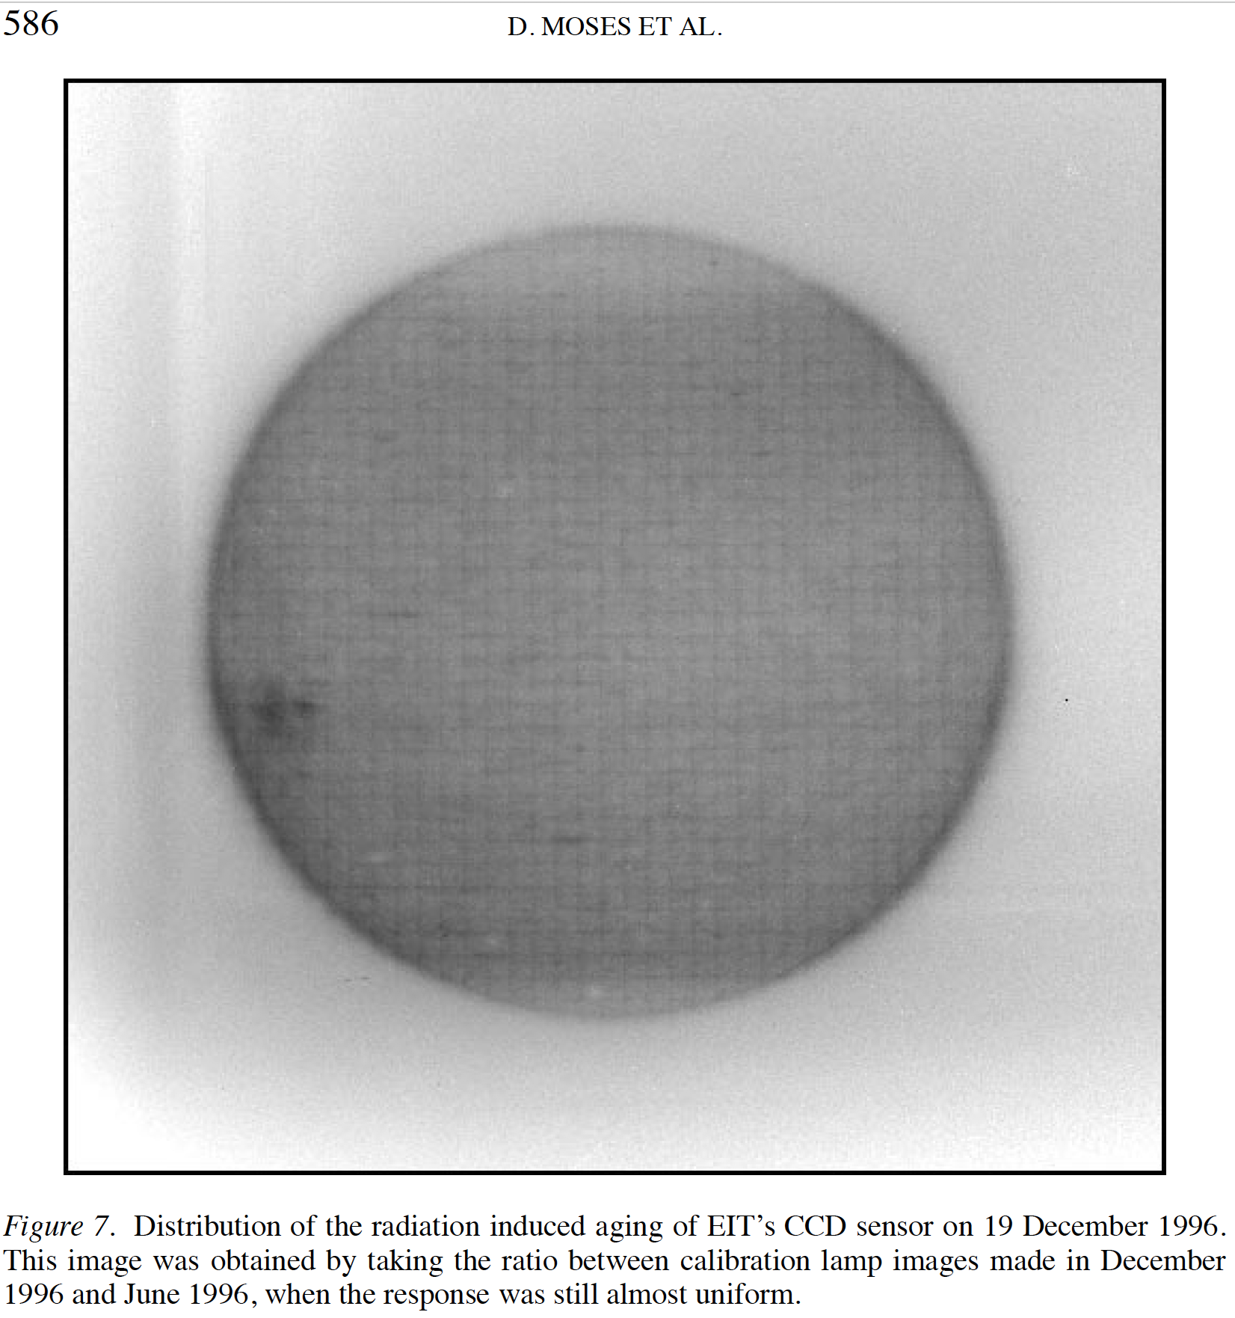
Surface Traps in Silicon Detectors (1)
Surface charging and radiation damage
Hysteresis
Collins et al.,
“Wide Field Camera 3 CCD Quantum Efficiency Hysteresis: Characterization and Mitigation,”
SPIE 7439, 2009
WF/PC 1 WFC3 WFC3
Radiation-damage
D. Moses et al., “EIT Observations of the Extreme Ultraviolet Sun,” Solar Physics 175: 571-599, 1997.
Notes:
Process limitations
Degradation of surfaces – high energy photons and particles can kill detectors

Slide 12
Surface Traps in Silicon Detectors(2)
Radiation damage: surface charging and “dead” layer
Surface depletion vs interface trap density
(implant dopant density 2x10¹⁹cm⁻³)
Surface depletion vs dopant density
(interface trap density 10¹³cm⁻³eV⁻¹)
Surface charging creates variable depletion layer

Slide 13
Surface Traps in Silicon Detectors(3)
Tradeoff between QE and stability in ion implanted surfaces
Lower dose
N_{a} = 2x10¹⁸ cm⁻³
Higher QE
Lower stability
Sandia boron implant
N_{a} = 2x10¹⁹ cm⁻³
Higher dose
N_{a} = 2x10²⁰ cm⁻³
Lower QE
Better stability
Density of states of 2D electron subband: g(E)_{2D}dE = (m*/𝜋ħ²)dE = 4.5x10¹⁴ cm⁻²eV⁻¹ dE

Slide 14
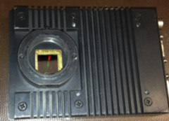
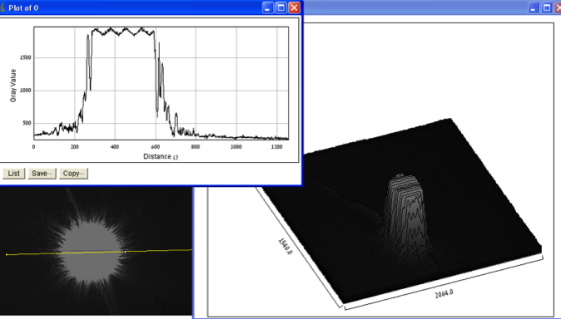
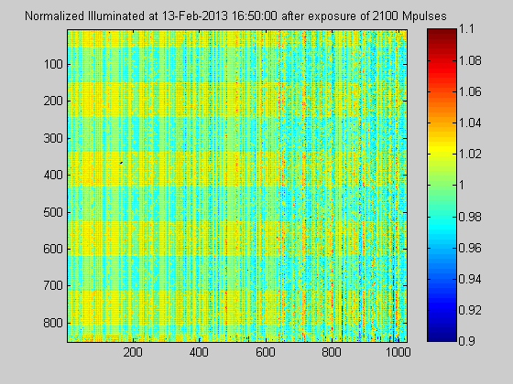
Surface Traps in Silicon Detectors (4)
DUV Stability and Radiation Hardness of Superlattice-doped Detectors
Superlattice-doped detectors exposed to pulsed DUV lasers at 193nm and 263nm over several months, > 2 billion pulses
Internal QE ~100%, stable to better than 1%.
No measurable hysteresis or persistence
Hoenk et al., Proc. SPIE. 9154, High Energy, Optical, and Infrared Detectors for Astronomy VI, Montreal 2014
Stable, high QE independent of surface damage
Normalized Spatial Response following 2.1 billion laser pulses at 193nm

Slide 15
Surface Traps in Silicon Detectors (5)
Radiation-induced surface damage
Interface trap densities in radiation-damaged surfaces can exceed 10¹⁴ cm⁻²
Ion-implanted surface
Damage causes “dead layer”
Superlattice-doped surface
Damage has no effect on QE
Superlattice doped detectors are stable against radiation-induced surface damage
Notes:
Comparison of surface “dead layer” for 3D doping vs. 2D doping as a function of interface trap density.
Hoenk et al., Proc. SPIE. 9154, High Energy, Optical and Infrared Detectors for Astronomy VI, Montreal 2014

Slide 16
Surface Traps in Silicon Detectors (5)
Eliminating Hysteresis and Persistence
Quantum confinement in 2D subbands suppresses surface trapping and recombination
High hole concentration in superlattice suppresses surface dark current and persistence
Notes:
Ion implanted surface
Low concentration of holes in surface depletion layer suppresses recombination
Variable surface charge leads to low QE, hysteresis, and persistence
Superlattice-doped surface
Extremely high concentration of holes bound to the superlattice-doped layer
Surface trap states are depopulated on very short timescales
Surface dark current is suppressed
Persistence is suppressed

Slide 17
Atomic Layer Deposition of AR Coatings and Filters (1)
Stability of 2D-doped detectors facilitates optical design
QE > 50% in near and far UV for
AR-coated CCDs and EMCCDs
Optical coatings and filters do not require low surface trap density
Nikzad et al., “Delta doped Electron Multiplied CCD with Absolute Quantum Efficiency over 50% in the near to far Ultraviolet Range for Single Photon Counting Applications,”
Applied Optics, 51(3): 365-369, 2012.
High, stable QE independent of surface trap density

Slide 18
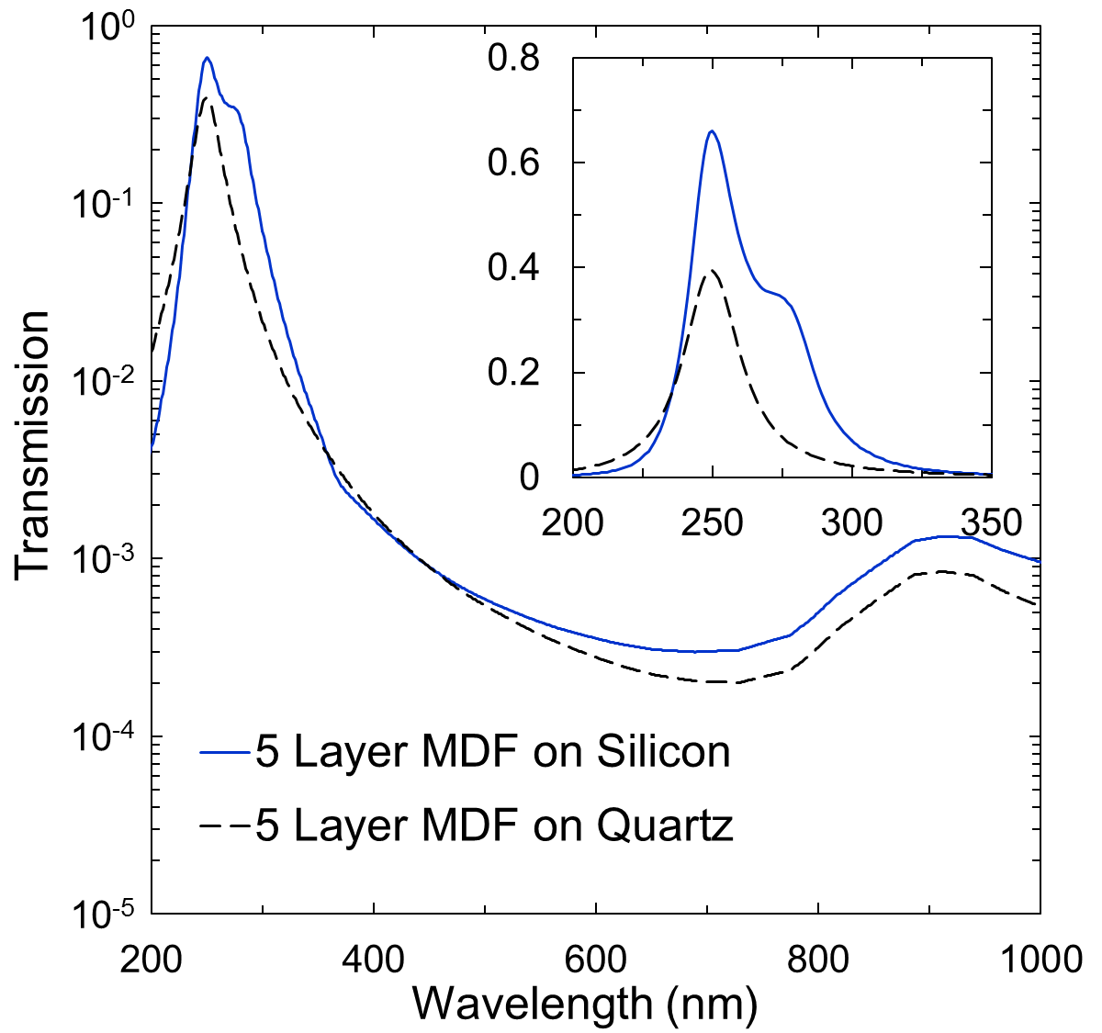
Atomic Layer Deposition of AR Coatings and Filters (2)
Superlattice-doped APDs with Integrated Solar-blind Filters
Hennessy et al., “Metal–dielectric filters for solar–blind silicon ultraviolet detectors,” Applied Optics 54(11): 3507-3512, 2015.
Superlattice-doped APDs with integrated metal-dielectric filters, Hoenk et al., 2016
Metal-dielectric filter with in-band QE>60% and out-of-band rejection ~10⁻⁴
Notes:
Superlattice doped avalanche photodiodes with integrated metal-dielectric filters.
Source: Hoenk et al., “Solar-blind, superlattice-doped avalanche photodiodes,” SPIE Astronomical Telescopes and Instrumentation, Edinburgh, Scotland, 2016

Slide 19
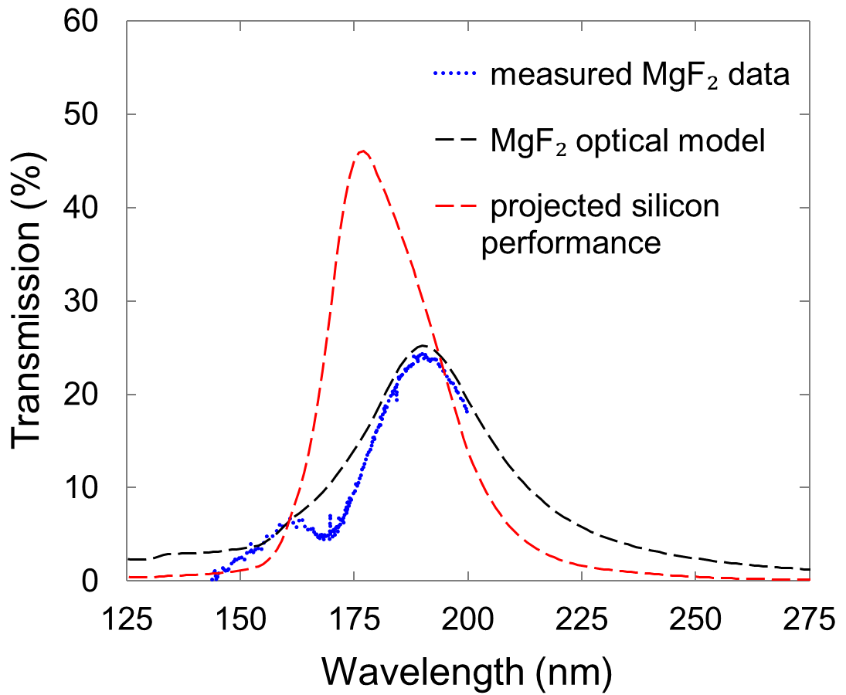
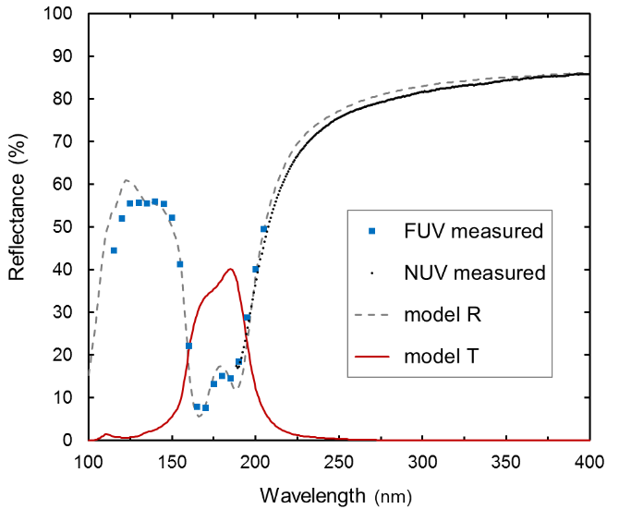
Atomic Layer Deposition of AR Coatings and Filters (3)
Far UV Bandpass Filters for EMCCDs and Low noise CMOS
MgF₂/Al and AlF₃/Al Integrated Metal-Dielectric Filters on EMCCDs

Slide 20
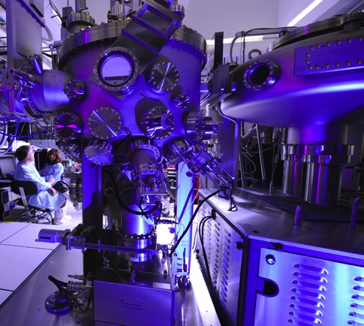
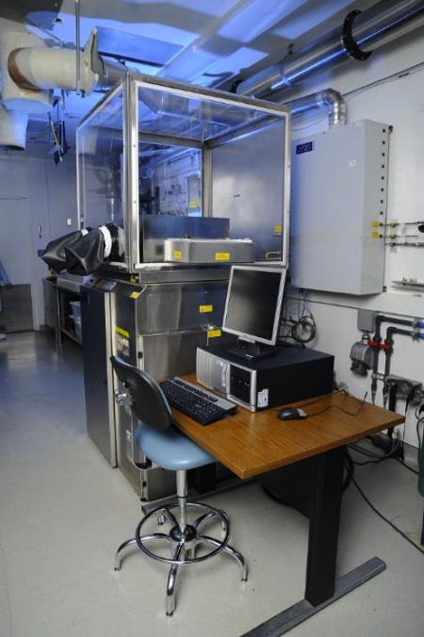
JPL’s Microdevices Laboratory
Molecular Beam Epitaxy
Atomic Layer Deposition
8-inch diameter wafer capacity, multi wafer batches
Notes:
JPL’s end to end back illumination detector processing is versatile and can be applied to detectors that are fully fabricated.
From top left:
Fully VLSI fabricated device wafer
“Handle” wafer bonded using direct wafer bonding to the device wafer
Device wafer gets thinned down to a few microns. Bonded handle wafer provides structural support
After thinning, wafer gets cleaned and put in the Molecular beam epitaxy (MBE) machine for delta doping/superlattice doping
After delta doping the handle wafer gets patterned and etched to expose the bond pads. Bond pads are used for wirebonding and electronic connection
Wafer gets diced. Atomic Layer Deposition (ALD) is used for depositing AR coatings and/or Visible-rejection filters. This will make silicon arrays solar blind!!

Slide 21
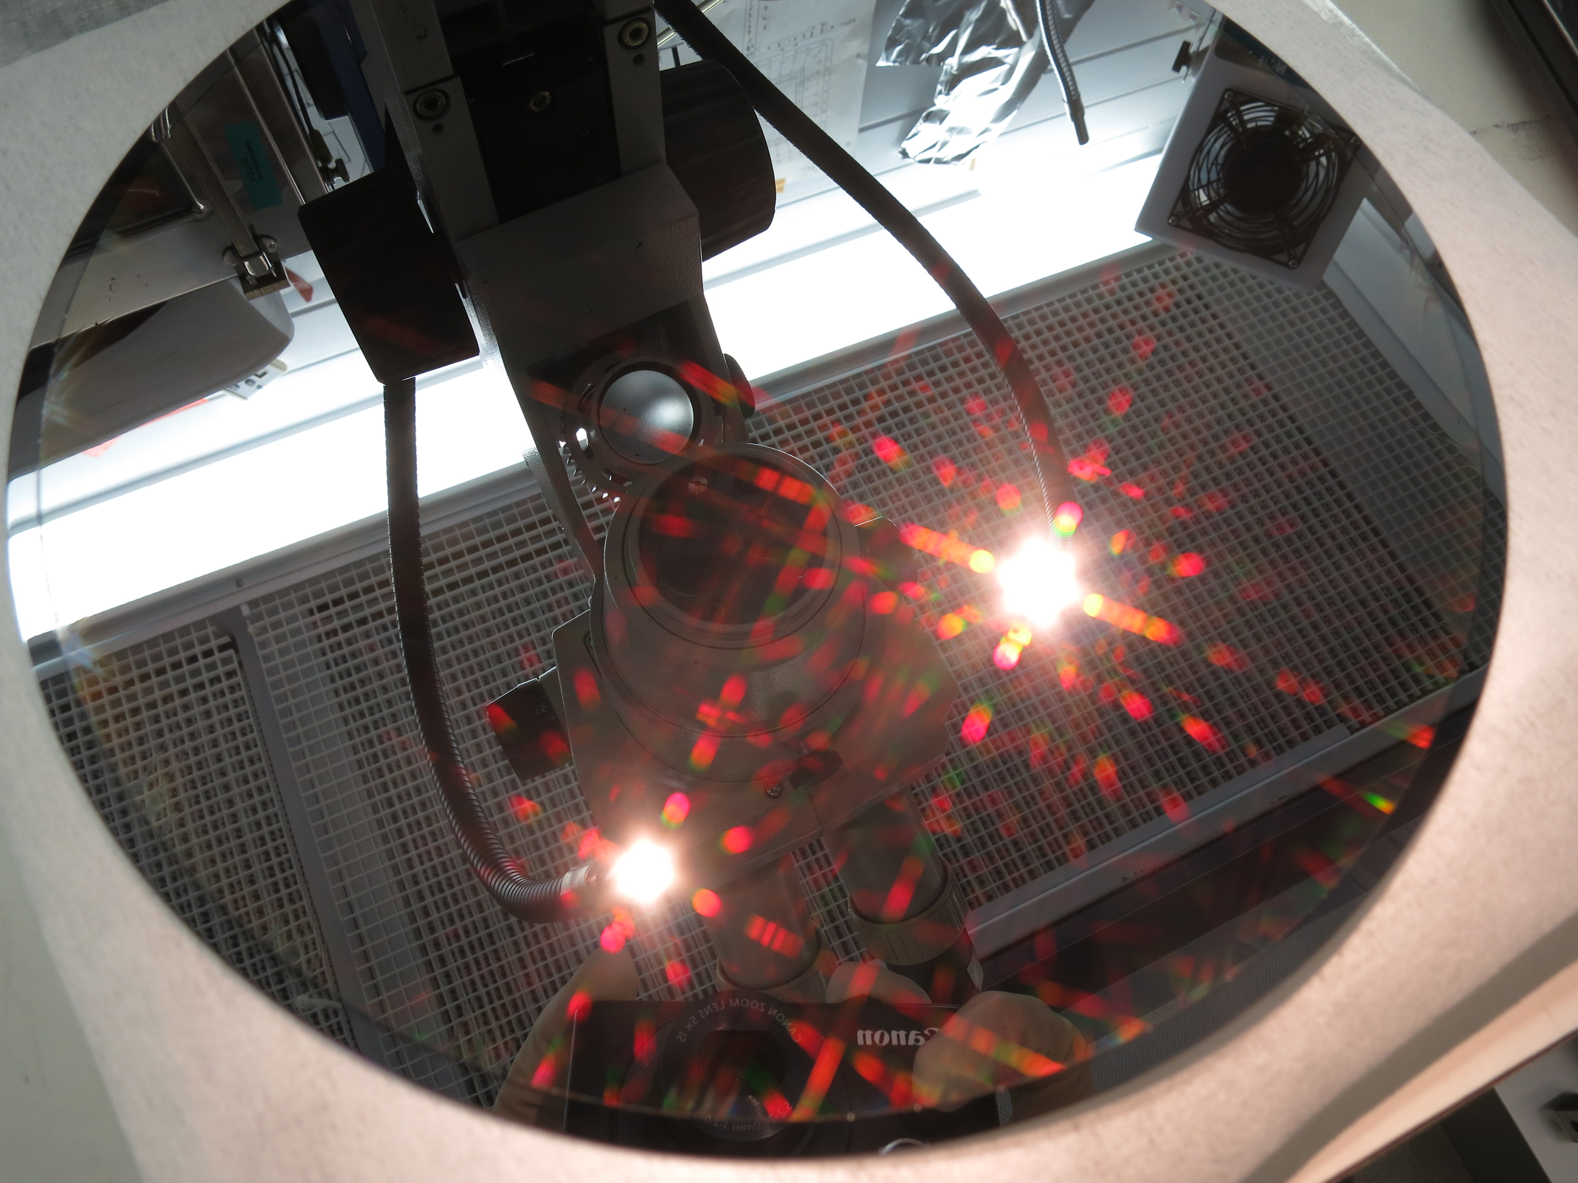
Superlattice-doped CMOS Imaging Detectors
High throughput, high yield MBE growth on 200mm wafers
M.E. Hoenk, U.S. Patents 8,395,243 and 9,024,344
Radiation hard, full wafer surface passivation with high, stable quantum efficiency.

Slide 22
Commercial Programs
Licensing and Technology Transfer of 2D-doping and AR Coating Technologies
Working with government, academia and industry to demonstrate 2D-doped detectors for diverse applications
  CMOS imaging detectors designed by CMOSIS, Panavision and RAL, and manufactured by Tower Jazz.
  CCD imaging detectors manufactured by e2v, STA, SITe, LBNL, etc.
  Avalanche Photodiodes manufactured by Radiation Monitoring Devices Inc.
  Others (proprietary)
Technology transfer and commercialization
  Superlattice doping and ALD coatings, Alacron Inc.
    Space Act Agreement for technology transfer of superlattice-doping technology.
    Exclusively licensed superlattice doping for semiconductor industry applications
      US patents # 8,680,637, # 8,828,852, # 8,395,243, #9,123,622
    Alacron is offering superlattice-doping as a service to detector manufacturers
  Others
    Hybrid advanced detectors, US patent #6,107,619, #6,346,700
      licensed by Sony, Micron, Panasonic, Samsung, Toshiba, Nikon, Cannon, etc.
    Delta and superlattice doping, US patents #6,403,963 , #7,800,040, #8,828,852
      licensed by Sony, Micron, Panasonic, Samsung, Toshiba, Nikon, Cannon, etc.
    Solid-State Curved Focal Plane Array / Back surface contact, US Patents # 7,786,421, #7,800,040
      licensed by Omnivision, Forza, and CMOSIS
Alacron Inc. BSI DUV camera with superlattice-doped, AR-coated CMOS imaging array.
Notes:
Commercialization of superlattice-doped detectors
Superlattice doping and ALD coatings, Alacron Inc.
Space Act Agreement for technology transfer of superlattice-doping technology.
Exclusively licensed superlattice doping for semiconductor industry applications
US patents # 8,680,637, # 8,828,852, # 8,395,243, #9,123,622
Alacron is offering superlattice-doping as a service to detector manufacturers
Others
Hybrid advanced detectors, US patent #6,107,619, #6,346,700
licensed by Sony, Micron, Panasonic, Samsung, Toshiba, Nikon, Cannon, etc.
Delta and superlattice doping, US patents #6,403,963 , #7,800,040, #8,828,852
licensed by Sony, Micron, Panasonic, Samsung, Toshiba, Nikon, Cannon, etc.
ALD AR coatings, US patents #9,123,622, #8,680,637
Solid-State Curved Focal Plane Array / Back surface contact, US Patents # 7,786,421, #7,800,040
licensed by Omnivision, Forza, and CMOSIS

Slide 23
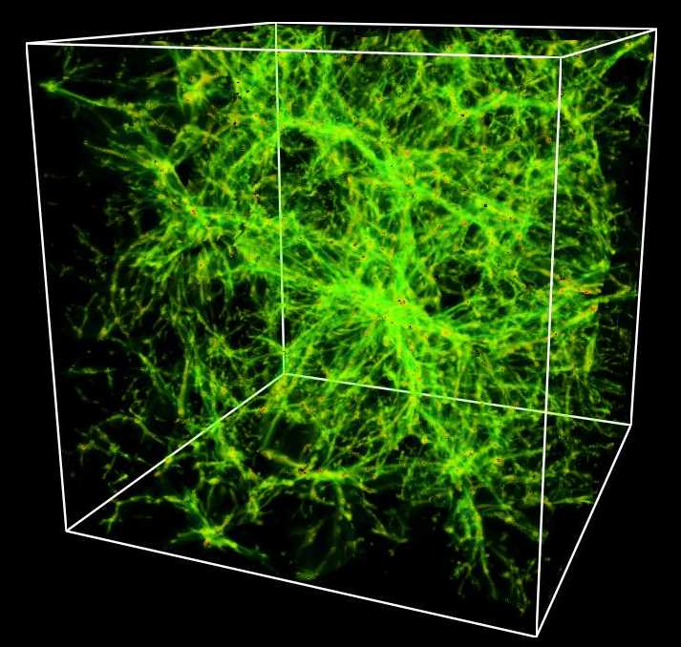
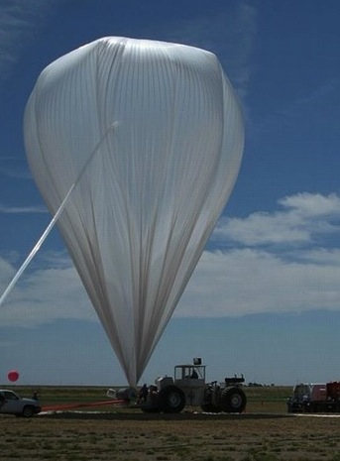
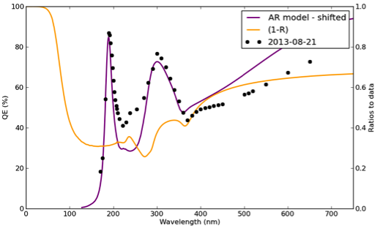
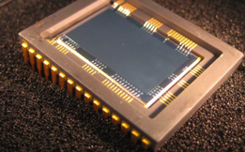
Mapping Intergalactic Medium: FIREBall balloon
Multilayer coating
5-layer coating
3-layer coating
Balloon PI: Chris Martin, Caltech
Superlattice doping and 3 or 5-layer ALD stack produce high UV QE UV
in 2-Megapixel EMCCD
Launch : Fall 2017

Slide 24
Efficiency and Stability of 2D-doped Silicon Detectors
Summary
Overview of 2D doping
Ultrafast X-ray Imaging Detectors
  Pulsed X-rays
  Low energy electrons
  Ultraviolet QE
Efficiency and stability of superlattice-doped detectors
  Bulk recombination
  Surface recombination
    Hysteresis and radiation damage in space
    Radiation damage, surface charging and the “dead” layer
    Trading QE vs. stability in ion-implanted detectors
    Superlattice-doped surfaces: DUV stability and radiation hardness
    Suppression of surface-trapping, hysteresis and persistence
AR and UV bandpass coatings
2D-doping on a large scale
  Production-scale processing
  Technology transfer
}
Direct comparison 2D-doped and ion-implanted detectors
2D-doping virtually eliminates bulk recombination
}
2D-doped detectors are immune from Si-SiO₂ interface traps, radiation damage, hysteresis and persistence
}
Stable, 2D-doped surfaces facilitate FUV and metal-dielectric coatings
Low cost 2D-doping

