Slide 1
CCD and CMOS X-ray Detector Development for Synchrotron and Space Applications
Andrew Holland^{1,2,} D. Hall¹, M. Soman¹, K. Stefanov¹,
K. Holland², P. Jerram³
Centre For Electronic Imaging, Open University, UK (www.open.ac.uk/cei)
XCAM Ltd., Northampton, UK (www.xcam.co.uk)
Teledyne e2v, Chelmsford, UK (www.e2v.com)

Slide 2
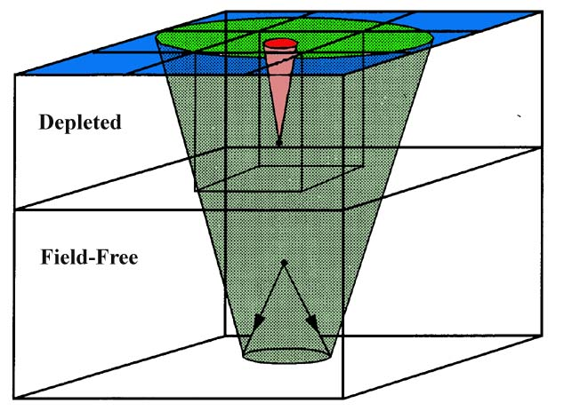
X-ray Photon Events in Pixel Detectors
Absorption in depletion region leads to be isolated single/double events
Absorption in field-free region leads to multi-pixel spread events

Slide 3
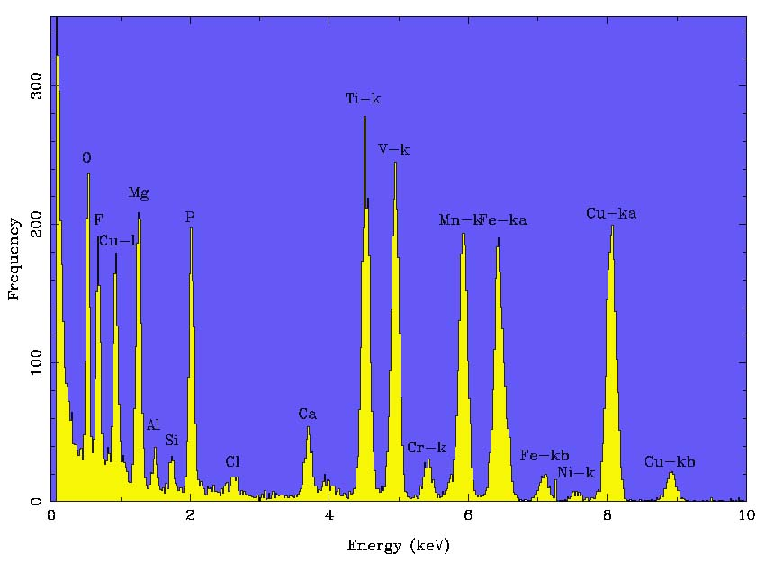
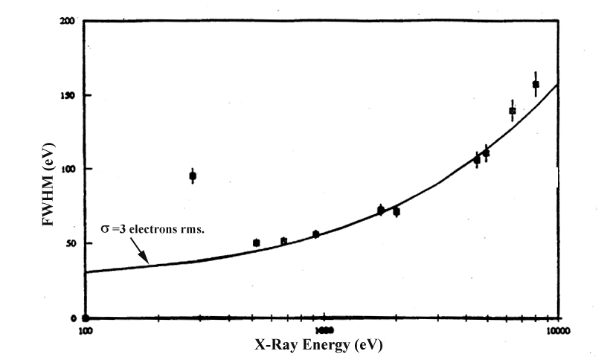
High Resolution Spectroscopy using a CCD
n_{electrons} = E/ω (300eV≅80 e-)
variance = FE/ω (V_{100e-}=12e-)
(Fano factor, F=0.12)
Requires photon-counting
mode
Composite spectrum
from e2v CCD12
“Fano-limited” resolution

Slide 4
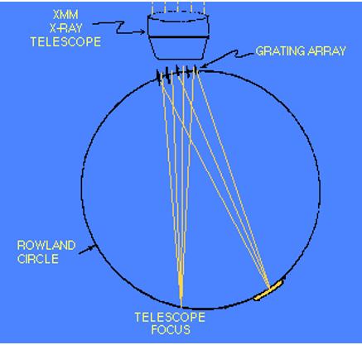
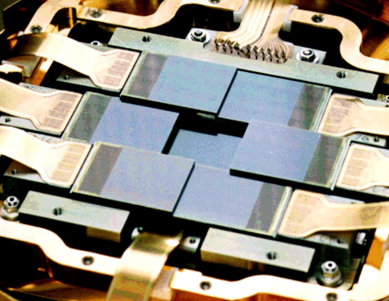
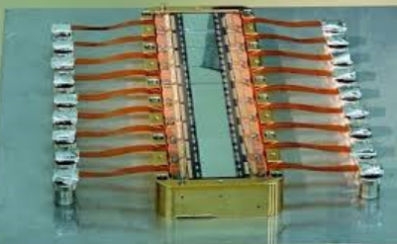
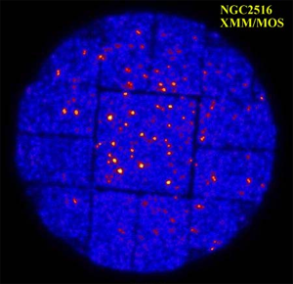
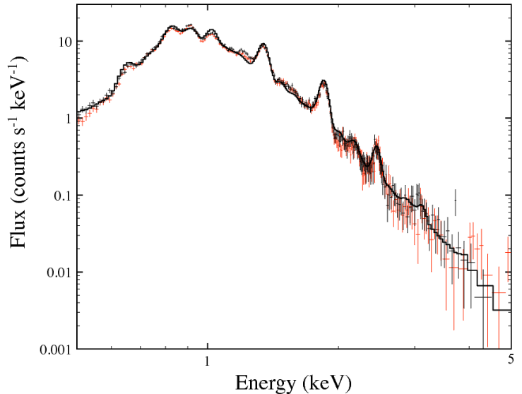
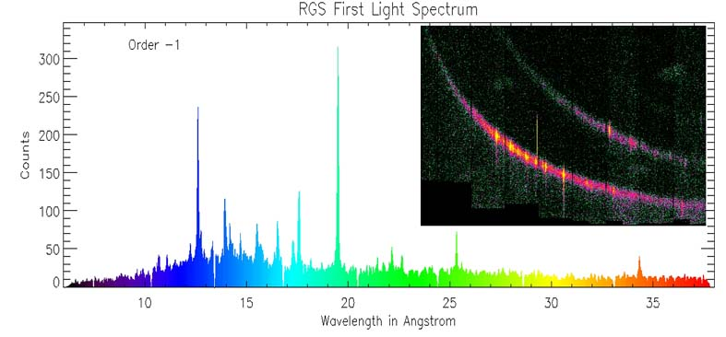
Imaging vs. Dispersive Spectrometer
XMM EPIC/MOS
XMM RGS
Imaging
Spectroscopy
High Resolution Spectroscopy

Slide 5
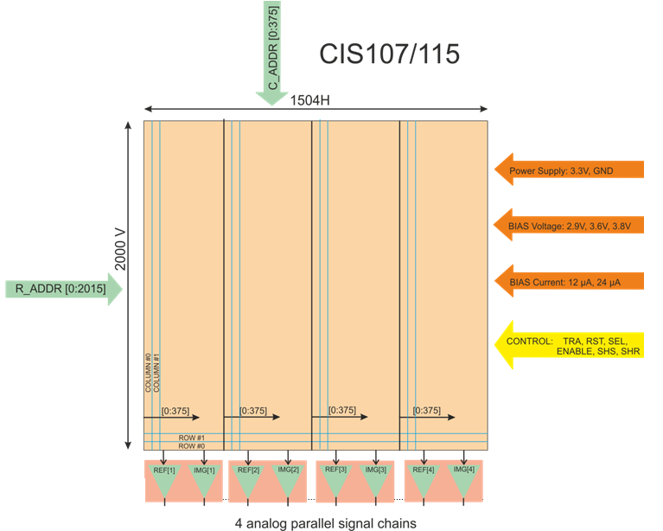
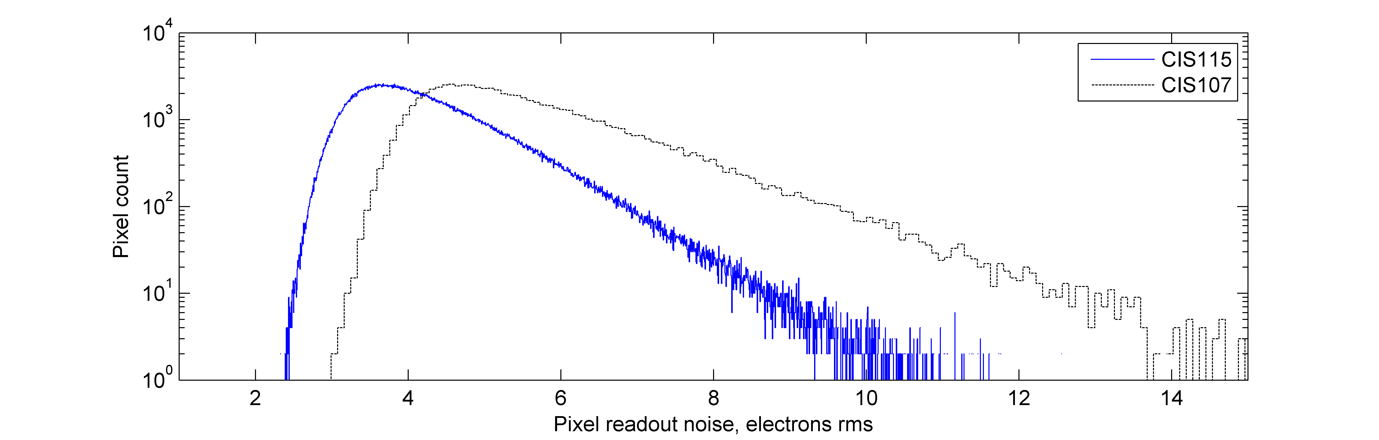
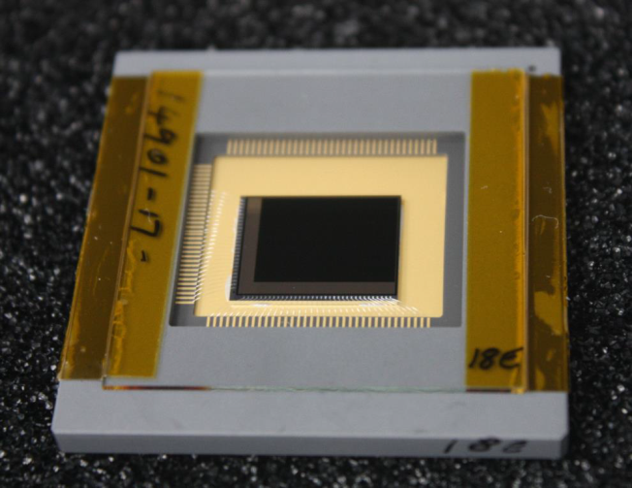
CMOS Image Sensors for X-ray Detection
e2v CIS115 is being developed for JUICE
for visible imaging of Jupiter’s moons
  Back-illuminated, 9-12μm thick
  3 Mpixel, read through 4 blocks
  7 μm pixel pitch
  Area = 1.4 cm²
  R=48μV/e-
  Noise 4-5 e- rms.
  Qualified to 250 krad TID

Slide 6
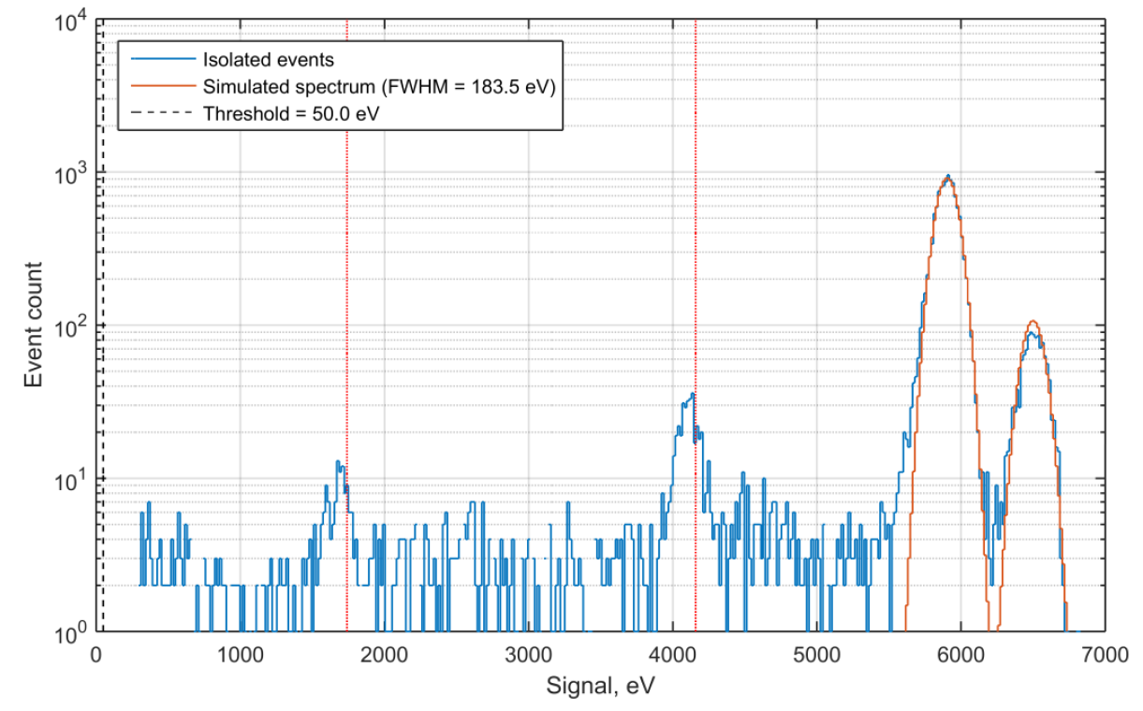
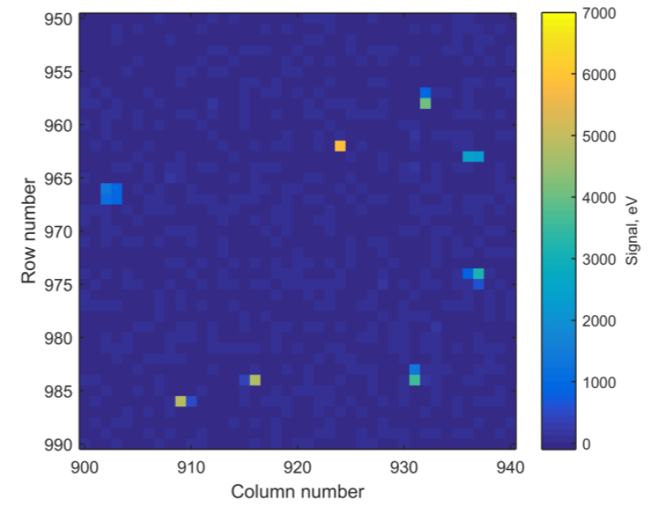
X-ray spectroscopy with CIS115
Recent results using Fe-55 from the calibration data of Matt Soman
Will enable 7μm and below spatial resolution
Around 60% of events could undergo centroiding to increase resolution further
Probably all sub-keV X-rays may be split
QE is currently low (device thickness) and no samples without AR coating
Accuracy 7μm
<7μm

Slide 7
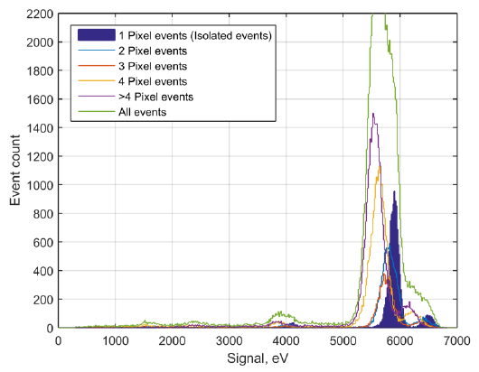
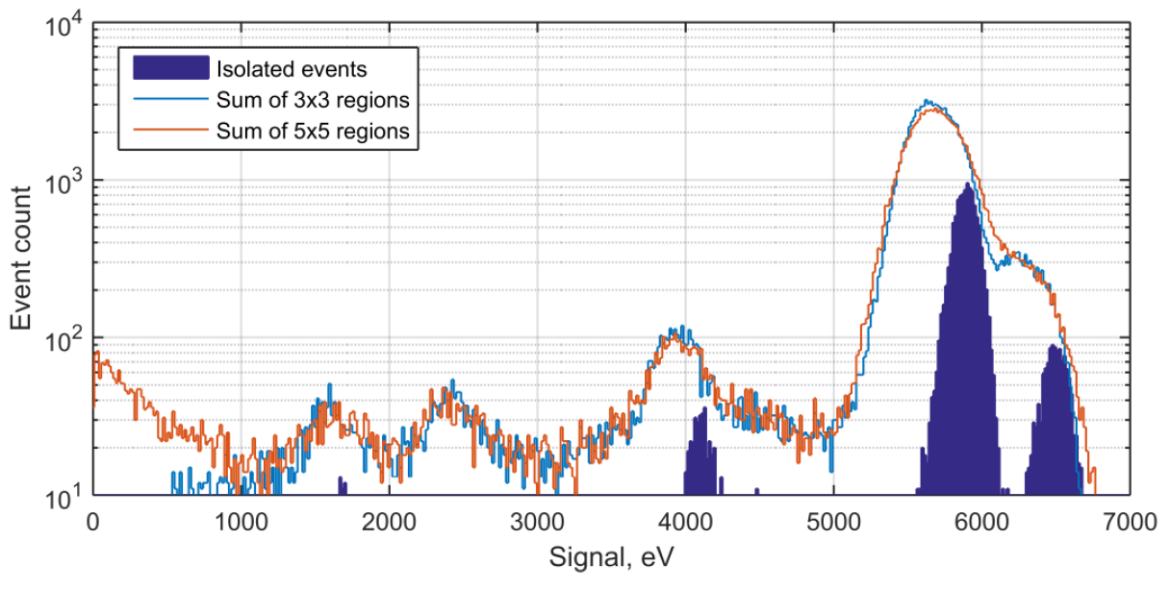
CIS115 Split event fractions
With this sensor variant, the majority of photon events are split (note @6keV)
This enables event centroiding and hence higher resolution than the pixel size
However, this also degrades non-dispersed photon counting spectroscopy (which would require thick/full depletion)

Slide 8
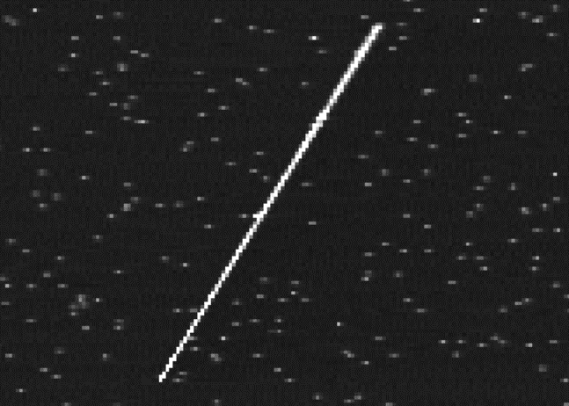
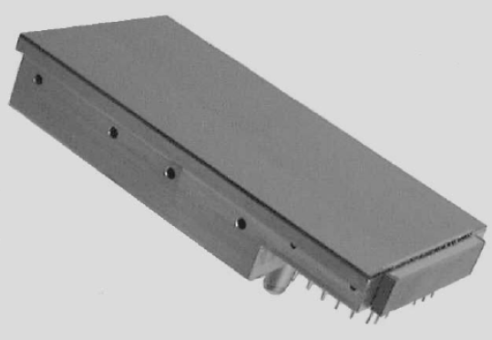
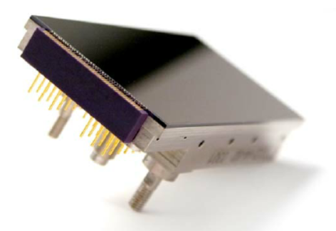
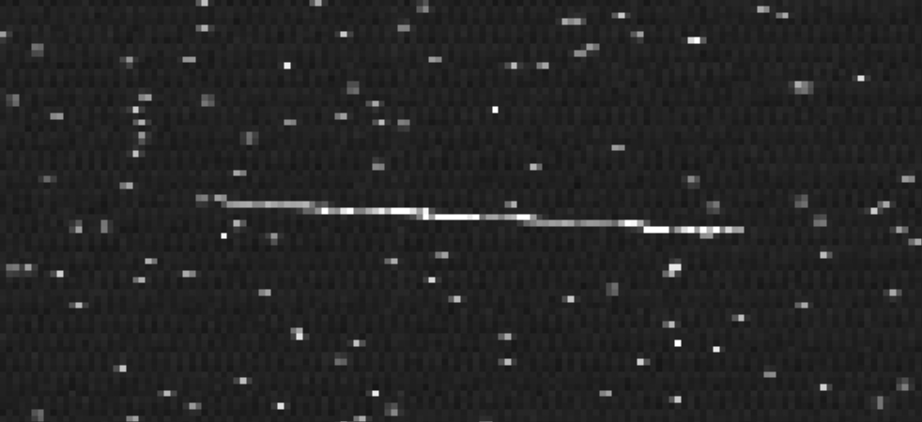
Fully Depleted CCDs
Thick fully-depleted CCDs have been available
for a few years
CCD261 – 2kx4k format
200 μm thick with full depletion
BB=0V
BB=-15V

Slide 9
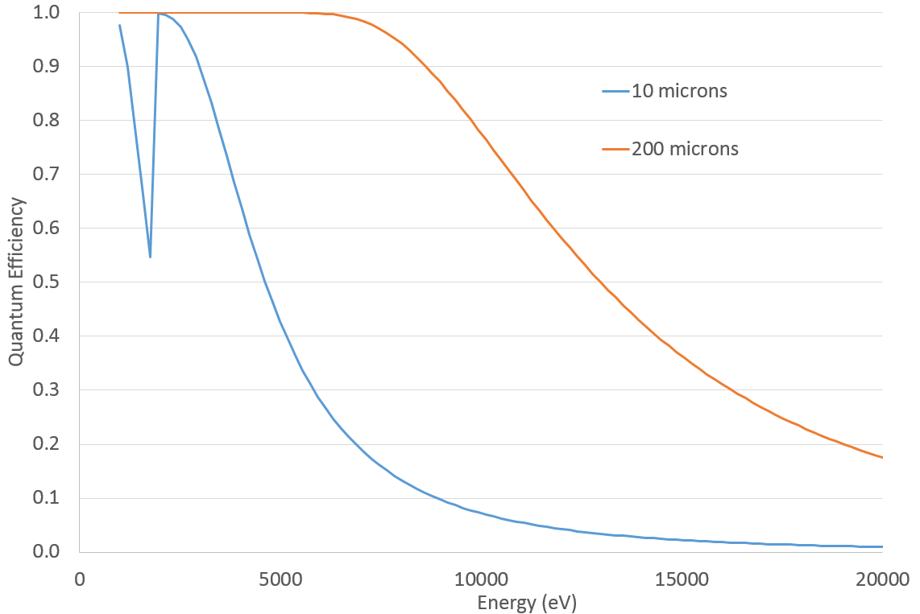
CMOS QE Improvement using Full Depletion
JUICE CIS115 sensors have ~5 μm depletion
on 10 μm BI structure
Restricted efficiency for X-ray use
Can obtain up to ~40μm BI devices on epi-Si
Test structures have been developed at OU
and fabricated by ESPROS
Device are currently being evaluated under
a PhD studentship
This development may go part-way toward making a useful X-ray detector using
a standard CMOS process
CCD
CMOS

Slide 10
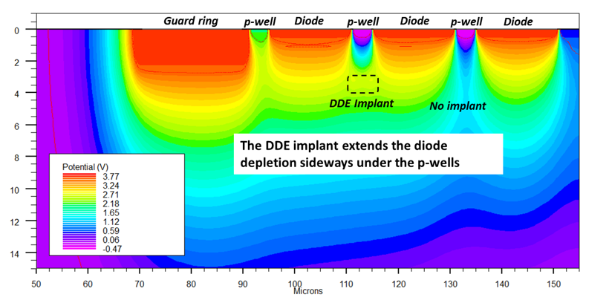
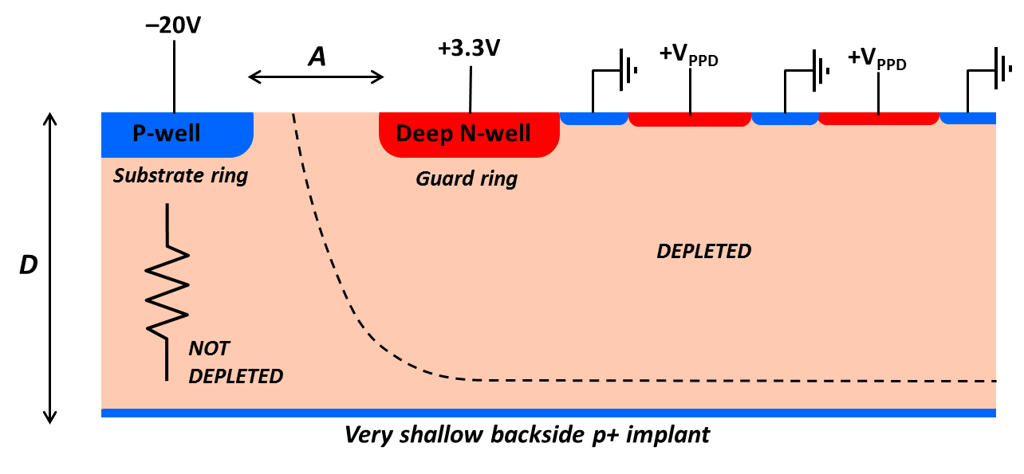
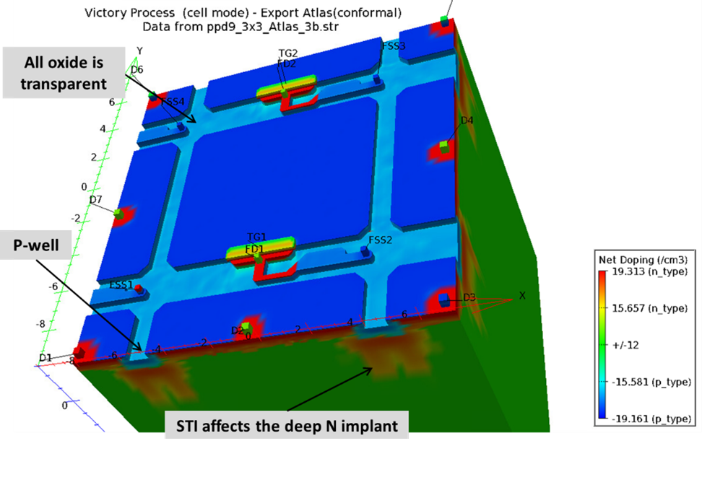
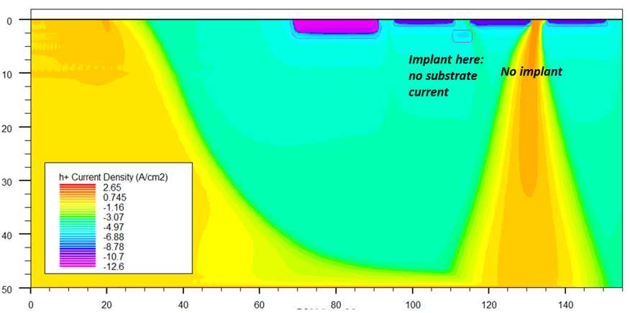
Development of a Pinned Photodiode CMOS Image sensor with Reverse Substrate Bias
Would like a fully-depleted + thick CMOS sensor
Problem of current flow when applying back-bias (i.e. making an expensive resistor!)
Working on DDE technology
Backed up by comprehensive 2&3D modelling

Slide 11
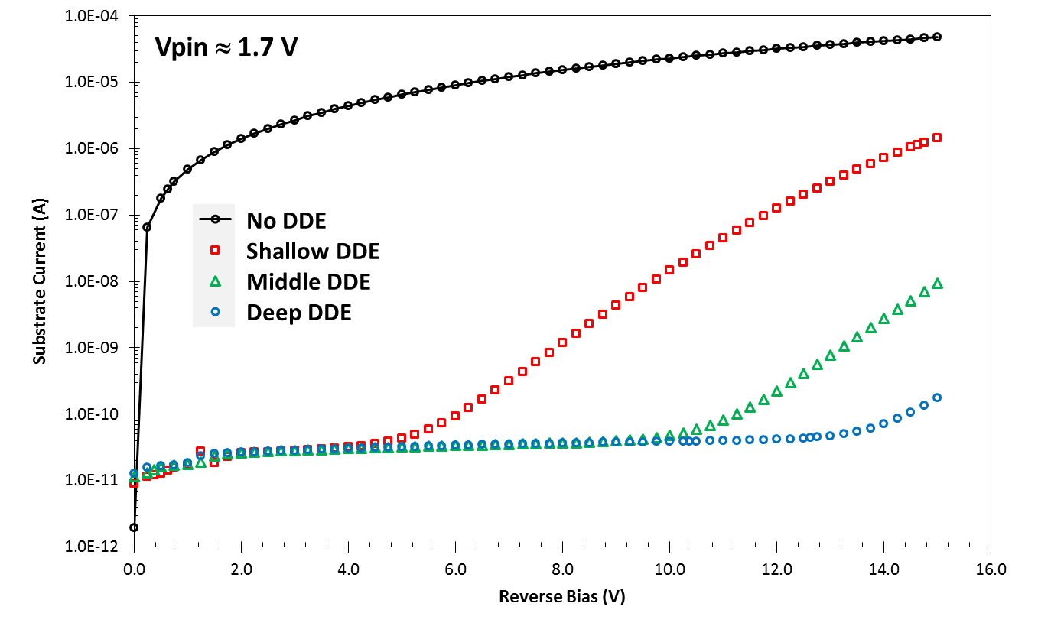
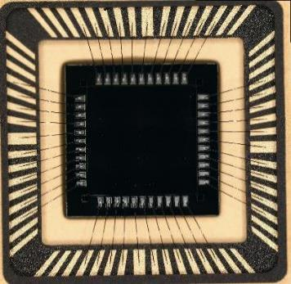
The DDE (deep depletion extension)
Test structures have been fabricated
The DDE principle has been demonstrated
The result may look fairly innocent… but!
This opens up the route toward fully-depleted CMOS image sensors
  CMOS foundry process
  100-200 μm active thickness

Slide 12
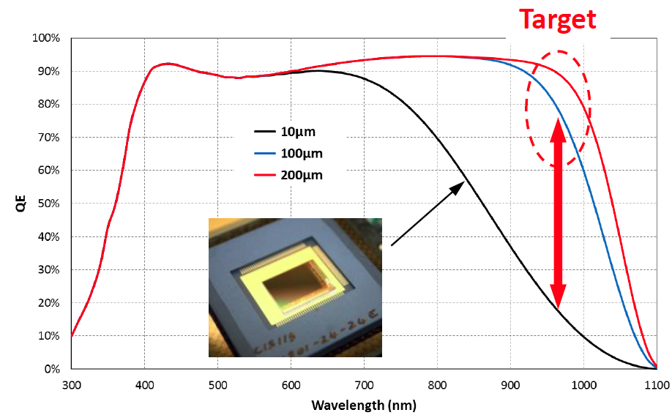
CMOS QE Improvement - toward Full Depletion
To make significant improvements need to use
bulk FZ silicon
& use reverse bias for full depletion
Supported by patent
First prototypes show very promising performance
Complementing established CMOS
properties
  Pinned photodiode for low noise
  High speed and low power readout
  Radiation hardness
Will improve both X-ray and IR QE for
future CMOS devices

Slide 13
The EM CCDs for Soft X-ray Detection
Iφ1
Iφ2
Iφ3
A standard CCD becomes an EMCCD by the insertion of a
multiplication
register
Rφ1
Rφ2
Rφ3
Rφ2HV

Slide 14
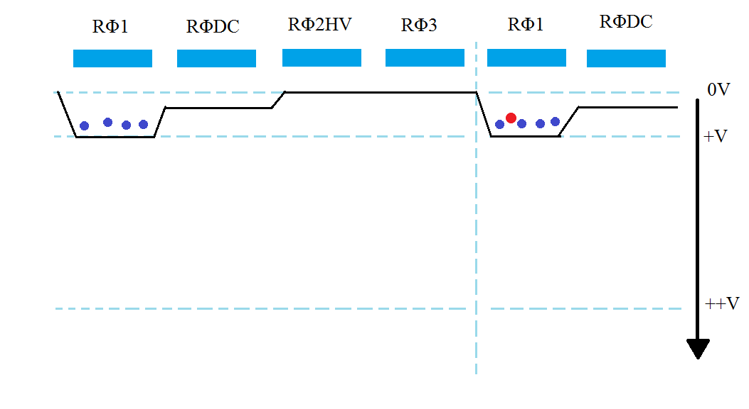
EM CCD Gain
The multiplication register utilises impact ionisation in 536 multiplication elements with each electron having a small chance of increasing the charge in each element.
A common issue with faster readouts is larger readout noise. EM-CCDs supress this larger noise due to the multiplication register increasing the signal sufficiently high enough allowing for faster reads.
Gain=(Gain/stage)^{Nelements}
Eg (1.01)⁵³⁶ = 207x.
If the noise is σ=50 e- rms.
e.n.c.=50/207 = 0.24 e- rms.

Slide 15
EM-CCDs giving increases SNR
Gain = 1
Gain = 7
1.0 keV
Improved detectability
0.3 keV

Slide 16
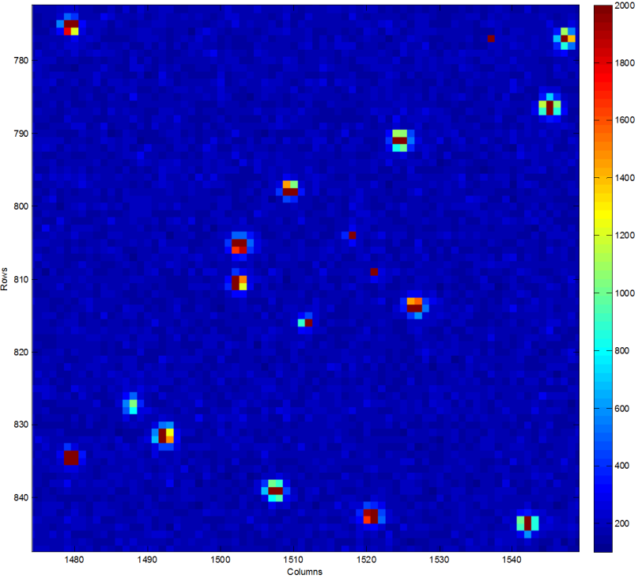
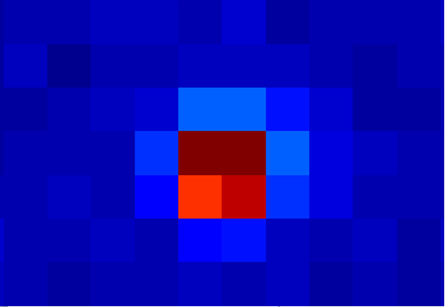
X-rays in an EM CCD
EM gain can enable the CCDs to be read
out with at high speed, with high noise,
yet with low e.n.c.
Modified Fano factor - v = (1+F)E/ω
due to shot noise on avalanche process
Sub-pixel charge centroiding can increase
spatial resolution
Example of an Mn-K X-ray
  Signal occupies ~12-16 pixels
  S/N~1000:1
  Enables centroiding to ~1 μm

Slide 17
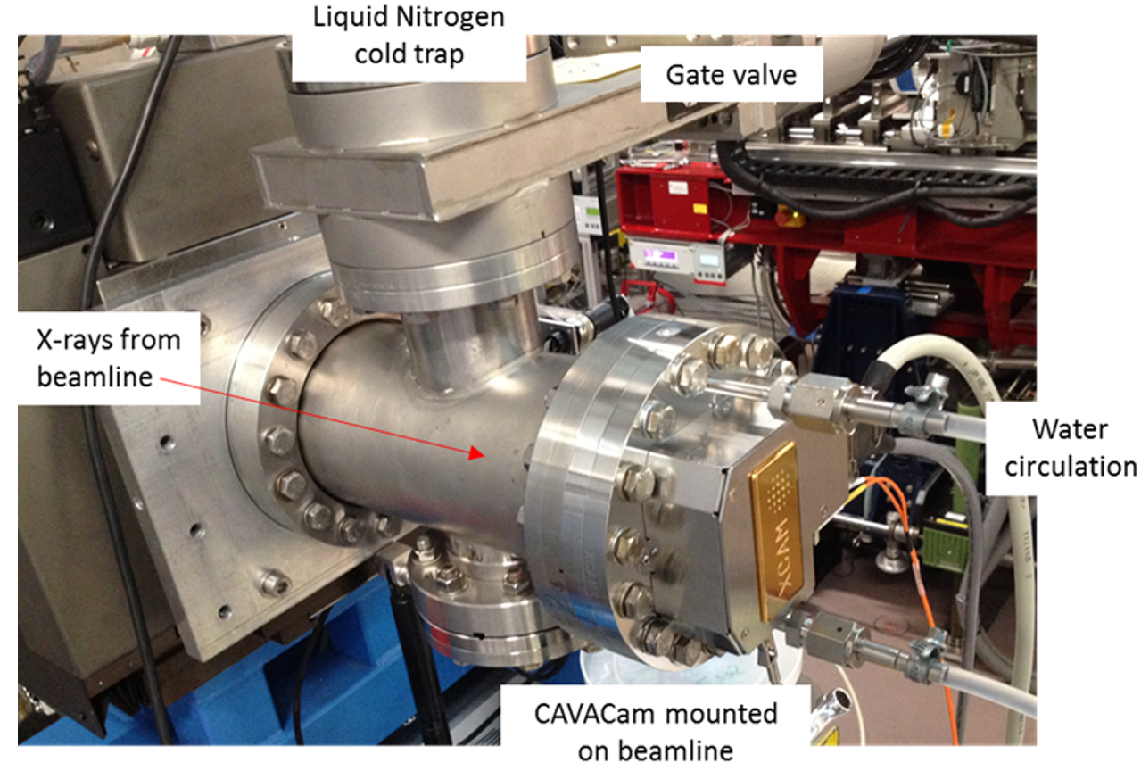
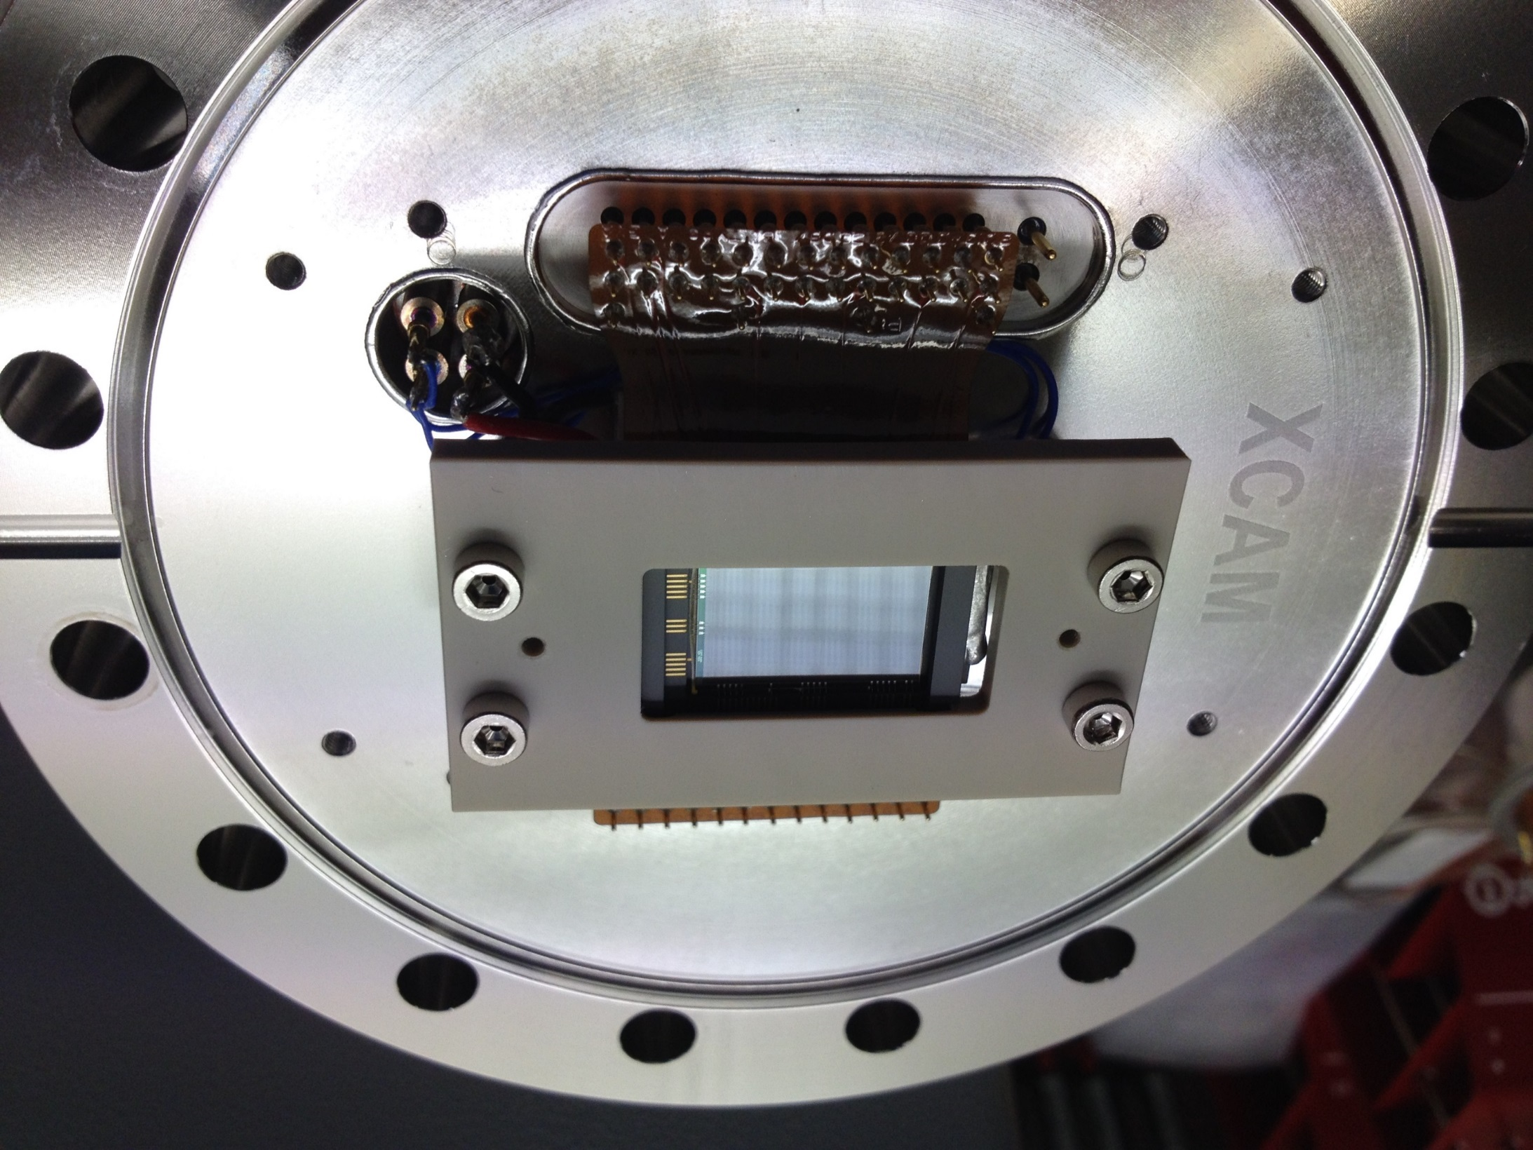
Soft X-ray QE Measurements
Since XMM, the CCD production and BI processing at e2v has been changed..
This programme was aimed at re-characterising the soft X-ray performance of the current build standards of the e2v BI process
Both Standard and Enhanced BI processes were evaluated
Custom CCD97s were produced
50-2000 eV range

Slide 18
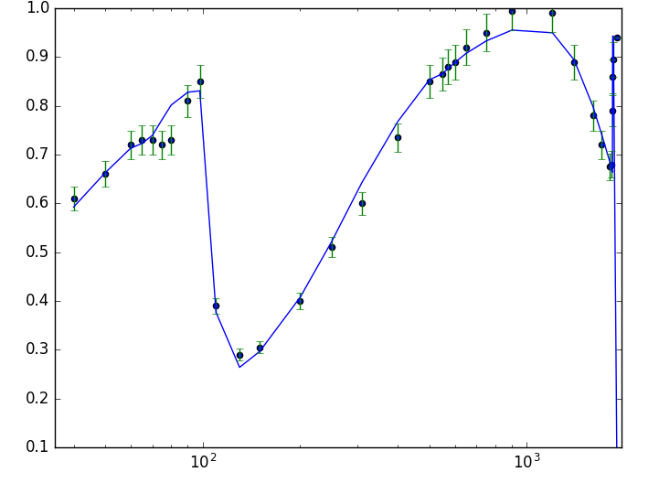
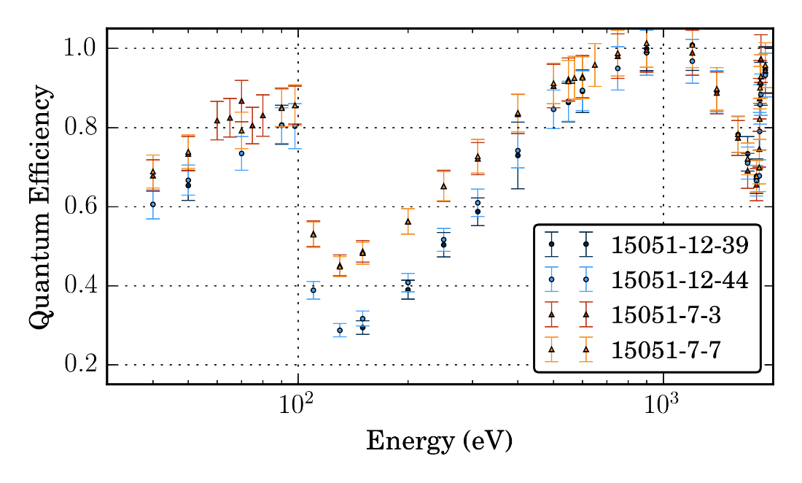
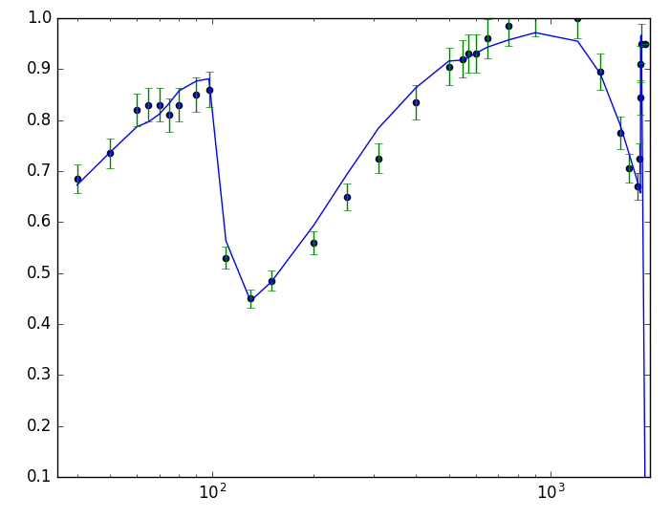
Soft X-ray QE Measurements at PTB
Measurements were taken on 2 devices of each type
Results were used to develop new modelling
Results are described in an e2v “White Paper”
https://www.e2v.com/products/imaging/technical-papers/
Basic Process
Enhanced Process

Slide 19
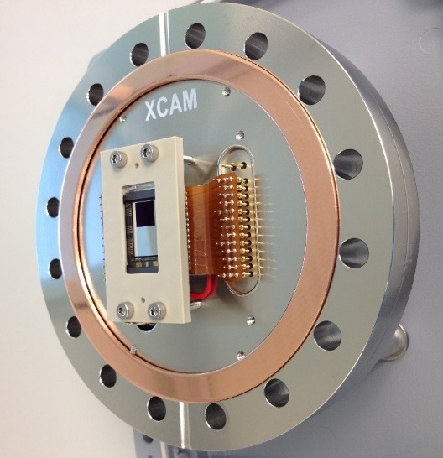
Light Blocking Filter Development
We have been developing new direct-deposited light blocking filters on BI CCDs
Explored a range of build configurations on a CCD97 test vehicle
Light filter put in place of the conventional store shield
Quantified the optical transmission including pinholes
Tested at the PTB facility at Bessy II for X-ray transmission

Slide 20
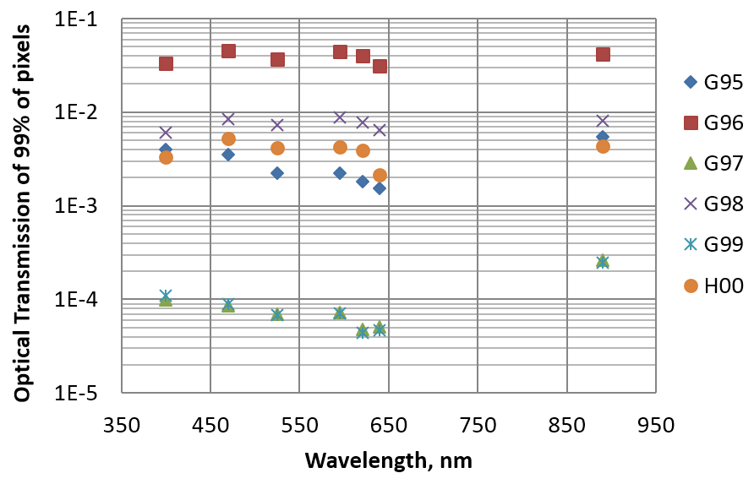
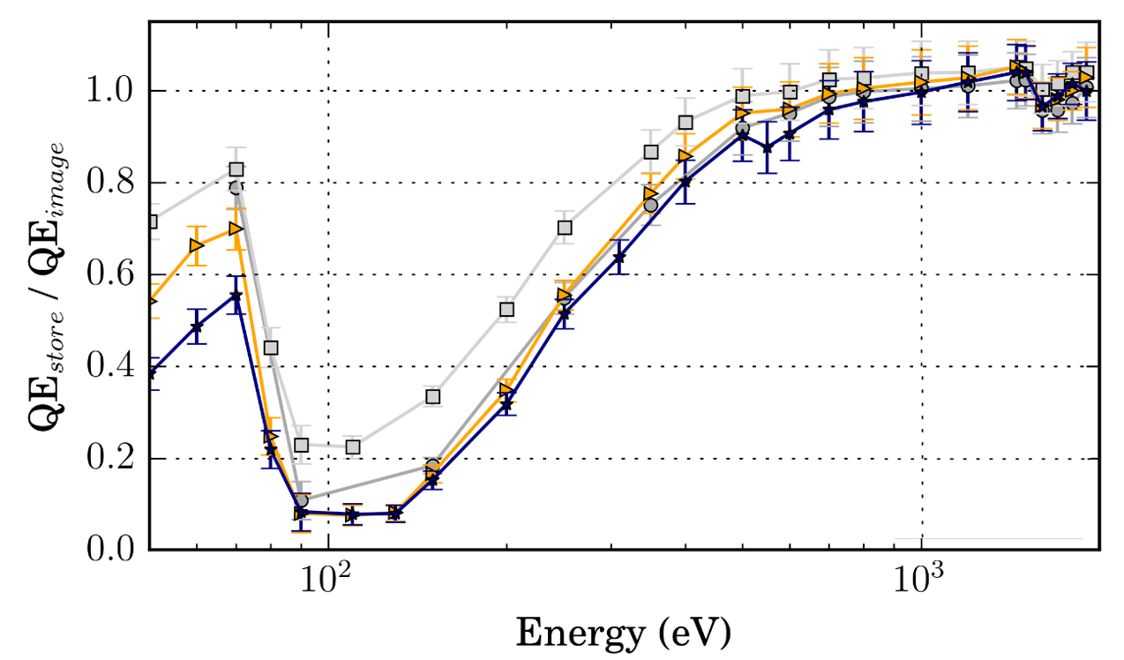
Light Blocking Filter Measurements
Optical transmission and X-ray transmission results
Further qualification of the process is being considered for the SMILE project

Slide 21
Current Applications Being Developed
X-ray Dispersive Spectroscopy
  RIXS Camera System
  OGRE Sounding rocket experiment
X-ray Imaging
  SMILE SXI

Slide 22
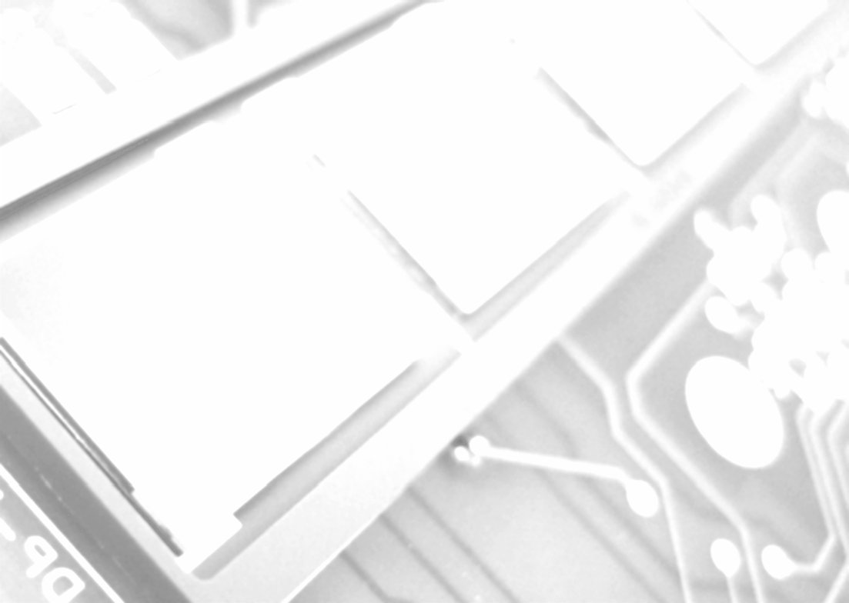


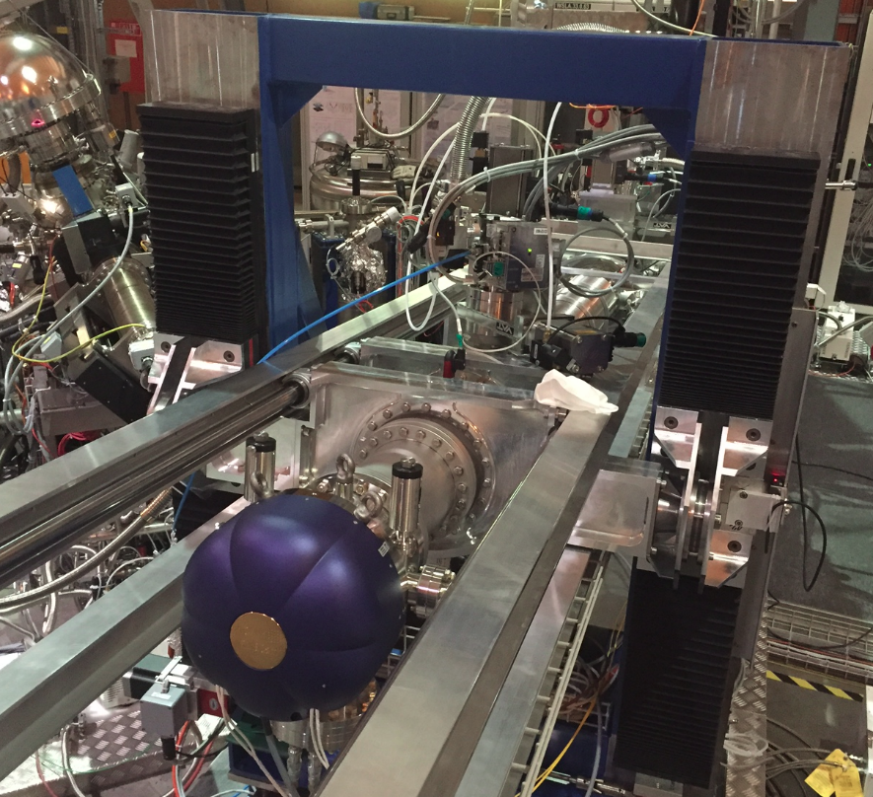
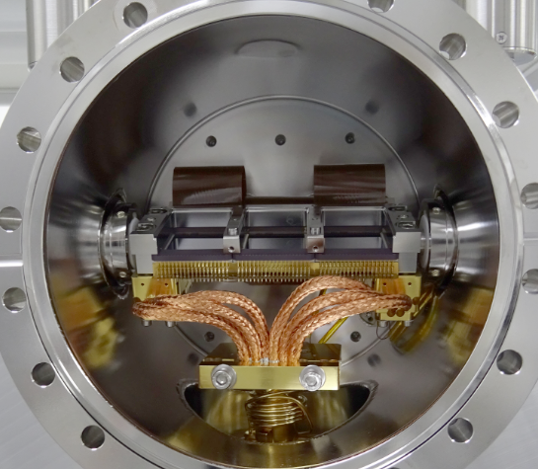
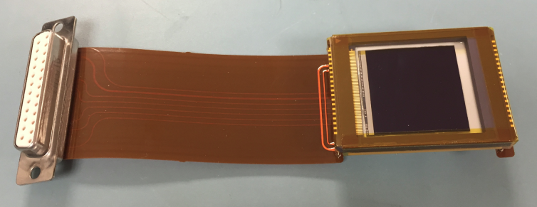
RIXSCam During Assembly & Test
For improved readout of dispersed X-ray grating spectrometers
XCAM has developed a camera system for RIXS using EM CCD207-40s & event centroiding
Triple-CCD camera system during assembly
Is fabricated as 3 independent camera systems, but with a master clock for synchronisation

Slide 23
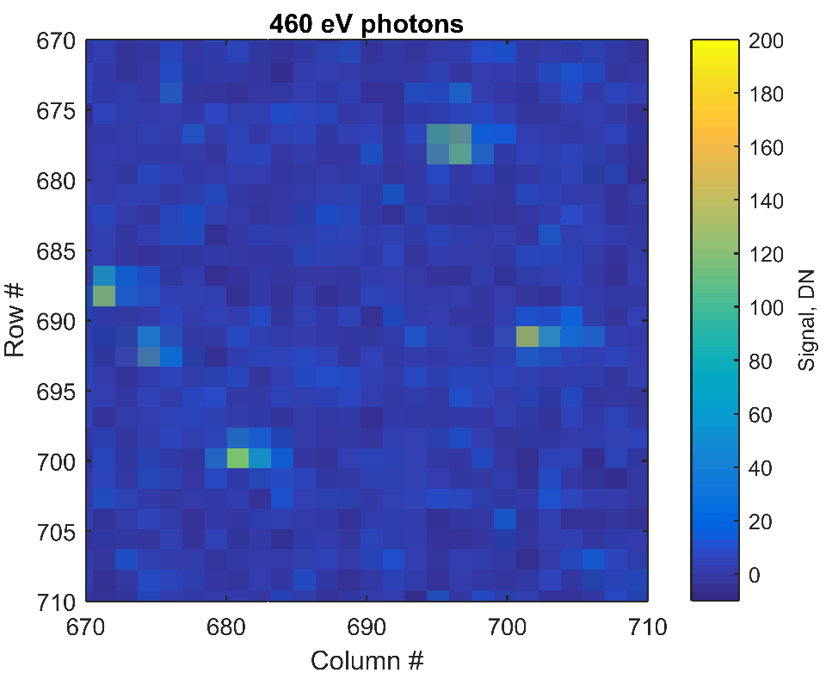

Soft X-rays in the RIXSCam
For soft X-rays in BI device photons are absorbed close to the entrance window
Majority of X-ray events undergo lateral diffusion during drift to potential wells
Recent results using the RISCCam from PSI/SAXES for a de-focussed line
460 eV photons with high S:N
Centroiding to 2 μm FWHM

Slide 24
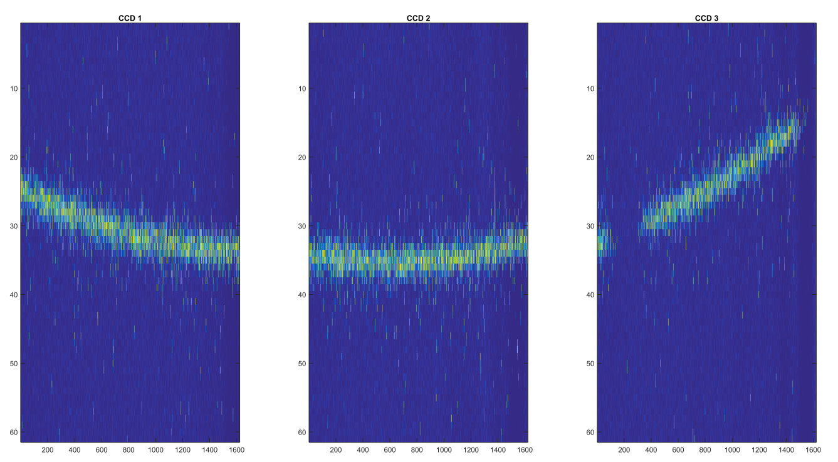
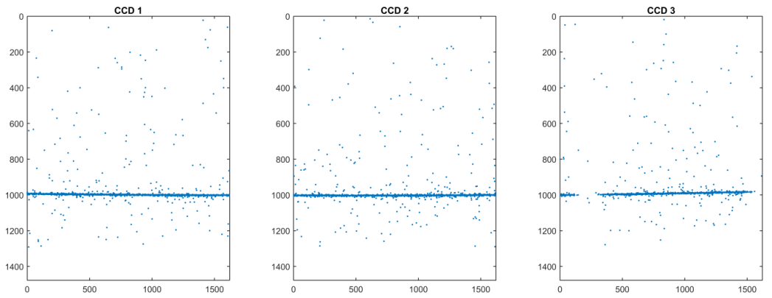
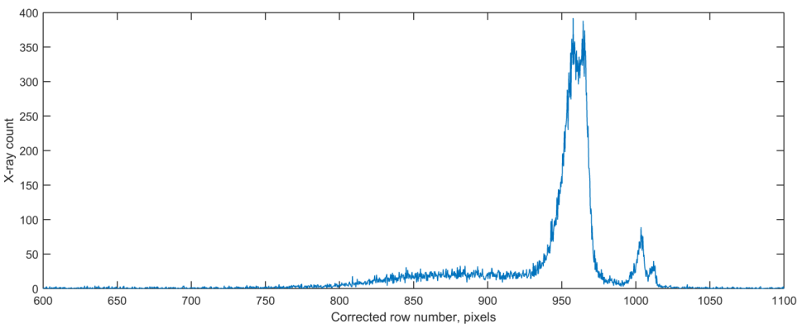
RIXSCam Early Commissioning Results
The RIXSCamTM includes the RIXS dll
which performs the on-the-fly event
centroiding and eta-correction to give
the high spatial resolution
Correction for diffraction curvature
Integrates into EPICs
Stack of
100 images
Centroided
photons
Example of an accumulated spectrum

Slide 25
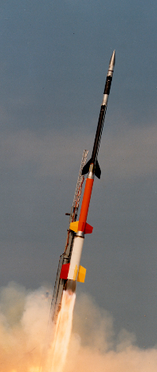
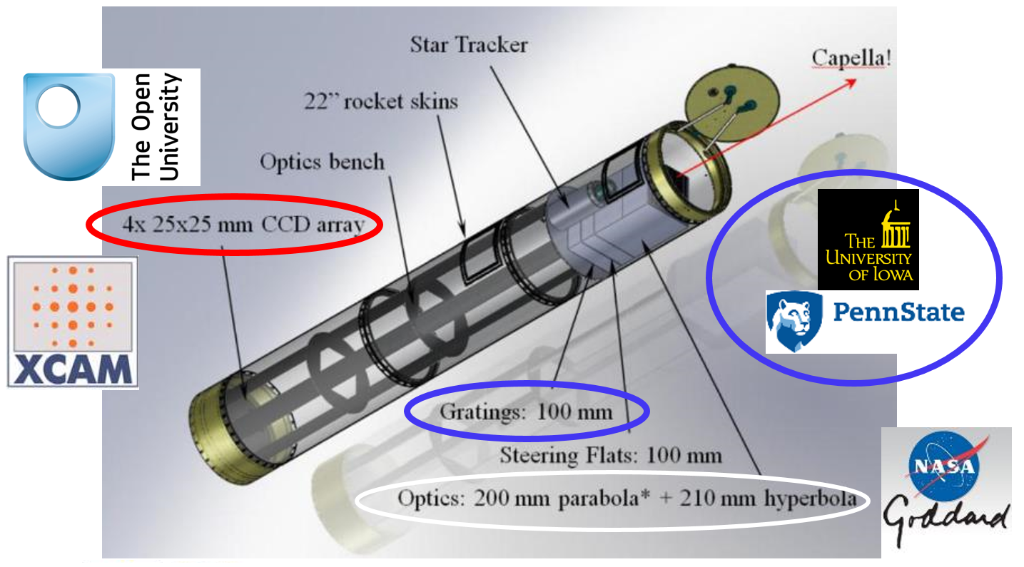
OGRE Sounding Rocket Experiment
Testing a high resolution (R~3000) grating spectrometer
Launch (currently) scheduled for Feb. 2020
XCAM-OU responsible for developing the X-ray camera
to read out the spectrum
Aimed at raising the TRL of the system components

Slide 26
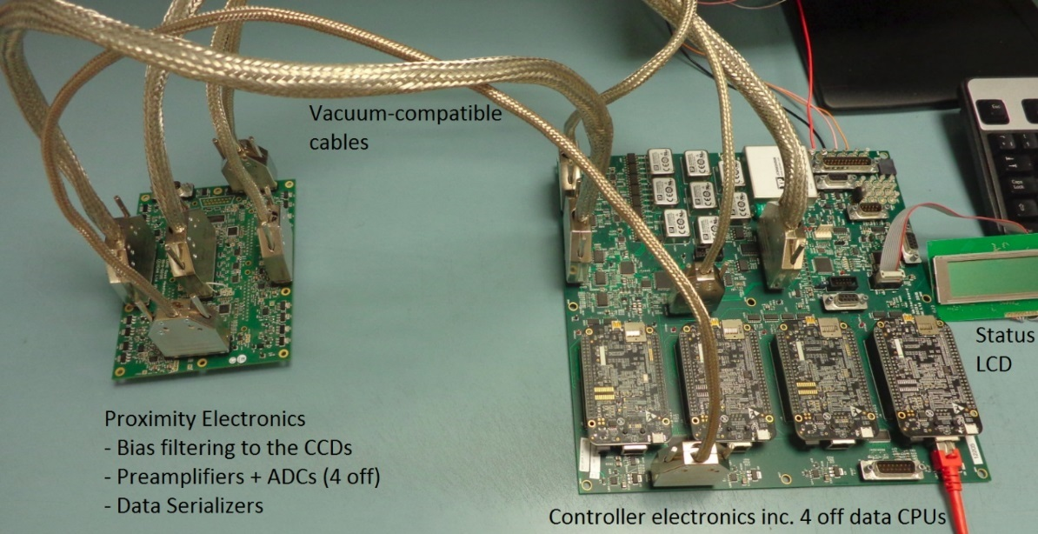


Prototype OGRE Camera System
Testing a high resolution (R~3000) grating spectrometer
Launch (currently) scheduled for Feb. 2020
XCAM-OU responsible for developing the X-ray camera to read out the spectrum.
Aimed at raising the TRL of the system components
Prototype camera electronics Laboratory CCD array

Slide 27


OGRE Performance Simulations
Current configuration of the OGRE optics system is shown on the right
During launch the payload will image Capella for ~5 minutes
Models of the measured X-ray spectrum
are given below
Grating
Detector
Mirror

Slide 28


The Earth through X-ray spectacles
Solar Wind Charge Exchange:
Heavy solar wind ions in collision
with neutral geocoronal atoms
A^{q+} + B → A^{(q-1)+*} + B⁺
A^{(q-1)+*} → A^{(q-1)+} + hν
P_{X-ray} = α n_{sw} u_{sw} n_{n}
X-ray power depends on SW density
and velocity and exosphere density
n_{n} ~ R⁻³

Slide 29

Q3 2021

Slide 30



Soft X-ray Imager on SMILE
UVI
FOV
SXI FOV
PLM
SVM
T. Sun (NSSC)
Lobster-eye Micropore Optic
Ultra-wide field of view
~16° x 27°
Focal length 30 cm
Optic Mass < 1kg
Instrument ~ 26 kg
PM

Slide 31


SXI CCD Configuration
Based on the PLATO CCD270 mask set
Optimised as an X-ray detector and
not an optical imager
Image 3791 rows
  6x binned at store IF
  631 rows
  5 CI rows
Store 719 rows
  87 spare rows

Slide 32

Radiation Damage in CCD270s
Once again, radiation damage is becoming a concern in the CCD270 for SMILE
A combination of limited radiation shielding and large CCD area compounds the problem
Radiation damage modelling and characterisation will need to be improved to meet the mission requirements
bottom
~row 1500
~row 3000
top

Slide 33


Silvaco Modelling
Suggested SBC with 4 um width in the parallel
direction for improved radiation hardness

Slide 34


Dynamic Modelling of the SBC
We have recently created dynamic simulations of charge flow in the proposed SBC for the SXI CCDs
Concerns that the charge may “balloon” beyond the SBC confinement into the normal channel seem un-founded
Indicates that the improved radiation hardness will be maintained during transfer

Slide 35

SXI Performance Modelling over Time
Radiation damage in these large CCDs is one of the key challenges
We are modelling anticipated performance over time
Further improvement arising from charge injection and lower operating temperature
Also responsible for development of in-flight correction software
The aim is to delay the operational period at which we start to lose photons…

Slide 36
Talk Summary
We continue to develop silicon CCD and CMOS image sensors for direct
X-ray detection
We are currently developing a new generation of CMOS sensors capable of
being fully-depleted to 100-200 μm
Optical light blocking filters are being developed
QE and transmission data is refining QE models
These developments are finding their way into new science applications (and hopefully more to come…)

Slide 37


