Slide 1






Powering the 21st Century with Integrated Photonics
Michael Liehr
January 23, 2019

Slide 2
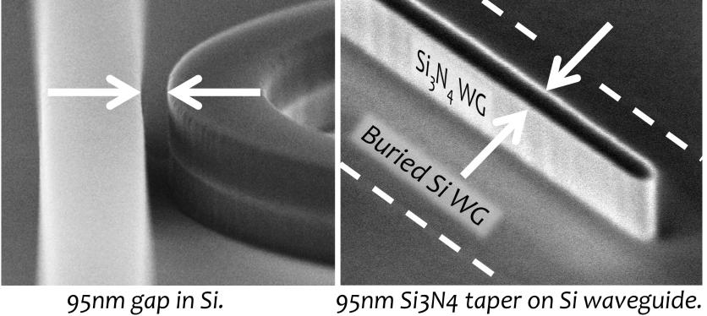
What Do We Mean by iPhotonics?
Photonics is the science and practice of using…and controlling…photons, the smallest unit of light.
Integrated photonics allow designers and manufacturers to put thousands of photonic components on a single chip of cheap silicon.

Slide 3
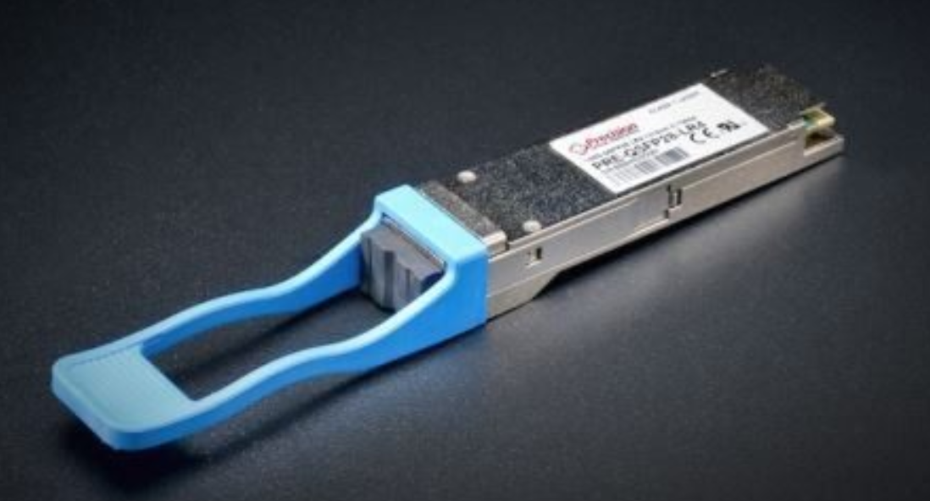


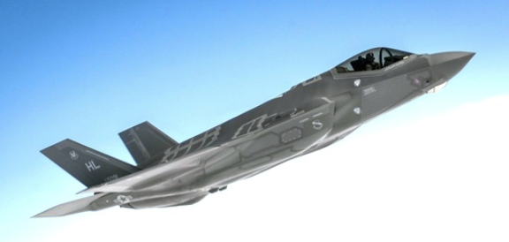
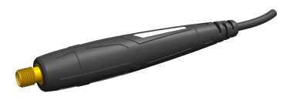

Products today and by 2022
Optical
Transceivers
Optical RF Cables
With permission by

Slide 4
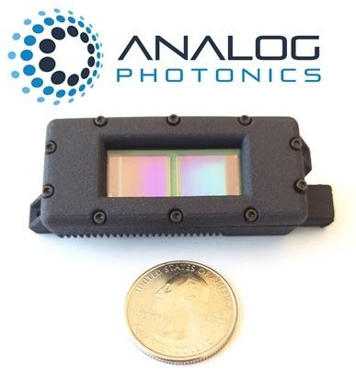
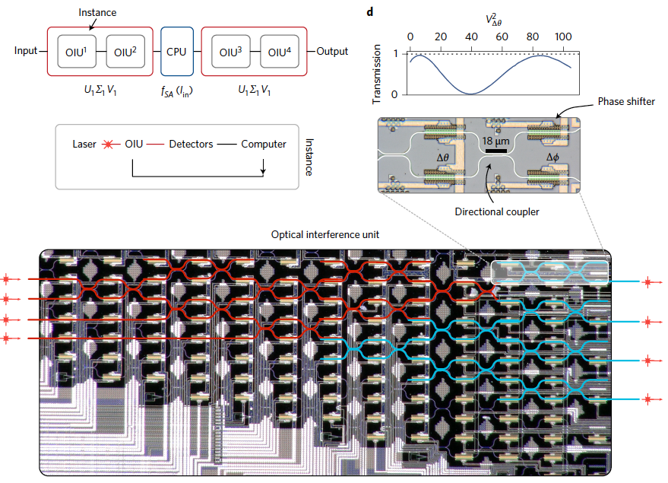
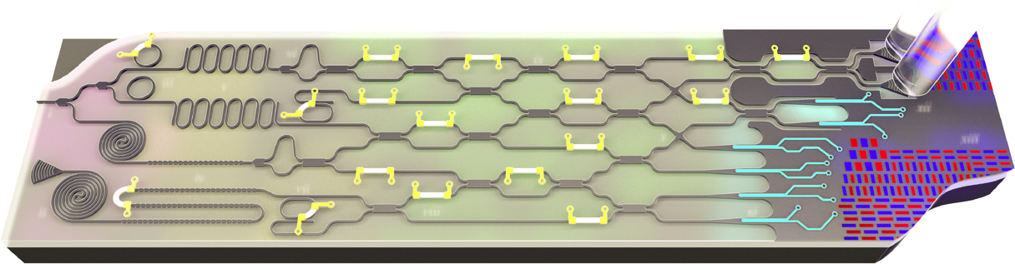
…and in the Future
LIDAR: phased arrays
Neuromorphic Computing: emulate the brain architecture using photonics networks
Quantum Applications:
Communication
Sensing
Computing

Slide 5
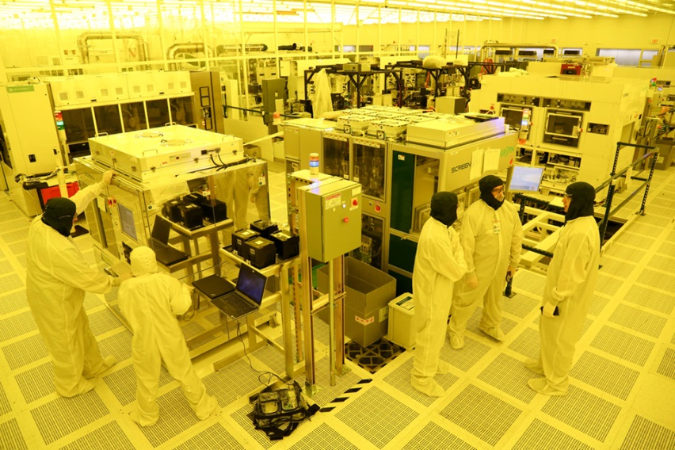


AIM Manufacturing Innovation Centers of Excellence: MPWA*
Services include foundry broker and operations for Si- and InP-based photonic devices and components.
Si Features include:
In-house 300mm fab facilities
III-V laser integration
Interposer 2.5D/3D integration
Integrated inline and optical test
In-house packaging and assembly
* Multi-Project Wafers and Assembly
5

Slide 6
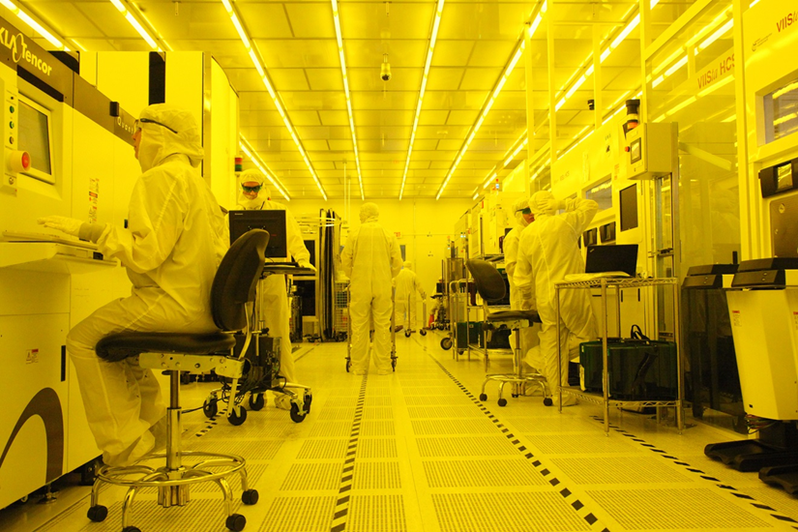
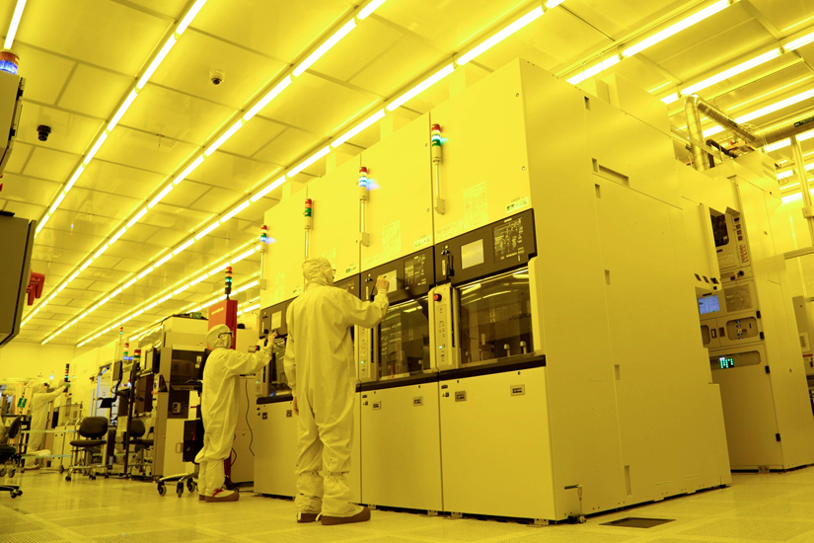
The Foundry behind AIM: Si Wafer Fab
24/7 Pilot Line for Development and EUH* production
1.3M ft² facility
Cutting edge 300mm toolset
135k ft² of class 1 capable cleanroom
Processing capability spans 65nm - 5nm CMOS
* Early-user Hardware
6

Slide 7
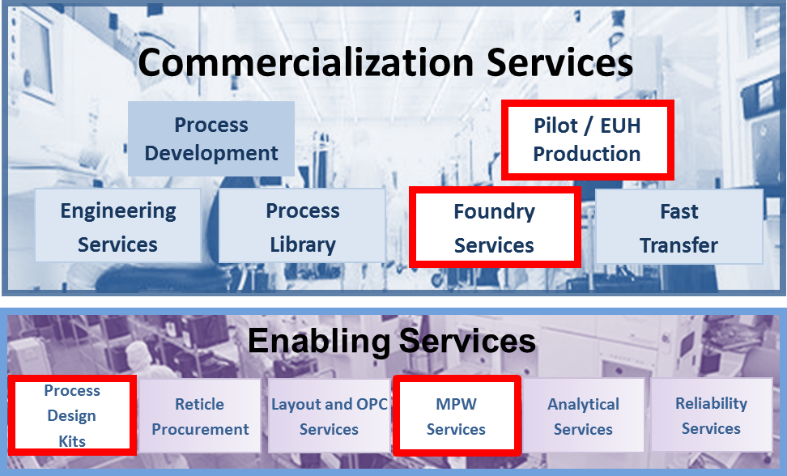















What is AIM Photonics ?
A full service provider and consortium for Integrated Photonics as part of the Manufacturing USA network
Applying the infrastructure and technology from the semiconductor industry to cost-reduce photonics
7

Slide 8
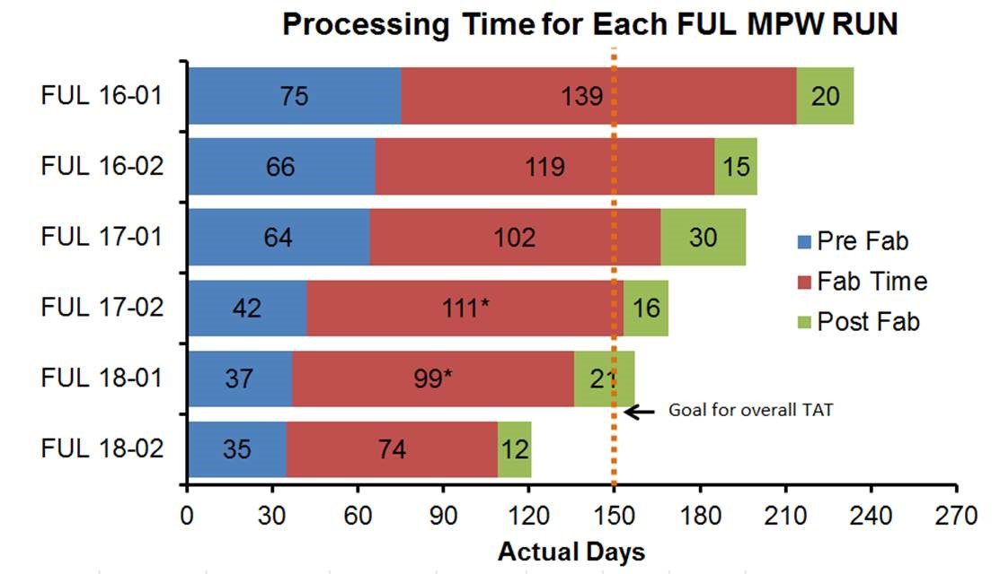
AIM: MPW Serviceability
2018:
Best in class PIC MPW turn around time
Implement quality program and WAC reports
2019:
Mature PIC MPWs run by MFG Eng. team
Interposers to be matured and streamlined
Our Program is Open to All
* EAR restrictions apply
8

Slide 9
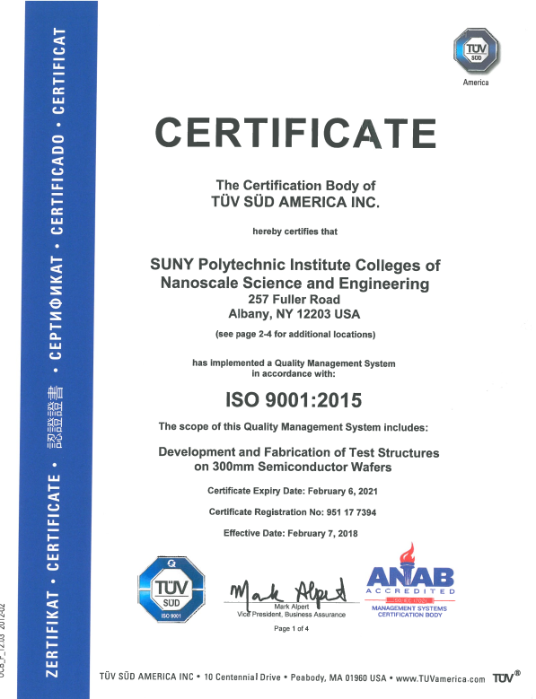
AIM Manufacturing: Line Controls
Fab Controls
Tool and process SPC
In-line Electrical Testing
Parametric data including shorts and opens
Overall wafer must meet WAC specifications
Defect Inspections
Automated bright field inspection
Final outgoing inspection
Inline Optical Testing
Waveguide loss and key device performance
Optical Wafer Acceptance Criteria (OWAC) report
9

Slide 10
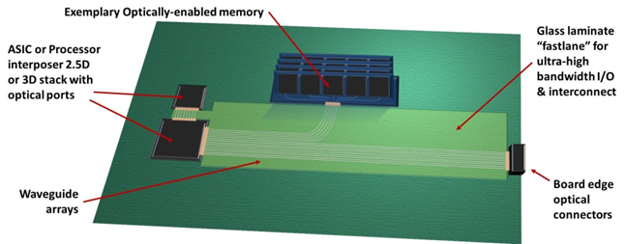


AIM Manufacturing:
Test, Assembly and Packaging
High cost of connectors: laser attach, fiber attach, connection between die
10

Slide 11

AIM Manufacturing: TAP
Wafer-scale photonics packaging
Wafer-scale testing
Interposer metallization
Die bonding
Chip singulation
Chip-scale test, assembly and packaging
Chip scale testing
Laminate and fiber attach
Surface mount assembly
80% of the cost of a PIC is in the package
11

Slide 12
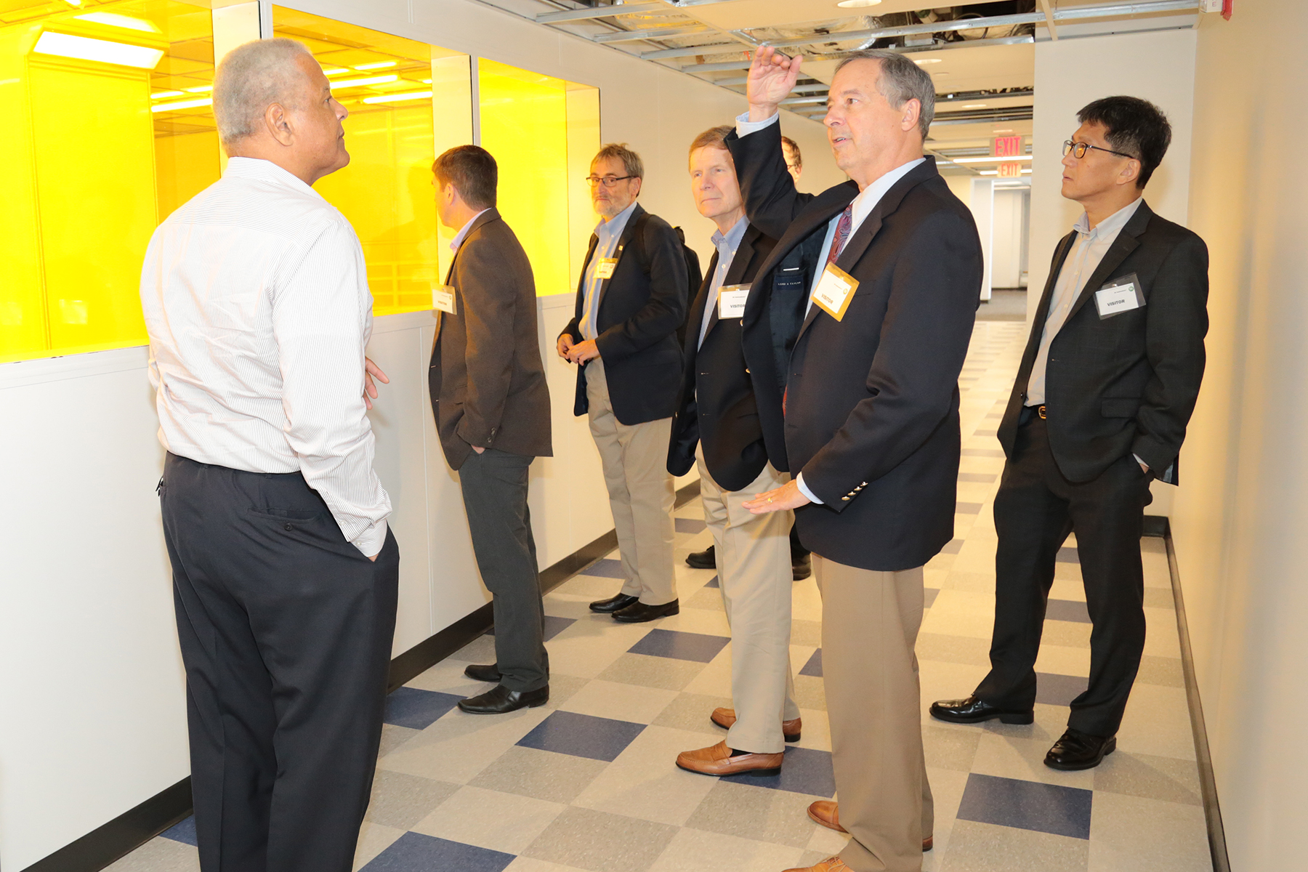
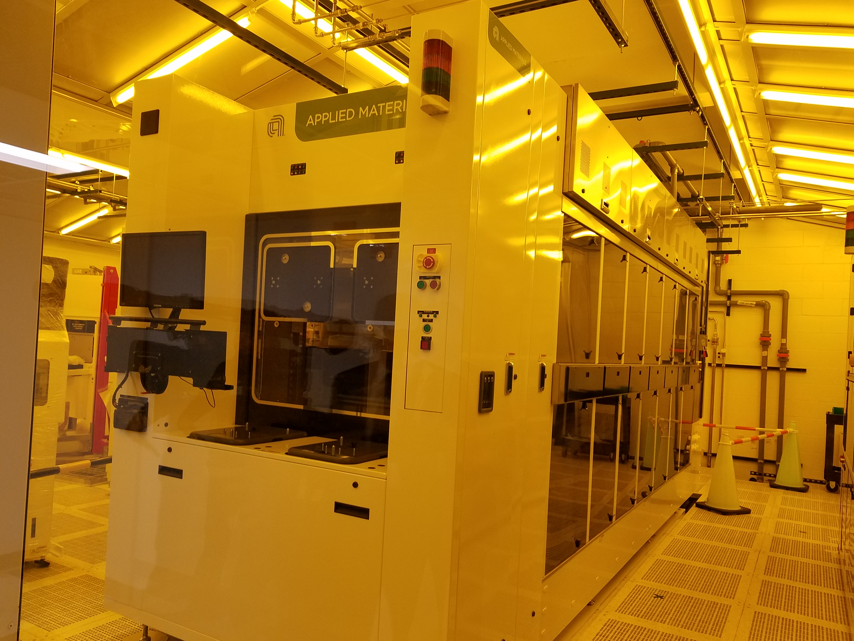
AIM Manufacturing: TAP
Process Tools
Electronic and photonic package and assembly, photonic test
> 100 tools on order / in progress
Tools began arriving 1Q18
Tool Installation
In execution stage
Phase 1 complete 1Q19
Customer Engagements
Commercial starts 4Q18
Welcoming inquiries
12

Slide 13
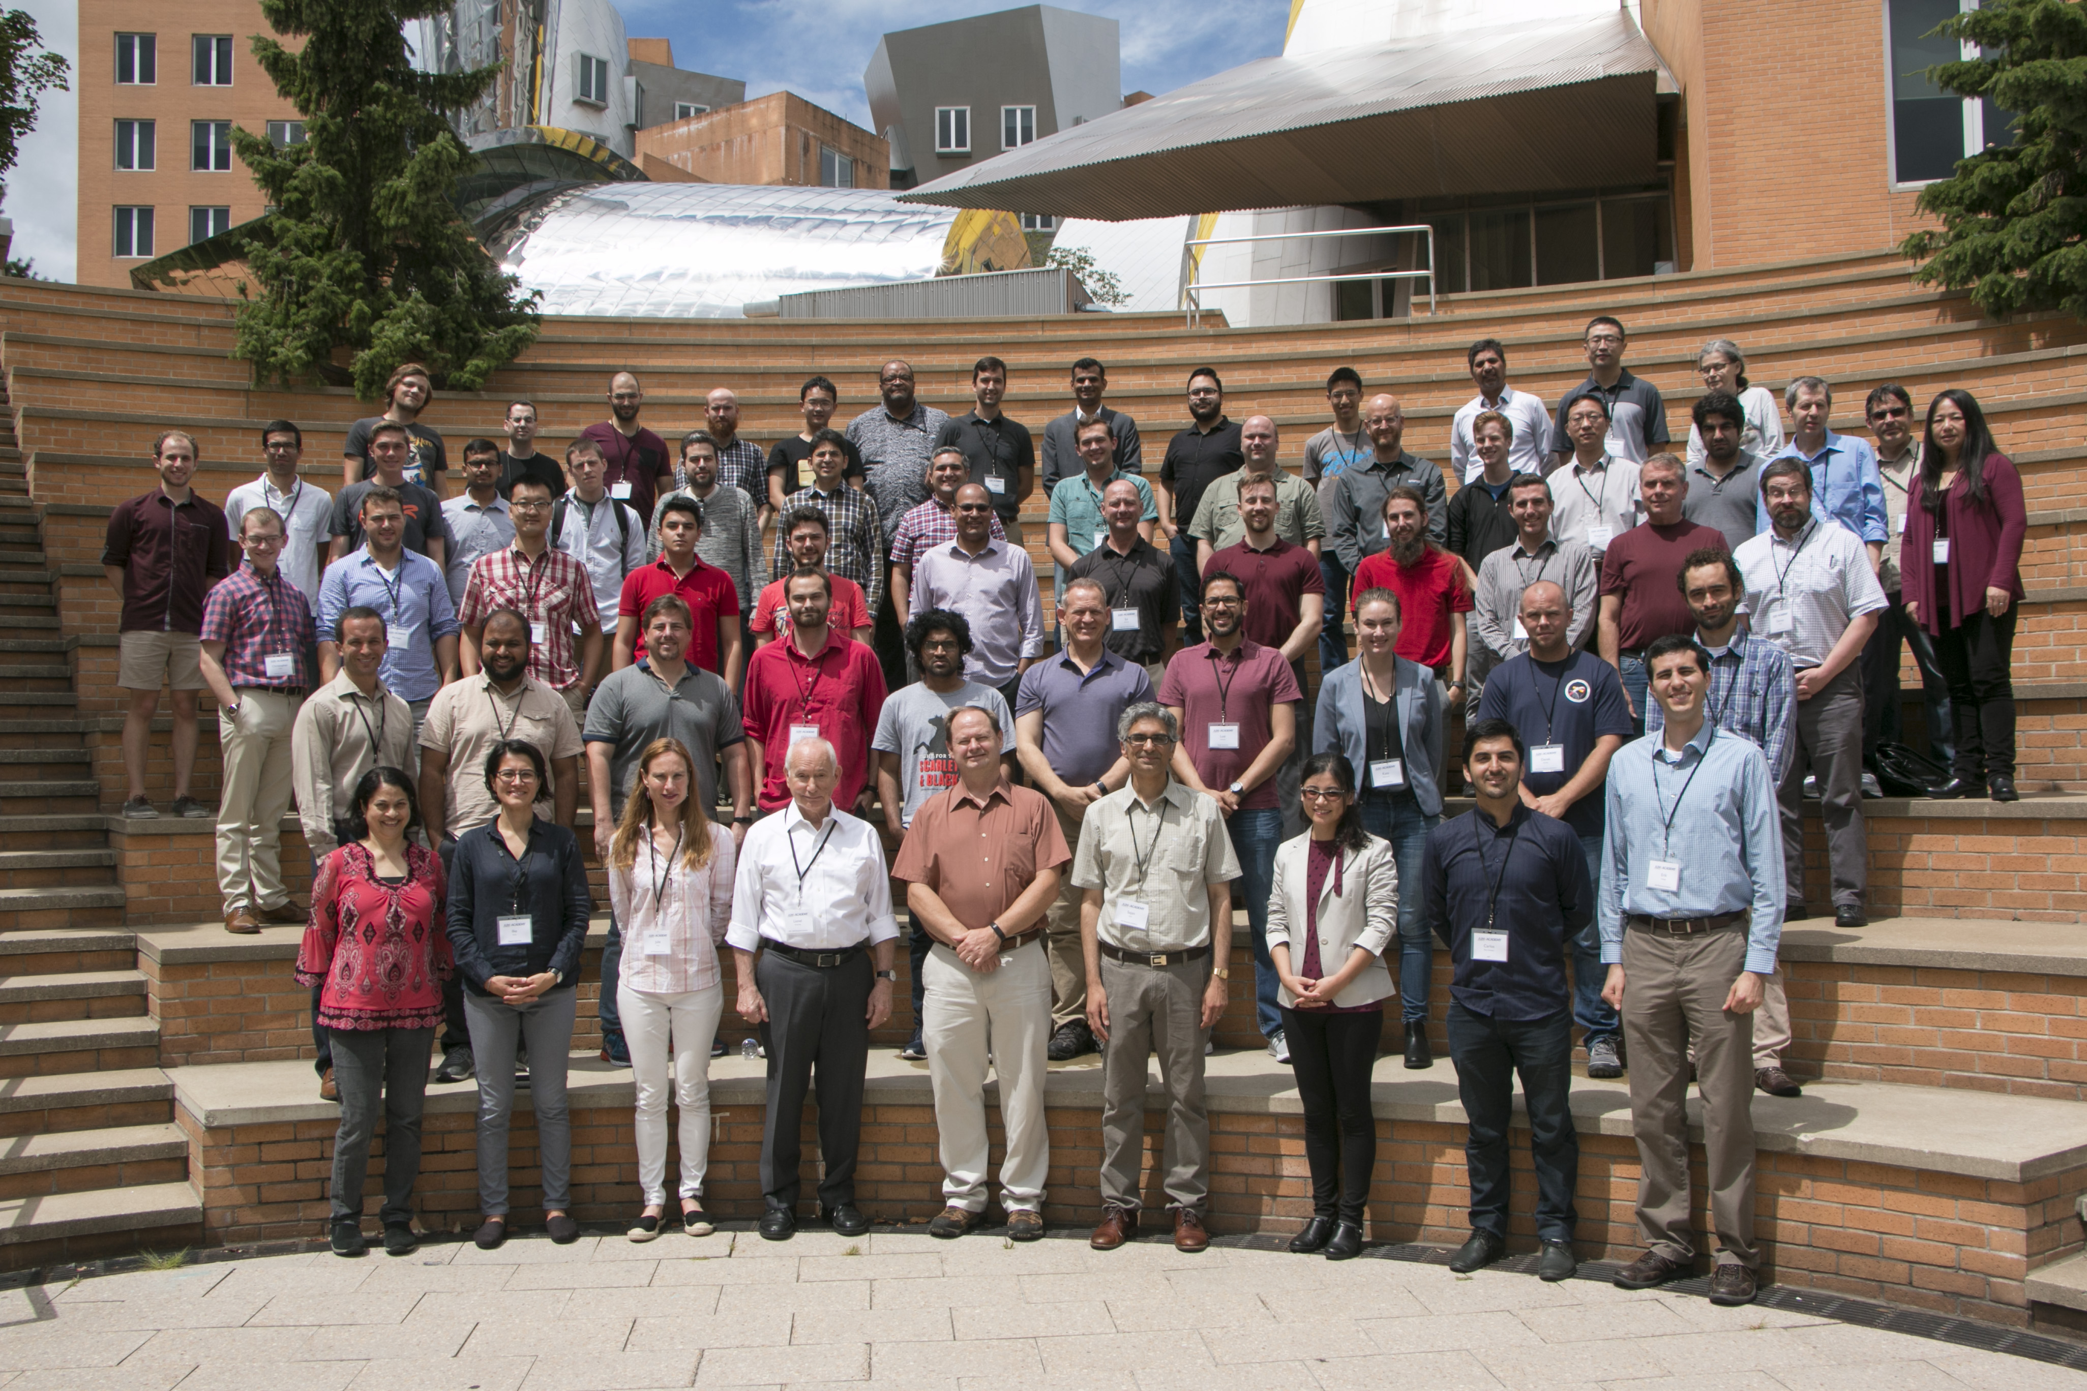
AIM Academy
AIM Photonics Academy (AIM Academy) is the unified education knowledge, technology, and workforce program for the institute. Activities include:
On-Line Instruction/Certification (edX)
Distribution of Education Modules (AIM Website)
Teaching and Toolkits
LEAP facilities for education/training, industry engagement, AIM prototyping
13

Slide 14
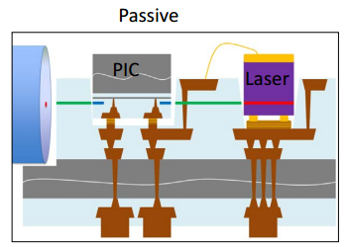
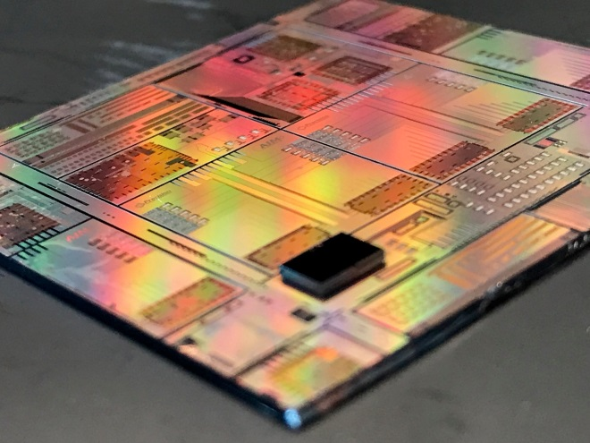
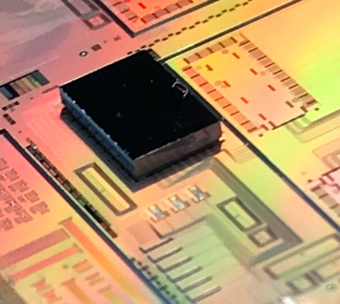
Current Technology
Full thickness PIC MPW chips are solder bonded inside the interposer PIC trench
Optical connection through nitride waveguide edge coupler

Slide 15
AIM Technology Roadmap
2018
Passive Interposer MPW + Initial Laser / PIC attach
Active interposer development begins
2019
Laser and PIC attach optimization
2020
2nd Active interposer MPW
1st Active interposer MPW w/ lower loss Si/SiN wgs
High resistivity substrates for active interposer

Slide 16
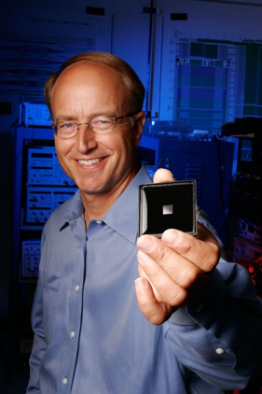
AIM Research:
Quantum Dot Lasers*
Less sensitivity to defects
Enables smaller devices
Enables amplification
Reduces need for isolators
Thermal stability
Integration cost advantage
Significant reliability progress
* Funded by AIM since 2016
16

Slide 17

AIM Photonic Quantum Roadmap
Nearer-term applications: quantum sensing /communication
J. Silverstone et al, IEEE J. Selected Topics In Quantum Electronics, 22 (6), Nov/Dec 2016
Single photon light sources
Very low-loss
waveguides
Single-photon
detectors
Fiber-couplers
WDMs
Grating couplers
Extinction Filters
Phase-shifters
Modulators
17

Slide 18
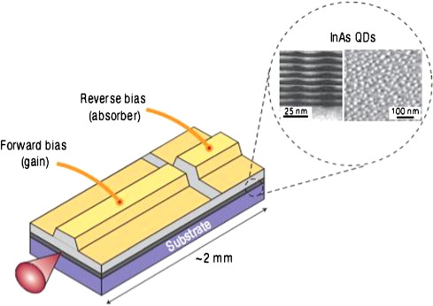
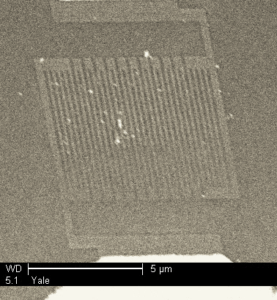
Challenging Components Specifications
Single-photon sources: indistinguishable, quasi-deterministic, at high frequency
Extremely-low-loss waveguides and components
Low energy switching
Cooling to 4 K
Single-photon detectors:
Very high quantum efficiency
Low noise, high speed, low jitter
Superconducting nanowire SPDs
Heteroepitaxial III-V QD lasers
John Bowers et al & AIM Photonics
NbN SNSPD (Annunziata Ph.D. thesis, Yale Univ)
18

Slide 19


Learn More
Learn More: www.aimphotonics.com
WWW.AIMPHOTONICS.COM
Some of this material is based on research sponsored by Air Force Research Laboratory throughout the American Institute for Manufacturing Integrated Photonics (“AIM Photonics”) under agreement number FA8650-15-2-5220.

Slide 20
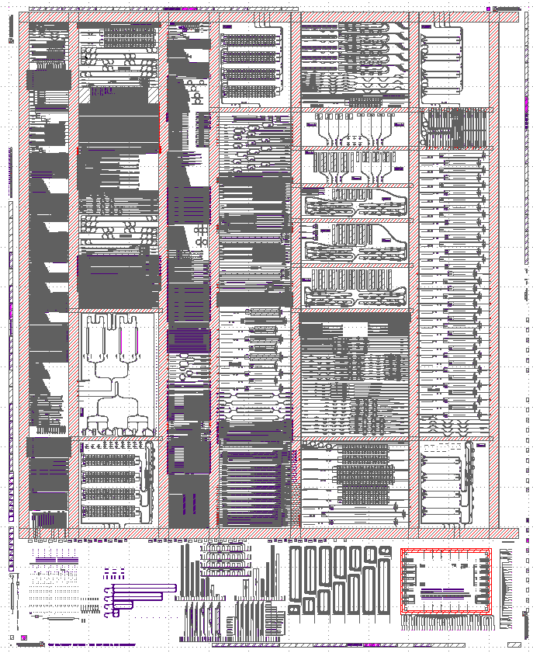
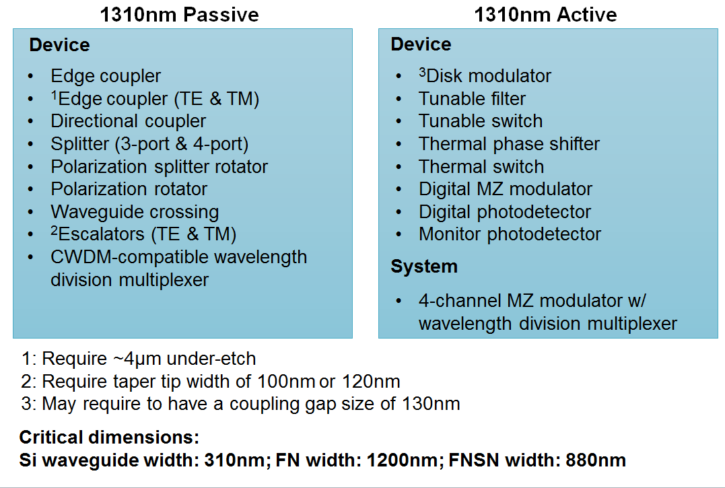
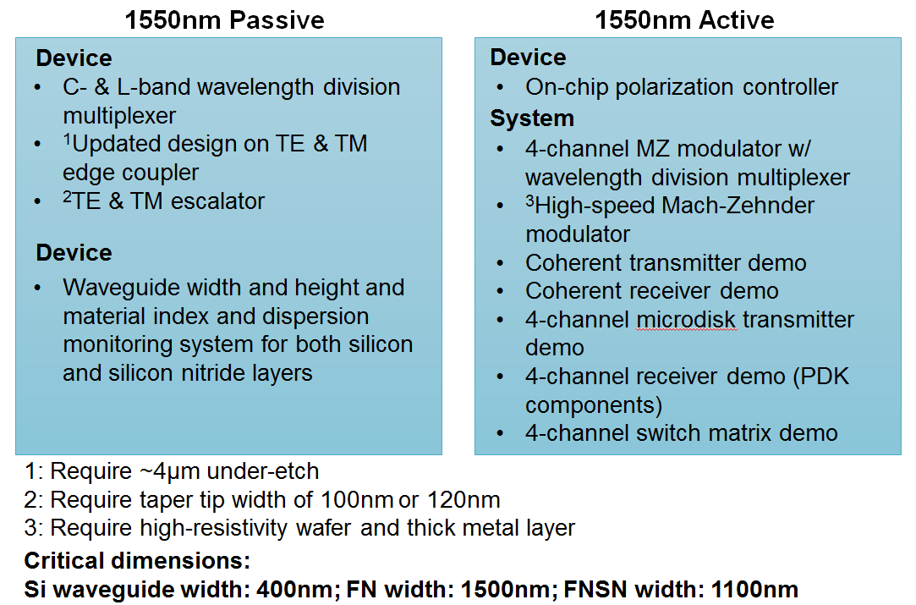
Modeling & High Res – Status 12/10/2018
Modeling Run “Bruin”
Key Deliverys:
1st Lot for PDK Modeling 12/6
Contains: New 1310 nm devices
Modeling Structures
1st High Res SOI Substrate Delivered (12/6)
Follow on modeling hardware – 1Q 2019 (3 lots, +PW)

