Slide 1
Origin of the Oort Cloud
Jessica Sorrell
“They have observed Ninety-three different Comets, and settled their Periods with great Exactness. If this is true (and they affirm it with great Confidence) it is much to be wished that their observations were made publick, whereby the Theory of Comets, which at present is very lame and defective, might be brought to the same Perfection with other Parts of Astronomy,”
- Jonathan Swift, Gulliver’s Travels (1726)
IMGS 461
Observ Tech Inst

Slide 2
How did the Oort cloud form?
Overview:
- Introduction
- Current theories on Oort cloud formation
- Testable questions
- Analysis
- Conclusion
- Future work
1
Notes:
Any model of planetary formation in our solar system has to account for the formation of the Oort cloud. Though no direct observations of the Oort cloud have been made, its presence is inferred from the behavior of long period comets and how they differ from short period

Slide 3
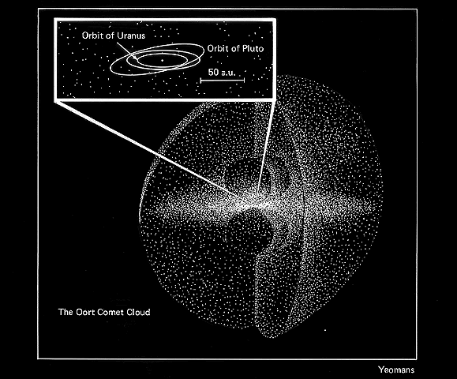
What is the Oort Cloud?
The Oort cloud comprises icy planetesimals at the edge of the sun’s gravitational influence
The existence of the Oort cloud was first hypothesized by Ernst Öpik in 1932, but further developed by Jan Oort in 1950 to explain observations of long-period comets
- Highly elliptic orbits
- Orbits with any inclination from the ecliptic plane
- Large proportion of comets with semi-major axis ~20,000 AU
- Presence of volatiles
2
Notes:
The hypothesis of the Oort cloud’s existence was motivated by a certain class of comets that had been frequently observed for over a century. These comets had orbital eccentricity close to 1, and arrived at an angle to the ecliptic. These comets were still possessed of much of their volatile ice, which would have already been sublimated had the comet passed close to the sun in the past. Jan Oort suggested that these comets in fact came from a distant spherical cloud, up to 150,000 AU from the sun. He argued that in this cloud, comets would be loosely gravitationally bound to the sun, and may be perturbed out of the cloud by interactions with nearby stars and galactic tides, kicking them into their elliptic orbits around the sun. This would explain the odd angles of inclination to the ecliptic, as they are too loosely bound to be flattened out into a plane.

Slide 4
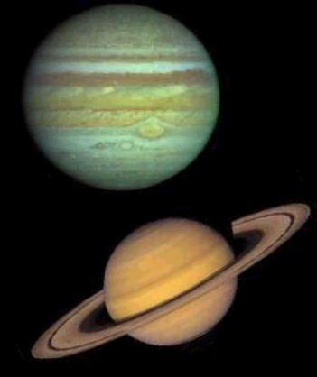
Current Theories
The comets that make up the Oort cloud formed within our solar system, in the region where the gas giants formed
Some argue the comets likely formed around Jupiter and Saturn, as Uranus and Neptune are too small (Bailey 1994)
3
Notes:
The prevailing theory is that the comets composing the Oort cloud formed during, and in the same region as, the formation of the gas giants. These planets then kicked the newly formed comets out of the planetary region. Those that remained gravitationally bound to our solar system became the Oort cloud. As to where in the outer solar system the comets formed, there is some debate. In 1994 Bailey wrote a paper estimating the mass of the Oort cloud at at least 380 earth masses, but Neptune and Uranus come to a cumulative mass of less than 32 earth masses, so such a distribution of mass is unlikely with current models of planet formation

Slide 5
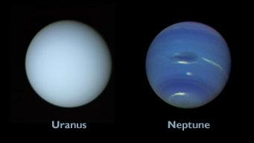
Current Theories
Others argue that the comets formed around Neptune and Uranus because Jupiter and Saturn are too massive, and would have ejected the planetesimals from the sun’s gravitational influence completely
4
Notes:
Others theorize that the planetesimals formed in the Neptune zone, arguing that Jupiter and Saturn would have ejected too many comets to account for the mass of the Oort cloud.

Slide 6
Current Theories
There are yet other theories that suggest long-period comets formed early on when the sun was still part of the cluster in which it formed (Levison 2010)
This theory is supported with models of the early solar environment in which the sun captures comets formed around other stars
5
Notes:
Another class of theories places comet-formation earlier, suggesting that formation took place while the sun was still part of its birth cluster. When the cluster began to blow apart, the sun captured many of the comets formed around other stars. Many of these theories are put forth to explain a theoretical deficit in the number of comets in the Oort cloud. This is not to say that there are fewer observed that theorized, but rather theory cannot soundly justify the observed flux of long-period comets.

Slide 7
Testable Questions
Are the comet masses assumed in current models reasonable?
~ 2x10¹¹ - 2x10¹² comets in the Oort cloud
Lower bound from P. J. Francis (2005)
Upper bound from P. R. Weissman (1996)
Would need an average comet mass of 1x10¹⁵ - 1x10¹⁶ kg to justify the 380 earth mass estimate of the Oort cloud
Capture model assumes an average comet mass of 4x10¹³ kg
Do we observe any amorphous water ice in long-period comets?
Indicative of temperature conditions of comet formation
Could have implications for environment of comet-formation
6
Notes:
The number of comets in the Oort cloud has been estimated to fall between 10^11 and 10^12 comets. This estimate comes from the observations of the number of new long-period comets compared with the rate at which the galactic tides pull them out of the cloud and in towards the sun.
Knowing that, we can observe long period comets and their estimated masses, doing a sanity check on the estimates current theories are predicated on.
In addition, we might look for the presence of amorphous water ice in new long-period comets (“new” meaning comets that have not passed near the sun before, and so should still have their ices intact)

Slide 8
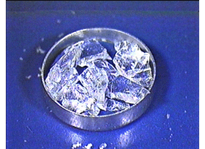
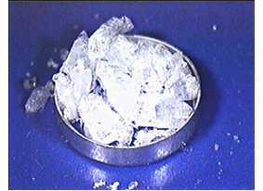
Testable Questions - Amorphous Ice
Amorphous ice is observed in molecular clouds
Forms when H₂O cools too quickly to form a crystal lattice
Begins crystallizing at temperatures ~120K
National Institute for Materials Science
7
Notes:
Amorphous ice is a disordered water solid with a glass-like structure. If liquid water is cooled to 136K over a matter of milliseconds, the molecules will remain in a state of disarray and will not form a crystal lattice. Amorphous ice can also be formed out of crystallized ice at high pressure.
This ice has been observed in the molecular clouds in the infrared, as it has a distinctive 3.1 micron absorption feature differing from the absorption features of crystalline ice. We might then expect to see amorphous ice left over from the molecular cloud that spawned our solar system. If we can observe amorphous ice in comets from the Oort cloud, we know that it’s unlikely these comets have seen temperatures greater than 120K since their formation, since it’s unlikely these comets would be exposed to extreme pressure or rapid transitions from liquid to solid out in the Oort cloud.

Slide 9
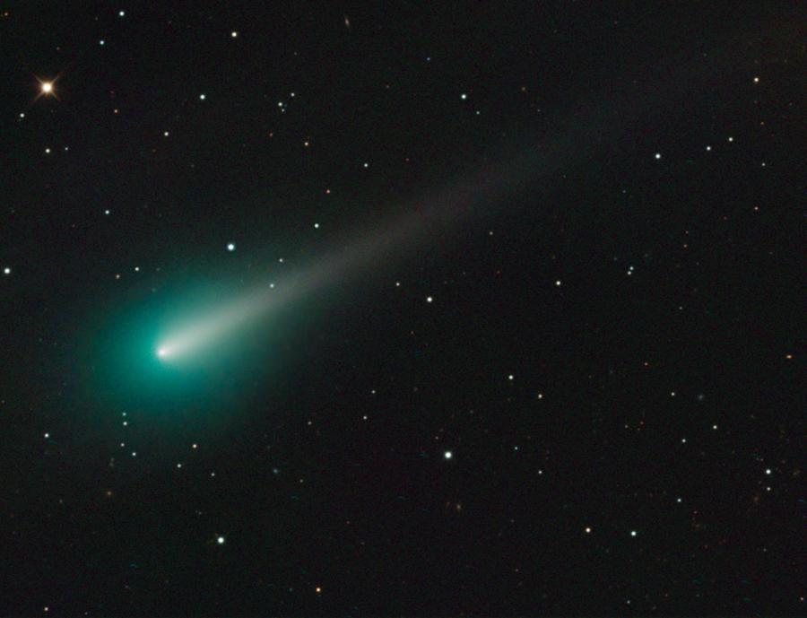
C/2012 S1 ISON
Discovered by Vitali Nevski and Artyom Novichonok at the International Scientific Optical Network near Kislovodsk, Russia on September 21, 2012
Inclination to ecliptic = 62.4 deg
Perihelion distance = q = 0.0124 AU
Eccentricity of orbit = e = 0.999998
aphelion distance =
q(1+e)/(1-e) = 12500 AU
-> Oort cloud comet
Comet ISON on the morning of Oct. 8, seen with the 0.8-meter Schulman Telescope at the University of Arizona SkyCenter atop Mount Lemmon. Credit: Adam Bloc
8
Notes:
To, hopefully, shed more light on these and other questions, astronomers have been enthusiastically observing Comet ISON during its orbit.
Comet ISON was discovered by Vitali Nevski and Artyom Novichonok, of the International Scientific Optical Network. Hence the name ISON. ISON is a dynamically new comet, and so a great target for insights into the origin of our solar system, and the Oort cloud in particular
It passed perihelion on November 28th, less than 2km from the sun, at which point it began to burn out.
//Note orbital elements

Slide 10
Relating Magnitude to Mass
H₁₀ = m - 5log \Delta - 10logr
Where H₁₀ is the comet’s magnitude at a distance of 1AU from both Earth and Sun
m, apparent magnitude
\Delta, distance from comet to Earth
r, distance from comet to the Sun
Assuming brightness varies as an inverse square of the distance to Earth and inverse fourth power law w.r.t. Sun
log M = 19.0 - .4H₁₀
For long-period comets. Estimate from Weissman 1982
9
Notes:
My first objective was to perform a sanity check on assumed masses used in theories on Oort cloud formation. To do this, I’ll take ISON to be typical of long-period comets. By observing ISON’s light curve and normalizing for distance from Earth and Sun, an estimate can be made of its mass
This mass can then be compared to the “typical” mass used for estimating the mass of the Oort cloud to see if it is in keeping with current theories

Slide 11
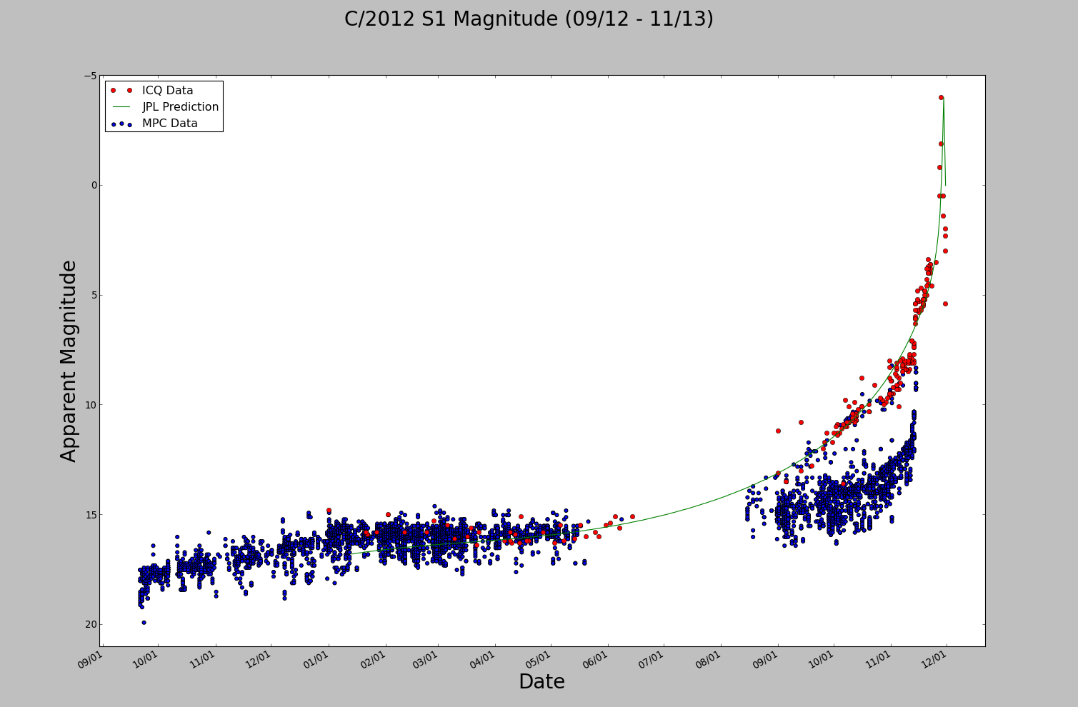
Relating Magnitude to Mass
10
Notes:
This is a plot of ISON’s apparent magnitude with data from 3 difference sources.
The red dots are from International Comet Quarterly, a non-profit journal, published at the Earth and Planetary Sciences Department at Harvard
The blue dots are from the Minor Planet Center database. The Minor Planet Center runs out of the Smithsonian Astrophysical Observatory and is funded by a NASA grant. It maintains databases of orbital elements, light curves, and observations for minor planets, comets, and natural satellites.
The green line is the prediction of magnitude provided by JPL.
The gap in data is from when ISON passed behind the sun
The growing discrepancy between ICQ data and MPC data is sensical. The ICQ data is taken from the whole comet, nucleus and coma, whereas the MPC data gives the magnitude of the nucleus alone.

Slide 12
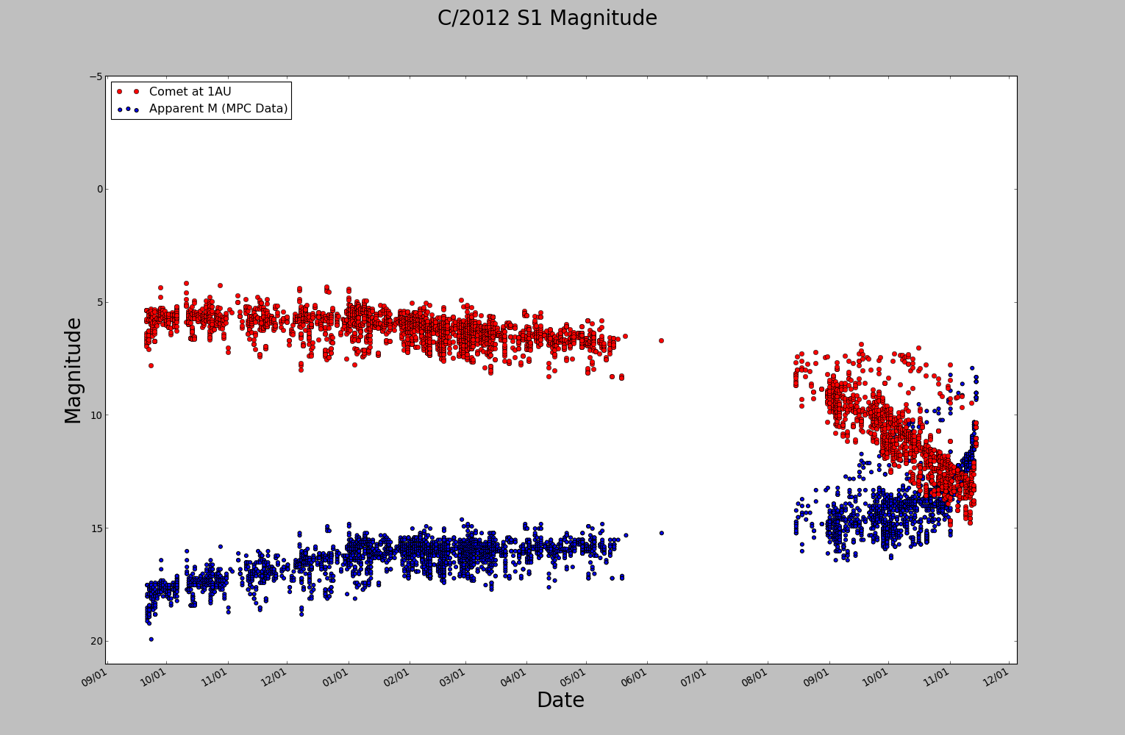
Relating Magnitude to Mass
11
Notes:
Applying the formula for adjusted magnitude to my dataset gives the red curve shown here. For ease of estimation, one would hope it would be a straight light. I reasoned that the best estimate I’d be able to get for the mass would come from the earliest datapoints, since that’s when the comet’s least active. The less active, the fewer chemical processes taking place in the comet.

Slide 13
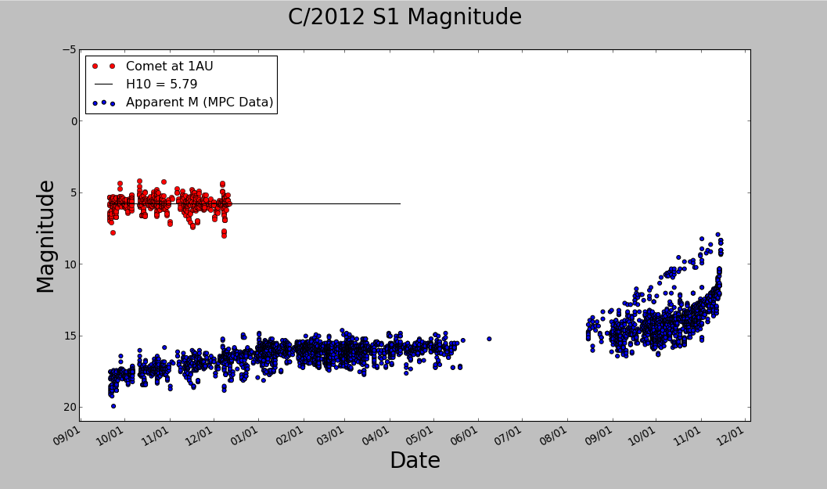
Relating Magnitude to Mass
12
Notes:
Calculating the average for the data gives us an H10 value of 5.79

Slide 14
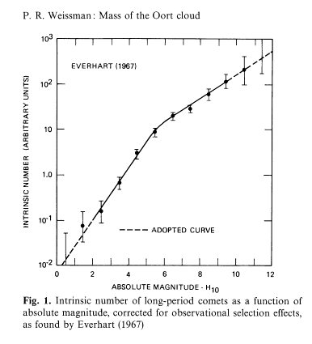
Relating Magnitude to Mass
log M = 19.0 - .4H₁₀
H₁₀ = 5.79
M = 4.83x10¹³ kg
M_{Oort} = 4.38x10¹³kg * N_{comets}
M_{Oort} between 1.5 and 15
earth masses
13
Notes:
Plugging in our magnitude gives us a mass estimate for ISON of about 5^13kg. If we assume comet ISON is typical this gives us a range on the mass of the Oort cloud of 1.5 - 15 earth masses. This protects the theory of Oort cloud formation in which comet formation took place in the Neptune region. The strongest argument against that theory being that the Oort cloud was over an order of magnitude larger than our upper bound. Our estimate for ISON’s mass is on the same order as the estimate used in the cometary capture theory, so that theory too remains on the table.
The graph on the right was developed by Everhart from observations of comets, with attempts to correct for observation biases (fewer Southern observatories, less likely to discover faint comets). This graph predicts the rate at which we might expect to find comets of various masses, and we can see that ISON is indeed a good typical mass for estimating the mass of the Oort cloud.

Slide 15
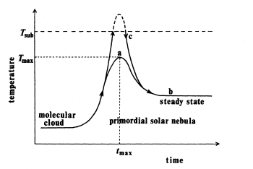
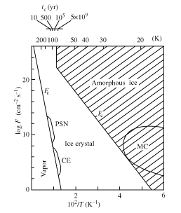
Amorphous Ice
Schematic thermal history from molecular cloud to primordial solar nebula - A. Kouchi et al (1994)
From A. Kouchi et al (1994), amorphous ice should be preserved in our solar system at distances r > 12 AU
We should expect to find amorphous ice beyond Saturn, and therefore in Oort cloud comets
Phase diagram for ice as a function of temperature and the deposition rate of water vapor. PSN, CE, and MC denote the primordial solar nebula, the circumstellar envelope, and molecular cloud
A. Kouchi et al (1994)
14
Notes:
Second objective was to look for the presence of amorphous ice in ISON’s light curve. When I first introduced the objective, I didn’t cite any previous work justifying the expectation that any amorphous ice should remain from the molecular cloud of the sun’s birth cluster. Kouchi et al published a paper in 1994 showing that amorphous ice should not form in the solar nebula. In the same paper he showed that the temperature of the solar nebula should have left much amorphous ice preserved in our solar system beyond the orbit of Saturn.
To look for this ice in ISON, I didn’t look for any direct observations, but instead went back to using my light curve as an indicator of activity. Amorphous ice is normally formed with other molecules, and so any amorphous water ice remaining in ISON should contain a great deal of dust and gas trapped inside. When ISON reaches the temperature at which amorphous water ice begins to crystallize, the change may cause an outburst of activity as this gas and dust is released. One should expect to see an outburst of activity when the comet reaches ~120K, when this takes place

Slide 16
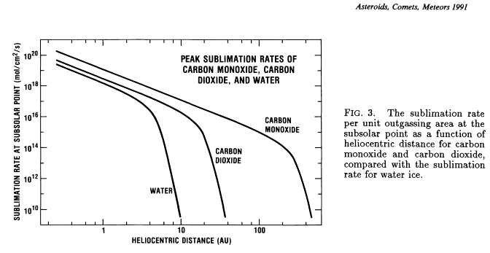
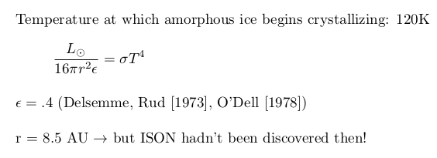
Amorphous Ice
Crystallization begins at ~120K, so look at ISON’s light curve around 8.5 AU
But Ison hadn’t been discovered then!
15
Notes:
Using a familiar formula, we can do a rough calculation to place a bound on where in ISON’s light curve to look for increased activity. This is only a very rough lower bound, however, as the comet is certainly not in radiative equilibrium. In addition, the comet’s coma can scatter and reflect incoming light, effectively cooling the nucleus.
That being said, we have a rough estimate of 8.5AU

Slide 17
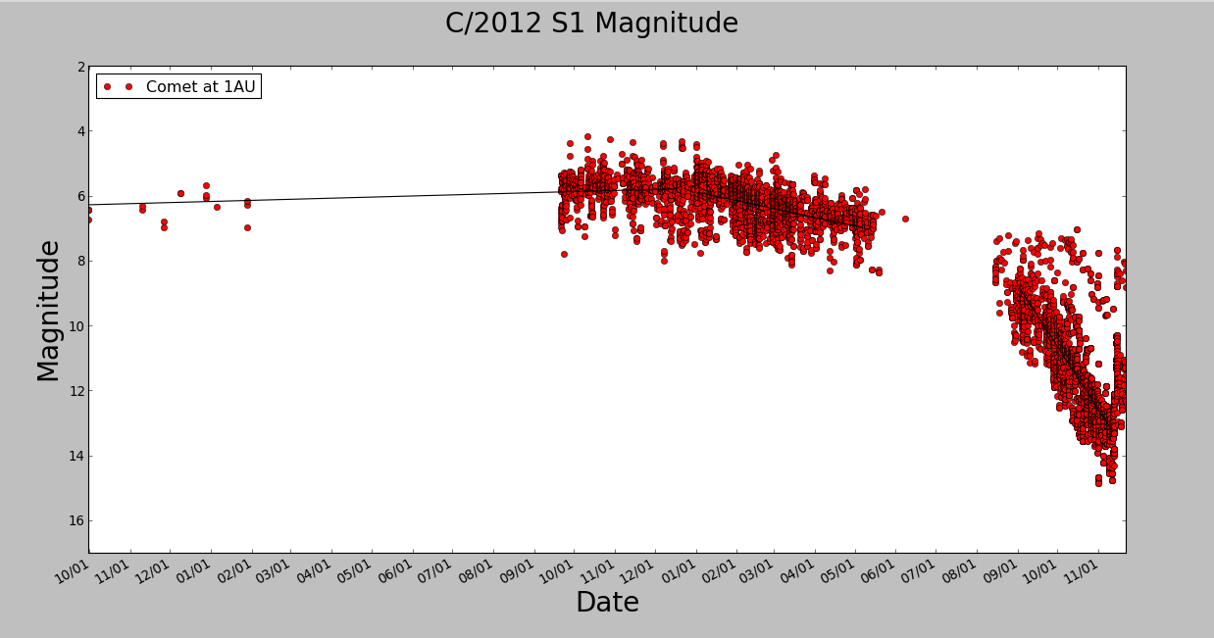
Amorphous Ice
16
Notes:
Since ISON hadn’t been properly discovered at that point, there’s not much data available on its activity beyond 6.5 AU or so. Precovery images were obtained from Pan-STARRS
Panoramic Survey Telescope and Rapid Response System which surveys the sky, detecting near earth objects.
ISON is at 8.5 AU mid-January
With this data we can, very weakly, claim there’s some increase in activity between 9.4 AU and 6.5 AU, but it’s difficult to say how continuous that increase in activity might be.
Could be that sublimation of CO or CO₂ is driving any activity, or maybe there’s a step-wise jump!
So we can’t really conclude anything about ISON’s amorphous ice composition.
However, there’s been published work suggesting that outburts of activity in other long-period comets at distances over 6AU might be attributed to amorphous ice crystallization, or that is might generally be a significant factor in driving consistent activity, along with CO and other volatiles. (D. Prialnik, Bar Nun A 1992 explaining Halley’s 14AU outburst with crystallization)( Grankowski 2007, assumed crystallization along with other mechanisms to accurately model the outburt of Centaur Comet Schwassmann-Wachmann 1)

Slide 18

Conclusion
No theory can be ruled out!
It’s possible that the comets comprising the Oort cloud formed in the Jupiter region or the Neptune region
The average mass of long-period comets is consistent with the mass assumed in the comet-capturing theory
Crystallization of water ice may model some poorly-understood behavior of long-period comets, but not sure
Aside from this one =>
Japan Ison Observing Campaign Site
17
Notes:
Unsurprisingly, I was not able to find any glaring holes in any of the current theories of Oort cloud formation. All could be equally valid for the conclusions drawn here.
Though crystallization of amorphous water ice is a potential explanation for previously inexplicable outburts of cometary activity, there are other possible explanation that can’t easily be isolated.

Slide 19
Future Work
Follow up with multiwavelength observations
- spectral data in infrared and optical to look at molecular emission
Re-examine mass estimate
Look into the implications of the presence of amorphous water ice in long-period comets
Learn how to do proper data reduction and manipulation
18
Notes:
With the addition of the earlier datapoints, how much does my mass estimate change? If there’s so much unpredictable variation in the normalized magnitude, is there perhaps a better way to estimate the mass of a given comet?
I decided to look for amorphous water ice largely because it was low-hanging fruit with the light curve I had already made, but what sort of competing theories can it decide, if any?
It didn’t come up much in the presentation, but there were many failed attempts at using data I had received from outside sources to look at the composition of ISON. I had difficulties with things as simple as opening fits files in IRAF and had more luck with PYRAF and IDL, but quickly realized that I didn’t know where to begin, what information was already included in my data, and how I should go about removing artifacts and the like. Given unlimited time, I would have liked to develop some facility with data reduction pipelines and how they differ from instrument to instrument.

Slide 20
Data Sources
Many thanks to Karl Battams of the Naval Research Laboratory, Michal Drahus at Caltech, and Carl Schmidt of University of Virginia for sharing their data (none of which appeared in this talk)!!!
NASA Jet Propulsion Laboratory - Horizons system
Mikulski Archive for Space Telescopes - Program ID 13197
The International Astronomical Union Minor Planet Center
19

Slide 21
References
Paul R. Weissman (1982). "The Mass of the Oort Cloud". Astronomy and Astrophysics
Julio A. Fernéndez (1997). "The Formation of the Oort Cloud and the Primitive Galactic Environment". Icarus 219
Harold F. Levison, Martin J. Duncan, Ramon Brasser, David E. Kaufmann (2010). “Capture of the Sun’s Oort Cloud from Stars in Its Birth Cluster”. Science 329
K. J. Meech, J. Svoren (2004). “Using Cometary Activity to Trace the Physical and Chemical Evolution of Cometary Nuclei”. University of Arizona Press
P. Lamy, Imre Toth, Y. Fernandez, H. Weaver (2004).“The Sizes, Shapes, Albedos, and Colors of Cometary Nuclei”. University of Arizona Press
A. Kouchi, T. Yamamoto, T. Kozasa, T. Kuroda, and J.M. Greenberg (1994). “Conditions for Condensation and Preservation of Amorphous Ice and Crystallinity of Astrophysical Ices”. Astronomy and Astrophysics
20

Slide 22
Questions?

