Slide 1

What “is” a Red Nova?
Zachary Silberman
Observational Techniques and Instrumentation
December 12, 2013

Slide 2
Outline
Introduction
Observations
Analysis
Discussion
Conclusion

Slide 3
The Definition of “Is”
1. What are the observational signatures of a “red nova”?
  How bright do they get?
  What prominent spectral lines do they exhibit?
  What are their temperatures?
2. Can these signatures help to distinguish red novae from similar events, such as classical novae?

Slide 4
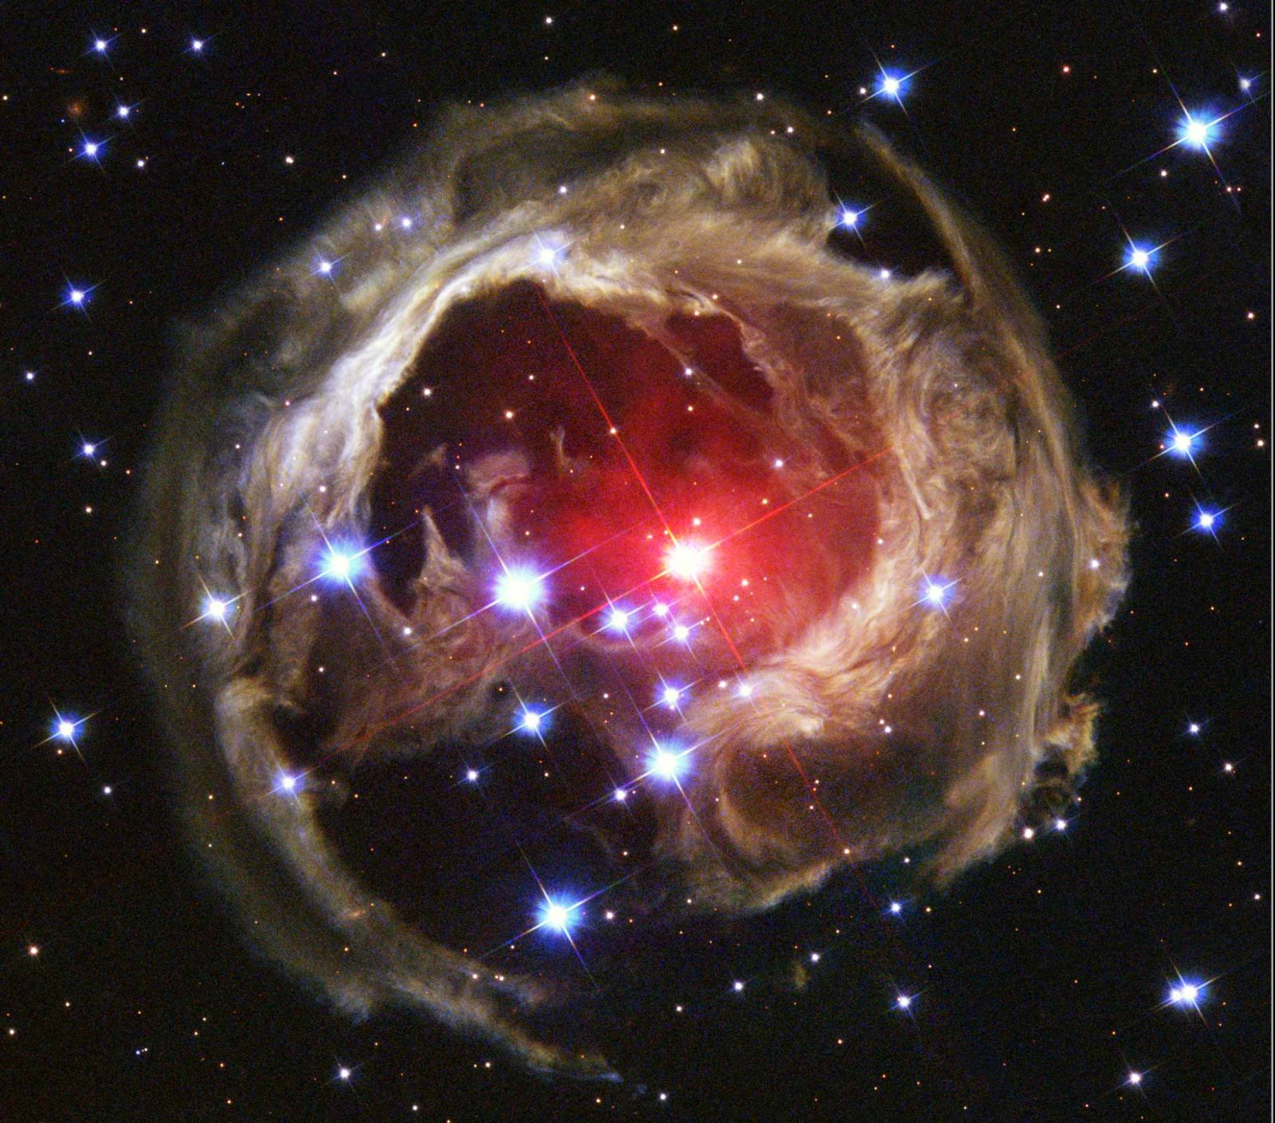
Why Do We Care?
Understanding outbursts
And especially this!
V838 Mon (apod.nasa.gov, 03-05-04)

Slide 5
List of Objects
V838 Monocerotis
  Nova Mon 2002
  Light Echo
V1309 Scorpii
  Nova Sco 2008
  Bright!
V838 Mon (apod.nasa.gov, 03-05-04)

Slide 6
Observations
OGLE (Optical Gravitational Lensing Experiment)
AAVSO (American Association of Variable Star Observers)
Spitzer (IRS)
Keck (HIRES)
SUNY Stony Brook/SMARTS Atlas of (mostly) Southern Novae
Other sources (through references)

Slide 7
Reduction and Analysis
SPICE (Spitzer)
MAKEE/HIRES Redux (Keck)
IDL

Slide 8
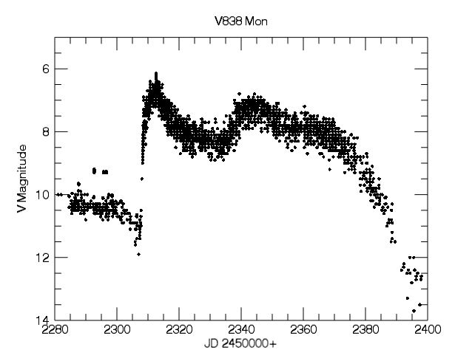
V838 Mon Light Curve
AAVSO

Slide 9
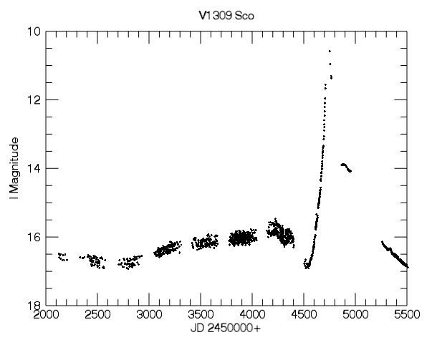
V1309 Sco Light Curve
OGLE

Slide 10
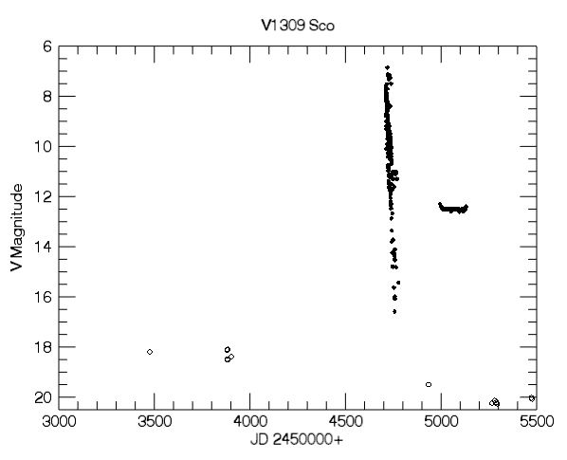
V1309 Sco Light Curve
Solid is AAVSO
Open is OGLE

Slide 11
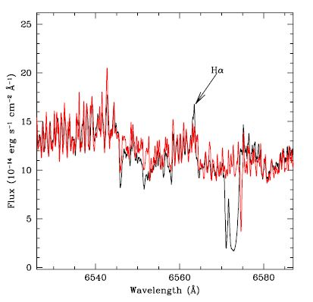
V838 Mon Visible Spectrum
Red is model of M5 III star
Note high Hα emission
From 2009
UVES-VLT
From Tylenda et al. 2011, A&A, 532, 138

Slide 12
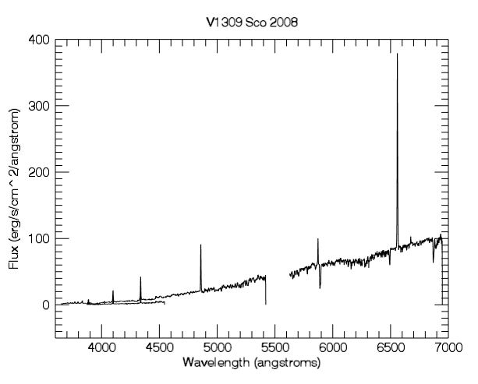
V1309 Sco Visible Spectrum
Four Balmer lines visible in the spectrum, especially Hα
SUNY SB/SMARTS

Slide 13
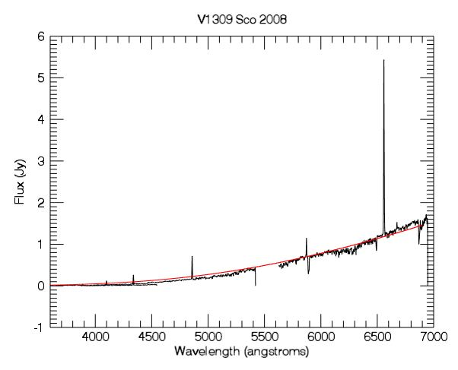
V1309 Sco Visible Spectrum
Here red is blackbody at 3000 K
SUNY SB/SMARTS

Slide 14
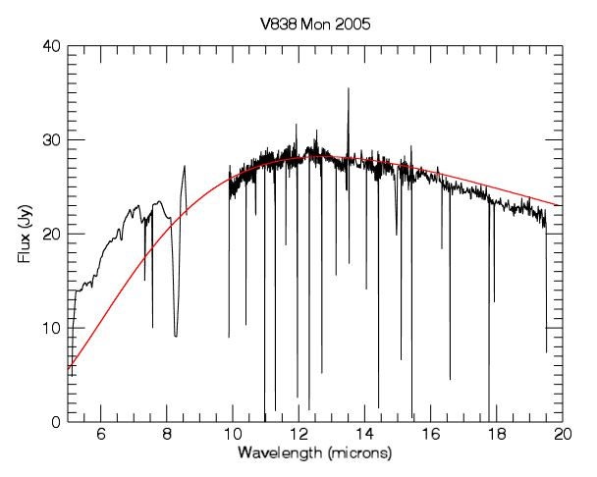
V838 Mon Mid-IR Spectrum
Red is blackbody at 400 K
Spitzer

Slide 15
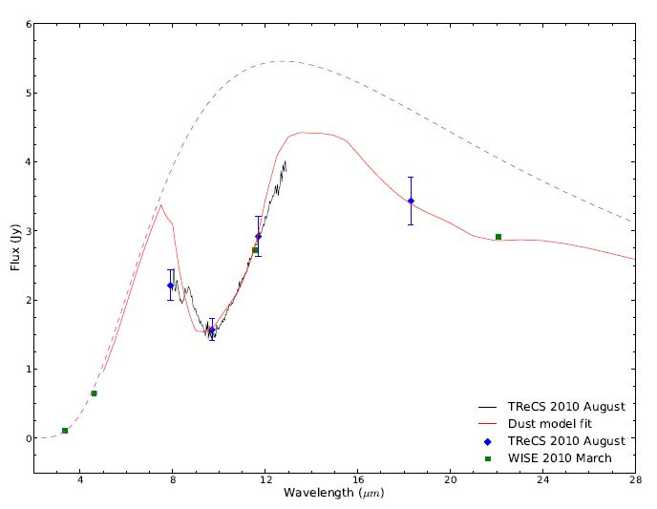
V1309 Sco Mid-IR Spectrum
Purple dotted line represents blackbody at 400 K
From Nicholls, et al. 2013, MNRAS, 431, 33

Slide 16
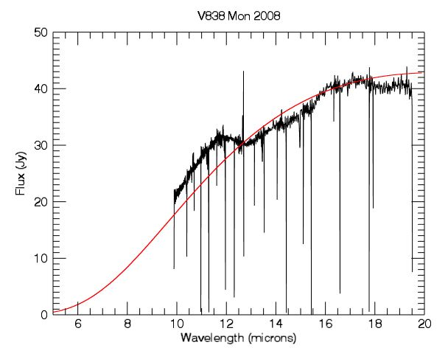
V838 Mon Mid-IR Spectrum
Red is blackbody at 250 K
Spitzer

Slide 17
Some Answers
Some properties of red novae:
  Large outbursts
  Tall, narrow Balmer lines
  Start out hot, then cool substantially
  Similar temperatures at similar stages
So where does that leave us?

Slide 18
Novae
In the classical case, caused by nuclear burning around a white dwarf
Leads to a wide range of outburst evolutions
In the violent case, can exhibit large increase in brightness, followed by decline
Temperature remains high as brightness declines
Alternate models involving various companion stars of the white dwarf can correctly predict some aspects of red nova evolution, but fail at others

Slide 19
Conclusions
Question 1
  Red novae get very bright and hot, have strong Balmer emission, and cool after the outburst
Question 2
  Light curves similar to those of classical novae, which is why they are a type of nova at all
  Temperature evolution of classical and red novae are completely different, allowing astronomers to distinguish between them.

Slide 20
Future Work
Consider extinction
Other properties, observational signatures
What is the mechanism causing red novae?
  Some other nova mechanism not yet considered?
  Binary mergers?
What is going on with the light echo?

Slide 21
Acknowledgements
I acknowledge with thanks the variable star observations from the AAVSO International Database contributed by observers worldwide and used in this research.
This work is based [in part] on observations made with the Spitzer Space Telescope, which is operated by the Jet Propulsion Laboratory, California Institute of Technology under a contract with NASA.
This research also used data from the OGLE-III and OGLE-IV missions, as well as data from Stony Brook/SMARTS.

Slide 22
References
Mason, E. et al. 2010, A&A, 516, 108
Nicholls, C. P. et al. 2013, MNRAS, 431, 33
  Used data from T-ReCS and WISE
Tylenda, R & Soker, N. 2006, A&A, 451, 223
Tylenda, R. et al. 2011, A&A, 528, 114
Tylenda, R. et al. 2011, A&A, 532, 138
  Used data from UVES-VLT

Slide 23
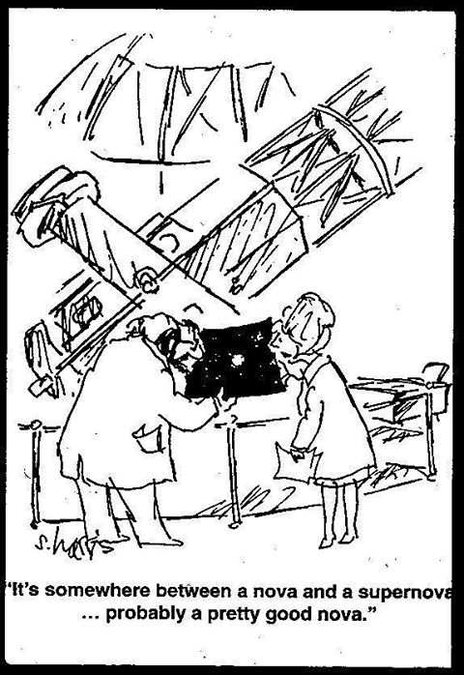
Thanks!
Courtesy Don Figer

