Slide 1
Optimal Matched Filtering to Find Gravitational Waves from LIGO* Sources
Brennan Ireland
Rochester Institute of Technology
Astrophysical Sciences and Technology
December 5, 2013
LIGO: Laser Interferometer Gravitational-wave Observatory

Slide 2
Outline
Background general relativity
State of the work
LIGO and observable sources
Optimal matched filtering
An ideal case of matched filtering
Discussion
Future Work
Conclusions

Slide 3
Background
General Relativity says that mass tells spacetime how to bend and curved spacetime tells mass how to move
Einstein field equations: G_{μν} = 8πT_{μν}
When massive objects accelerate, they give off gravitational radiation, which are ripples in spacetime
This radiation is like the radiation from a dipole in E&M, but for gravitational waves, the first non-zero moment is the quadrupole moment

Slide 4
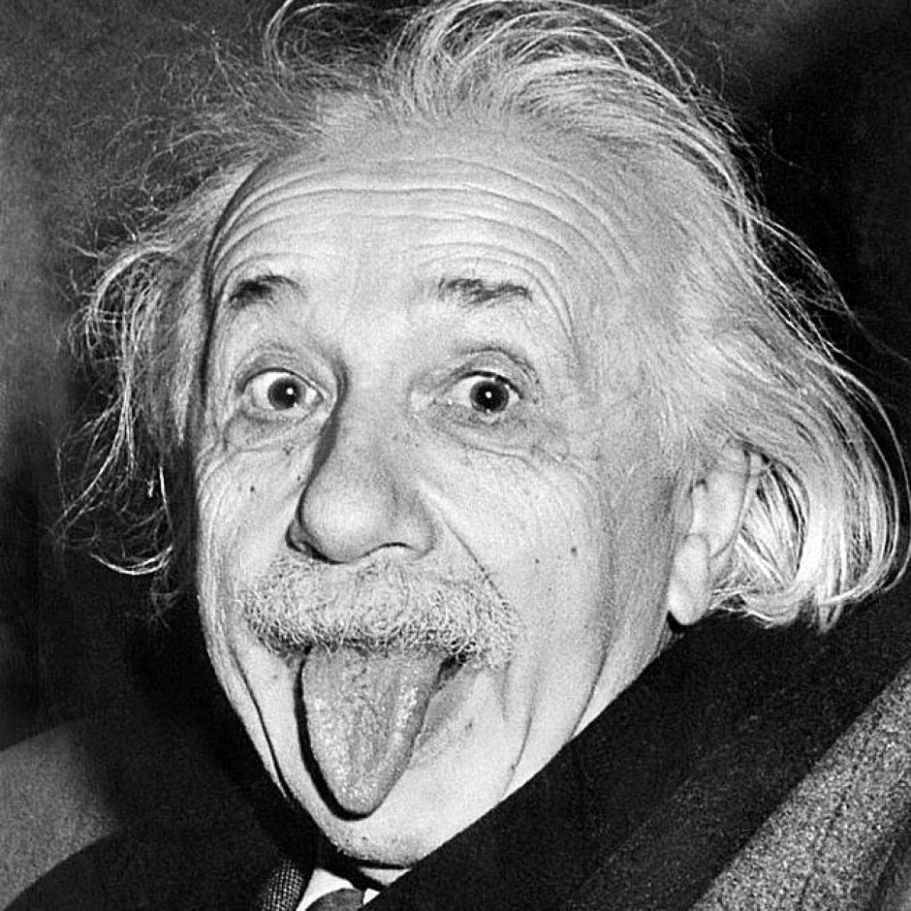
Background
Einstein first predicted this gravitational radiation, but said that it would be impossible to ever detect due to the tiny amplitudes of the waves.
We are out to prove Einstein wrong, and right!
Picture courtesy of: http://foglobe.com/albert-einstein.html

Slide 5
Background
Binary black hole pair in the relativistic regime

Slide 6
State of the Work
There have been no direct detections of Gravitational Waves… yet
LIGO is being upgraded to Advanced LIGO, which will come online sometime in the next couple of years
First direct detection in 5 years?
The race is on between LIGO and IPTA

Slide 7
LIGO
LIGO: (Laser Interferometer Gravitational-wave Observatory)
LIGO uses a Michelson Interferometer to accurately determine small changes in distance
Michelson Interferometer: splits a beam of light into two paths, and as they recombine, an interference pattern is created if the two signals are out of phase

Slide 8
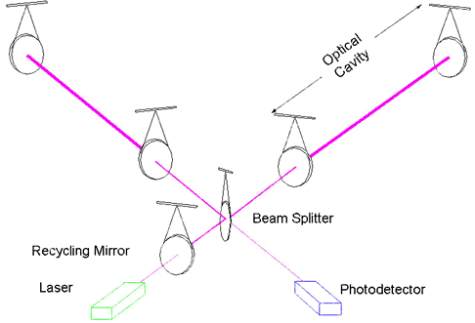
LIGO: Operation
The signal will be out of phase if one of the arms has been stretched out or contracted by a gravitational wave passing through
Two orthogonal optical cavities 4 km long measure the quadrupolar deformation as the gravitational wave passes through
Photo courtesy of: http://www.ligo.caltech.edu/LIGO_web/firstlock/ifo_sketch.html

Slide 9
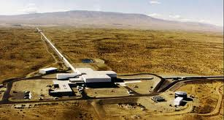
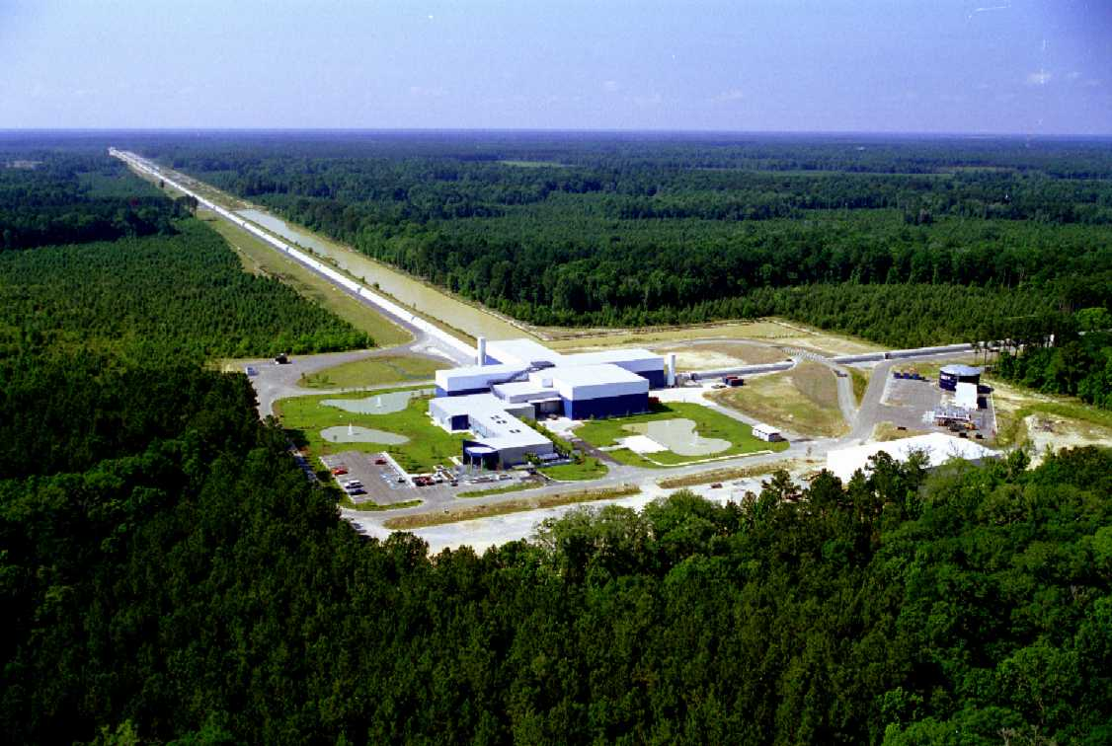
There are two LIGO detectors in the US, LIGO Hanford and LIGO Livingston
By having multiple detectors, we can use the time delay between the two received signals to triangulate the position of the signal on the sky
Photos courtesy of: http://www.ligo.org/multimedia/gallery/lho.php
http://www.ligo.caltech.edu/~ll_news/s5_news/s5article.htm

Slide 10
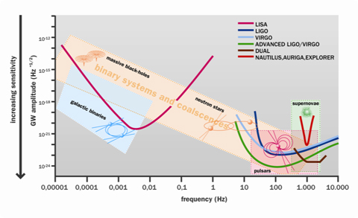
Observable Sources
LIGO searches over the frequency range ~1 Hz to ~ 1,000 Hz. It looks for bursts, mergers, pulsars, and background from the early universe.
Note the frequency range over which the different observatories search. This is why LISA would be an excellent addition to our current observatories.
Gravitational wave detector Sensitivity curves, in gravitational wave frequency versus amplitude.
Photo courtesy of: http://www.aspera-eu.org/index.php?Itemid=98&id=254&option=com_content&task=view

Slide 11
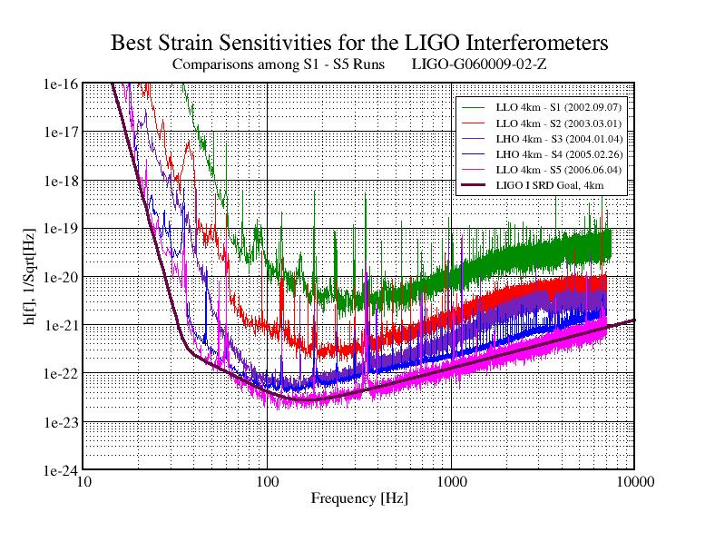
LIGO Observable Sources
Sensitivities of the different LIGO observing runs, from 2002 until 2006.
Note that there was an additional run in 2010 (not shown here) before the advanced LIGO update took place.
Photo courtesy of: https://www.advancedligo.mit.edu/summary.html
Notes:
The Strain sensitivity is what the detector actually measures, after all of the

Slide 12
Observable Sources
Strain is defined to be the physical displacement divided by the arm length
Used to make h[f] unitless
The strain sensitivity of 10⁻²⁰ corresponds to a physical change in length of the arms on the order of 10⁻¹⁸ meters
That’s 1,000 times smaller than the width of a proton!

Slide 13
Optimal Matched Filtering
How does one measure a displacement of 10⁻¹⁸ meters?
Obtained by correlating a known signal (e.g. template), with an unknown signal to detect the presence of the template in the unknown signal.
This is to maximize the SNR in a stochastic noise background
Notes:
Stochastic noise: Noise that has a random probability distribution, but finite variance.

Slide 14
Optimal Matched Filtering
To do this method, we need a template waveform to use to extract the signal from the background
In practice one must have a template bank of many waveforms and check the compatibility with each template to find the best match
I use an optimal system, where I know the parameters I am searching for, and can therefore use a single template, which saves computing time.

Slide 15
Optimal Matched Filtering
To make the match filter work optimally, one must take the Fourier Transform of the time series to go to frequency space, then do the filter (still in frequency space). We can multiply the Fourier Space template and data, then divide by the noise power in each frequency bin. Taking the Inverse Fourier Transform of the filter output puts it back in the time domain, so the result will be plotted as a function of time off-set between the template and the data.

Slide 16
Optimal Matched Filter Example
Let’s look at an example of a perfect matched filter
A blind injection is a false set of data that is injected into the detector without anyone knowing, to see if the detectors data pipelines are good and to see if the signal processing can pick out events through the real detector noise.
Data and codes courtesy of LOSC: https://losc-dev.ligo.org

Slide 17
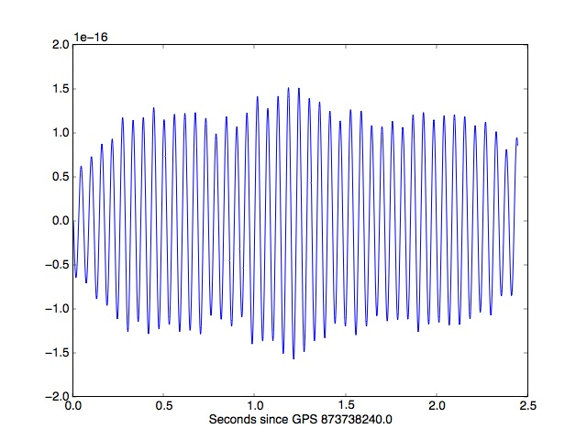
The Raw Time Series Data
Plotted is the strain (*10⁻¹⁶) versus time ( in seconds). Note that in this slice only 2.5 seconds have been plotted here. This is the step size that we use to conduct our search.

Slide 18
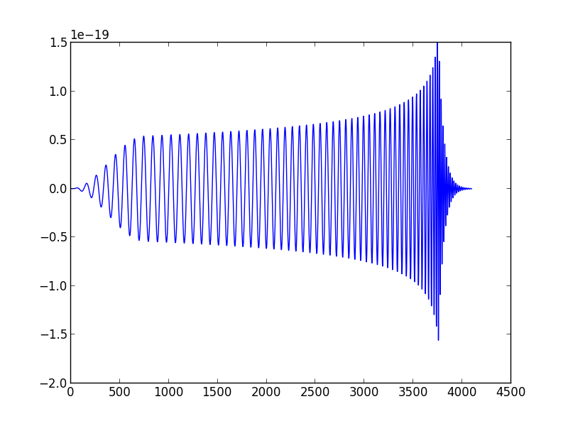
The Template
This is the template waveform used for this example. We search for this signal in the data and extract it.

Slide 19
The cross-correlation of the data
This is the cross-correlation of the ideal data with the template. Note the spike around 5000 seconds. This implies a correlation between the data and the template.
Note also the “noise” of this measure, and that it is almost periodic. We will discuss this in the coming slides.

Slide 20
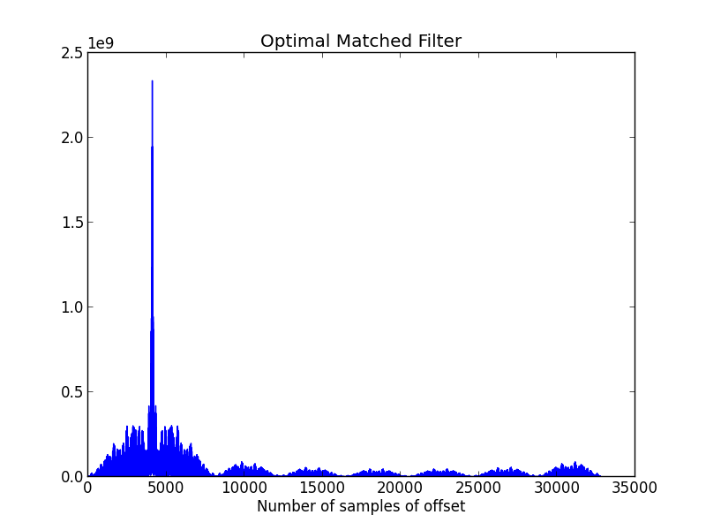
An Ideal Match Filter
This is the output of the matched filter.
Note that the “noise” here is much smaller. This is because we have applied the filter, and we aren’t just searching for a correlation. This is NOT the SNR however.
Again note the periodicity. This is due to the periodicity of the template.

Slide 21
What does a bad match look like?
We’ve seen the ideal case of applying a match filter to some perfect data. Now let’s look at applying the wrong filter to some data, and see a null result.
This is done by taking the raw time series data, and plugging in an incorrect template.

Slide 22
A Bad match
Note that the scale is 2 orders of magnitude lower than the last match filter.
There is no clear peak here, meaning one of two things:
Either there is no signal here, or we have applied the wrong template (which we have done in this case).

Slide 23
Discussion
We have seen an optimal matched filter, and what a bad match looks like.
Questions we can ask: How can this method fail, and what do we need for this method work?

Slide 24
How can this method fail?
We missed the template required to extract the signal (rare at this point)
General Relativity is wrong
Gravitational Waves don’t exist
The signal is still below the detector sensitivity

Slide 25
What do we need for this method work
The raw data must have a signal in it
The template must be the correct waveform to match the data
The data must be able to be manipulated. The Fourier series must be able to be taken, and we need to have an idea of the background noise to divide by to extract the signal

Slide 26
Future Work
Instead of having an optimal matched filter, apply a template bank to the search so the parameters can be unknown and a signal can still be found
Apply this method to “real” LIGO data to find events, win a Nobel Prize, etc.

Slide 27
Conclusions
Gravitational wave astronomy is at the cusp of the first direct detection of gravitational waves
The LIGO facilities are large antenna that are designed to pick up these gravitational waves
To extract the signal from the noisy data, we perform optimal matched filtering to reduce the noise
The detection of these gravitational waves will be the ultimate test of Albert Einstein’s theory of general relativity in the strong field regime

Slide 28
Thank You!

