Slide 1

NGC 660:
Disk Kinematics in a Polar Ring Galaxy
Derek Cabone, Rochester Institute of Technology

Slide 2
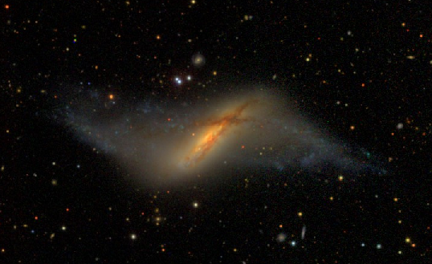

Outline
Introduction
Observation
Analysis
Conclusion
Future Work
SDSS

Slide 3
Goals (for today)
Does a ring alter the kinematic characteristics of the disk
Is the central distribution of mass in a polar ring galaxy different from a normal spiral

Slide 4
Observation

Slide 5
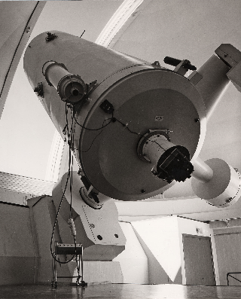
Collection
October 16, 1991
ESO 1.52 m telescope at La Silla
B&C spectrograph grating #26
Wavelength range from 4850-6850 Å
1 hour exposure
PA of 55º
Reduction via the MIDAS system
Fit to Gaussian distribution
Driel et al.
ESO

Slide 6
Analysis

Slide 7
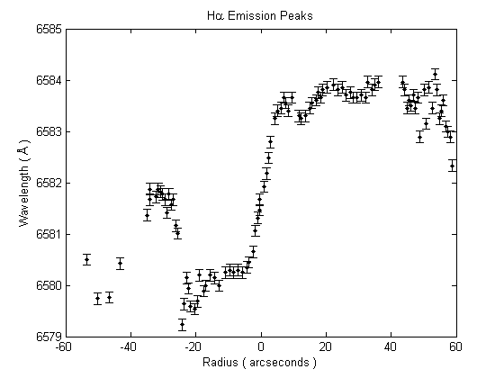
Hα Emission
Rest Wavelength:
  λ = 6562.81 Å

Slide 8
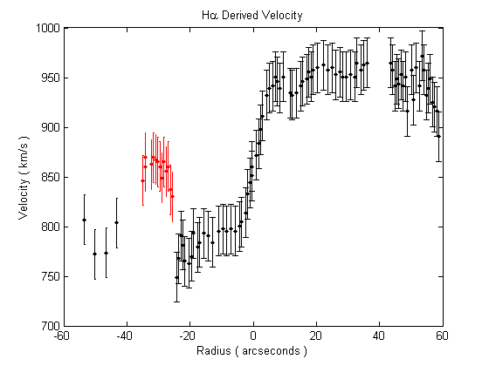
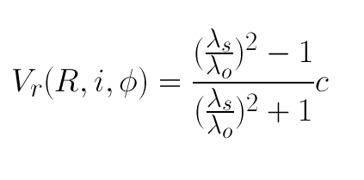
Line of Sight Velocity

Slide 9
Orientation
E
N

Slide 10
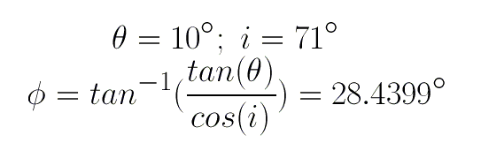
Geometry of Inclination
R
ϕ
y
r
h
h
i
x
θ
y
x

Slide 11
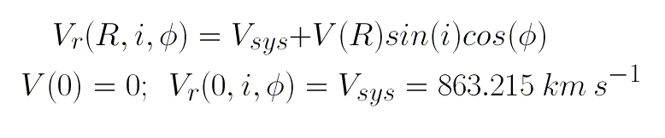

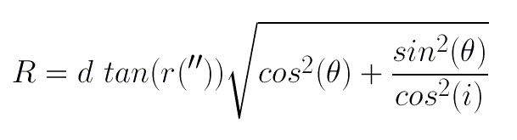
Distance and Radius

Slide 12
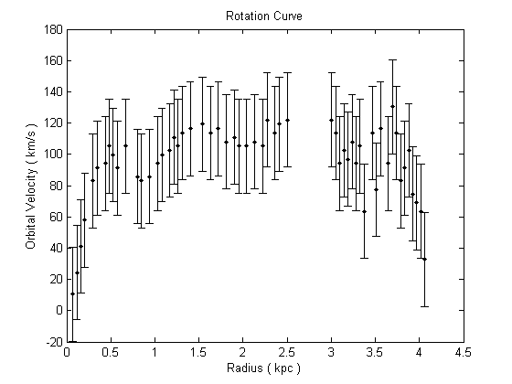

Rotation Curve

Slide 13
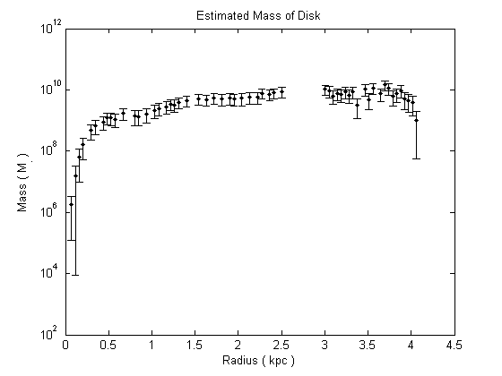


Rough Mass Estimate

Slide 14
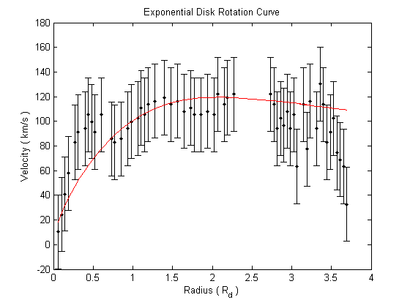

Exponential Rotation Curve

Slide 15
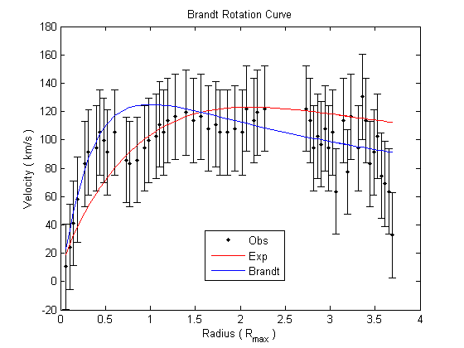



Brandt Model

Slide 16
Discussion
Designed to characterize highly flattened systems
Brandt model implies that the rotational velocity declines beyond optical radius
Generally not true; rotation curve remains flat to observable limit

Slide 17
Future Work
Observe 21cm emission to extend radial limit
Measure rotation curve in polar ring
Consolidate analysis into three dimensional kinematic profile

