Slide 1
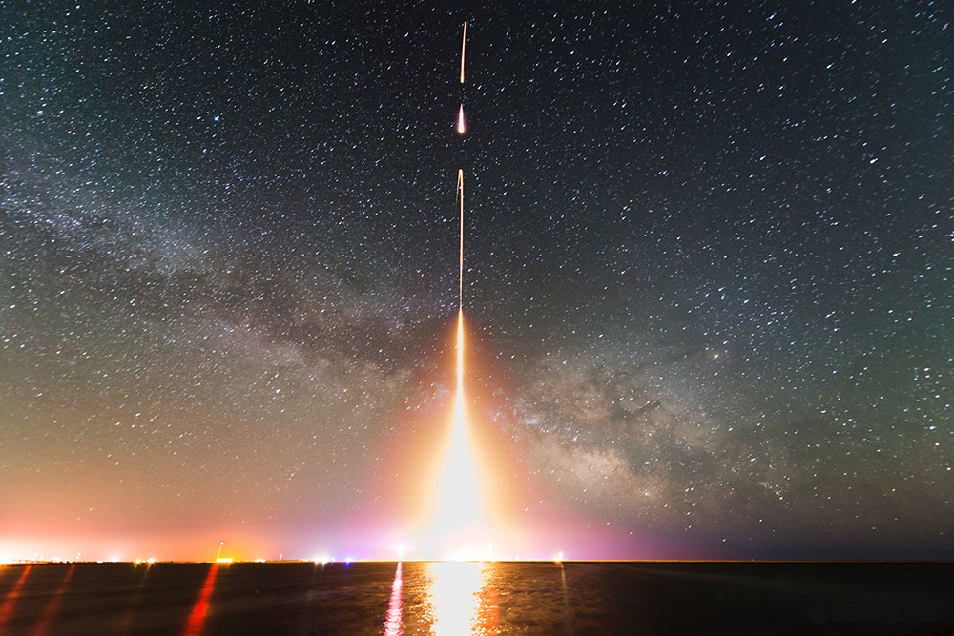
School of Physics & Astronomy
Center for Detectors
Seminar
Mapping the Large Scale Structure of the Cosmos from the Big Bang to the Present
Michael Zemcov
California Institute of Technology
Friday • February 27, 2015• 1pm • GOS 3365

