Slide 1
New Imaging Detectors for Astronomy
Future Photon Initiative
Center for Detectors
Don Figer
College of Science, Professor
Future Photon Initiative, Director
Center for Detectors, Director
January 9, 2025

Slide 2
Outline
speaker bio
single photon optical imaging detectors
new large-format infrared detectors (such as needed by Cryoscope)
a single photon astrophotonic optical spectrograph
the RIT Center for Detectors
the RIT Future Photon Initiative

Slide 3
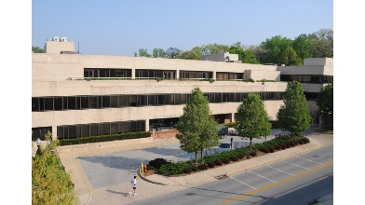
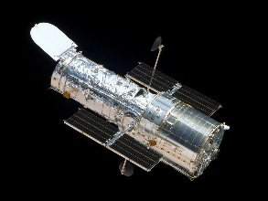
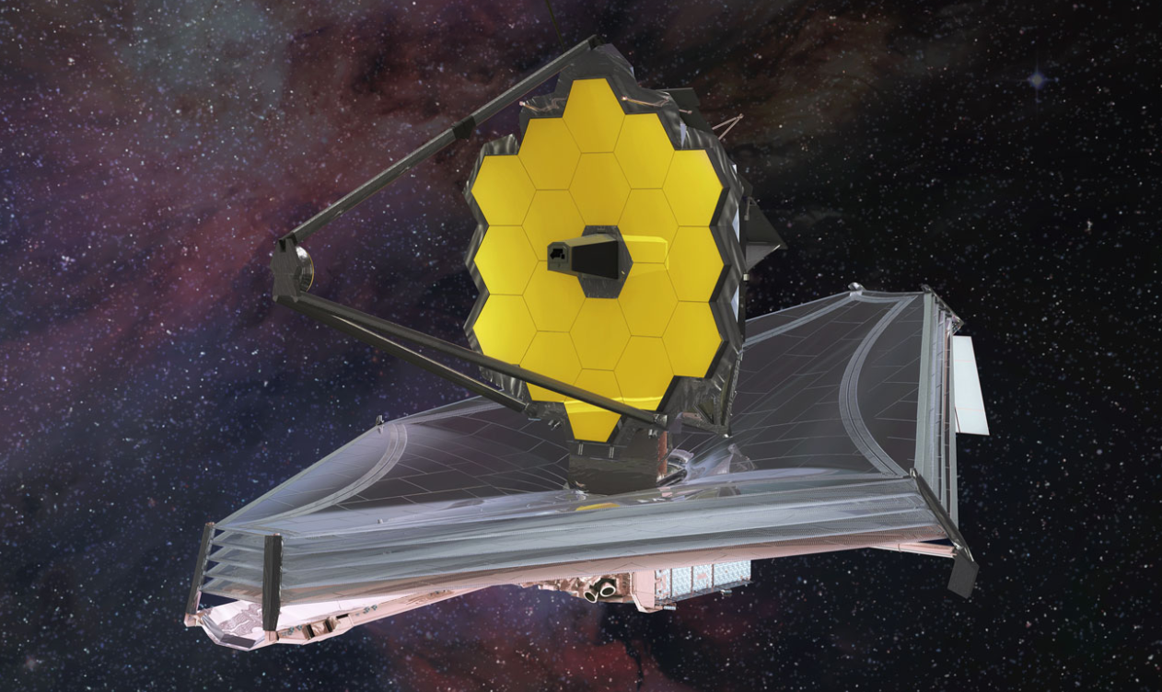
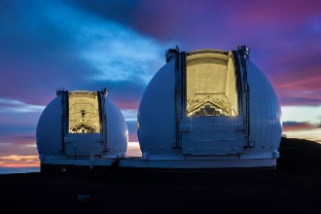
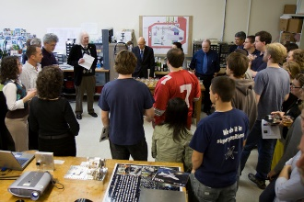
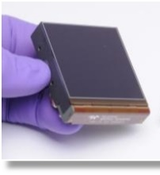
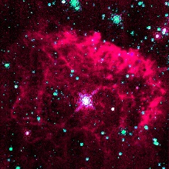
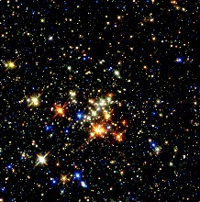
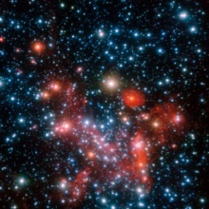
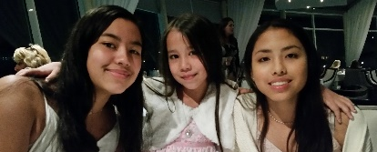
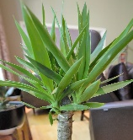
Don Figer - Speaker Bio
Professor in College of Science at RIT
Professor in Astrophysical Sciences and Technology Graduate Program
Director of the Center for Detectors
Director of the Future Photon Initiative
At RIT since 2006
Previously
  Space Telescope Science Institute (operates Hubble and JWST)
  UCLA (designed optics for infrared spectrograph on Keck)
Research Interests: Detectors, Massive Stars, Massive Star Clusters, Galactic Center
3 daughters, no pets, a few plants

Slide 4
Single Photon Optical Imaging Detectors
Justin Gallagher

Slide 5
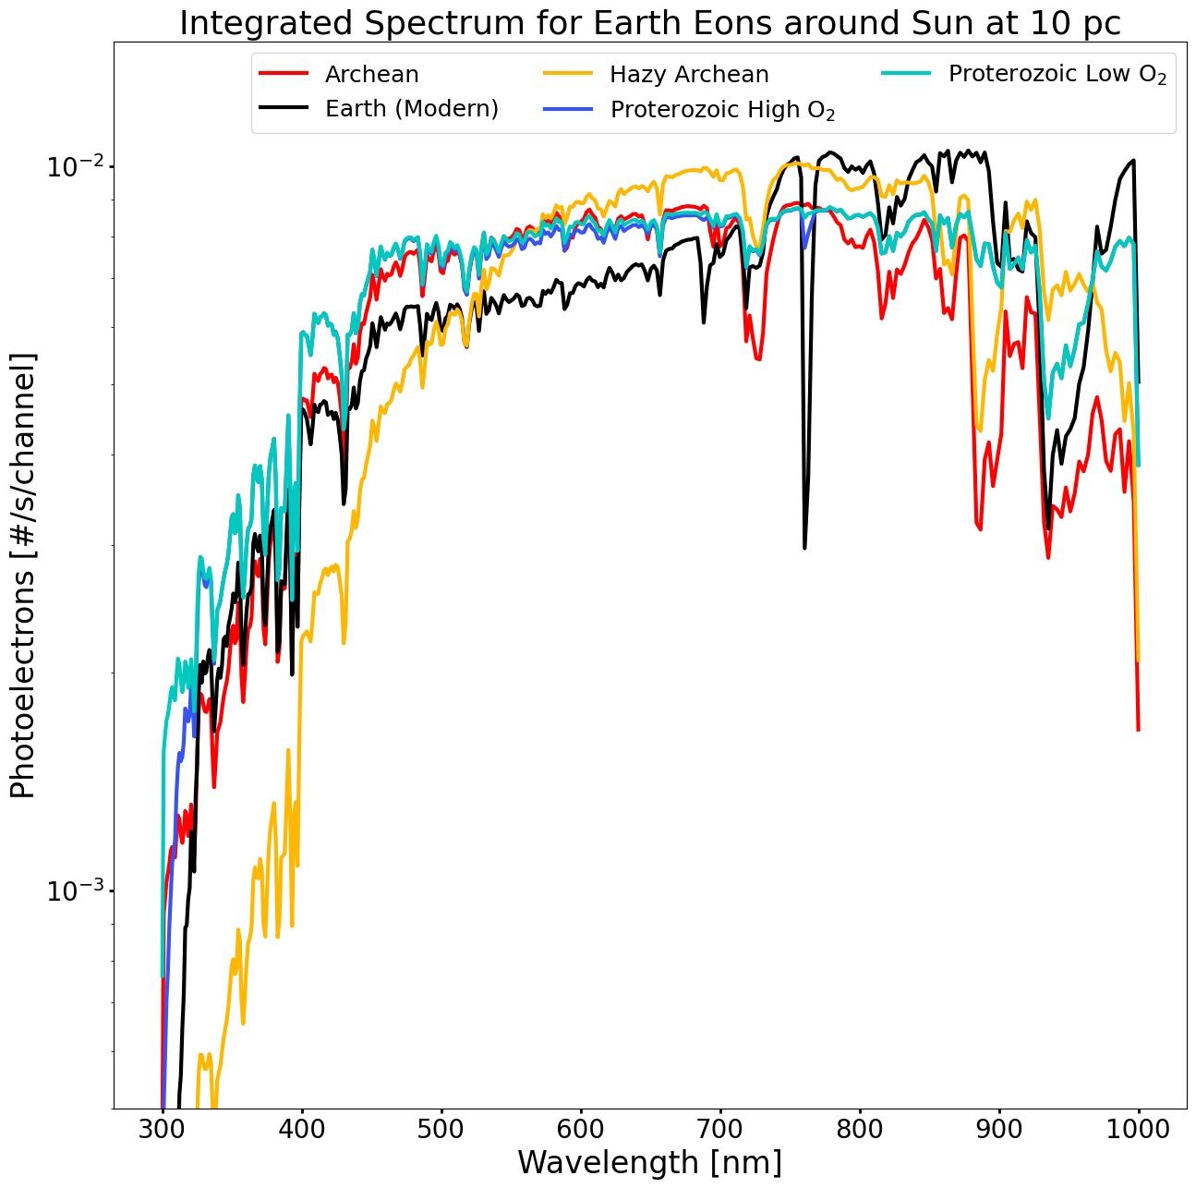

Life in the Universe

Slide 6
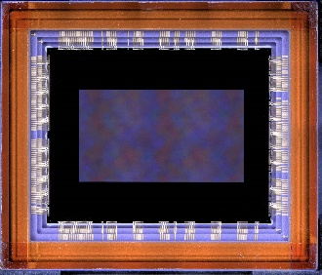
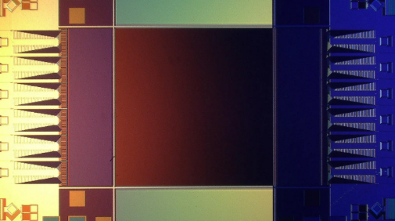
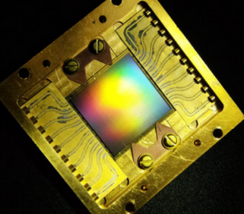
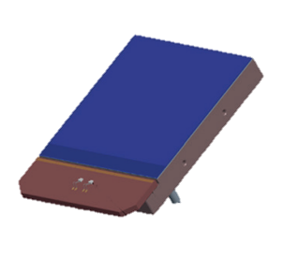
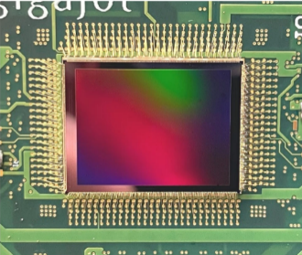
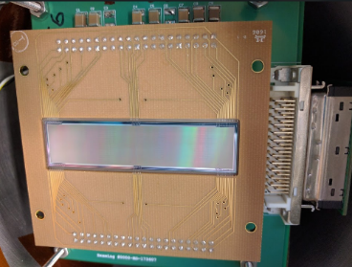
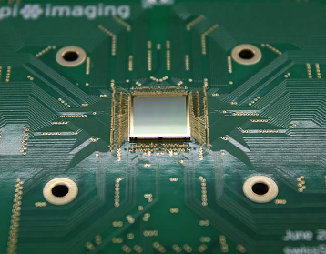
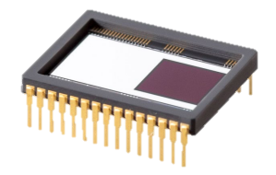
State of the Art Detector Candidates for Future Missions
challenging requirements for UV/O/IR observations
single-photon sensing
low dark current
near-zero read noise
multiple candidate detector technologies
CMOS: 9.4 Mpix
BAE HWK4123
SNSPD: 0.4 Mpix (Adam McCaughan/NIST)
MKID: 20 kpix (Mazin Lab, Breckenridge 2021)
CMOS: Teledyne e2v CIS301/302
EMCCD: Teledyne e2v CCD351-00
CMOS: 163 Mpix QIS (Ma et al. 2022)
Skipper CCD: 3.5 Mpix (SENSEI Collaboration)
SPAD: Pi Imaging SPAD 512² (Antolovic et al. 2022)

Slide 7
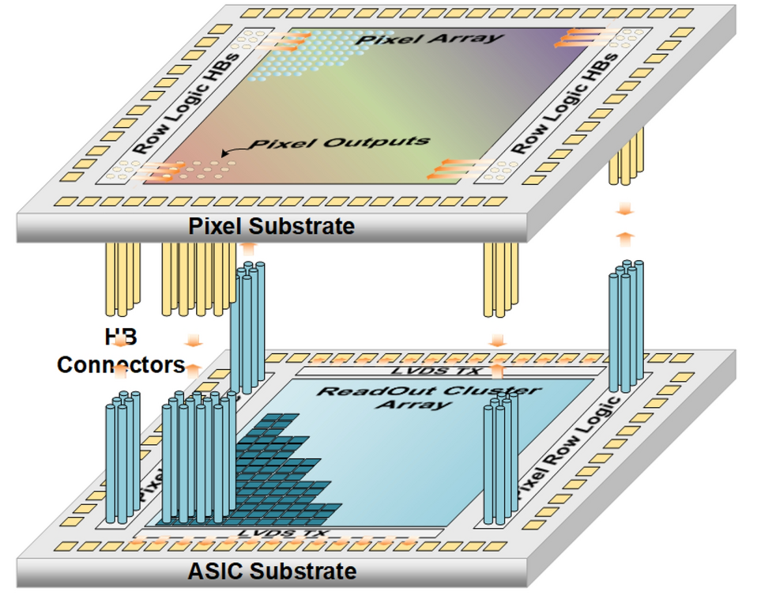
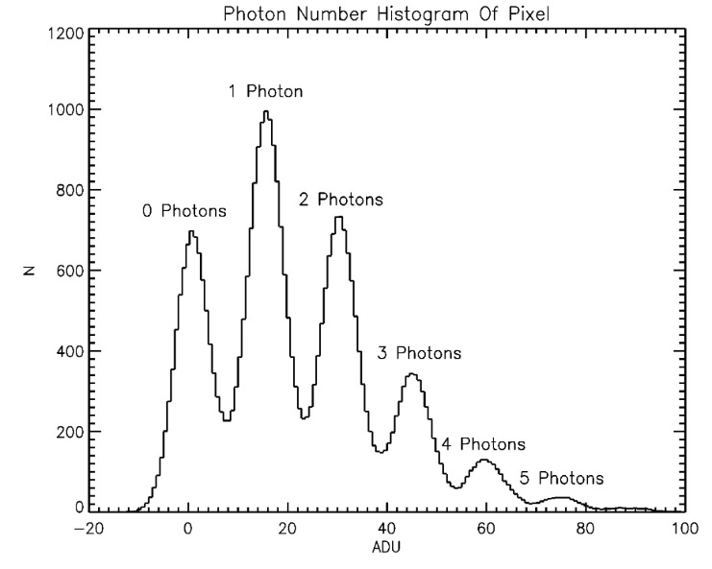
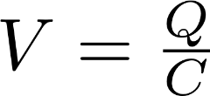
Single Photon Sensitivity
low-capacitance floating diffusion sense node
high-gain response of >320 μV/e-
exceeds electronics read noise
correlated double/multiple sampling
discrete photoelectron peaks
Ma, J. et al. Ultra-high-resolution quanta image sensor with reliable photon-number-resolving and high dynamic range capabilities. Sci Rep 12, 13869 (2022). https://doi.org/10.1038/s41598-022-17952-z

Slide 8
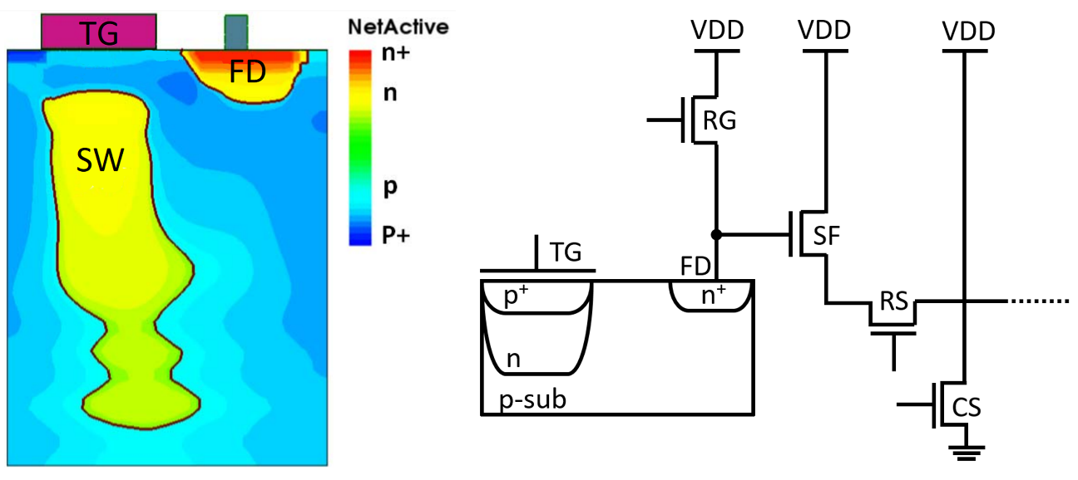

Single Photon Detector Operation

Slide 9
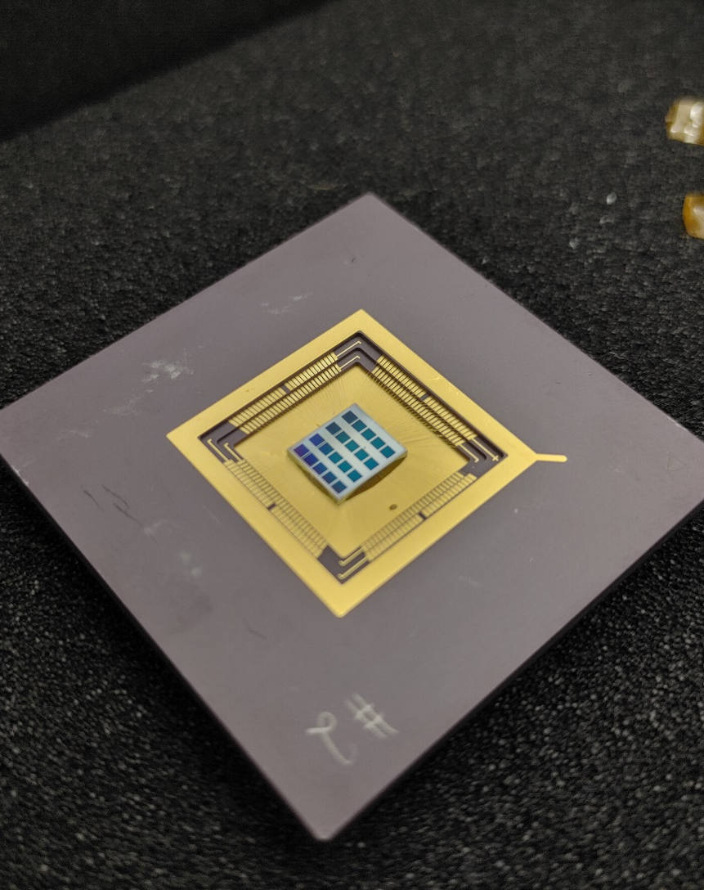
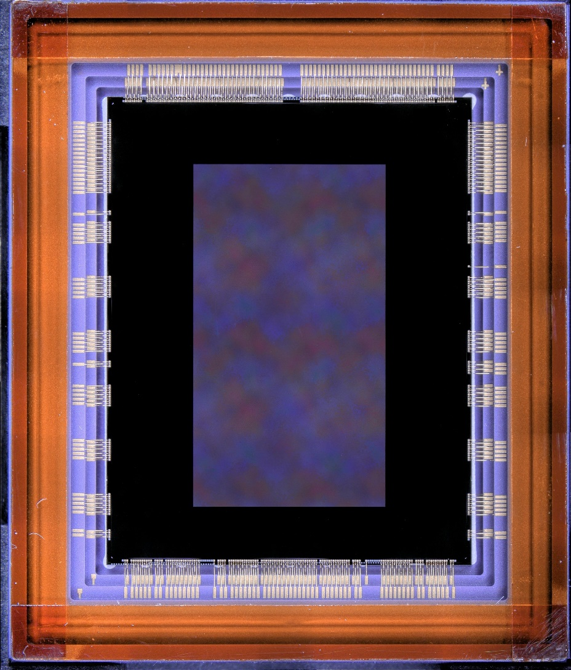
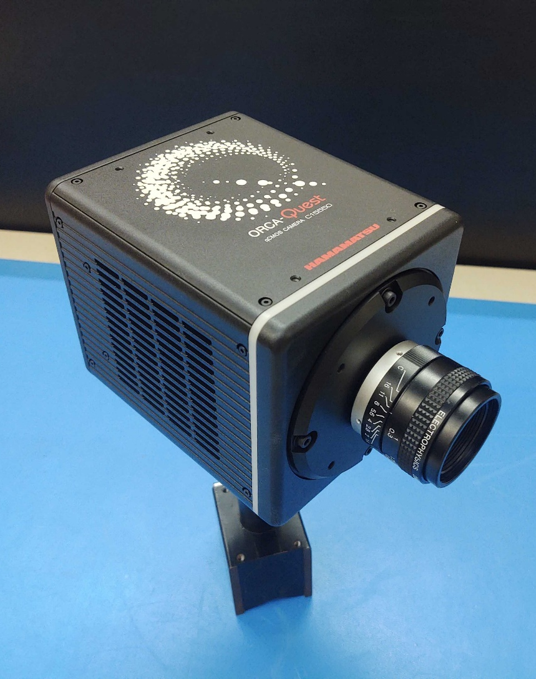
Single-Photon CMOS Image Sensors
QIS CMOS
1 Megapixel Sensors
1.1 μm pixels
HWK4123
9.4 Megapixel
4.6 μm pixels
ORCA-QUEST
HWK4123

Slide 10

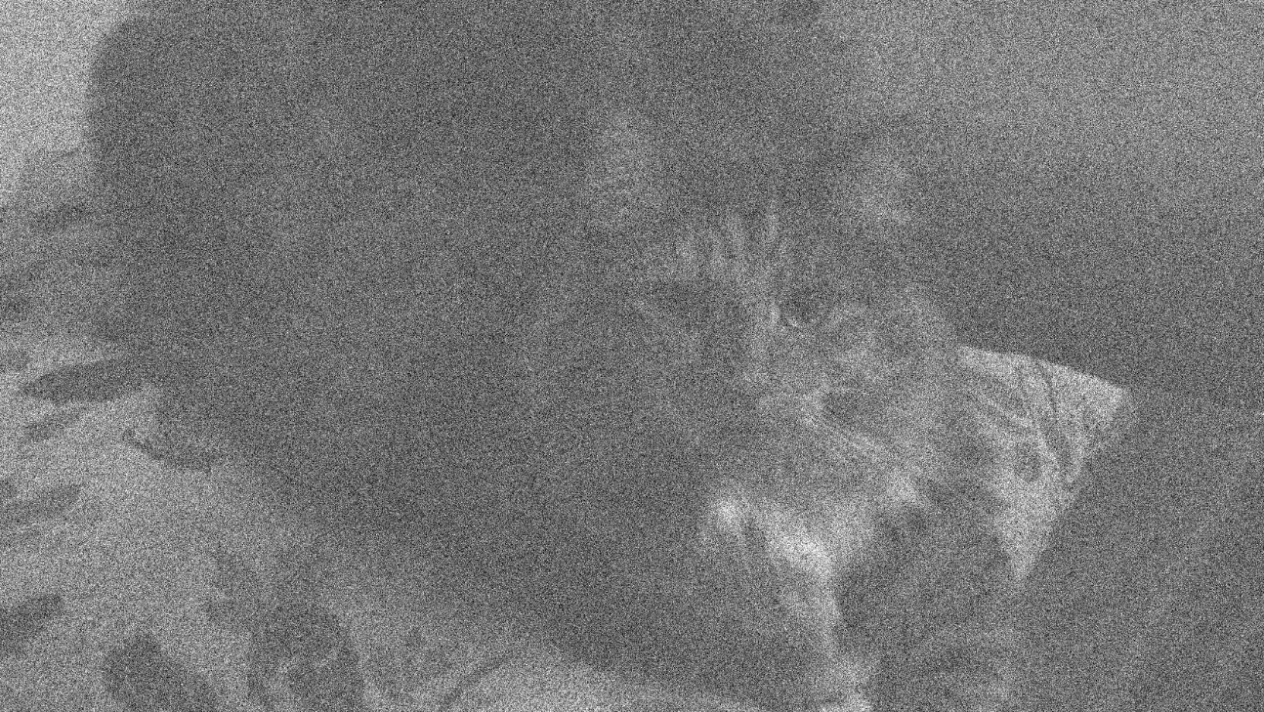
Single Photon Images
Mean Signal = 2 e⁻
Read Noise = 0.25 e⁻
Mean Signal = 2 e⁻
Read Noise = 1.0 e⁻

Slide 11
Sensor Parameters and Performance
Sensor Parameters
Parameter | Unit | QISSAT1-2 | HWK4123
Format | - | 1024 × 1024 | 4096 × 2304
Pixel Size | μm | 1.1 | 4.6
Sensor Performance Metrics
Dark Current | e⁻/pix/s | 0.0004 (253 K) | 0.006 (233 K)
Quantum Efficiency | % (325 nm) | 35 | 60
 | % (500 nm) | 83 | 87
 | % (940 nm) | 7 | 36
Read Noise (median) | e⁻ | 0.27 | 0.23
Full Well Depth | e⁻ | 275 | 7000
Fill Factor | % | 100 | 100
Frame Rate | fps | up to 30 | up to 120
Current TRL | - | 5 (pixels) 4 (ROIC) | 4

Slide 12
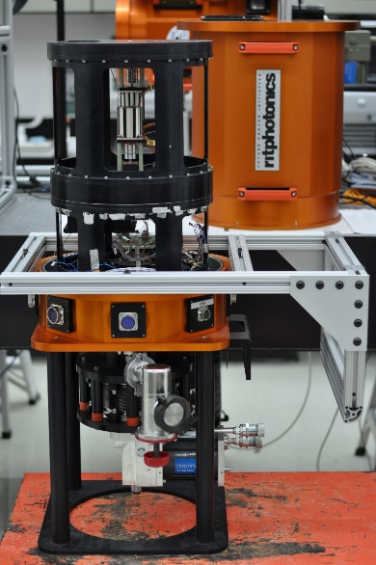
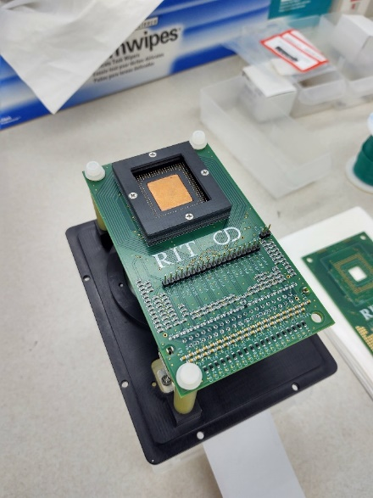
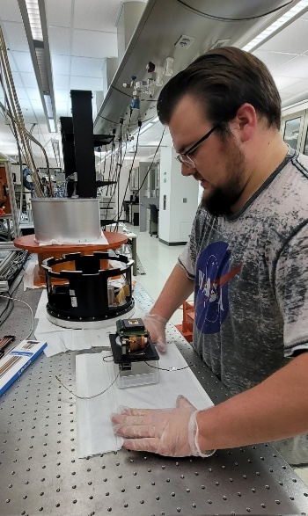
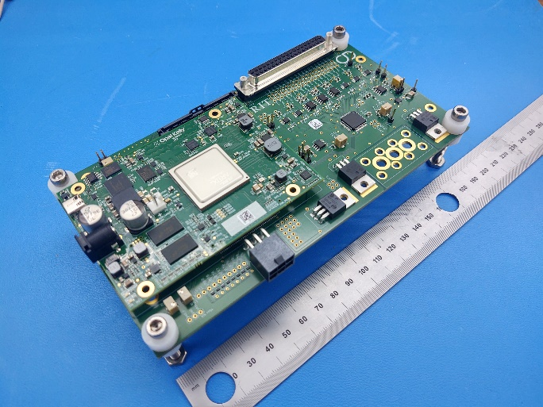
New FPGA-based Electronics

Slide 13
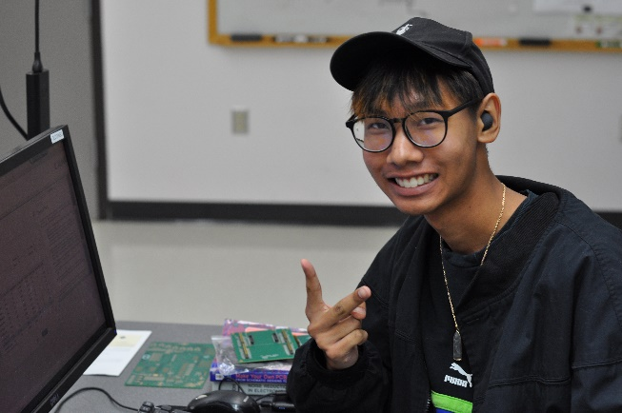
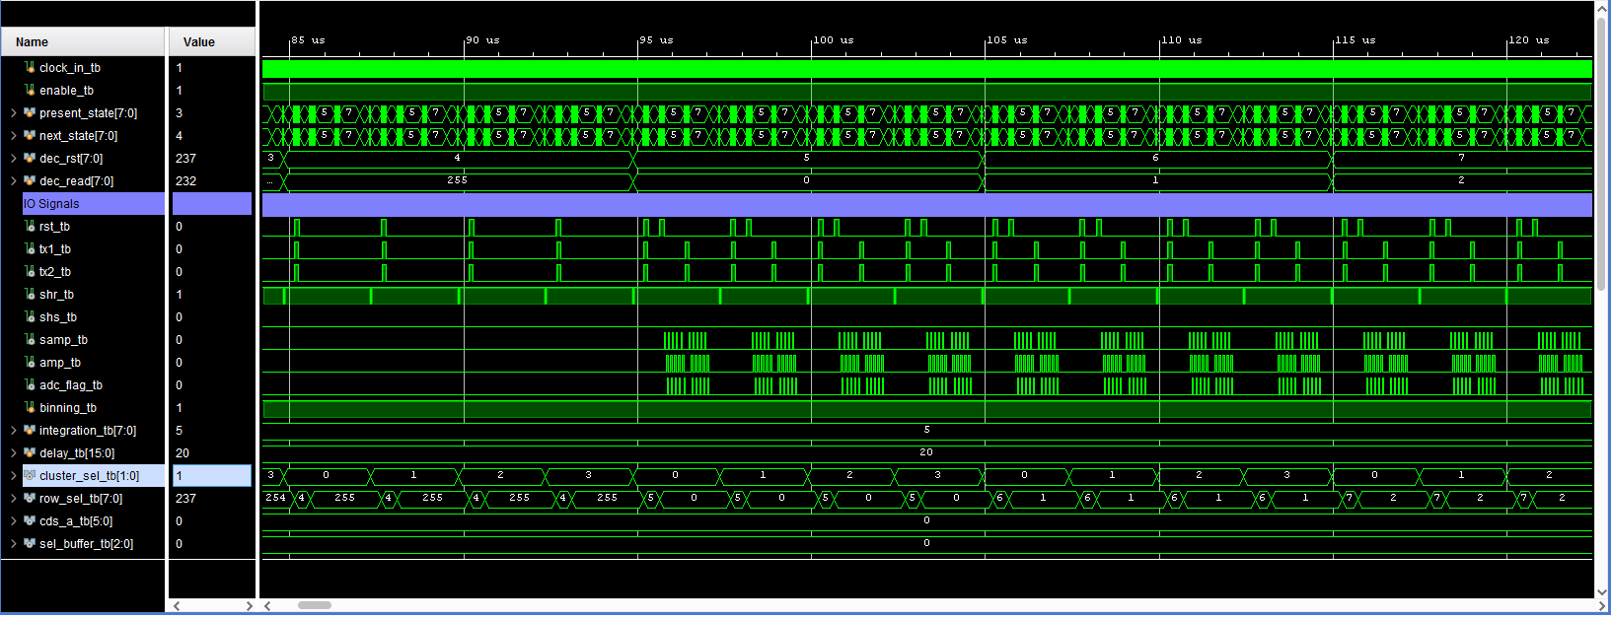
Radiation Mitigation Readout Modes
create and validate single event upset mitigation readout modes
develop and test damage mitigation operational modes
leverage CMOS digital pixel multiplexing
generate modular waveforms for custom readout
verify performance of custom modes at radiation beam line
advance new readout modes beyond TRL2

Slide 14
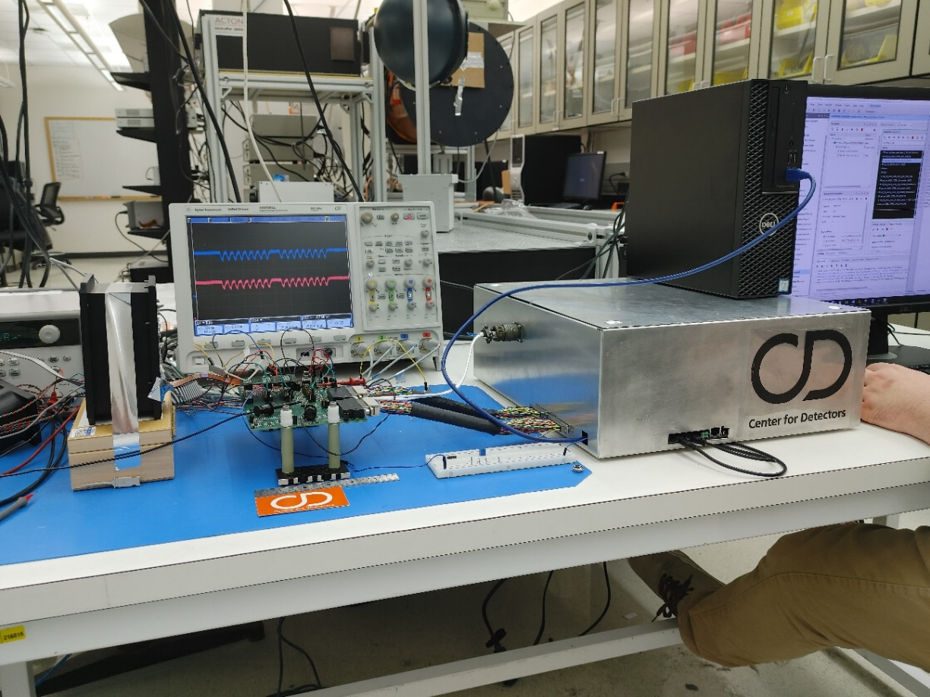
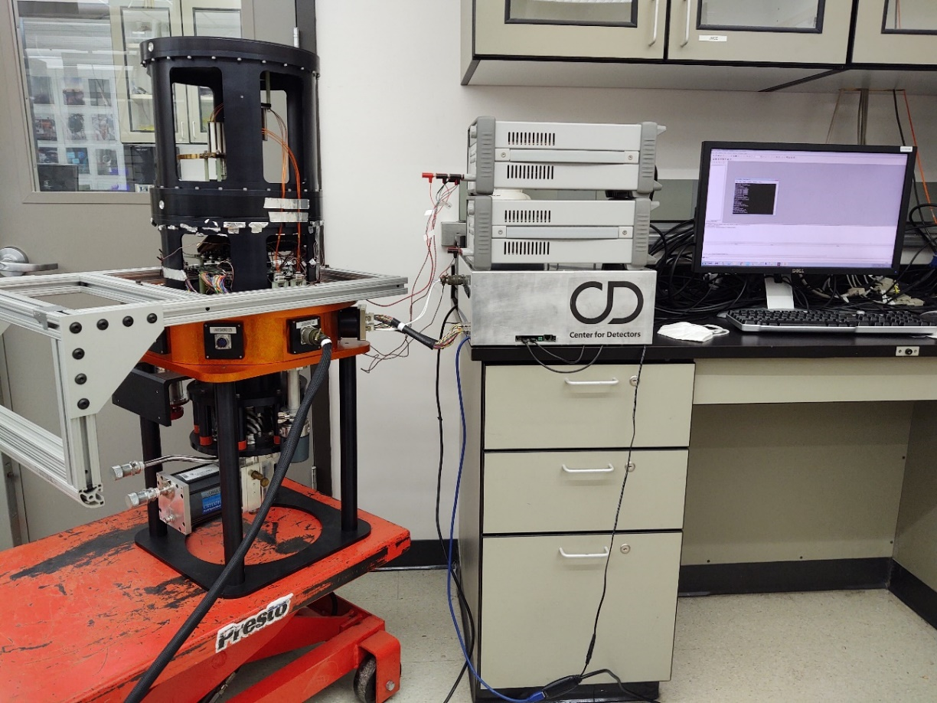
Custom Cryogenic and Vacuum Safe Readout Electronics

Slide 15
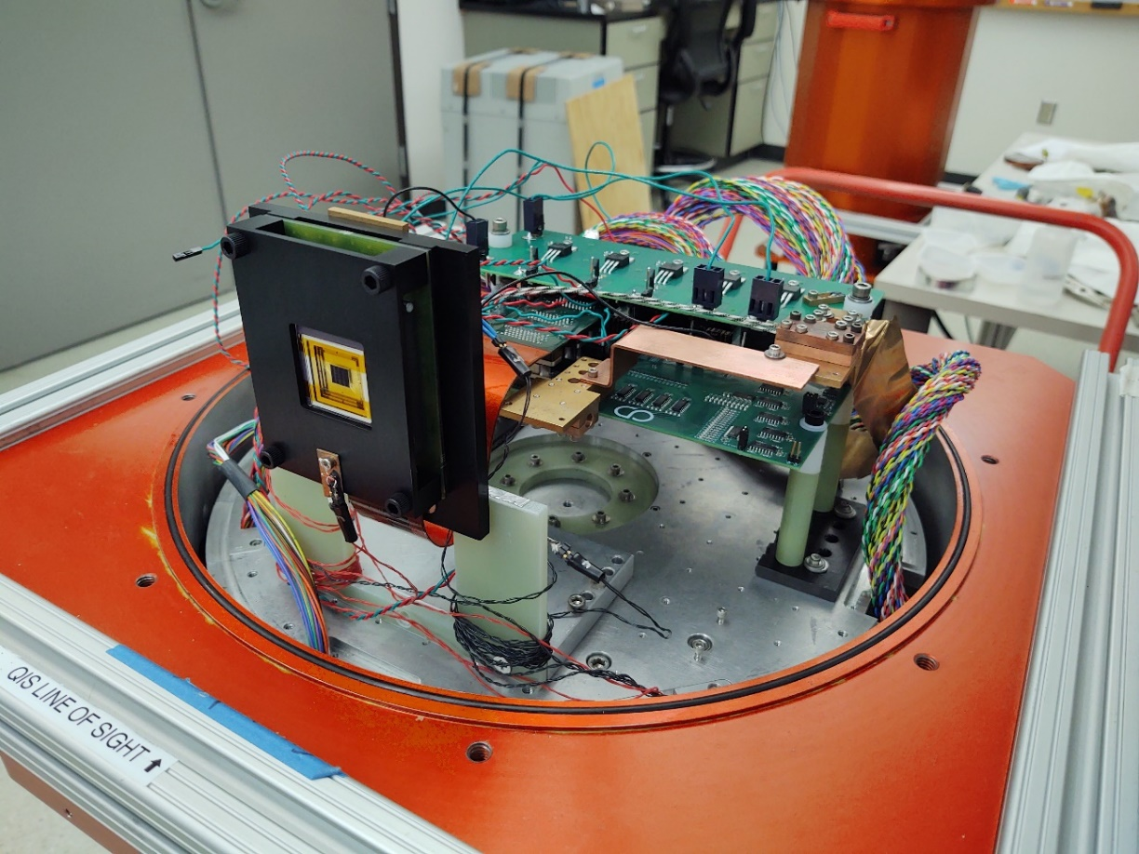
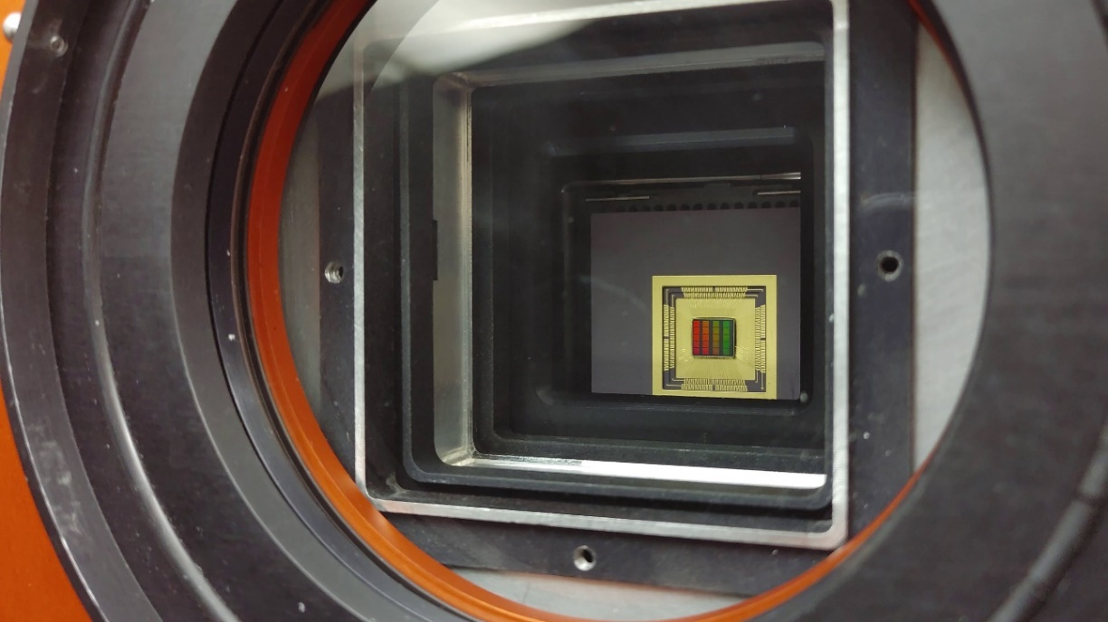
Detector Mounted for Radiation (left) and Optical (right) Testing

Slide 16
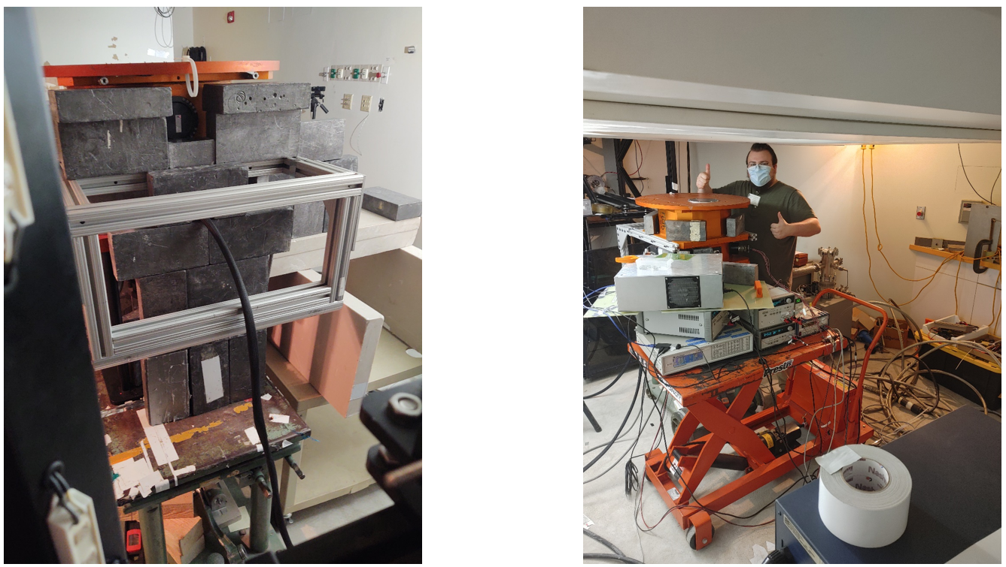
Dewar and Detector at the Proton Radiation Testing Facility

Slide 17
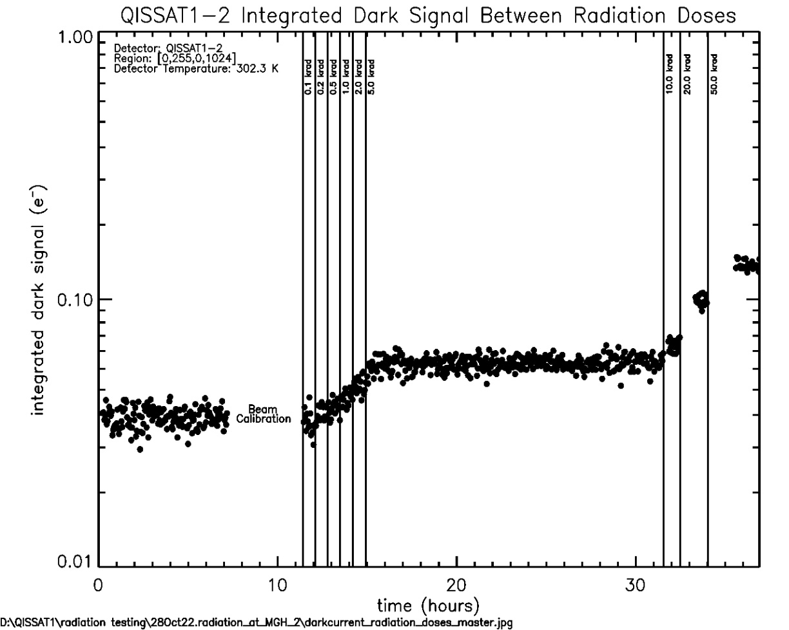
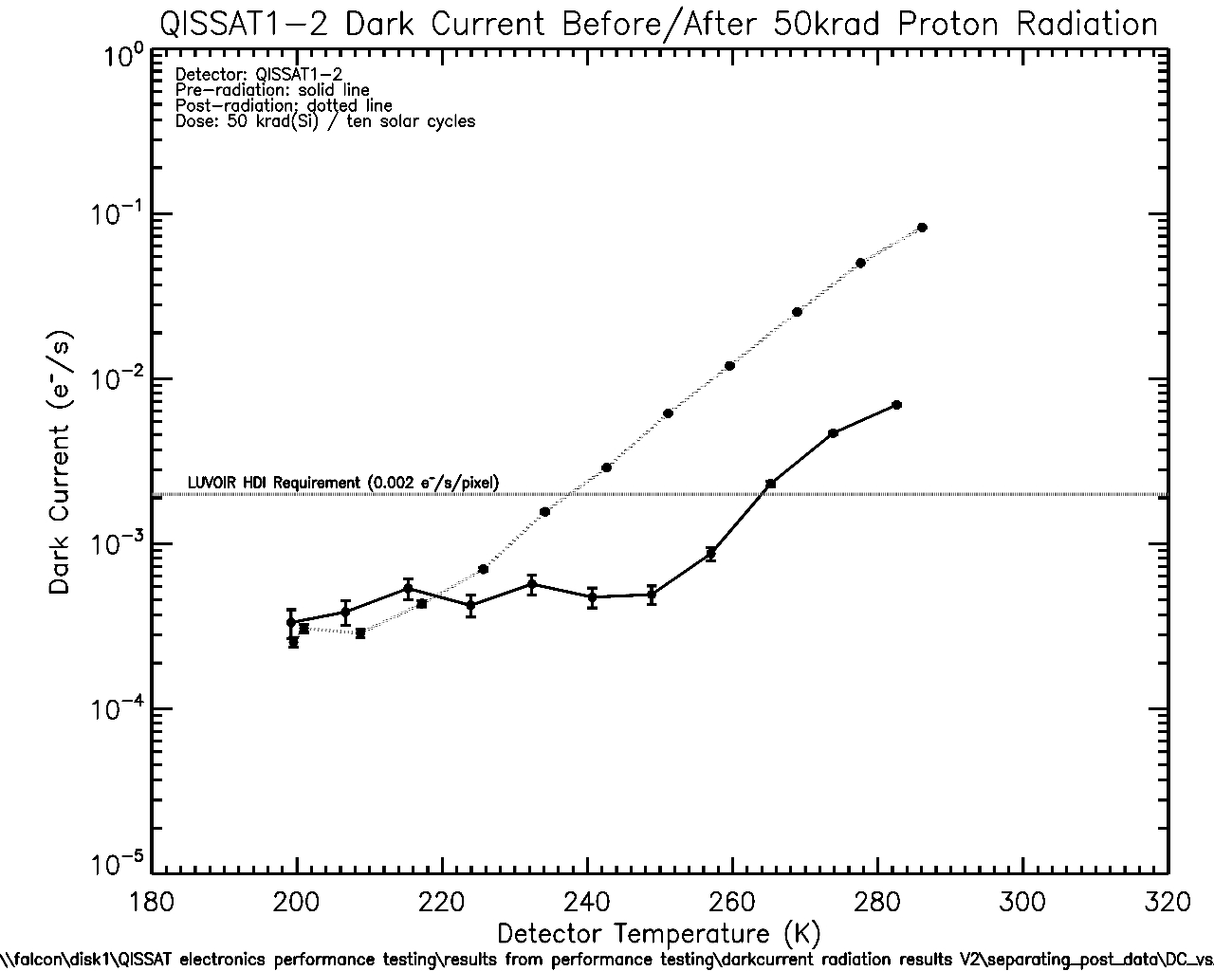
Integrated Dark Signal as a Function of Radiation Dose

Slide 18
Dark Current After Irradiation
Doubling Temperature =~8.5K

Slide 19
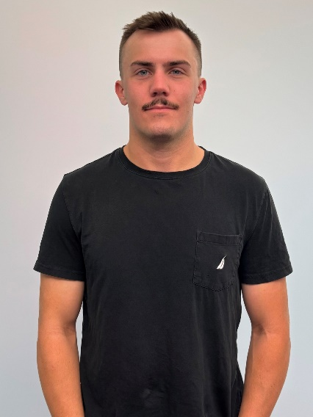
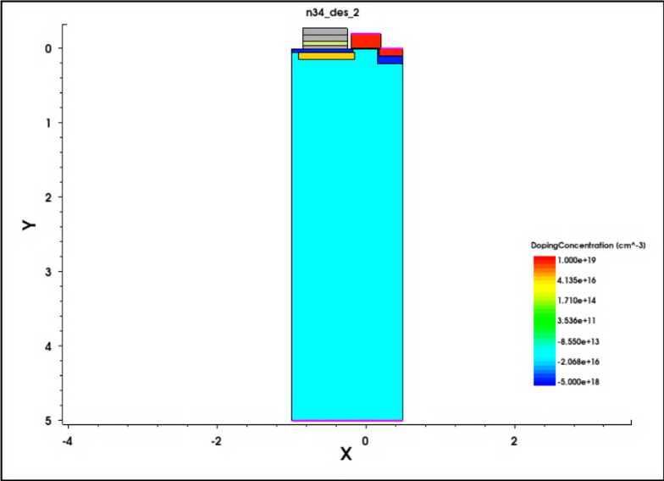
Single-Photon Sensing NIR Photodiode
develop Si TCAD model of pixel using Synopsys Sentaurus
demonstrate pixel operation and low-capacitance sense node
migrate structure to MCT material platform
simulate photodiode performance and compare to Si predecessor
advance single-photon sensing and photon-number resoling NIR photodiode beyond TRL2

Slide 20
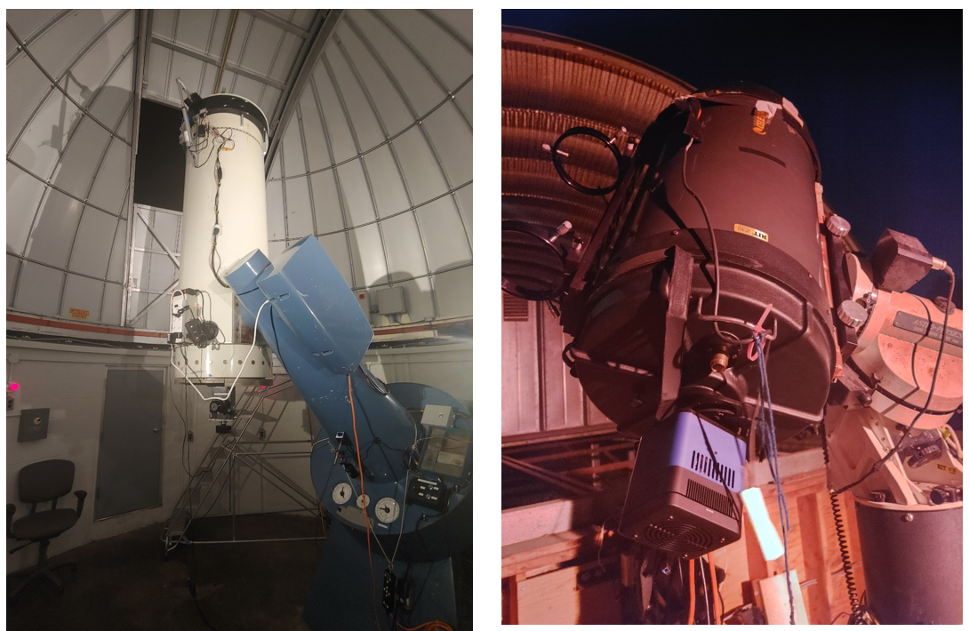
Telescopes at UofR’s Observatory (left) and RIT’s Observatory (right)

Slide 21
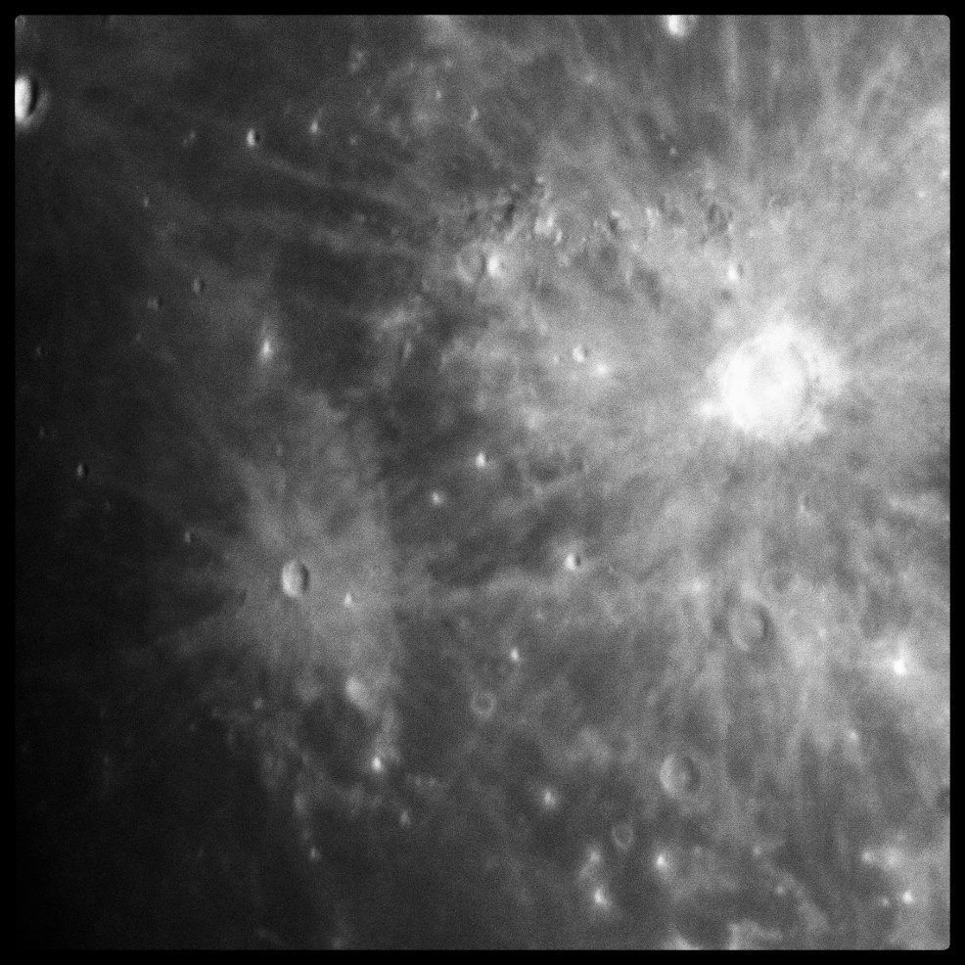
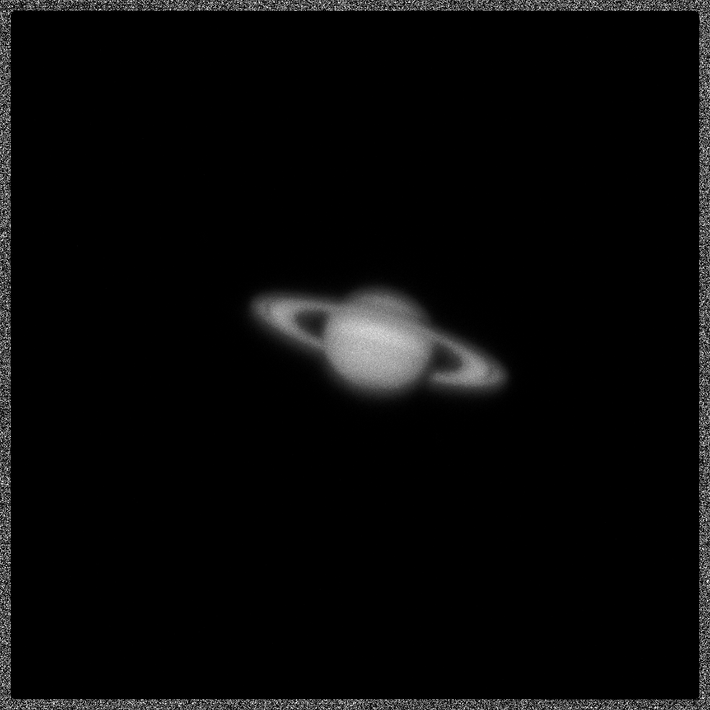
Image of Lunar Terminator and Saturn
Gallagher, J., Buntic, L., Figer, D. F., and Deng, W. 2022, “Characterization of single-photon sensing and photon-number resolving CMOS image sensors,” SPIE Astronomical Telescopes and Instrumentation, Montreal, Paper 12191-28

Slide 22
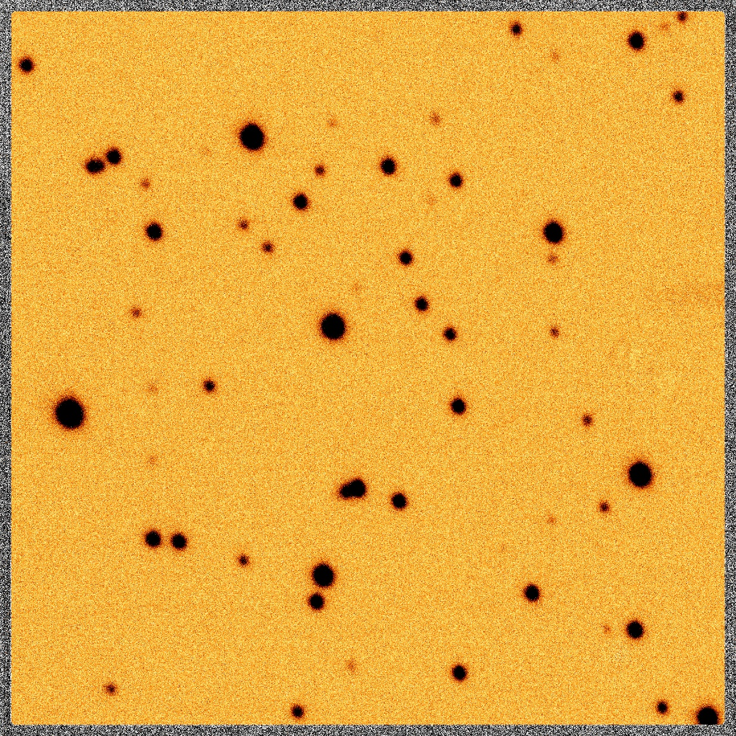
Raw image of M67 using QISCDK
Gallagher, J., Buntic, L., Figer, D. F., and Deng, W. 2022, “Characterization of single-photon sensing and photon-number resolving CMOS image sensors,” SPIE Astronomical Telescopes and Instrumentation, Montreal, Paper 12191-28

Slide 23
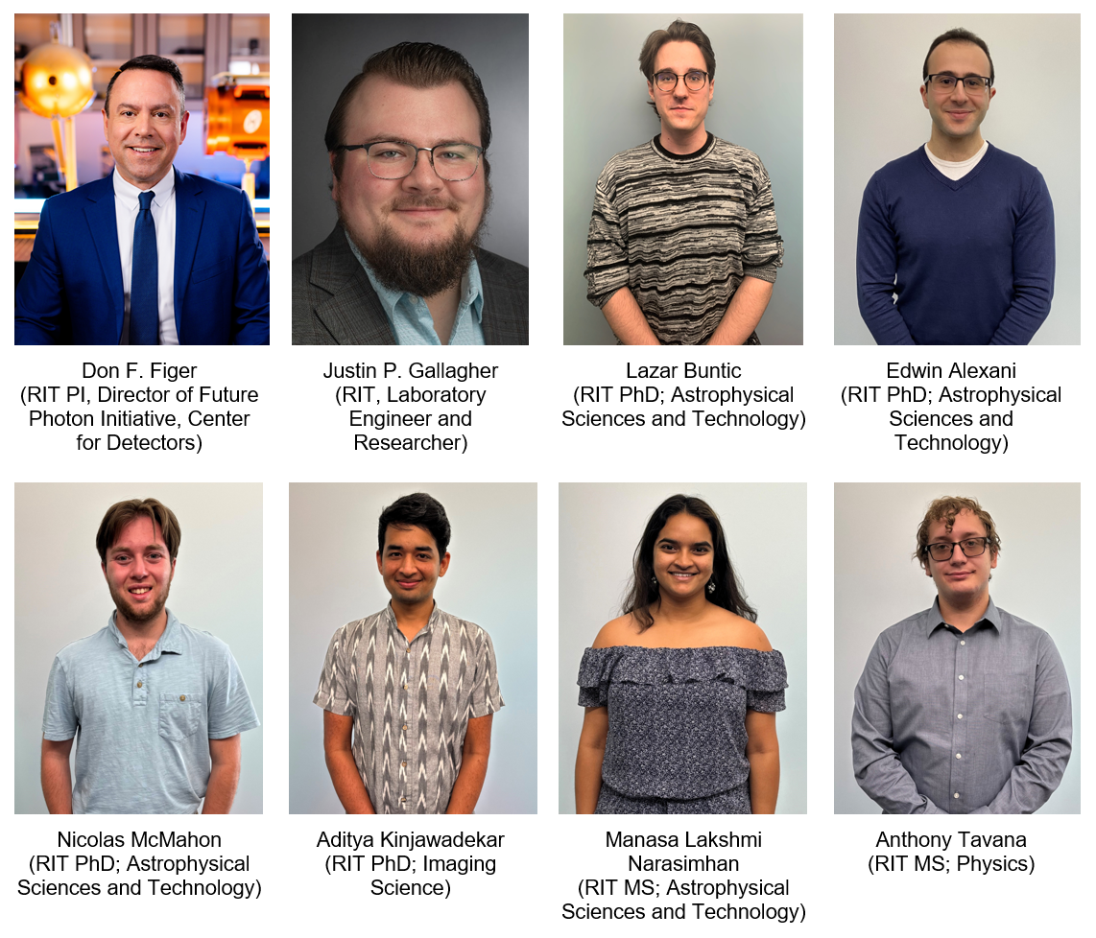
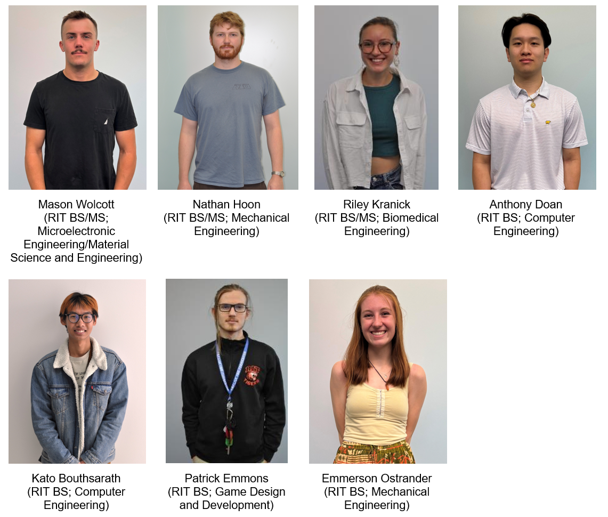
Team Members

Slide 24
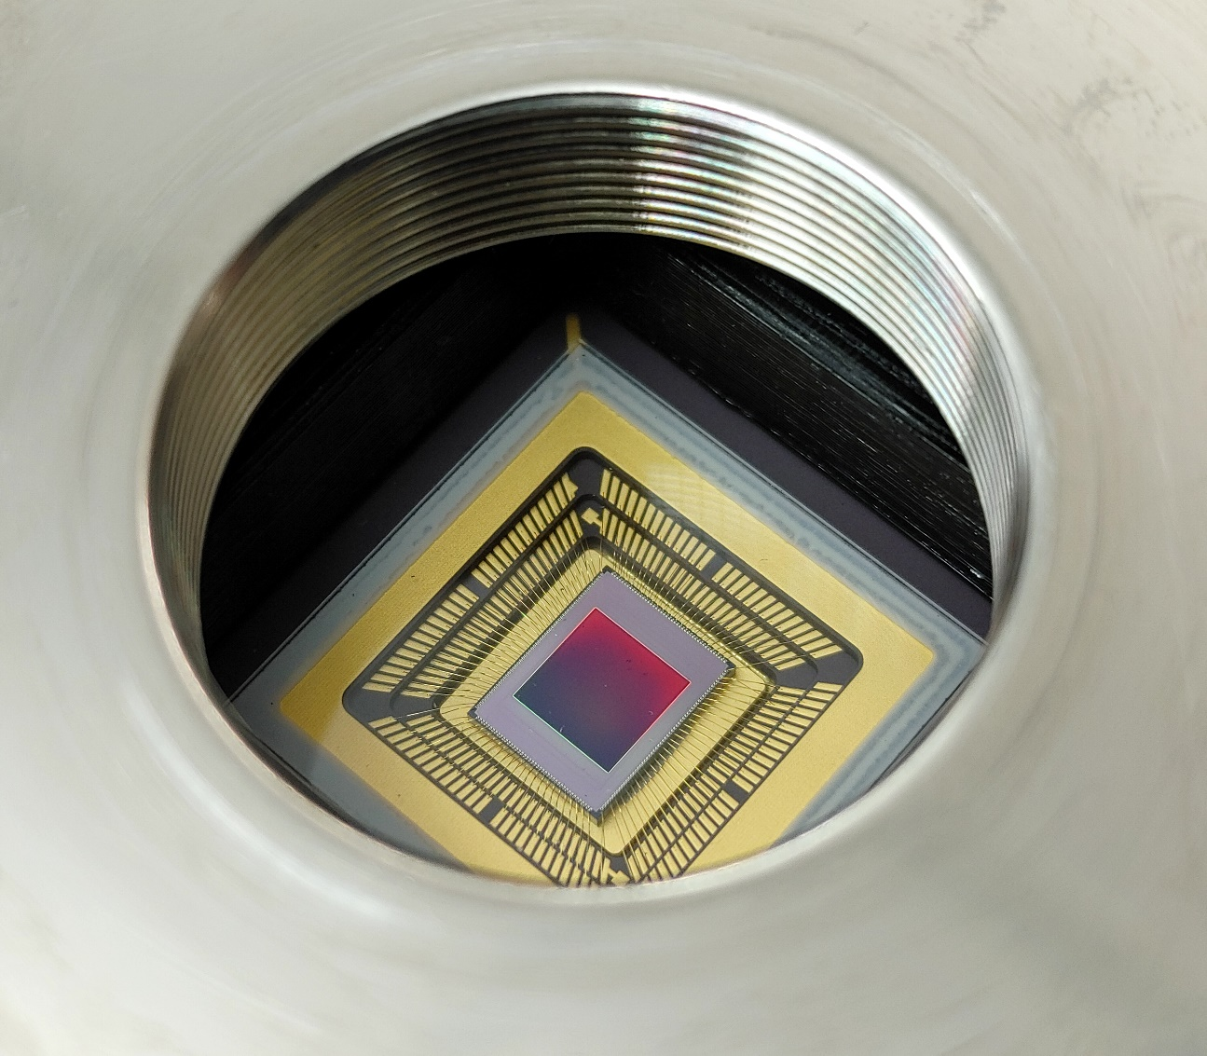
Summary
challenging science
observe low photon flux sources
detect biosignatures on exoplanets
develop detector technologies for HWO single-photon sensing in UV, optical, and NIR
Recent Publications:
Gallagher, J. P., Buntic, L., Deng, W., Fossum, E. R., and Figer, D. F. 2024, Radiation tolerance of a single-photon counting complementary metal-oxide semiconductor image sensor, J. Astron. Telesc. Instrum. Syst. 10(3), 036003, doi: 10.1117/1.JATIS.10.3.036003.
Gallagher, J. P., Buntic, L., Alexani, E., Bouthsarath, K., and Figer, D. F. 2024, Characterizing radiation-tolerant single photon resolving CMOS detectors, Proceedings Volume 13103, X-Ray, Optical, and Infrared Detectors for Astronomy XI; 131030S, Yokohama, Japan, https://doi.org/10.1117/12.3019105.
Gallagher, J. P., Buntic, L., Figer, D. F., Deng, W. 2024, Characterization of single-photon sensing and photon-number resolving CMOS image sensors, Proc. SPIE 12191, X-Ray, Optical, and Infrared Detectors for Astronomy X, Montreal, Canada, https://doi.org/10.1117/12.2629006

Slide 25
New Large-format Infrared Detectors
Lazar Buntic

Slide 26
New Infrared Detectors for Astronomy
largely dominated by HgCdTe (MCT) CMOS detectors due to highly tunable bandgap of MCT
  HxRG series from Teledyne, for example
  primarily MCT grown on CdZnTe (CZT)
limited use of InSb, InGaAs, and non-CMOS architectures otherwise
SATIN project at RIT led the development of MCT-on-Si as a competitive architecture

Slide 27
Timeline of the SATIN Project
SATIN: SWIR Advanced Technology Instruments for NSF and NASA
2011-2014 – joint NSF-NASA program
  developed MCT-on-Si mesa arrays in two fabrication runs
    first run made two 2K devices, one on CZT, one on Si; as well as five 1K variable unit cell (VUC) devices with various mesa sizes
    second run made three more devices, two of which came from the same wafer (one of these was thinned to demonstrate extension of SW QE cutoff)
2014-2021 – Second NSF ATI program
  three rounds of development and fabrication
    first round tested two substrate removal processes
    second round confirmed reduction in dark current tail by lowering etch pit density
    final round developed 8 planar-structure VUC devices

Slide 28



Lattice Mismatch in MCT-on-Si

Slide 29


VUC Device Quadrants
1024x1024 devices, HgCdTe-on-Si
Raytheon VIRGO 1K ROIC
quadrants have different junction sizes
planar structure grown via MBE process
p-type (MCT:As) on n-type (MCT:In)

Slide 30

Well Depth and Linearity
full well depth is the maximum amount of charge that can be integrated by the pixel
linearity is a measure of the voltage response of the p-n junction to accumulating charge
parameters are measured via the photon transfer experiment, in which the detector is illuminated until saturated
future work will:
  further work already done to model pn-junction size effect on well depth
  generate model to explain ‘odd’ linearity behavior (possibly due to a source of ‘fixed’ capacitance in addition to the variable capacitance of the p-n junction)

Slide 31

Quantum Efficiency
the rate at which incident photons are converted to photoelectrons for a given wavelength
measured by scanning a monochromator across the full range of wavelengths and using NIST-calibrated diodes to determine the amount of incident light
QE extends below Si cutoff (1.1 µm) due to removal of growth substrate
QE was extended to include ‘K-dark’ band (~2.5-2.7 µm) in final SATIN lot
  effectiveness of this extension proportional to junction size
future work will:
  further investigation into improved LW QE with smaller junction size
  propose model to explain this behavior

Slide 32

Read Noise
noise associated with process of digitizing charge and ‘reading’ it out
measured by taking many fast reads (to minimize dark current contribution) and evaluating the variance
shot noise from glow due to clock ringing is a large source for our system
future work will:
  determine if other sources of glow also contribute to high read noise
  propose models for the glow contribution to RN from various sources

Slide 33

Dark Current

Slide 34


Observing at the C.E.K. Mees Observatory

Slide 35
Larger Formats
HELLSTAR (HgCdTe Extremely Large Layout Sensor Technology for Astrophysics Research)
4Kx6K SCI/Atolla
4Kx4K Raytheon (DKIST)

Slide 36
A Single Photon Astrophotonic Optical Spectrograph
Edwin Alexani, Pradip Gatkine

Slide 37



Single Photon Counting Photonic Spectrograph
combine single photon counting detector with photonic spectrograph
reduce SWaP
detect biosignatures in exoplanets
simulate performance and compare to HWO simulator
design prototype in visible range (500-800nm)

Slide 38
Future Photon Initiative

Slide 39
Future Photon Initiative
The Future Photon Initiative develops photonic devices in pursuit of answers to grand questions, leveraging efforts of existing RIT research groups using the generation, transmission, manipulation, absorption, and detection of photons.
FPI cross-disciplinary teams collaborate with external university groups, industry, and national laboratories to develop new photonic device technology.
Areas include solar energy, biophotonics, high performance imaging, astrophysics, quantum, and communication.
Eight groups: Center for Detectors, Integrated Photonics Group, Nanolithography Research Lab, NanoPower Research Labs, Photonic Systems Lab, Photonics and Optics Workforce Education Research, Semiconductor Nanofabrication Lab, and the Simone Center for Innovation and Entrepreneurship.

Slide 40

FPI Research Funding

Slide 41
Center for Detectors

Slide 42

Center for Detectors
CfD designs, develops, and implements photon devices to enable scientific discoveries. | CfD trains students through research and development in detectors, instrumentation, observational astrophysics, nanostructures, silicon photonics, quantum optics and photonics, and wide bandgap materials. | The CfD was established in 2010, and includes seven professors and over two dozen students at all levels of matriculation. | Staff and student researchers investigate high impact engineering and development problems through external financial support from federal agencies, private foundations, national laboratories, and industry. | The CfD operates nine laboratories in three buildings and has an average of 32 externally funded projects (~$2.5M/year).

Slide 43

Integrated Photonics Group
The RIT Integrated Photonics Group conducts research in the Lobozzo Photonics and Optical Characterization lab. | Dr. Preble and his team develop high performance nanophotonic devices and systems using complementary metal-oxide-semiconductor compatible materials and processes. | Their work enables unique performance and efficiency by leveraging the inherently high bandwidths and low power of photons with the intelligence of electronics.

Slide 44

Suborbital Astrophysics Lab
The Suborbital Astrophysics Laboratory designs, integrates, and launches sounding rocket payloads for astrophysical science. | It includes clean facilities to allow disassembly and assembly of rocket instruments, optical and electronic development and validation instruments, and cryogenic and vacuum capabilities. | In this lab, Dr. Zemcov and his team prepared the CSTARS and CIBER-2 payloads for flight at White Sands Missile Range, NM.

Slide 45







































CfD Students

Slide 46







CfD Professors
Don Figer
Stefan Preble
Zoran Ninkov
Parsian K. Mohseni,
Dorin Patru
Michael Zemcov
Jing Zhang

Slide 47
FPI Professors

Slide 48


Don Figer
Ed Hach
Director | Future Photon Initiative | Center for Detectors
Professor | College of Science
Assistant Professor | School of Physics & Astronomy
Dr. Figer researches massive stars, massive star clusters, the Galactic center and advanced detectors for cross-disciplinary applications. Other research interests include developing integrated sensor systems on a wafer and development of a single photon sensing and photon number resolving detector.
Dr. Hach researches quantum information processing using entanglement as a practical manageable resource. His work considers single and multi-photon interactions that provide higher sensitivity and lower power operation than electronic components with similar functionality. He also investigates continuous variable quantum systems for use in quantum systems.
.
figer@cfd.rit.edu
eehsps@rit.edu

Slide 49


Karl Hirschman
Mishkat Bhattacharya
Director | Semiconductor & Microsystems Fabrication Laboratory
Professor | Elec. & Microelectronic Eng.
Professor
School of Physics and Astronomy
College of Science
Dr. Hirschman researches silicon and metal-oxide thin-film electronics in the Thin Film Electronics group. The group’s thin-film transistors using sputter-deposited Indium-Gallium-Zinc-Oxide demonstrate results among the best reported in the literature. His research focuses on low-temperature polycrystalline silicon explores alternative methods of crystallization using a flash-lamp annealing process.
Dr. Mishkat Bhattacharya is a Professor of Physics and Astronomy at the Rochester Institute of Technology. He is a program faculty in the Center for Imaging Sciences at RIT and a member of the Center for Coherence and Quantum Optics at the University of Rochester. Dr. Bhattacharya teaches freshman mechanics, modern physics, quantum mechanics, and quantum optics. He reviews regularly for journals such as Physical Review Letters, the Journal of Physics B, and the American Journal of Physics.
kdhemc@rit.edu
mxbsps@rit.edu

Slide 50


Seth Hubbard
Santosh Kurinec
Director | NanoPower Research Labs
Professor | School of Physics & Astronomy | PhD Microsystems Engineering
Professor | Electrical & Microelectronic Engineering
Dr. Hubbard leads a team of undergraduate and graduate students and research staff working on the epitaxial growth, fabrication and characterization of nanostructured solar photovoltaic devices. His group's expertise involves vapor phase epitaxy of photovoltaic devices and nanostructures, nanostructured device design, photovoltaic characterization as well as testing.
Dr. Kurinec’s research activities include nonvolatile memory, photovoltaics, advanced integrated circuit materials and processes. Her nonvolatile memory research has focused on magnetic tunneling and phase change memory devices. Her photovoltaics research is collaborative with other research centers, where she brings her experience of integrating a wide range of electronic materials on silicon platforms.
smhsps@rit.edu
skkemc@rit.edu

Slide 51


Cristian Linte
Drew Maywar
Associate Professor | Biomedical Engineering
Associate Professor | Electrical, Computer, and Telecommunications Engineering Technology
Dr. Linte’s research interests focus on exploring the use of medical imaging to generate new paradigms for image-guided visualization and navigation for minimally invasive therapy. His research endeavors employ both technologies and techniques toward the development, evaluation, and pre-clinical integration of image guidance environments for surgical navigation of minimally invasive cardiac interventions.
Dr. Maywar researches fiber-optic networks and communication systems, all-optical signal processing, photonics and opto-electronics, optical phenomenon, and nonlinear optics. The Photonics Systems Research group investigates both digital and analog optical-communication systems, with particular interest in polarization diversity, multi-level phase and power modulation schemes, and nonlinear optical-domain signal processing.
calbme@rit.edu
drew.maywar@rit.edu

Slide 52


Parsian Mohseni
Jie Qiao
Assistant Professor | Microsystems Engineering PhD
Associate Professor
Chester F. Carlson Center for Imaging Science
College of Science
Dr. Mohseni’s research interests are cross-disciplinary in nature, spanning the fields of solid state physics, optoelectronics, materials characterization, nano-engineering, and physical chemistry. His research aims to establish innovative synthesis paradigms that allow for precise manipulation of material properties at the nanometer scale and enable next-generation device technologies in optoelectronics, photonics, nanoelectronics, and photovoltaic energy conversion.
Jie Qiao is an Associate Professor in the Carlson Center for Imaging Science at Rochester Institute of Technology. She leads the Advanced Optical Fabrication, Instrumentation & Metrology Laboratory where her team of graduate students and postdocs work on ultrafast-lasers-enabled advanced photonics/optics / waveguide laser fabrication, wavefront sensing, and spatial-temporal control of laser beams.
pkmohseni@rit.edu

Slide 53


Zoran Ninkov
Robert Pearson
Professor | Chester F. Carlson Center for Imaging Science
Associate Professor | Electrical and Microelectronic Engineering
Dr. Ninkov researches and develops instruments and detectors for astronomy, remote sensing, and other applications. His group is developing digital micromirror devices for use in space, Terahertz detector technology for inspection applications, and quantum dot coated detector arrays for enhanced deep ultraviolet sensitivity. He and his team are building a multi-object spectrograph for the SOAR 4.1 meter telescope in Chile.
Dr. Pearson researches semiconductor processing, device characterization, micro-electro-mechanical systems design, device simulation, fabrication and testing. Dr. Pearson teaches VLSI design, semiconductor processing, semiconductor devices, memory systems, and electronics.
ninkov@cis.rit.edu
repemc@rit.edu

Slide 54


Stefan Preble
Alireza Vahid
Professor | Microsystems Engineering Ph.D
Associate Professor
Kate Gleason College of Engineering
Dr. Preble researches silicon photonic devices with the goal of realizing applications that leverage high speed, bandwidth and sensitivity of light. His Integrated Photonics group develops silicon photonic chips that will revolutionize computing, communication, and sensing systems. The group’s key research areas are optical interconnects for chip-to-chip and on-chip low energy communications, silicon compatible nonlinear optics, quantum optical computing and communication, and ultra-sensitive optical sensing.
Dr. Vahid’s research is inspired by the challenges of wireless networks beyond 5G (B5G), sequence assembly, and modern data storage technologies. He is a Gleason Endowed Associate Professor of Electrical and Microelectronic Engineering and a member of ESL Global Cybersecurity Institute at Rochester Institute of Technology.
sfpeen@rit.edu
arveme@rit.edu

Slide 55


Sean Rommel
Ke Xu
Director| Microelectronic Engineering
Professor | Electrical and Microelectronic Engineering
Assistant Professor
School of Physics and Astronomy
College of Science
Dr. Rommel researches nanoelectronic devices and circuits, photonic and optoelectronic devices/circuits, and advanced semiconductor fabrication techniques. He develops III-V material systems for growth on silicon substrates and has demonstrated the co-integration of CMOS devices and resonant interband tunnel diodes.
Dr. Ke Xu’s research is focused on two-dimensional (2D) materials-based nanoelectronic and iontronic (Ion-controlled electronic) devices, with the focus on understanding ion-electron transport at the molecular level, for application in next-generation energy-efficient electronic devices at the limit of scaling for memory, logic, energy storage, neuromorphic computing, and quantum information science.
slremc@rit.edu
ke.xu@rit.edu

Slide 56


Michael Zemcov
Jing Zhang
Assistant Professor | School of Physics & Astronomy
Assistant Professor | Electrical and Microelectronic Engineering
Dr. Zemcov’s research focus is instrumentation for cosmological observations, including the cosmic microwave and infra-red backgrounds. He develops instruments and data analysis methods for a varitey of platforms, including ground-based, sub-orbital rockets, and orbital observatories. An additional scientific focus is on the epoch of reionization, secondary anisotropies in the cosmic microwave background, and studies of the history of the star formation in the Universe using novel techniques and experiments.
Dr. Zhang’s research focuses on developing highly efficient III-Nitride and GaO semiconductor based photonic, optoelectronic, and electronic devices. Her research group is working on the development of novel quantum well active regions and substrates for enabling high-performance ultraviolet and visible LEDs/ lasers, as well as engineering of advanced device concepts for nanoelectronics.
zemcov@cfd.rit.edu
jzeme@rit.edu

Slide 57

Ben Zwickl
Assistant Professor | School of Physics & Astronomy
Dr. Zwickl researches how students develop experimental and research skills in the undergraduate curriculum and how those skills are applied after graduation. His group investigates the early careers of technicians, engineers, and researchers in optics and photonics to better understand the transition from school to career.
ben.zwickl@rit.edu

