Slide 1


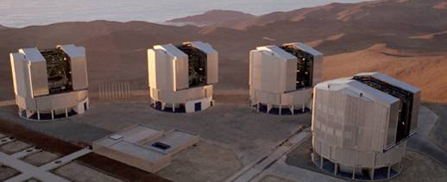
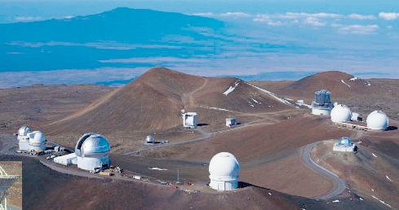
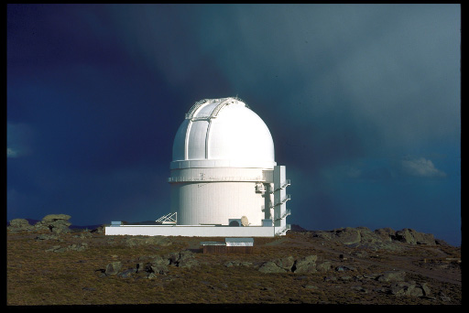
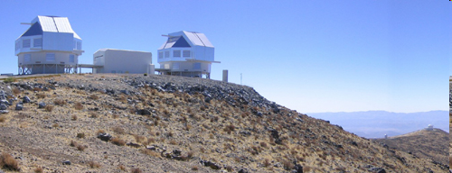
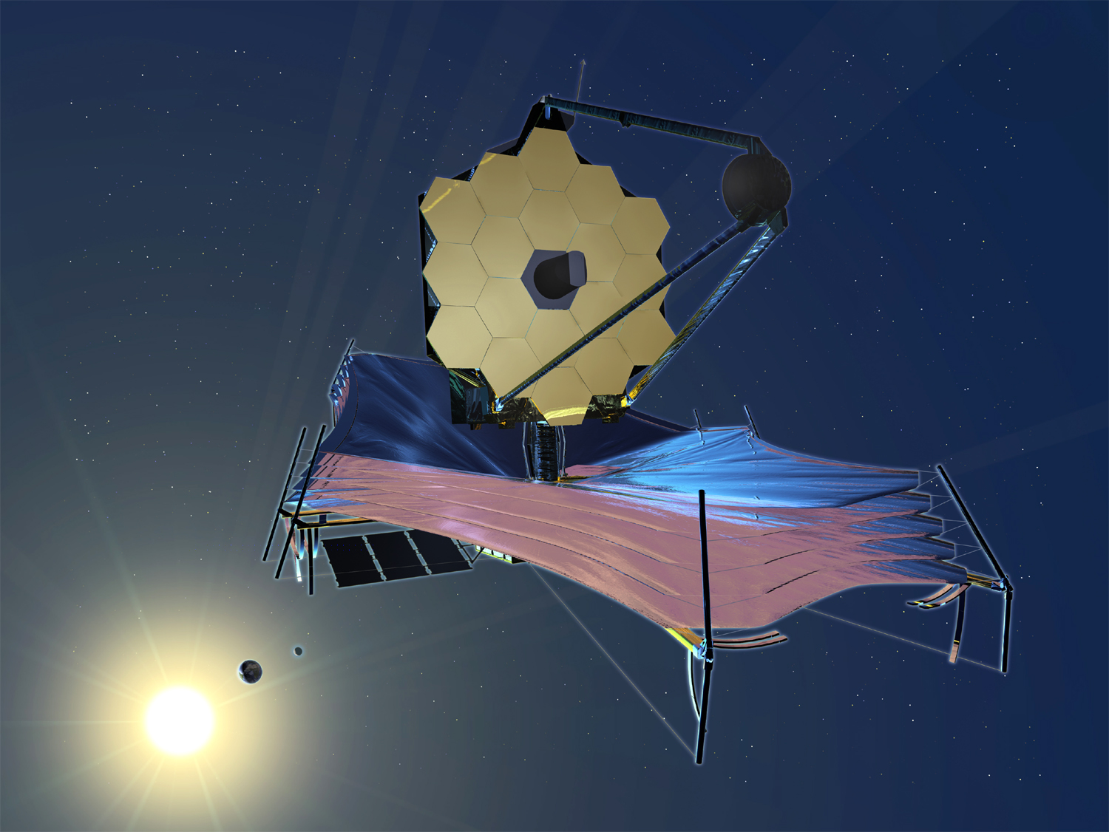
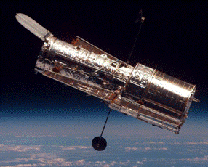
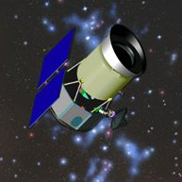
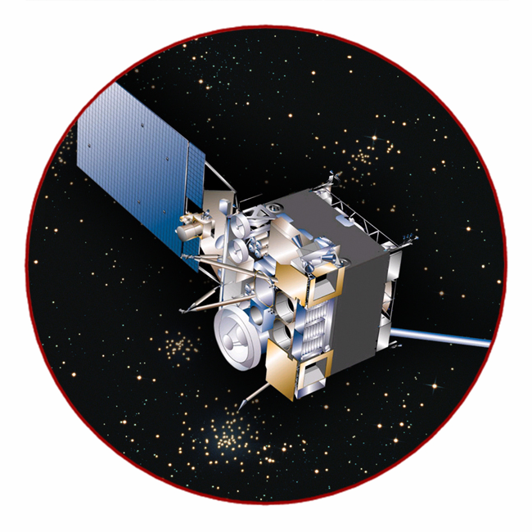
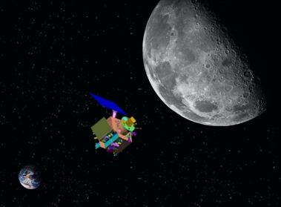
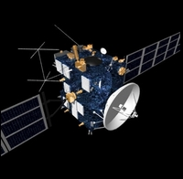
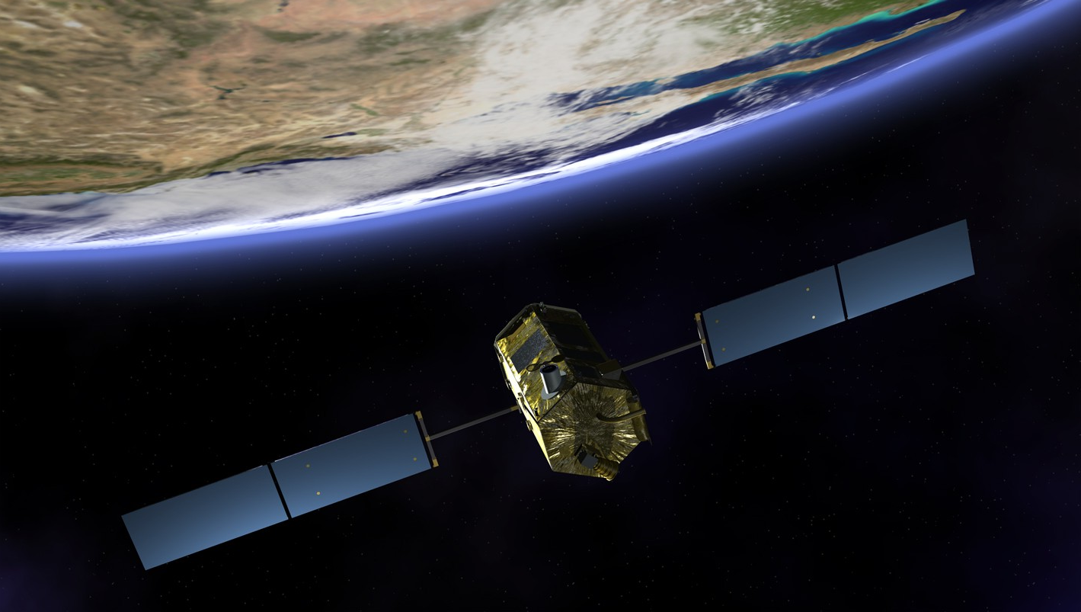

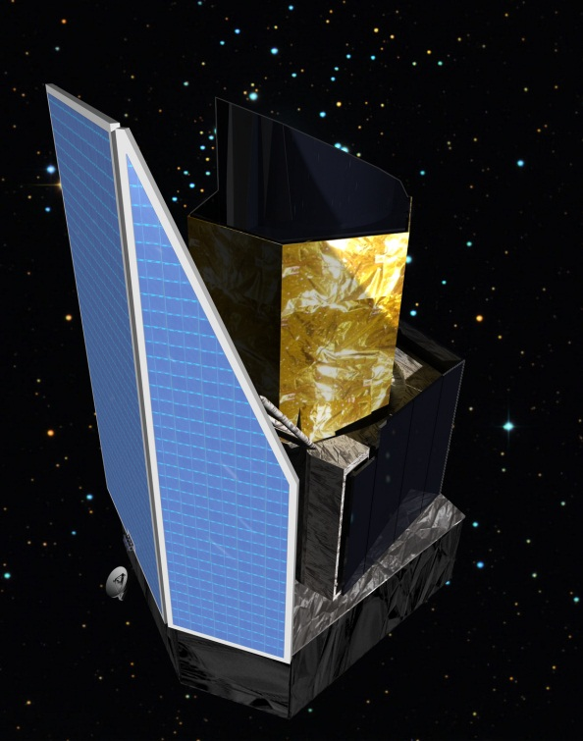
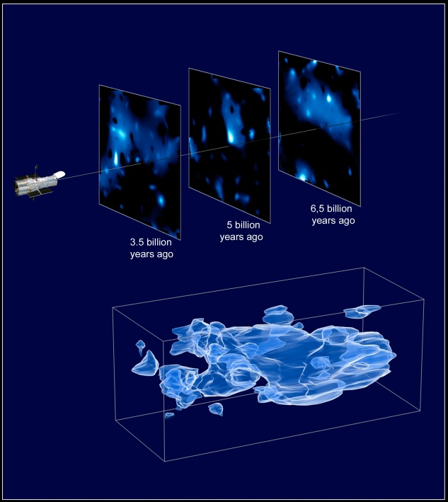
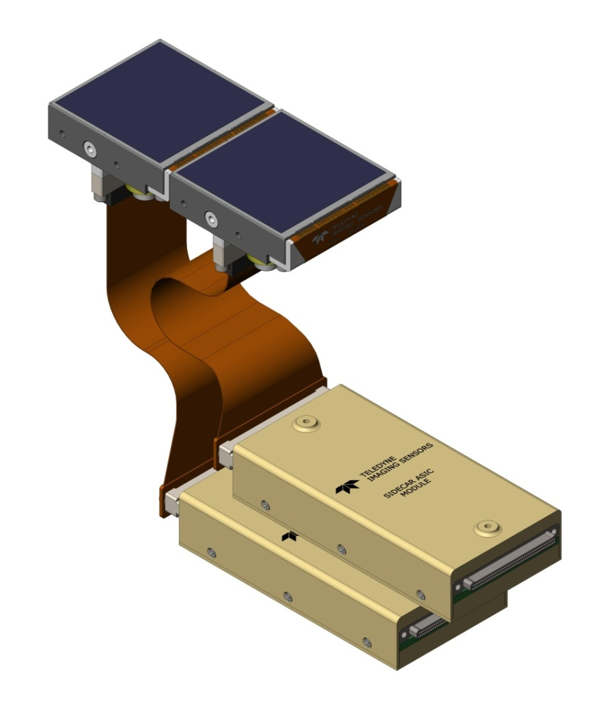
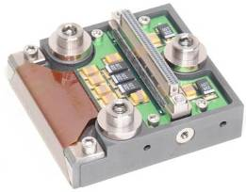
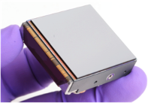
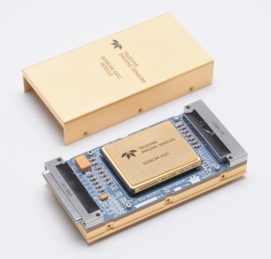
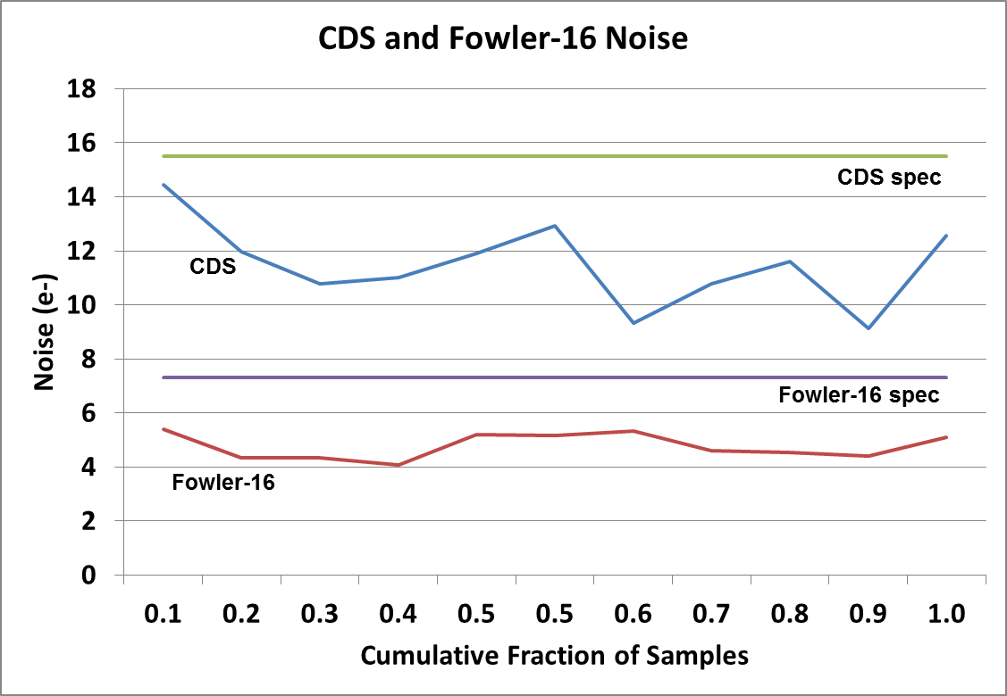
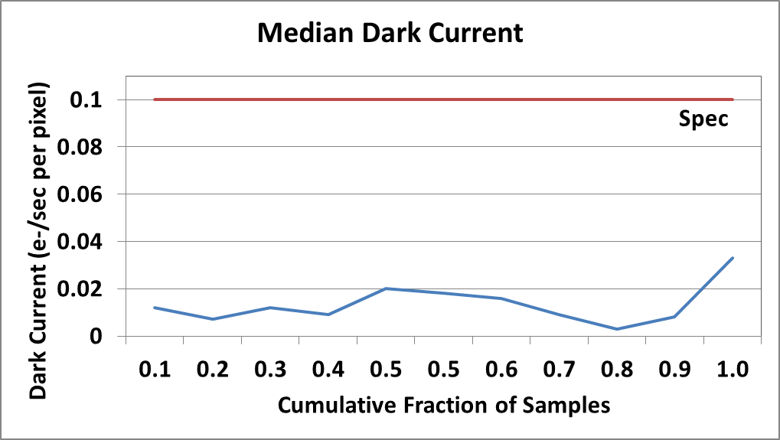
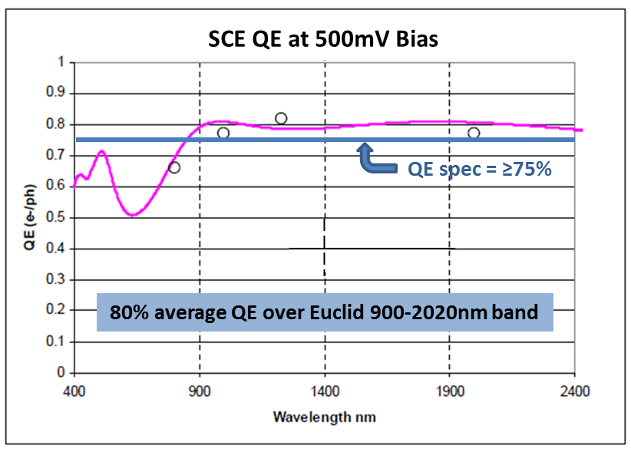
Infrared Sensor Chip Systems for ESA’s Euclid Mission
Selmer W. Anglin, Eric C. Piquette, Mark C. Farris, Scott A. Cabelli, Richard Blank, John M. Edwards, Andre W. Wong, Lalit Bhambhani, James W. Beletic (Teledyne Imaging Sensors, Camarillo, CA); Gerard Luppino, Ryan Bradley, Eric Moore (GL Scientific, Honolulu, Hawaii)
Your Partner for:
Ground-Based Astronomy
Space-Based Astronomy
Earth and Planetary Science
Euclid : European Space Agency’s Dark Energy Mission
Euclid objectives
Euclid plans to achieve the following science goals…
  Determine dark energy equation of state
  Distinguish general relativity from modified gravity theories
  Determine the nature of dark matter
By making weak lensing and redshift measurements
  Minimum survey area of 15,000 deg² (40% of all)
  Measure shapes and shears of galaxies
  Measure galaxy redshifts to determine galaxy clustering
NISP instrument (Laboratoire d’Astrophysique de Marseille (LAM), France) – Opto-mechanical assembly with filter wheel assembly, grism wheel assembly, optical assembly and calibration unit
Euclid spacecraft (Thales Alenia Space, Italy)
Near-Infrared Detection System (NI-DS) made of 16 Sensor Chip Systems (4 × 4 mosaic of SCS subassemblies)
Teledyne H2RG
Sensor Chip System (SCS)
Euclid Sensor Chip System (SCS)
2.3 µm cutoff H2RG detector (~100 K)
SIDECAR Module focal plane electronics (~145 K)
Custom flexible cable (SCA-to-SIDECAR) tailored to the thermal interface requirements of Euclid SCS
SIDECAR Module made of CE-9 material provides an excellent CTE match to NISP mounting structure
SIDECAR to drive a 6-meter harness interfacing to Euclid warm electronics
Custom SIDECAR firmware for enabling all Euclid operating modes
H2RG SCA
2K × 2K × 18 µm MBE mercury cadmium telluride (HgCdTe) detector
Flight SCA package with molybdenum pedestal for cryogenic operation
Wirebond rigidflex assembly provides electrical interconnection to and from SCA
High-density 85-contact AirBorn Nano series connector brings out all capabilities of Teledyne H2RG readout integrated circuit (ROIC)
H2RG Sensor Chip Assembly
(bottom side) (detector side)
SIDECAR Focal Plane Electronics
Compact; fits within H2RG footprint to enable modular mosaic focal plane assemblies
Designed for cryogenic operation down to ~77 K by selection of appropriately CTE-matched materials
For SIDECAR Module performance data, please see Cabelli / Farris poster (SDW2013), “The SIDECAR ASIC Module (SMd) – An Ultra Compact Focal Plane Array Controller Package for Space Flight and Ground-Based Applications”
Euclid SCA Performance Demonstrated
Seven (7) SCAs delivered in Evaluation Phase meet Euclid Grade 1 performance requirements
CDS and Fowler-16 noise performance for SCAs delivered for Euclid.
Median dark current performance for SCAs delivered for Euclid.
The work reported in this poster was performed for the European Space Agency during the Euclid Evaluation Phase. However, any views expressed herein can in no way be taken to reflect the official opinion of ESA.
Spectral QE curve obtained by fitting AR coating transmittance curve to QE data points (white circles) measured at discrete LED wavelengths

