Slide 1
Development of Sensitive Long-wave Infrared Detector Arrays for Passively Cooled Space Missions
Craig McMurtry, Donald Lee, James Beletic, Chi-Yi A. Chen, Richard T. Demers, Meghan Dorn, Dennis Edwall, Candice Bacon Fazar, William J. Forrest, Fengchuan Liu, A. Mainzer, Judith L. Pipher, Aristo Yulius

Slide 2
We wanted to develop LWIR (10micron) HgCdTe detector arrays for many years.
LWIR HgCdTe is an alternative to Si:As arrays for space missions that do not require wavelength coverage to 27 microns.
LWIR HgCdTe can be operated at 35 – 40K which allows for longer lasting and less expensive passively cooled space missions.
For example, the Spitzer Space Telescope has exhausted its cryogens but continues to take data in a reduced capacity. The IRAC instrument had 4 IR broadband imaging sensors, all of which operated with wavelengths less than 10 microns. The focal plane of the IRAC instrument is now at T=27.8K, but only the two InSb arrays are working while the two Si:As arrays are not.

Slide 3
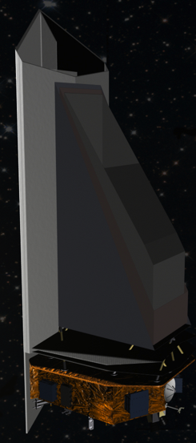
Near-Earth Object Camera
(NEOCam)
Where did we get funding for this LWIR HgCdTe detector development?
Discovery proposal submitted in 2006, 2010
Awarded technology development in 2010
Wide-field imager operating at 2 wavelengths: 4-5 & 6-10 μm
4+ year mission to discover & characterize near-Earth objects (NEOs), Main Belt asteroids, comets

Slide 4
Near-Earth Object Camera
(NEOCam)
NEOCam's primary science objectives are threefold:
To assess the present-day risk of near-Earth object (NEO) impact.
To study the origin and ultimate fate of our solar system's asteroids.
To find the most suitable NEO targets for future exploration by robots and humans.

Slide 5
Near-Earth Object Camera
(NEOCam)
Why do we need LWIR arrays? Why can’t Pan-STARRS and LSST find all the NEOs?
Sorry CCD folks, but asteroids below 1Km are difficult to detect at visible wavelengths.
Small surface area
Low surface reflectivity (albedo)
Can’t see interior to earth due to sunlight
But for objects that around 1 AU (Earth-Sun distance), their temperature is about 300K.
Blackbody peak at 10 microns!

Slide 6
LWIR HgCdTe Detector Characterization
NEOCam Requirements:
All of the results presented here are for SCA H1RG-16885.
1024 x 1024 pixels
10.6 micron cutoff at T=30K.
 | Requirement
Format | 1024x1024
Wavelength | 10μm
Temperature | 35 – 40 K
Dark Current | <200 e-/s/pix
CDS Read Noise | <50 e-
QE | >60% (not AR coated)
Well depth | >45 Ke-
Operability | >90%

Slide 7
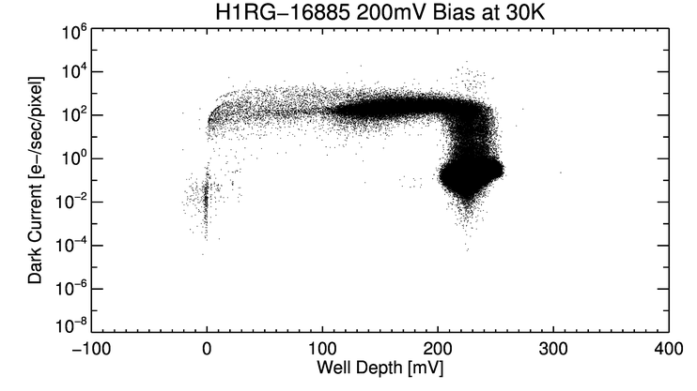
LWIR HgCdTe Detector Characterization
Well Depth vs. Dark Current
Having low dark current but low well depth is not useful.
This shows that most of the pixels have excellent well depth with very low dark current, and are centered around 0.1e-/s and 230mV.
180mV = 50Ke-
230mV = 63Ke-

Slide 8
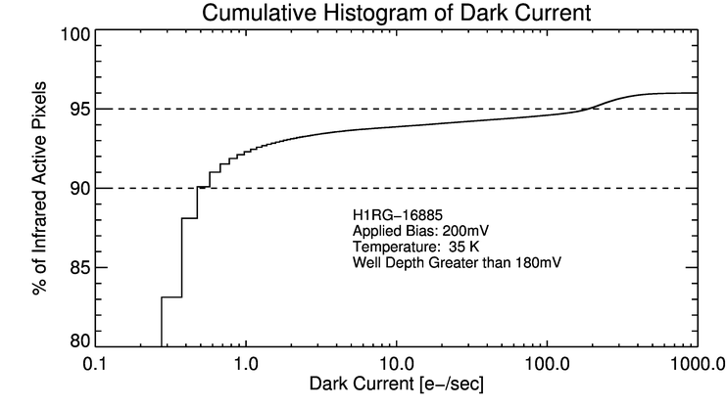
LWIR HgCdTe Detector Characterization
Histogram of cumulative dark current
200 mV applied reverse bias.
T = 35K

Slide 9
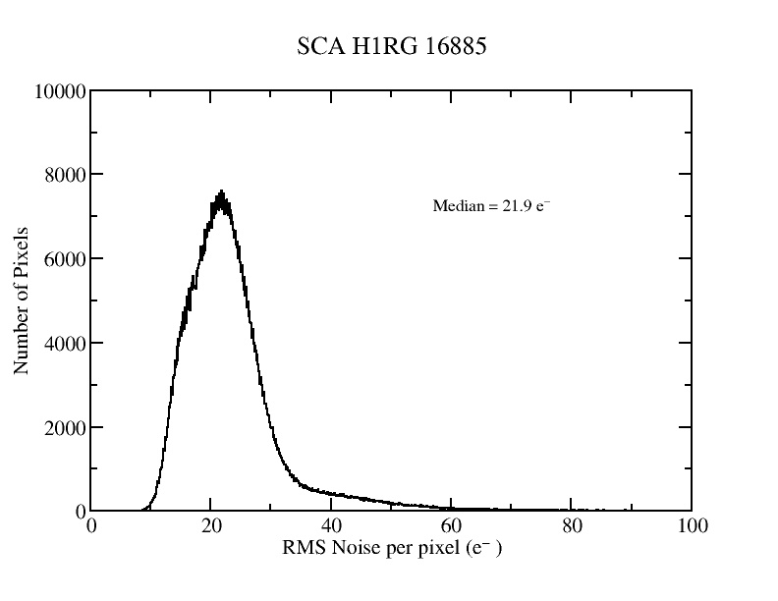
LWIR HgCdTe Detector Characterization
Histogram of Read Noise
Fowler-1 or CDS.

Slide 10
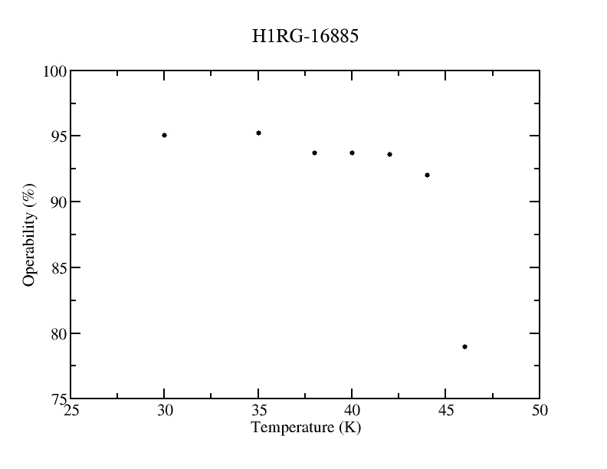
LWIR HgCdTe Detector Characterization
Operability vs. Temperature
200 mV applied reverse bias.
All pixels that have <200 e-/s dark current with > 180mV of well depth and < 50e- read noise are classified as operable.

Slide 11
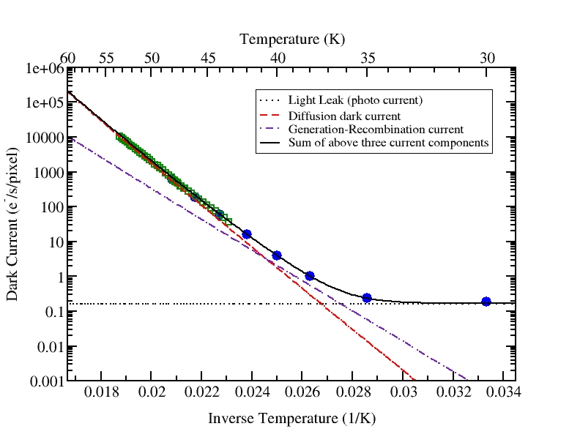
LWIR HgCdTe Detector Characterization
Dark Current vs. Temperature
200 mV applied reverse bias. All plotted have 240 mV ACTUAL well depth.
Dark current at low end is limited by light leak (from 77K shield through 4K shield).
Wow, at 35K we are achieving 1000 times lower dark current than our requirement!

Slide 12
LWIR HgCdTe Detector Characterization

Slide 13
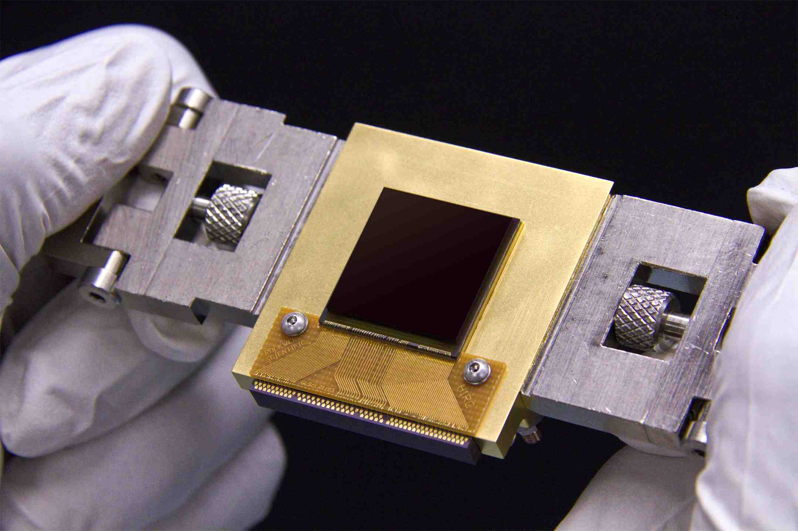
HgCdTe Detector Development
4 goals for NEOCam detector development:
Increase cutoff wavelength to >10 μm: DONE
Increase % pixels meeting dark current spec to >=90%: DONE
Increase operability (well depth): DONE
Increase format from 512x512 to 1024x1024 pixels: DONE

Slide 14
HgCdTe Detector Development
We have gone past the original directives for this program.
Achieved substrate removal.
Started radiation hardness testing (high energy protons).

Slide 15
Conclusions
The 10.6 micron cutoff HgCdTe developed by TIS is performing well at temperatures between 35 – 40K.
LWIR HgCdTe is now ready for sensitive (astronomical) space missions that would benefit from the cost savings of eliminating cryogens or cryo-coolers.
Future work:
Complete proton radiation testing (TRL-6!!)
Extend cutoff wavelength to 15 microns (funded!)

