Slide 1
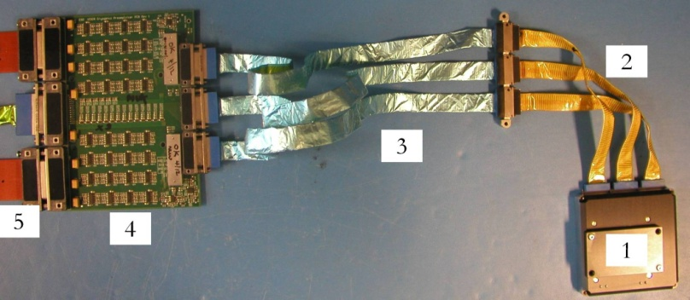
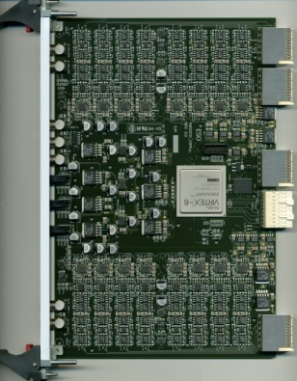
Booth R8
Options for Scientific and AO Detector Control in the era of ground based Extremely Large Telescopes
Derek Ives, Gert Finger, Leander Mehrgan and Javier Reyes
European Southern Observatory
6K detector mount
Space qualified manganin woven cables – thermal break
with twisted pairs, miniature connectors
3. Copper woven ribbon cables, twisted pairs, full Al shielding
4. 64 channels fully differential preamps, 10 Mpixel operation
at 50 K
32 channels, 16 bit
10 MHz ADCs with FPGA
VERTEX-6 processing

Slide 2
Booth R8
Questions :-
Commercial, in-house developments or even ASIC, what is the preferred option and why ?
Can an ASIC ever be a solution for a ground based generic detector controller?
Can we cover all the detector requirements with one system design?
Are detector voltage and current monitoring a prerequisite for any design ?
What ideas are proposed at other institutes ?
Will future detectors be integrated with full built in control, simplifying external control systems
What other future technology trends are foreseen and applicable to detector operation ?
Plug – “Longer wavelength detector
session on Friday afternoon”

