Slide 1
CNES activities in detectors for scientific space missions
Alain BARDOUX
alain.bardoux@cnes.fr
SDW Florence 2013 – A Bardoux

Slide 2
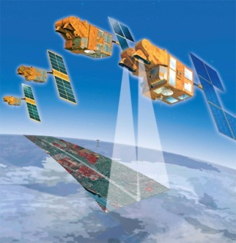
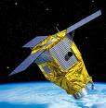
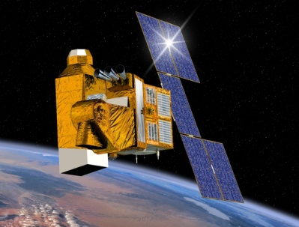
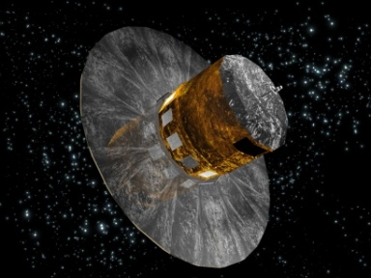
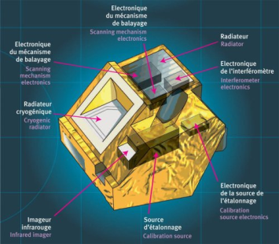
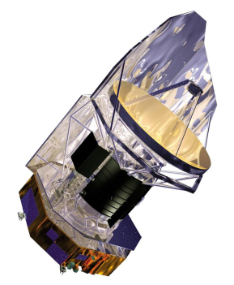
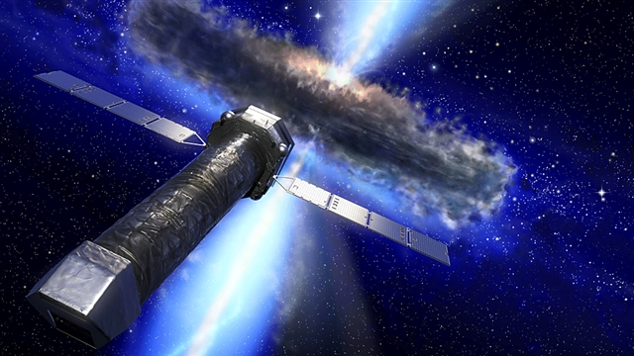
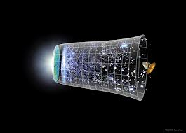
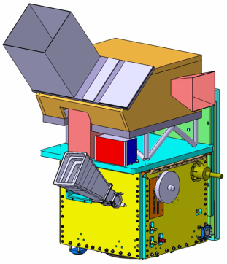
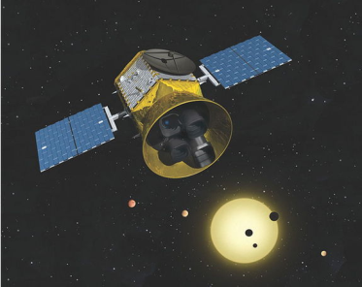
CNES : French Space Agency
SPOT, Pleiades
Earth onservation
Helios, CSO
Earth obs for
Defence
Gaia
Star mapping
IASI, IASI-NG
Atmospheric
sounding
Corot
Exoplanets
Asterosismology
And many others
Herrschel
Stars & Galaxies
evolution
Athena
Black hole
High energy astronomy
B mode
Origin of Univrse
Exomars
Mars Exploration
Echo
Exoplanets
Microcarb
CO2 survey
SDW Florence 2013 – A Bardoux
Notes:
CNES is leading or involved , in a lot of space missions, National, bi /multilatera and in ESA frame
The missions supported by CNES are not limited to those presented here :
Only those requiring detector development are evocated here

Slide 3
A travel through wavelengths
…. and technologies
Diamond
QWIP
Doped Si
CdTe
I-CCD
MCT
NbSi
CCD
Tantal
CMOS
InSb
Germanium
AlGaN
InGaAs
TES
DSSD
α-Si
SDW Florence 2013 – A Bardoux
Notes:
Iwill talk only aboutpre-developments, not on on-going missions
This pesentation will focus only on certain technologies

Slide 4
X Ray
SDW Florence 2013 – A Bardoux

Slide 5
Missions In X ray domain
Missions in development
      Taranis
      SVOM
      Solar Orbiter
Mission in pre-development (not decided)
  Athena (black hole matter survey)
  Spectral domain 0.2-6keV (Instrument XMS, résolution 3eV@6keV)
  nominal solution based on TES (Goddard, NIST)
      Développement of an alternative solution
      Loft
      French developemntsfocused on Front end ASIC’s
SDW Florence 2013 – A Bardoux

Slide 6


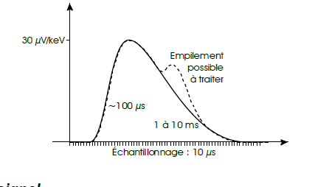
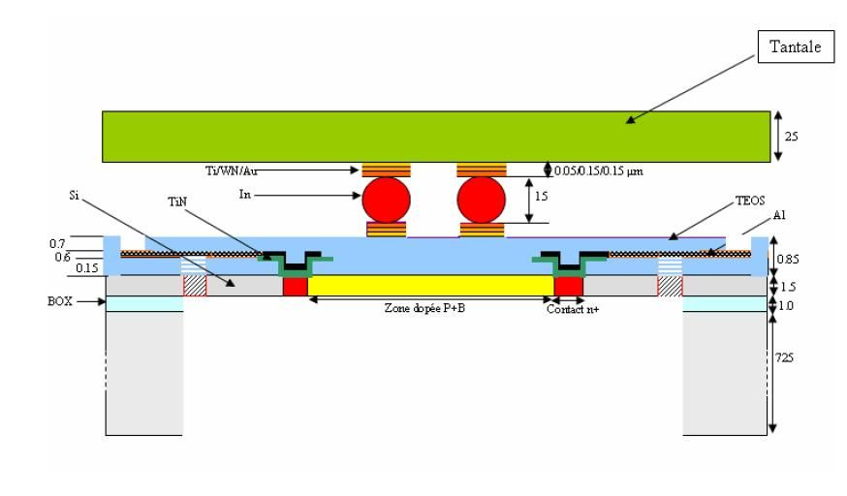
Xray microcalorimeter
Detection of Xray photons
Counting
Energy measurement
Split of 3 functions
  Absorbeur High Z
  Sensor
  Thermal insulation
  + Specific electronics
SDW Florence 2013 – A Bardoux

Slide 7
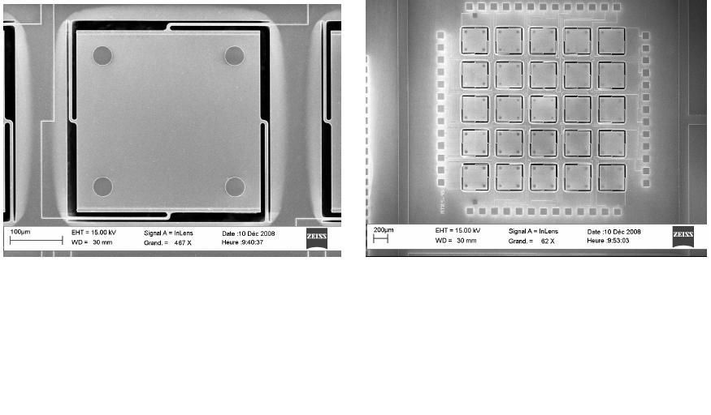
Xray microcalorimeter : on going development
Main axis
collective manufacturing
improvement of existing Technology (PACS) Silicon compatible technology
Goal
32x32 demonstrateur for Athena
Technological choices
  Absorbeur High Z Tantal
  Sensor Doped Silicon
  Thermal insulation SiO2
  Sensor temperature 50 to 70mK
SDW Florence 2013 – A Bardoux

Slide 8
Xray microcalorimeter Readout circuit
Several stages to optimize thermal budget
HEMT
SiGe ASIC
SDW Florence 2013 – A Bardoux

Slide 9
Xray microcalorimeter : performances
Signal :
30 to 100 µV/keV ie 150µV to 600 µV for a 6keV photon
Energy range : 300 ev to 30 keV
Dynamic : 300eV to 30keV ie 9µV to 3mV
Noise
Expected resolution : 6eV FWHM at 6 keV
Noise 0,1µV to 0,3µV
Power dissipation
Goal 128 mW for 4000 pixels
ie 1mW for 32 pixels
SDW Florence 2013 – A Bardoux

Slide 10
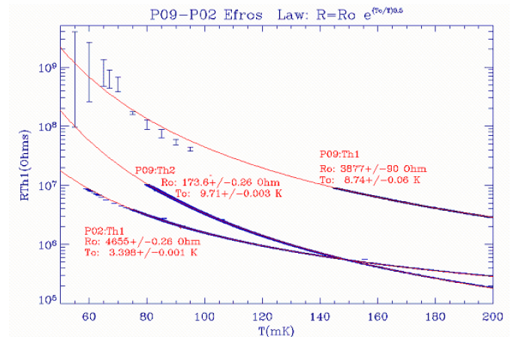
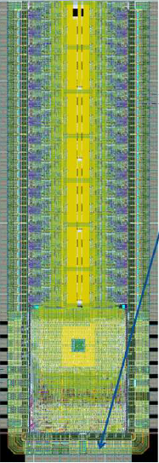
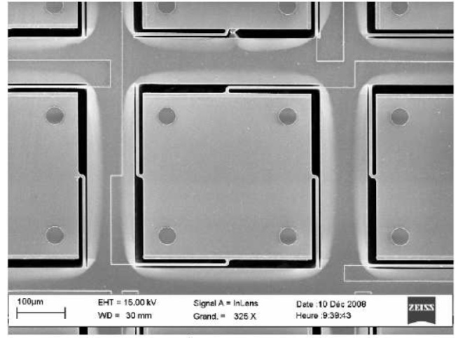
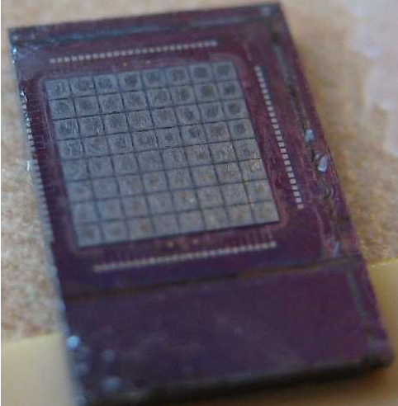
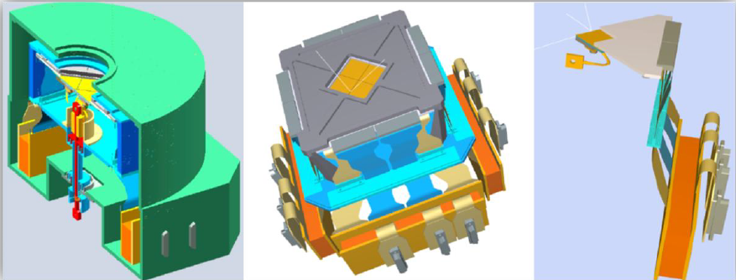
Xray microcalorimeter : realizations
SDW Florence 2013 – A Bardoux
Notes:
µcal X (X mlouo jusqu » a keV)
solu abase de TES
brique techno : Asic CL reprise de Asci DCMB (SiGe)
integration en interco : synergie avvec Artemis
portage sur PF 100mm
obj demonstarteur 32x32 pour athena
Irfu adossé au Sedi et leti
On va deytecteer photon X et on faiut compatge en ragardant son energie
Asic de lecture
Reprise de la techno Pacs en la simplifiant (terreau pour IR lointain)
Descente à 50 mK pour ameliorer perfon , aux carac visées
Fab collective : c’est la force leti
Report absorbeuer : dans ces lon d’onde o utilise tanatale
Simplification de setapes techno
PTA : paforme techno amon

Slide 11
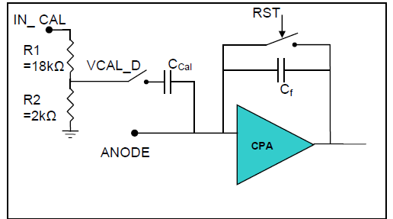
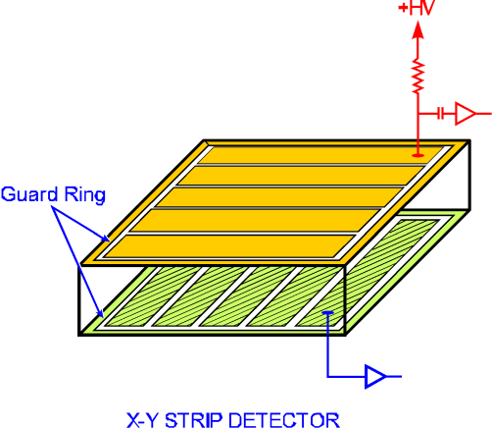
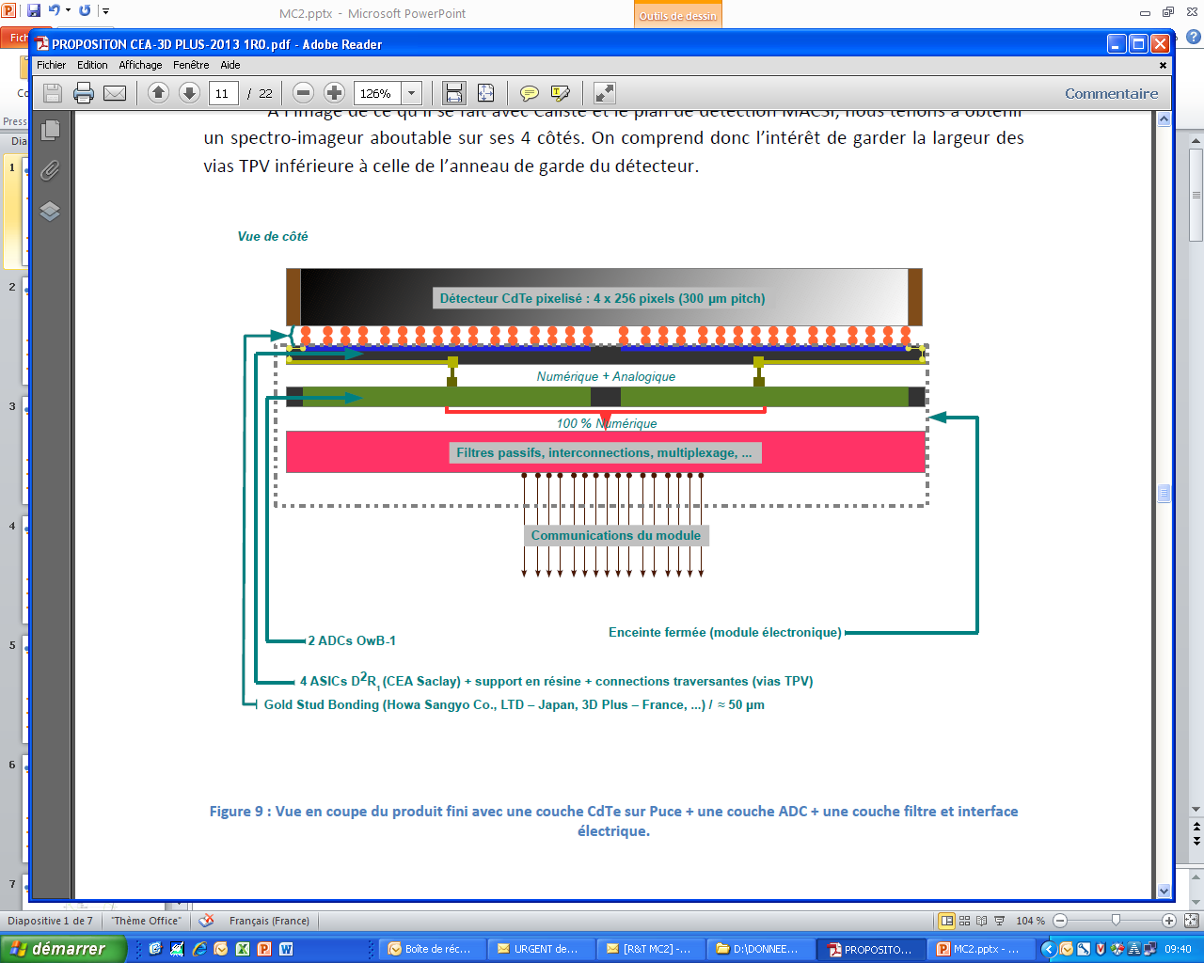
Other activities in Xray domain
LOFT :((IRAP) ultra low noise and consomption front end ASIC
(15e ENC, 200µW)
Compton telescop : (APC) : tower of DSSD (souble stripped Si detector) up to 100MeV
(See Youri Dolgorouky’s talk)
Germanium stripped detector (IRAP) ultimate performance spectro imager
(1 to 200keV)
CdTe high density focal plane (CEA/IRFU) :
small pixel (300µm) 4 side buttable module
for large and high density focal planes
Hybridation haute densité
SDW Florence 2013 – A Bardoux
(reportés sur un support permettant de réduire la
densité en face arrière)

Slide 12
Visible
SDW Florence 2013 – A Bardoux

Slide 13


Visible detection : CCD
  No specific developpment in terms of scientific detectors
      CNES activity is focused on High speed TDI for High resolution pushbroom Earth observation (resolution below 70cm)
    Development of technogical blocks (at e2v) useful for future scientific detectors
      Large wafer backthinned
      Anti-etalon process
      Black coating
      Low noise on chip amplifier
      Close cooperation with ESA
SDW Florence 2013 – A Bardoux

Slide 14
Visible Détection CMOS
  No specific developpment in terms of scientific detectors
      CNES activity is focused on High speed TDI for High resolution pushbroom Earth observation (below 70cm)
    same concern as ESA : setting up a whole supply chain whith good perennity
      Design house
      Foundry
      backthinning
      Assembly (space quality)
      Test and Space qualification
  Developpment of technological blocks that could be useful for scientific detectors
      CCD on CMOS , allowing TDI detection and CMOS readout
      Standard high performance »large » pixels (13 to 26µm pitch)
      Qualification of µlens and commercial component
    possible developpement for NEAT mission (Nearby Earth Astrometric Telescope)
SDW Florence 2013 – A Bardoux

Slide 15
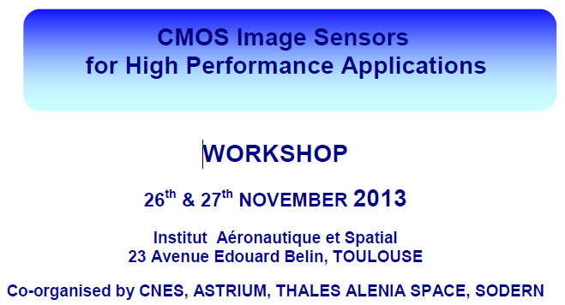
To know more about CMOS detectors
Workshop « CMOS for High
Free registration at :
https://cct.cnes.fr/content/workshop-cmos-image-sensors-high-performance-applications
Or contact me
alain.bardoux@cnes.fr
SDW Florence 2013 – A Bardoux

Slide 16
Infra Red
SDW Florence 2013 – A Bardoux

Slide 17
2 main axis
Toward a large SWIR high performance detector (in coordination with ESA)
Toward a LWIR detector for Echo mission
Other activity
- Test of MCT APD
SDW Florence 2013 – A Bardoux

Slide 18


Large SWIR detectors
  Several activities
  Improvement of manufacturing yield of large detectors
    detection wafer size increasing,
    hybridization reliability improvement
  Development of a low noise readout circuit
  Combined with a detection circuit impoved by ESA activity
  -> prototype
SDW Florence 2013 – A Bardoux

Slide 19
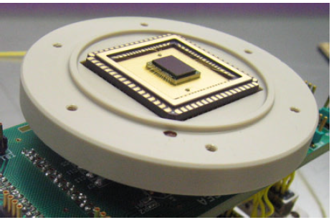
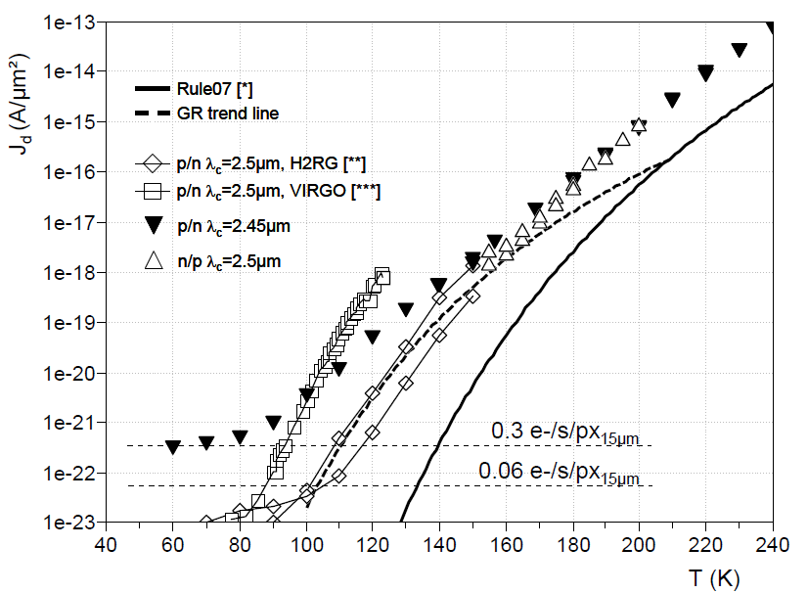
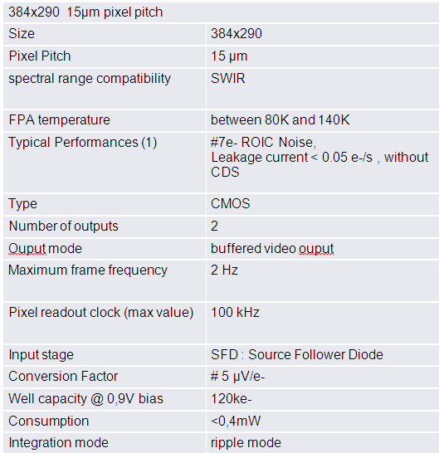
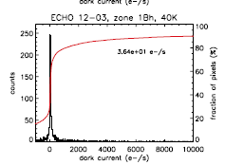
high performance SWIR

Slide 20
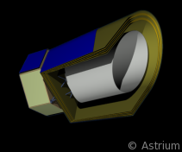
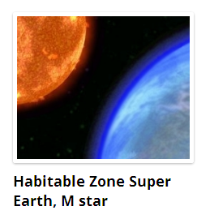
Echo mission
EChO (Exoplanet Characterisation Observatory; Cosmic Vision theme 1 - What are the conditions for planet formation and the emergence of life?) - a mission to investigate exoplanetary atmospheres, addressing the suitability of those planets for life and placing our Solar System in context
      Domain 5-12µm (French contribution)
      Driver : Dark current < 500é/s
      Technology : optimized HgCdTe
-
SDW Florence 2013 – A Bardoux

Slide 21
Developments for EChO
4 detectors already fabricated and tested at CEA (LETI/Irfu) for temperature between 80 and 30K :
  1 detector fabricated with « standard » p/n technology
  3 detector fabricated with « optimisated » p/n technology
A large amount of pixels (on a detector) compliant
with the need (< 500 e-/s) thanks to the optimised process.
Other wafer batch (p/n optimised process
at CEA Leti) under progress to provide 8 detectors to be tested by CEA Irfu
SDW Florence 2013 – A Bardoux

Slide 22
Submm & mm
SDW Florence 2013 – A Bardoux

Slide 23
Scientific missions in submm- mm
- Post Planck mission
  spectral domaine simililar to Plank one Planck
  (100, 143, 217, 353, 545 et 857 GHz ie, 350 µm to 3 mm)
  several technology candidate
  TES (NbSi) arrays
  LEKID arrays
  LETI all Solocon technology
Main drivers
Matrix development to improve performance and field of view
Collective manufacturing
SDW Florence 2013 – A Bardoux
Notes:
Cosmologie : mm polarisatiob find diffus
Structurationd el’univers (suite Herschel)

Slide 24

TES
pixel has 3 main functions
  Absorber (wavelength quarter cavity, antenna,…)
  Senseur is a supra bolometer (TES)
  Thermal insulation
MUX à SQUID senseur TES
SDW Florence 2013 – A Bardoux

Slide 25
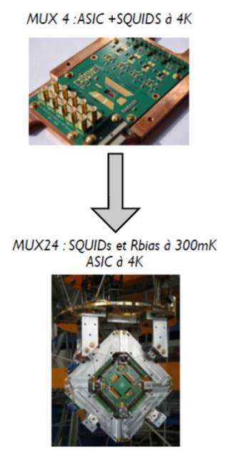
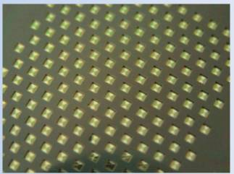
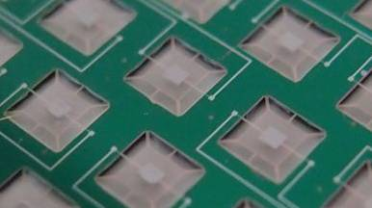
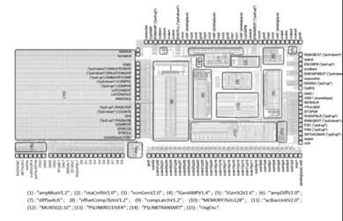
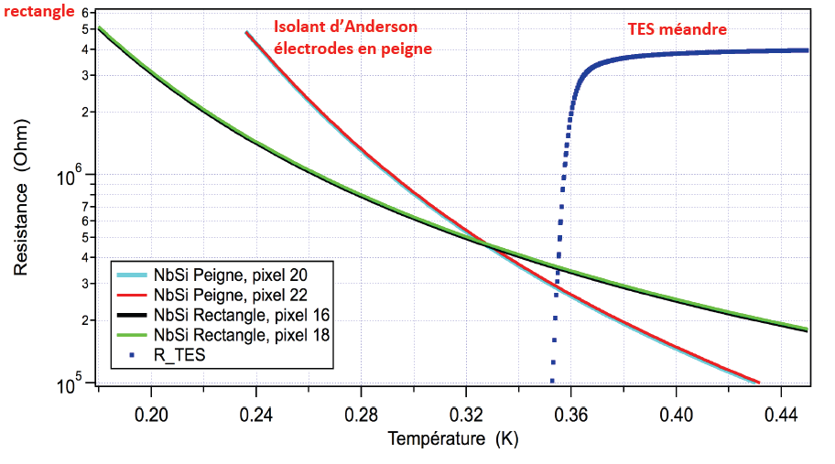
NbSi TES
NEP~5.10⁻¹⁷ W/Hz ^{1/2}
SDW Florence 2013 – A Bardoux
Notes:
TES faible impedance : SQUID ; APC a fait integraton et a dvpé un Asic
DCMB senseur NbSi quron depose, puis on structure pour faire membrane
Det 350 mK et etage deporté pour sauvegarder budget thermiqe

Slide 26
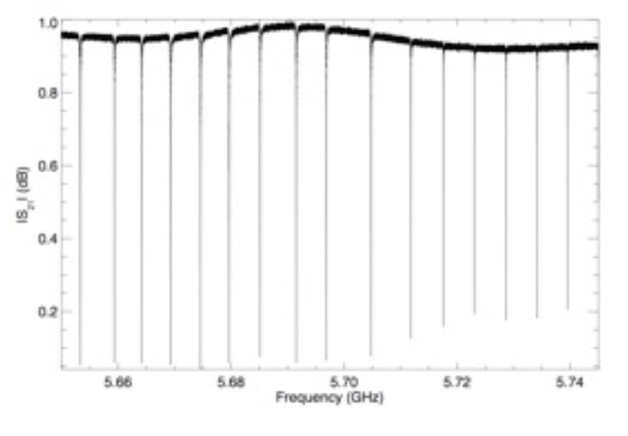
LEKIDS (Lumped Element Kinetic
Inductance Detectors )
LEKID (Lumped element Kinetic Inductance Detector) is based on inductance variation of a supraconductor film wrt incident power : resonnant frequency variation
one metal layer on a silicon substrate
No MUX required !
SDW Florence 2013 – A Bardoux
Notes:
LE KID circuit resonnat associé a chaque pixele.
Ligne µonde
Chaque det a sa propre resonnace
Sous effet rayonnement shift de la freq de resonnance (et aussi amplitude)
Av : pas besoin de mux mourd

Slide 27
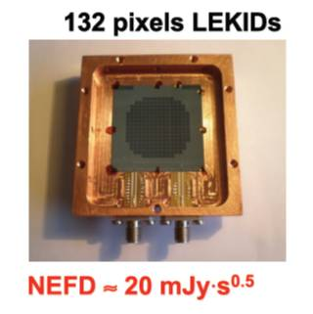
LEKID realization
a 144-pixel Aluminum array was fabricated and tested in a dilution fridge with optical access, yielding an average optical NEP of ~2E-16 W/Hz^1/2 (best pixels showed NEP = 6E-17 W/Hz^1/2 under 4-8 pW loading per pixel).
A second prototype of LEKIDs has been tested at the IRAM 30 m telescope. A new LEKID geometry for 2 polarizations will be presented. Also first optical measurements of a titanium nitride array.
Well asapted for 1mm-3mm range
SDW Florence 2013 – A Bardoux

Slide 28
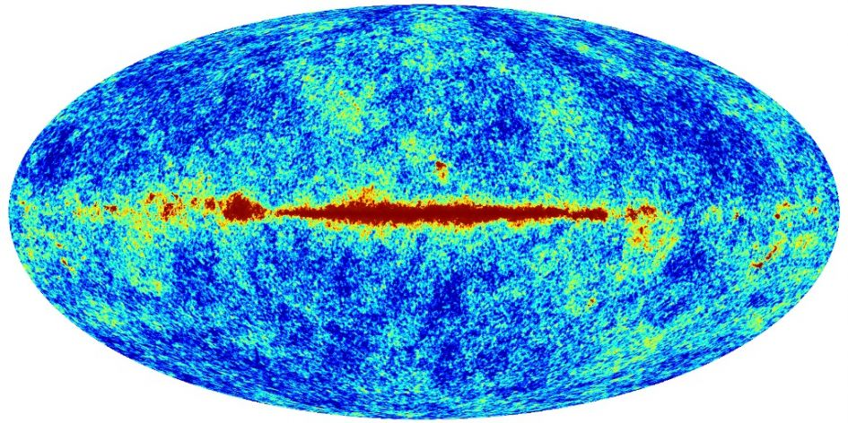
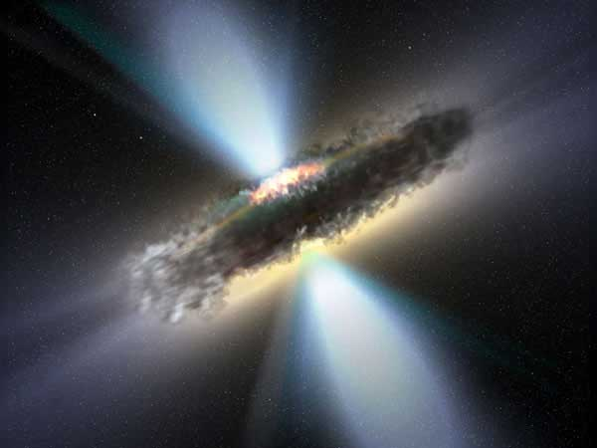
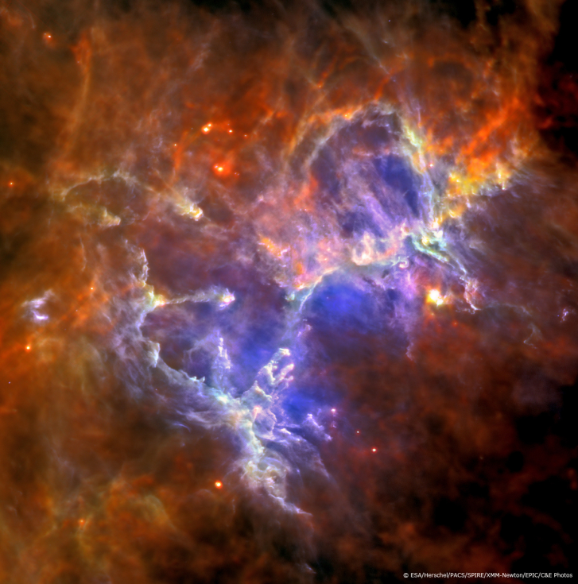
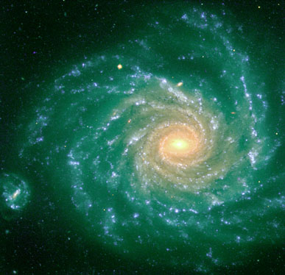
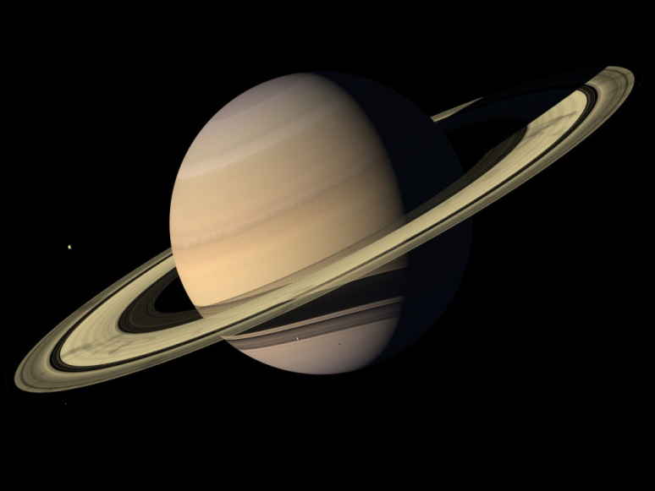
Conclusion

Slide 29
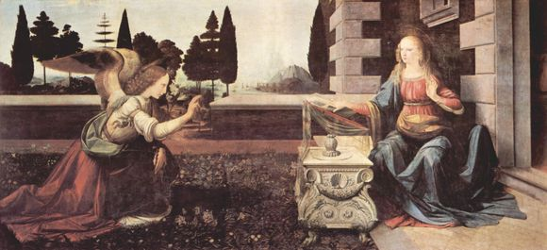
Annunciation by Leonardo da Vinci
Galleria degli Uffizi - Florence

Slide 30
THANKS FOR YOUR ATTENTION

