Slide 1
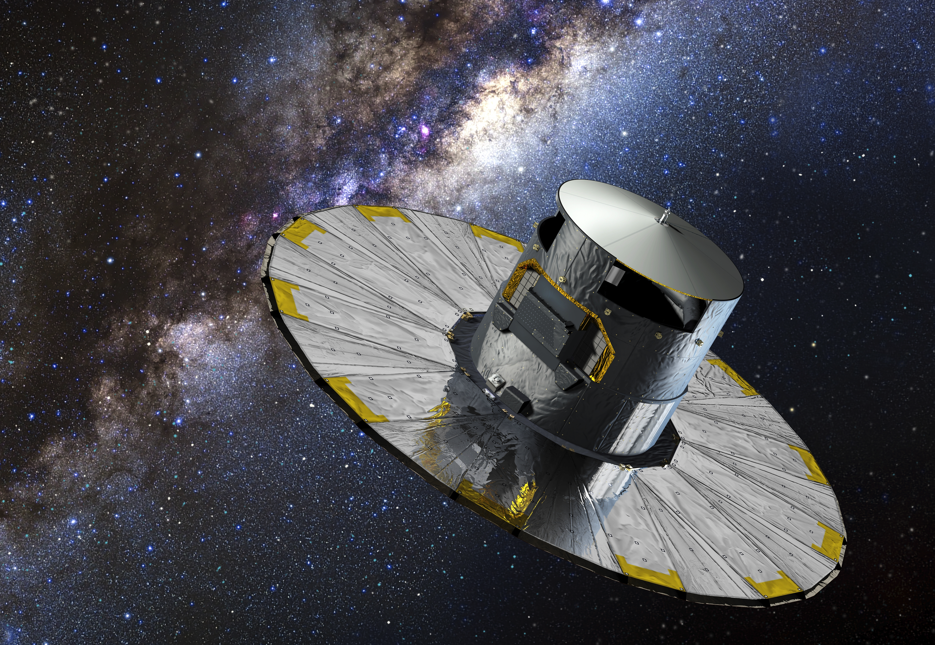
The launch of Gaia
Ralf Kohley
Scientific Detector Workshop 2013
Florence, 9 October 2013

Slide 2
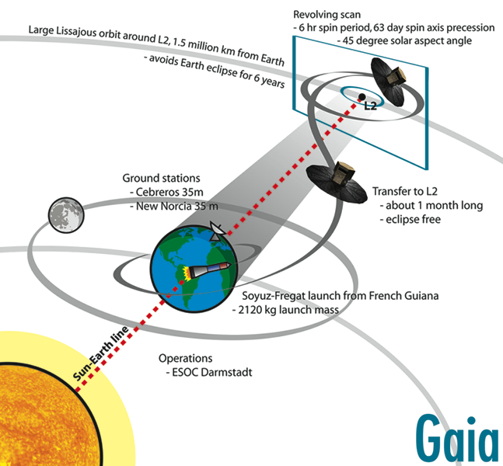
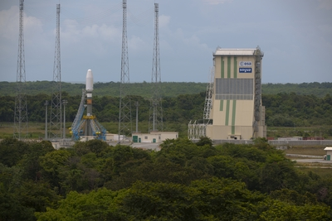
Mission timeline
Launch campaign Kourou
LEOP + transfer to L2
Commissioning + PV
Operations
|
08/2013
|
11/2013
|
12/2013
|
04/2014
|
2019
Launch:
20 November 2013
Credit: Images © ESA
Notes:
LEOP: Launch and Early Orbit Phase

Slide 3
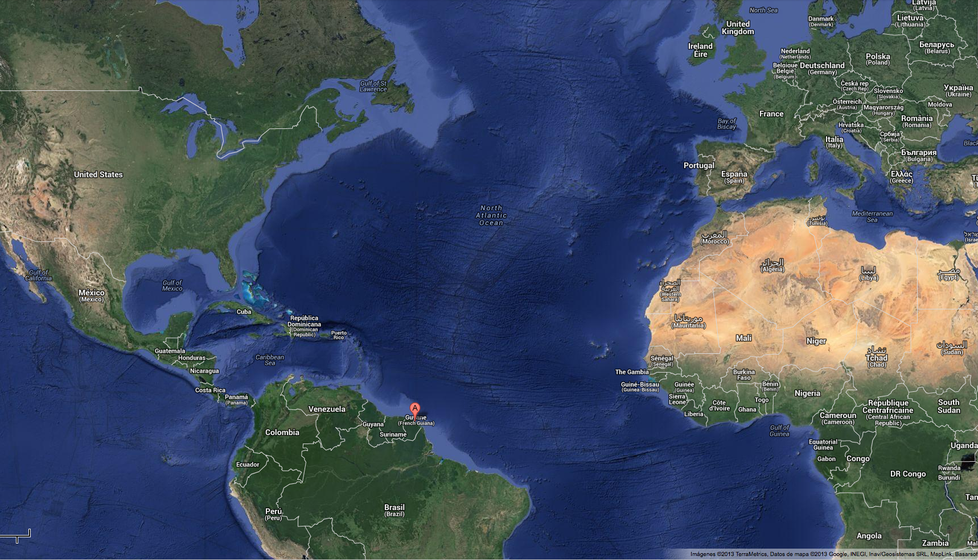
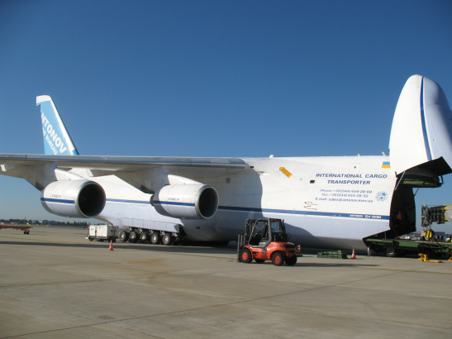
Shipping to Kourou

Slide 4
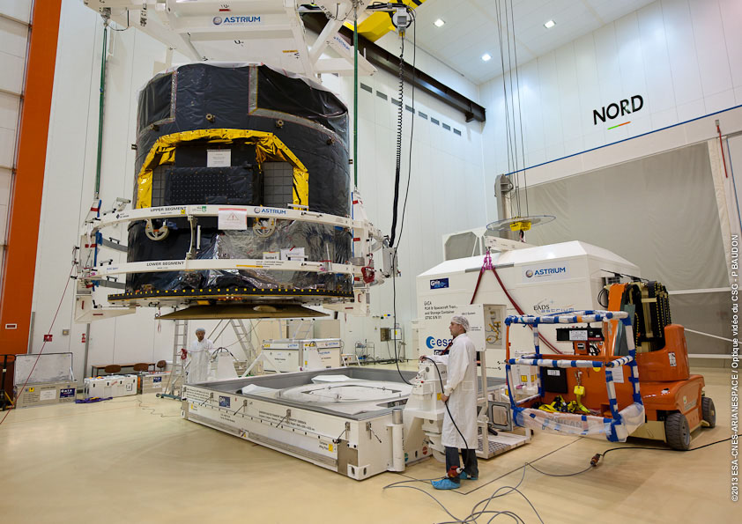
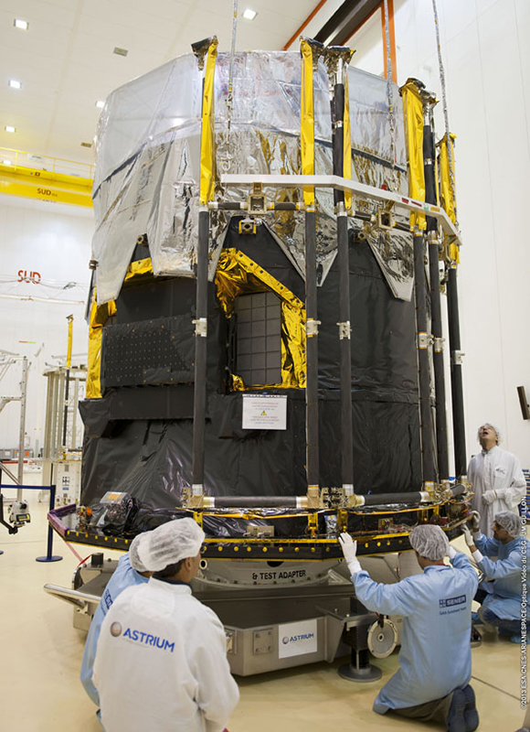
Launch Campaign (Spacecraft integration)
Credit: Images © 2013 ESA – CNES - Arianespace

Slide 5
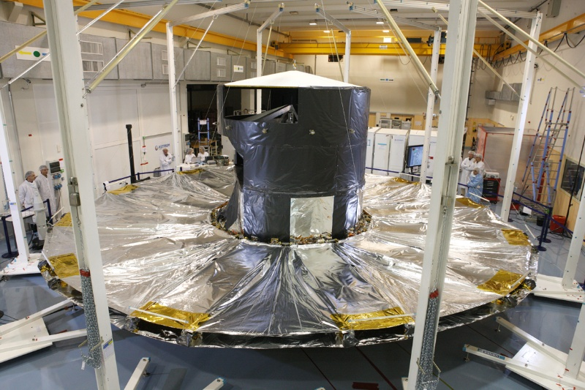
Deployed sunshield
Credit: Image © 2011 Astrium

Slide 6
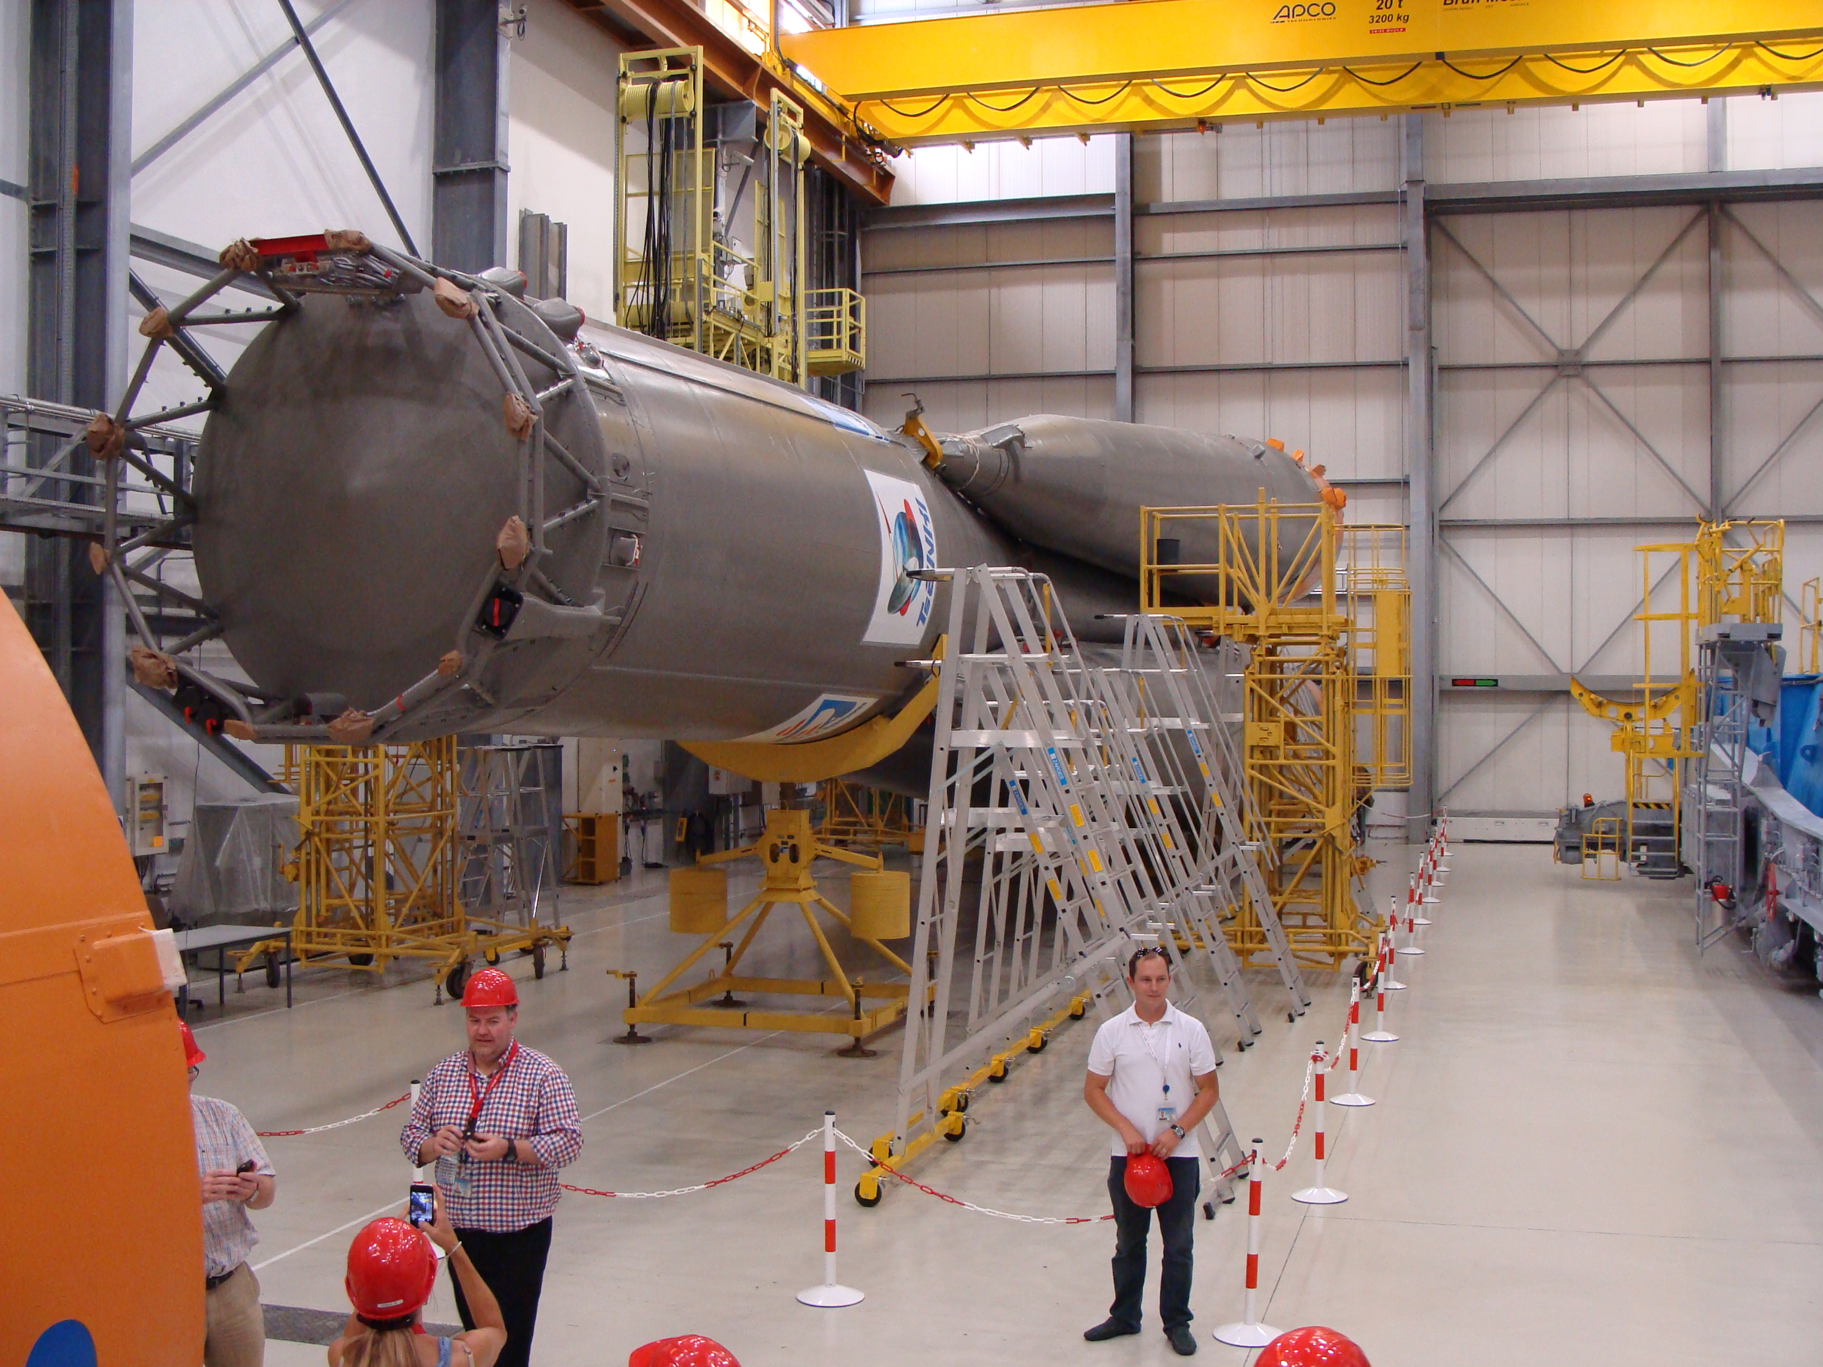
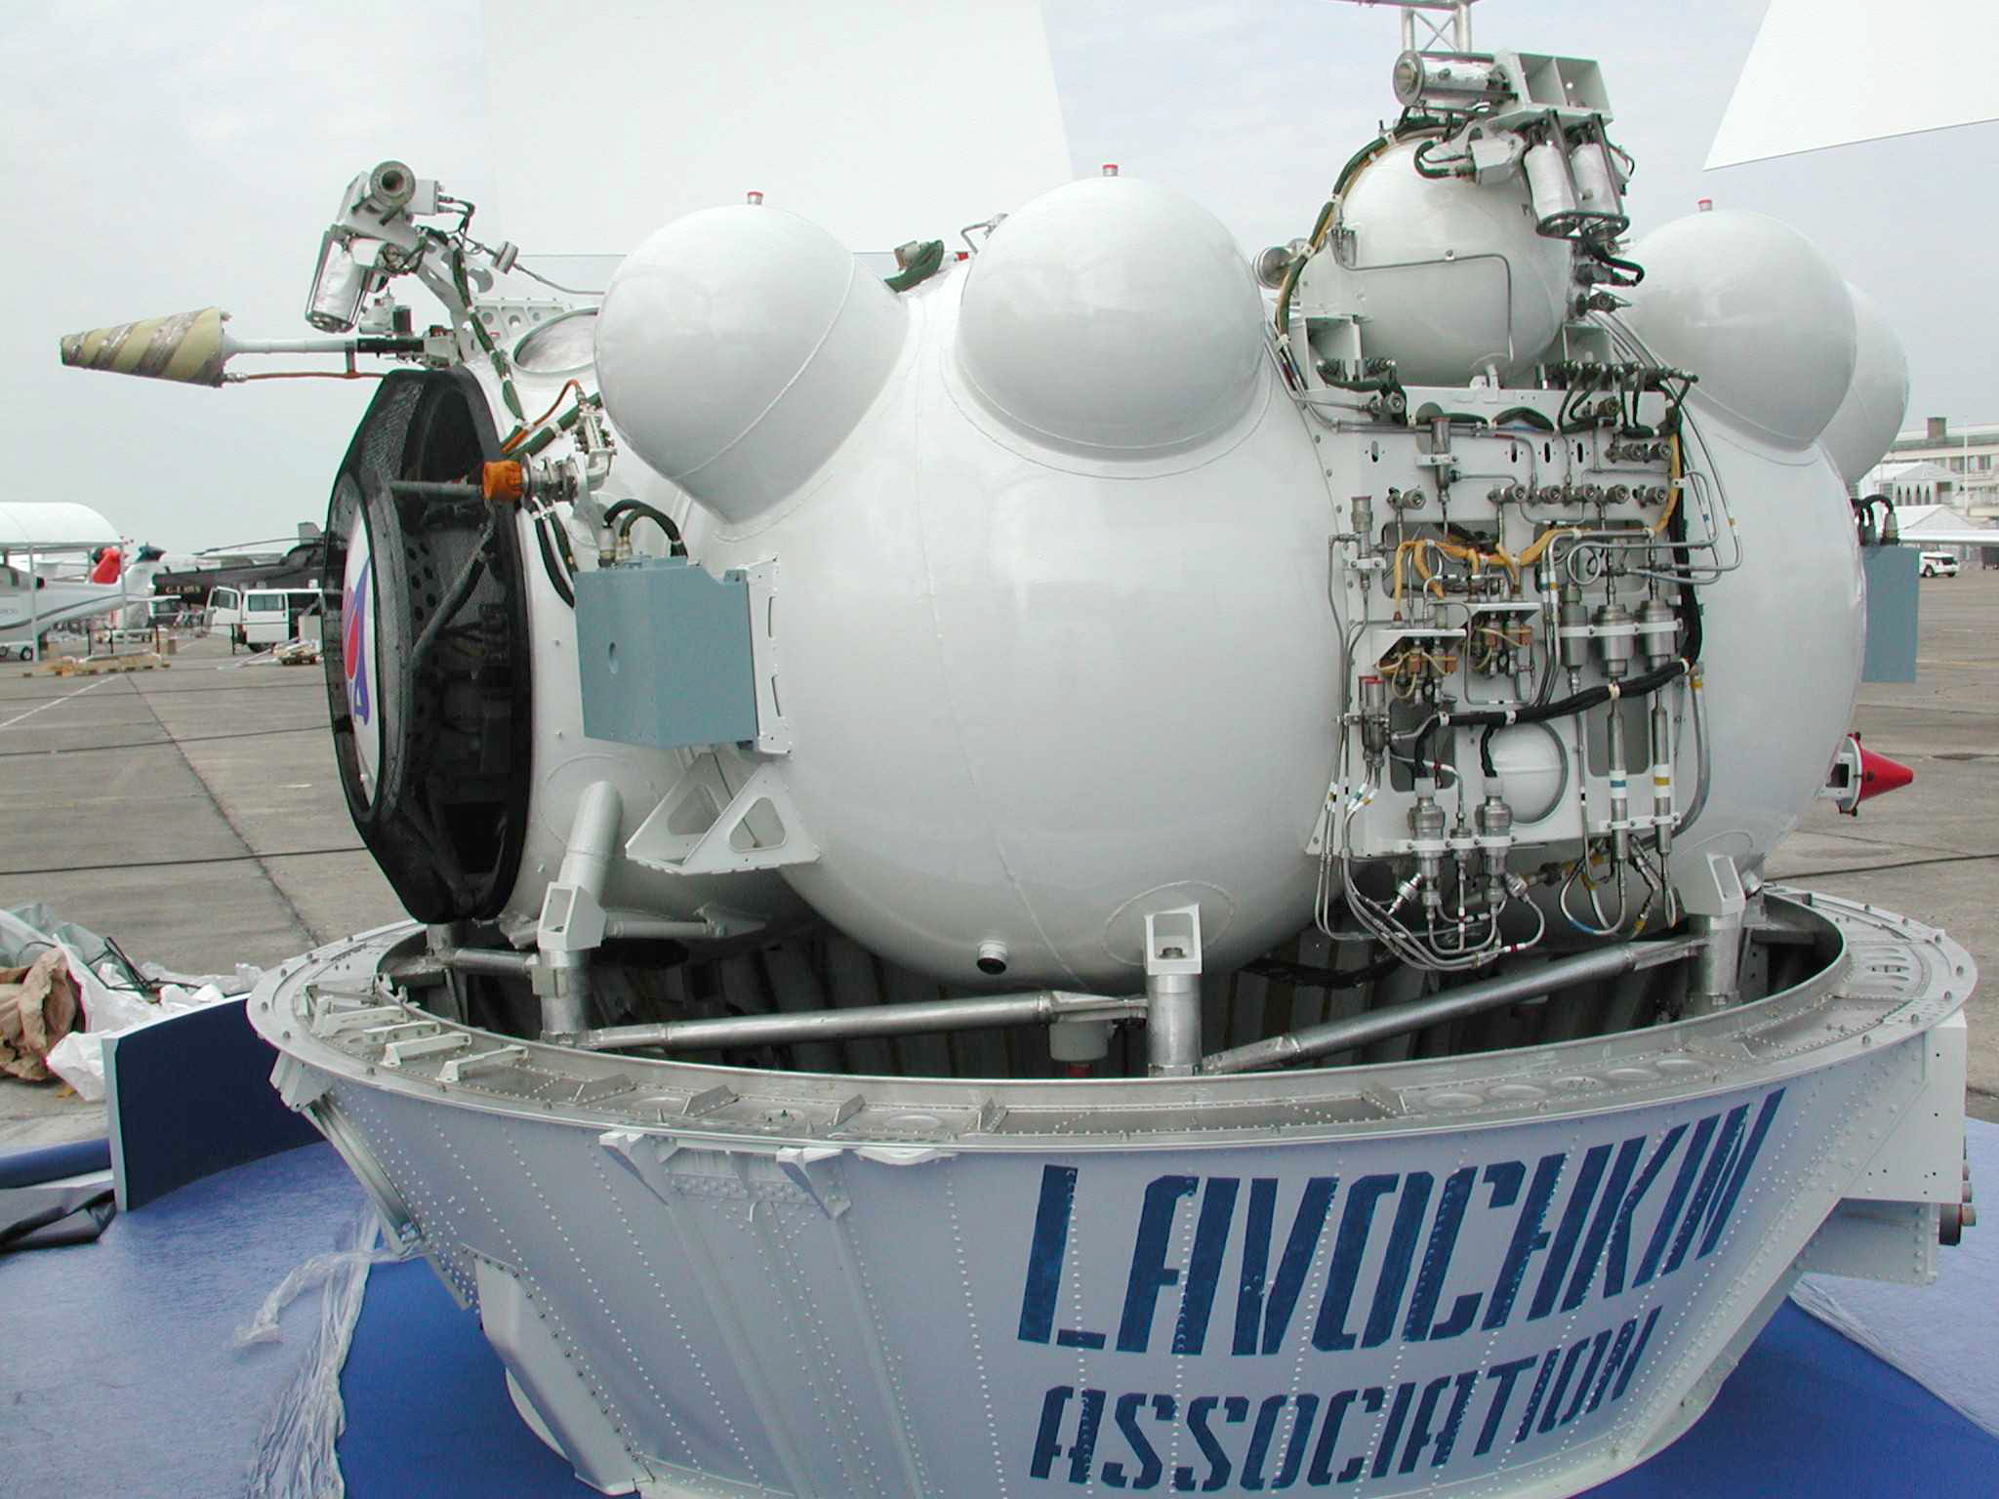
Launch Campaign (Launcher integration)
Image: Fregat upper stage
Credit: Images © 2013 ESA – CNES - Arianespace
Image: Soyuz 1st and 2nd stage

Slide 7
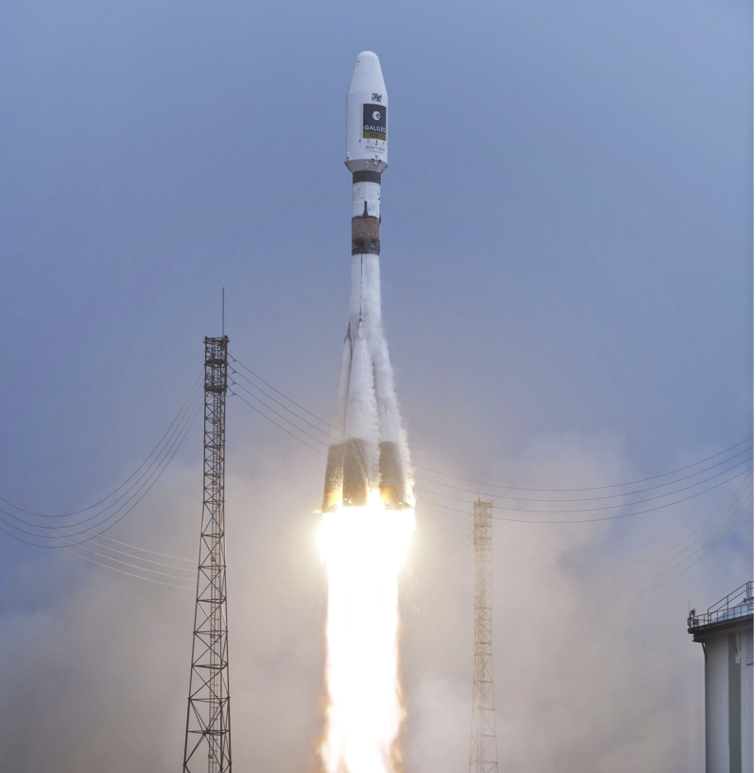
Gaia
Credit: ESA

Slide 8
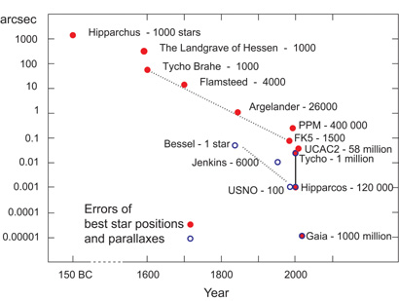
The need for Gaia
The primary objective of the Gaia mission is to provide a census of
more than 1,000 million (one billion) stars in our Galaxy and beyond.
Studies of the Galaxy require:
  Accurate distances and motions, combined with
  physical properties of stars
  (temperatures, metallicities, surface gravities, interstellar extinctions/reddenings, masses, ages, ....)
  A representative, complete sample of stars down to faint magnitudes
This can only be achieved from space and requires astrometry, photometry, and spectroscopy.
Gaia will perform a unique and unbiased all-sky survey to map the three-dimensional position to micro-arsecond accuracy and velocity of all objects 5.7 to 20th magnitude, radial velocities down to 17th magnitude.
Image: Progress of
astrometric accuracy (ESA)
Notes:
Edicott mentioned the first e2v deep-depleted CCD to go into space.

Slide 9
Gaia: the discovery machine
1 billion objects in 3D will provide:
in our Galaxy …
  the distance and velocity distributions of all stellar populations
  the spatial and dynamic structure of the bulge, disk and halo
  its formation history and past evolution
  a rigorous framework for stellar structure and evolution theories
  a large-scale survey of double and multiple stars (~100,000,000)
  a large-scale survey of extra-solar planets (~5,000 photometric, ~2,000 astrometric)
  a large-scale survey of Solar System bodies (~250,000)
… and beyond
  definitive distance standards out to the Magellanic Clouds
  rapid reaction alerts for supernovae and burst sources (~6,000)
  resolved galaxies (~1,000,000)
  quasars and redshifts (~500,000)
  microlensing (~2,000 photometric; a few astrometric?)
  fundamental quantities to unprecedented accuracy (e.g. PPN γ to 2×10⁻⁶)
Notes:
Edicott mentioned the first e2v deep-depleted CCD to go into space.

Slide 10
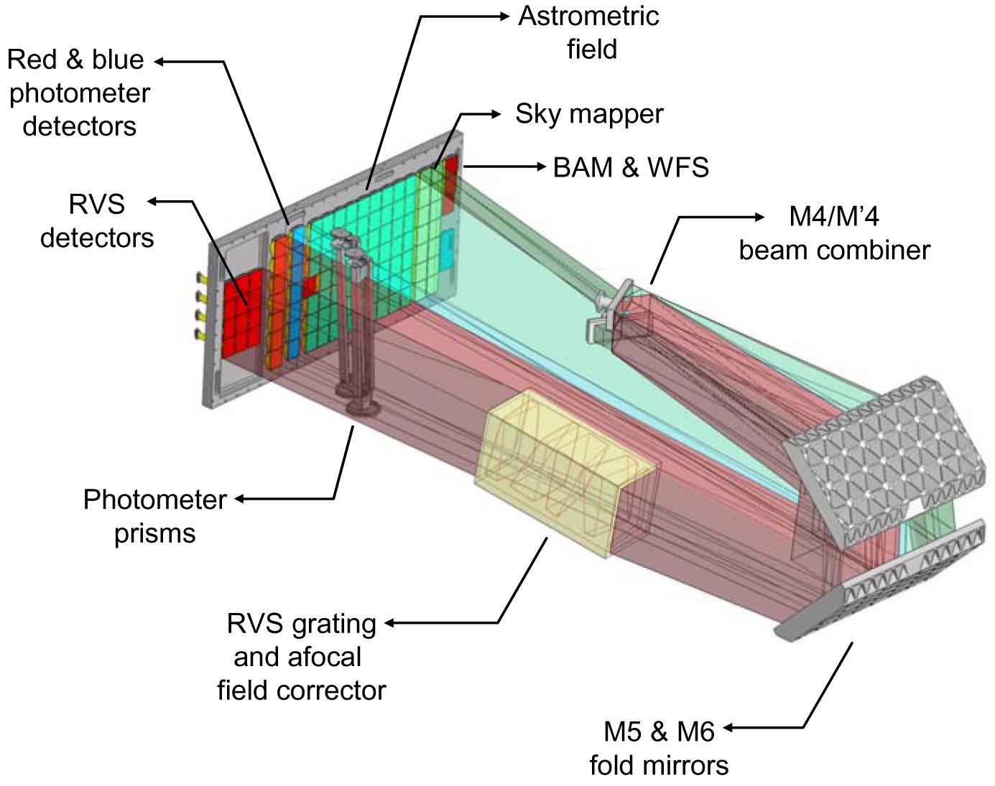
Gaia: Astrometry, Photometry, Spectroscopy
3 science instruments in combined focal plane:
Astrometry:
320-1000 nm
(G magnitude)
Blue photometer:
320–680 nm
Red photometer:
640–1000 nm
Spectroscopy:
847–874 nm
(resolution 11,500)
Credit: Figure courtesy
EADS-Astrium
Notes:
Edicott mentioned the first e2v deep-depleted CCD to go into space.

Slide 11
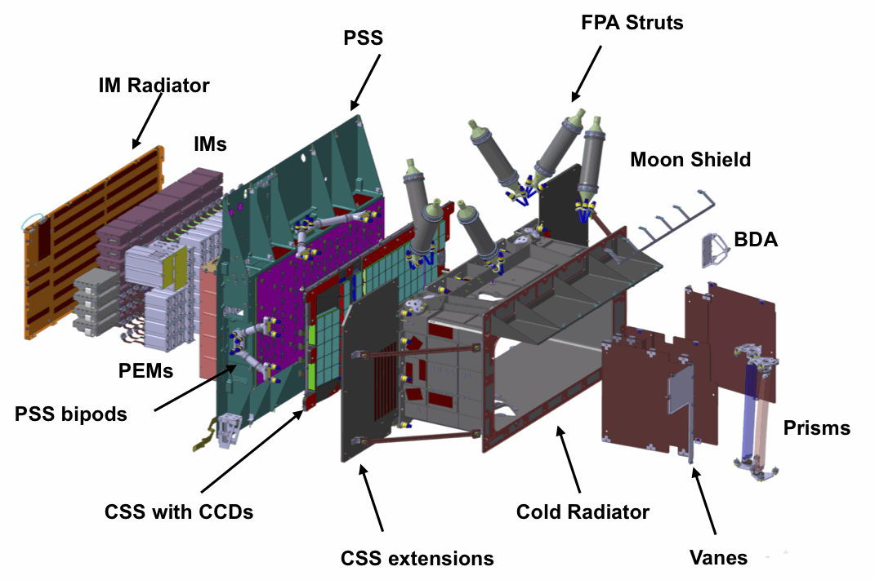
Focal plane schematics
Warm
Cold
Credit: Figure courtesy
EADS-Astrium
Notes:
Left of PSS: warm electronics with IM radiator to outer space.
Right of PSS: cold parts right of PSS with the cold radiator to payload cavity.
FPA mean temperature: 163K, gradient: 6K (158K – 164K).
Micro-Kelvin stability.

Slide 12
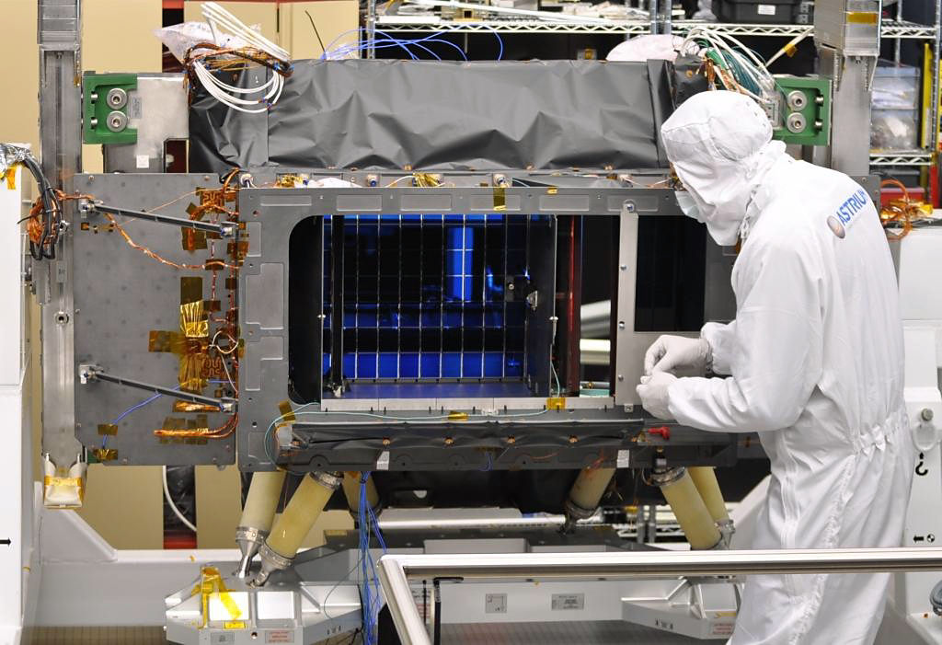
Assembled focal plane
Credit: Figure courtesy
EADS-Astrium

Slide 13
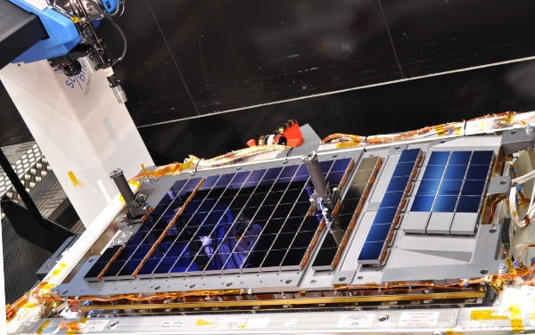
CCDs integrated in FPA
CCDs integrated on common support structure (CSS):
  1 x 0.5 m in size
  20 kg, all Silicon Carbite (SiC)
  Excellent thermal and mechanical stability
  WFS opto-mechanical assemblies directly mounted on the CSS in front of WFS CCDs.
  106 CCDs mounted on CSS aligned in 7 rows and 17 functional strips.
  0.28 m² of Silicon
WFS
Credit: Figure courtesy
EADS-Astrium
Notes:
Micro-Kelvin thermal stability.

Slide 14
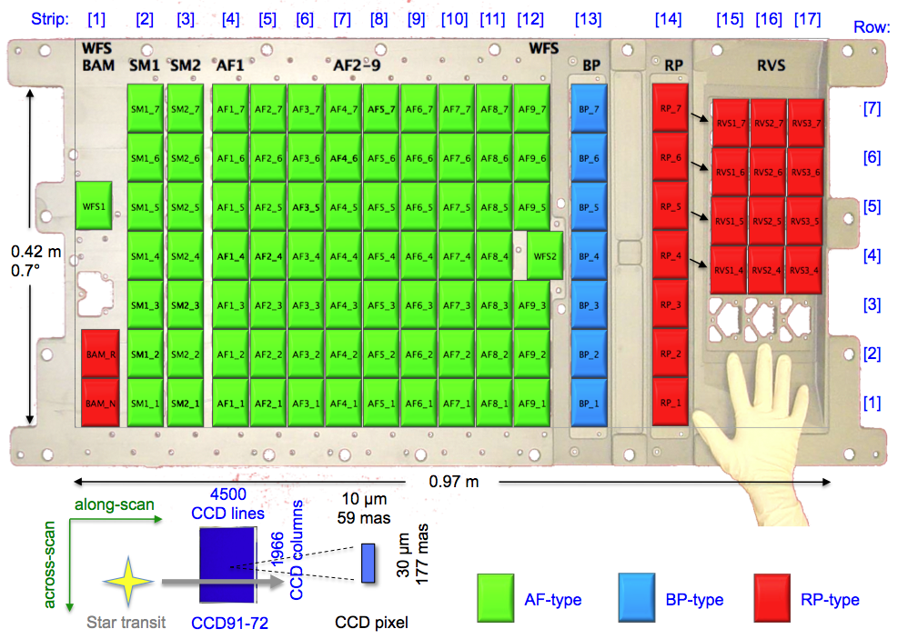
FPA arrangement of 106 CCDs
e2v technologies CCD91-72:
10µm x 30µm pixels
1966 columns x 4500 rows (TDI stages)
4 phase parallel, 2 phase serial register
Single low noise amplifier
Charge injection structure
Lateral anti-blooming drain
12 Special TDI gates to reset TDI integration
Summing register for parallel binning
Serial binning on output node
3 variants:
  AF: 16µm, standard silicon, broadband AR
  BP: 16µm, standard silicon, blue enhanced AR
  RP: 40µm, deep-depleted, red enhanced AR
Object
detection
Astrometric field
Photometers
Radial velocity
spectrograph
Credit: underlying image courtesy Boostec
Notes:
Edicott mentioned the first e2v deep-depleted CCD to go into space.

Slide 15
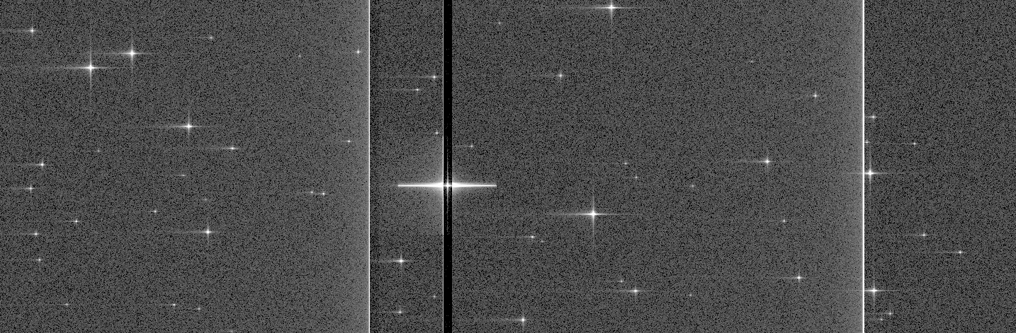
Astrometric data
Credit: Image courtesy Michael Davidson (VirtualScan simulation)

Slide 16
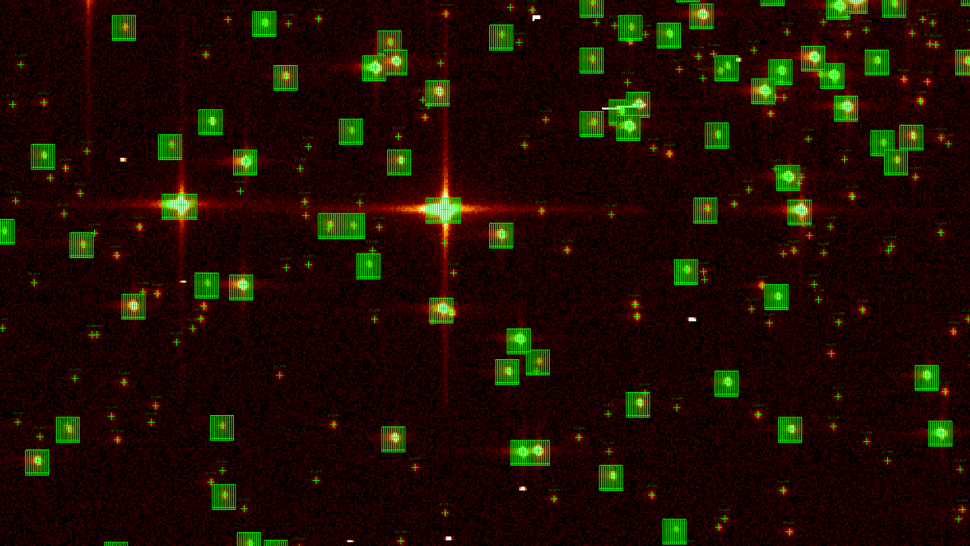
Autonomous object detection
Credit: Image courtesy Jos de Bruijne and Guido De Marchi (GIBIS simulation)

Slide 17
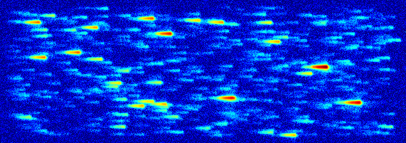
Photometric data
Credit: Image courtesy Anthony Brown (GIBIS simulation)

Slide 18
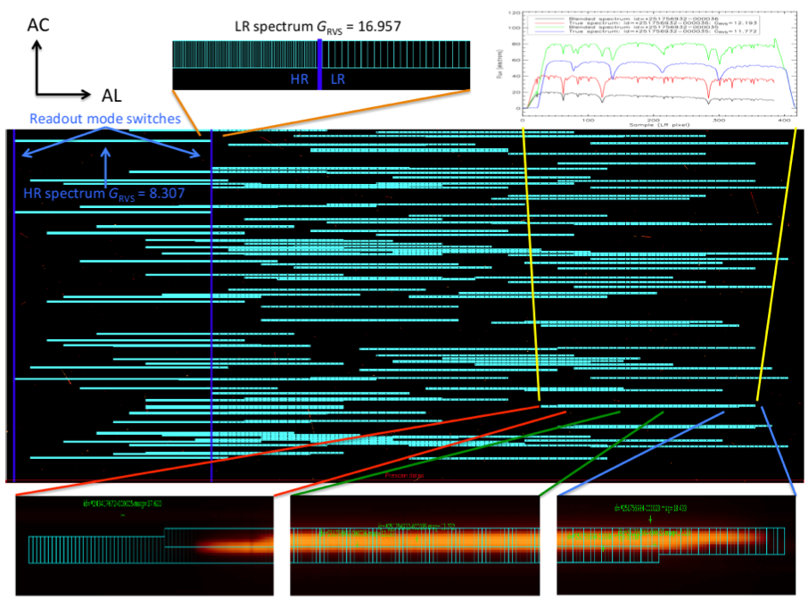
Spectroscopic data
Credit: Image courtesy George Seabroke and Katja Janssen

Slide 19
Calibration means
  No shutter
  No flat field source
  No full frame readout (only regions of interest in science data)
  No dedicated calibration objects/fields (continuous TDI scan, no stare modes)
  But …
  Charge injection
  TDI blocking gates
  Large parameter space to modify on-board algorithms behaviour
  Engineering interface
  Data processing determines calibration parameters from science data
  (self-calibrating concept)

Slide 20
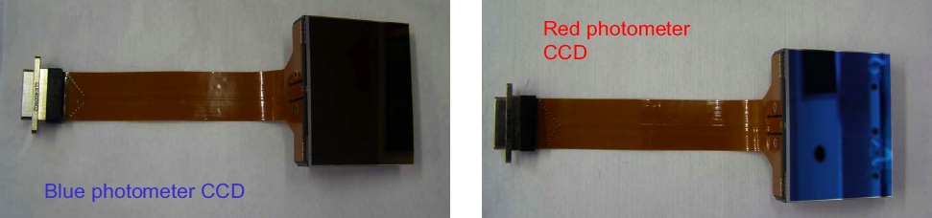
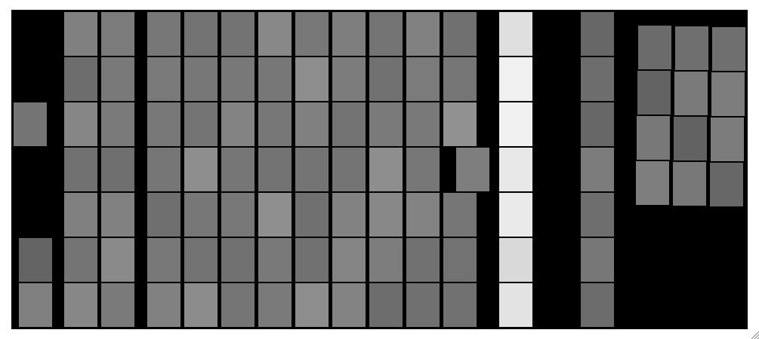
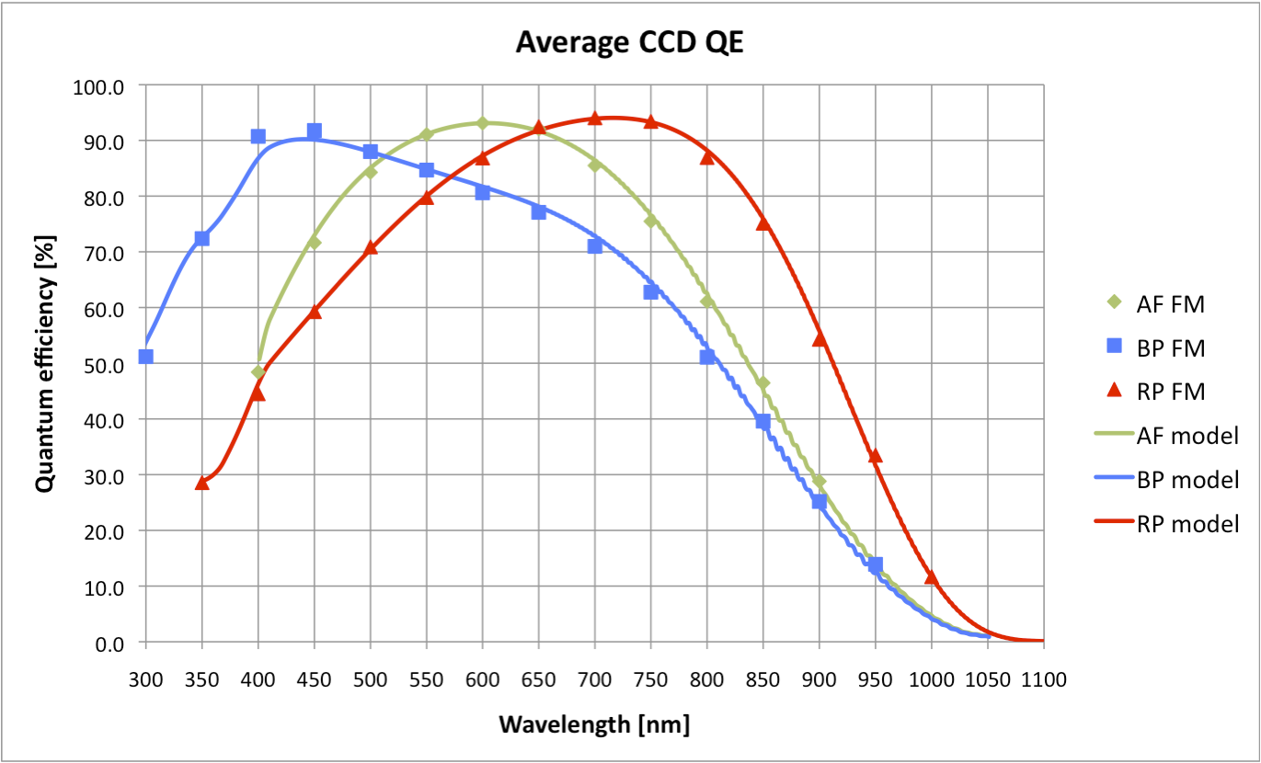
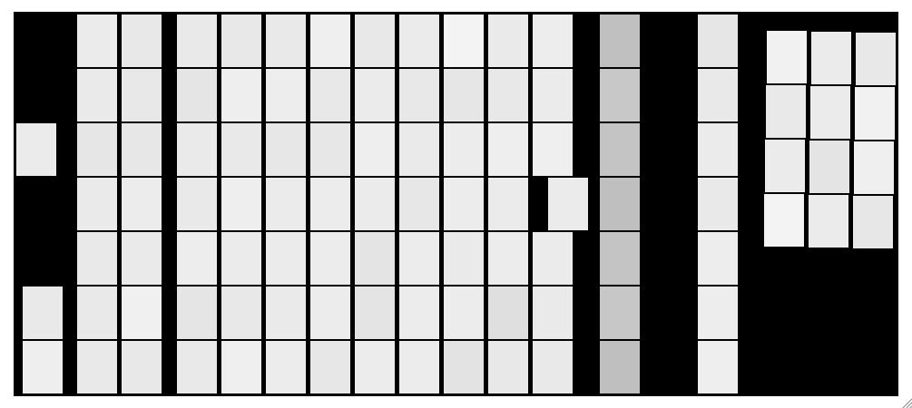
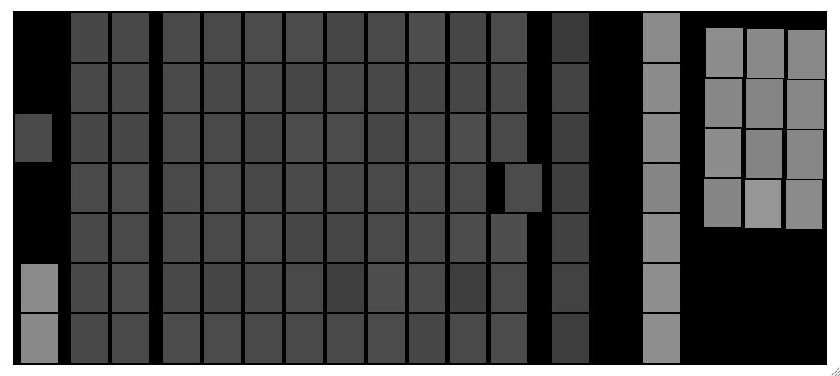
CCD performance
95%
39%
75%
96%
23%
AF
RP
BP
RVS
59%
Credit: QE model courtesy Maximilian Fabricius.
Notes:
BP @ 400nm:1sigma: 3.4%,9.1% p-v
AF @ 650nm:1sigma: 1.2%,7.6% p-v
RP @ 900nm:1sigma: 1.6%,6.9% p-v

Slide 21
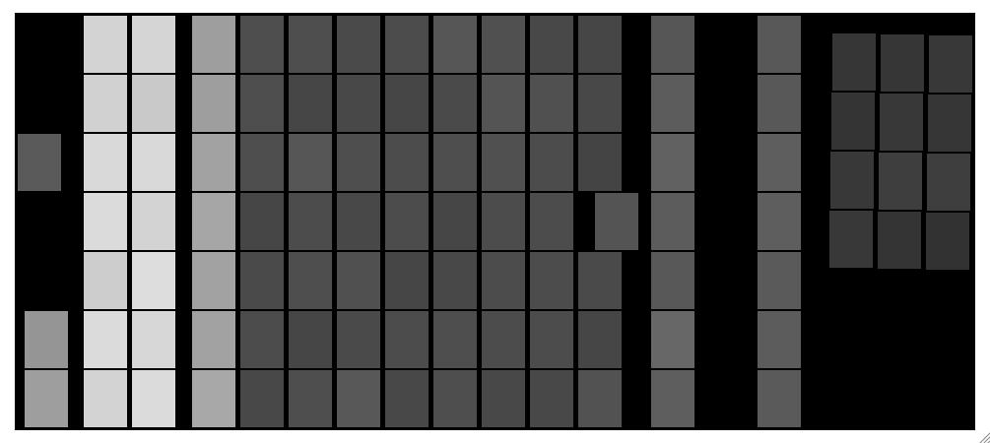
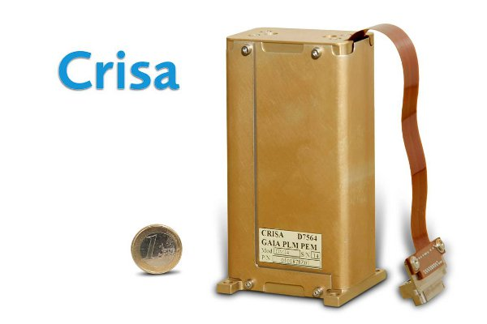
CCD controller performance
CCD controller (PEM) build by EADS Astrium Crisa, Spain:
  ASIC based sequencer
  3 MSPS 16-bit ADC
  2 bandwidth selector and 2 gain stages
  DCDS with digital oversampling (up to 8 samples averaged) for slower readout speeds
  Minimal footprint for FPA mounting
Different readout modes depending on function in focal plane:
  40 to 833 kHz pixels rates (10 MHz serial clocking)
  3e- to 11e- readout noise
  All modes synchronized to 0.9828 ms TDI line shift time
  Different binning modes depending function and object brightness
2.6e-
11.3e-
Image: Read-out noise in FPA context.
Notes:
Stdev: 0.2-0.3e-

Slide 22
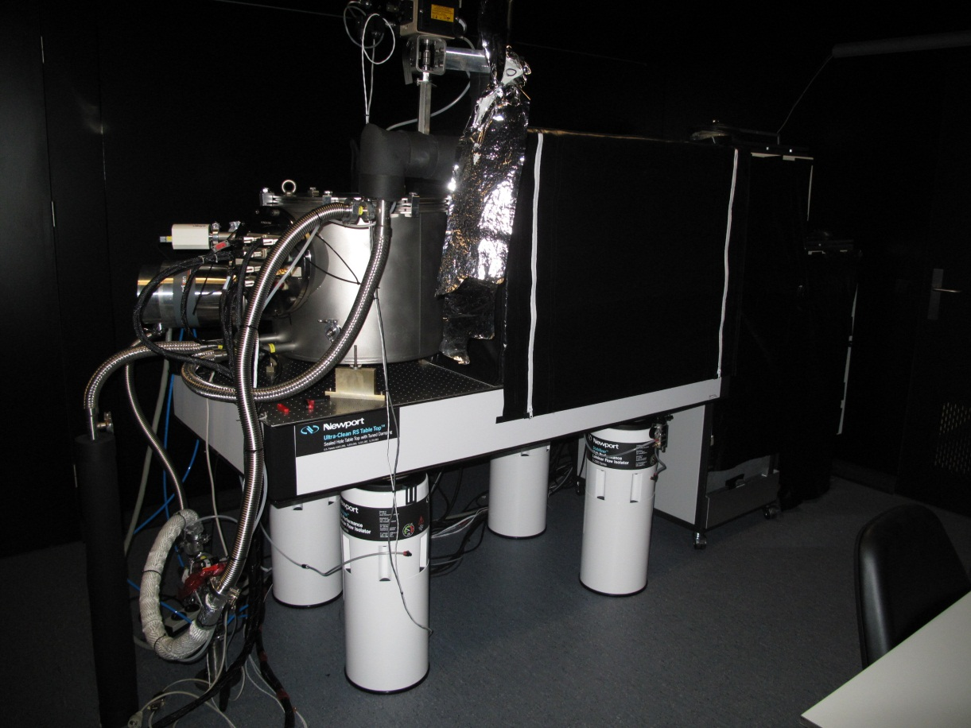
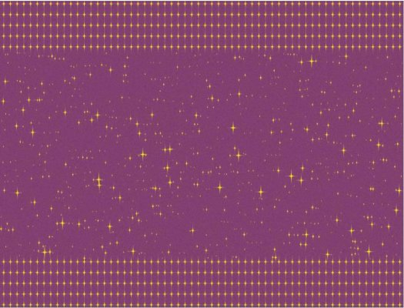
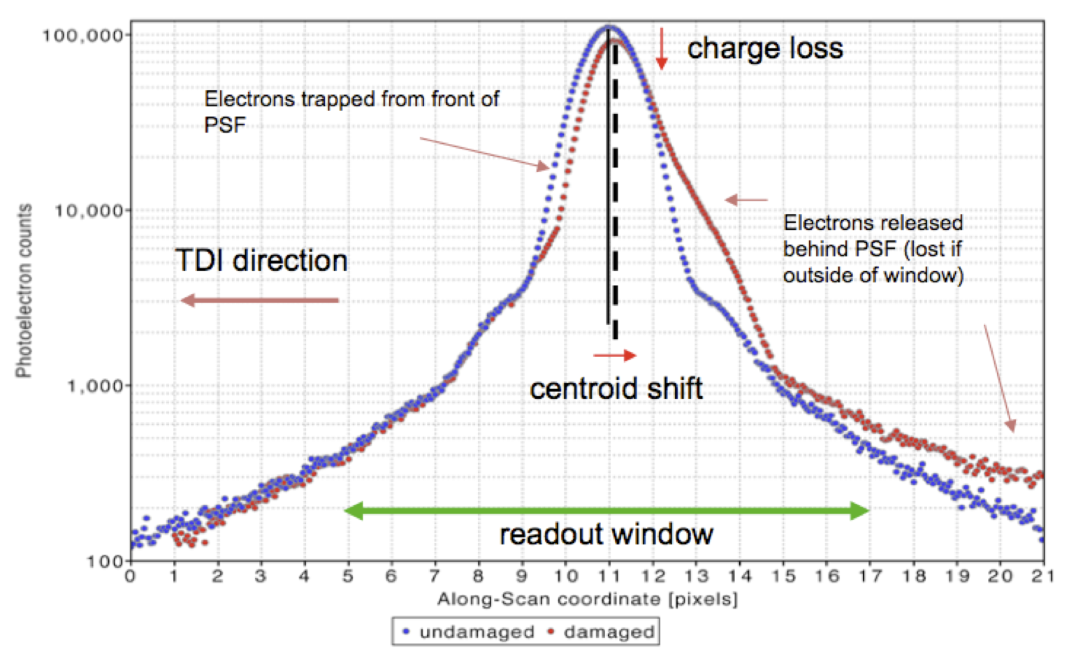
Radiation test bench during development and operations
Astrium Radiation test bench facility:
  5 test campaigns successfully completed to support SOC/DPAC radiation effect modelling on CCDs.
  Facility now at ESTEC and operative to support operations.
Credit: Photo courtesy Peter Verhoeve
Image: Monte-Carlo simulation of LSF deformation due to radiation induced CTI for illustration. Courtesy Thibaut Prod’homme.
Image: Artists impression of “sky-like” mask for testing of radiation effects on astrometry.
Courtesy Denis Marchais (EADS Astrium).

Slide 23
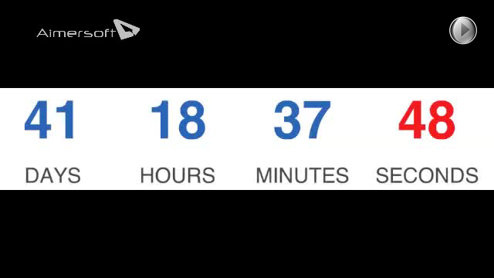
Countdown

