Slide 1
A Novel 4k×4k EMCCD Sensor for Scientific Use
Douglas Jordan¹, Paul Jorden¹, Claude Carignan², Jean-Luc Gach³, Olivier Hernandez⁴
¹e2v technologies ltd, ²University of Cape Town, Department of Astronomy, ³Marseille Université LAM/CNRS, ⁴Université de Montréal LAE/CRAQ

Slide 2
Summary
Device design
Specifications
Preliminary data from 2MHz characterisation, focussing mainly on clock induced charge.

Slide 3

Device summary
The CCD282 is a large low-light level (L3) imaging sensor developed by e2v technologies for the University of Montreal
The intended use is for photon counting
The device will be used on the MeerLICHT optical telescope which is a single, robotically operated, 60cm telescope which is to be used in partnership with the MeerKAT radio telescope for imaging astronomical transient (explosions and outbursts) in the optical and radio wavelengths simultaneously.
There is also intention to place a device on a 10m telescope for scanning Fabry-Perot.
https://www.astro.ru.nl/wiki/research/meerlicht

Slide 4
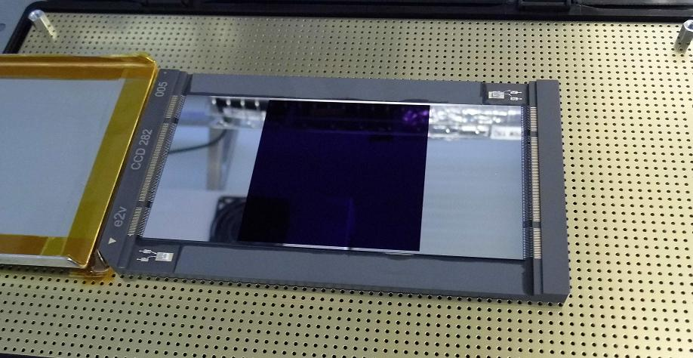
CCD282 sensor and package

Slide 5
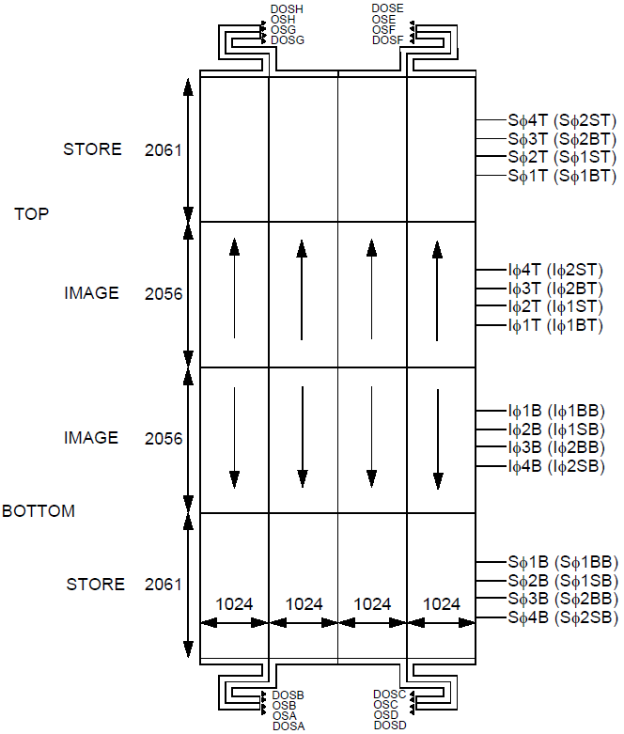
CCD282 schematic

Slide 6
CCD282 design
4k x 4k image area with equivalent store areas for frame-transfer operation.
Overspill in multiplication register to limit the maximum signal and reduce aging effects.
8 outputs with dummy outputs
15 MHz readout
6µs line transfer (~12ms frame transfer)
> 5fps
Two-phase image and store operation
Back thinned
Amplifiers are very similar to that of the CCD220 and is expected to have a noise of 50e- rms at 15MHz with CDS.

Slide 7
CCD282 package
The package consists of a multilayer Aluminium-Nitride (AlN) ceramic package with integral tracking and pins.
Both the top surface and the bottom surface of the package are ground, to ensure good flatness, required to achieve an image area flatness of better than 20μm and a good thermal interface to the bottom of the package.
Two PT1000 temperature sensors are glued to the package using a thermally conductive epoxy, allowing the CCD temperature to be measured relatively accurately
Areas to either side of the CCD are provided to allow space to clamp the package to a thermal interface (cold finger) to provide good thermal contact.
Notes:
Geometric measurements have flatness of 5.7um and 7.2um

Slide 8
Key parameters
The following parameters will be explored in more detail in this presentation as part of a 2MHz device characterisation
Amplifier responsivity
CIC and CTE
  Parallel
  Serial
Multiplication gain

Slide 9
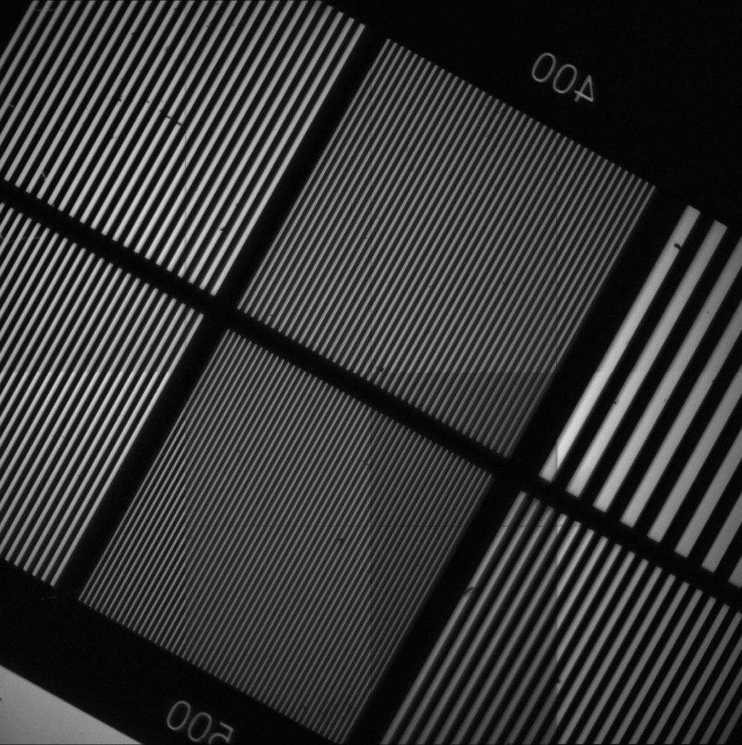
CCD282 first light
First image at ~-60°C

Slide 10
Amplifier responsivity
The CCD282 amplifier is similar to the CCD97 and CCD220 amplifiers but with altered geometry to allow for dummy outputs for each output.
The eight outputs have well matched responsivity values. As measured by Fe55 x-rays
Amplifier | Responsivity (µ/e⁻)
A | 1.10
B | 1.10
C | 1.10
D | 1.09
E | 1.11
F | 1.12
G | 1.13
H | 1.11

Slide 11
Design for low clock induced charge
As the device is intended to be used for photon counting applications the level of clock induced charge (CIC) must be kept to a minimum.
Low 2-phase barrier dose enabling low clock voltages
Non-inverted mode operation (NIMO) as inverted mode operation (IMO) is found to have higher CIC.
Low temperature operation to minimise dark current.
Operating multiplication gain at the lowest level required to resolve individual photons

Slide 12
Measuring parallel clock induced charge
To measure the levels of parallel CIC the device was cooled to -100°C and 1,000,000 lines were binned into the register in the dark.
To remove the dark signal the device held with IΦ3 and IΦ4 high for an identical amount of time and the whole image binned into the register.
However due to the large size of the device the power dissipation on chip is high. Causing significant warming (1°C/s) and therefore an increase in dark current. Making the subtraction of dark signal from CIC difficult.
A novel method was required to subtract the dark signal to extract a value for the parallel CIC.
Notes:
Power ~3W just from the Iphi clocking. Normal operation ~200mW (from CV^2f calculation)

Slide 13
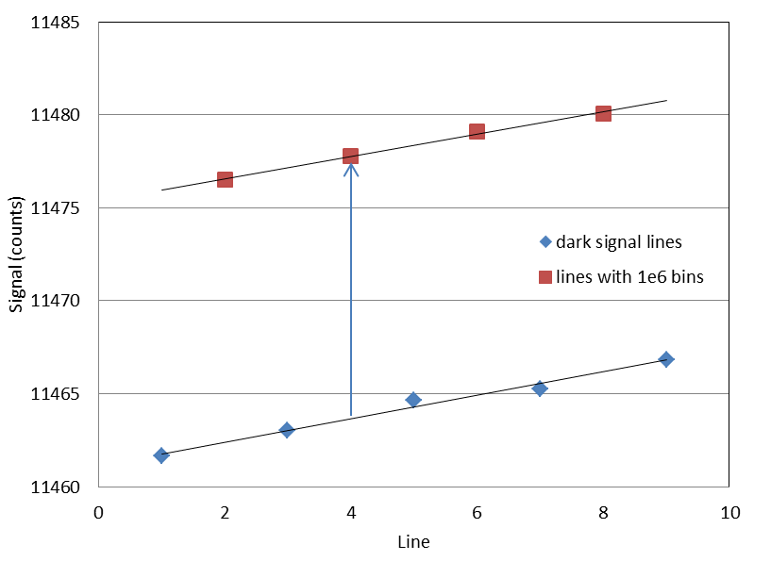
Measuring parallel clock induced charge
Alternate lines were taken of CIC and dark signal enabling a subtraction of the dark signal which increases throughout data acquisition.
The dark signal subtracted was an average of the two neighbouring dark rows.
The average signal (cosmic ray events removed) of alternating rows of dark signal and dark signal plus CIC from 1,000,000 binned rows, each having gone through 4112 line transfers.
Notes:
Note this also removes the register dark signal and offset.

Slide 14
Measuring parallel clock induced charge
Above is an example image showing the two different rows

Slide 15
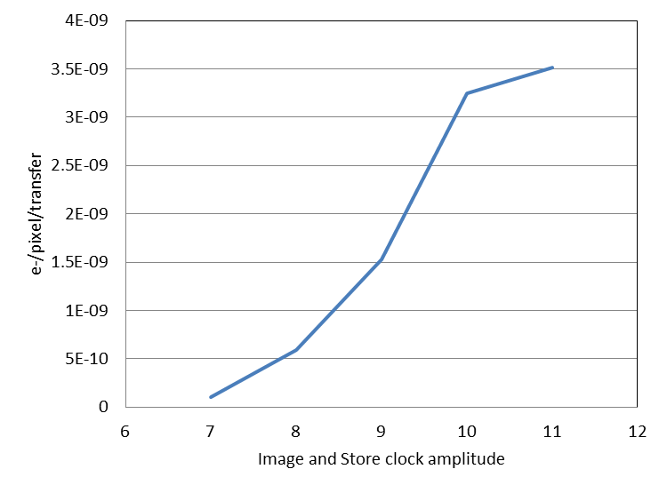
Measuring parallel clock induced charge
The level of CIC decreases with clock amplitude
For a frame with 11V parallel clocks these values suggest ~250e⁻ per frame of CIC and at 7V below 10e⁻ of CIC per frame.
For these voltages CTE was measured at >99.9995% using
Fe55 x-rays.

Slide 16
Serial clock induced charge
To get low serial CIC the following voltages must be optimised
  RΦ voltage amplitude
  RΦDC voltage
  RΦ2HV voltage amplitude
For minimum serial CIC the multiplication gain should be kept as low as possible.

Slide 17
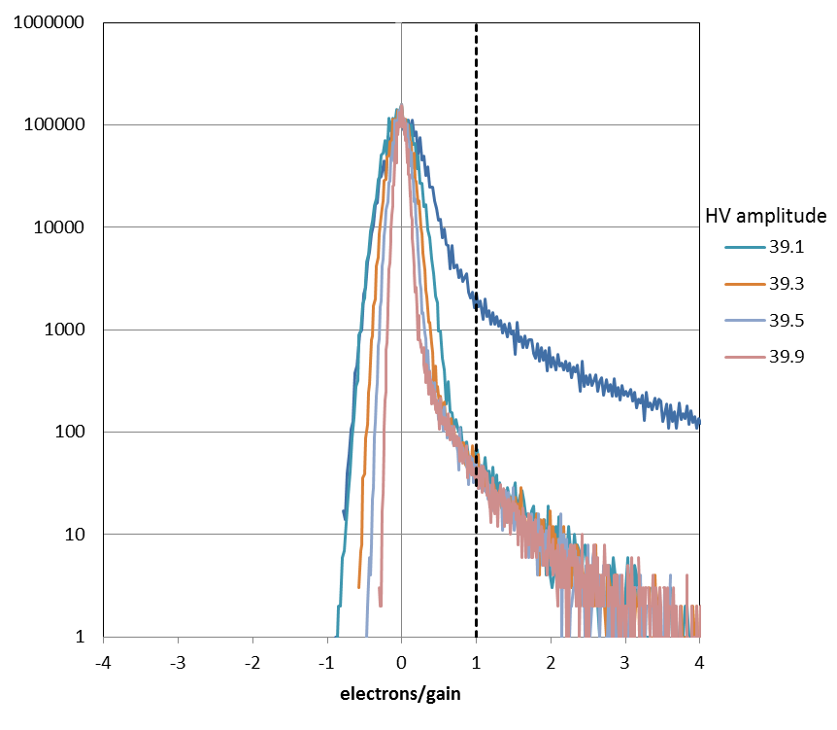
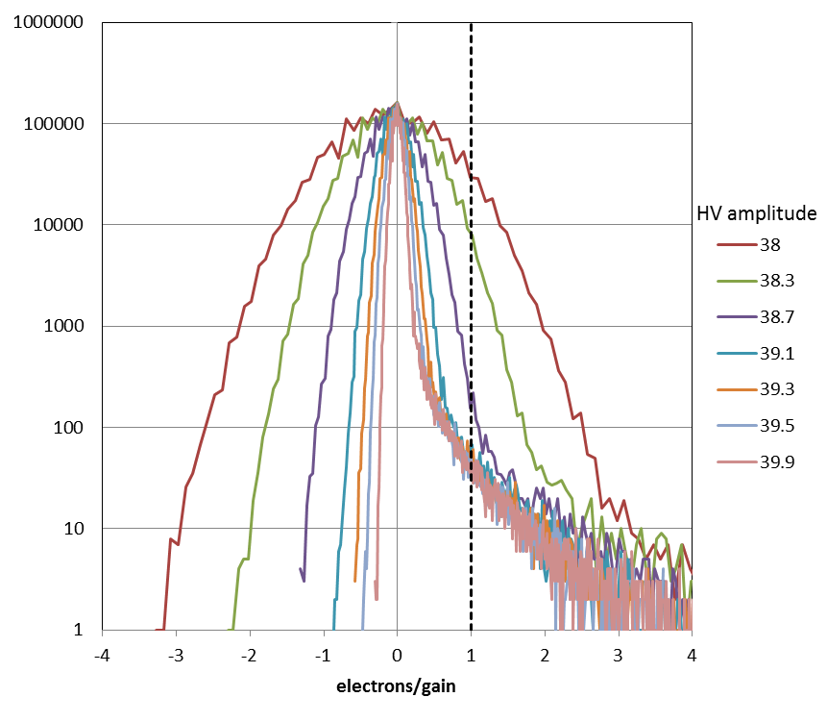
Serial clock induced charge
To measure the CIC histograms of overscan were plotted with frequency vs. output signal/gain. Any pixel which had e⁻/gain>1 was counted as a CIC event.
Note: this data does not
remove dark signal
Clock | Voltage
RΦ | 10V
RΦDC | 3.5V

Slide 18
Serial clock induced charge
Note this method will only detect the CIC from the standard register prior to the multiplication register and in the early stages of the multiplication register.
CIC from later than this will not be multiplied by a sufficient factor to be detected
It should also be noted that the serial clock timing was in no way optimised for these measurements.

Slide 19
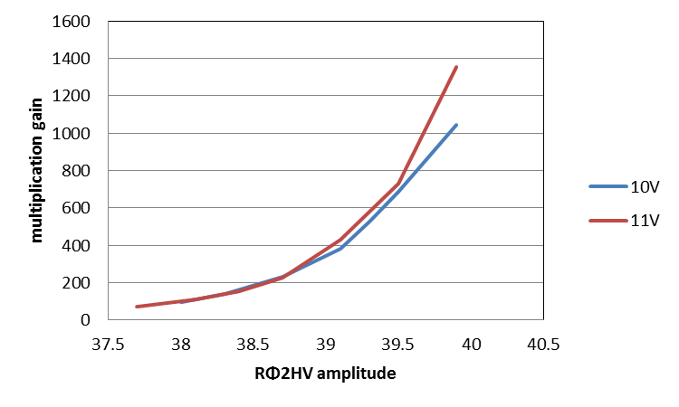
Multiplication gain versus RΦ2HV voltage
RΦDC set at the minimum value for good CTE of 3.5V

Slide 20
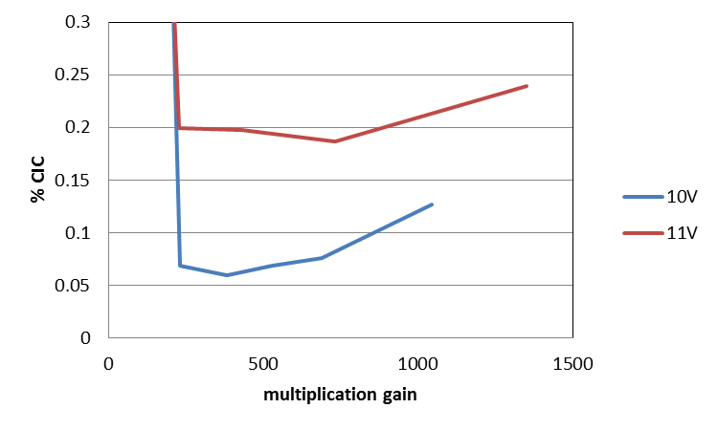
Serial clock induced charge
The gain is higher for 11V clocks therefore allowing a lower HV amplitude but the benefit seems to be lost
From this data set an optimum multiplication gain of ~300x was found at an RΦ amplitude of 10V with RΦDC set at 3.5V.
Minimum at ~0.06% which
equates to ~3x10⁻⁷e⁻/pix/transfer
CTE at unity gain was measured as
>99.9995% for these voltages

Slide 21
Photon counting spurious signal
Combination of CIC and dark signal at -110°C operation temperature with a frame rate of 5.5s⁻¹ will produce approximately 11000e⁻ spurious signal per 4kx4k frame or 0.0006e⁻/pix/frame.
  Parallel CIC – 10e⁻
  Serial CIC and dark signal – 10,000e⁻
  Image dark signal – 1,000e⁻
    Dark signal expected to be ~0.005e⁻/pix/min at -110°C (not measured)
  Note: This is only an estimate based on -100°C characterisation at 2MHz readout.

Slide 22
Summary
The CCD282 is the largest EM-CCD ever built.
It is primarily designed for fast frame rate photon counting, so requires low CIC.
Low 2-phase barrier doping and low clock voltages reduce parallel CIC to negligible levels.

Slide 23
Thanks
Thanks should also go to the following people at e2v:
  Bev Lord - Project Manager
  Charles Woffinden - Technical Authority
  Michael Willis - Project Engineer
  Kevin Hadfield - Design Engineer
  Daniel Norrington - Mechanical/Package Engineer
  Andrew Pike - Characterisation
  Sam Dixon and Dean Yeoman - Systems Engineering

