Slide 1
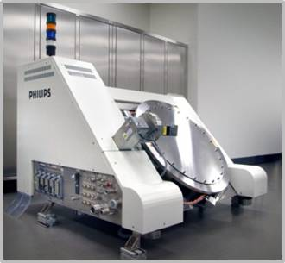
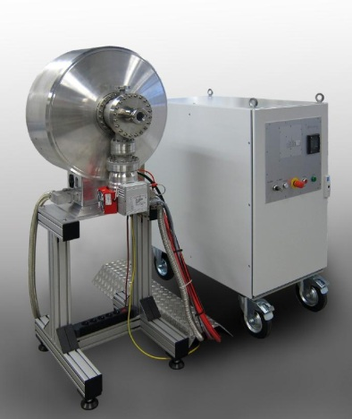
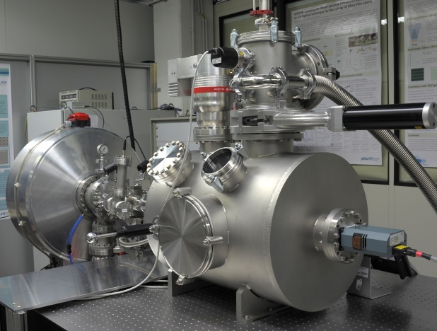
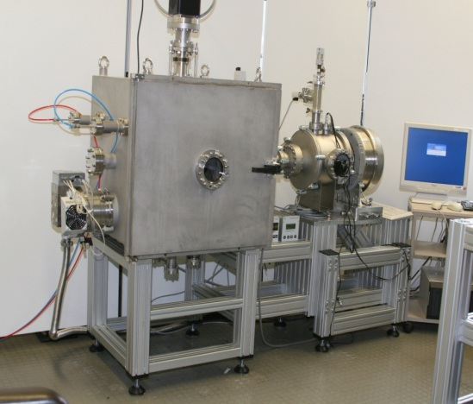
Terrestrial short wavelength metrology for solar science
Focus of research:
EUV sources & metrology
Industrially relevant EUV applications
Reflectometry
Nanostructuring
Imaging
Reflectometer
High power EUVL source
High brightness metrology source
Laboratory exposure tool
Defect inspection microscope
Stefan Herbert
Scientific Detector Workshop 2013
9th October 2013, Florence, Italy

Slide 2
Terrestrial short wavelength metrology for solar science
Motivation of attendance:
Space science applications and EUV lithography/metrology share:
Vacuum- and cleanlineness requirements - highest quality standards
Challenges, connected with EUV-specific optical equipment and detectors
Combine competences and experiences for mutual benefit
Contribution for joint activities:
Plasma source with quasi-solar emission spectrum
Flexible metrology test bench for characterization of optics & detectors in the EUV
Outgassing studies in vacuum
Stefan Herbert
Scientific Detector Workshop 2013
9th October 2013, Florence, Italy

