Slide 1



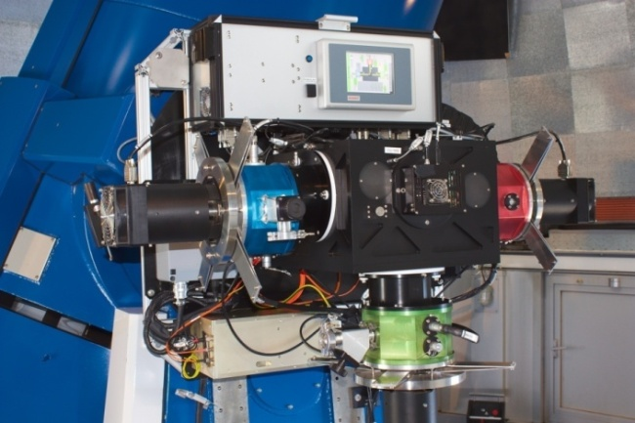
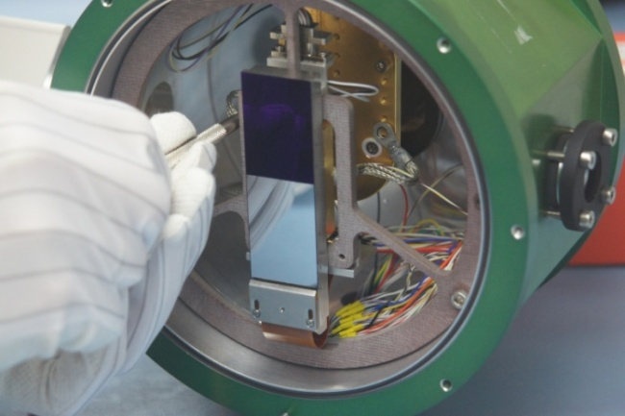
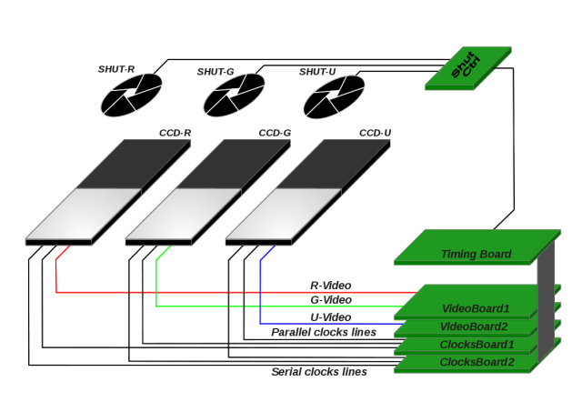
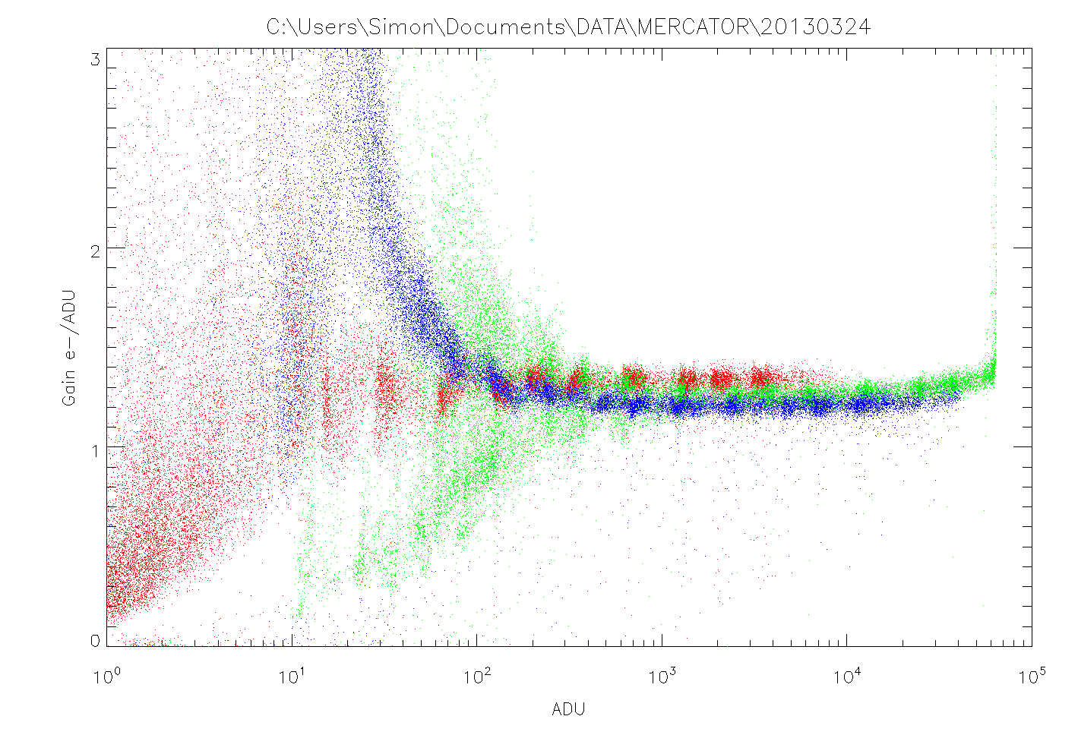
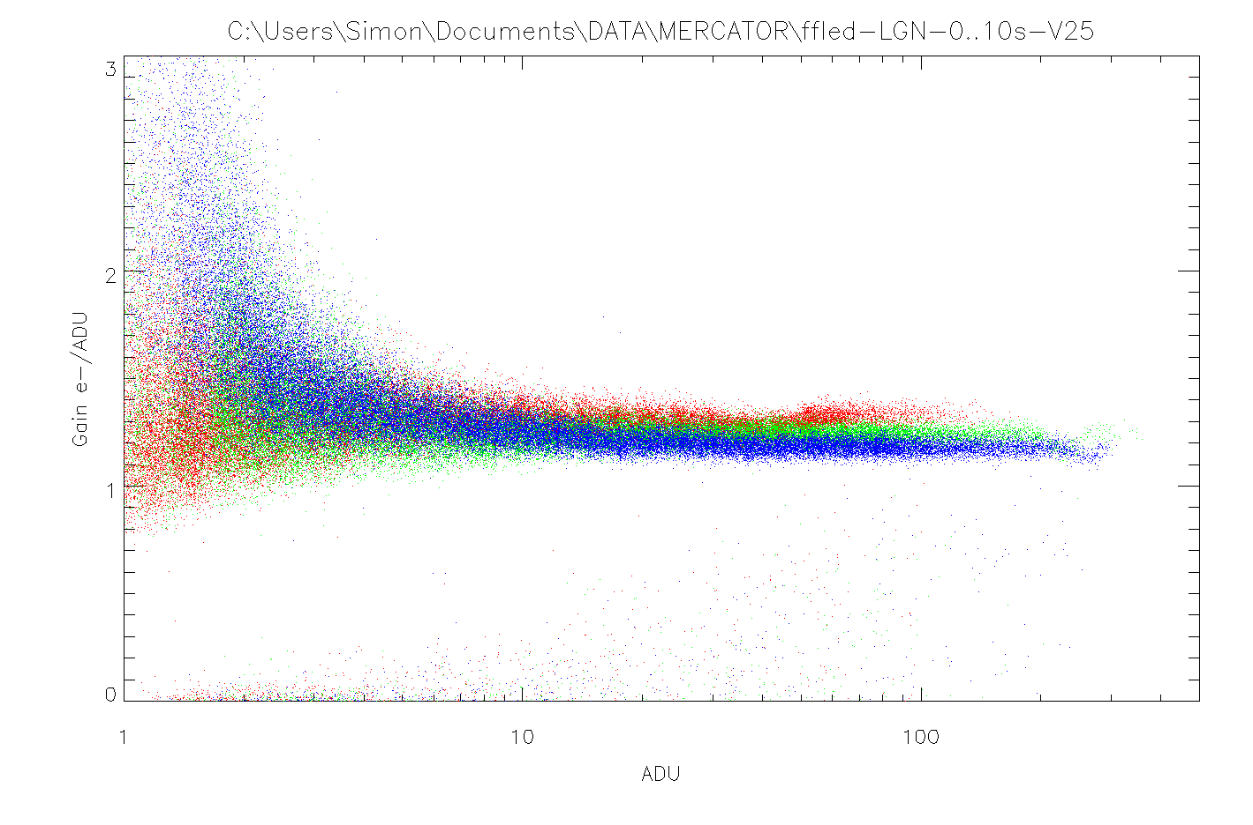
Large Frame Transfer Detectors for the MAIA imager
Jesús Pérez Padilla^{1,2}, Simon Tulloch³, Gert Raskin², Saskia Prins^{1,2}, Florian Merges^{1,2}
¹ Mercator Telescope, Roque de los Muchachos observatory, La Palma, Canary Islands, Spain
² Instituut voor Sterrenkunde, KU Leuven, 3001 Leuven, Belgium
³ QUCAM, Cádiz, Spain
Mercator Telescope
Institute of Astronomy
MAIA
Mercator Adv. Instr. for Ateroseismology
3-channel (SDSS u’, g’, r’ bands).
Frame transfer detectors
2048x6144 13.5µm pixels. 2k x 3k imaging area, and 2k x 3k storage area.
Acquisition system
ARC GEN-III controller. Two ARC-45 Video boards, and two ARC-32 Clock Driver boards
Linearity study and optimization
Detectors showed a non-linear behavior at lower levels of signal. Problem was solved by controller timing code optimization, aided by an accurate method for photometric analysis.
Read-out characteristics
System uses the FT characteristic to allow different exposure times for the three channels.
 | Slow (LGN) | Fast (MGN)
Read-out frequency | 156kPixel s⁻¹ | 227kPixel s⁻¹
Read-out noise | 3.5 - 4 e⁻ | 4.5 - 5 e⁻
Single row read-out time | 13.7 ms | 9.5 ms
Full frame read-out time | 43.1 s | 29.8 s
Full frame transfer time | 295 ms | 295 ms
Conversion gain | 0.8 ADU/e⁻ | 0.4 ADU/e⁻
R
U
G
Linearity down to very low signal levels (<10 ADU)
Gain error ≈ ±5%

