Slide 1
NIR HgCdTe
Avalanche Photodiode Arrays for Wavefront Sensing and Fringe Tracking
G. Finger, I. Baker, D. Alvarez, D. Ives, L. Mehrgan,
M. Meyer, J. Stegmeier

Slide 2
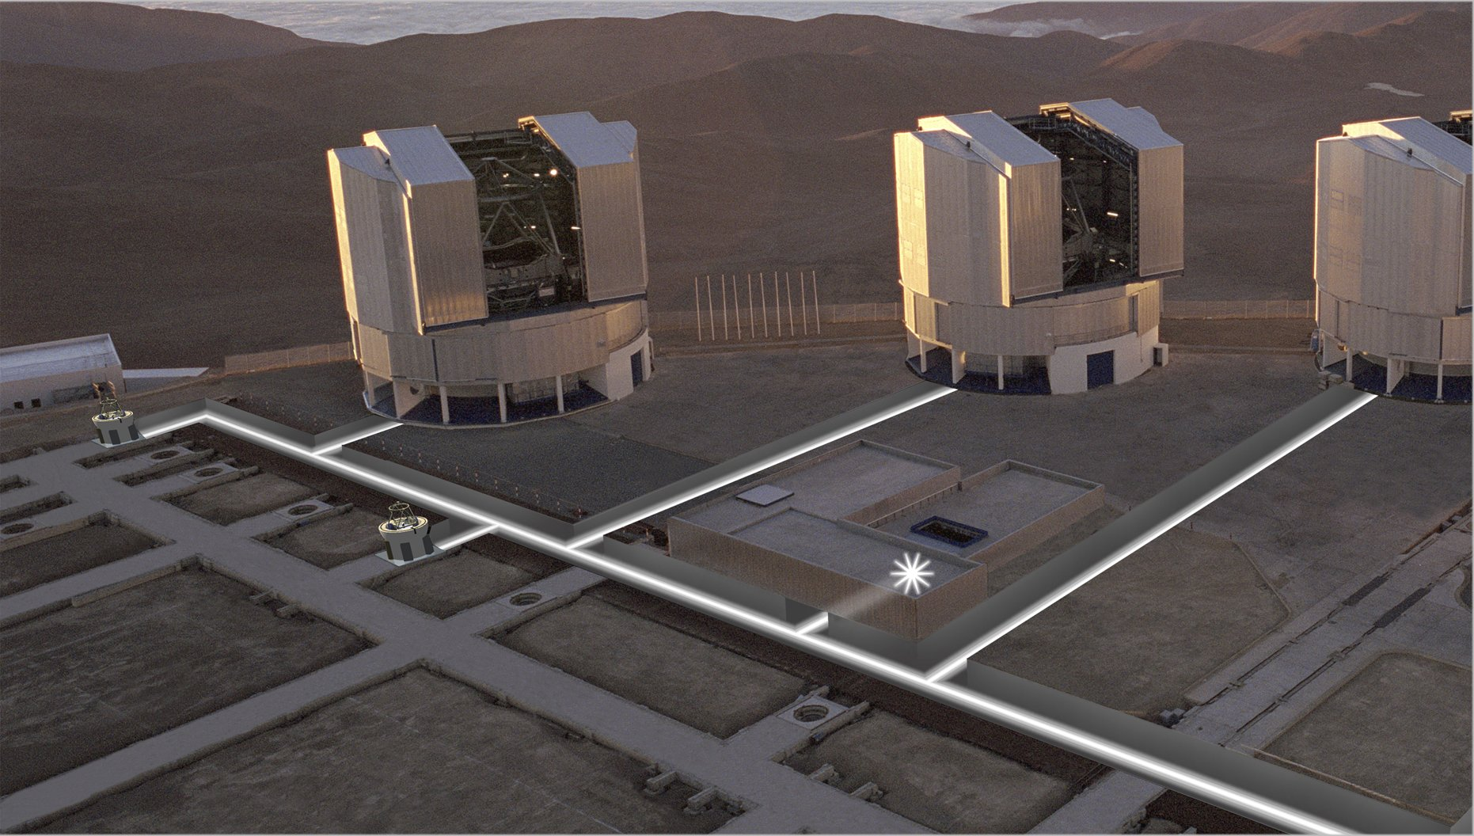
VLTI: VLT Interferometer
VLTI has
spatial resolution
of 200 m telescope
(ELT 40m)
fringes need to be
stabilized
IR AO WFS
for each telescope
high speed low noise sensor required

Slide 3
Introduction
motivation: for the VLTI
high speed low noise near infrared
wavefront sensors and a
fringe tracker are desperately needed
sensor: the sensor should have:
cutoff wavelength λ_{c}=2.5 μm (Hg_{1-x}Cd_{x}Te)
frame rate ~ 1KHz
readout noise << 3erms

Slide 4
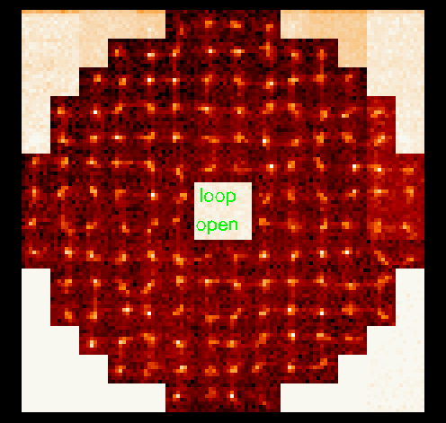
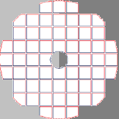
Shack-Hartman wavefront sensor
CONICA:
12x12 subapertures
Hawaii1 IR WFS
12x12 star images
measure image shift in each subaperture :
local tilt of wavefront
correct deformable mirror
GRAVITY:
9x9 subapertures
8x8 pixel each
72 x 72 pixels needed
courtesy J. Kolb

Slide 5
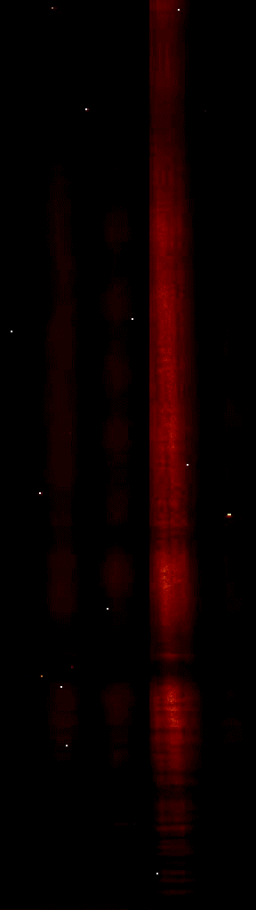
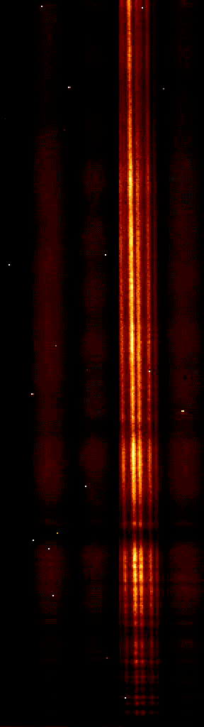
AMBER
multiaxial beam combination of
3 telescopes
with phase closure
dispersed fringes interfere on detector
medium resolution R=1500
FINITO fringe tracker
to stabilize fringes with PICNIC array
FINITO off
FINITO on
courtesy A. Richichi

Slide 6
how to achieve noise of <<3 erms at 5 MHz ?
noise of CMOS sensors (PICNIC,H2RG) scaled to speed of 5 MHz: RON ~ 70 erms
APD:
Avalanche Photo Diode:
HgCdTe is direct semiconductor (unlike Si)
noiseless amplification inside infrared pixel
m_{e}<<m_{h} : pure electron multiplication

Slide 7
band diagram of eAPD
  n-on-p required for eAPD
  collect electron avalanches
  mass of electron << mass of hole
  rapid energy loss of holes due to phonon scattering
  hole mobility << electron mobility

Slide 8
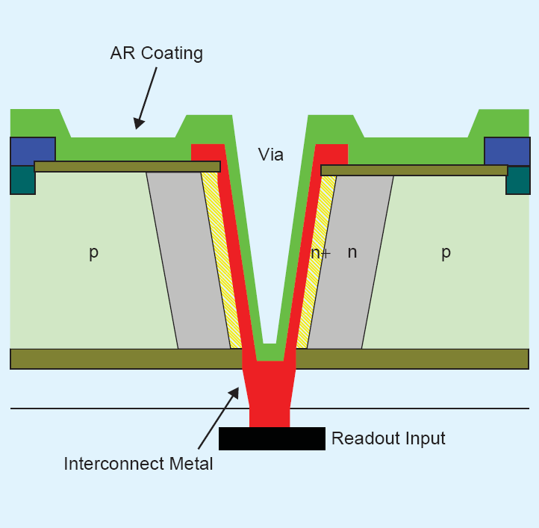
LPE via-hole eAPD diode structure
LPE structure used at
SELEX SE
mill hole with ion beam
to generate n–region
in p-type material
cylindrical p-around-n
diode geometry
metal via to make contact to mux (no In bumps)
loophole interconnect technology
Ref: D. Kinch

Slide 9
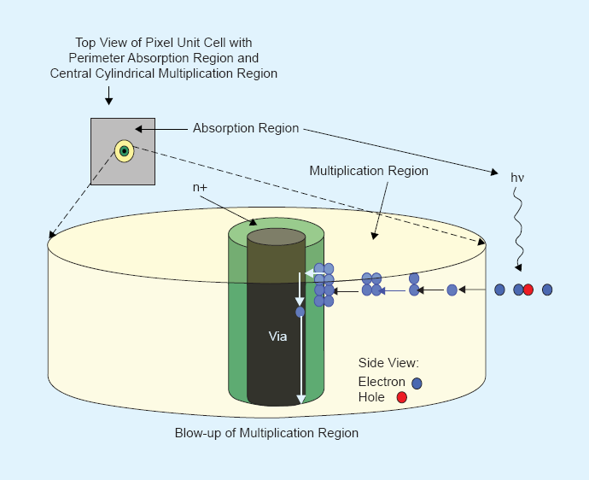
cylindrical p-around-n loophole diode
photon is absorbed in p region
charge is collected by lateral diffusion
avalanche amplification
in high electric field
of depletion region
cylindrical geometry favors electron amplification

Slide 10


2-dimensional eAPD array
multiplication region
format 320 x 256
pixel pitch : 24 μm
n-on-p required for eAPD
(our MBE science arrays
are p-on-n)
n
p

Slide 11
design of custom specific ROIC SAPHIRA
  design a new low noise ROIC needed which is specialized for AO and FT
  Selex Avalanche PHotodiode InfraRed Array SAPHIRA
  key features:
  format: 320 x 256 NIR HgCdTe Diode Array
  32 parallel video outputs corresponding to 32 adjacent pixels in a row
  sub-frame with multiplex advantage
  full frame readout in less than 500μs with 5MHz clock
  low noise of SFD
  high conversion gain : low capacitance of integrating node
  nondestructive readout
  selectable reset for each window to get different integration times for each window
  (star separator)
  selectable reference pixels

Slide 12
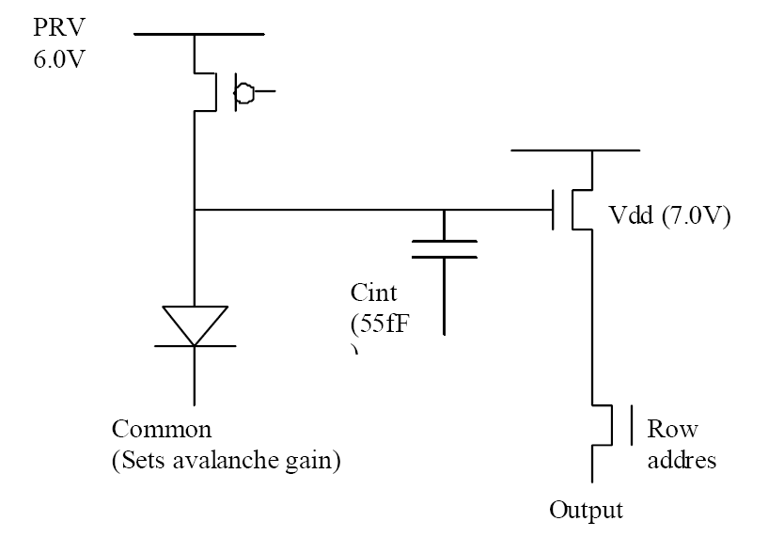
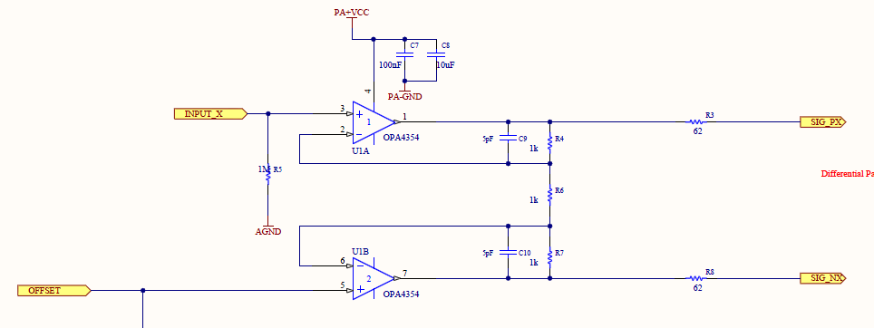
SAPHIRA unit cell
unit cell source follower per detector SFD
OPA4354: high speed (250 MHz)
symmetric cryogenic preamp
off chip on focal plane
30fF
EXTREF

Slide 13
SAPHIRA window topology for GRAVITY
full array 320x256 pixel
Wavefront sensor:
96x72 pixels needed
3x72 conversion strobes
fringe tracker:
48 spectra to be read
with 24 windows each having 32x1 pixel
separation 5 rows
24 conversion strobes

Slide 14
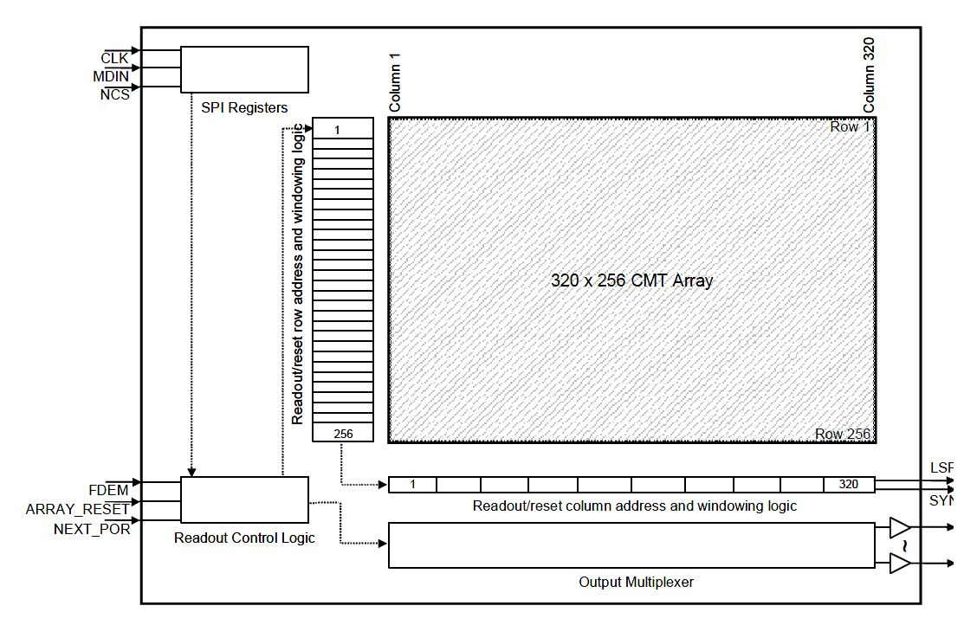
SAPHIRA window topology
reset region lager than window region because of edge effects
Programmable windows and reset regions with download of bit stream
Wavefront sensor:
96 x72 pixels needed
Fowler-16 possible
for DIT=904 μs
fringe tracker:
48 spectra to be read
with 24 x 32x1 pixel windows
Fowler-128 possible for DIT of 1.4 ms
readout noise reduced by Fowler sampling
window
reset

Slide 15
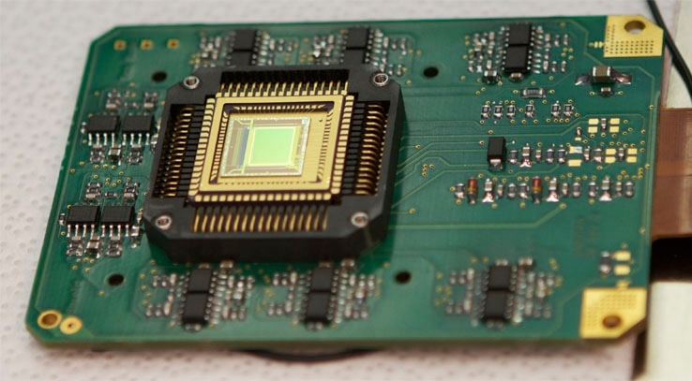
symmetric cryogenic preamplifiers
additional cooling plane
for preamplifiers
320 x256 SAPHIRA SELEX eAPD in LCC package
cryogenic symmetric preamplifier:
well proven design with Aladdin, VIRGO and H2RG arrays
OPAMP TLC2274 too slow (2.2 MHz)
replaced by OPA 354:
gain bandwidth 250MHz
noise: 6.5nV/√Hz
Preamp gain 3
cryogenic opamps for 32 channels: OPA354

Slide 16
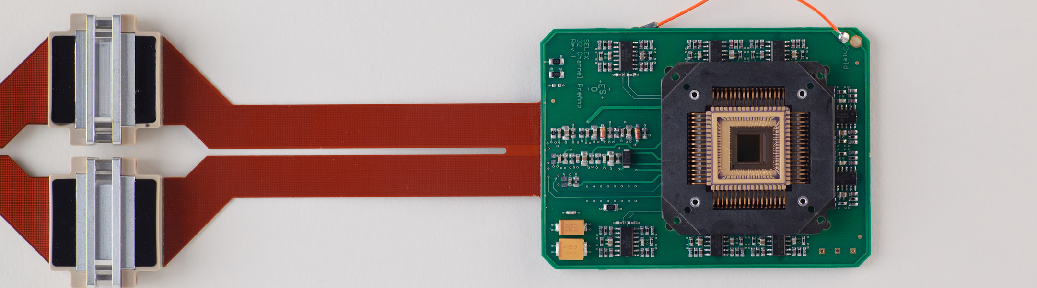
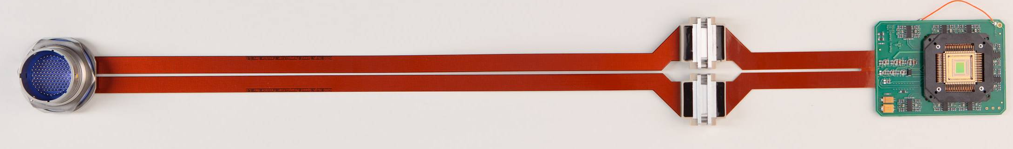
SAPHIRA readout electronics
32 channel 5 MHz cryogenic preamplifier board is compatible with PICNIC board
68-pin LCC package compatible with PICNIC socket
50 cm flexboard is compatible with Hawaii-2RG flexboard and 128 pin hermetic connector
150 cm external cable to NGC DFE
temperature diode
50 cm flex board + 150 cm external cable

Slide 17
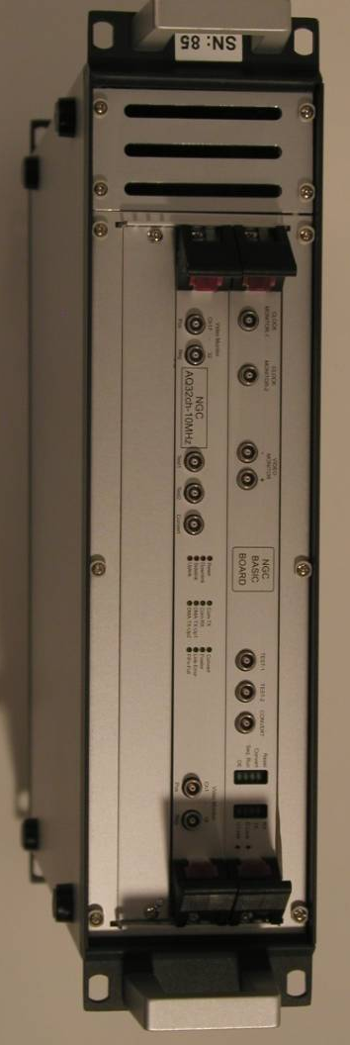
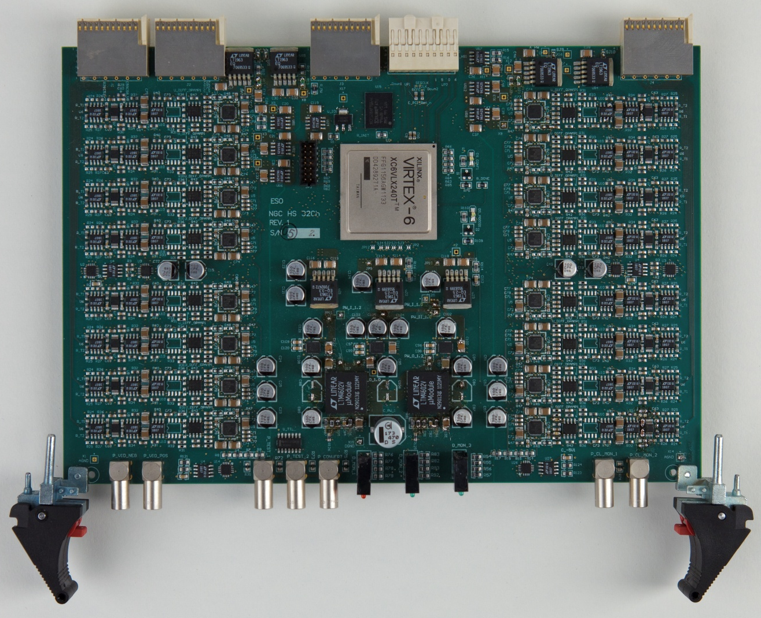
SAPHIRA readout electronics
standard 2-slot NGC system: front-end basic board (sequencer, clock &bias )
new 32-channel 10 MHz ADC board & preprocessor in FPGA
ADC

Slide 18
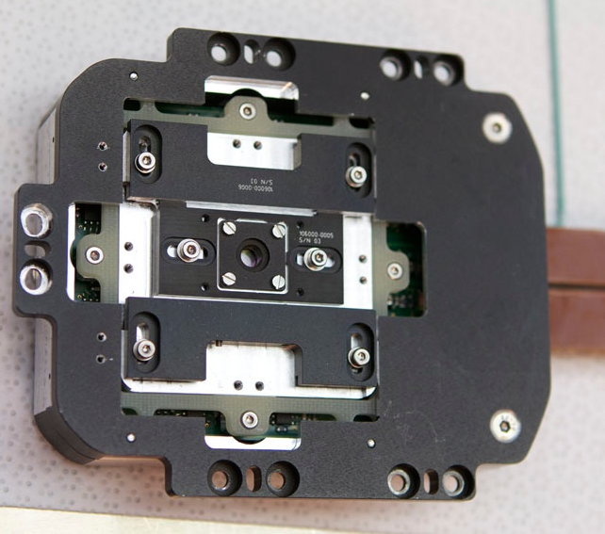
SAPHIRA detector mount for GRAVITY WFS
science grade LPE array mounted in GRAVITY WFS
lenslet array
is moveable to select
window of 72x72 pixels
on best part
of 320x256 pixel array

Slide 19
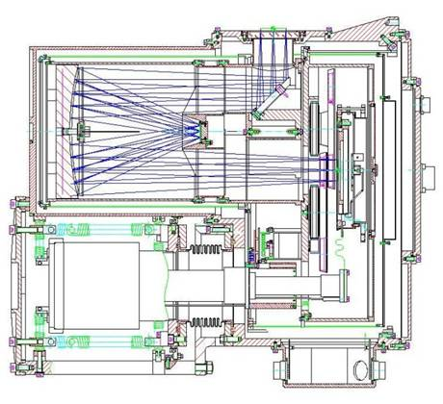
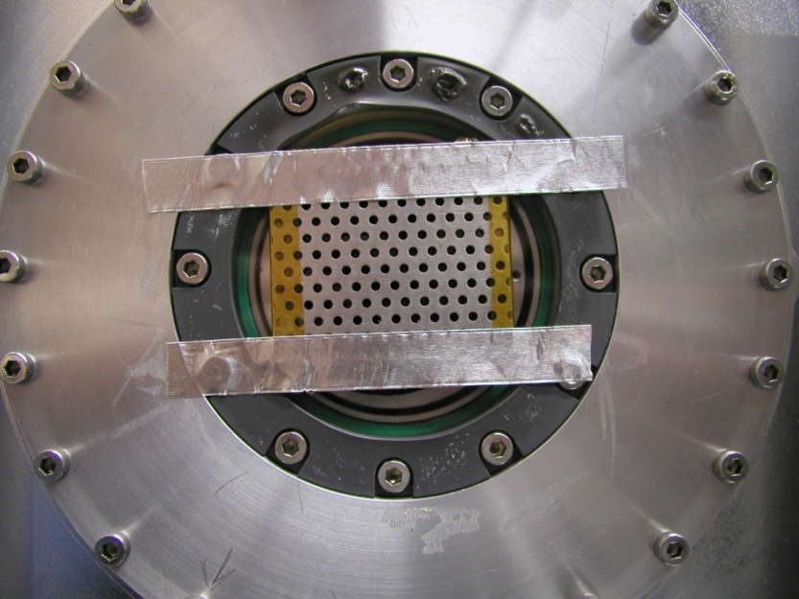
IRATEC test camera
Offner relay f/11
clod filter wheel with
bandpass filters: J,H,K
test pattern with grid of holes
in image plane illuminated
by extended blackbody
detector
filter wheel
CCC
Offner relay

Slide 20
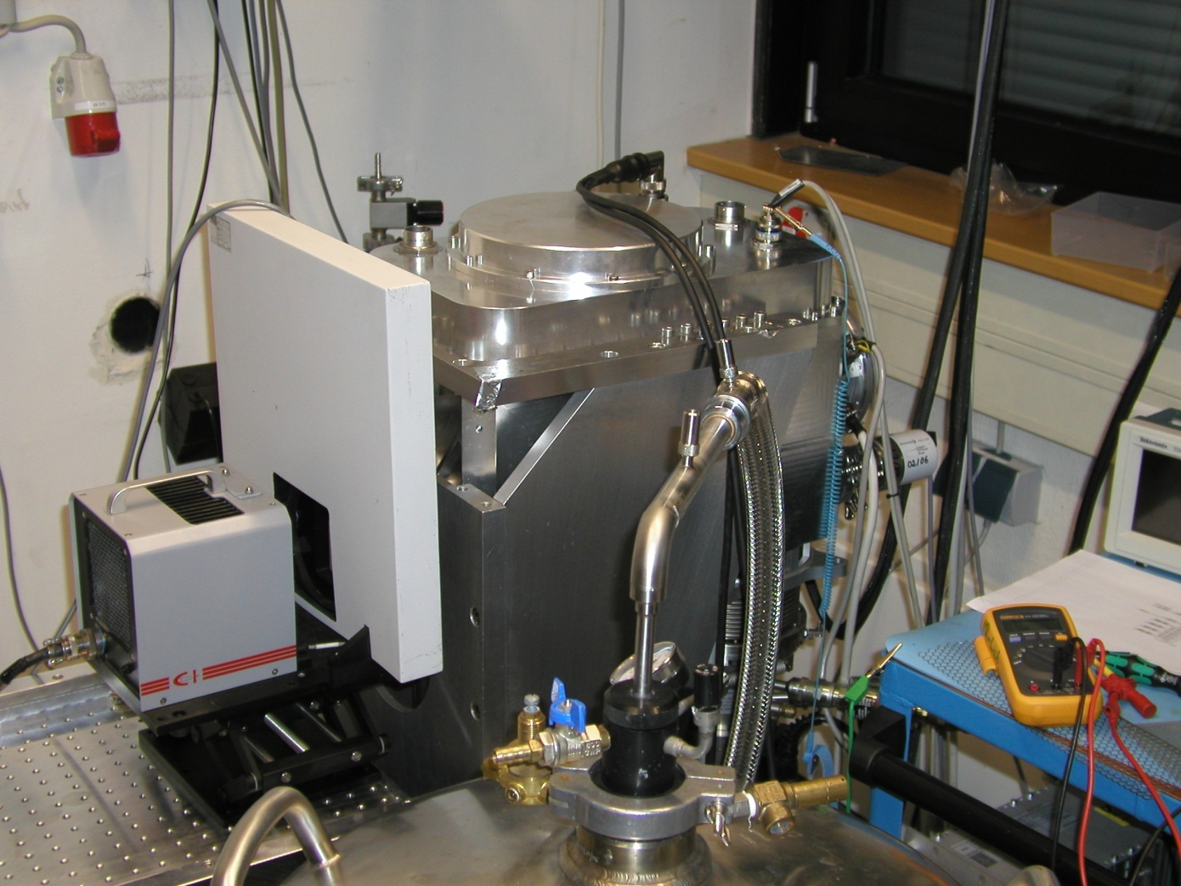
NIR HgCdTe eAPD: calibrated test pattern
Offner relay f/11
clod filter wheel with
bandpass filters: J,H,K
test pattern with grid of holes
in image plane illuminated
by extended blackbody

Slide 21
typical output from ESO Test rig
signal
noise
cuts: 0 / 513 electrons
cuts: 0 / 42 erms
noise is limited by photon shot noise
H-band, DIT 1.3 ms, APD gain 28

Slide 22
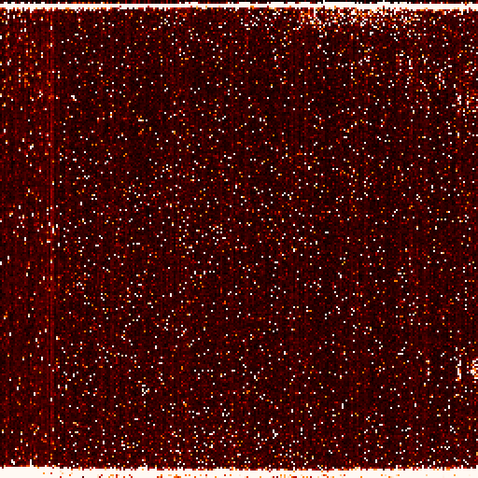
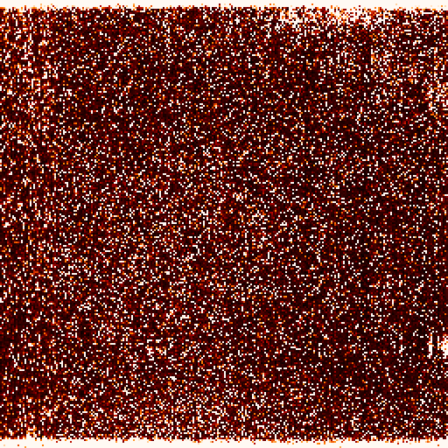
LPE cosmetics for APDgain = 16.6
T=40K
T=80K

Slide 23
bad pixel dark current process: tunneling
at low temperatures tunneling is dominant dark current process
transmission coefficient for tunneling
T=16E/V(1-E/V)exp(-2βa)
β= SQRT(2m(V-E))/ ℏ
V-E: height of potential barrier a: width of potential barrier
tunnel current decreases exponentially
with height and width of potential barrier

Slide 24
band to band tunneling
direct tunneling from valence to conduction band has low probability due to the width of the potential barrier
transmission coefficient for tunneling
T ∝ exp(-2βa)

Slide 25
Trap Assisted Tunneling: TAT
traps at mid band assist tunneling
width of potential berrier reduced by factor of 2
transmission coefficient for tunneling to trap
T ∝ exp(-βa)

Slide 26
Trap Assisted Tunneling: TAT
traps at mid band assist tunneling
width of potential berrier reduced by factor of 2
transmission coefficient for tunneling to trap
T ∝ exp(-βa)
β ∝ SQRT (V-E)

Slide 27
Reduce Trap Assisted Tunneling
with larger diodes the depletion widths increases (lower doping)
width of potential barrier increases
a’>a
transmission coefficient for tunneling from trap decreases:
T ∝ exp(-βa’)
better cosmetics

Slide 28
Reduce Trap Assisted Tunneling
with larger diodes the depletion widths increases (lower doping)
width of potential barrier increases
a’>a
transmission coefficient for tunneling from trap decreases:
T ∝ exp(-βa’)
suppress trap assisted tunneling
▬► better cosmetics

Slide 29
cosmetics of small LPE diodes for APDgain = 28
T=40K
T=80K

Slide 30
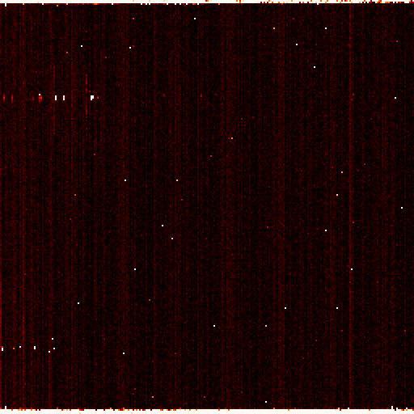
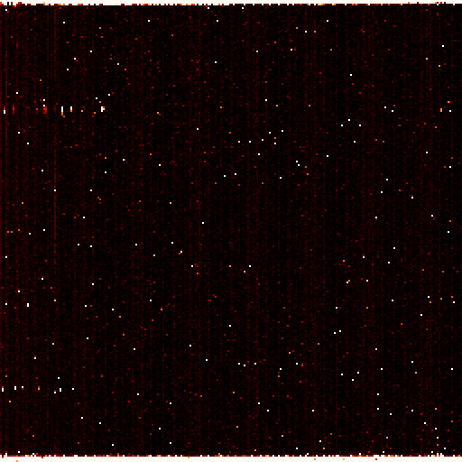
cosmetics of large LPE diodes for APDgain = 28
T=40K
T=80K
reduce width and height of potential barrier for tunneling

Slide 31
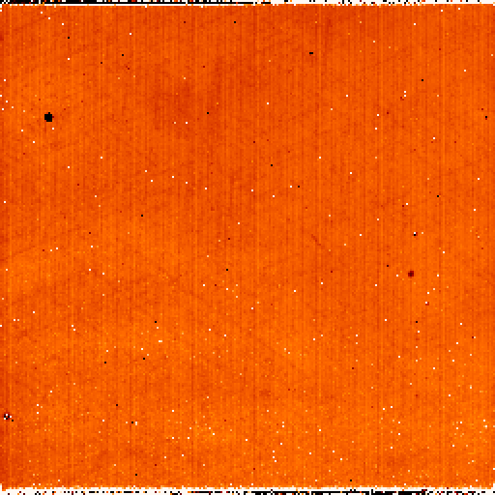
LPE uniformity
APD gain 18.2
uniformity almost perfect
Tdet=41.5K

Slide 32
temperature dependence of QE
QE increases at low temperatures
QE in K = 82 % at T=41.5K
QE in H = 62 % at T=41.5K

Slide 33
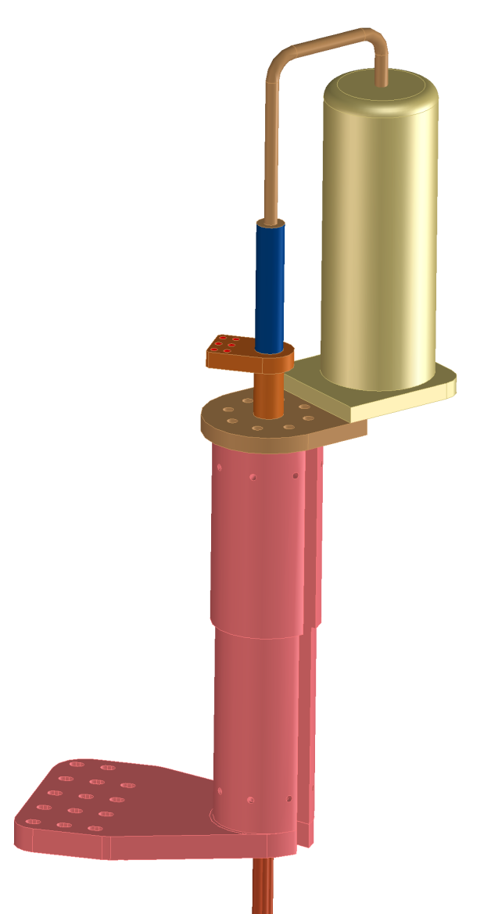
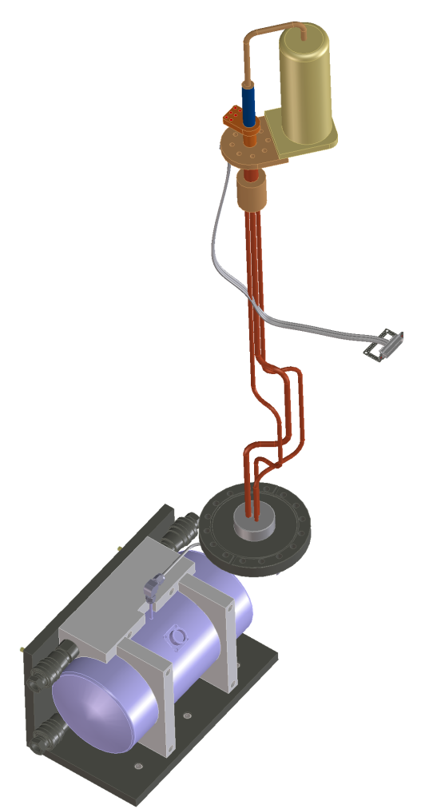
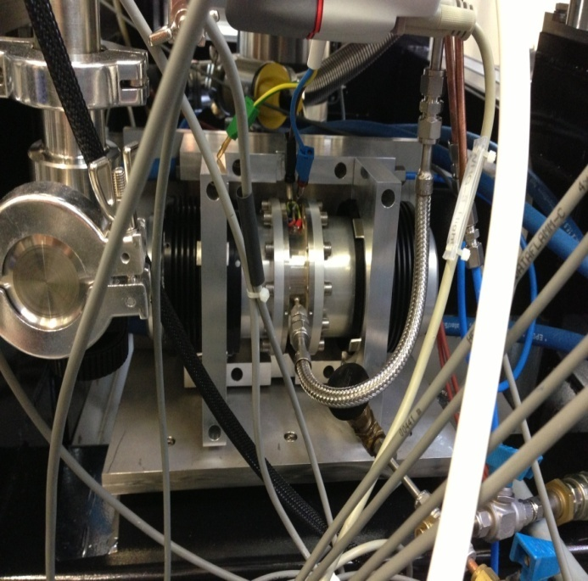
Pulse Tube Closed Cycle Cooler
designed for bath cryostats to cool only detector to 40K
warm end at T=80K
cooling power 2.8W at T=41.8K
low vibrations: compressor pistons in opposition
power 150W
T=41.8K
vacuum gauge for size comparison
water cooling
high pressure He line
bath cryostat T=80K
compressor

Slide 34
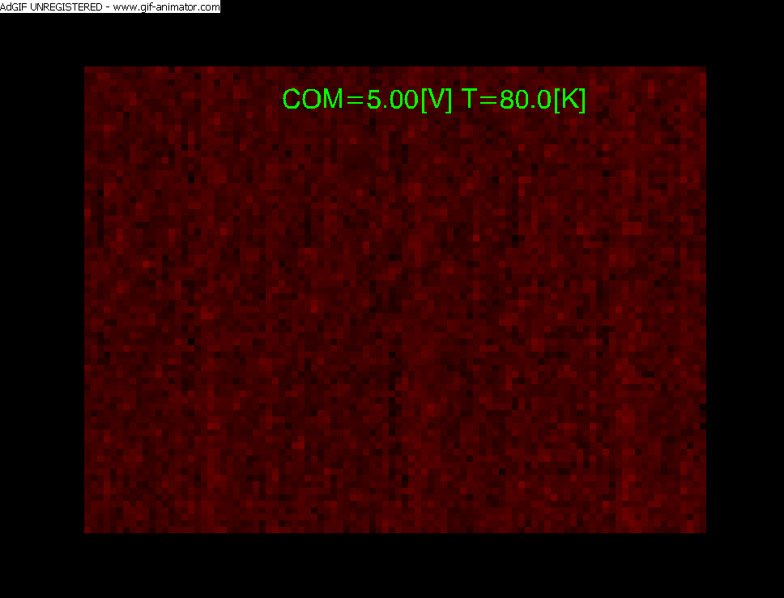
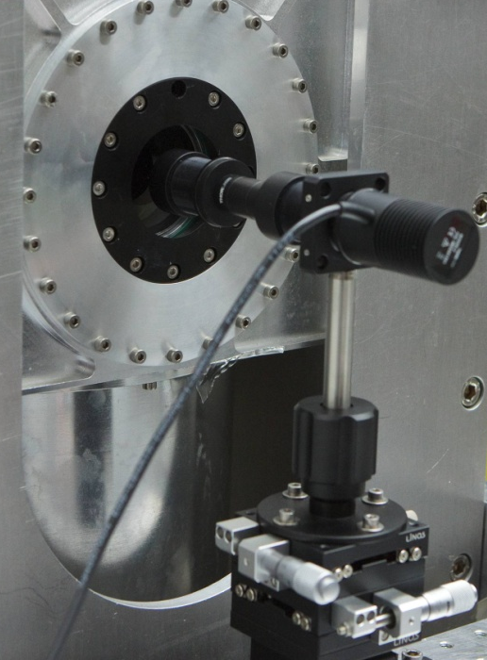
sensitivity of LPE with Fowler sampling
SAPHIRA prototype
spot projector with lenslet array
diode illuminating pinhole
pinhole imaged into image plane of
Offner relay by lenslet array
window of 96x72 pixels
Integration time 1.13 ms , T=80K
16 Fowler pairs &1 subpixel sample

Slide 35
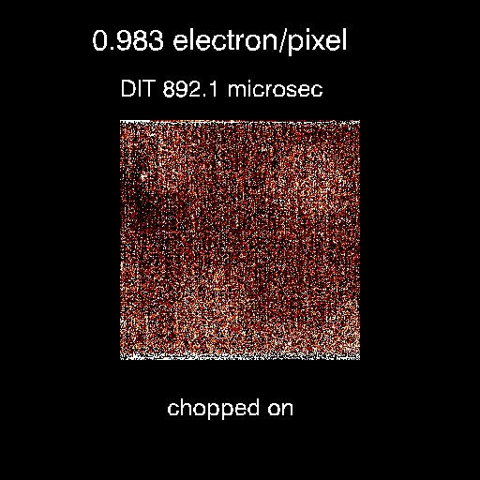
LPE subelectron sensitivity !
filter H-band
chop frequency 20 Hz
blackbody temperature : on 80C
off 20C
optics: Offner relay f/11
signal fluence
0.983 electrons /pixel/DIT
for integration time of 892 μsec
readout mode:
double correlated sampling
bias voltage 12.15V

Slide 36
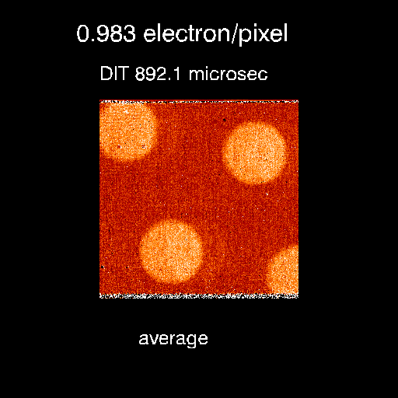
LPE subelectron sensitivity
filter H-band
chop frequency 20 Hz
blackbody temperature : on 80C
off 20C
optics: Offner relay f/11
fluence
0.983 electrons /pixel/DIT
for integration time of 892 μsec
readout mode:
double correlated sampling
bias voltage 12.15V
gain 42, APD gain 16

Slide 37
transition from LPE to MOVPE
LPE/via-hole technology
substrate CdZnTe
excellent breakdown quality
panchromatic
moderate avalanche QE
MOVPE/mesa technology
Substrate GaAs
moderate breakdown quality
spectral response limited to 1.4-2.5 μm
solid state engineering possible

Slide 38
band diagram of MOVPE mesa structure
homojunction
same bandgap for absorber and
gain region
photons absorbed in p-type
drift region and amplified in
n-type gain region
danger area at junction:
crystallographic defects cause
excessive dark current
at high field due to TAT
homojunction MOVPE array was used to develop bonding techniques for SAPHIRA ROIC
cosmetic quality limited already at moderate APD gain
higher dislocation density

Slide 39
change of growth technology from LPE to MOVPE
heterojunction
widen bandgap at junction
photons absorbed and
amplified in n-type region
electrons experience only
partial APD gain
compensated by higher
bias voltage
better breakdown voltage
yields higher APD gain
higher operating temperature
better cosmetics

Slide 40
persistence of heterojunction MOVPE
K-band
chop frequency 10 Hz
data cube with series of
DIT=1 ms exposure times
response at T=53 K too slow
rise time 50ms
response faster when operating temperature increased from
T=53 K to T=85K

Slide 41
K-band flatfield cosmetics of MOVPE
APD gain 28.2
T_{detector} = 85K
T_{blackbody} = 100C – 20C
DIT=1ms
only 18 bad pixels at maximum APD gain at operating temperature of T=85K
fraction of good pixels: 0.99978
CCD type quality

Slide 42
K-band flatfield cosmetics of LPE
APD gain 16.6
T_{detector} = 45K
T_{blackbody} = 100C – 20C
DIT=1ms
best LPE array
(GRAVITY fringe tracker)

Slide 43
photon transfer curve of MOVPE heterojunction
38.1 μV/ADU at output
transfer gain of SAPHIRA
V_{node}/V_{output} = 0.62
gain = 11.22 e / ADU
5.44 μV / electron
C_{node} = 29.4 fF at
bias of 2.61V
gain change below 2V due to change of capacitance
gain change above 3V due to APD gain

Slide 44
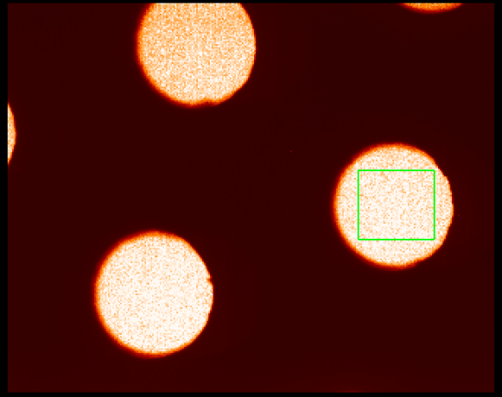
QE H-band
array common 2V
QE 0.3
area taken in right hole

Slide 45
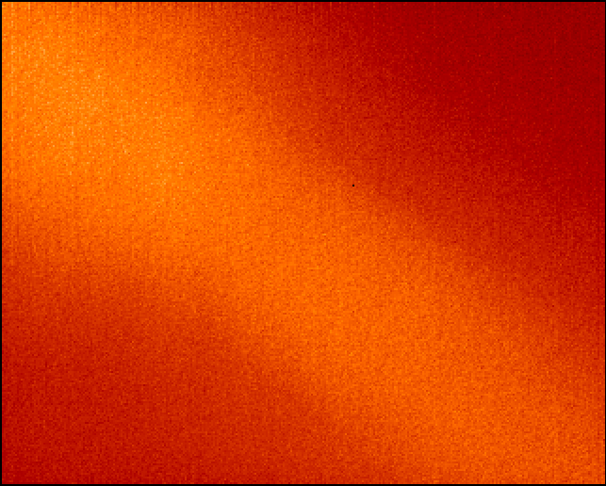
flatfield of heterojunction MOVPE
QE = 0.65
QE = 0.49
APD gain 53.7
K-band
array common 2V
operating temperature T=85K
variation of QE across array due to variation of As doping
incomplete ionisation of As dopants
As acts as trap for electrons
electron has more time to recombine
new wafer run with reduced As doping (1/3) to bring QE up to 80%
minimum
maximum

Slide 46
APD gain MOVPE heterostructure / LPE
LPE gain measured on GRAVITY FT science array
APD gain of MOVPE heterostructure is a factor of 2 larger
Increased gain of MOVPE heterostructure because of
narrow bandgap gain region (λ_{c}=3.5 μm )

Slide 47
Excess Noise
excess noise factor f
(S/N)_{out}=f (S/N)_{in}
noise figure F=f ²
excess noise determined form
ratio of photometric gain and
conversion gain obtained from
photon transfer curve
almost noiseless amplification
excess noise close to unity
for APD gain up to 28 for LPE
excess noise slightly higher for MOVPE due to microscopic variation of stoichiometry x of
Hg_{1-x}Cd_{x}Te

Slide 48
dark current of MOVPE heterostructure
operating temperature T=85K
dark current depends exponentially on bias voltage
dark current amplified by APD gain at integrating node

Slide 49
dark current of MOVPE heterostructure
dark current depends exponentially on bias voltage
dark current amplified by APD gain at integrating node
dark current back referred to absorber region before APD gain (divide by APD gain)
dark current may be dominated by instrumental photon background of camera (λ_{c}=3.5 μm in gain region)
repeat measurement with blind detector
dark current negligible for integration times up to 30ms
at T = 85K

Slide 50
readout noise double correlated sampling
APD gain 53.7
full frame 320x256 pixel
single DCS
integration time 1.26 ms
readout noise 0.8 erms

Slide 51
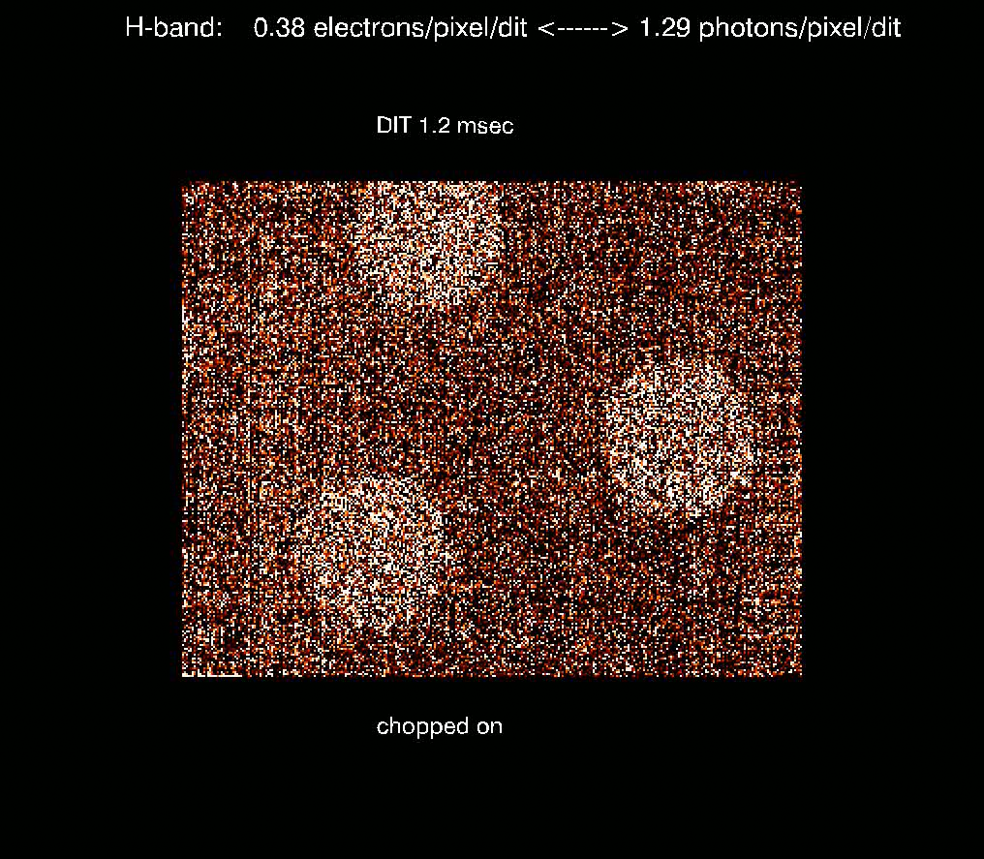
subelectron sensitivity
filter H-band
single double correlated clamp
chop frequency 10 Hz
blackbody temperature : on 70C
off 20C
optics: Offner relay f/11
fluence
1.29 photons / pixel / integration time
0.38 electrons / pixel / integration time
for integration time of 1.17 msec
readout mode:
double correlated sampling
bias voltage 12.15V

Slide 52
subelectron sensitivity
filter H-band
single double correlated clamp
chop frequency 10 Hz
blackbody temperature : on 70C
off 20C
optics: Offner relay f/11
fluence
1.29 photons / pixel / integration time
0.38 electrons / pixel / integration time
for integration time of 1.17 msec
readout mode:
double correlated sampling
bias voltage 12.15V

Slide 53

sensitivity LPE / MOVPE heterostructure
LPE
MOVPE heterostructure
factor of 3 less electrons
filter H-band
single double correlated clamp
chop frequency
10 Hz
bias voltage 12.16V
Offner relay f/11
TBB : 80 C / 20C
fluence: 1.96 photons
1.12 electrons
TBB : 70 C / 20C
fluence: 1.29 photons
0.38 electrons

Slide 54

readout noise with Fowler sampling
APD gain 53.7
window size 96x72 pixel
as needed for GRAVITY WFS
integration time 988 μs
16 Fowler pairs
preprocessing in FPGA of NGC ADC board
readout noise 0.26 erms
demonstrates strength and flexibility of SAPHIRA ROIC
animation corresponds to signal of 1 e⁻/ms/pixel
DIT 1ms
96x72 pixel
GRAVITY WFS
1 e/ms/pixel

Slide 55
Conclusions
with eAPDs NIR subelectron sensitivity is a reality at framerates of 1KHz
flux of 1 photon/exposure/pixel easily detected for DIT of 1ms
RON: 0.8 erms for DCS of full frame
0.26 erms with 16 Fowler pairs for 96x72 pixel window
LPE has high QE in K-band (82%) at T = 45 K
cosmetics and APD gain of MOVPE heterostructures far superior at T=85K
than LPE material at T=45K ▬► no pulse tube, no vibration
current QE of MOVPE limited by partial ionisation of Arsenic in depletion region
new wafer run will fix QE by lowering Arsenic doping
outlook:
panchromatic response can be developed by reducing bandgap of HgCdTe top layer and by removing CdTe buffer layer
with reduced dark current (<1E-2 e/s/pixel) SAM-APDs (separate absorption and multiplication) will become noise free science arrays

Slide 56
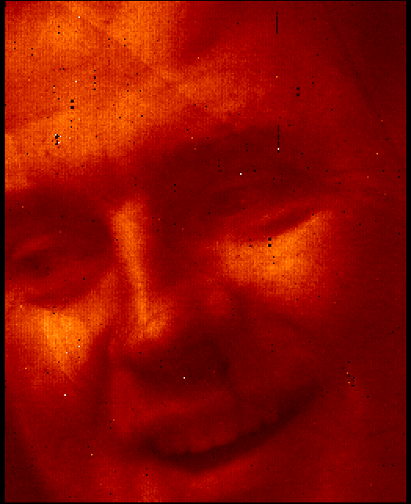
test pattern at 36 C
THE END
eAPD LPE prorotype (SWALLOW)
λ_{c}=2.65 μm HgCdTe eAPD
bias voltage=7.1V
APD gain=7.34
T=60K
DIT=7.6 ms, BW=5MHz

Slide 57
linearity at high bias with APD gain of 28
plot of detector signal voltage versus fluence
detector linearity at high bias
APD gain of 28
non-linearity increases at high APD gain
APD gain changes during integration
28.00

Slide 58
histogram of uniformity / bad pixels
APD gain 53.7
Definition of bad pixels: deviating +/-33% from mean
18 bad pixels
fraction of good pixels: 0.99978
8 hot pixels
10 dead pixels

Slide 59
Noise Model
N: number of integrated photons, G: APD gain, F=noise figure , C: node capacitance T: mux transfer gain, Q: quantum efficiency, e: electron charge, Neph: Noise equivalent photons, V_{RON} noise voltage, RON readout noise in electrons
V_{signal} = NGTe/C var(N_{eph}GTe/C)=var(V _{total} )
var(V _{total} )= var(V _{photon shot noise} _{after APD gain} )+ var(V_{RON} _{after APD gain})
var(N _{after APD gain}) = var(N _{before APD gain}) G²F = NG²F (Poisson statistics)
N_{eph} reduction by reducing RON from
1 erms to 0 erms is only a factor of 0.7
F=1.3
Q=.8
N_{eph min}=1.6 phot rms for RON=0

