Slide 1
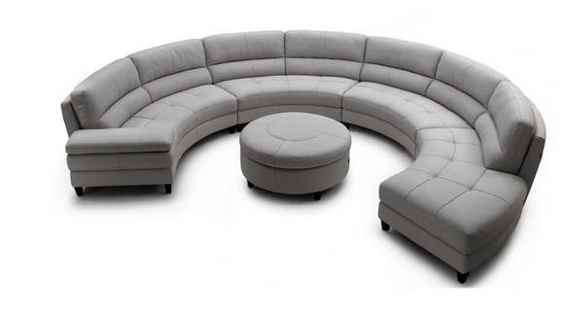
Curved Detectors Roundtable
Olaf Iwert, ESO
© Image courtesy of Bloombety, Pavoncello Rotunda
Interior Decoration and Home Design Blog
Notes:
OK 2

Slide 2
Curved Roundtable Challenge
Do NOT think ‘Detectors’,
but
think Optics and Detector !
Optical SYSTEM Performance
Notes:
OK 2
Fundamentally: System Simplification gives better optical performance

Slide 3

Curved Detectors Roundtable
How we normally think:
© www.appdynamics.com
Notes:
OK 2

Slide 4
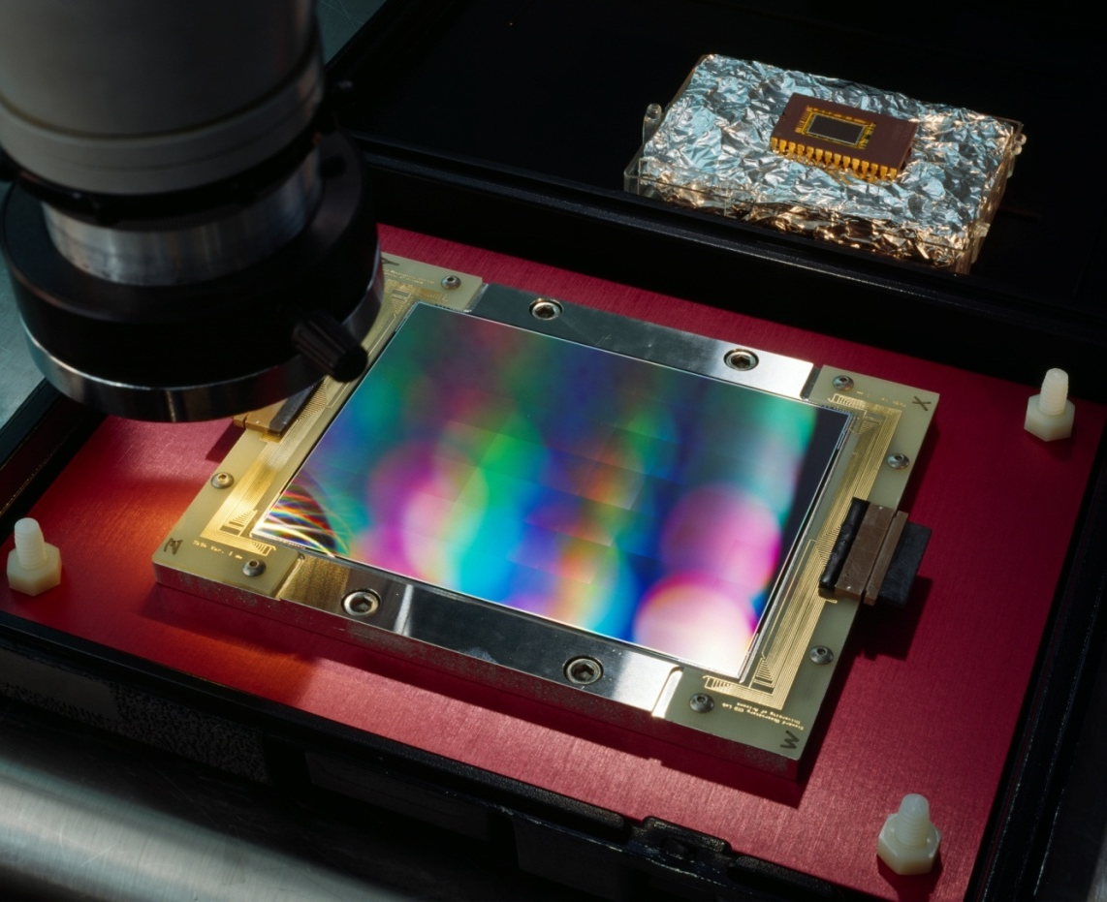
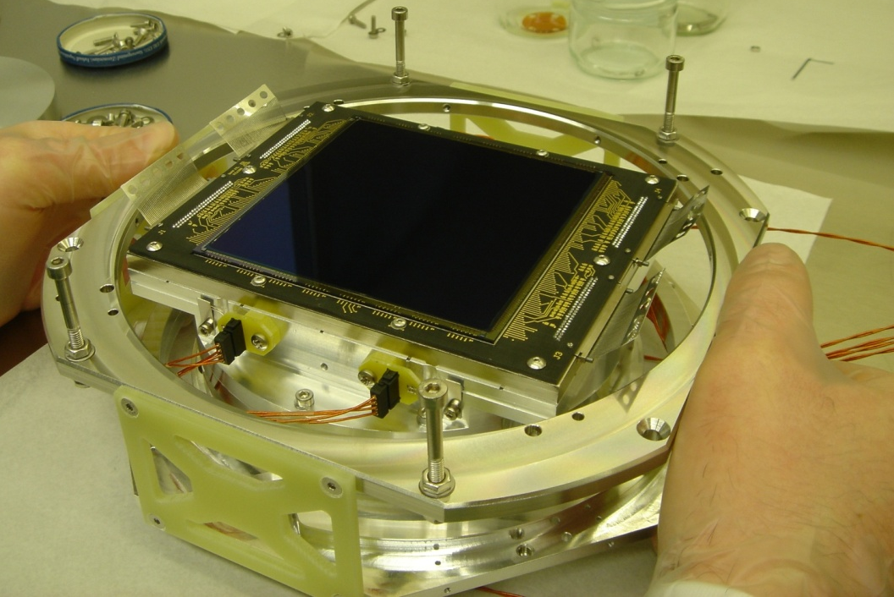
Flat Scientific CCD Detectors
So far fighting very hard for the
State-of-the-Art of flat detectors –
what a long way it took for them to
“grow up” and get mature.
Thinned silicon &
Backside illuminated
Cryogenic operation
Notes:
OK 2

Slide 5
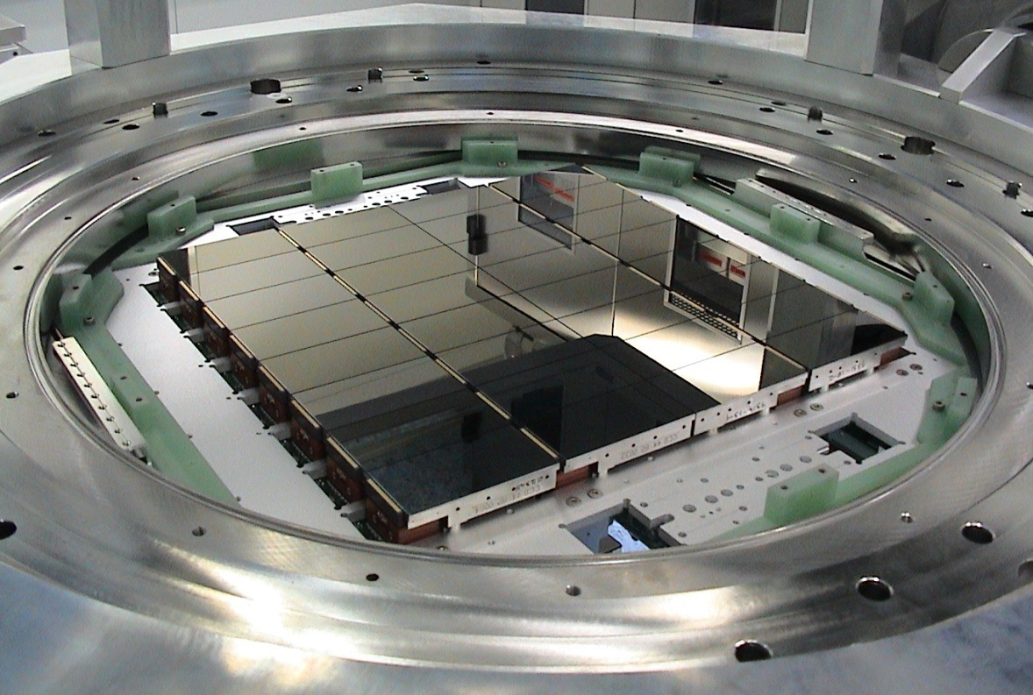
Detector Mosaic for wide field of view
ESO
OmegaCAM
CCD mosaic
268 M Pixel,
32 CCDs,
~ 24 x 24 cm²
light sensitive
area
Notes:
OK 2

Slide 6
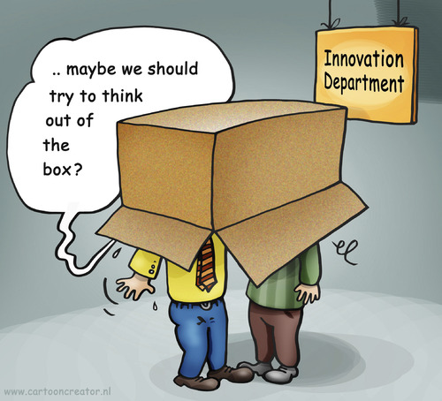
Curved Detectors Roundtable
What we sometimes should do:
Notes:
OK 2

Slide 7
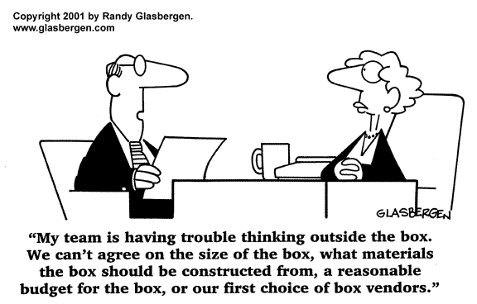
Curved Detectors Roundtable
What then often happens:
Notes:
OK, 2

Slide 8
Curved Detectors Roundtable
This shows:
If you want to think outside the box:
Get mentally rid of your box now !
Purpose of this roundtable session
Notes:
OK 2

Slide 9
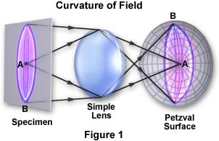
From an optical point of view:
The first detector to think about is a 3 dimensionally curved detector
Petzval Field Curvature
Flat detectors:
require field flattener
more optics & errors
less transmission (faint objects!)
large FOV not correctable
optics complex & expensive
© http://www.microscopyu.com/tutorials/java/aberrations/curvatureoffield/
Notes:
OK 2

Slide 10
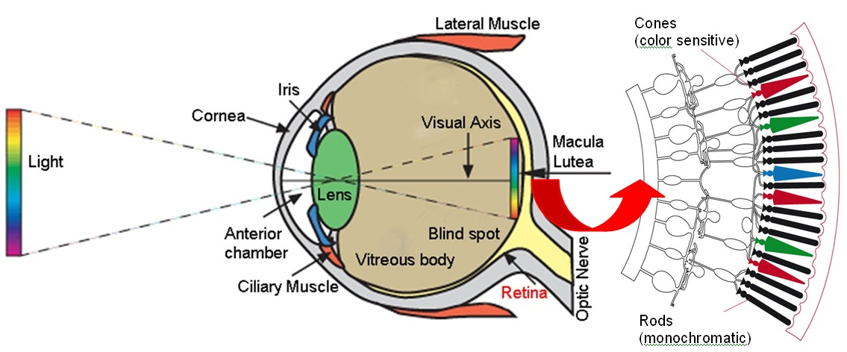
Nature does not use (Spherically) Curved Detectors for fun
Some hundred million years of human evolution can’t be wrong:
Notes:
OK 2

Slide 11
So, why not curve electronic detectors ?
Interaction of Optical designers / Detector nerds
Somewhere we have to start with a new SYSTEM concept to overcome current limits….
[A. Einstein]: ‘ If at first the idea is not absurd, then there will be no hope for it. ‘
Notes:
OK, 2

Slide 12

Notes:
OK 2

Slide 13
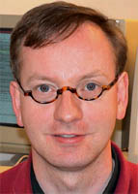
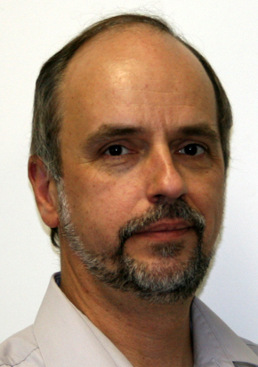
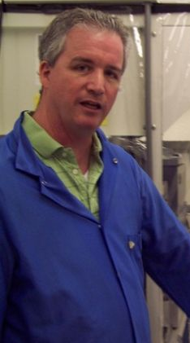
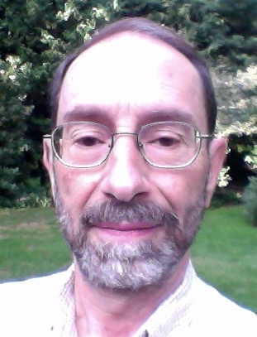
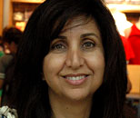
Roundtable Cast of Characters:
Barry Burke
MIT/Lincoln Labs
SST focal plane built with curved detectors
5000 mm Radius
7 Minutes
Olaf Iwert
ESO
Motivation
Optical Examples
Applications
7 Minutes
David Ouellette & Michael Lesser
ITL, U. of Arizona
60x60 mm², thick detector curved,
500 mm Radius
Tested at – 120 C
7 Minutes
Shouleh Nikzad JPL
Curving pioneer, diff. approaches,
Modulating Radius ‘on the fly’
7 Minutes
+ YOU: Remember my Email ccdworld ?
Notes:
OK,2

Slide 14
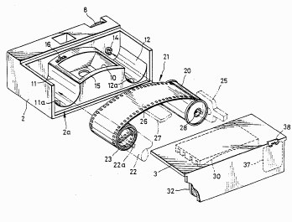
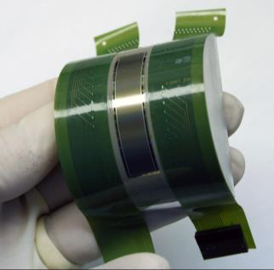
Cylindrical versus 3D curvature
Disposable cameras:
Curved focal plane
Cheap optics
Remarkable image quality
Cylindrical curved CCD
Opticians mostly need 3 dimensional curvature
Mostly spherical & concave, but also convex & evtl. aspherical
© Fuji Photo v. Jazz Photo (Fed. Cir. 2005);
home.online.no ; Michael Lesser
Notes:
OK, 2

Slide 15
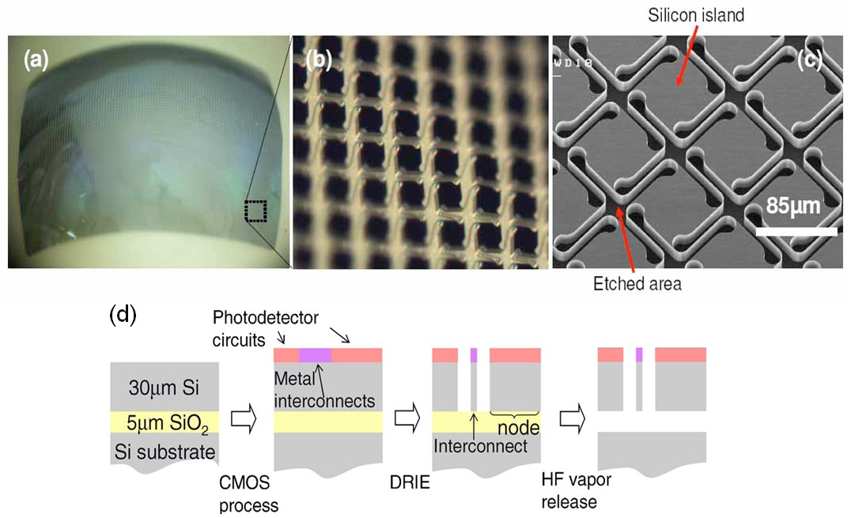
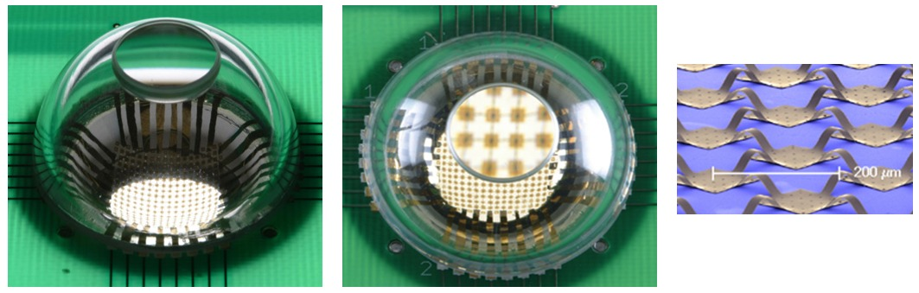
Curving Schemes, not detailed here (1)
Patterned Silicon
< 100 % Fill factor
© Rim Stanford; Rogers, Univ. Illinois
Notes:
OK, 2

Slide 16
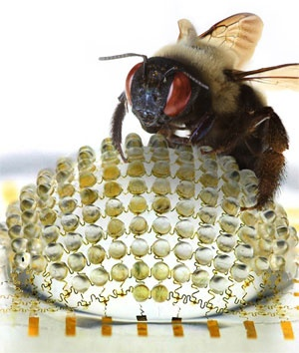
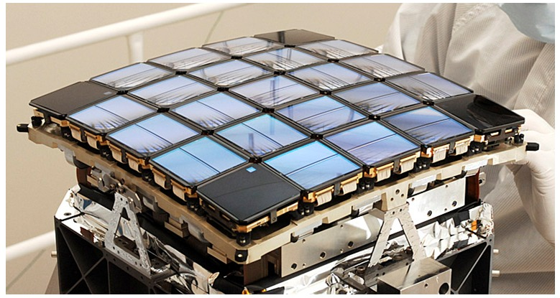
Curving Schemes, not detailed here (2)
© Rogers, Univ. Illinois;
Ball Aerospace
Notes:
OK, 2

Slide 17
Prime Focus on:
Curvature process, where
detector produced conventionally
and afterwards curved (CCD / CMOS / IR)
Only possibility, since semiconductor manufacturing only works with flat wafer processing
© ASML
Notes:
OK, 2
Litho optics (Anton) 8 MEU, 1.4 m high, > 50 % aspheric lenses, depth of focus 40 nm, scale down factor 40, 25mm fileld with 4ppb error, active compensation with measurement devices and integrated heaters

Slide 18
Telescope
Instrument Optics
Examples
Notes:
OK, 2

Slide 19
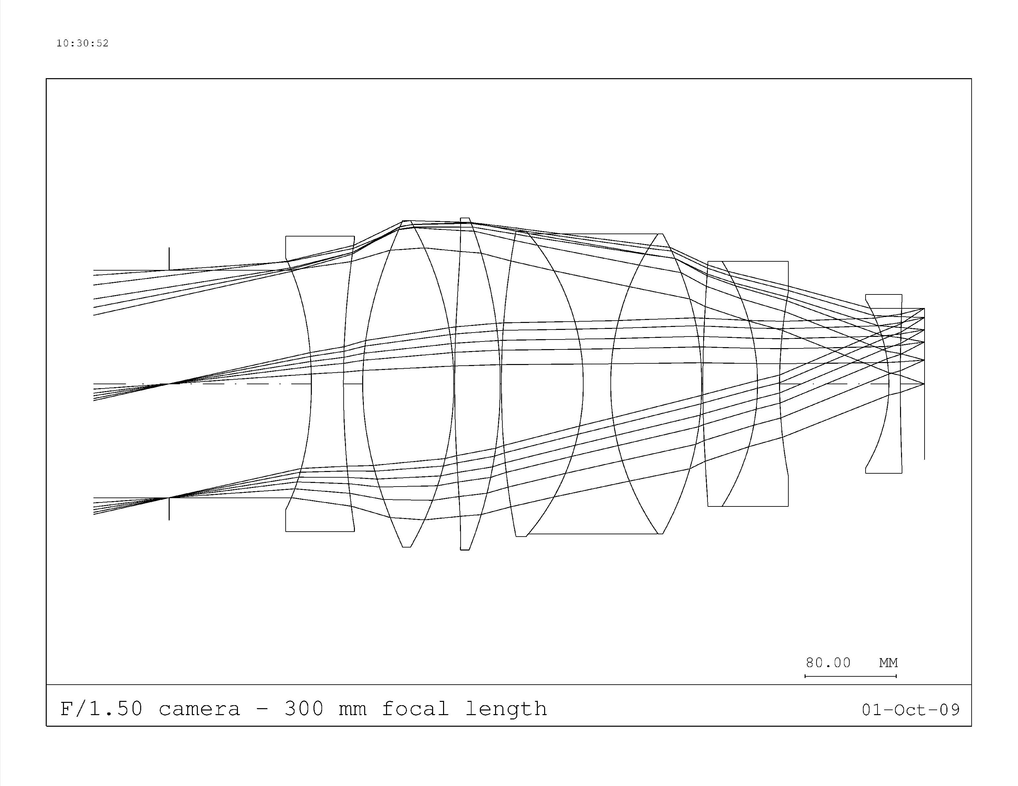
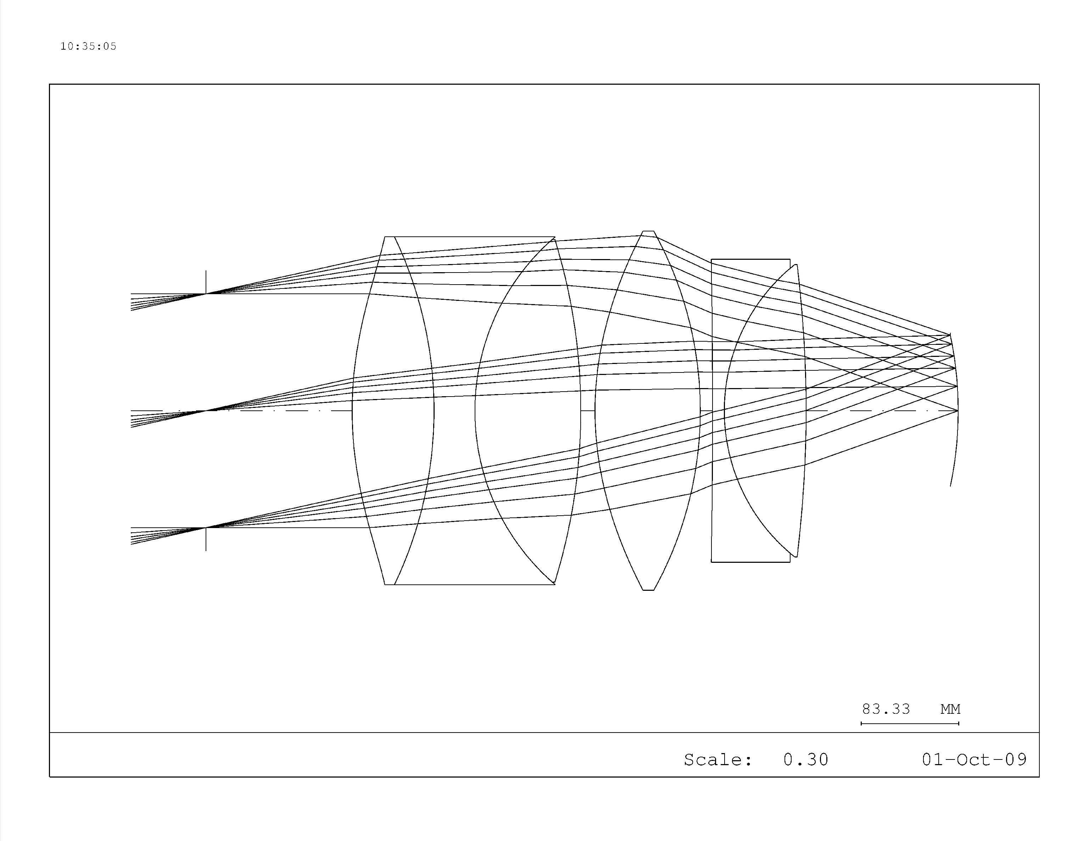
1. Why a Curved Detector (for E-ELT)?
Flat
Detector
Curved Detector
Vignetting
Optical characteristics (both camera optics):
Focal length: 300 mm F/Number: 1.50
Entrance pupil diameter: 200 mm Entrance pupil location:125 mm in front of 1st lens
Angular field of view: 25 º Detector: up to 100 x 100 mm
With a flat detector often NO optical design with an affordable
number of lenses can be found with identical transmission
and identical field of view.
Notes:
OK, 2
CODEX

Slide 20
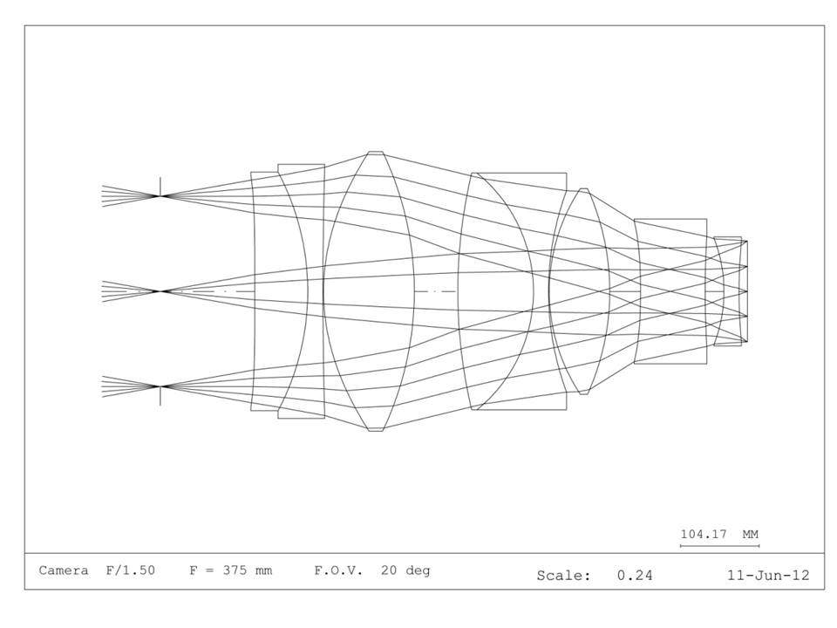
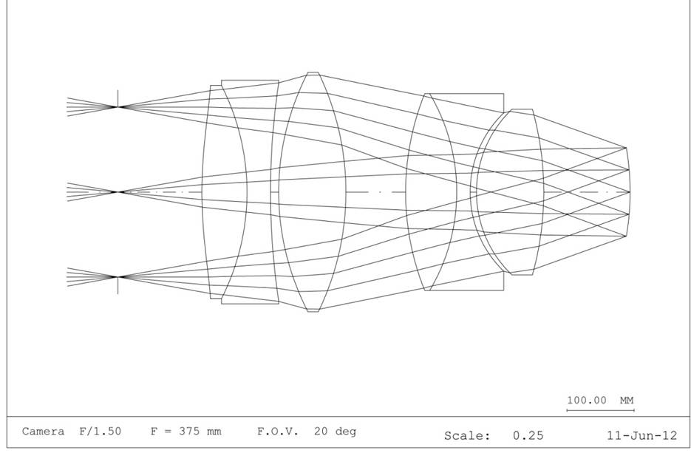
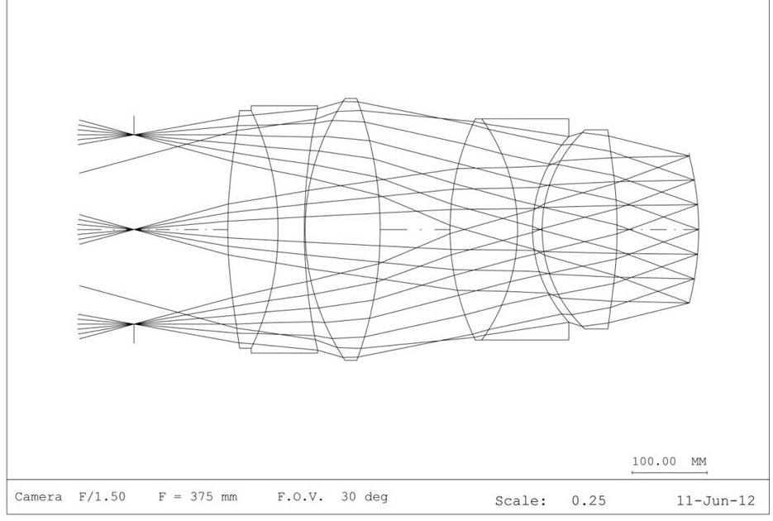
2. Why a Curved Detector (for E-ELT) ?
Avoid: extreme lens radii / cementing /
aspherical elements
Simplify optics and reduce cost
Improve image quality (spot / vignett.)
Enable larger field of view
Increase back focal distance
Flat
Detector
FoV Limit
Curved
Detector
Curved
Detector
F = 375 mm
Pupil: 250 mm located 125 mm
in front of the 1st surface
F/1.50
Wavelength range 480 – 1000 nm
Same concept, Largest FoV
Notes:
OK, 2
OPTIMOS

Slide 21
3. Why a Curved Detector ?
Flat Detector:
Lens mounting difficult
7 elements
3 aspheric surfaces
Some expensive materials
Centering tolerances due to
high incidence on surfaces
Complex interface to CCD
Curved Detector (R 500 mm):
Only 4 elements
Only 2 moderate aspherical
surfaces
Only classical material
Centering tolerances relaxed /
low incidence angle on surfaces
Back focal distance >200 mm to
detector
Flat
Detector
Both Cameras: FOV 100 x 120 mm, F 1.8
Curved Detector
Notes:
Ok, 2
MAYBE CUT THIS ONE OR THE MICROSCOPE ?
Spectrograph optics (4MOST)
Mainly number of elements, (but VLT)
Combination manufacturability and elements, and BFD

Slide 22
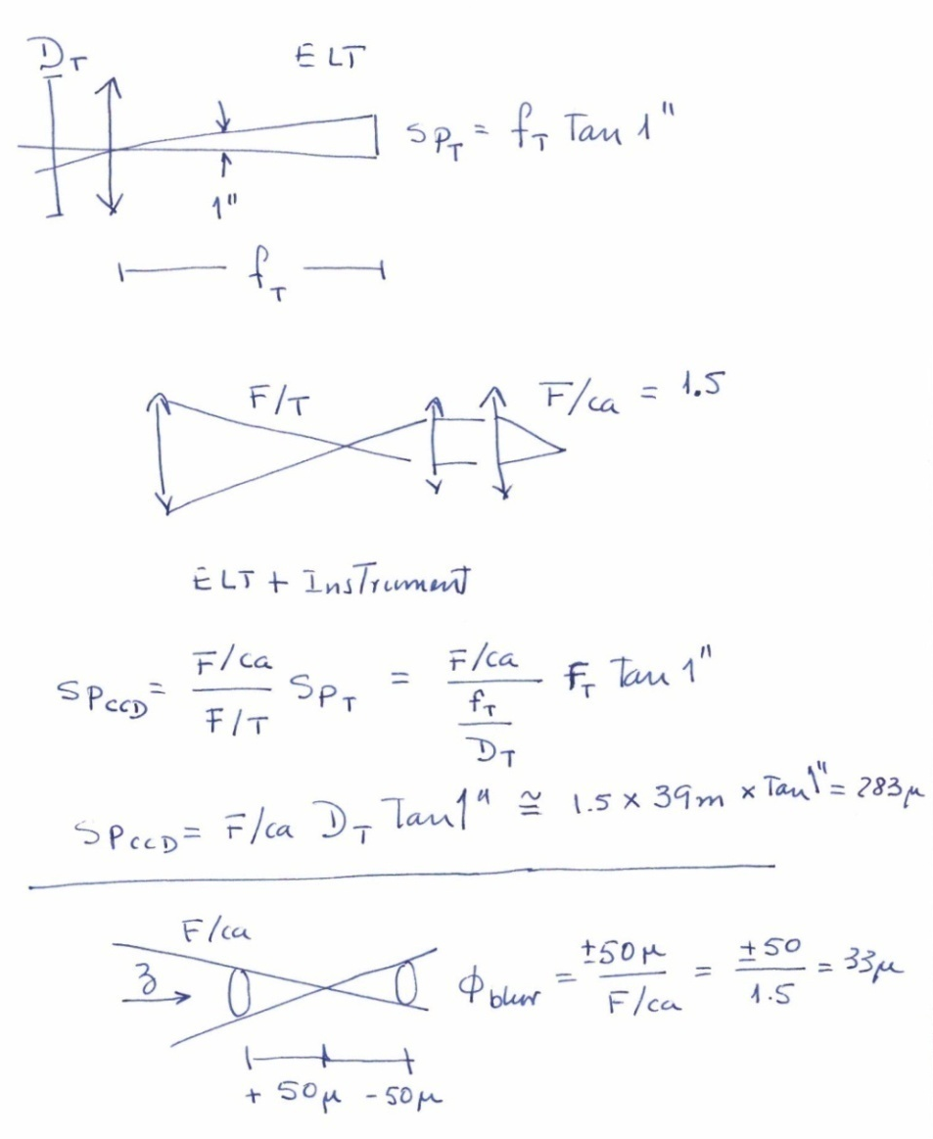
4. Large telescopes & fast optics
need high curvature accuracy ?
NO !
E-ELT: 39 m
Instrument Optics F1.5
Image scale on detector
~ 283 µm for 1 arcsec
∆z +/- 50 µm gives negligible image blur of +/- 33 µm
Even F1 possible
More ‘shape reserve’ than
with current flat detectors!
Notes:
OK, 2
First approximation and conservative, as result for image degradation with 5% is even more !
In principle compare with reduced seeing, but also add the blur and the actual image size normally quadratically !

Slide 23
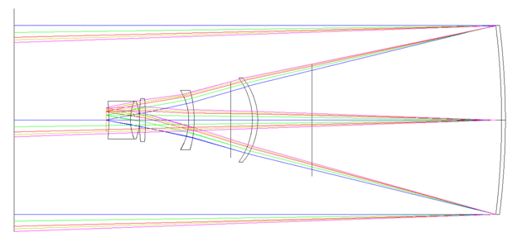
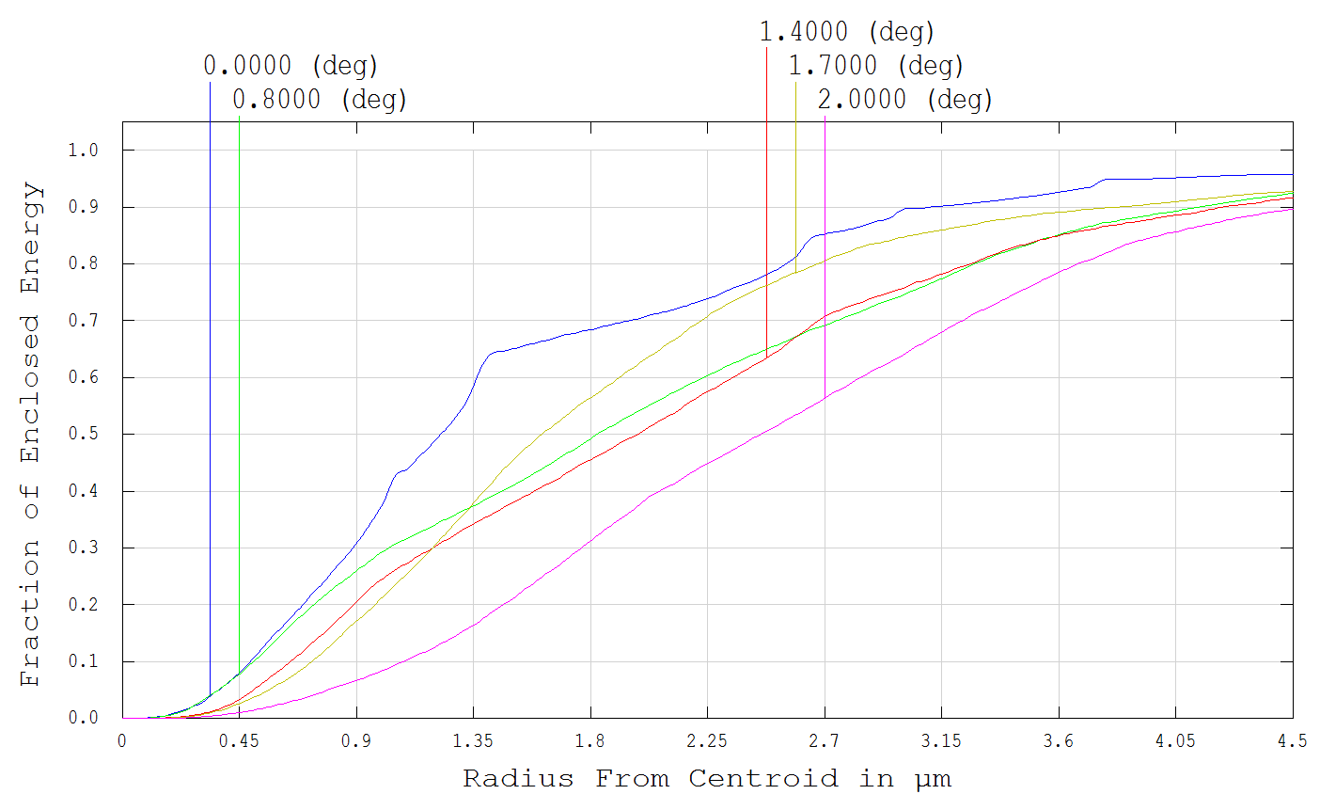
5. Is optical improvement bound to one specific curvature radius ? (1)
FLAT
DETECTOR
NEO/LEO Space Junk Telescope
350 mm aperture Prime Focus Corrector
4 degree field diameter
(similar to SST, but 24 x 36 mm² DSLR detector), 2003 by A. Rakich
Whole field:
80% encircled energy
in ø 7.4 µm
Notes:
OK, 2

Slide 24
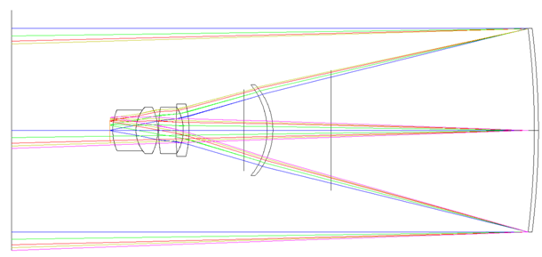
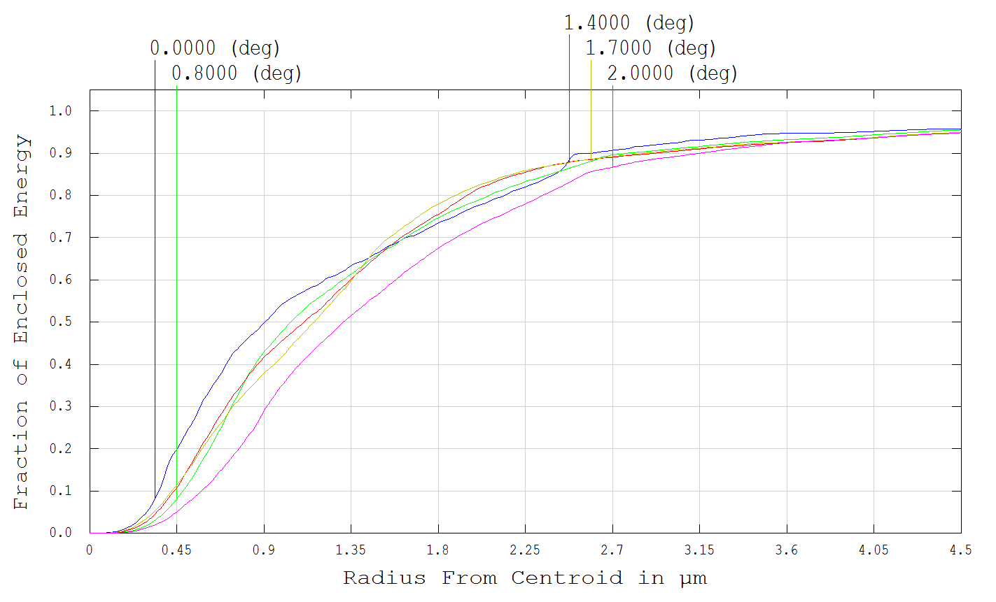
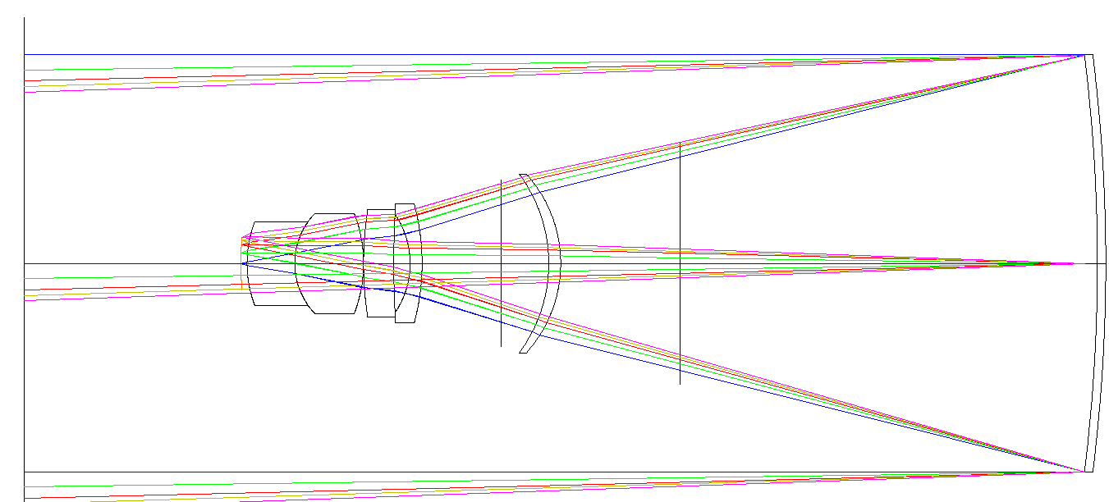
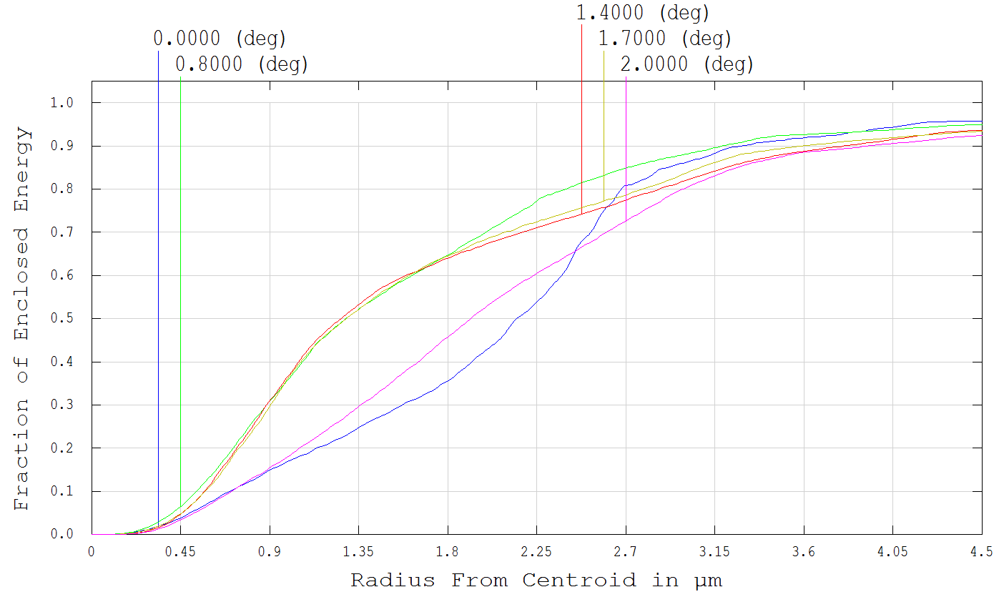
5. Is optical improvement bound to one specific curvature radius ? (2)
4.7 µm Diameter
Improvement factors (vs. flat):
Resolution 1.57
Energy Concentration 2.5
NOW CURVED DETECTOR,
R = 300 mm
6 µm Diameter
Improvement factors (vs. flat):
Resolution 1.25
Energy Concentration 1.56
Less CURVED DETECTOR,
R = 500 mm
Some curvature already helps in many optical designs
- must not be the ultimate one - much better than the flat detector
Notes:
OK, 2

Slide 25
Other Applications:
Microscopes
Military applications
Mass-market products
From high-end items to
low-cost items
Notes:
OK, 2
Principal system problems are to a large extent identical

Slide 26
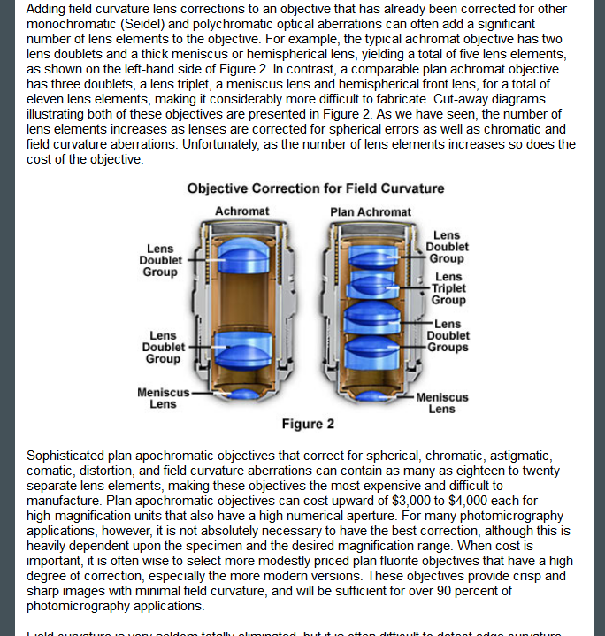
Microscope Optics – similar problem (1)
Field Curvature ~ Magnification
Field curvature is very annoying:
Manual field scanning by
(manual) focusing
© http://www.microscopyu.com/tutorials/java/aberrations/curvatureoffield/
Notes:
OK, 2
Field curvature an even bigger
problem in stereo microscopes

Slide 27
Microscope Optics – similar problem (2)
Optical correction for some field curvature:
© http://www.microscopyu.com/tutorials/java/aberrations/curvatureoffield/
Notes:
OK, 2

Slide 28
Microscope Optics – similar problem (3)
Correction possible since some years,
BUT:
Large FOV at high magnification is not
correctable (fraction of field only)
Reduced working distance <> Illumination
Reduced transmission
Other optical errors
Complexity / Cost
A curved detector could overcome this –
relatively small size, but high curvature
© http://www.microscopyu.com/tutorials/java/aberrations/curvatureoffield/
Notes:
OK, 2

Slide 29
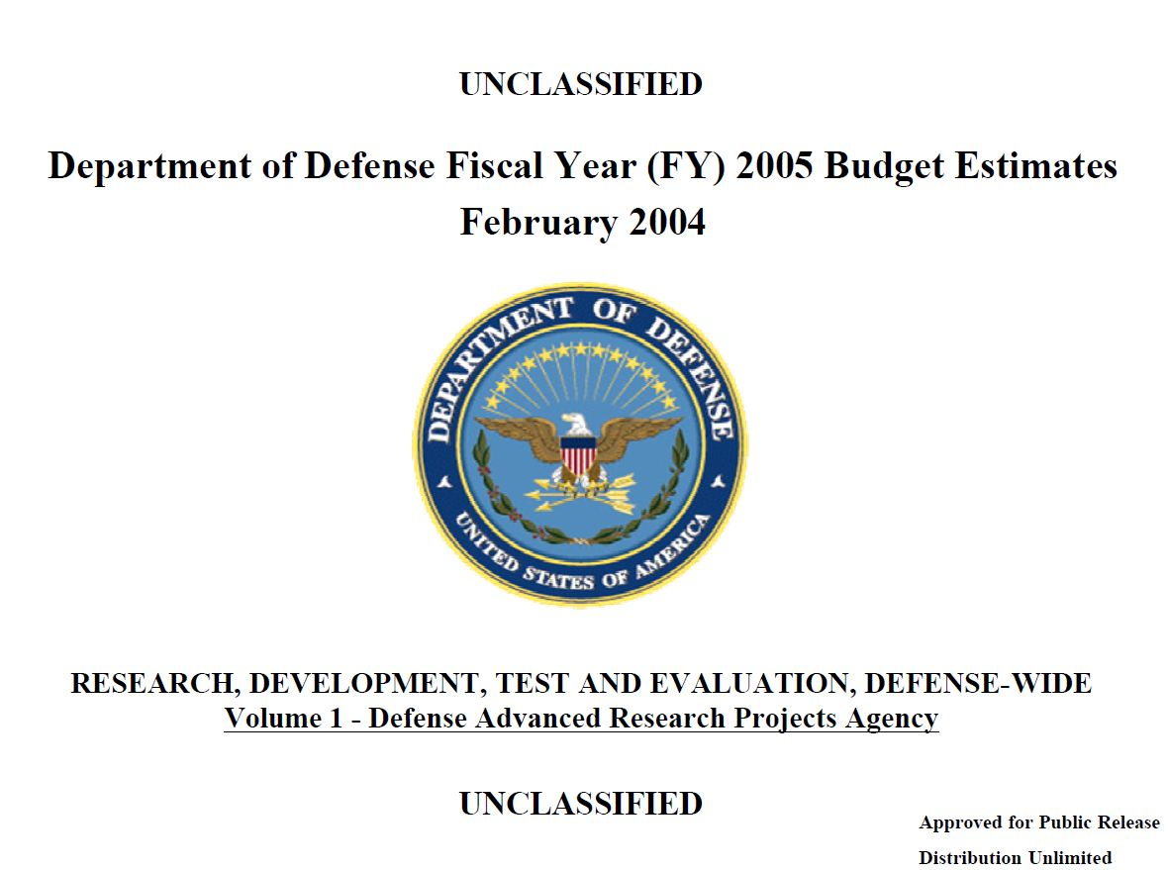

Slide 30
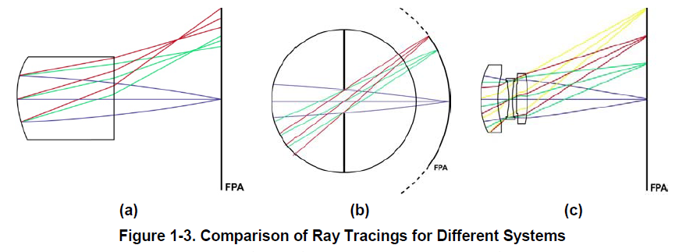
DARPA / IDA / MTO activities (1)
Defense Advanced Research Projects Agency /
Institute for Defense Analysis /
Microsystem Technology Office
HARDI Program, Hemispheric Array Detector for Imaging,
IDA document NS-D-4268, January 2011
MONTAGE Program
Interest in curved detectors, as of:
Off-axis aberrations
Limited FOV
Image post processing unless exotic optics used
Complicated optics / high cost
Notes:
OK, 2
(US Army Research Laboratory quotes our paper about curved detectors )

Slide 31
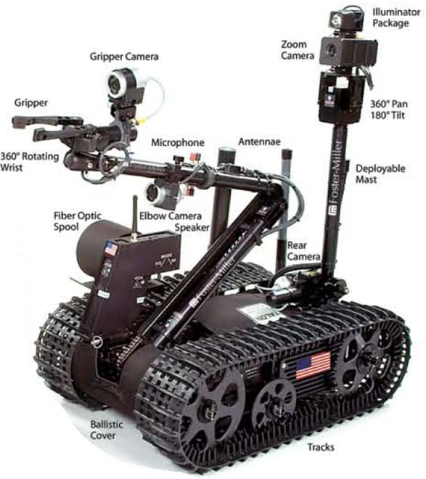
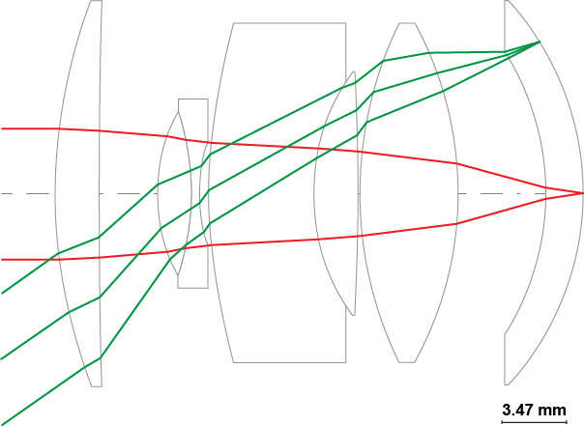
DARPA / IDA / MTO activities (2)
Defense Advanced Research Projects Agency /
Institute for Defense Analysis /
Microsystem Technology Office
Robot cameras for Advanced Mine Detection System
Miniature unmanned aerial vehicles (compact, lightweight)
WFOV, Variable High Resolution in ROI, Zoom capability, 3D, Video
MIT: 15 mm Curvature radius
MTF improvement spectacular !
Notes:
OK, 2

Slide 32
(U) The MONTAGE program aims to implement a revolutionary change in the design principles for imaging sensor systems, enabling radical transformation of the form, fit, and function of these systems for a wide variety of high-value DoD applications. Significant improvements in the performance, affordability, and deployability of imaging sensor systems will obtain from rational co-design and joint optimization of the imaging optics, the photo sensor array and the post-processing algorithms.
Specific demonstrations include reduction of the depth/thickness of an imaging sensor by an order of magnitude without compromising its light gathering ability or resolution. This dramatic reduction in thickness will then allow the imaging sensors to be deployed conformally around a curved surface of a platform (e.g., UAV, tank, or helmet). Furthermore, the flexibility generated by the incorporation of post-processing in the image formation will allow variable resolution image formation, which in turn reduces the data load for subsequent image exploitation and communication systems. Advanced post-processing algorithms will support video operation at frame rates in excess of 10 frames per second using standard computing platforms.
Program Plans:
- Develop novel optical designs allowing depth reduction by 10X.
- Concurrent with optics design, develop sensor array design and post-processing algorithms to realize signal-to-noise ratio and resolution of comparable optical aperture.
- Demonstrate ability to allocate highest spatial resolution to specified regions of interest in the image while maintaining medium resolution elsewhere.
- Develop architectures for surpassing detector size-limited resolution and potentially exceed optically limited resolution.
- Demonstrate operation of a thin imaging system deployed on a curved surface.
- Demonstrate real time performance of thin imaging systems in representative DoD applications with performance evaluated using application-specific metrics for image quality, sensor cost, power consumption, mechanical properties.
C L A S S I F I E D
INFO
Notes:
OK, 2

Slide 33
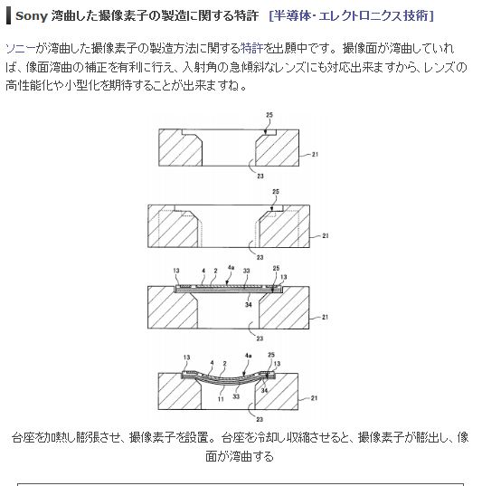
It’s not a Trick – it’s a SONY Patent (1)
Curved Detector
Very detailed patent, suggests actual experimental work:
CMOS
Different curving techniques described, e.g.:
Thermal expansion
Vacuum suction
Modification of curvature on the fly by pressure / magnetic field
(central portion)
© SONY Patent
Notes:
OK, 1
Japanese a great example for thinking outside the box !!
Originality / associations for Kanjis
Mention NIKON and PENTAX people if previous slides supressed

Slide 34
It’s not a Trick – it’s a SONY Patent (1)
Curved Detector
Do the real thing to overcome the shortcomings of the “adaptor”
Different curving techniques:
Mounting to substrate with different thermal expansion
Pressure / Covers broad range in patent 78 pages) : different techniques + CMOS
http://www.heise.de/foto/meldung/Kurz-und-Knapp-Gewoelbte-Sensoren-und-Objektive-fuer-Spiegellose-1837878.html
Notes:
OK, 1
Japanese a great example for thinking outside the box !!
Originality / associations for Kanjis
Mention NIKON and PENTAX people if previous slides supressed

Slide 35
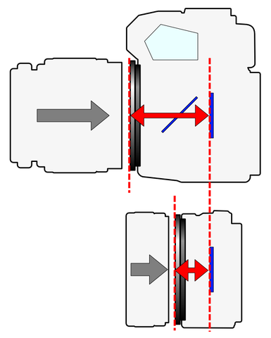
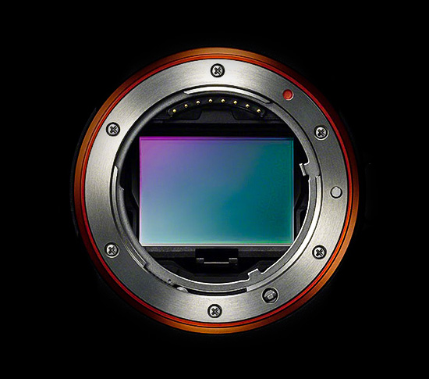
New trend: Full frame sensor (24x36mm²) mirrorless cameras
Main goals :
Compact
Lightweight
Best image quality with least optics,
especially image corners
Less back focal distance
>> No room for field flattener
>> easier with curved detector
Lower production cost
Exchangeable Lenses
Conventional SLR (full frame)
Camera
Mirrorless
Full Frame
Camera
©http://en.wikipedia.org/wiki/File:Flange_Focal_Length_%282_types_camera%29.PNG#file
Notes:
OK, 1

Slide 36
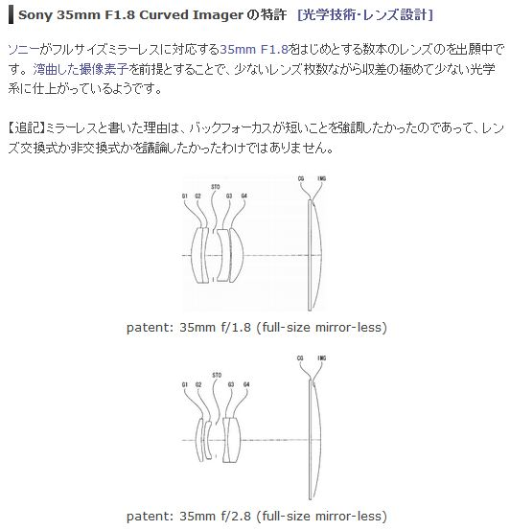
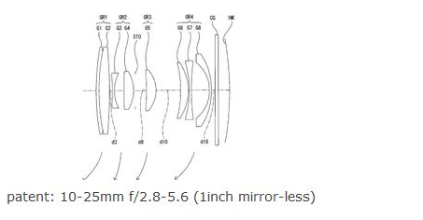
It’s not a Trick – it’s a SONY Patent (2)
Optics for Curved Detector
Sony patent 2013-61476 in Japan
Back focal distance minimized
Not possible with flat det.
Already built with flat detector:
>= 8 lenses (Nikon, Olympus)
>= 7 lenses
(Olympus)
Curved detector:
4 lenses
+ ZOOM in connection with lens shift and curvature modification
Curved detector:
4 lenses
Notes:
OK, 1
Estimate curvature radius, but exact radii and index of refraction are not known !
Also Pentax rumours about curved Detectors

Slide 37
FROM DIFFERENT APPLICATIONS
TO REALIZATION:
ESO / ITL
CURVING PROCESS
Notes:
OK 2

Slide 38
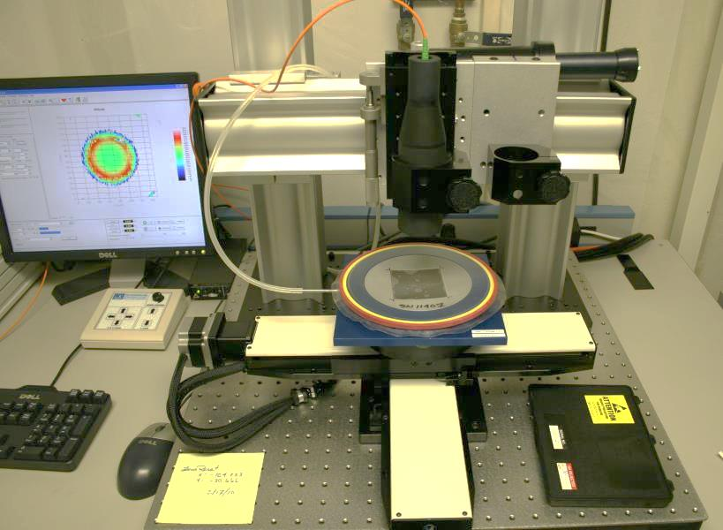

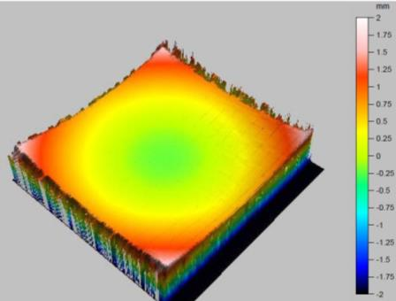
Results and potential of a novel curving process for large area scientific imagers
Olaf Iwert , ESO
David Ouellette &
Michael Lesser
ITL, U. of Arizona, USA
Bernard Delabre, ESO
Notes:
20 minutes talk w/o discussion
Simplified view
Specialized application of detectors for astronomy optimized for some performance parameters, based on thinned silicon. State of the art for thinned silicon.
Co-operation in research: Quite a number of findings / results / processs in here, which have been worked out by other groups, copied with permission
Myself no semiconductor physicist
Many graphics contributed by others > credit

Slide 39
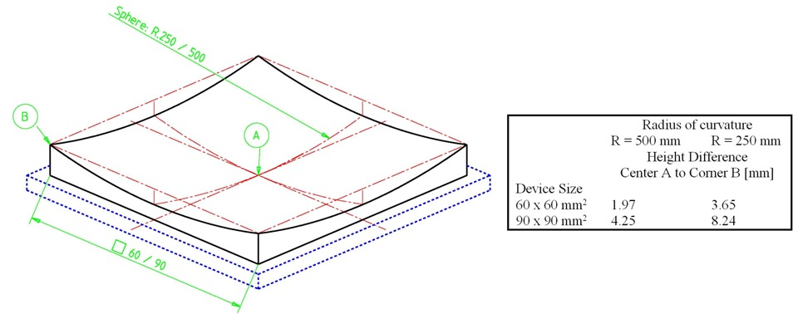
ESO Feasibility Study 2010
Basic requirements for monolithic spherically curved CCDs:
Goals: Combine state-of the-art CCD performance with curvature
Get a working curved CCD and test its performance cold
Notes:
OK 1

Slide 40
ESO / ITL curving approach (2)
University of Arizona Imaging Technology Laboratory (ITL) did the main development for the curved detectors under contract with ESO,
with the following goals:
  Characterize large CCD detector before curvature
  Curve large CCD thick (spherically, concave) > 200 µm
  Achieve curvature radius 500 … 250 mm
  Support device permanently
  Characterize electro-optical performance cold
    If successful, extend to thinned CCD
Notes:
OK 1

Slide 41
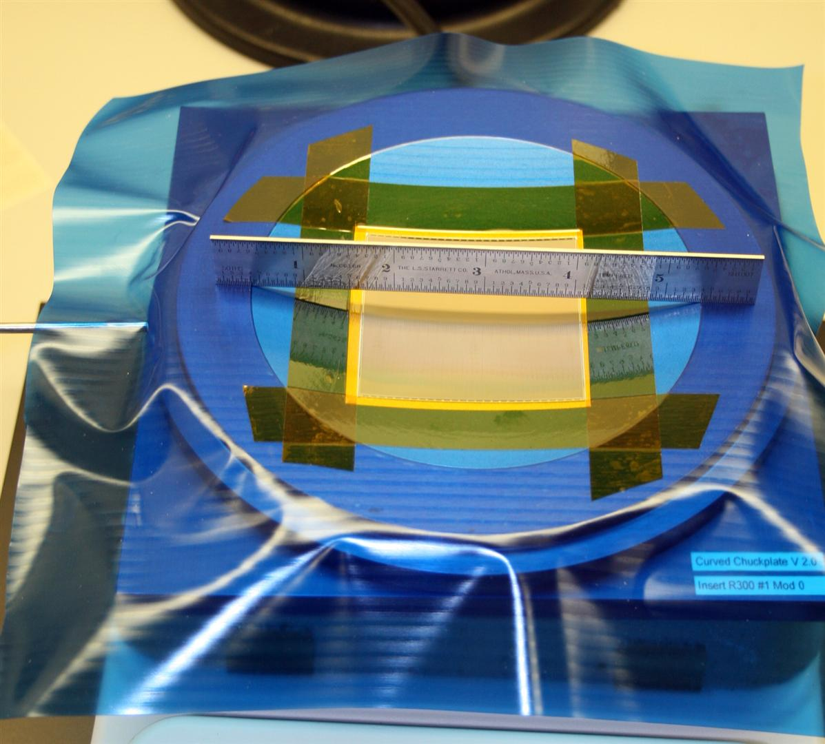
ESO / ITL curving approach (3)
The first trials to achieve the curvature of working CCDs
looked really good:
Notes:
OK 1

Slide 42
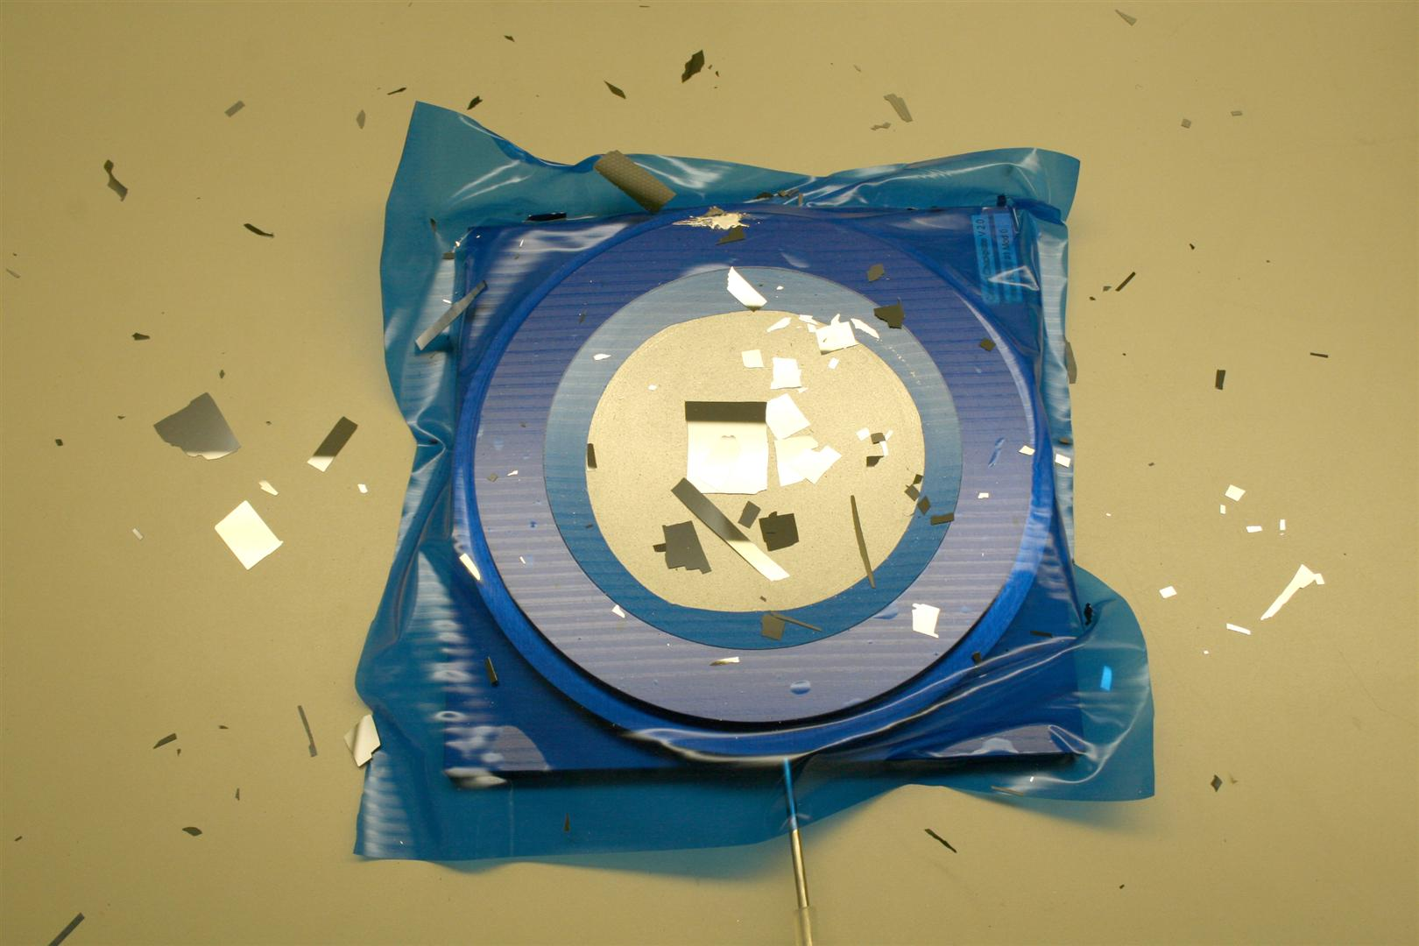
ESO / ITL curving approach (4)
Until this happened:
“At least they take
some minutes
now before
they explode –
that’s progress…”
Notes:
OK 1

Slide 43
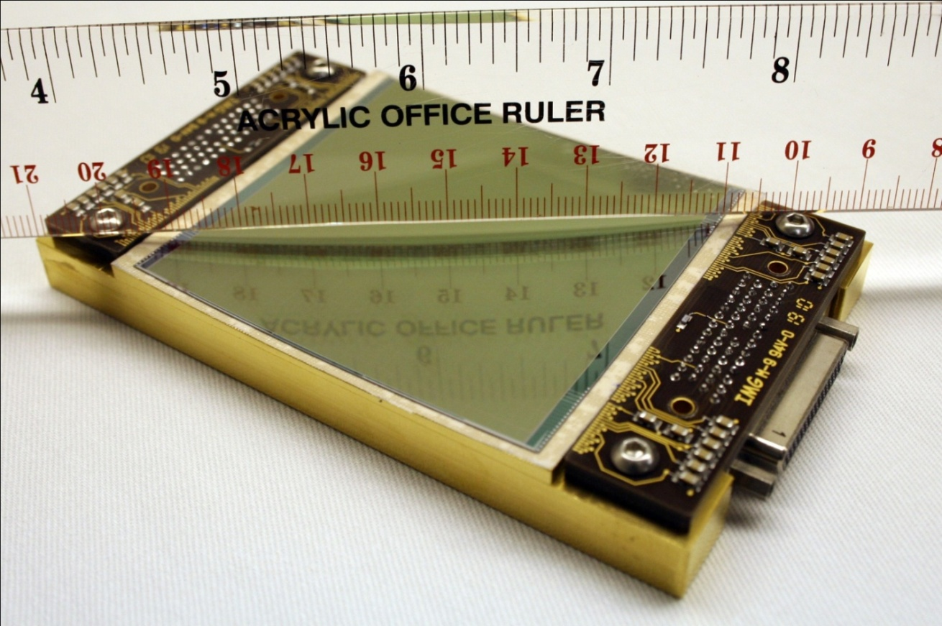
ESO / ITL curving approach (5)
After process training and optimisation:
1st curved working CCD, cold first light
Curvature Radius ~500 mm (3D), device size 60 x 60 mm²
Frontside illuminated,
Thickness ~200 um,
permanently supported
Three curved
CCDs have
been produced,
two were
delivered to ESO
Notes:
OK 1

Slide 44
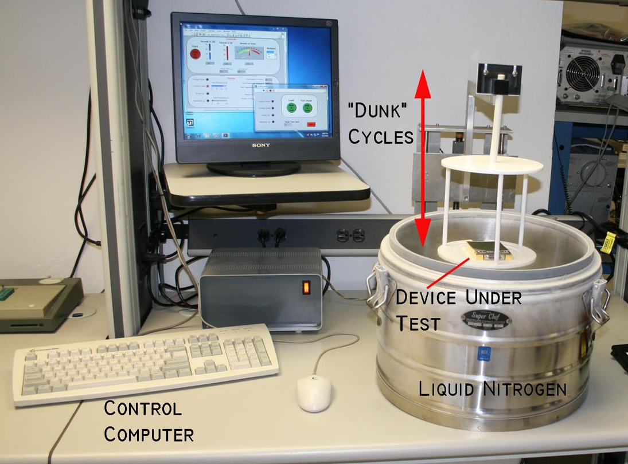
ESO / ITL curving approach (6)
Cryogenic Measurement Results (1):
Stress Testing :
~ 10 cycles of
dunking into liquid Nitrogen
did not show
any problems
Notes:
OK 1

Slide 45
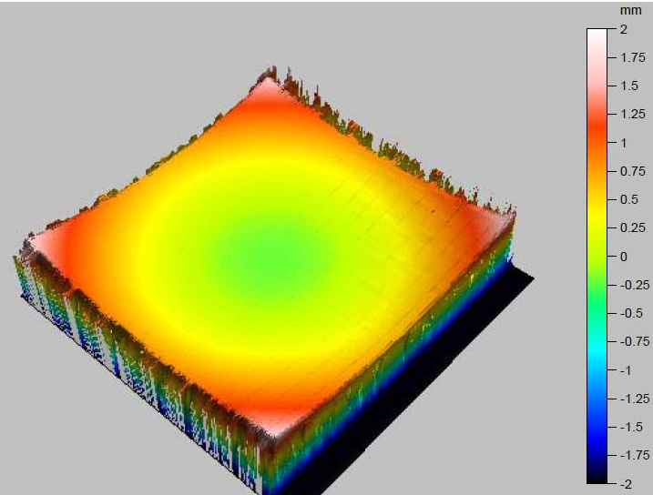
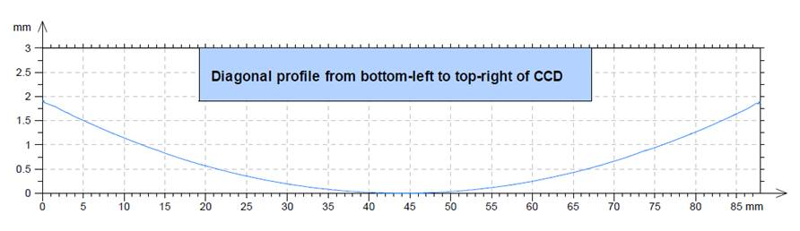

ESO / ITL curving approach (7)
Measurement Results (2):
~ 500 mm curvature radius over 60 x 60 mm² area, fairly symmetrical:
Notes:
OK 1

Slide 46

ESO / ITL curving approach (8)
Cryogenic Measurement Results (3):
-120 Deg C:
600 sec dark exposure
Flat field exposure
No more
cosmetic defects than before
(Strip patterns
are due to
metal
bussing on
frontside of
this CCD type)
Notes:
OK 1

Slide 47

ESO / ITL curving approach (9)
Cryogenic Measurement Results (4):
4k x 4k
Testing after curvature shows basically no difference
to results before / reference device
Notes:
OK 1

Slide 48
ESO / ITL curving approach (10)
Measurement Results Conclusion:
All cryogenic test results show that the
electro-optical performance before and after
curvature is almost identical:
- Charge Transfer
- Imaging Defects
- Readout Noise
- Dark Current
(This is in contrast to theoretical performance deterioration)
Once packaged, no reliability issues occurred
Notes:
OK 1

Slide 49
ESO / ITL curving approach (11)
Potential for further improvements:
    Curvature shape & repeatability
    Curvature radius << 500 mm requires more development effort
    Larger detectors
    Extension to thinning

Slide 50

ESO / ITL curving process: 2 Vac (1)
Overview of process components:
Notes:
OK 1

Slide 51










ESO / ITL curving process: 2 Vac (2)
Overview of process steps:
A
B
C
D
G
H
E
F
I
J
Notes:
OK 1

Slide 52
ESO / ITL curving process: 2 Vac (3)
Process Step 1:
Apply silicon CCD to adhesive overlay film
Notes:
OK 1

Slide 53
ESO / ITL curving process: 2 Vac (4)
Process Step 2:
Mask off any unnecessary adhesive areas
Notes:
OK 1

Slide 54
ESO / ITL curving process: 2 Vac (5)
Process Step 3:
Place mounted silicon CCD and masked
overlay film onto lower vacuum chuck
Notes:
OK 1

Slide 55
ESO / ITL curving process: 2 Vac (6)
Process Step 4:
Open vacuum valve and evacuate lower chuck.
(Masking not shown.)
Notes:
OK 1

Slide 56
ESO / ITL curving process: 2 Vac (7)
Process Step 5:
Place upper chuck onto stack.
(Note that vacuum is still applied to lower chuck.)
Notes:
OK 1

Slide 57
ESO / ITL curving process: 2 Vac (8)
Process Step 6:
Apply adhesive sealant to outside of upper chuck and onto overlay film
Notes:
OK 1

Slide 58
ESO / ITL curving process: 2 Vac (9)
Process Step 7:
Apply vacuum to upper chuck while maintaining lower chuck vacuum
Notes:
OK 1

Slide 59
ESO / ITL curving process: 2 Vac (10)
Process Step 8:
Continue process of “crossing over” the vacuum. Eventually, upper chuck will be at full vacuum, and lower chuck will be vented to atmosphere, causing the silicon to transfer onto the upper chuck. The imaging surface is protected by the overlay film. Note that the overlay film’s adhesive must have very high strength, but also be easily removed.
Notes:
OK 1

Slide 60
ESO / ITL curving process: 2 Vac (11)
Process Step 9:
The upper chuck and stack is removed from the lower chuck.
The function of the masking (shown again here) is to allow easy release of the unit from the lower chuck
Notes:
OK 1

Slide 61
ESO / ITL curving process: 2 Vac (12)
Process Step 10:
The upper chuck is still under vacuum. It is flipped over onto the bench.
Notes:
OK 1

Slide 62
ESO / ITL curving process: 2 Vac (13)
Process Step 11:
The “die attach” side of the CCD is now exposed – ready for packaging:
Epoxy and Invar package are applied.
The epoxy is cured.
After the die attach epoxy is fully cured, the vacuum is shut off. The adhesive seal (red) is peeled away.
The overlay film is removed from the packaged curved CCD, exposing the imaging surface.
Wirebonding and other processing follows.
Notes:
Ok 1

Slide 63

ESO / ITL curving process:
CURVING PROCESS HARDWARE:
Notes:
OK 1

Slide 64
Conclusions
General View:
  Curved detectors have core applications in different fields
  Our application is the extreme case for size & backside illumination, but also has the highest demand from the optical point of view (e.g., ELT instruments)
Curved Detectors:
  For the first time ever a detector of 60 x 60 mm² size has been curved to ~ 500 mm radius – fully functional
  Reliability in cold operation and measurement results show no noticeable performance degradation
  Thinning of the curved detector is compatible with the developed process
  All objectives of this R&D project have been reached
  We are interested in partners for further development
Notes:
OK 1

Slide 65
Credits
This R&D project illustrates:
In Theory: Theory and Practice are the same
In Practice: They are not !
All CCD curving work for this project done by ITL,
U. of Arizona, USA under contract to ESO.
All CCDs supplied by Semiconductor Technology
Associates (STA).
Thank you very much
Notes:
OK 1

