Slide 1
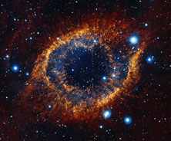
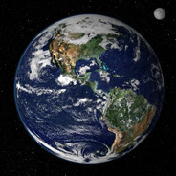
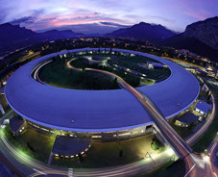

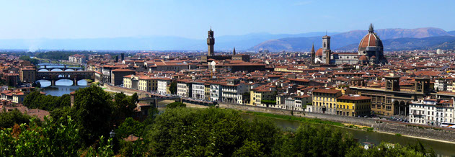
Welcome to the
Scientific Detector Workshop 2013
7-11 October 2013
Florence, Italy

Slide 2

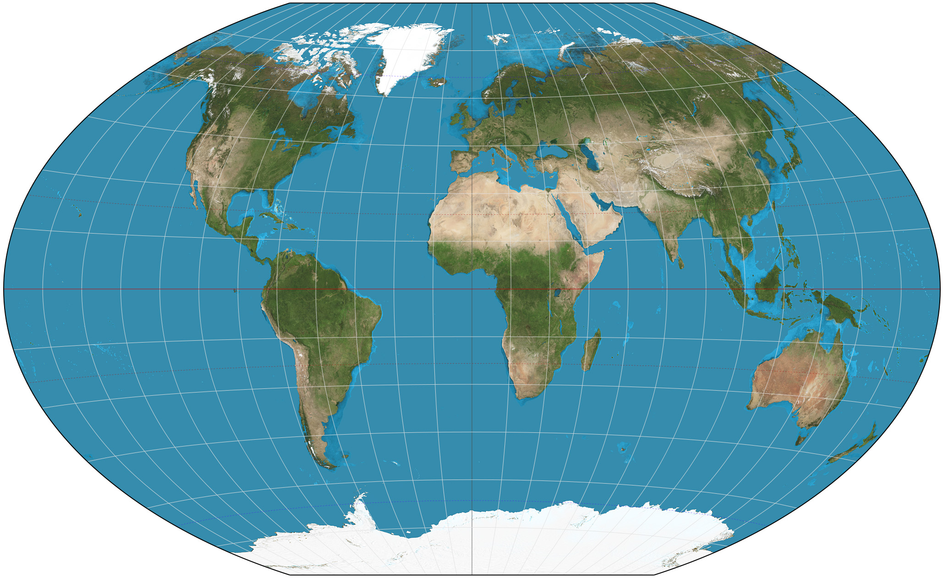
A gathering of the leaders in high performance detectors
for scientific applications from the x-ray to the infrared
162 attendees
90 organizations
18 countries
6 continents

Slide 3









Grazie mille (a thousand thanks) to the host organizations and sponsors who have generously supported the workshop
Host organizations Co-chairs
Astrophysical Institute of Potsdam Martin Roth
European Southern Observatory Paola Amico
Teledyne Technologies, Inc. James Beletic
Lead organizer: Katherine Beletic
Local partner
Arcetri Observatory
Sponsors
National Astronomical Observatory of Japan
Conceptual Analytics
e2v technologies
Semiconductor Technology Associates (STA)
GL Scientific

Slide 4
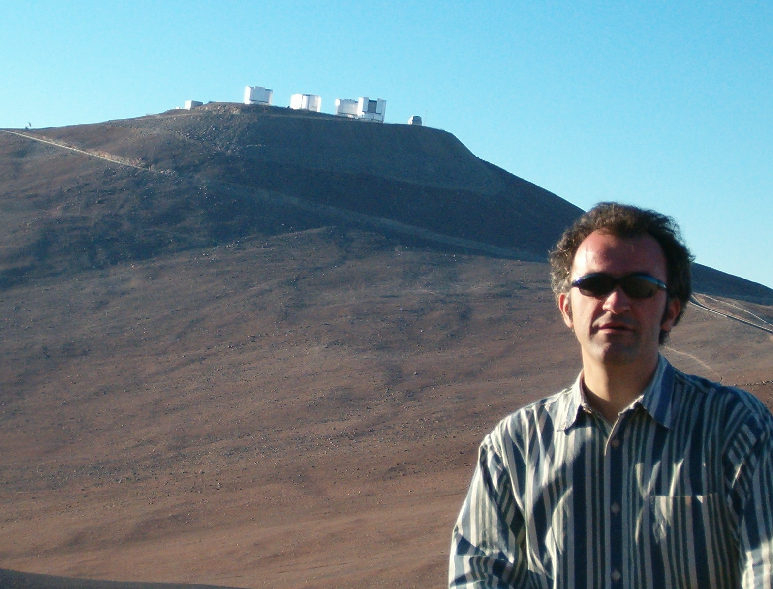
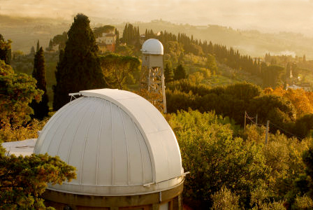
Welcome from Osservatorio di Arcetri
Director: Filippo Mannucci

Slide 5
Outstanding technical program
Papers on a wide range of subjects
Science
  Astronomy
  Earth Science
  Synchrotrons
  Analytical Chemistry
Wavelengths
  Gamma rays
  X-rays
  UV
  Visible
  Infrared
Technologies
  Observatories
  Instrumentation
  Detector materials (Si, HgCdTe, InSb, Si:As, CdTe, III-Nitrides)
  Detector architectures: CCD, Monolithic CMOS, Hybrid CMOS
  Focal plane electronics
  Cryostats and cryogenic controllers
  Detector characterization

Slide 6
Outstanding technical program
Invited talks: 6
  30 minutes each (25 min. presentation, 5 min. Q&A)
  25 pages in the proceedings
Oral presentations: 56
  20 minutes each (15 min. presentation, 5 min. Q&A)
  10 pages in the proceedings
Poster papers: 42
  Posters are up all week long – put them up today
  2 minute poster pop
  Stand by your paper during the coffee break following the poster pop
    These posters will be “flagged” to make them easy to find
  10 pages in the proceedings
Roundtables: 2
  Curved Si detectors
  Focal Plane Electronics
Special talk on the Museo Galileo
  Tuesday afternoon – followed by private visit to Museo Galileo
Special evening talk on imaging spectroscopy
  At Teatro Odeon

Slide 7
This workshop is for sharing knowledge
All talks to be distributed to participants on Friday afternoon
  USB memory stick (provided by SDW2013)
  Talks distributed as Powerpoint unless the author requests .pdf
Audio of all talks digitally recorded
  Audio will be synchronized to the slide presentation
  DVDs will be distributed to all participants
  Speak into the microphones, both speakers and questioners
    Workshop volunteers will bring microphones to the audience for Q&A
Please respect your fellow attendees
  Do not run over your allotted speaking time
  Please attend all sessions – schedule allows time to visit Florence
  Please turn off your cell phone ringers!

Slide 8
Proceedings
Manuscripts due on October 31
Black & white (gray scale) printing
For extra charge, you can print some or all of your pages in color
  ~$100 per color page (TBC)
As previously, we fill all empty white space in book with photos
  Please send photos and identify people in the photos
  Send entertaining captions if you wish
  We cannot make a commitment to use submitted photos
We project 1300 to 1400 pages, in two volumes
We need your photo for the proceedings
  Photos taken at each break, “20 persons per break
  See Thomas Craven-Bartle, official SDW2013 portrait photographer

Slide 9
Wear your badges at all times
We don’t all know each other
Some of us suffer from poor memories
Badges are required to control access to catered events
  The catering has been scaled to the number of registered persons
Your registered guests need to wear their badges to social events
  Galileo Museo
  Aperitivo & Teatro Odeon talk
  Workshop dinner

Slide 10
Many changes to the printed program
U.S. government shutdown prevented NASA employees from attending
  Five Goddard Space Flight Center staff have withdrawn
  Fortunately, JPL and STScI staff are still able to join us
Some other papers withdrawn at the last minute
  The schedule is different than what you have in the program pamphlet
  See printed schedules in the lobby to be certain of the time of the talks, especially your talk
All talks must be loaded on the presentation computer the day before your session
  One computer for loading and verifying talks
  Tied by a server to the presentation computer
  These are PCs, and you must use Powerpoint to present your talk
    Apologies to Apple and Keynote fans

Slide 11

Highlights
Monday, October 7

Slide 12
Changes to the schedule
Many… last minute
Check the program outside
…or online
Especially if you are a speaker
...or a session chair

Slide 13
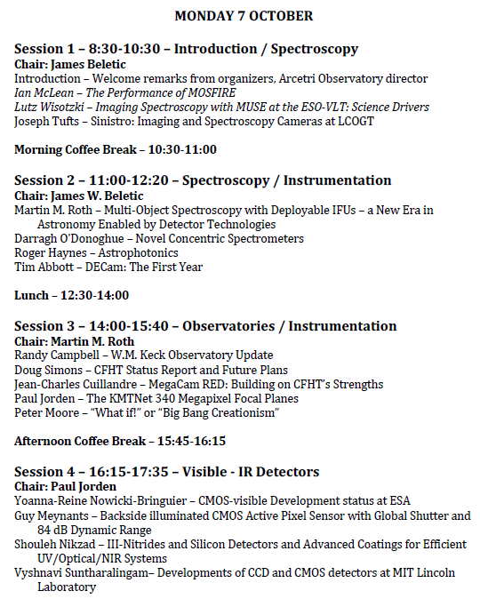

Slide 14

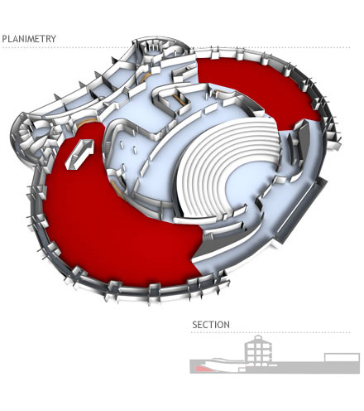
Coffee/caffe’
10:30
15:45

Slide 15
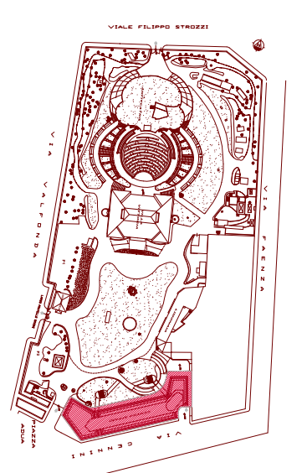

Catering provided by
Gerist
Lunch
12:30-14:00

Slide 16
WIFI
Username: sensors
Password: dwj2013

Slide 17
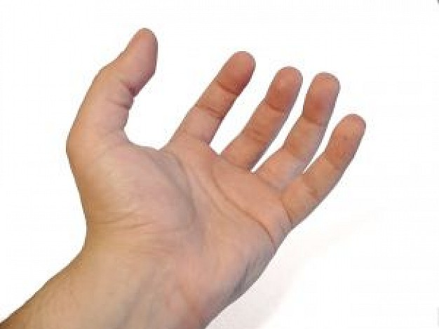
Speak Italian, one gesture a day
Consider them multiparametric:
value, direction, frequency, amplitude, symmetry, multiplicability, etc.
Go to the point
Summarize
Conclude

