Slide 1
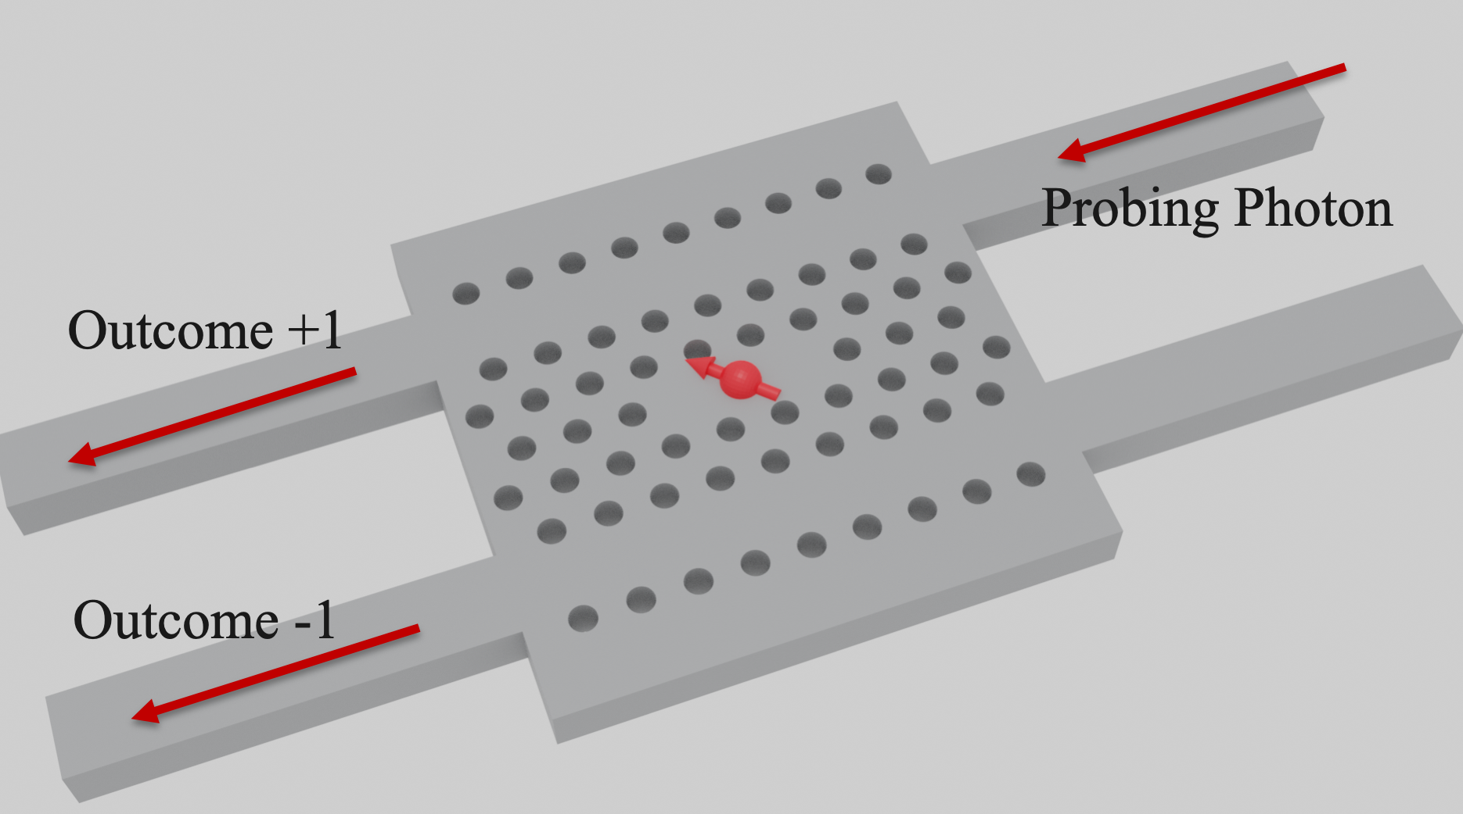
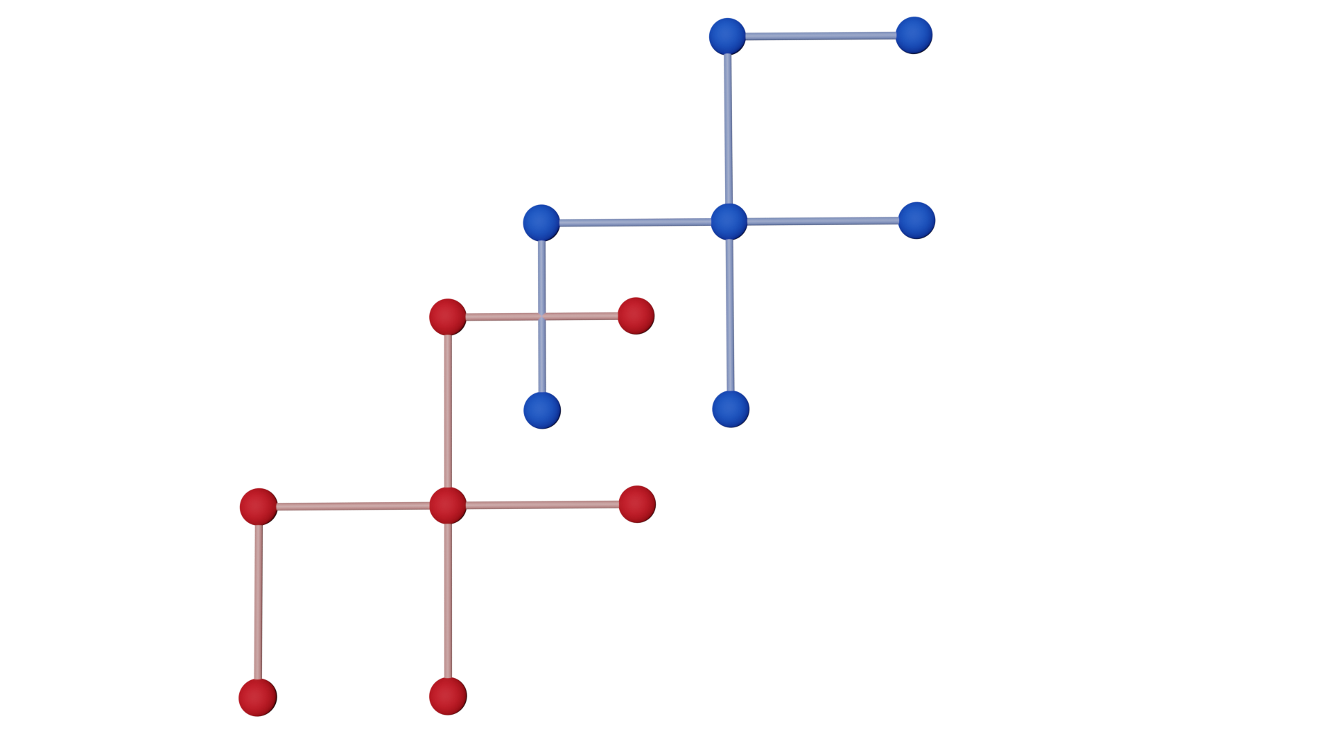
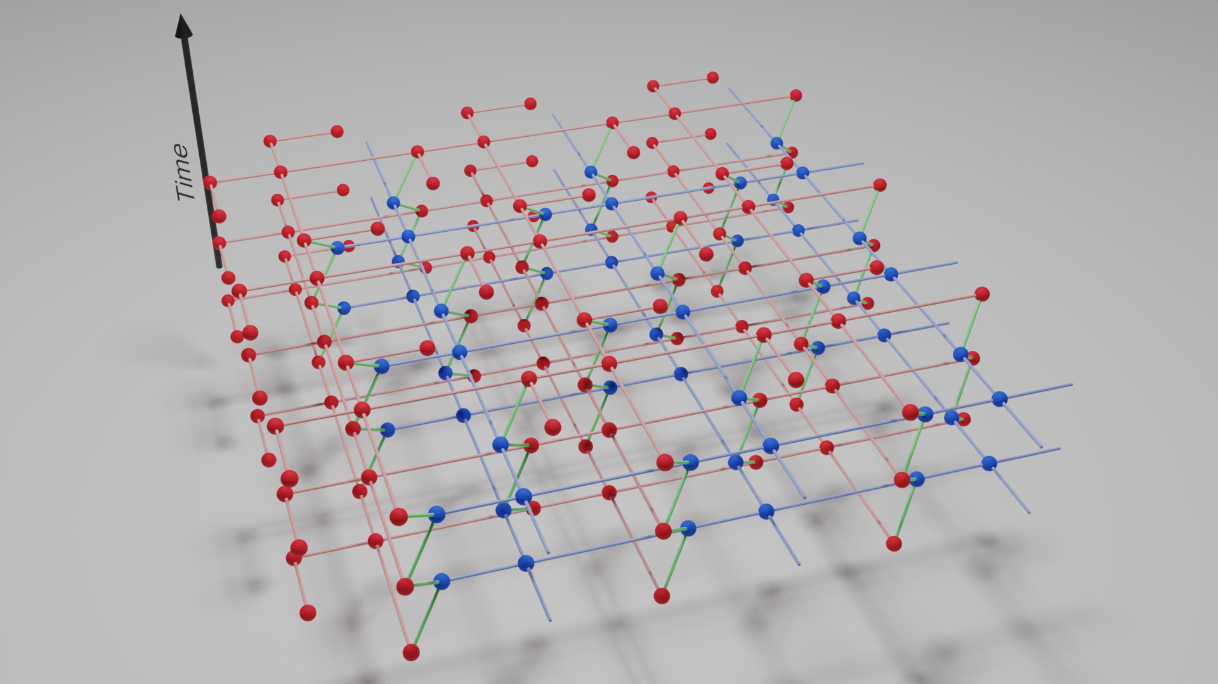
A Quantum Computer Architecture Based on Silicon Donor Qubits Coupled by Photons
Xiruo Yan^{1,2}, Warit Asavanant³, Hirsh Kamakari¹, Jingda Wu², Jeff F. Young^{1,2} and Robert Raussendorf^{1,2}
¹Department of Physics and Astronomy, University of British Columbia
²Stewart Blusson Quantum Matter Institute, University of British Columbia
³Department of Applied Physics, The University of Tokyo
Introduction
Building Blocks
Architecture
Measurement based quantum computation [1]
Se⁺ [4]
Unit-cell clusters
Qubit
$$\left|1\right\rangle$$
2D Cluster state
Entanglement
Dimension
$$\left|0\right\rangle$$
Silicon microcavity
[6]
Fault-tolerant threshold for photon loss: ~1%
[5]
References
3D (2D space + 1D time) cluster state [2,3]
[1] R. Raussendorf, H. J. Briegel, Phys. Rev. Lett. 2001, 86, 5188.
[2] R. Raussendorf, J. Harrington, Phys. Rev. Lett. 2007, 98, 190504.
[3] K. Nemoto, M. Trupke, S. J. Devitt, A. M. Stephens, B. Scharfenberger, K. Buczak, T. Nöbauer, M. S. Everitt, J. Schmiedmayer, W. J. Munro, Phys. Rev. X 2014, 4, 031022.
[4] K. J. Morse, R. J. Abraham, A. DeAbreu, C. Bowness, T. S. Richards, H. Riemann, N. V. Abrosimov, P. Becker, H.-J. Pohl, M. L. Thewalt, S. Simmons, Sci. Adv. 2017, 3, e1700930.
[5] E.Waks,J.Vuckovic,Phys.Rev.Lett.2006,96,153601.
[6] X. Yan, W. Asavanant, H. Kamakari, J. Wu, J. F. Young, R. Raussendorf, Adv. Quant. Tech. 2020, 2000011
Entanglement requires non-local operations
Non-local operations achieved by measurement only

