Slide 1
The Quantum Illumination Story
Jeffrey H. Shapiro
Photonics for Quantum 2 Workshop
July 30, 2020

Slide 2
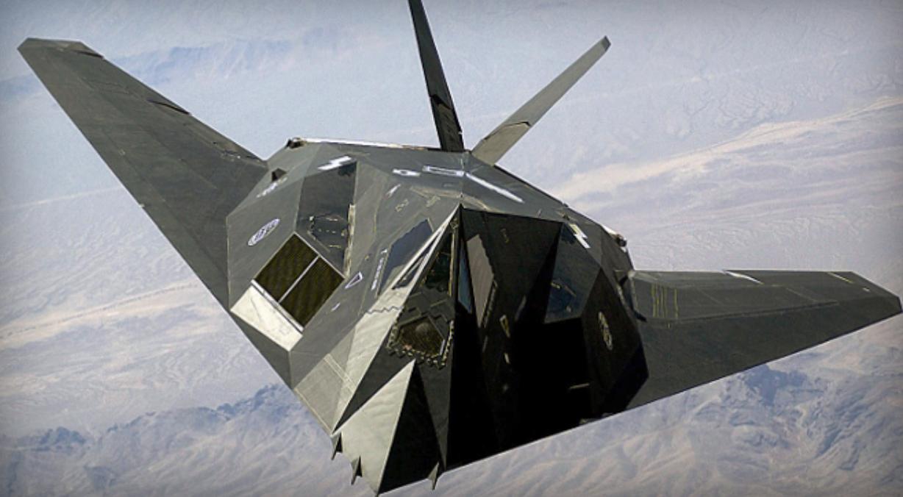
Stealth Aircraft…

Slide 3
Stealth Aircraft… and its Existential Threat
Quantum Radar!

Slide 4
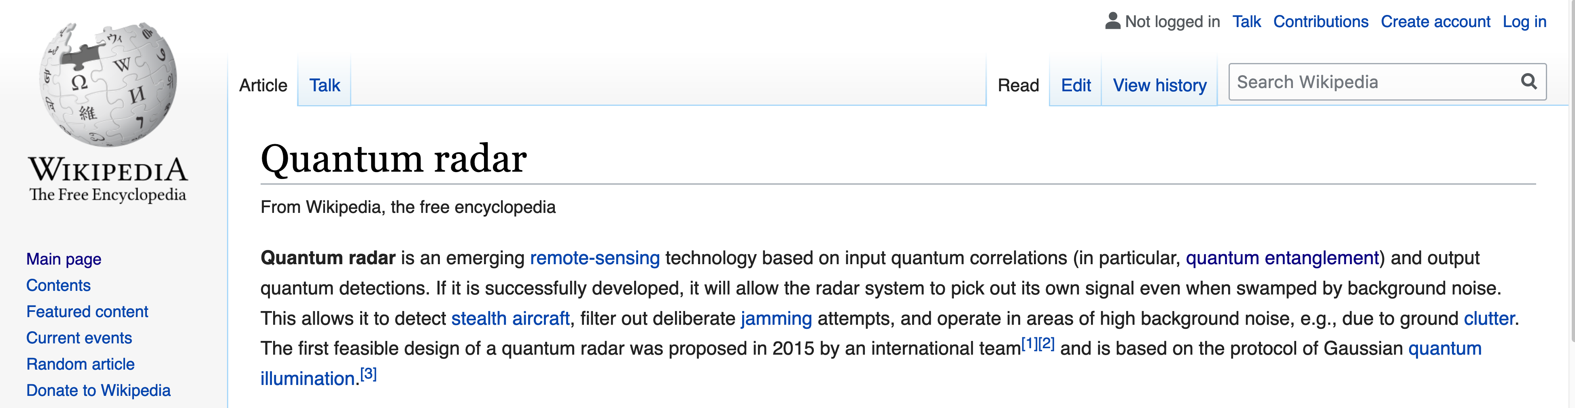
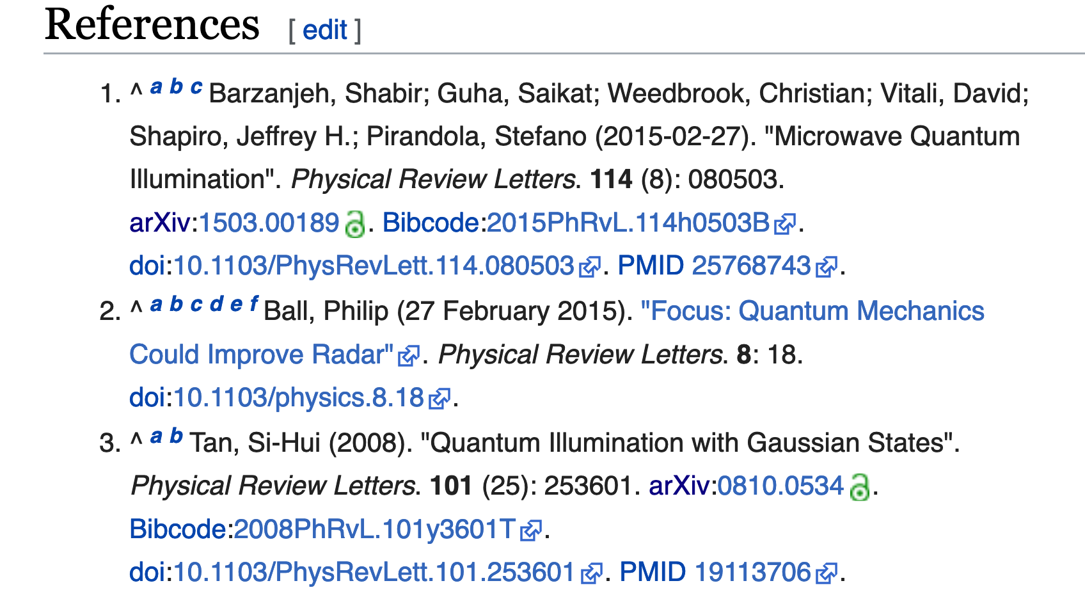
Wikipedia knows about Quantum Radar
and I’m partly responsible…
and I’m partly responsible…
…but not for the hype about stealth aircraft

Slide 5
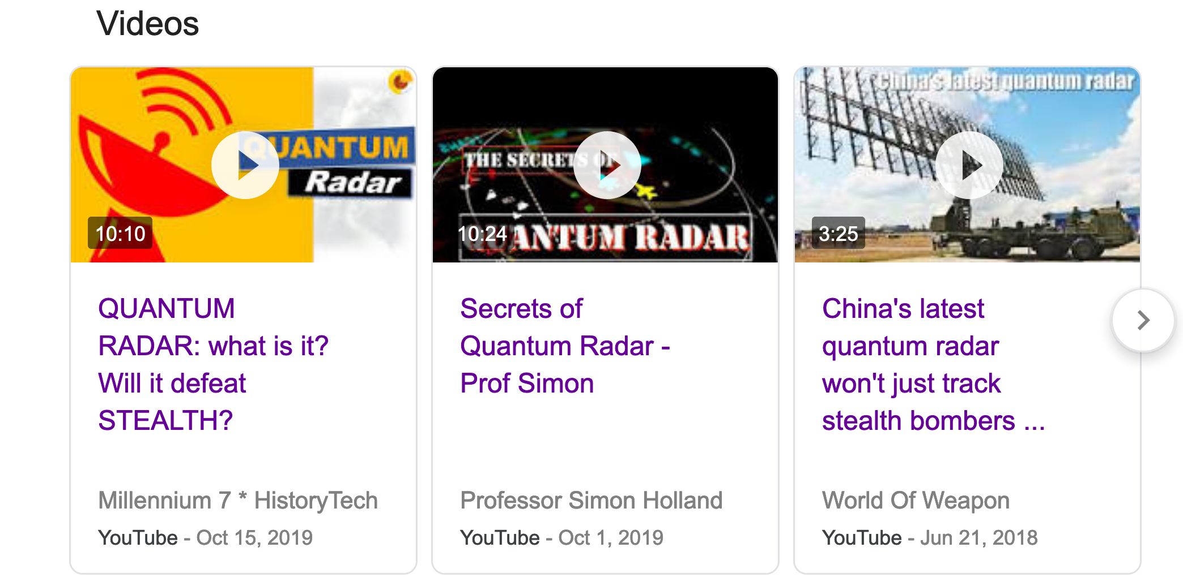
YouTube has Quantum Radar Videos

Slide 6
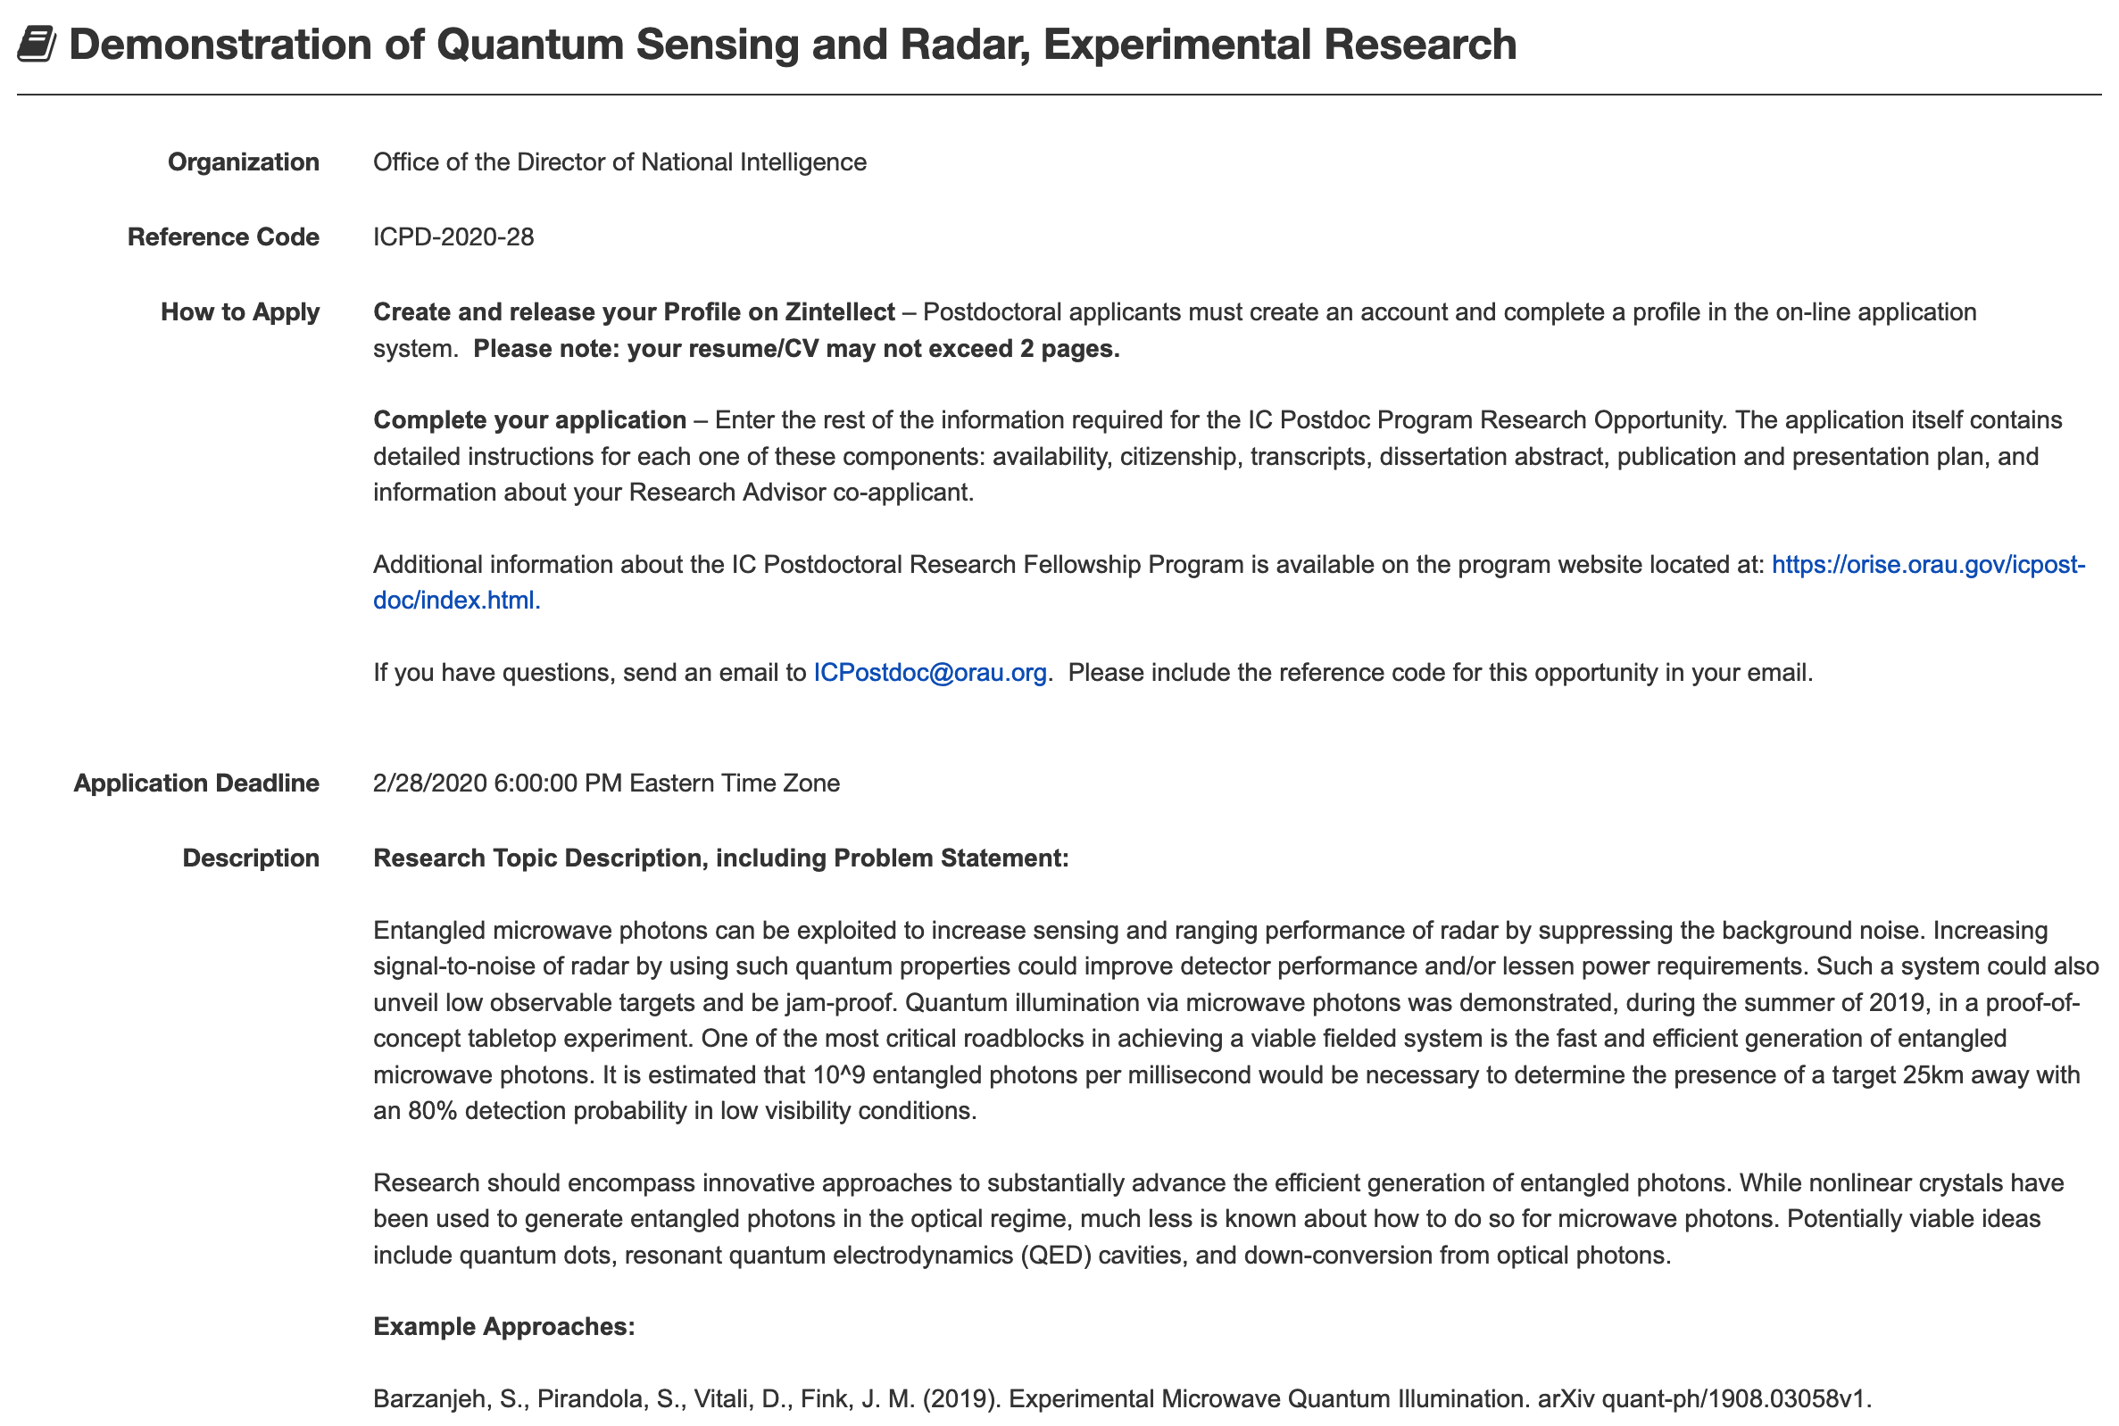
The Intelligence Community wants Quantum Radar

Slide 7
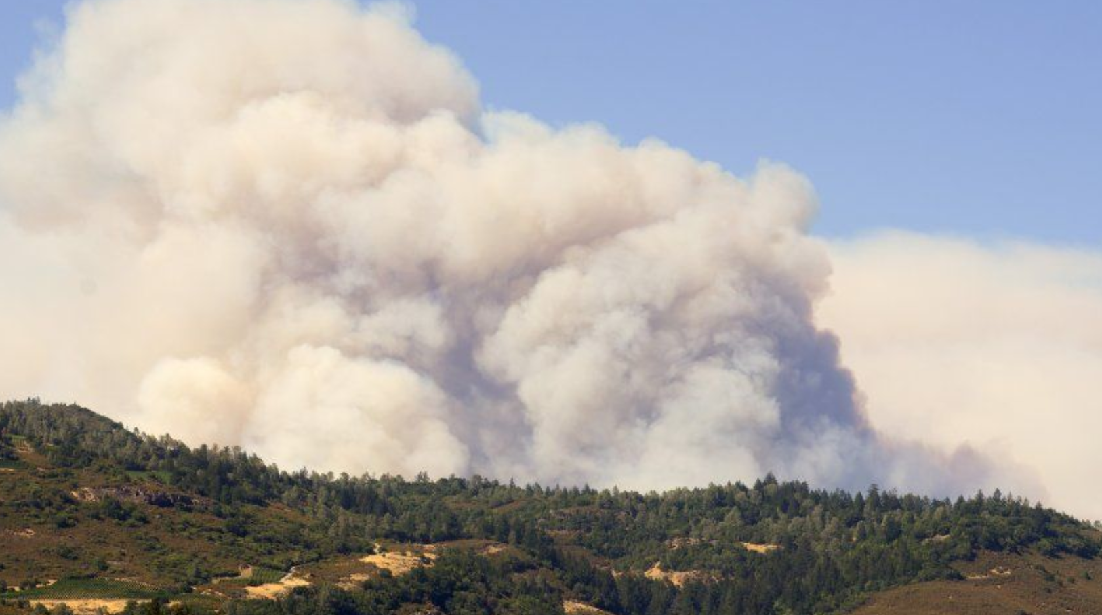
But is there Fire under the Quantum Radar Smoke?
The quantum illumination story will answer that question

Slide 8
The Quantum Illumination Story
Prologue and preliminaries
Lloyd’s quantum illumination and its downfall
Tan et al.’s quantum illumination
Quantum illumination receivers and experiments
Microwave quantum illumination
The end (?) of the quantum illumination story
Quantum illumination’s spinoffs
Your final exam
Acknowledgments and further reading

Slide 9
The Quantum Illumination Story: Abridged
Prologue and preliminaries
Lloyd’s quantum illumination and its downfall
Tan et al.’s quantum illumination
Quantum illumination receivers and experiments
Microwave quantum illumination
The end (?) of the quantum illumination story
Quantum illumination’s spinoffs
Your final exam
Acknowledgments and further reading

Slide 10
Prologue: Classical versus Quantum Radars
Semiclassical photodetection theory
  light is a classical (possibly stochastic) electromagnetic wave
  photodetection’s fundamental noise is shot noise
Quantum photodetection theory
  light is quantum mechanical
  photodetection is a quantum measurement
Definition: classical state
  semiclassical and quantum photodetection give same predictions
  laser light, LED light, sunlight… are classical states
Classical radar
  measurement statistics correctly obtained semiclassically
  laser (coherent-state) radars are classical radars
Quantum radar
  measurement statistics must be obtained quantum mechanically
  single-photon and entangled-state radars are quantum radars

Slide 11







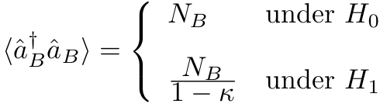
Tan et al.’s Bosonic-Channel CS Radar
Coherent-state target detection
?
coherent-state signal:
thermal background:
Chernoff bound:
Tan, et al., Phys. Rev. Lett. 101, 253601 (2008)

Slide 12

Tan et al.’s Bosonic-Channel QI Radar
Coherent-state target detection
?
thermal-state signal:
thermal background:
Chernoff bound:
Tan, et al., Phys. Rev. Lett. 101, 253601 (2008)

Slide 13
Tan et al.’s Error-Probability Bounds
Upper bounds (UBs) are Chernoff bounds: exponentially tight
Lower bound (LB) is Bhattacharyya bound: known to be loose
All bounds are for optimum quantum receivers
No QI receiver known in 2008 provided any advantage over CS
Homodyne reception for CS radar achieves CS Chernoff bound
The CS lower bound applies to all classical radars of the same N_{S} value
QI’s upper bound < CS’s lower bound QI beats all classical radars
Tan, et al., Phys. Rev. Lett. 101, 253601 (2008)

Slide 14
The Why and How Questions for Tan et al.’s QI
Why does entanglement provide an advantage?
  signal-idler entanglement is in the phase-sensitive cross correlation…
  but… loss (𝜅 << 1) and noise (N_{B} >> 1) kill that entanglement
  even so, classical resources cannot produce as strong a signature
How can we realize the predicted quantum advantage?
  the usual signal-idler coincidence counting doesn’t work…
    high-brightness background implies every idler detection yields a coincidence
  coherent (heterodyne/homodyne) detection doesn’t work…
    error-probability Chernoff bounds obey
  …we need a quantum phase-sensitive cross-correlation measurement

Slide 15

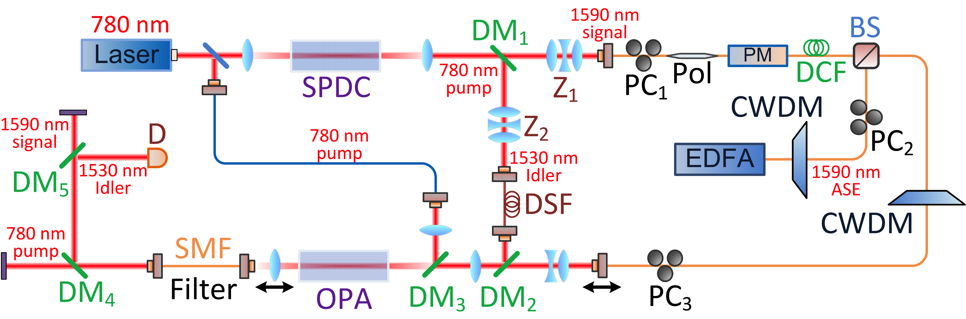
Optical Parametric Amplifier (OPA) Receiver for QI
Low-gain OPA generates
Photon counter measures
Error probability:
Guha and Erkmen, Phys. Rev. A 80, 052310 (2009)
Quantum-illumination (QI) setup
SNR gain with QI
QI
20% SNR improvement despite 14 dB of loss and noise 75 dB stronger than the returned signal
CI
Zhang, et al., Phys. Rev. Lett. 114, 110506 (2015)

Slide 16
Microwave Quantum Illumination
QI needs low-brightness signal, high-brightness background, and high time-bandwidth product
High-brightness background not present at optical wavelengths…
but it is at microwave wavelengths… so let’s do microwave QI
Target-detection configuration
Electro-optomechanical converter
Barzanjeh, et al., Phys. Rev. Lett. 114, 080503 (2015)

Slide 17

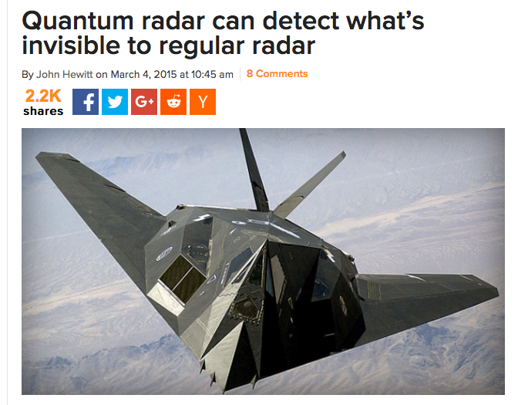
Microwave Quantum Illumination… and its Hype

Slide 18
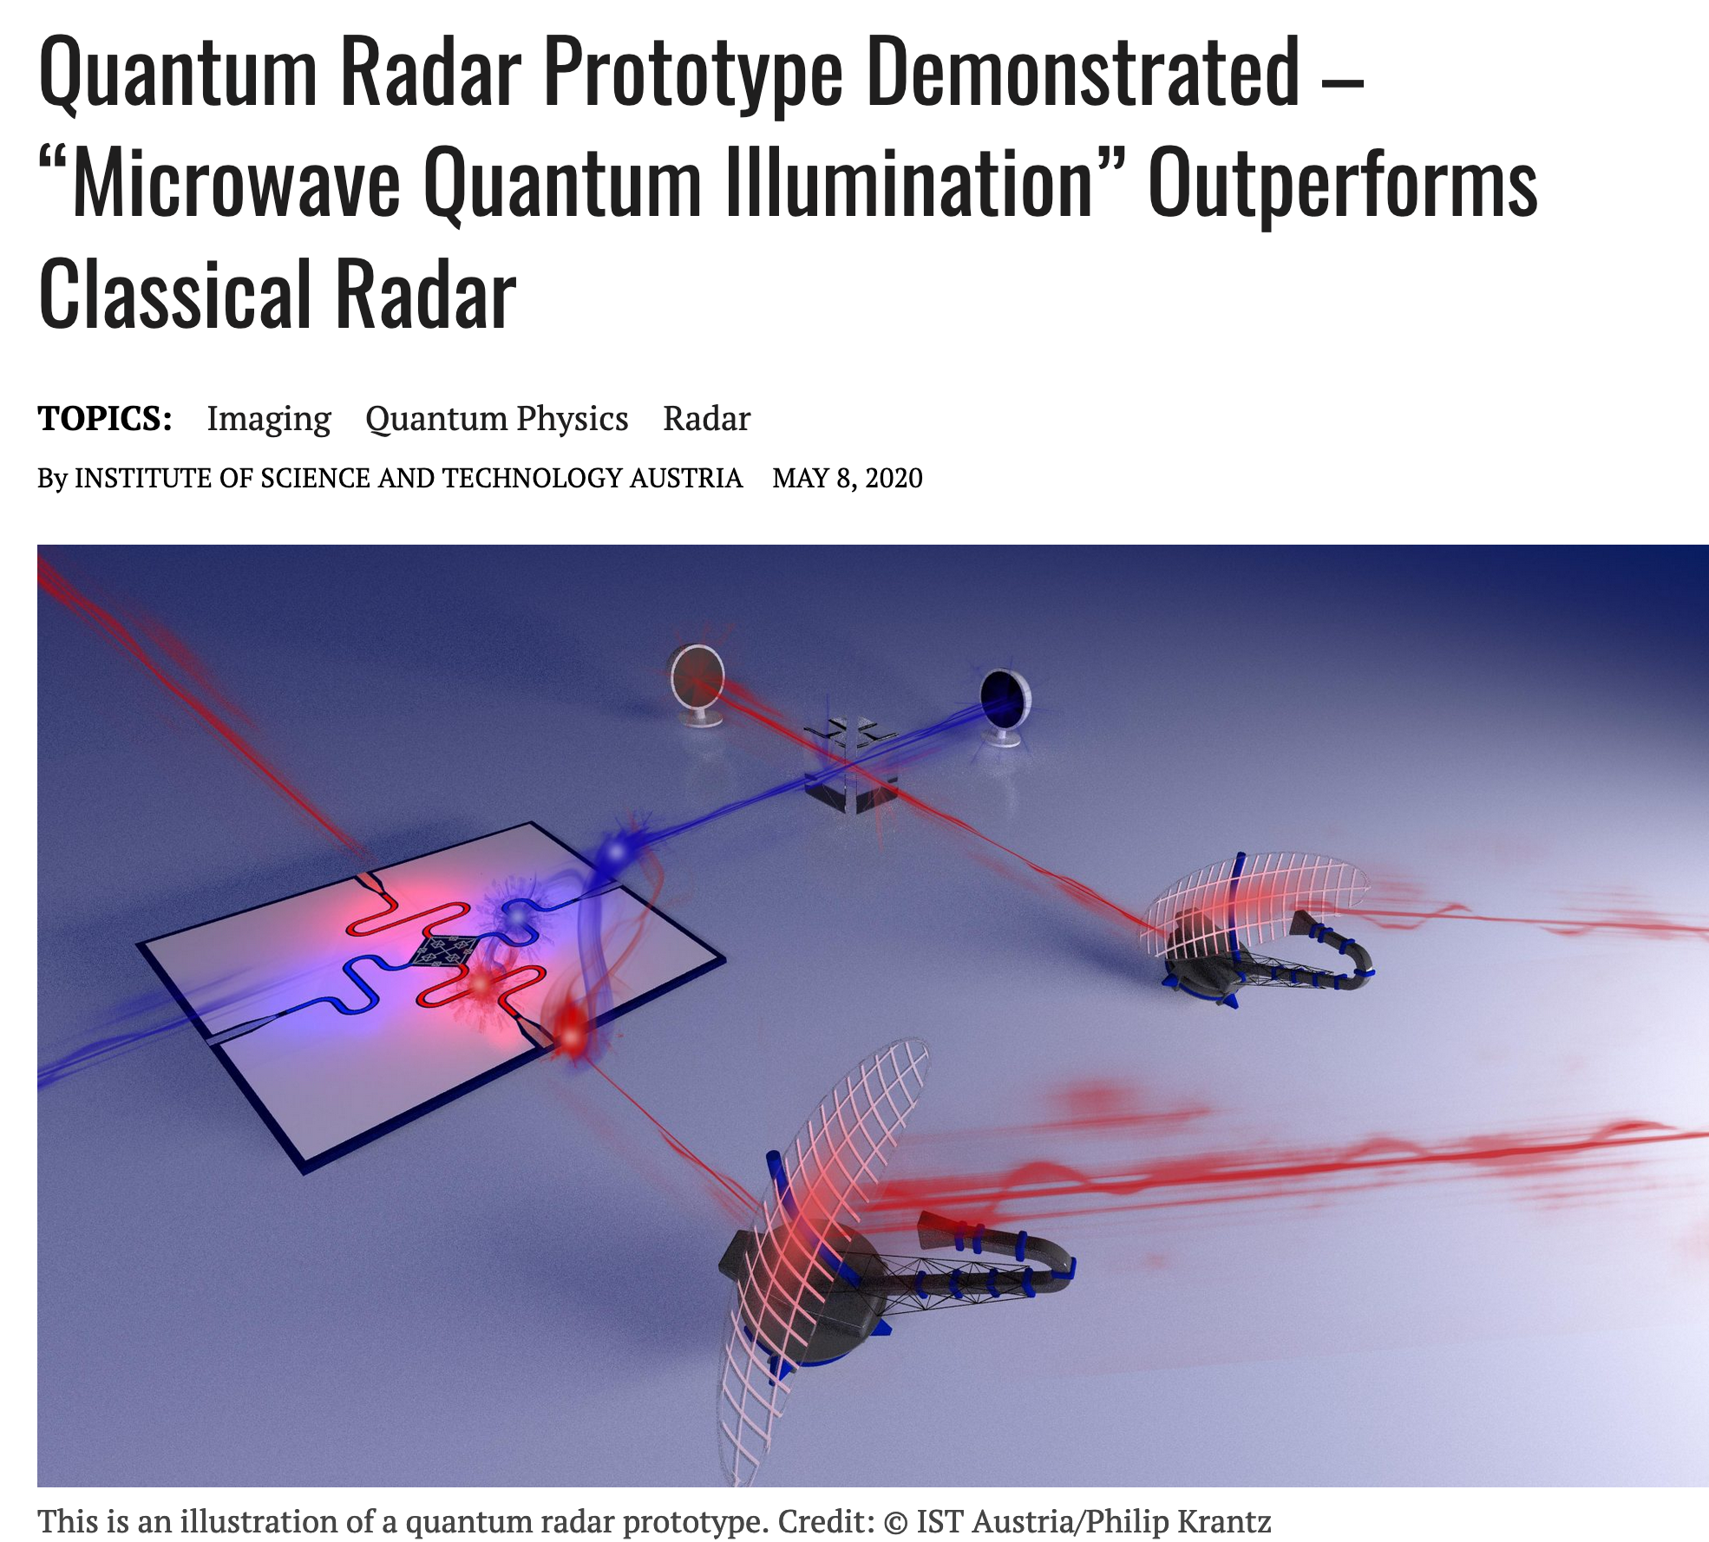
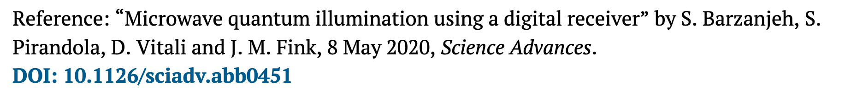
And the Hype Goes on…

Slide 19
A Digression… Correlated Noise Radars
A correlated noise radar…
  prepares correlated signal and reference beams
  detects the reference beam immediately
  interrogates the region of interest with the signal beam
  detects the return from the region of interest
  correlates the detected reference and return to sense target presence
A quantum-correlated noise (QCN) radar…
  employs entangled signal and reference beams
A classically-correlated noise (CCN) radar…
  employs classical-state signal and reference beams
SPDC transmitter with heterodyne receiver is a QCN radar…
  but amplifying the transmitter beam will make it a CCN radar

Slide 20
Microwave QI Experiments… and Their Limitations
Luong et al., IEEE Trans. Aerosp. Electron. Sys. 56, 2041 (2020)
Luong et al.’s is a classically-correlated noise radar…
  transmits the amplified SPDC-produced signal
  heterodyne detects the SPDC-produced idler and returned signal
Luong et al. compare to a suboptimum classically-correlated noise radar…
  heterodyne detects the classically-correlated idler and returned signal
Their QTMS radar outperforms neither a CS-Hom radar nor an optimized classically-correlated noise radar

Slide 21
Microwave QI Experiments… and Their Limitations
Barzanjeh et al., Sci. Adv. 6, eabb0451 (2020)
Barzanjeh et al.’s is a classically-correlated noise radar…
  transmits the amplified SPDC-produced signal
  heterodyne detects the SPDC-produced idler and returned signal
Barzanjeh et al. compare to a suboptimum non-SPDC classically-correlated noise radar and an optically-amplified CS-transmitter radar…
Their SPDC radar outperforms neither a true CS-Hom radar nor an optimized classically-correlated noise radar

Slide 22
Receiver Operating Characteristics
Miss probability (P_{M}) versus false-alarm probability (P_{F})
CS-Het is coherent-state radar with heterodyne reception
CCN is classically-correlated noise radar: perfectly correlated low-brightness signal and high-brightness idler with heterodyne reception
QCN is quantum-correlated noise radar: SPDC source with heterodyne reception
CS-Hom is coherent-state radar with homodyne reception
QI-OPA is quantum illumination with OPA receiver
No surprises here…
  CS-Hom is best classical radar
  Heterodyne receiver offers no QI advantage
Shapiro, IEEE Aerosp. Electron. Sys. Mag. 35, 8 (2020)

Slide 23
The End (?) of the QI Story
Optical QI not advantageous…
  no performance gain because of low-brightness background
Microwave QI not advantageous...
  minimal performance gain because of limited time-bandwidth product
Optimum QI suffers from single resolution-bin interrogation...
  6 dB gain for single azimuth-elevation-range-Doppler-polarization bin
  3 dB gain for two azimuth-elevation-range-Doppler-polarization bins
  no gain for four azimuth-elevation-range-Doppler-polarization bins
Idler storage is a big problem...
  currently best choice is optical idler stored in an optical fiber
  OPA receiver offers no performance gain for range beyond 11.25 km
  Optimum receiver offers no gain for range beyond 22.5 km
Remember QI’s meta-lesson: entanglement can be beneficial for an entanglement-breaking bosonic channel

Slide 24
Further Reading: The Rest of the QI Story
IEEE Aerosp. Electron. Sys. Mag. 35, 8 (2020), available online at IEEE Xplore

Slide 25
Quantum Illumination’s Important Spinoffs
Quantum key distribution (QKD) — if pushed to high enough secret-key rates (SKRs) — will enable one-time-pad (OTP) encryption, i.e., information-theoretic-secure transmission
But, BB84’s SKRs are Mbps class at metropolitan-area distances, so QKD is used to rekey classical cryptosystems
Floodlight QKD¹, an intellectual grandchild of QI target detection, may enable Gbps SKRs over metropolitan-area distances, so OTP encryption could become possible
Zhuang, et al., Phys. Rev. A 95, 012332 (2017); Zhang, et al., Quantum Sci. Technol. 3, 025007 (2018)
But, suppose an adversary has somehow acquired your cryptosystem’s decryption key…
Quantum low probability of intercept² (QLPI) to the rescue…
  an intellectual great-grandchild of QI target detection, QLPI enables Alice and Bob to defeat the key-disclosure threat
Shapiro, et al., J. Opt. Soc. Am. B 36, B41 (2019)

Slide 26
Your Final Exam…
Will this source make quantum radar work?

Slide 27
Your Final Exam… and its short answer
No!

Slide 28
Full Credit… requires some supporting evidence
The IC wants 10¹² entangled microwave photon-pairs/s
  pairs/s = pairs/mode x modes/s = N_{S} x W
  REMEMBER: QI relies on low brightness, N_{S} << 1, for its advantage
Edge case A
  N_{S} = 1, conservative upper limit on low-brightness operation
  10¹² pairs/s → W = 1 THz, unattainable in the microwave region
Edge case B
  W = 50 GHz, conservative upper limit on bandwidth at 60 GHz carrier
  10¹² pairs/s → N_{S} = 20, definitely not low-brightness operation
And we haven’t even mentioned other major problems…
  broadband quantum memory, OPA or FF-SFG receiver, …

Slide 29
Acknowledgments
My QI collaborators…
  Shabir Barzanjeh, Baris Erkmen, Saikat Guha, Seth Lloyd, Lorenzo Maccone, Sara Mouradian, Stefano Pirandola, Si-Hui Tan, David Vitali, Christian Weedbrook, Franco Wong, Zheshen Zhang, and Quntao Zhuang
Financial support for my QI research came from…
  W. M. Keck Foundation, DARPA, Office of Naval Research, Army Research Office, Air Force Office of Scientific Research, and MITRE Corporation

Slide 30
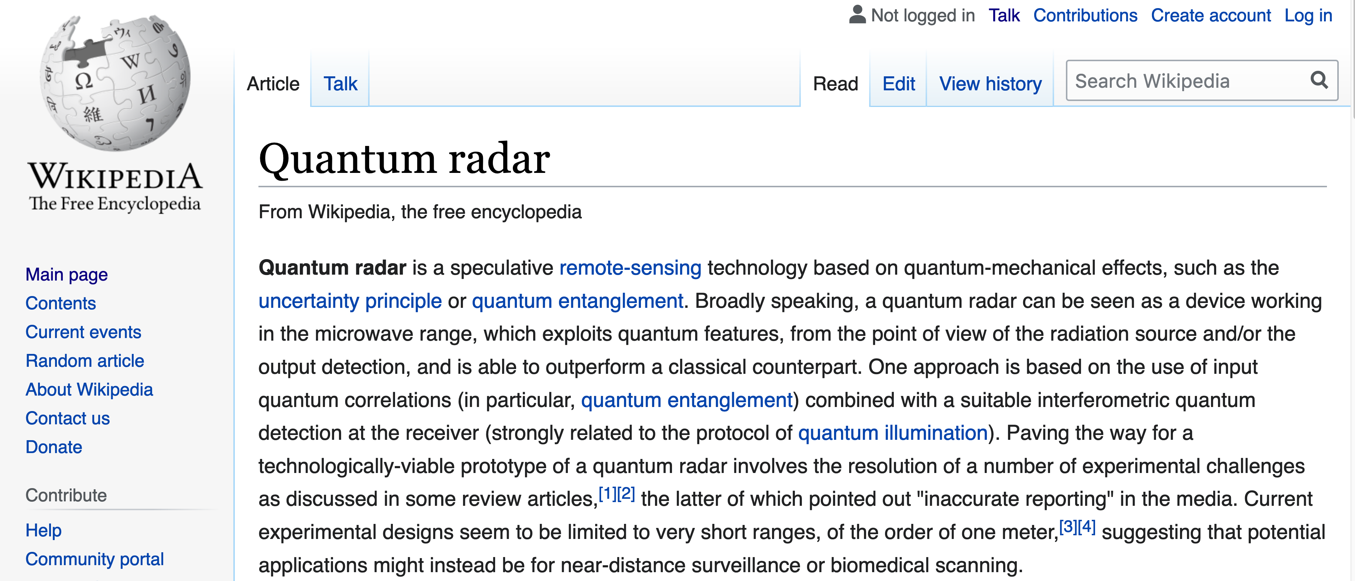
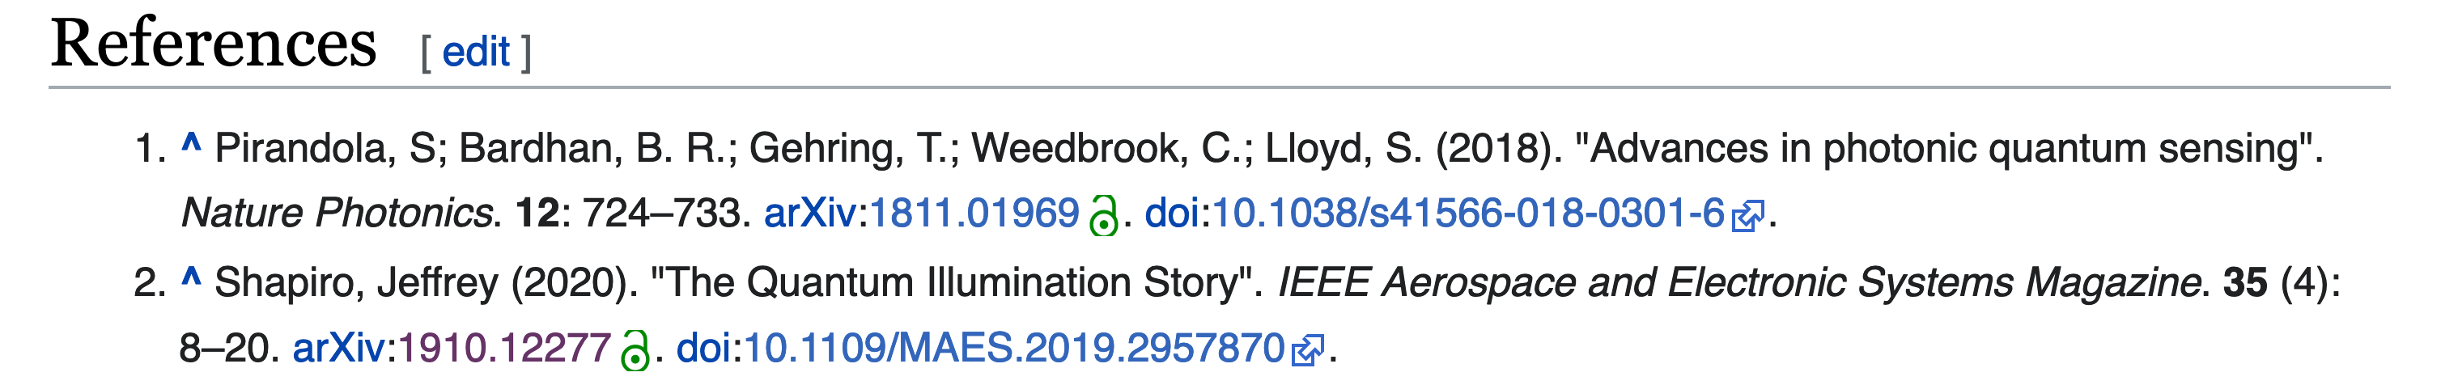
Epilogue… Wikipedia has been Updated

