Slide 1
Characterizing Entanglement from Correlations:
The Multi-partite case
Slide 1 of 34
James Schneeloch,
Christopher C. Tison, Michael L. Fanto, Shannon Ray, and Paul M Alsing
Quantum Information Processing Group, Information Directorate, Rome, NY 13441 USA
DISTRIBUTION A Approved for public release ; distribution unlimited 88ABW-2020-2140

Slide 2
Outline
Slide 2 of 34
What is quantum entanglement?
What makes 3-party entanglement special?
Measuring entanglement from correlations
Measures of three party entanglement
  Residual vs resource measures
Our method of quantifying three-party entanglement from correlations
The entanglement-correlation connection
DISTRIBUTION A Approved for public release ; distribution unlimited 88ABW-2020-2140

Slide 3
The Nature of Entanglement
Slide 3 of 34
DISTRIBUTION A Approved for public release ; distribution unlimited 88ABW-2020-2140

Slide 4
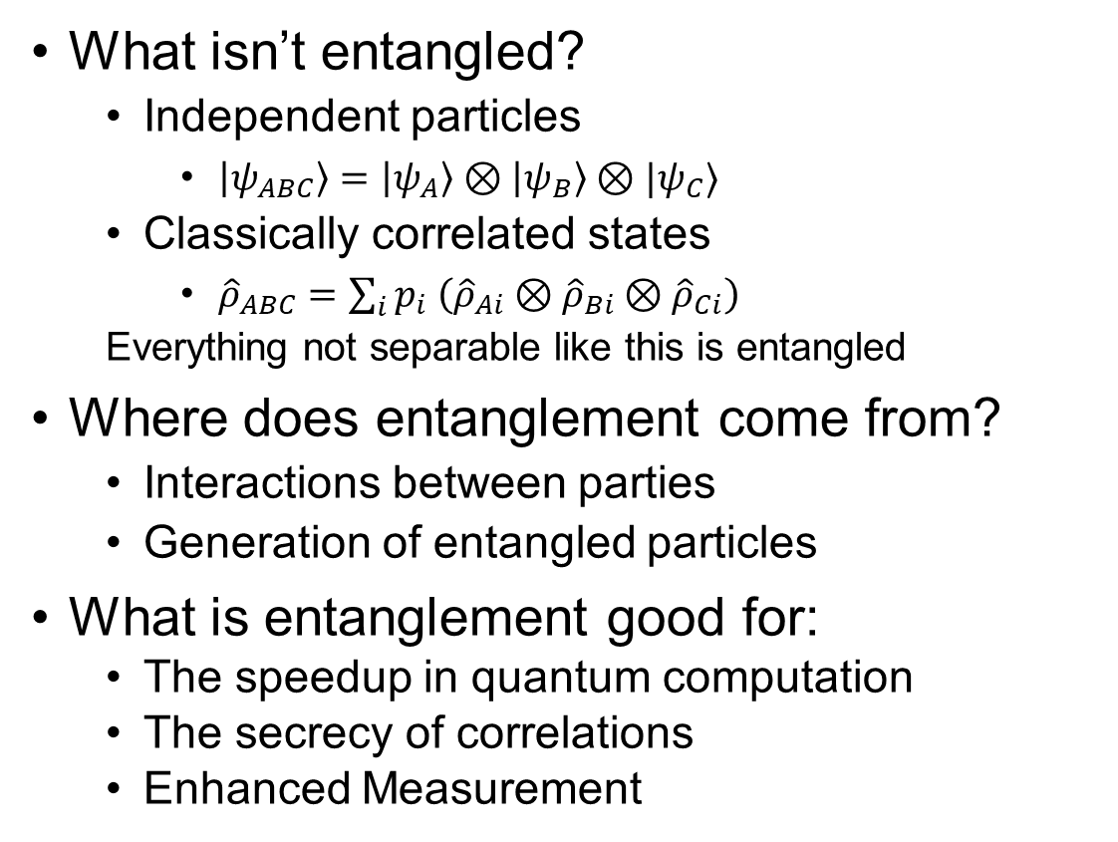
What is entanglement?
(It’s more the rule than the exception)
Slide 4 of 34
What isn’t entangled?
  Independent particles
    $\left|ψ_{ABC}\right\rangle =\left|ψ_{A}\right\rangle ⊗\left|ψ_{B}\right\rangle ⊗|ψ_{C}⟩$
  Classically correlated states
    ${\hat{ρ}}_{ABC}=\sum_{i}{p_{i} \left({\hat{ρ}}_{Ai}⊗{\hat{ρ}}_{Bi}⊗{\hat{ρ}}_{Ci}\right)}$
  Everything not separable like this is entangled
Where does entanglement come from?
  Interactions between parties
  Generation of entangled particles
What is entanglement good for:
  The speedup in quantum computation
  The secrecy of correlations
  Enhanced Measurement
DISTRIBUTION A Approved for public release ; distribution unlimited 88ABW-2020-2140
Notes:
Enhanced measurement: E.g., squeezed light LIGO, beating the standard quantum limit in phase estimation (n independent particles vs noon state) and illumination
With a fairly sampled set of states (uniform on the eigenvalue simplex, and uniform on the Haar measure of Unitary transformations), the probability that a randomly drawn quantum state is separable decreases exponentially with system dimension. See Zyczkowski et al. “Volume of the set of Separable States”, Phys. Rev. A, 58, 2, (1998).

Slide 5
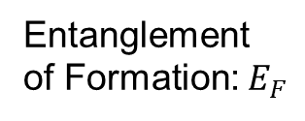
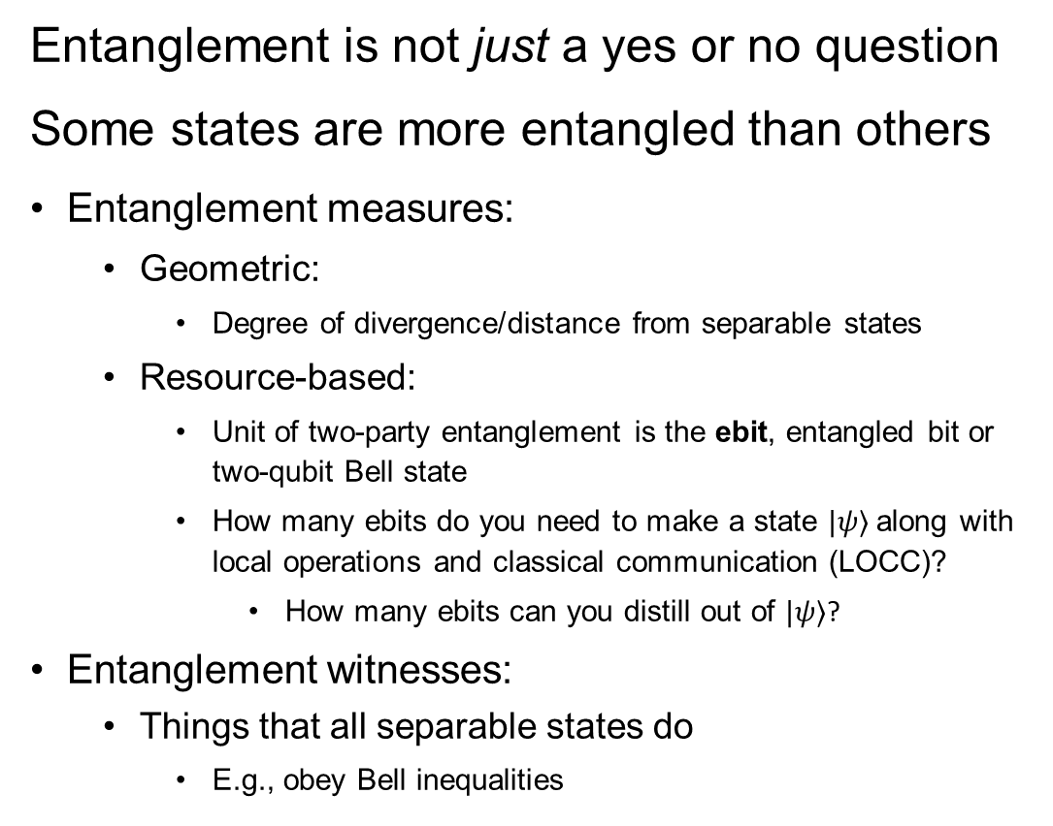
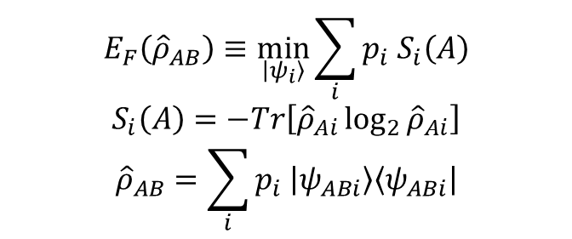
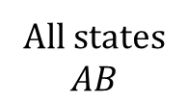
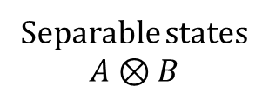
Entanglement between two parties
Slide 5 of 34
Entanglement is not just a yes or no question
Some states are more entangled than others
Entanglement measures:
  Geometric:
    Degree of divergence/distance from separable states
  Resource-based:
    Unit of two-party entanglement is the ebit, entangled bit or two-qubit Bell state
    How many ebits do you need to make a state $|ψ⟩$ along with local operations and classical communication (LOCC)?
      How many ebits can you distill out of $|ψ⟩$?
Entanglement witnesses:
  Things that all separable states do
    E.g., obey Bell inequalities
Witness
All states
$$AB$$
Separable states
$$A⊗B$$
Entanglement
of Formation: $E_{F}$
$$E_{F}\left({\hat{ρ}}_{AB}\right)≡\min_{\left|ψ_{i}\right\rangle }{\sum_{i}{p_{i} S_{i}\left(A\right)}}$$
$$S_{i}\left(A\right)=−Tr\left[{\hat{ρ}}_{Ai}\log_{2}{{\hat{ρ}}_{Ai}}\right]$$
$${\hat{ρ}}_{AB}=\sum_{i}{p_{i} \left|ψ_{ABi}\right\rangle \left\langle ψ_{ABi}\right|}$$
DISTRIBUTION A Approved for public release ; distribution unlimited 88ABW-2020-2140

Slide 6
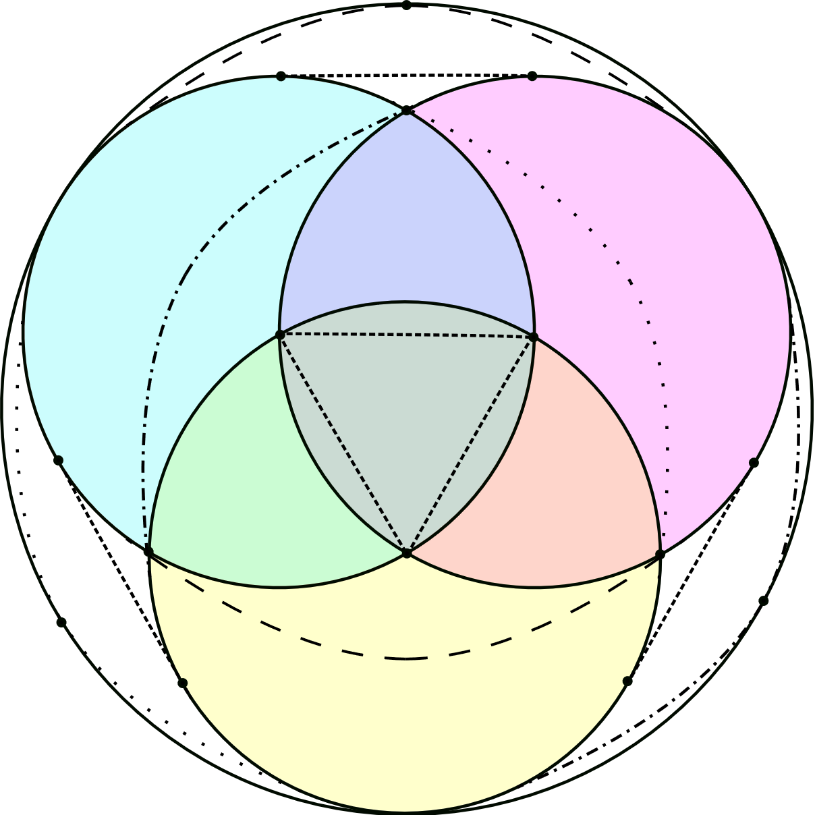
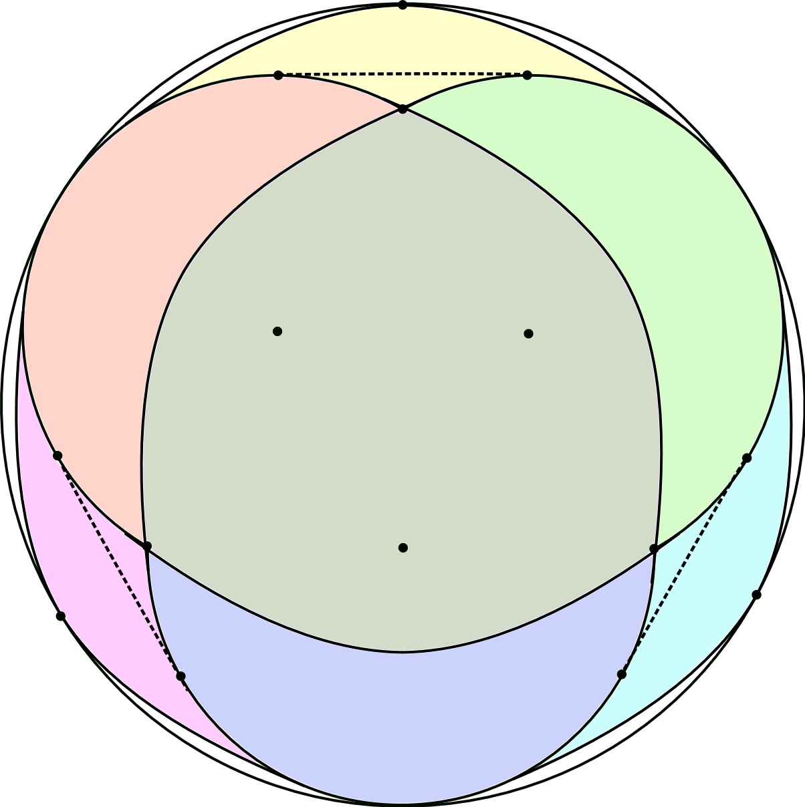
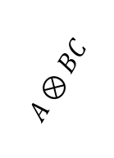
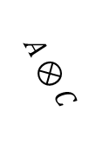
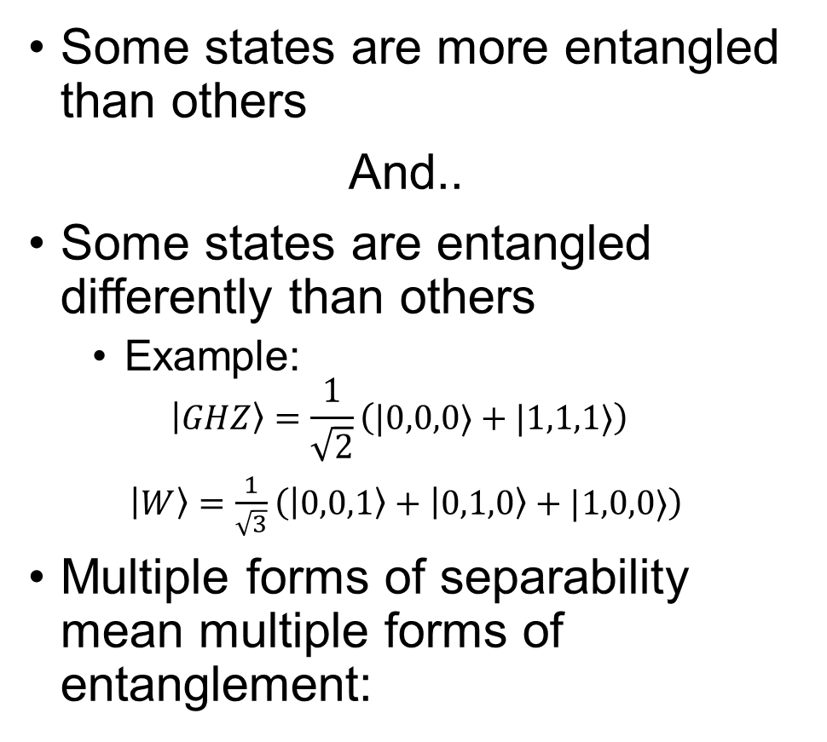



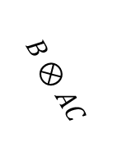
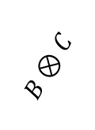
Entanglement between three or more parties
Slide 6 of 34
Some states are more entangled than others
And..
Some states are entangled differently than others
  Example:
$$\left|GHZ\right\rangle =\frac{1}{\sqrt{2}}\left(|0,0,0⟩+|1,1,1⟩\right)$$
$\left|W\right\rangle =\frac{1}{\sqrt{3}}$ $\left(\left|0,0,1\right\rangle +\left|0,1,0\right\rangle +|1,0,0⟩\right)$
Multiple forms of separability mean multiple forms of entanglement:
$$A⊗BC$$
$$B⊗AC$$
$$A⊗B⊗C$$
Two-party classes
$$A⊗B$$
$$C⊗AB$$
Three-party classes
$$A⊗C$$
$$B⊗C$$
DISTRIBUTION A Approved for public release ; distribution unlimited 88ABW-2020-2140
Notes:
Next slide will go into classes in more detail, so there’s no need to discuss It here. All that needs to be said is that two-party states can be ordered from least to most entangled because there’s only one form of separability. For three parties, you need to qualify from what form of separability the entanglement is being defined.

Slide 7
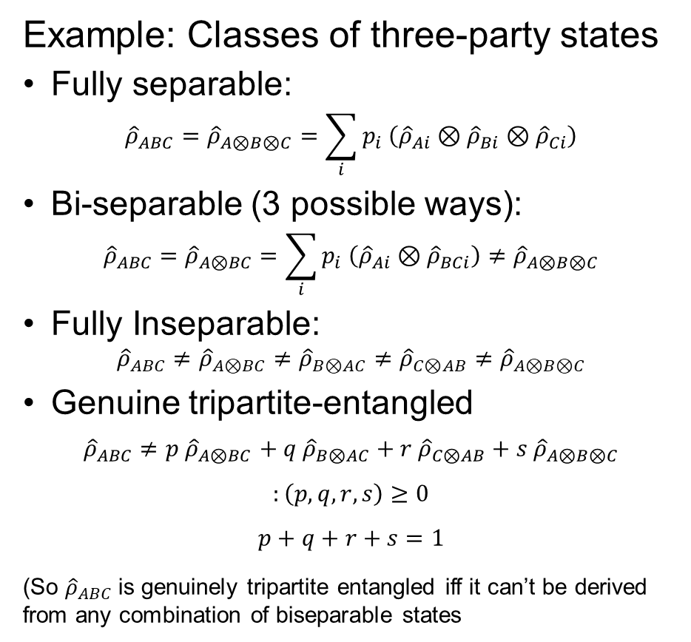
Entanglement between three or more parties
Slide 7 of 34
Example: Classes of three-party states
Fully separable:
$${\hat{ρ}}_{ABC}={\hat{ρ}}_{A⊗B⊗C}=\sum_{i}{p_{i} \left({\hat{ρ}}_{Ai}⊗{\hat{ρ}}_{Bi}⊗{\hat{ρ}}_{Ci}\right)}$$
Bi-separable (3 possible ways):
$${\hat{ρ}}_{ABC}={\hat{ρ}}_{A⊗BC}=\sum_{i}{p_{i} \left({\hat{ρ}}_{Ai}⊗{\hat{ρ}}_{BCi}\right)}≠{\hat{ρ}}_{A⊗B⊗C}$$
Fully Inseparable:
$${\hat{ρ}}_{ABC}{≠{\hat{ρ}}_{A⊗BC}≠{\hat{ρ}}_{B⊗AC}≠{\hat{ρ}}_{C⊗AB}≠\hat{ρ}}_{A⊗B⊗C}$$
Genuine tripartite-entangled
$${\hat{ρ}}_{ABC}{≠p \hat{ρ}}_{A⊗BC}+ q {\hat{ρ}}_{B⊗AC}+r {\hat{ρ}}_{C⊗AB}+s {\hat{ρ}}_{A⊗B⊗C}$$
$$:\left(p,q,r,s\right)≥0$$
$$p+q+r+s=1$$
(So ${\hat{ρ}}_{ABC}$ is genuinely tripartite entangled iff it can’t be derived from any combination of biseparable states
Fully inseparable, but not tripartite entangled
$$A⊗BC$$
$$B⊗AC$$
Triply biseparable, but not fully separable
$$A⊗B⊗C$$
Two-party classes
$$A⊗B$$
$$C⊗AB$$
Three-party classes
Side note:
A fully representative diagram would require four spatial dimensions!
$$B⊗C$$
$$A⊗C$$
DISTRIBUTION A Approved for public release ; distribution unlimited 88ABW-2020-2140
Notes:
Each biseparable set (e.g., A\otimes BC) is the convex hull of biseparable pure states in that set.
The intersection of two biseparable sets can only occur at the boundary because pure states cannot exist on the interior.
If each set of biseparable states is of dimension N, the intersection of two sets is at most N-1 dimensional , and the intersection of all three sets is at most N-2 dimensional.
The class of triply biseparable states is at least 2-dimensional because it contains states both inside and outside the set of fully separable states.

Slide 8
Measuring
Entanglement
Slide 8 of 34
DISTRIBUTION A Approved for public release ; distribution unlimited 88ABW-2020-2140

Slide 9
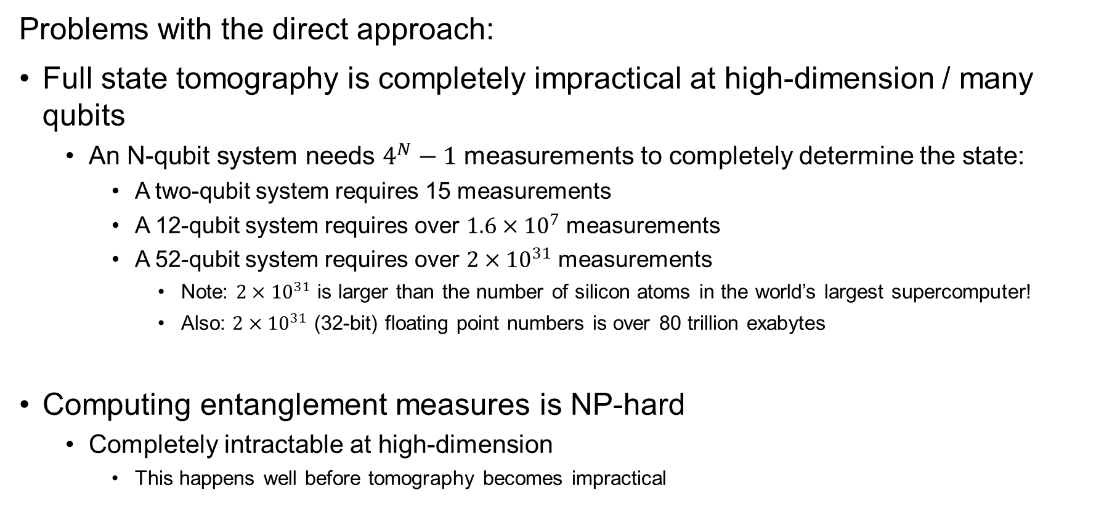
How do we measure entanglement?
Slide 9 of 34
Problems with the direct approach:
Full state tomography is completely impractical at high-dimension / many qubits
  An N-qubit system needs $4^{N}−1$ measurements to completely determine the state:
    A two-qubit system requires 15 measurements
    A 12-qubit system requires over $1.6×{10}^{7}$ measurements
    A 52-qubit system requires over $2×{10}^{31}$ measurements
      Note: $2×{10}^{31}$ is larger than the number of silicon atoms in the world’s largest supercomputer!
      Also: $2×{10}^{31}$ (32-bit) floating point numbers is over 80 trillion exabytes
Computing entanglement measures is NP-hard
  Completely intractable at high-dimension
    This happens well before tomography becomes impractical
DISTRIBUTION A Approved for public release ; distribution unlimited 88ABW-2020-2140
Notes:
20 nonillion = 20 million trillion trillion
https://images.nvidia.com/content/pdf/worlds-fastest-supercomputer-summit-infographic.pdf
Y. Huang, “Computing Quantum Discord is NP-Complete,” New Journal of Physics16, 033027 (2014)

Slide 10
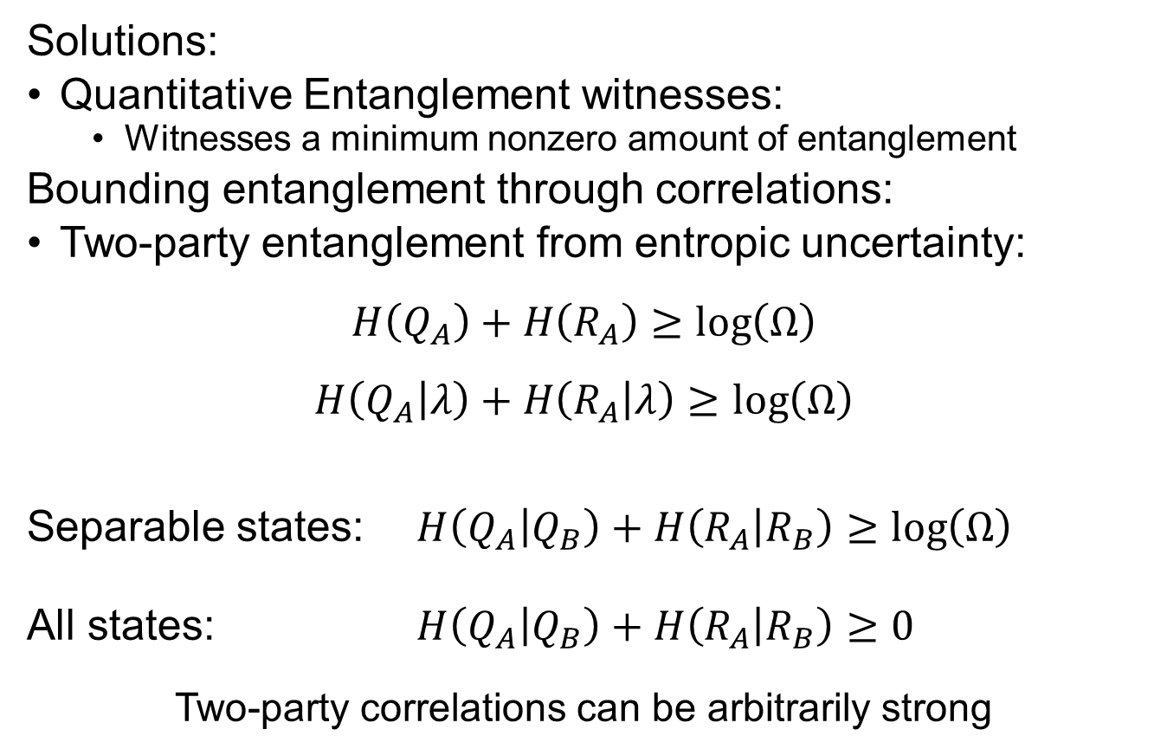
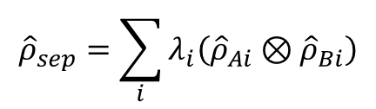
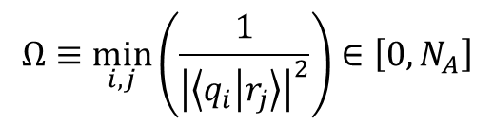

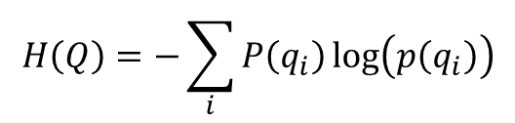
Measuring Entanglement with Correlations
Slide 10 of 34
Solutions:
Quantitative Entanglement witnesses:
  Witnesses a minimum nonzero amount of entanglement
Bounding entanglement through correlations:
Two-party entanglement from entropic uncertainty:
$$H\left(Q_{A}\right)+H\left(R_{A}\right)≥\log\left(Ω\right)$$
$$H\left(Q_{A} | λ\right)+H\left(R_{A} | λ\right)≥\log\left(Ω\right)$$
Separable states: $H\left(Q_{A} | Q_{B}\right)+H\left(R_{A} | R_{B}\right)≥\log\left(Ω\right)$
All states: $H\left(Q_{A} | Q_{B}\right)+H\left(R_{A} | R_{B}\right)≥0$
Two-party correlations can be arbitrarily strong
$$H\left(Q\right)=−\sum_{i}{P\left(q_{i}\right)\log\left(p\left(q_{i}\right)\right)}$$
$$H\left(Q_{A} | Q_{B}\right)=H\left(Q_{A},Q_{B}\right)−H\left(Q_{B}\right)$$
$$Ω≡\min_{i,j}\left(\frac{1}{{\left|\left\langle q_{i} | r_{j}\right\rangle \right|}^{2}}\right)∈\left[0,N_{A}\right]$$
$${\hat{ρ}}_{sep}=\sum_{i}{λ_{i}\left({\hat{ρ}}_{Ai}⊗{\hat{ρ}}_{Bi}\right)}$$
DISTRIBUTION A Approved for public release ; distribution unlimited 88ABW-2020-2140

Slide 11
Measuring Entanglement with Correlations
Slide 11 of 34
Solutions:
Quantitative Entanglement witnesses:
  Witnesses a minimum nonzero amount of entanglement
Bounding entanglement through correlations:
Two-party entanglement from entropic uncertainty:
$$H\left(Q_{A}\right)+H\left(R_{A}\right)≥\log\left(Ω\right)$$
$$H\left(Q_{A} | λ\right)+H\left(R_{A} | λ\right)≥\log\left(Ω\right)$$
Separable states: $H\left(Q_{A} | Q_{B}\right)+H\left(R_{A} | R_{B}\right)≥\log\left(Ω\right)$
All states: $H\left(Q_{A} | Q_{B}\right)+H\left(R_{A} | R_{B}\right)≥0$
Two-party correlations can be arbitrarily strong
$$H\left(Q\right)=−\sum_{i}{P\left(q_{i}\right)\log\left(p\left(q_{i}\right)\right)}$$
$$H\left(Q_{A} | Q_{B}\right)=H\left(Q_{A},Q_{B}\right)−H\left(Q_{B}\right)$$
$$Ω≡\min_{i,j}\left(\frac{1}{{\left|\left\langle q_{i} | r_{j}\right\rangle \right|}^{2}}\right)∈\left[0,N_{A}\right]$$
$${\hat{ρ}}_{sep}=\sum_{i}{λ_{i}\left({\hat{ρ}}_{Ai}⊗{\hat{ρ}}_{Bi}\right)}$$
DISTRIBUTION A Approved for public release ; distribution unlimited 88ABW-2020-2140

Slide 12
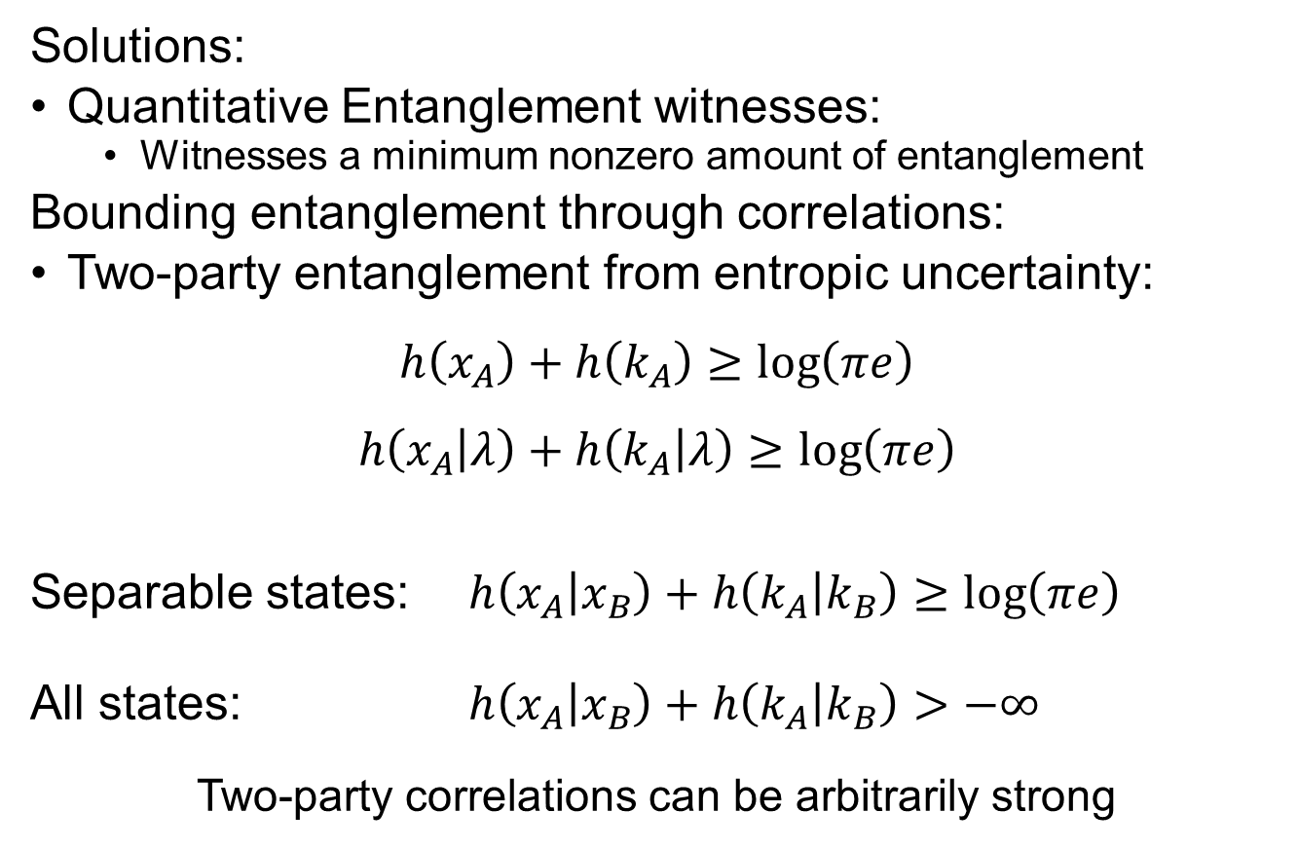


Measuring Entanglement with Correlations
Slide 12 of 34
Solutions:
Quantitative Entanglement witnesses:
  Witnesses a minimum nonzero amount of entanglement
Bounding entanglement through correlations:
Two-party entanglement from entropic uncertainty:
$$h\left(x_{A}\right)+h\left(k_{A}\right)≥\log\left(πe\right)$$
$$h\left(x_{A} | λ\right)+h\left(k_{A} | λ\right)≥\log\left(πe\right)$$
Separable states: $h\left(x_{A} | x_{B}\right)+h\left(k_{A} | k_{B}\right)≥\log\left(πe\right)$
All states: $h\left(x_{A} | x_{B}\right)+h\left(k_{A} | k_{B}\right)>−∞$
Two-party correlations can be arbitrarily strong
$$h\left(x\right)=−∫dxρ\left(x\right)\log\left(ρ\left(x\right)\right)$$
$$h\left(x_{A} | x_{B}\right)=h\left(x_{A},x_{B}\right)−h\left(x_{B}\right)$$
$${\hat{ρ}}_{sep}=\sum_{i}{λ_{i}\left({\hat{ρ}}_{Ai}⊗{\hat{ρ}}_{Bi}\right)}$$
DISTRIBUTION A Approved for public release ; distribution unlimited 88ABW-2020-2140

Slide 13


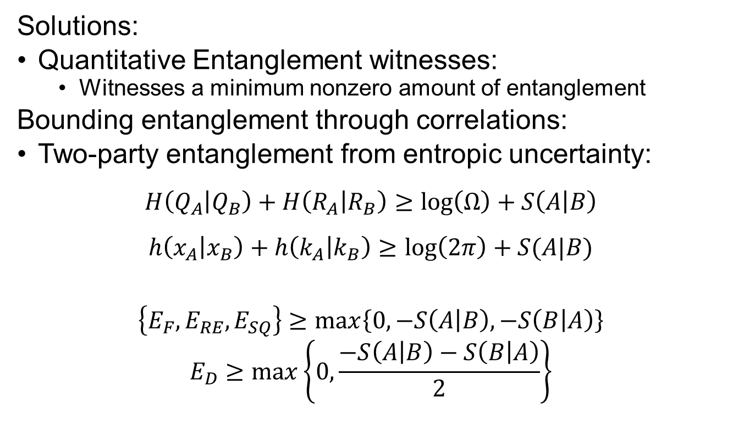
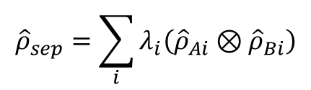
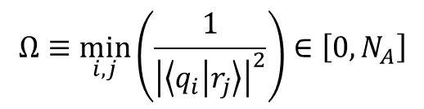
Measuring Entanglement with Correlations
Slide 13 of 34
Solutions:
Quantitative Entanglement witnesses:
  Witnesses a minimum nonzero amount of entanglement
Bounding entanglement through correlations:
Two-party entanglement from entropic uncertainty:
$$H\left(Q_{A} | Q_{B}\right)+H\left(R_{A} | R_{B}\right)≥\log\left(Ω\right)+S\left(A | B\right)$$
$$h\left(x_{A} | x_{B}\right)+h\left(k_{A} | k_{B}\right)≥\log\left(2π\right)+S(A|B)$$
$$\left\{E_{F},E_{RE},E_{SQ}\right\}≥\max\left\{0,−S\left(A | B\right),−S\left(B | A\right)\right\}$$
$$E_{D}≥\max\left\{0,\frac{−S\left(A | B\right)−S\left(B | A\right)}{2}\right\}$$
$$H\left(Q\right)=−\sum_{i}{P\left(q_{i}\right)\log\left(p\left(q_{i}\right)\right)}$$
$$H\left(Q_{A} | Q_{B}\right)=H\left(Q_{A},Q_{B}\right)−H\left(Q_{B}\right)$$
$$S\left(A\right)=−Tr\left[{\hat{ρ}}_{A}\log\left({\hat{ρ}}_{A}\right)\right]$$
$$S\left(A | B\right)=S\left(AB\right)−S\left(B\right)$$
$${\hat{ρ}}_{sep}=\sum_{i}{λ_{i}\left({\hat{ρ}}_{Ai}⊗{\hat{ρ}}_{Bi}\right)}$$
$$Ω≡\min_{i,j}\left(\frac{1}{{\left|\left\langle q_{i} | r_{j}\right\rangle \right|}^{2}}\right)∈\left[0,N_{A}\right]$$
DISTRIBUTION A Approved for public release ; distribution unlimited 88ABW-2020-2140

Slide 14
Measuring Entanglement with Correlations
Slide 14 of 34
This can be a very successful approach! (currently Record-setting)
Measured position and momentum correlations of entangled down-converted photon pairs
Course graining
never over-estimates
bound
Needed only 6456
measurements of
68-billion-dimensional
state space
DISTRIBUTION A Approved for public release ; distribution unlimited 88ABW-2020-2140

Slide 15
From two parties to three
Slide 15 of 34
DISTRIBUTION A Approved for public release ; distribution unlimited 88ABW-2020-2140

Slide 16


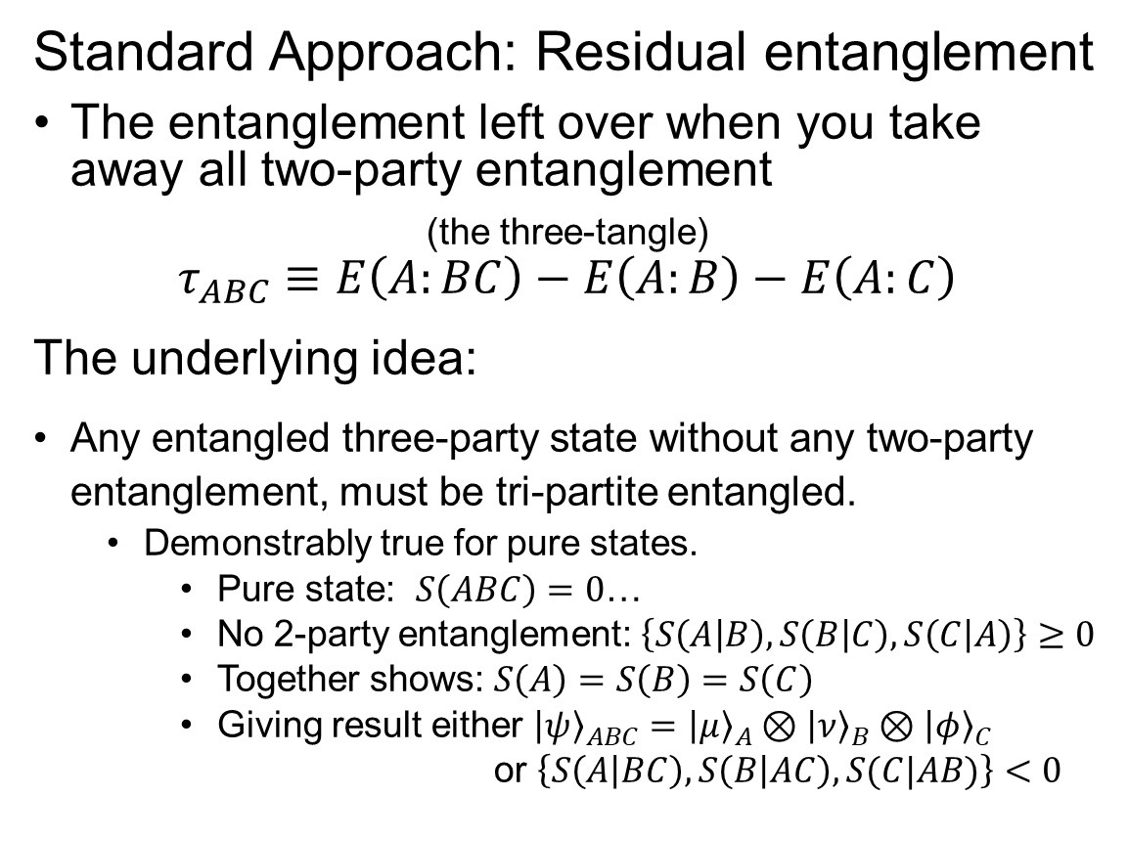
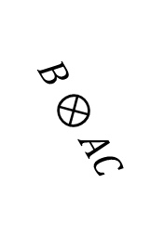
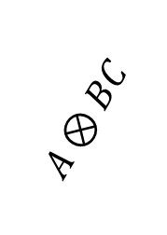
Measures of Three-Party Entanglement
Slide 16 of 34
Standard Approach: Residual entanglement
The entanglement left over when you take away all two-party entanglement
(the three-tangle)
$$τ_{ABC}≡E\left(A:BC\right)−E\left(A:B\right)−E\left(A:C\right)$$
The underlying idea:
Any entangled three-party state without any two-party entanglement, must be tri-partite entangled.
  Demonstrably true for pure states.
    Pure state: $S\left(ABC\right)=0$…
    No 2-party entanglement: $\left\{S\left(A | B\right),S\left(B | C\right),S\left(C | A\right)\right\}≥0$
    Together shows: $S\left(A\right)=S\left(B\right)=S\left(C\right)$
    Giving result either ${\left|ψ\right\rangle }_{ABC}={\left|μ\right\rangle }_{A}⊗{\left|ν\right\rangle }_{B}⊗{\left|φ\right\rangle }_{C}$
    or $\left\{S\left(A | BC\right),S\left(B | AC\right),S(C|AB)\right\}<0$
$$A⊗BC$$
$$B⊗AC$$
$$A⊗B⊗C$$
$$C⊗AB$$
Three-party classes
DISTRIBUTION A Approved for public release ; distribution unlimited 88ABW-2020-2140

Slide 17
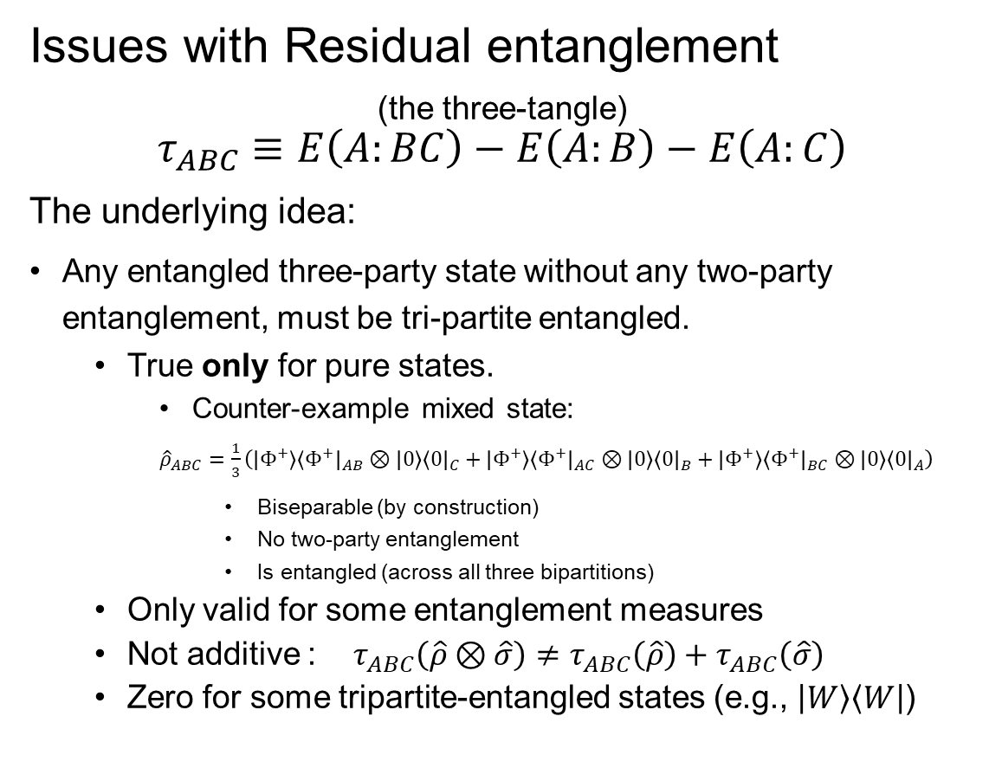
Measures of Three-Party Entanglement
Slide 17 of 34
Issues with Residual entanglement
(the three-tangle)
$$τ_{ABC}≡E\left(A:BC\right)−E\left(A:B\right)−E\left(A:C\right)$$
The underlying idea:
Any entangled three-party state without any two-party entanglement, must be tri-partite entangled.
  True only for pure states.
    Counter-example mixed state:
${\hat{ρ}}_{ABC}=\frac{1}{3}\left(\left|Φ^{+}\right\rangle {\left\langle Φ^{+}\right|}_{AB}⊗{\left|0\right\rangle \left\langle 0\right|}_{C}+\left|Φ^{+}\right\rangle {\left\langle Φ^{+}\right|}_{AC}⊗{\left|0\right\rangle \left\langle 0\right|}_{B}+\left|Φ^{+}\right\rangle {\left\langle Φ^{+}\right|}_{BC}⊗{\left|0\right\rangle \left\langle 0\right|}_{A}\right)$
      Biseparable (by construction)
      No two-party entanglement
      Is entangled (across all three bipartitions)
  Only valid for some entanglement measures
  Not additive : $τ_{ABC}\left(\hat{ρ}⊗\hat{σ}\right)≠τ_{ABC}\left(\hat{ρ}\right)+τ_{ABC}\left(\hat{σ}\right)$
  Zero for some tripartite-entangled states (e.g., $\left|W\right\rangle \left\langle W\right|$)
$$A⊗BC$$
$$B⊗AC$$
$$A⊗B⊗C$$
$$C⊗AB$$
Three-party classes
DISTRIBUTION A Approved for public release ; distribution unlimited 88ABW-2020-2140
Notes:
https://arxiv.org/abs/2003.14390

Slide 18
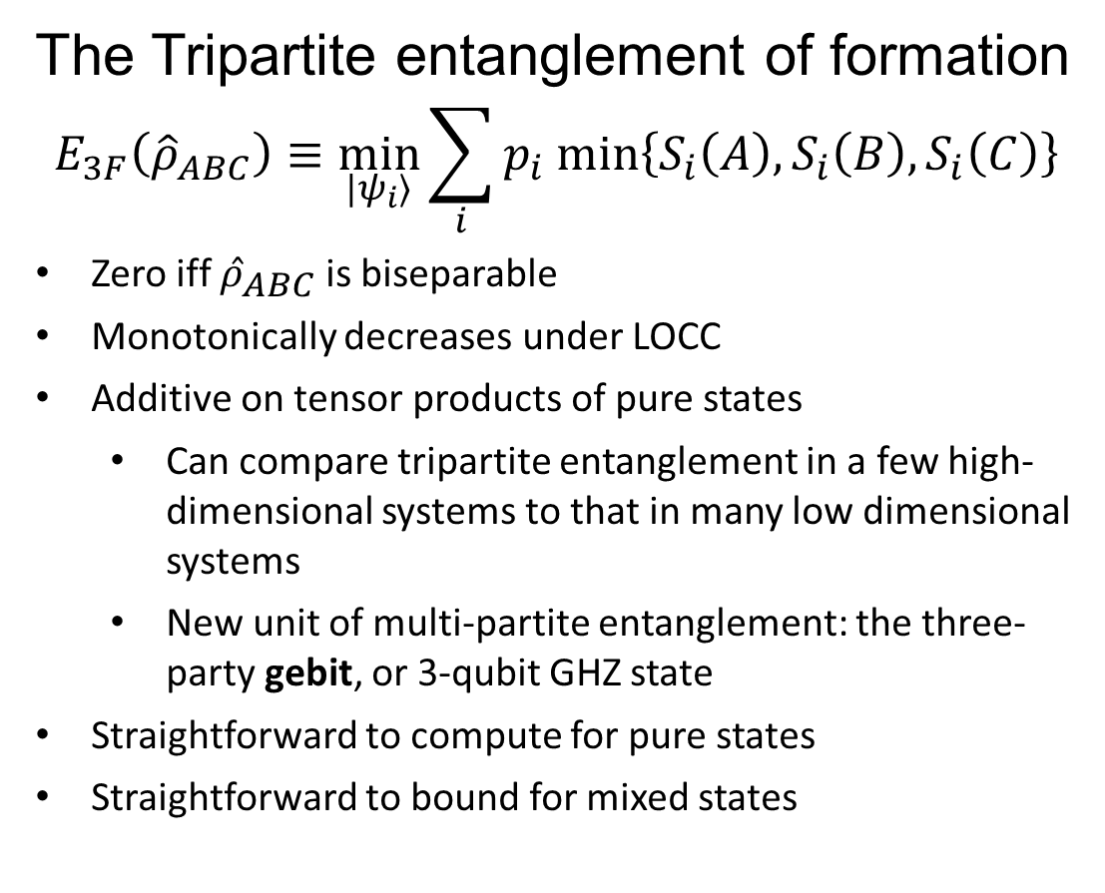
Measures of Three-Party Entanglement
Slide 18 of 34
The Tripartite entanglement of formation
$$E_{3F}\left({\hat{ρ}}_{ABC}\right)≡\min_{|ψ_{i}⟩}{\sum_{i}{p_{i} min\left\{S_{i}\left(A\right),S_{i}\left(B\right),S_{i}\left(C\right)\right\}}}$$
Zero iff ${\hat{ρ}}_{ABC}$ is biseparable
Monotonically decreases under LOCC
Additive on tensor products of pure states
  Can compare tripartite entanglement in a few high-dimensional systems to that in many low dimensional systems
  New unit of multi-partite entanglement: the three-party gebit, or 3-qubit GHZ state
Straightforward to compute for pure states
Straightforward to bound for mixed states
$$A⊗BC$$
$$B⊗AC$$
$$A⊗B⊗C$$
$$C⊗AB$$
Three-party classes
DISTRIBUTION A Approved for public release ; distribution unlimited 88ABW-2020-2140

Slide 19
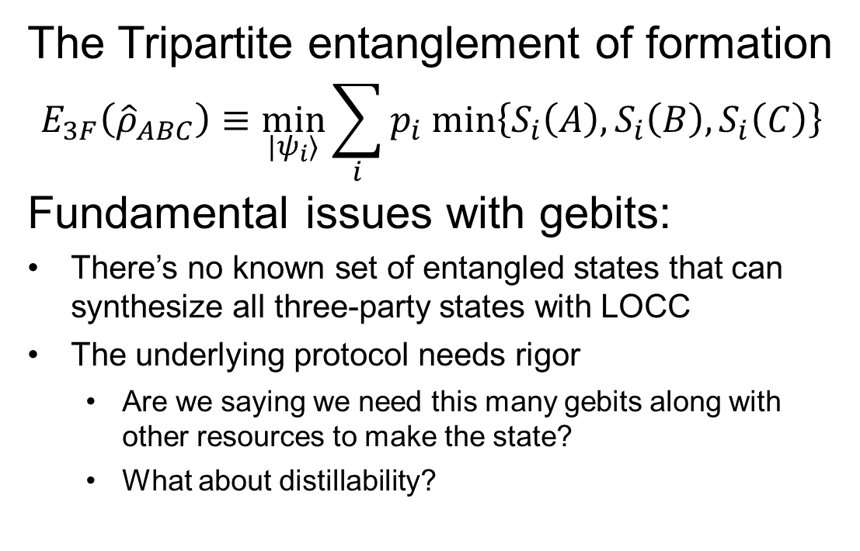
Measures of Three-Party Entanglement
Slide 19 of 34
The Tripartite entanglement of formation
$$E_{3F}\left({\hat{ρ}}_{ABC}\right)≡\min_{|ψ_{i}⟩}{\sum_{i}{p_{i} min\left\{S_{i}\left(A\right),S_{i}\left(B\right),S_{i}\left(C\right)\right\}}}$$
Fundamental issues with gebits:
There’s no known set of entangled states that can synthesize all three-party states with LOCC
The underlying protocol needs rigor
  Are we saying we need this many gebits along with other resources to make the state?
  What about distillability?
$$A⊗BC$$
$$B⊗AC$$
$$A⊗B⊗C$$
$$C⊗AB$$
Three-party classes
DISTRIBUTION A Approved for public release ; distribution unlimited 88ABW-2020-2140

Slide 20
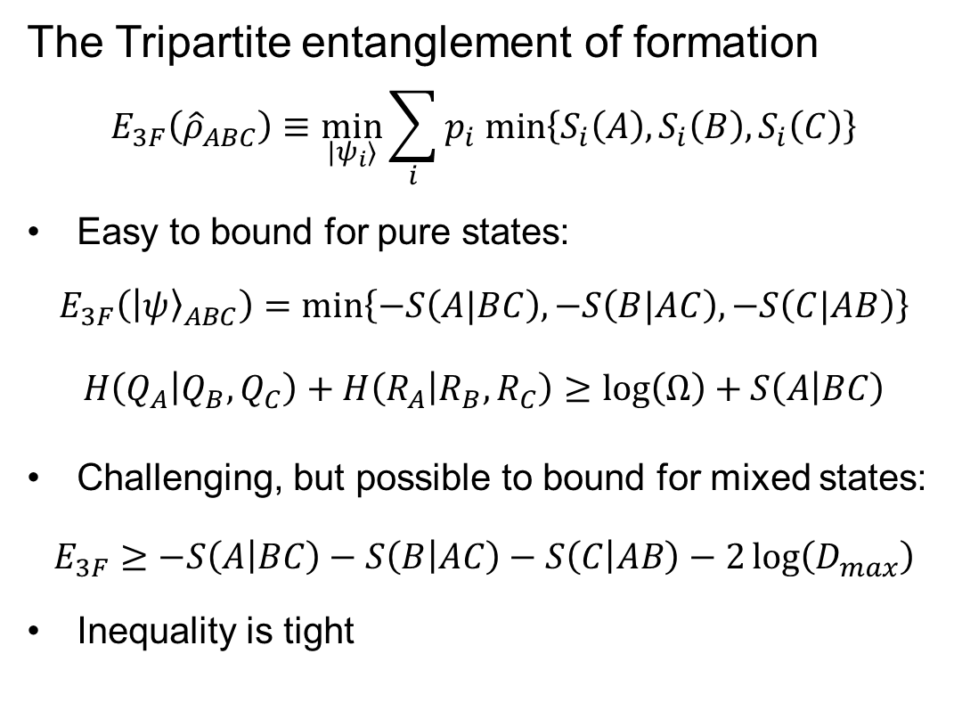
Bounding Three-Party Entanglement
Slide 20 of 34
The Tripartite entanglement of formation
$$E_{3F}\left({\hat{ρ}}_{ABC}\right)≡\min_{|ψ_{i}⟩}{\sum_{i}{p_{i} min\left\{S_{i}\left(A\right),S_{i}\left(B\right),S_{i}\left(C\right)\right\}}}$$
Easy to bound for pure states:
$$E_{3F}\left({\left|ψ\right\rangle }_{ABC}\right)=\min\left\{−S\left(A|BC\right),−S\left(B|AC\right),−S\left(C|AB\right)\right\}$$
$$H\left(Q_{A} | Q_{B},Q_{C}\right)+H\left(R_{A} | R_{B},R_{C}\right)≥\log\left(Ω\right)+S\left(A | BC\right)$$
Challenging, but possible to bound for mixed states:
$$E_{3F}≥−S\left(A | BC\right)−S\left(B | AC\right)−S\left(C | AB\right)−2\log\left(D_{max}\right)$$
Inequality is tight
$$A⊗BC$$
$$B⊗AC$$
$$A⊗B⊗C$$
$$C⊗AB$$
Three-party classes
DISTRIBUTION A Approved for public release ; distribution unlimited 88ABW-2020-2140

Slide 21
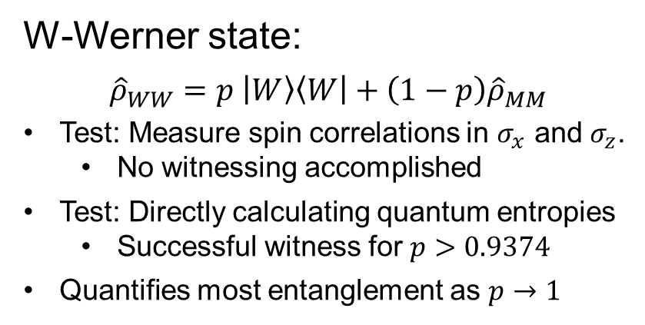
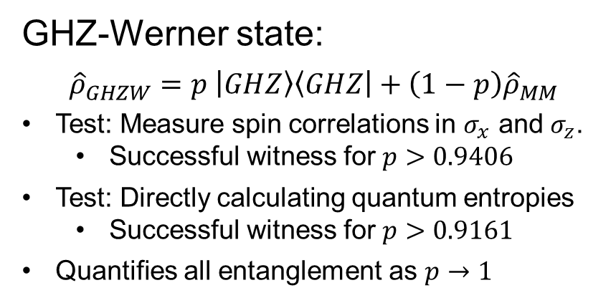
How successful is our strategy?
Slide 21 of 34
GHZ-Werner state:
$${\hat{ρ}}_{GHZW}=p \left|GHZ\right\rangle \left\langle GHZ\right|+\left(1−p\right){\hat{ρ}}_{MM}$$
Test: Measure spin correlations in $σ_{x}$ and $σ_{z}$.
  Successful witness for $p>0.9406$
Test: Directly calculating quantum entropies
  Successful witness for $p>0.9161$
Quantifies all entanglement as $p→1$
Open question: Can we do better using higher-order forms of entropy?
W-Werner state:
$${\hat{ρ}}_{WW}=p \left|W\right\rangle \left\langle W\right|+\left(1−p\right){\hat{ρ}}_{MM}$$
Test: Measure spin correlations in $σ_{x}$ and $σ_{z}$.
  No witnessing accomplished
Test: Directly calculating quantum entropies
  Successful witness for $p>0.9374$
Quantifies most entanglement as $p→1$
DISTRIBUTION A Approved for public release ; distribution unlimited 88ABW-2020-2140
Notes:
The tripartite entanglement of the pure W state is 0.918296 three-party gebits, almost as much as the GHZ state itself!
The maximum amount of entanglement obtained for the mixed state from knowing the conditional entropies is 0.7549 three-party gebits
Knowing the W state is pure, one could quantify 0.4425 gebits from it, but that’s unrealistic

Slide 22

How successful is our strategy?
Slide 22 of 34
GHZ-Werner state:
$${\hat{ρ}}_{GHZW}=p \left|GHZ\right\rangle \left\langle GHZ\right|+\left(1−p\right){\hat{ρ}}_{MM}$$
Test: Measure spin correlations in $σ_{x}$ and $σ_{z}$.
  Successful witness for $p>0.9406$
Test: Directly calculating quantum entropies
  Successful witness for $p>0.9161$
Quantifies all entanglement as $p→1$
Open question: Can we do better using higher-order forms of entropy?
Fidelity witness:
$$p>\frac{3}{7}$$
Full inseparability:
$$p>\frac{1}{5}$$
W-Werner state:
$${\hat{ρ}}_{WW}=p \left|W\right\rangle \left\langle W\right|+\left(1−p\right){\hat{ρ}}_{MM}$$
Test: Measure spin correlations in $σ_{x}$ and $σ_{z}$.
  No witnessing accomplished
Test: Directly calculating quantum entropies
  Successful witness for $p>0.9374$
Quantifies most entanglement as $p→1$
DISTRIBUTION A Approved for public release ; distribution unlimited 88ABW-2020-2140
Notes:
N-partite negativity witness works exceptionally well for GHZ Werner state in that the high degree of symmetry makes it so that partial transposition over any bipartition yields the same set of eigenvalues. Indeed, the negativity witness for N qubits in the general case gives a minimum value for p as $\frac{1}{{1+2}^{N−1}}$, much better than the fidelity witness.

Slide 23
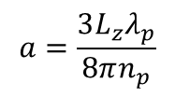
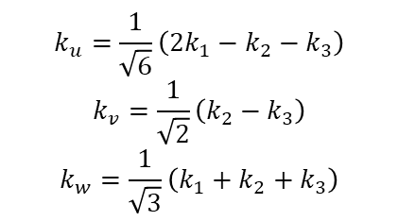
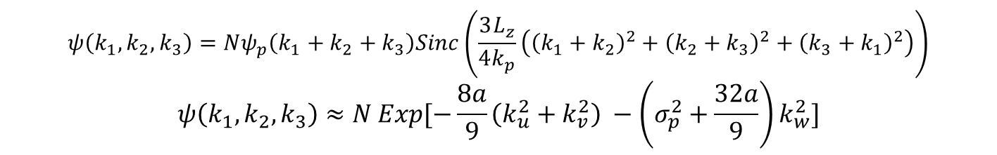
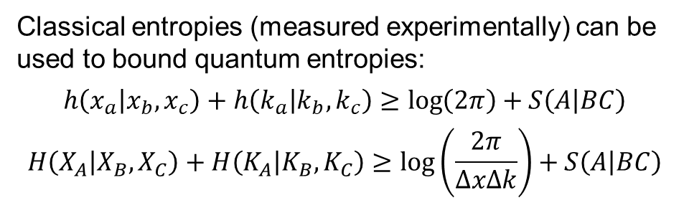
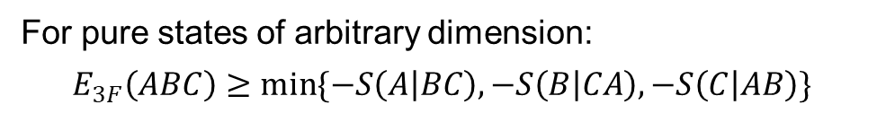
How successful is our strategy? (Examples)
Slide 23 of 34
Tri-photon pure state wavefunction
from third-order SPDC
$$a=\frac{3L_{z}λ_{p}}{8πn_{p}}$$
$$ψ\left(k_{1},k_{2},k_{3}\right)=Nψ_{p}\left(k_{1}+k_{2}+k_{3}\right)Sinc\left(\frac{3L_{z}}{4k_{p}}\left({\left(k_{1}+k_{2}\right)}^{2}+{\left(k_{2}+k_{3}\right)}^{2}+{\left(k_{3}+k_{1}\right)}^{2}\right)\right)$$
$$ψ\left(k_{1},k_{2},k_{3}\right)≈N Exp[−\frac{8a}{9}\left(k_{u}^{2}+k_{v}^{2}\right) −\left(σ_{p}^{2}+\frac{32a}{9}\right)k_{w}^{2}]$$
$$k_{u}=\frac{1}{\sqrt{6}}\left(2k_{1}−k_{2}−k_{3}\right)$$
$$k_{v}=\frac{1}{\sqrt{2}}\left(k_{2}−k_{3}\right)$$
$$k_{w}=\frac{1}{\sqrt{3}}\left(k_{1}+k_{2}+k_{3}\right)$$
For pure states of arbitrary dimension:
$$E_{3F}\left(ABC\right)≥\min{\{−S\left(A | BC\right),−S\left(B | CA\right),−S\left(C | AB\right)\}}$$
Classical entropies (measured experimentally) can be used to bound quantum entropies:
$$h\left(x_{a} | x_{b},x_{c}\right)+h\left(k_{a} | k_{b},k_{c}\right)≥\log\left(2π\right)+S\left(A | BC\right)$$
$$H\left(X_{A} | X_{B},X_{C}\right)+H\left(K_{A} | K_{B},K_{C}\right)≥\log\left(\frac{2π}{ΔxΔk}\right)+S\left(A | BC\right)$$
DISTRIBUTION A Approved for public release ; distribution unlimited 88ABW-2020-2140

Slide 24
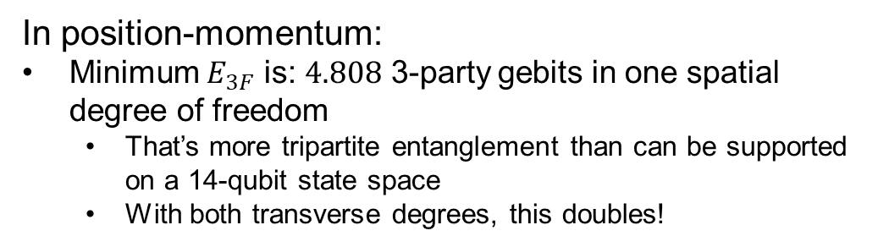
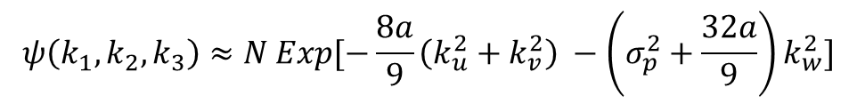

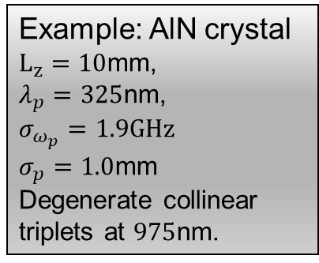
How successful is our strategy? (Examples)
Slide 24 of 34
Tri-photon pure state wavefunction
from third-order SPDC
$$a=\frac{3L_{z}λ_{p}}{8πn_{p}}$$
$$ψ\left(k_{1},k_{2},k_{3}\right)≈N Exp[−\frac{8a}{9}\left(k_{u}^{2}+k_{v}^{2}\right) −\left(σ_{p}^{2}+\frac{32a}{9}\right)k_{w}^{2}]$$
Example: AlN crystal
$L_{z}=10$mm,
$λ_{p}=325$nm,
$σ_{ω_{p}}=1.9GHz$
$σ_{p}=1.0$mm
Degenerate collinear
triplets at $975$nm.
In position-momentum:
Minimum $E_{3F}$ is: $4.808$ 3-party gebits in one spatial degree of freedom
  That’s more tripartite entanglement than can be supported on a 14-qubit state space
  With both transverse degrees, this doubles!
DISTRIBUTION A Approved for public release ; distribution unlimited 88ABW-2020-2140

Slide 25
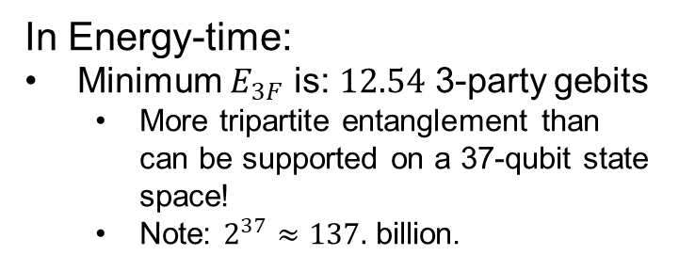
How successful is our strategy? (Examples)
Slide 25 of 34
Tri-photon pure state wavefunction
from third-order SPDC
$$a=\frac{3L_{z}λ_{p}}{8πn_{p}}$$
$$ψ\left(k_{1},k_{2},k_{3}\right)≈N Exp[−\frac{8a}{9}\left(k_{u}^{2}+k_{v}^{2}\right) −\left(σ_{p}^{2}+\frac{32a}{9}\right)k_{w}^{2}]$$
Example: AlN crystal
$L_{z}=10$mm,
$λ_{p}=325$nm,
$σ_{ω_{p}}=1.9GHz$
$σ_{p}=1.0$mm
Degenerate collinear
triplets at $975$nm.
In Energy-time:
Minimum $E_{3F}$ is: $12.54$ 3-party gebits
  More tripartite entanglement than can be supported on a 37-qubit state space!
  Note: $2^{37}≈137.$ billion.
In position-momentum:
Minimum $E_{3F}$ is: $4.808$ 3-party gebits in one spatial degree of freedom
  That’s more tripartite entanglement than can be supported on a 14-qubit state space
  With both transverse degrees, this doubles!
DISTRIBUTION A Approved for public release ; distribution unlimited 88ABW-2020-2140

Slide 26
From three parties to N
Slide 26 of 34
DISTRIBUTION A Approved for public release ; distribution unlimited 88ABW-2020-2140

Slide 27
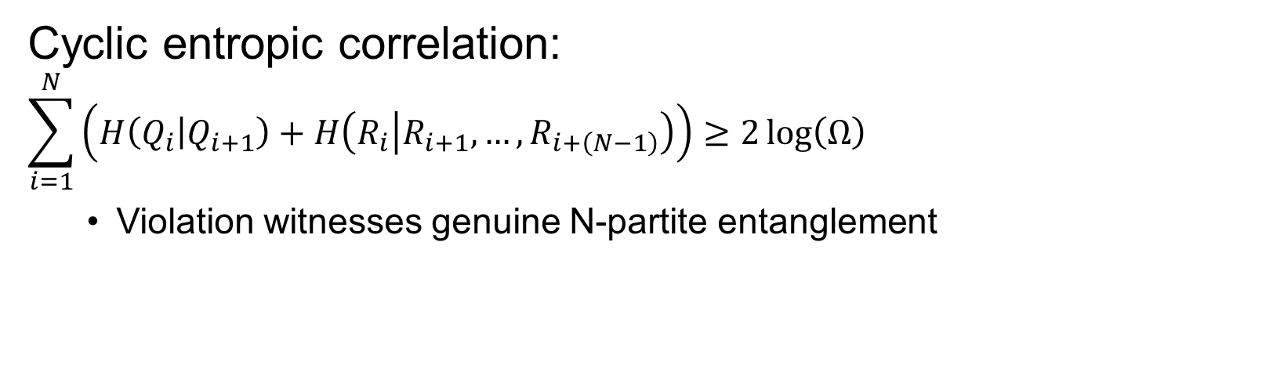
Witnesses for N Parties
Slide 27 of 34
Cyclic entropic correlation:
$$\sum_{i=1}^{N}{\left(H\left(Q_{i} | Q_{i+1}\right)+H\left(R_{i} | R_{i+1},…,R_{i+\left(N−1\right)}\right)\right)}≥2\log\left(Ω\right)$$
  Violation witnesses genuine N-partite entanglement
DISTRIBUTION A Approved for public release ; distribution unlimited 88ABW-2020-2140

Slide 28
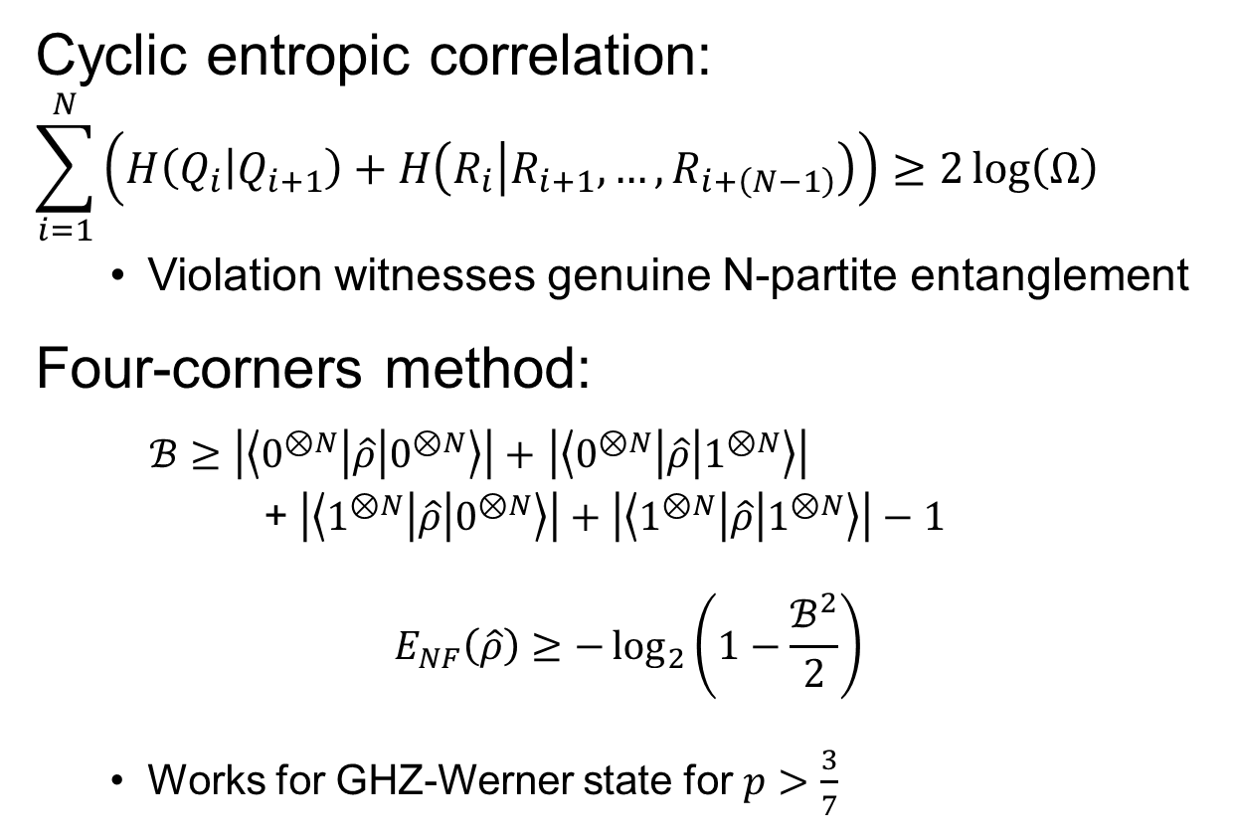
Witnesses for N Parties
Slide 28 of 34
Cyclic entropic correlation:
$$\sum_{i=1}^{N}{\left(H\left(Q_{i} | Q_{i+1}\right)+H\left(R_{i} | R_{i+1},…,R_{i+\left(N−1\right)}\right)\right)}≥2\log\left(Ω\right)$$
  Violation witnesses genuine N-partite entanglement
Four-corners method:
$ℬ≥\left|\left\langle 0^{⊗N} | \hat{ρ} | 0^{⊗N}\right\rangle \right|+$ $\left|\left\langle 0^{⊗N} | \hat{ρ} | 1^{⊗N}\right\rangle \right|$
+ $\left|\left\langle 1^{⊗N} | \hat{ρ} | 0^{⊗N}\right\rangle \right|+\left|\left\langle 1^{⊗N} | \hat{ρ} | 1^{⊗N}\right\rangle \right|−1$
$$E_{NF}\left(\hat{ρ}\right)≥−\log_{2}\left(1−\frac{ℬ^{2}}{2}\right)$$
  Works for GHZ-Werner state for $p>\frac{3}{7}$
DISTRIBUTION A Approved for public release ; distribution unlimited 88ABW-2020-2140

Slide 29
The entanglement-correlation connection
Slide 29 of 34
DISTRIBUTION A Approved for public release ; distribution unlimited 88ABW-2020-2140

Slide 30

Quantum Uncertainty limits N-partite correlations
Slide 30 of 34
Two parties:
The entropic uncertainty principle between maximally uncertain $\hat{Q}$ and $\hat{R}$ (and maximum entanglement):
$$H\left(Q_{A} | Q_{B}\right)+H\left(R_{A} | R_{B}\right)≥0$$
$$h\left(x_{A} | x_{B}\right)+h\left(k_{A} | k_{B}\right)>−∞$$
(No upper limit to correlations between two parties)
DISTRIBUTION A Approved for public release ; distribution unlimited 88ABW-2020-2140

Slide 31
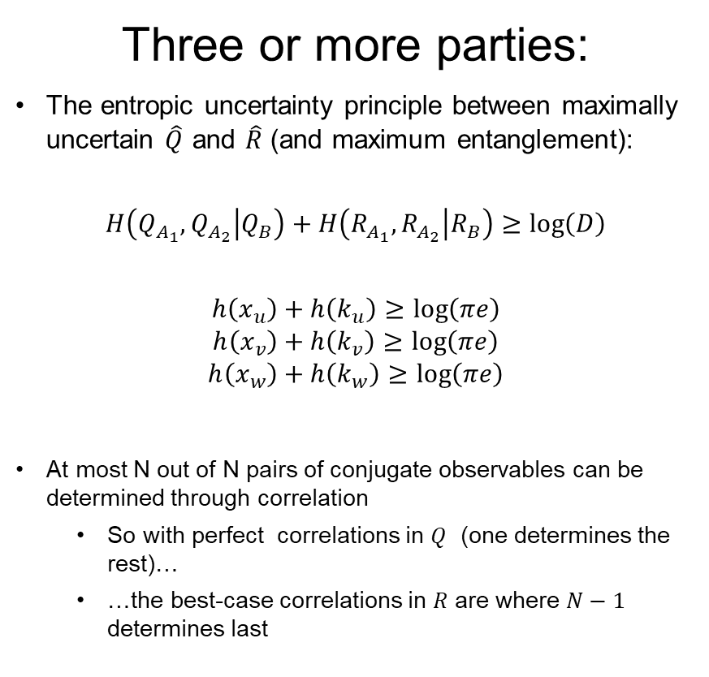

Quantum Uncertainty limits N-partite correlations
Slide 31 of 34
Three or more parties:
The entropic uncertainty principle between maximally uncertain $\hat{Q}$ and $\hat{R}$ (and maximum entanglement):
$$H\left(Q_{A_{1}},Q_{A_{2}} | Q_{B}\right)+H\left(R_{A_{1}},R_{A_{2}} | R_{B}\right)≥\log\left(D\right)$$
$$h\left(x_{u}\right)+h\left(k_{u}\right)≥\log\left(πe\right)$$
$$h\left(x_{v}\right)+h\left(k_{v}\right)≥\log\left(πe\right)$$
$$h\left(x_{w}\right)+h\left(k_{w}\right)≥\log\left(πe\right)$$
At most N out of N pairs of conjugate observables can be determined through correlation
  So with perfect correlations in $Q$ (one determines the rest)…
  …the best-case correlations in $R$ are where $N−1$ determines last
$$x_{u}=\frac{1}{\sqrt{6}}\left(2x_{1}−x_{2}−x_{3}\right)$$
$$x_{v}=\frac{1}{\sqrt{2}}\left(x_{2}−x_{3}\right)$$
$$x_{w}=\frac{1}{\sqrt{3}}\left(x_{1}+x_{2}+x_{3}\right)$$
DISTRIBUTION A Approved for public release ; distribution unlimited 88ABW-2020-2140

Slide 32
Conclusion
Slide 32 of 34
DISTRIBUTION A Approved for public release ; distribution unlimited 88ABW-2020-2140

Slide 33
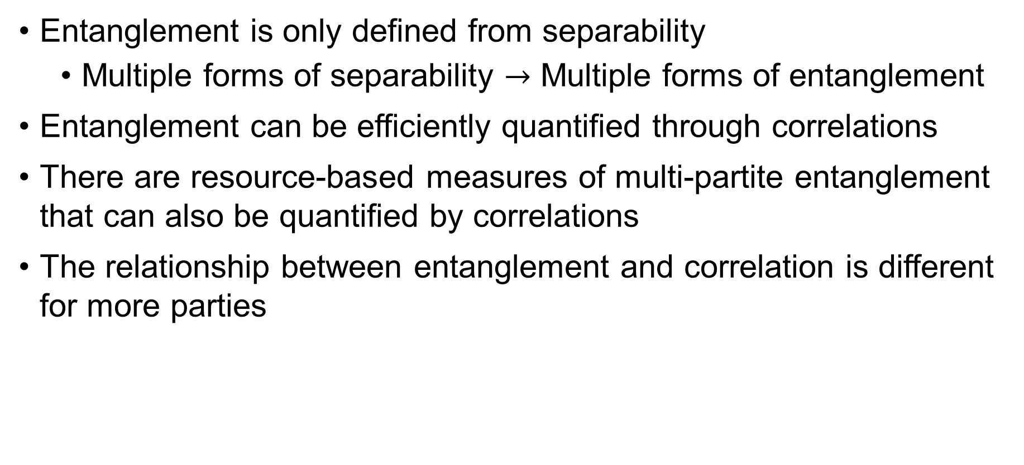
Concluding points
Slide 33 of 34
Entanglement is only defined from separability
  Multiple forms of separability $→$ Multiple forms of entanglement
Entanglement can be efficiently quantified through correlations
There are resource-based measures of multi-partite entanglement that can also be quantified by correlations
The relationship between entanglement and correlation is different for more parties
DISTRIBUTION A Approved for public release ; distribution unlimited 88ABW-2020-2140

Slide 34
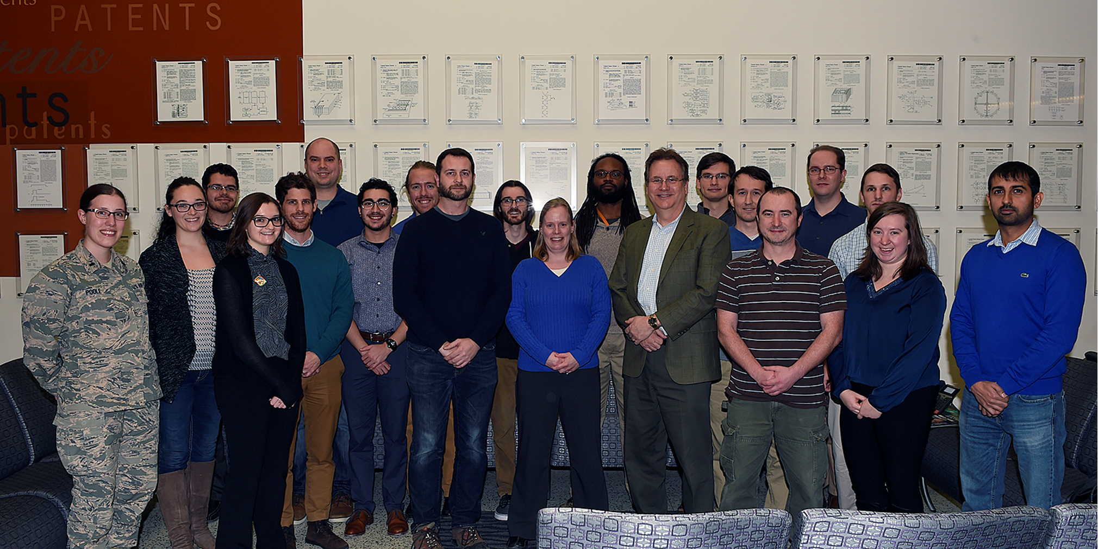
Thanks for listening!
Slide 34 of 34
DISTRIBUTION A Approved for public release ; distribution unlimited 88ABW-2020-2140

Slide 35
Works cited
Slide 35 of 34
Dai, Y., Xu, Z., You, W., Zhang, C., and Gunhe, O., “Experimentally Accessible Lower Bounds for Genuine Multipartite Entanglement and Coherence Measures”, Phys. Rev. App. 13, 054022 (2020).
Jones, K. E., “Summit by the numbers”, ORLC media (Oak Ridge Leadership computing) https://www.olcf.ornl.gov/2018/06/08/summit-by-the-numbers/
Schneeloch, J., Tison, C. C., Fanto, M. L., Ray, S. R., And Alsing, P. M., “Quantifying Tri-partite Entanglement with Entropic Correlations”, arXiv 2004.03579 (2020).
Schneeloch, J., Tison, C. C., Fanto, M. L., Alsing, P. M., and Howland, G. A., “Quantifying entanglement in a 68-billion-dimensional quantum state space”, Nat. Commun. 10, 2785, (2019).
Uskov, D. and Alsing, P., “Vector Properties of Entanglement in a Three-Qubit System”, arXiv:2003.14390 (2020).
Wu, J., Kampermann, H., Bruss, D., Klockl, C., and Huber, M., “Determining lower bounds on a measure of multipartite entanglement from few local observables”, Phys. Rev. A, 86, 022319 (2012).
Y. Huang, “Computing Quantum Discord is NP-Complete,” N. J. Phys.,16, 033027 (2014).
Zyczkowski, K., Horodecki, P., Sanpera, A., and Lewenstein, M., “Volume of the set of separable states”, Phys. Rev. A, 58, 883 (1998).
DISTRIBUTION A Approved for public release ; distribution unlimited 88ABW-2020-2140

Slide 36

Contingency slide: Four Corners Method
Slide 36 of 34
See PRA 86, 022319 (2012)
The minimum quantum entropy over all bipartite splits measures multipartite entanglement:
Bound $ℬ$ $≤E_{M}\left(\hat{ρ}\right)=\min_{|ψ⟩}{\sum_{i}{p_{i}\min_{γ}{\sqrt{S_{L}\left({\hat{ρ}}_{γi}\right)}}}}$
$S_{R}\left(\hat{ρ}\right)=−\log_{2}\left(1−\frac{S_{L}\left(\hat{ρ}\right)}{2}\right)$ is a concave-up function of $\sqrt{S_{L}\left(\hat{ρ}\right)}$, so…
$$−\log_{2}\left(1−\frac{ℬ^{2}}{2}\right)≤\min_{|ψ⟩}{\sum_{i}{p_{i}\min_{γ}{S_{R}\left({\hat{ρ}}_{γi}\right)}}}$$
$$\min_{|ψ⟩}{\sum_{i}{p_{i}\min_{γ}{S_{R}\left({\hat{ρ}}_{γi}\right)}}}≤\min_{\left|ψ\right\rangle }{\sum_{i}{p_{i}\min_{γ}{S\left({\hat{ρ}}_{γi}\right)}}}=E_{NF}\left(\hat{ρ}\right)$$
DISTRIBUTION A Approved for public release ; distribution unlimited 88ABW-2020-2140

Slide 37


Contingency slide 2: Four Corners Method
Slide 37 of 34
See PRA 86, 022319 (2012)
Example bound (PRA 83, 062325 (2011)):
$$ℬ=2\left|\left\langle 0^{⊗N}\left|\hat{ρ}\right|1^{⊗N}\right\rangle \right|−\sum_{q=1}^{2^{N}−2}{\sqrt{\left\langle q\left|\hat{ρ}\right|q\right\rangle \left\langle 2^{N}−1−q\left|\hat{ρ}\right|2^{N}−1−q\right\rangle }}$$
Example state: GHZ-Werner of N-qubits
${\hat{ρ}}_{GW}=p\left|GHZ\right\rangle \left\langle GHZ\right|+\left(1−p\right){\hat{ρ}}_{MM}$
$ℬ>0$ for $p>\frac{2^{N−1}−1}{2^{N}−1}$ e.g., $>\frac{3}{7}$ for 3-qubit ${\hat{ρ}}_{GHZW}$
What is $\left|q\right\rangle$?
Example: 6 qubits, and q=17
In binary, $17→10001$
and $\left|17\right\rangle →\left|0,1,0,0,0,1\right\rangle$
DISTRIBUTION A Approved for public release ; distribution unlimited 88ABW-2020-2140

Slide 38

Contingency slide 3: Multipartite negativity of GHZ-Werner state
Slide 38 of 34
The N-partite Negativity
$$𝒩_{N}\left(\hat{ρ}\right)≡\min_{|ψ_{i}⟩}{\sum_{i}{p_{i} \min_{α}\left\{𝒩_{i}\left({\hat{ρ}}_{α|\overline{α}}\right)\right\}}}$$
N-qubit GHZ-Werner state:
$${\hat{ρ}}_{GHZW}=p \left|GHZ\right\rangle \left\langle GHZ\right|+\left(1−p\right){\hat{ρ}}_{MM}$$
Fully separable under partial trace
Set of eigenvalues of partial transpose is constant over all possible partial transposes:
$$\vec{λ}=\left(\frac{1−p}{2^{N}},…,\frac{1−p}{2^{N}},\frac{1+\left(2^{N}−1\right)p}{2^{N}}\right)$$
$${\vec{λ}}_{PT}=\left(\frac{1−p}{2^{N}},…,\frac{1−p}{2^{N}},\frac{1−\left(2^{N−1}+1\right)p}{2^{N}},\frac{1+\left(2^{N−1}−1\right)p}{2^{N}}\right)$$
Fully inseparable for $p>\frac{1}{{1+2}^{N−1}}$
DISTRIBUTION A Approved for public release ; distribution unlimited 88ABW-2020-2140

