Slide 1
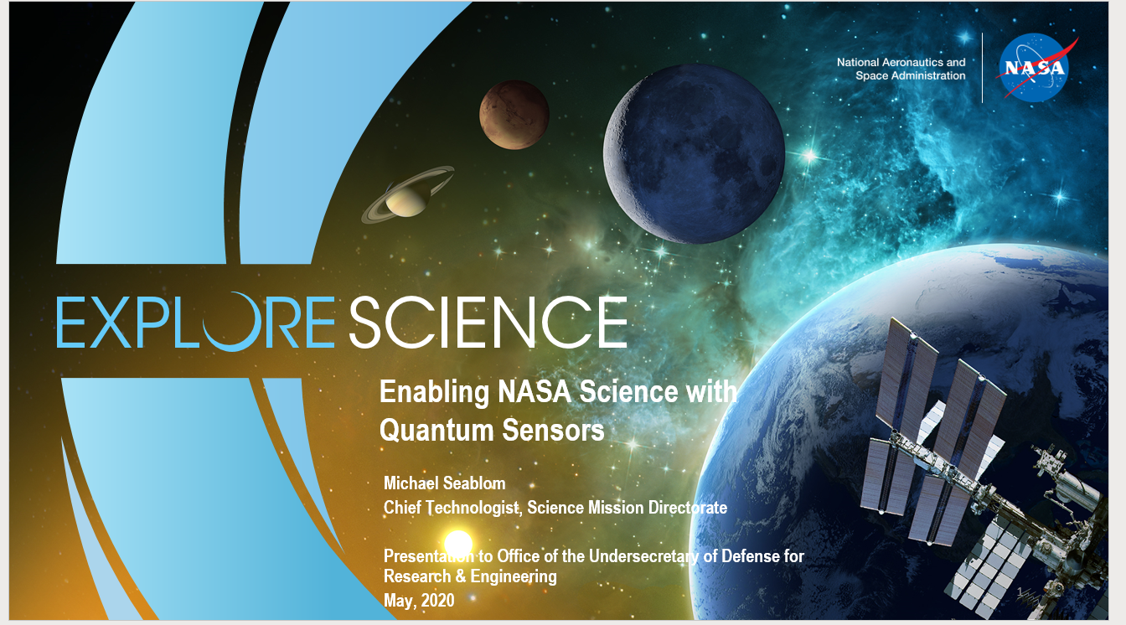

Slide 6
A Potential Scenario for the Reference Quantum Mission

