Slide 1

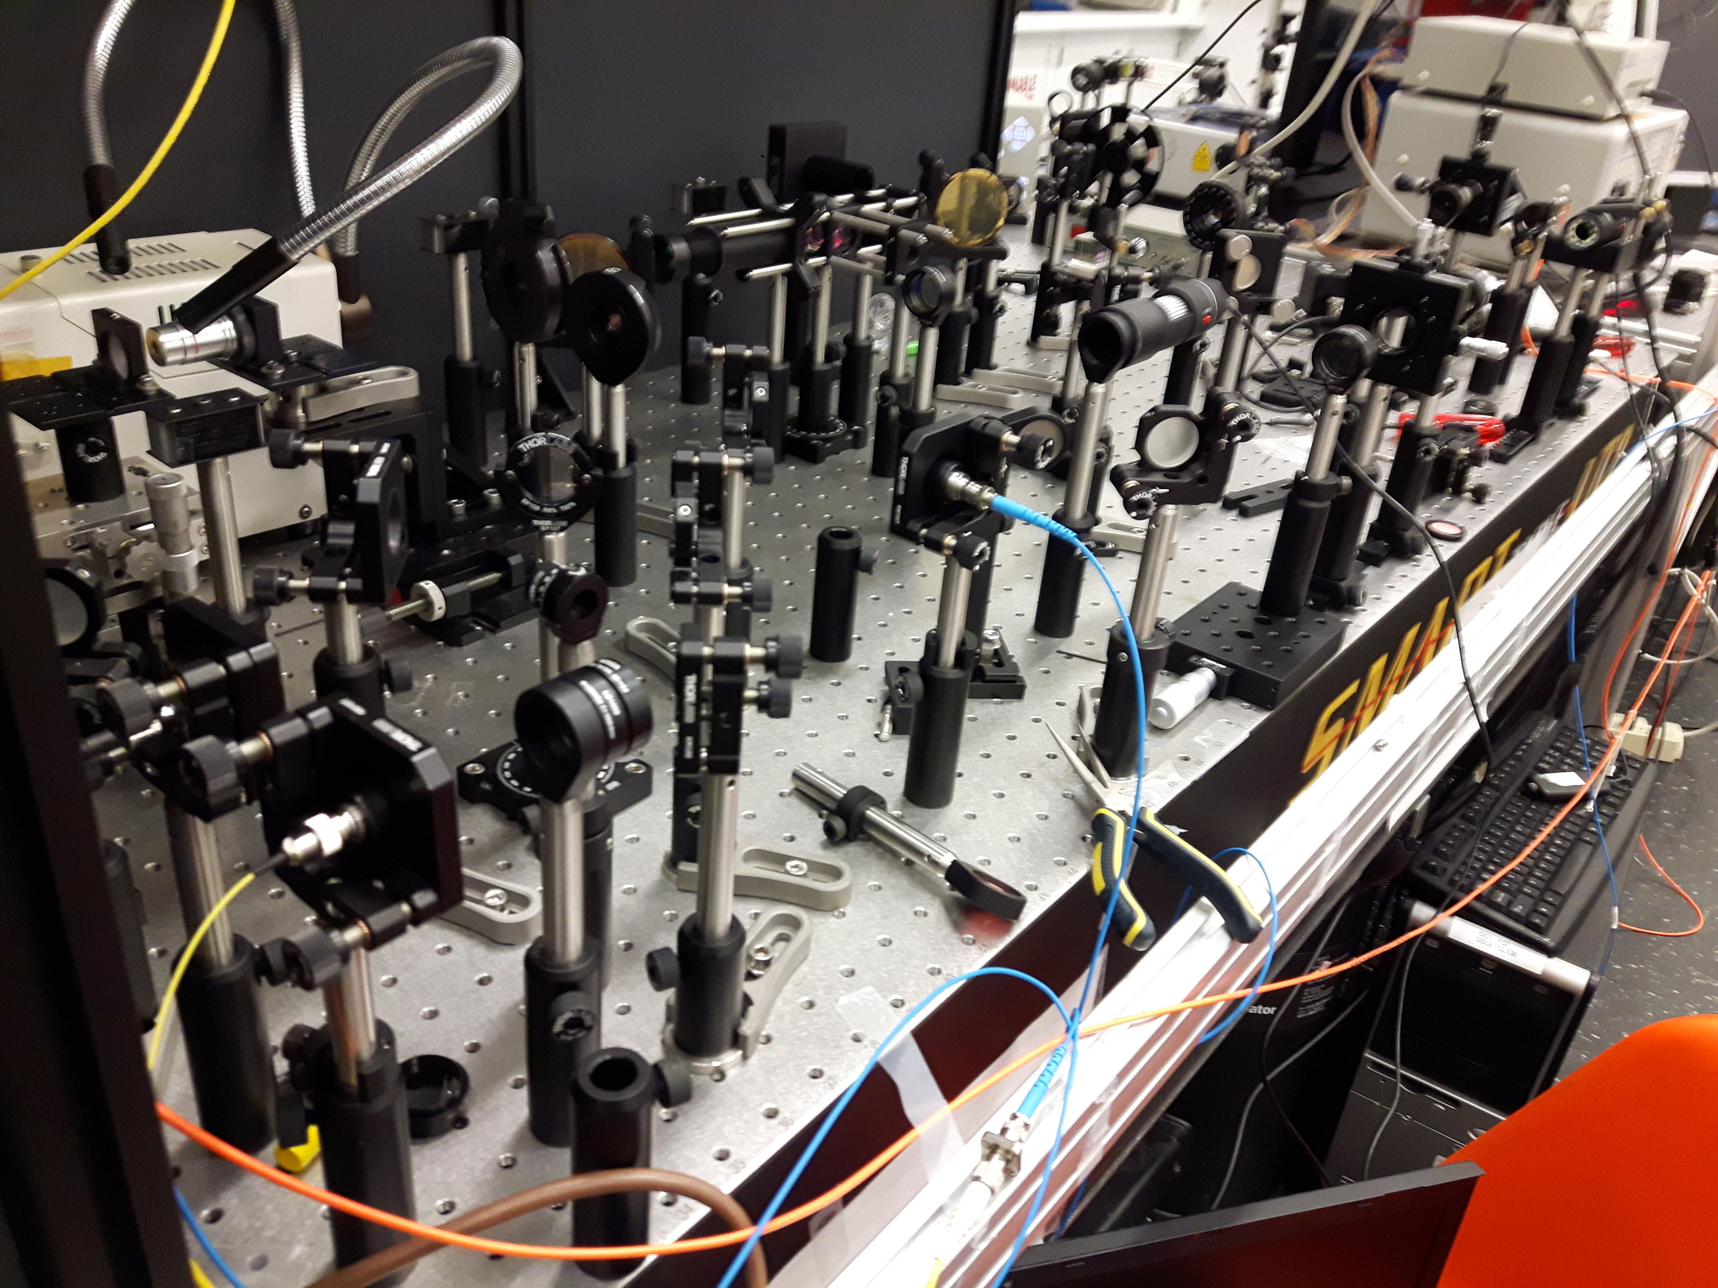

Nonlinear Quantum Photonics in Graphene-Silicon Heterostructure
Hamed Majedi
Integrated Quantum Optoelectronics Lab (IQOL)

Slide 2

Quantum Optics
Photonics Technology
Nonlinear Optics
Quantum Photonics
Quantum Light Sources
Waveguides & Resonators
Processing &
Control
Quantum Light Detectors
Photonic Crystals +
Nonlinear Optics in Graphene & 2D Quantum Materials
Superconducting Nanowire Single
Photon Detectors
Nanowire Quantum Dot
Single & Entangled
Photon sources
Quantum Photonic Integrated Circuits

Slide 3
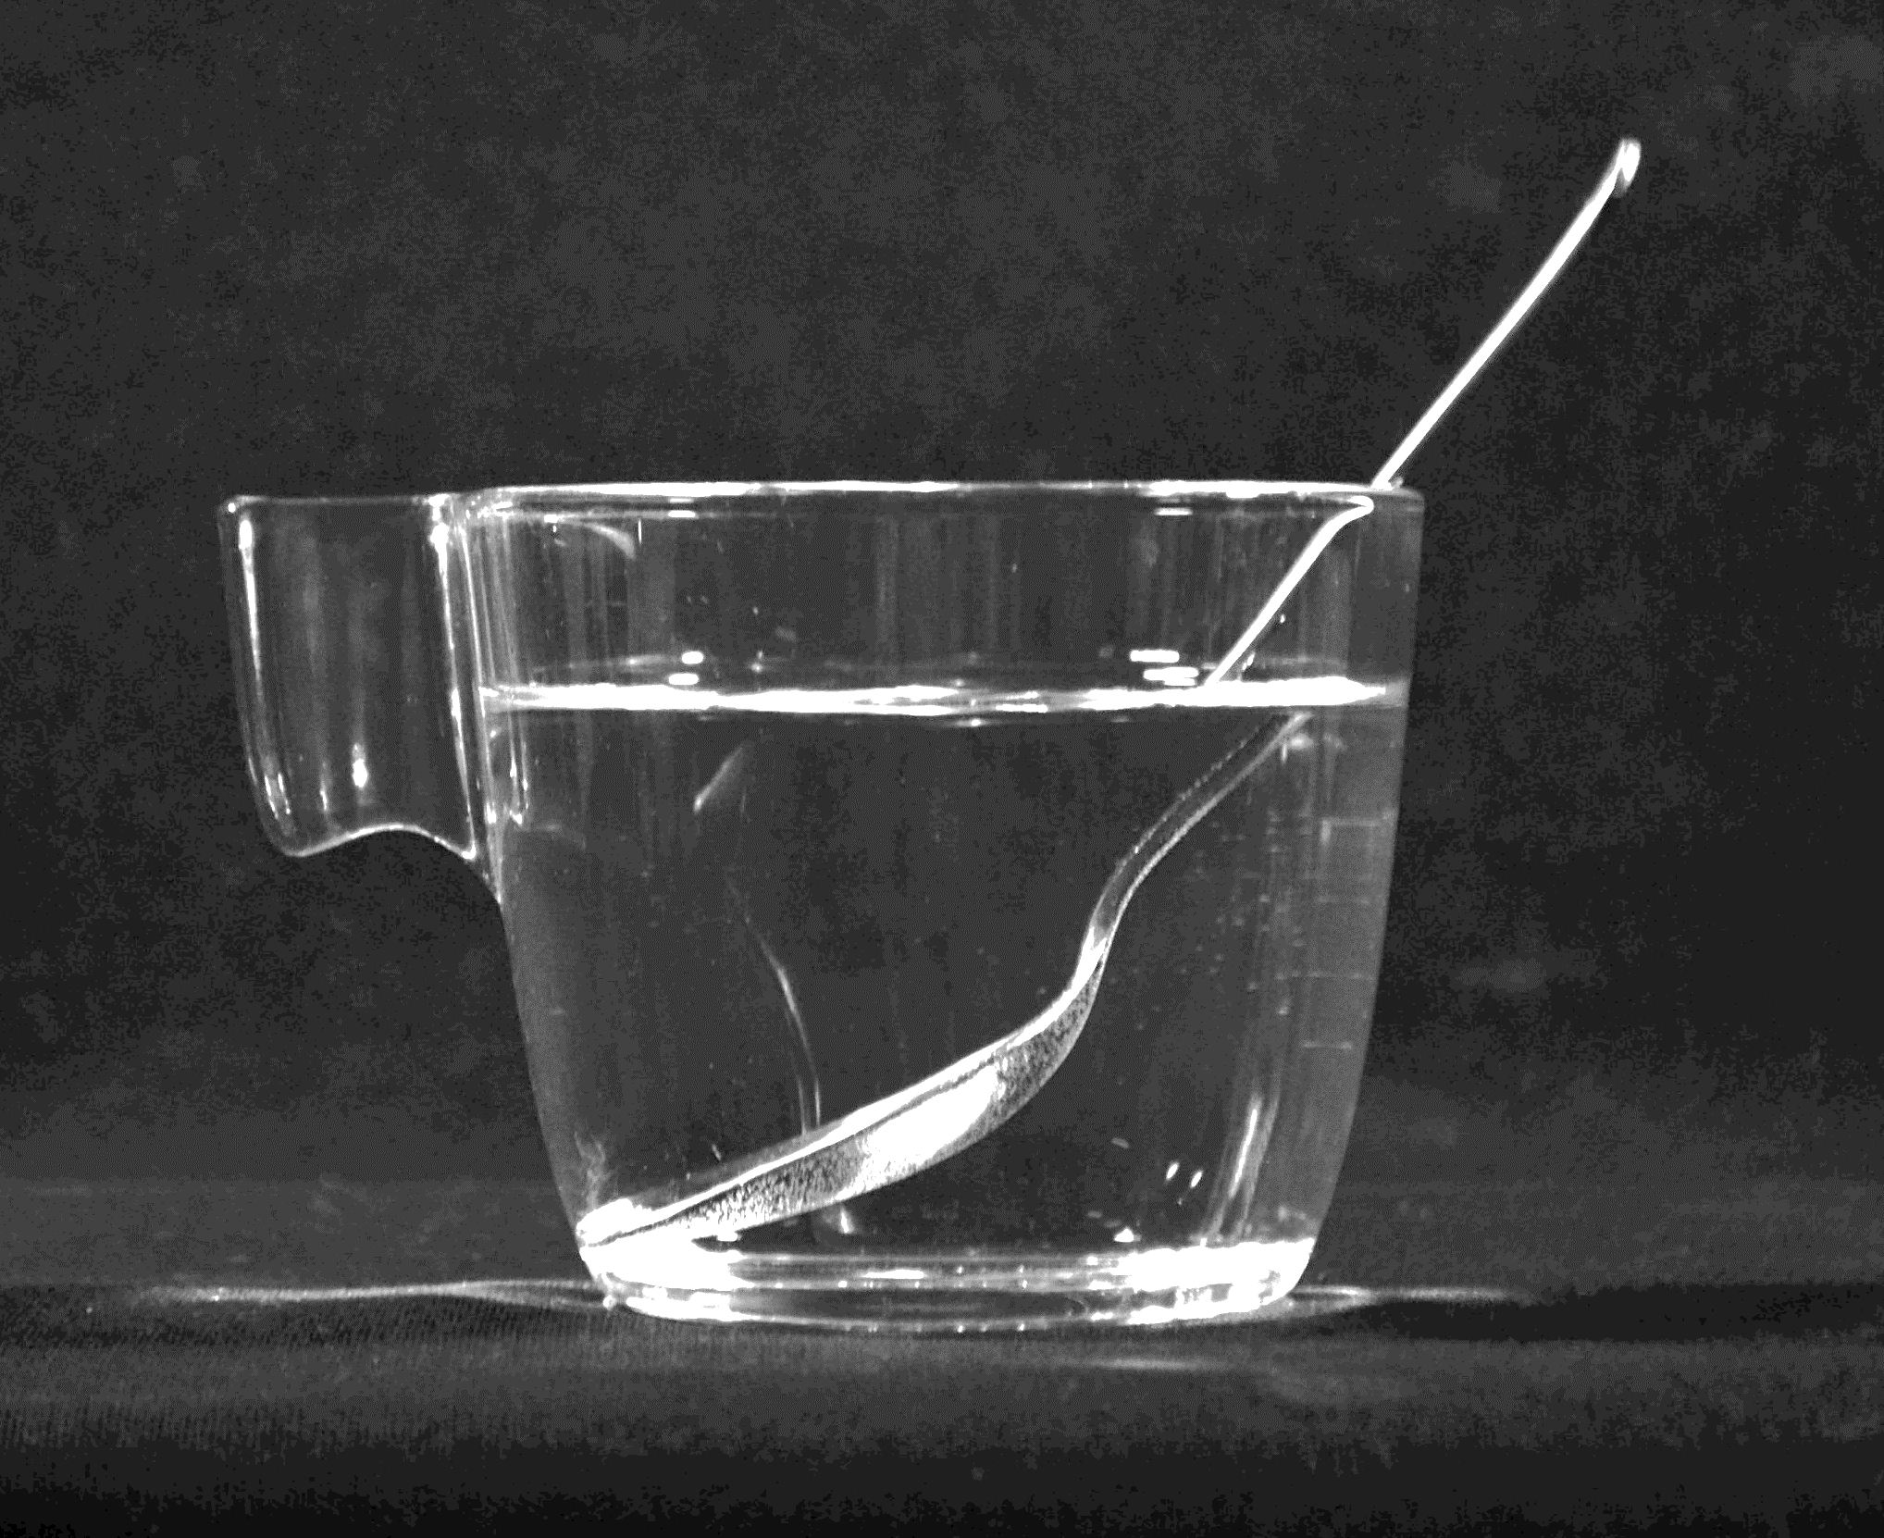
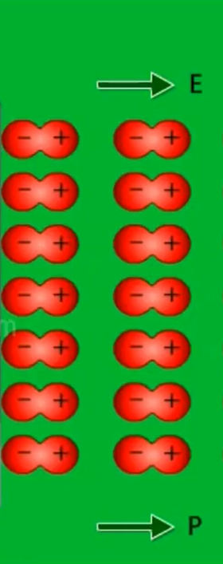
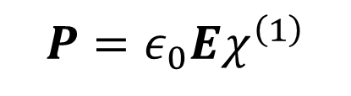

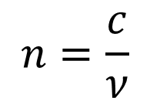
Introduction: Linear Optics
$$n=\frac{c}{ν}$$
$$=\sqrt{ε_{r}}$$
$$P=ε_{0}Eχ^{\left(1\right)}$$
-
+
$$D=ε_{0}E+P=ε_{0}ε_{r}E$$

Slide 4
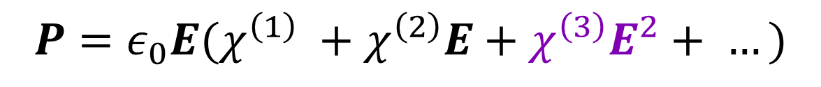



Introduction: Nonlinear Optics
$$P=ε_{0}E(χ^{\left(1\right)} +χ^{\left(2\right)}E+χ^{\left(3\right)}E^{2}+ …)$$
Kerr effect
$$n(I)=n_{0}+n_{2}I$$
$${10}^{−16}$$
$${− 10}^{−11} cm^{2}/W$$

Slide 5
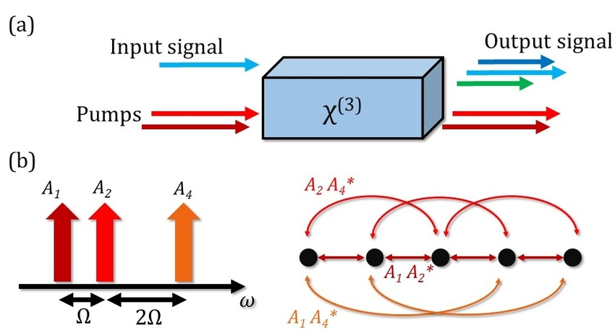
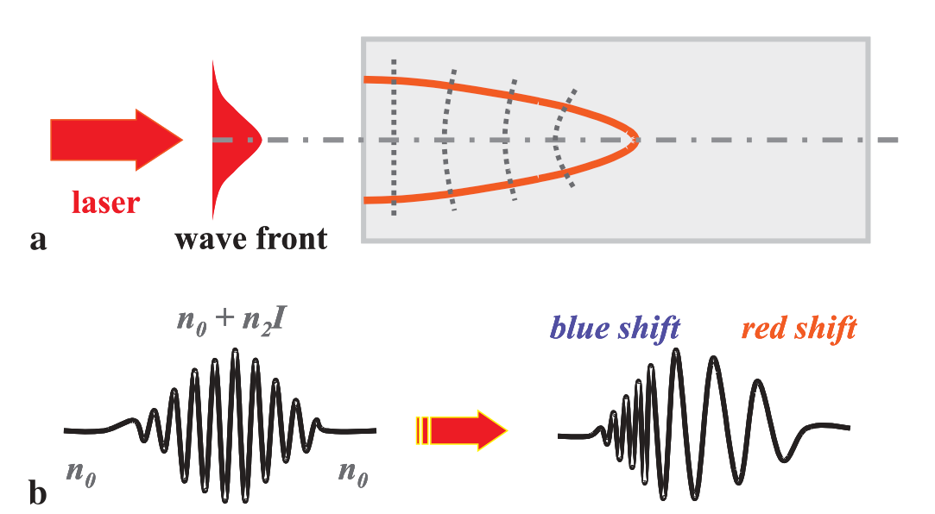

Nonlinear Optics
Frequency mixing (e.g. SPDC)
Self-phase modulation
Self-(de)focusing
Parametric Amplification
Electromagnetic Induced Transparency
All Optical Modulation/Switching
[1]
[2]
[2]

Slide 6
Applications of Nonlinear Optics
Lasers,
Optical Control
THz sources,
Pulsing,
Material Science
Spectroscopy
Information Technology
Optical Signal Processing
Data Storage
Sensors
Quantum Optics
Quantum Information
Hunt for large and wideband nonlinearity, electrical tunability,
ease of integration and fabrication with conventional Photonic circuitry

Slide 7
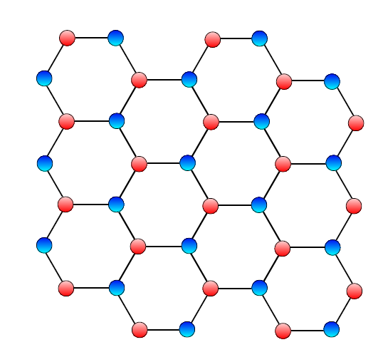
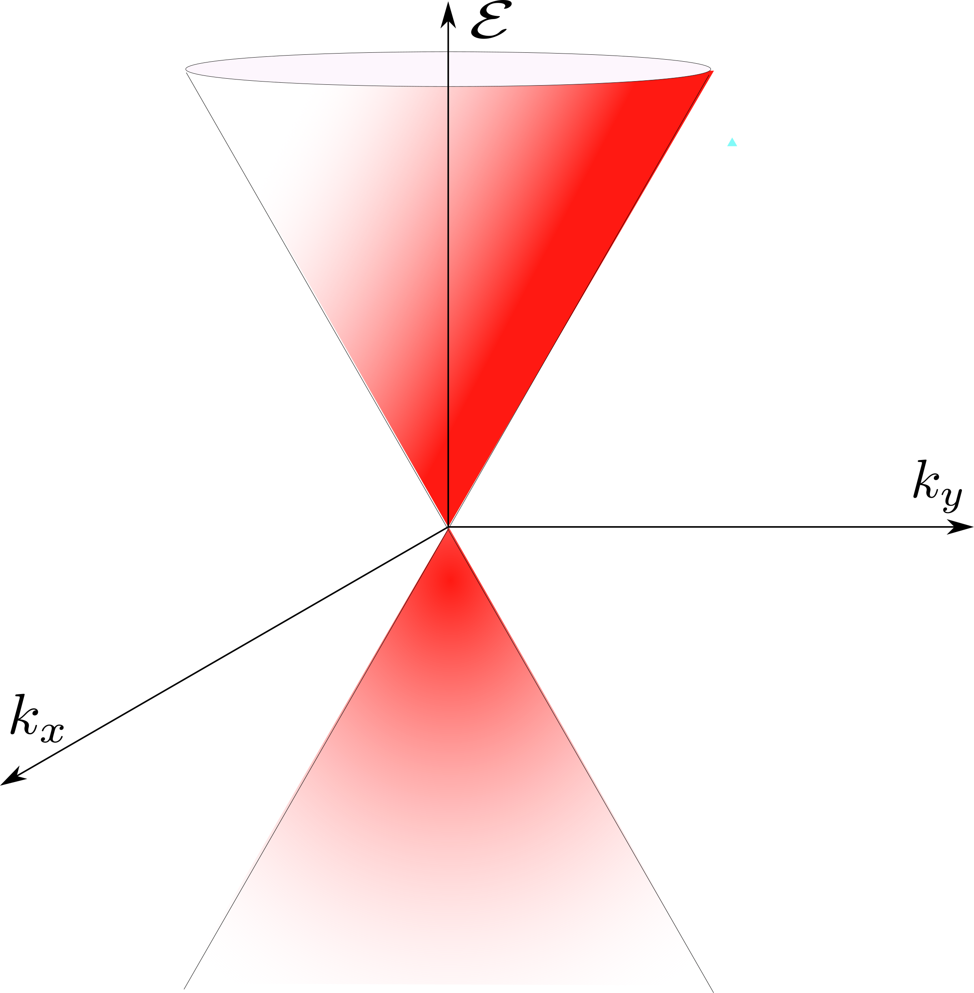

Graphene Structure & Linear Dispersion
Strong $σ$Bounds

Slide 8
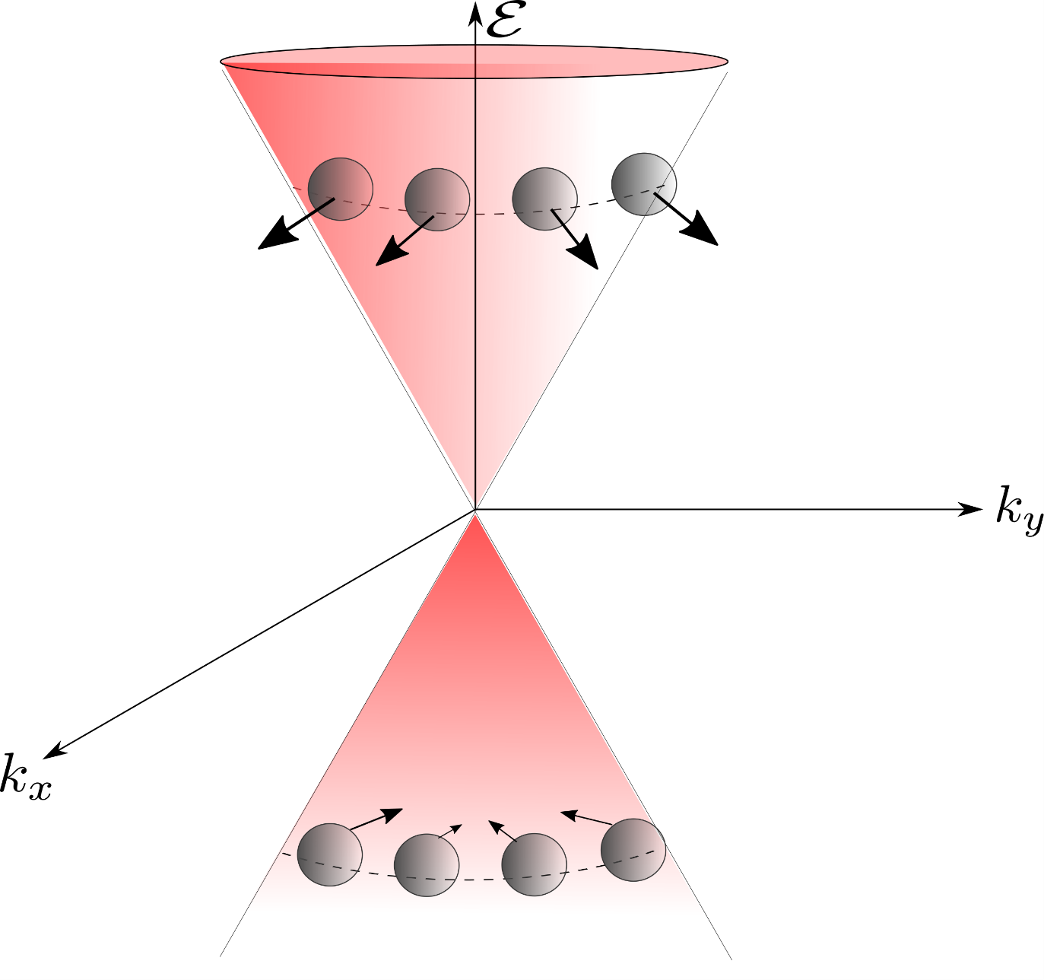
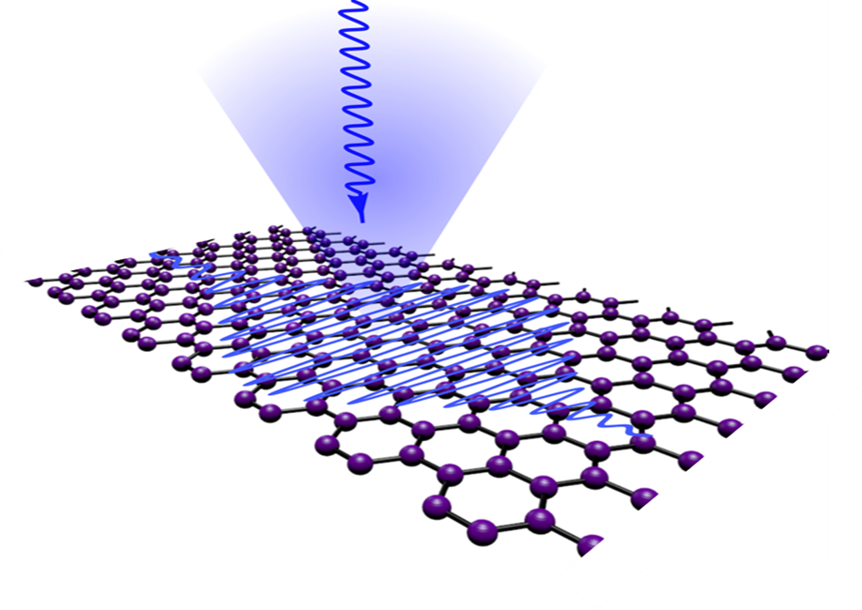

Pseudospin & Chairality helps large optical nonlinearity & it is topologically protected.
Inherently has large electric dipole.
Pseudospin is locked with momentum
$$ℏV_{F}k.\hat{σ }Ψ=E_{k}Ψ$$

Slide 9
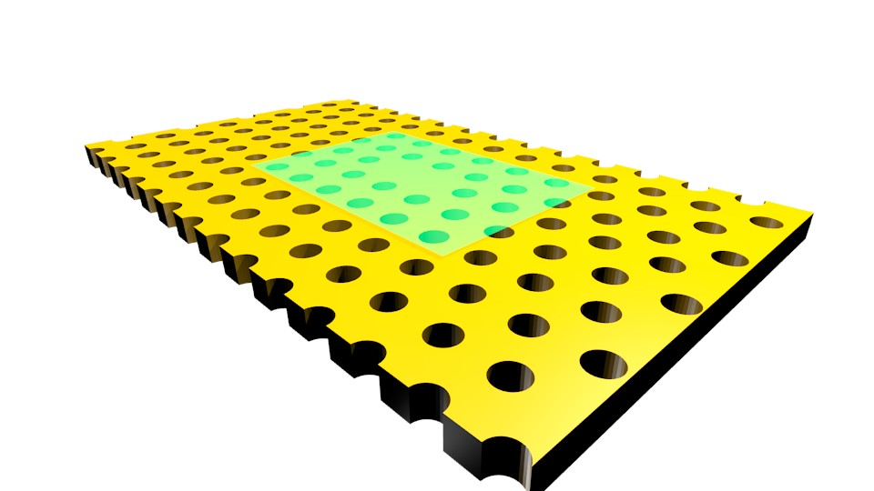
Strong and wideband light matter interaction
It has been observed in experiments that graphene exhibits strong nonlinearity, show positive & negative Kerr coefficient.
Innate flexibility of graphene to be integrated with silicon optical plat forms.
Ultrafast carrier dynamics
Graphene is Transparent.
Tunable optical properties
MOTIVATE graphene based integrated and quantum nonlinear optics
Graphene integrated with PhC nanocavities

Slide 10
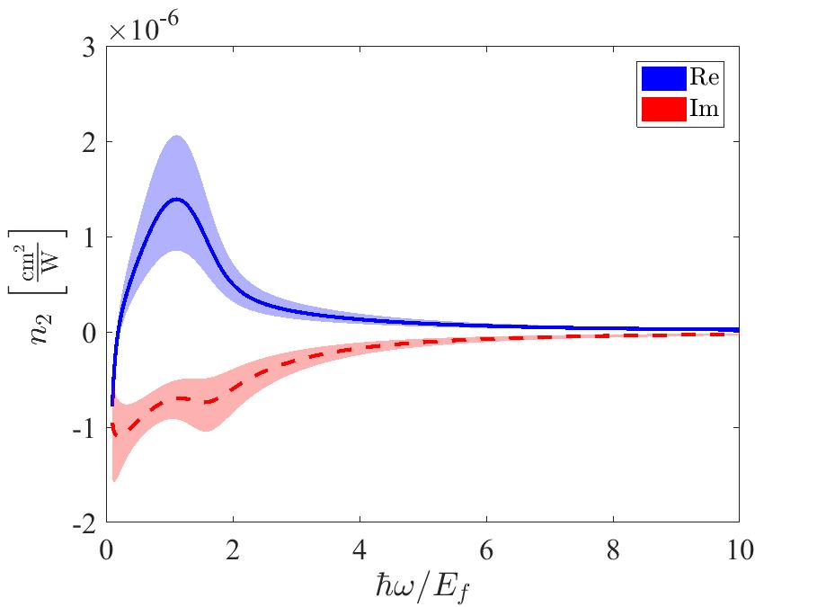
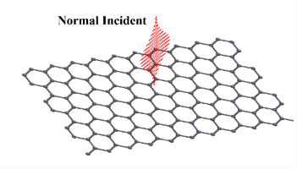
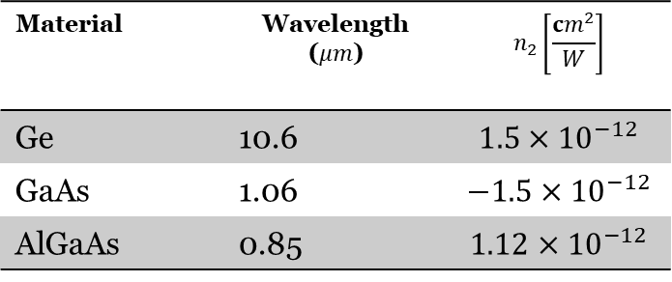

Kerr-like! Nonlinearity of Graphene
$$n=n_{0}+In_{2}$$
Intensity dependent refractive index
Material | Wavelength ($μm$) | $$n_{2}\left[\frac{{cm}^{2}}{W}\right]$$
Ge | 10.6 | $$1.5×{10}^{−12}$$
GaAs | 1.06 | $$−1.5×{10}^{−12}$$
AlGaAs | 0.85 | $$1.12×{10}^{−12}$$

Slide 11
Graphene’s nonlinear optics is nonperturbative close to Dirac point!

Slide 12
Measurements of n & n2

Slide 13
Linear Refractive Index of Graphene

Slide 14
Linear Refractive Index of Graphene

Slide 15


Measurement of n2
$$n=n_{0}+n_{2}I$$
$$n_{2} \sim {10}^{−6} − {10}^{−12}cm^{2}/W$$
Systematically probe the spectral and temporal dependence of the nonlinear refractive index of graphene.
Measurement technique
Wavelength (λ)
Pulse-duration (τd)
Fermi energy (Ef)
Sample preparation
(CVD, liquid, exfoliation)
Notes:
As you see now the value for n2 varies about 6 orders of magnitude, and is sometimes reported to be positive or negative. As far as implementation in devices goes, this introduces a large range for this value and we need to be sure of what behaviour to expect so systems can be designed accurately. So the question becomes what exactly is the source of this large variation. By looking at the various experimental studies, we see generally that the experiment itself is a contributing factor to what we observe.
*CLICK*
In particular, the measurement technique used to characterise the nonlinearity, laser properties like the wavelength and pulse-duration, and sample dependent properties like the Fermi energy and any effects stemming from the fabrication technique or the substrate. In the studies, the effect of these parameters is not generally discussed. However as varying results are being reported, there was now discussion about varying experimental conditions contributing to this fact. But no experimental studies explicitly addressed this issue. Looking at theoretical work where the effect of these parameters can be calculated it is clear that this value shouldn’t actually be a constant. It strongly depends on all these factors. And n2 can actually be modulated orders of magnitude by tuning the experimental conditions.
So the question becomes, how can be form predictable models for design if there are so many factors effecting what we observe?
*CLICK*
The simple answer is that we have to start by looking at each factor one at a time and see how it effects the response. In doing so, we build towards the understanding of the fundamental processes that are in play.
And this is what we begin to do in this work. We look at the dependence of n2 on the excitation wavelength, pulse duration and how this nonlinearity evolves with time. When we start to understand how the nonlinearity changes with these parameters, we can begin to use this information for practical purposes like using it to tune n2 to positive or negative orders of magnitude, which is limited in silicon photonics. Add that to how integrable graphene is for on-chip devices, this will certainly be significant in the development of graphene based photonic devices.

Slide 16
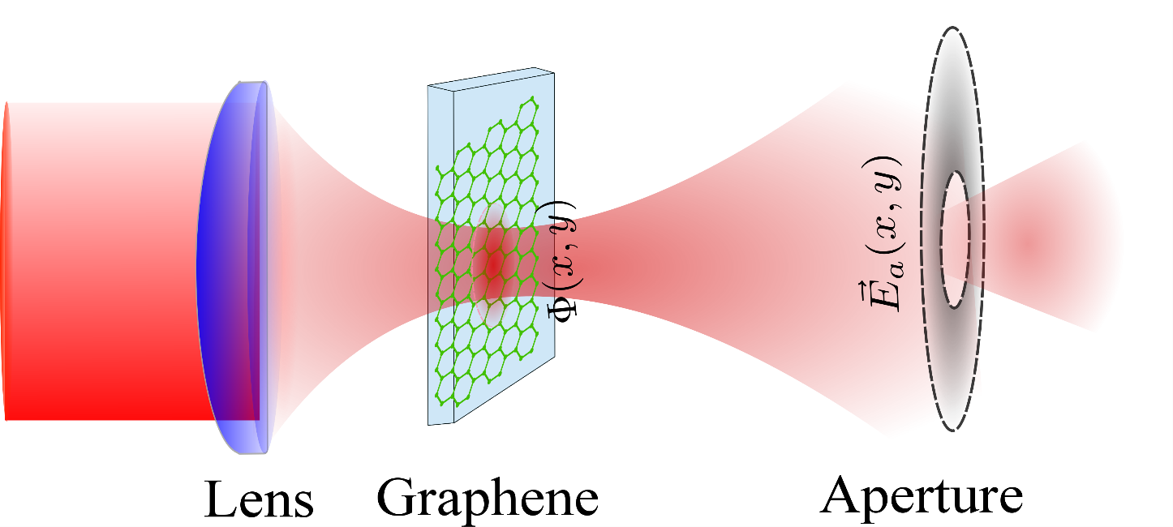
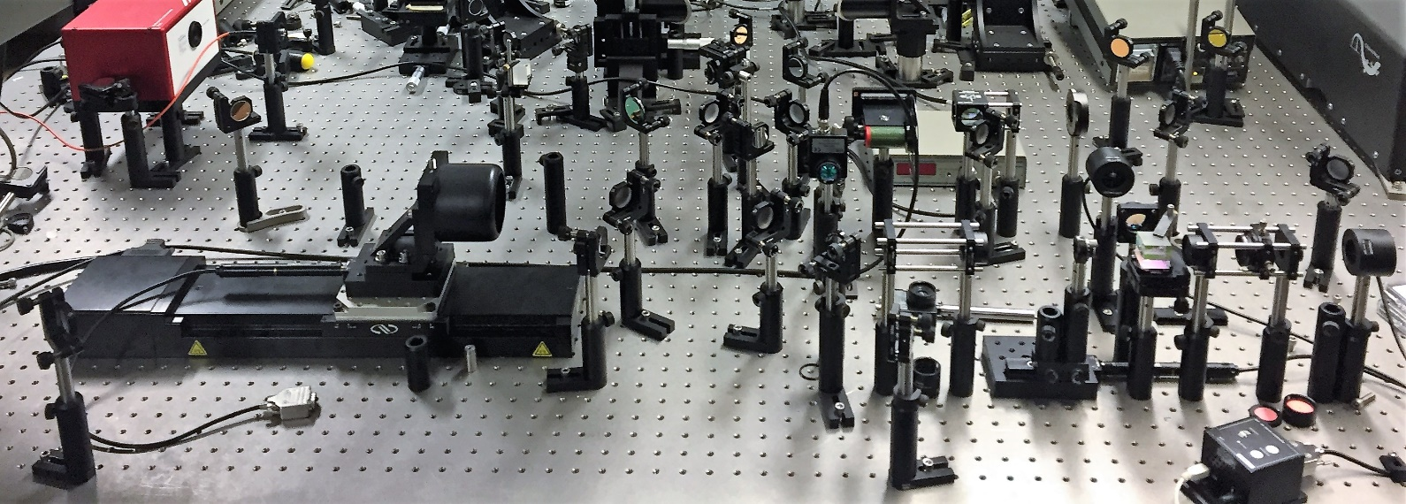
Z-Scan Experiment
Moving the sample around the focal point

Slide 17
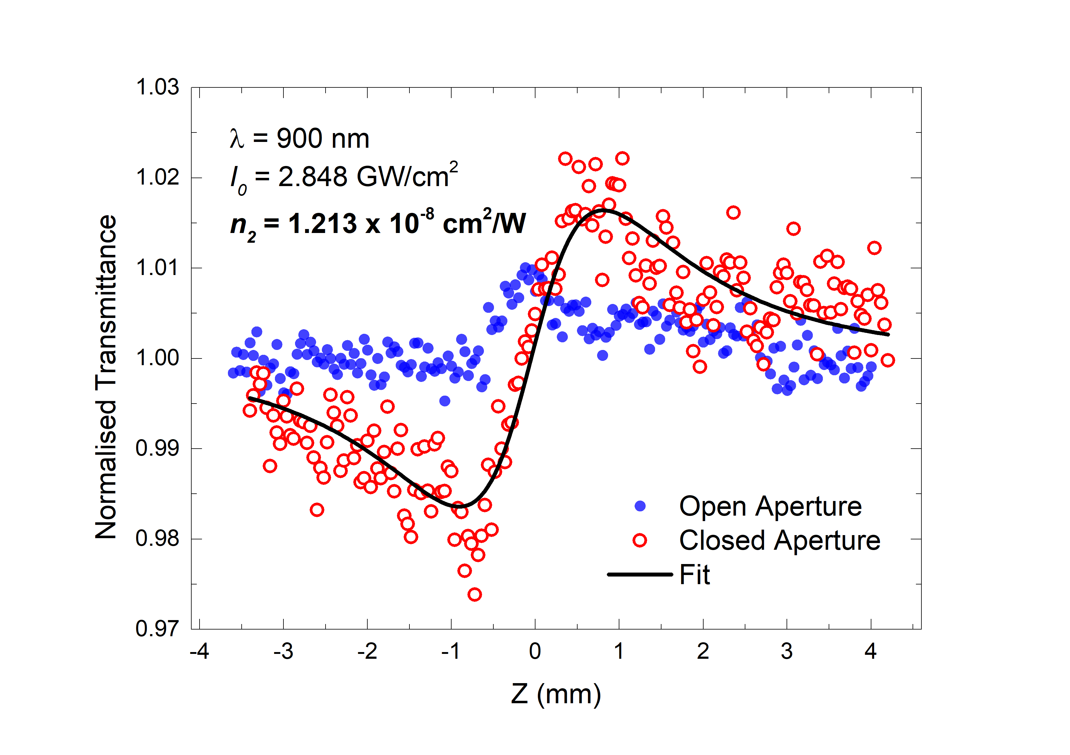
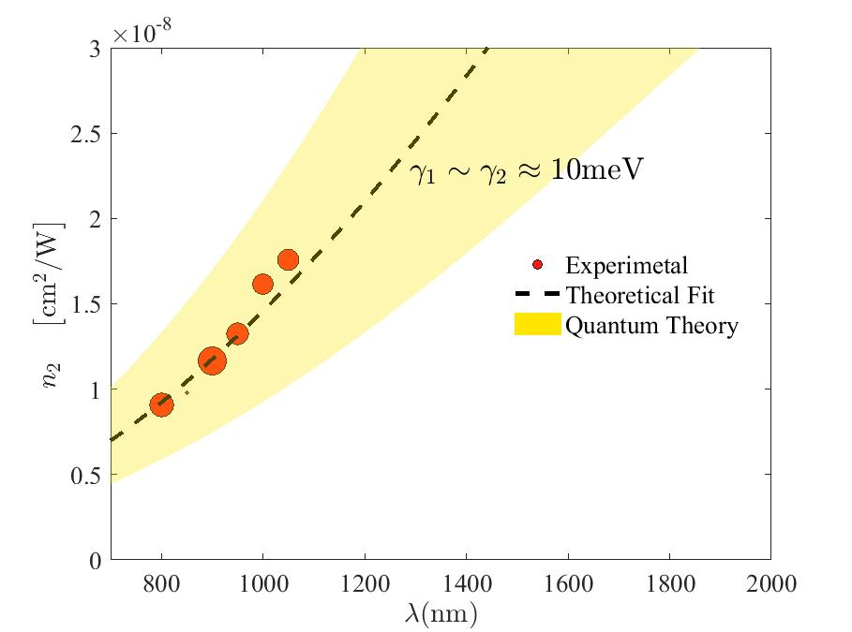
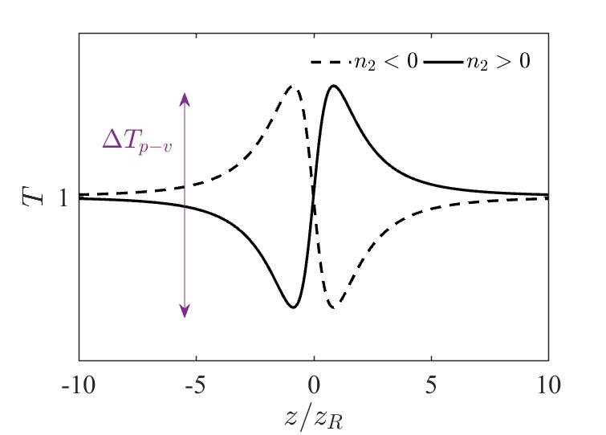

Z-Scan Experimental Results
$$n_{2}∝λ^{2}$$
Normalized Transmission
Kerr Coefficient!

Slide 18
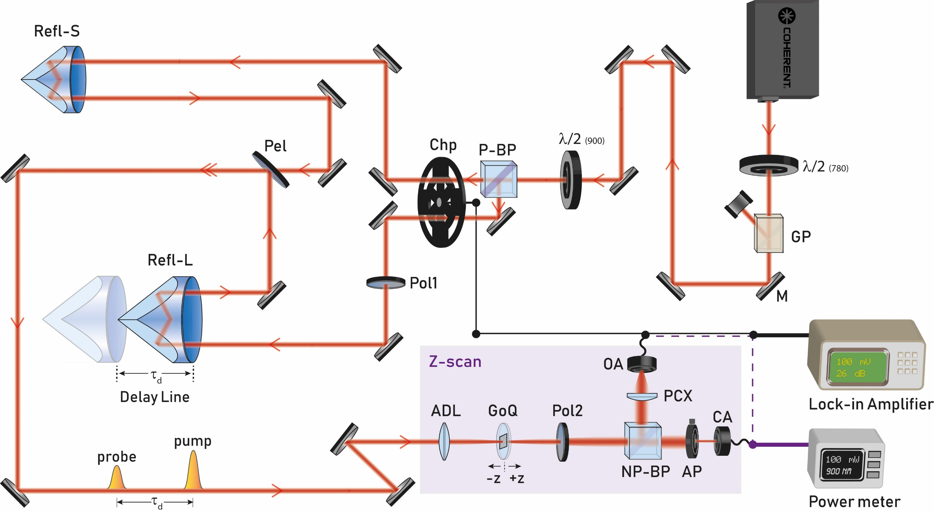
Pump-probe integrated Z-scan (PPZS)
λ/2 (780) | Half-waveplate, 780 nm
GP | Glan-Laser Polariser
M | Silver Mirror
λ/2 (900) | Half-waveplate, 900 nm
P-BP | Polarising beamsplitter
Chp | Dual-frequency optical chopper
Pol1/2 | Polariser
Refl-S | Small retroreflector
Refl-L | Large retroreflector
Pel | Pellicle beamsplitter
ADL | Achromatic doublet lens
GoQ | Graphene on Quartz
NP-BP | Non-polarising beamsplitter
PCX | Plano-convex lens
AP | Aperture
Notes:
In order to streamline the spectral and temporal measurements, we made this pump-probe integrated Z-scan set-up which allows for multiple modes of measurement. The highlighted box is the standard Z-scan set-up, while the auxiliary optics and components allow for integration of a delay line. The pump and the probe are separated using polarisers in the Z-scan dual beam mode and additionally with optical chopping and lock-in when operating in standard pump-probe mode. Our laser source is a high-power tunable source that can be varied from 690 to 1050 nm, with a pulse-width of 100 fs and a repetition rate of 80 MHz. So with this set-up we can perform standard Z-scan measurement in single-beam mode, time-resolved Z-scan and a standard pump-probe measurement in dual beam mode.

Slide 19
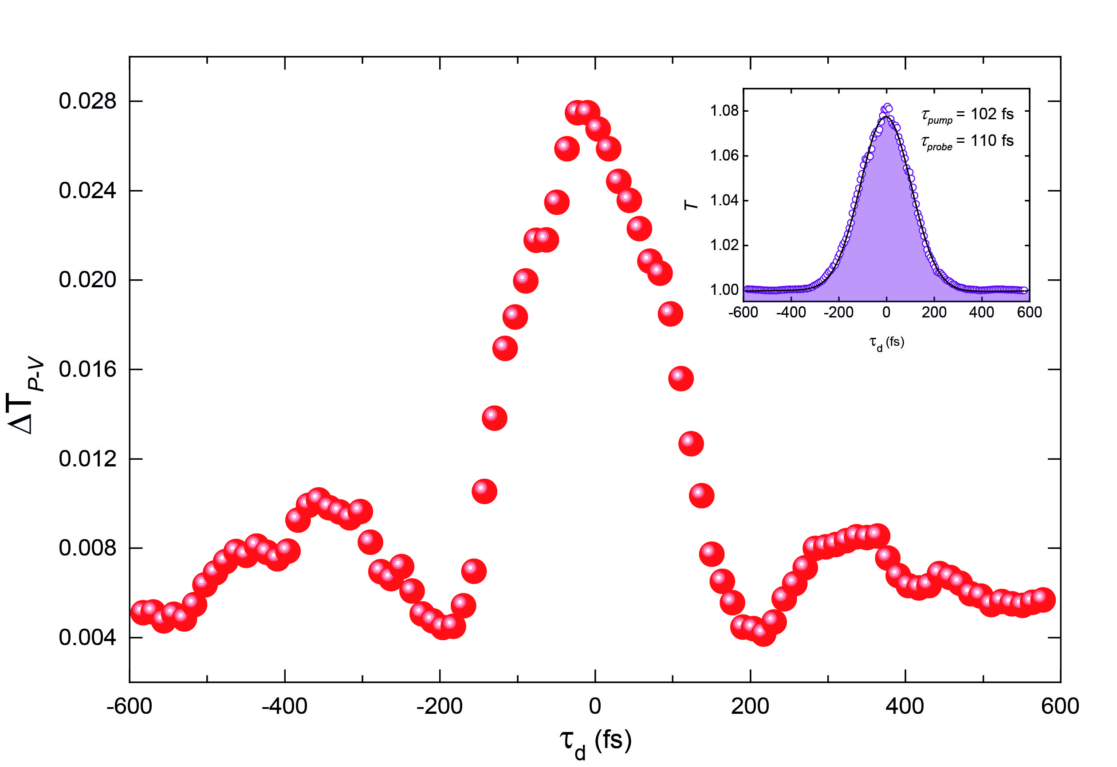
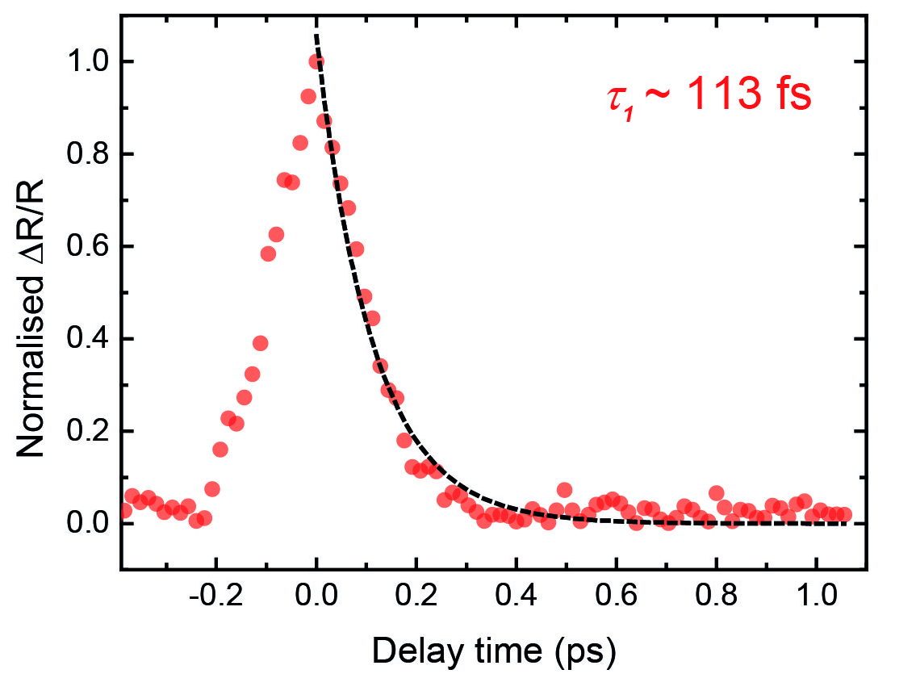



Temporal evolution
$$n_{2} \sim {1.12 ×10}^{−8} cm^{2}/W$$
$$n=n_{0}+n_{2}I$$
$$Δn$$
Temporal correlation
Time-resolved Z-scan
Notes:
Using the delay line section of the experimental set-up we were able to perform some time-resolved measurements. First with the use of the optical chopper and lock-in amplifier we acquired the temporal correlation for graphene to obtain a tau_1 relaxation time of 113 fs. However, since the pump and probe pulse-widths are almost the same as the obtained tau_1 there is some uncertainty about this value.
*CLICK*
In this experiment, we acquire the differential transmittance at the peak and valley position of the single- beam Z-scan trace as a function of the probe delay. The inset is sample curve acquired near the peak position. Using this data we can also look at the temporal correlation between the two beams and resolve the beam width of the probe given the pump is taken to be 102 fs which we measured in a subsequent measurement.
In the main figure we plot the transmittance difference between peak and valley positions as a function of probe delay. We see this is a profile similar to a regular pump probe measurement, with similar time scale of tau 1. The maximum transmittance peaks at zero delay, where highest excited carrier density is reached then it relaxes on a longer time scale with the differential transmittance dropping to a more or less constant value. We were hoping to see the rise and decay of the nonlinearity as the carrier population difference evolves but this doesn’t seem to be the case. Taking the power of the pulse as described by a Gaussian distribution where the peak is where we have the peak power and extracting the n2 for the differential transmittance values, we get more or less a constant n2 value of 1.12 times 10^-8 near the peak, which coincides with our previous measurement. And as the intensity decreases away from the peak, the value grows due to decreased saturation effects, like we saw previously. So any modulation we’re seeing here is simply due to the power of the pulse. What we understand from this data is that our pulses may not be short enough to probe the dynamics in our graphene sample. We can still achieve some modulation of the delta N term where the intensity can be varied and subsequently the n2 changes too. This isn’t a linear relationship exactly, as saturation is something that is becoming of interest in graphene nonlinear optics.

Slide 20
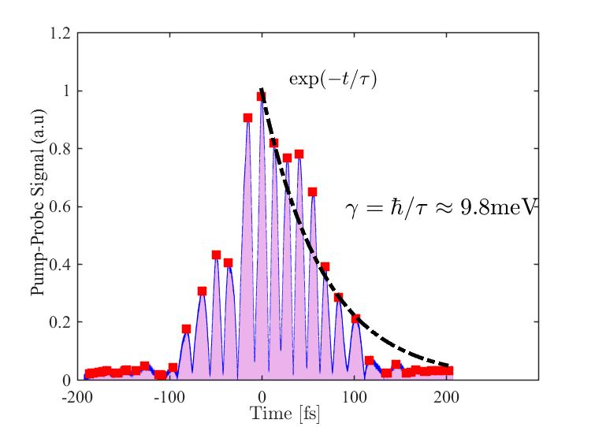

Slide 22
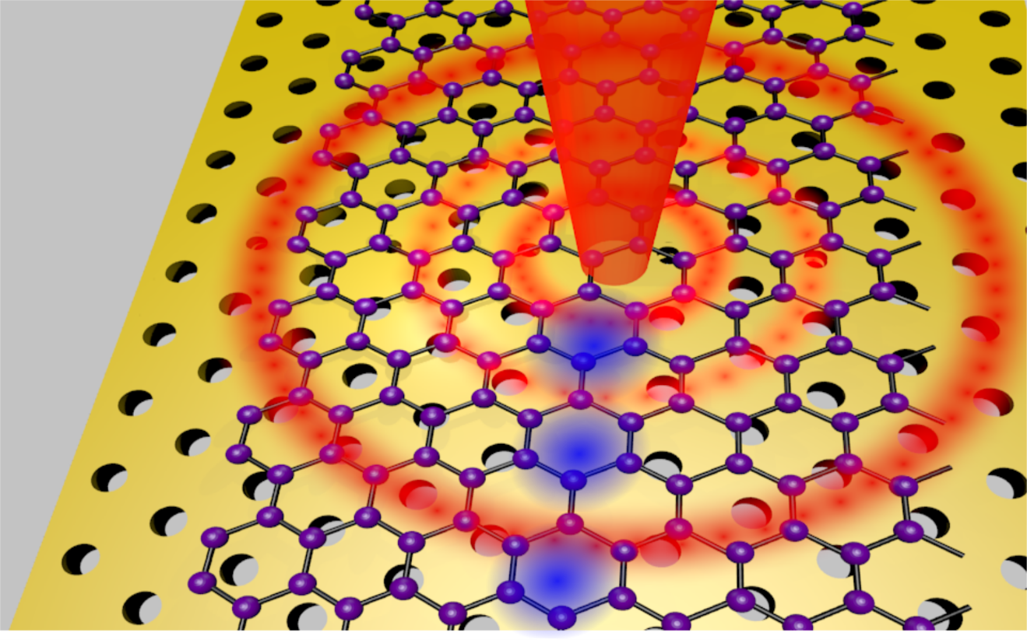
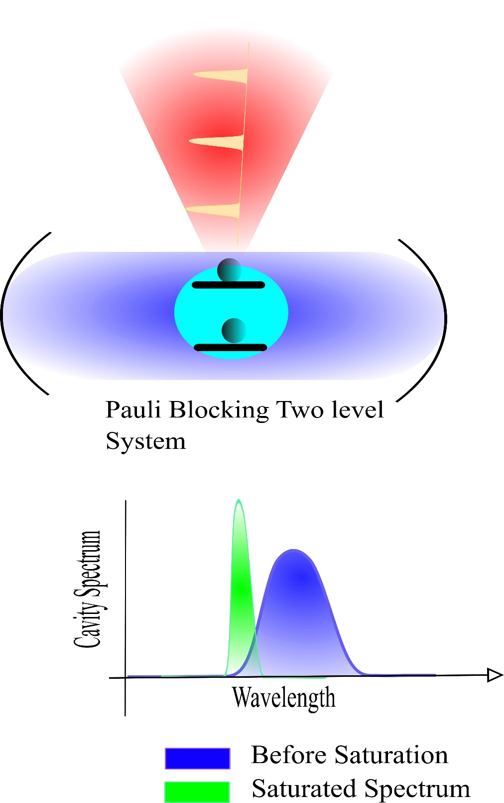
All-Optical Modulation
Resonance frequency and quality factor varies by saturation of atom
Control: Pulse laser , 1064nm , 120 fs
Signal : Continuous 1550 nm
Inspired from pump-probe technique.

Slide 23
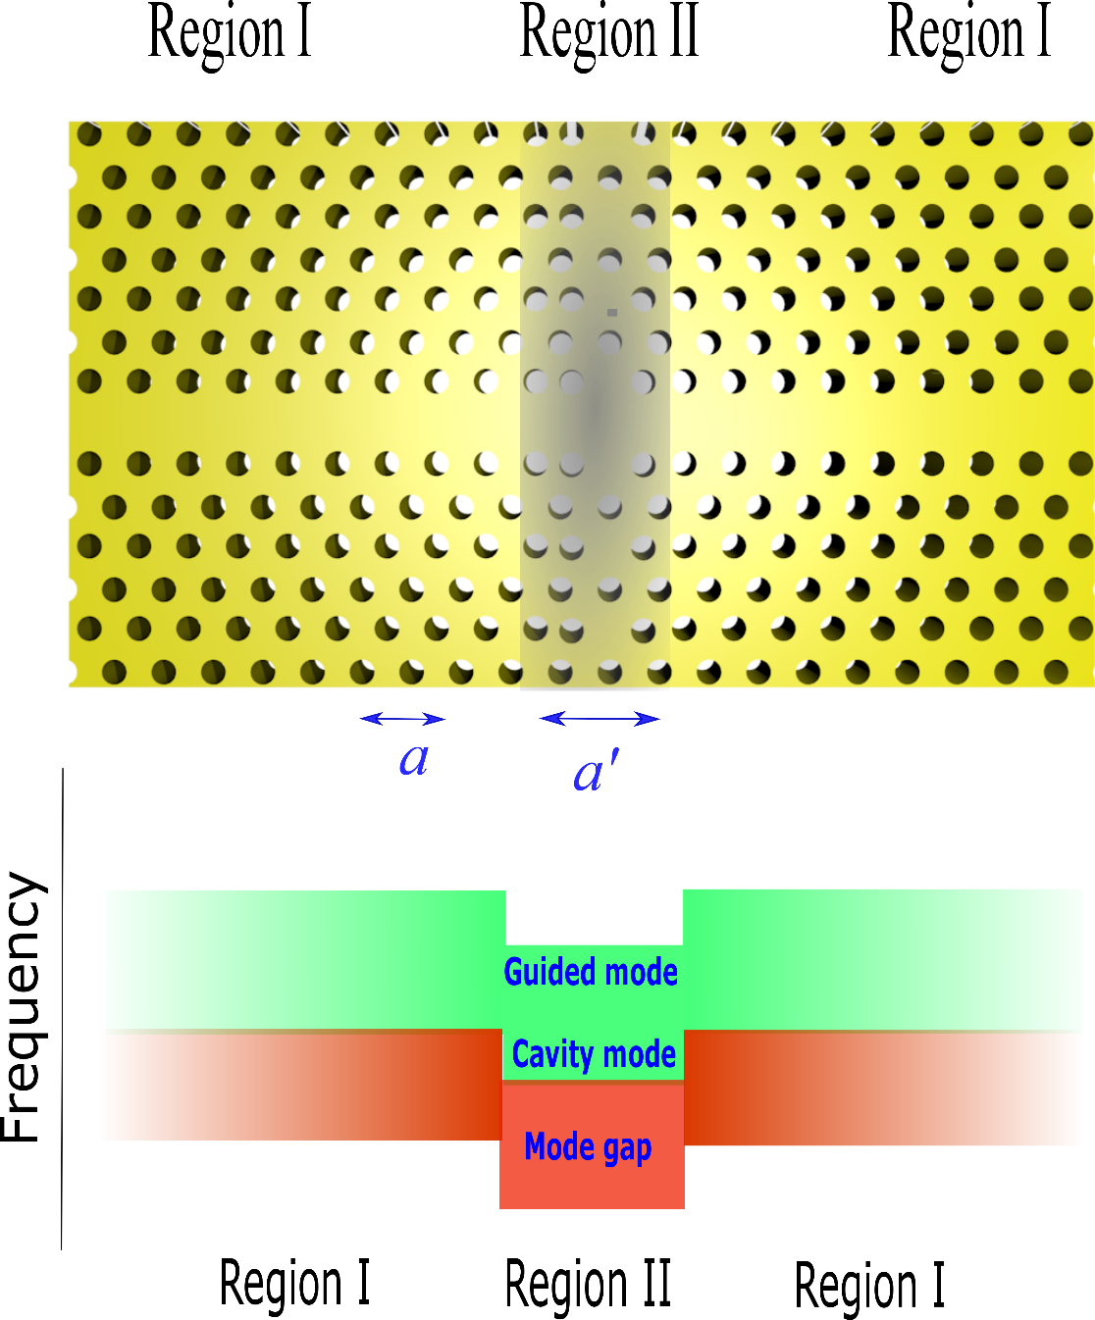
Fabricated Device
Photonic Crystal double Heterostructure
Acknowledgment:
Photonic Crystal Fabricated by Dr. Milad Khoshnegar
Graphene was transferred by Dr. Mohsen Raieszadeh.

Slide 24
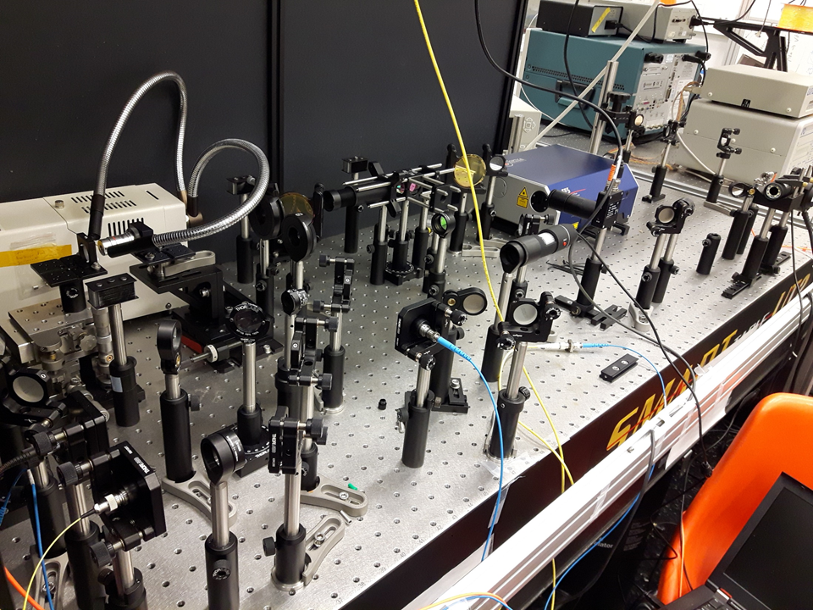
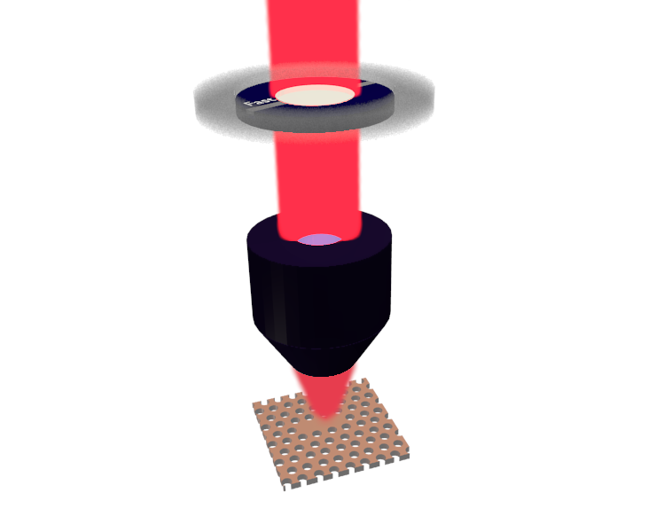
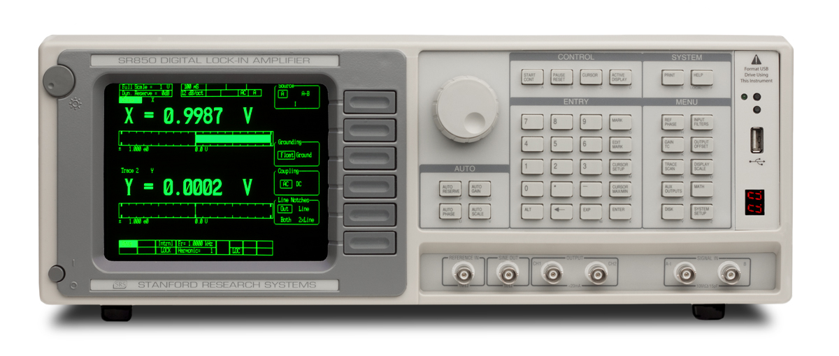
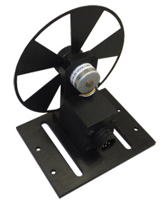
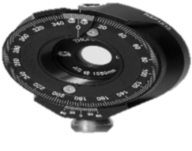

Confocal Cross-Polarized Reflectometry Setup
Polarizing
Beam splitter
$10 μm$ Pin hole
Detector
Confocal Spatial Filtering
half-wave plate
Excitation beam
Lock-in Amplifier
Photonic Crystal nanocavity
$$x$$
$$y$$
1064nm

Slide 25
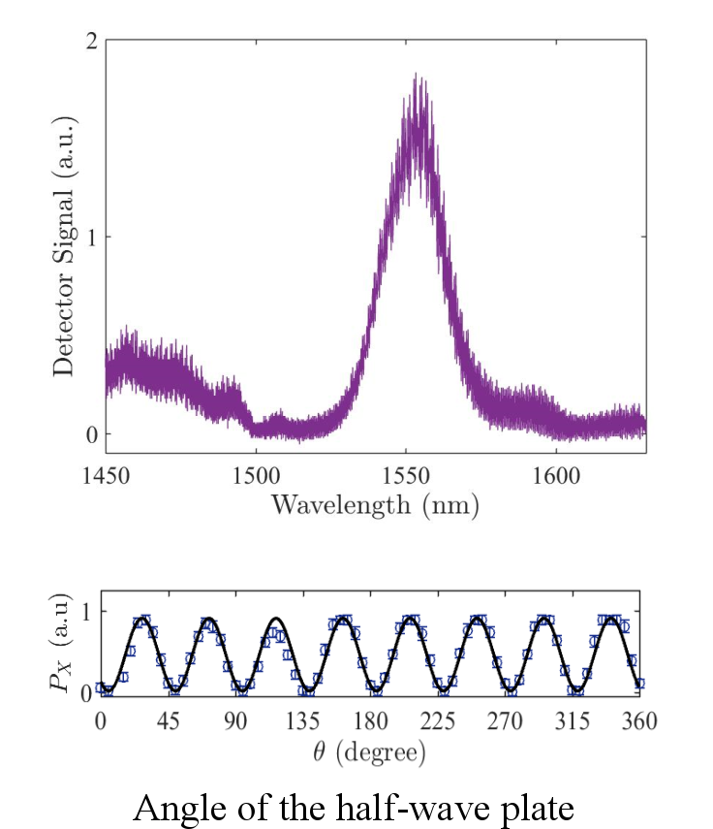
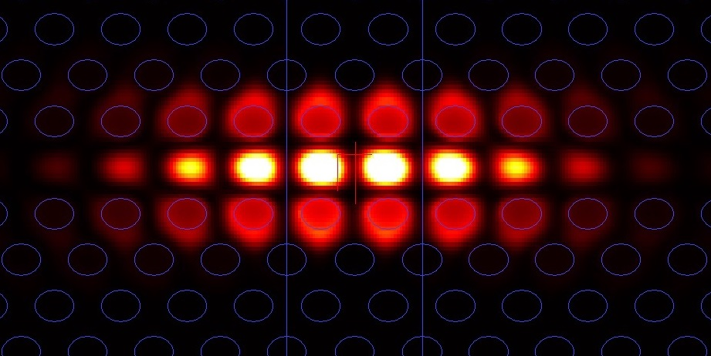
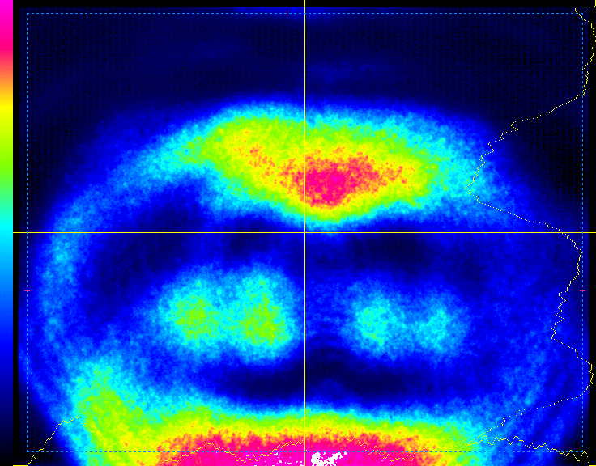
Results: Resonant Reflectometry
Cavity spectrum
Mode shape (FDTD)
Co-polarized IR imaging

Slide 26
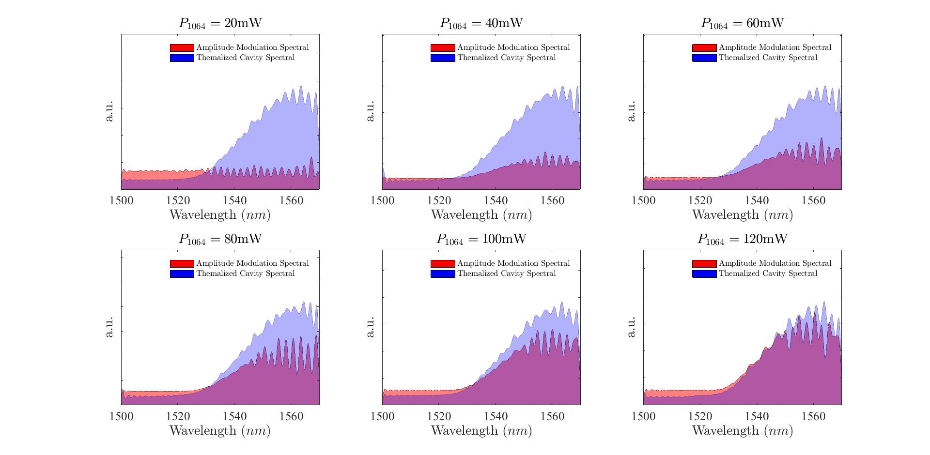
Results: All-Optical Amplitude Modulation
Modulation Depth

Slide 28
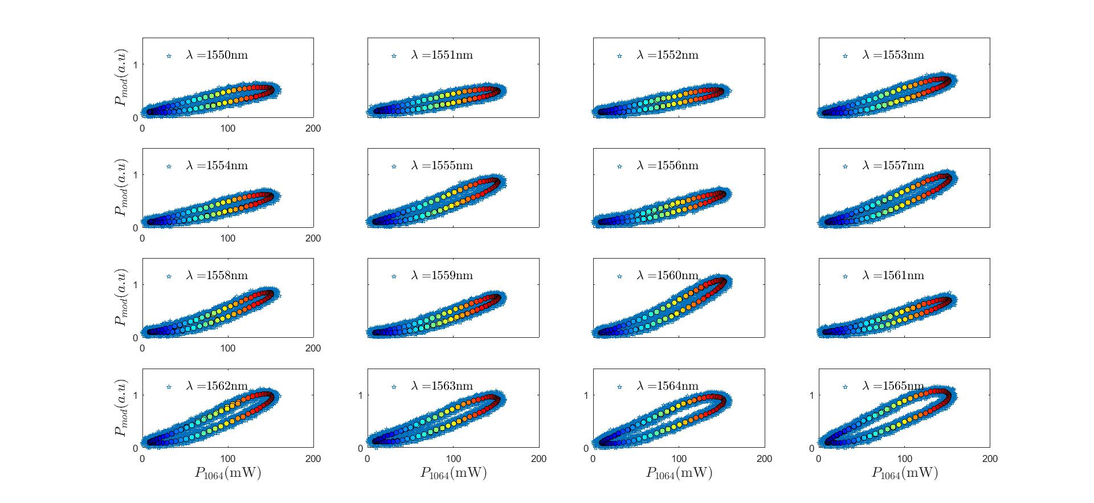
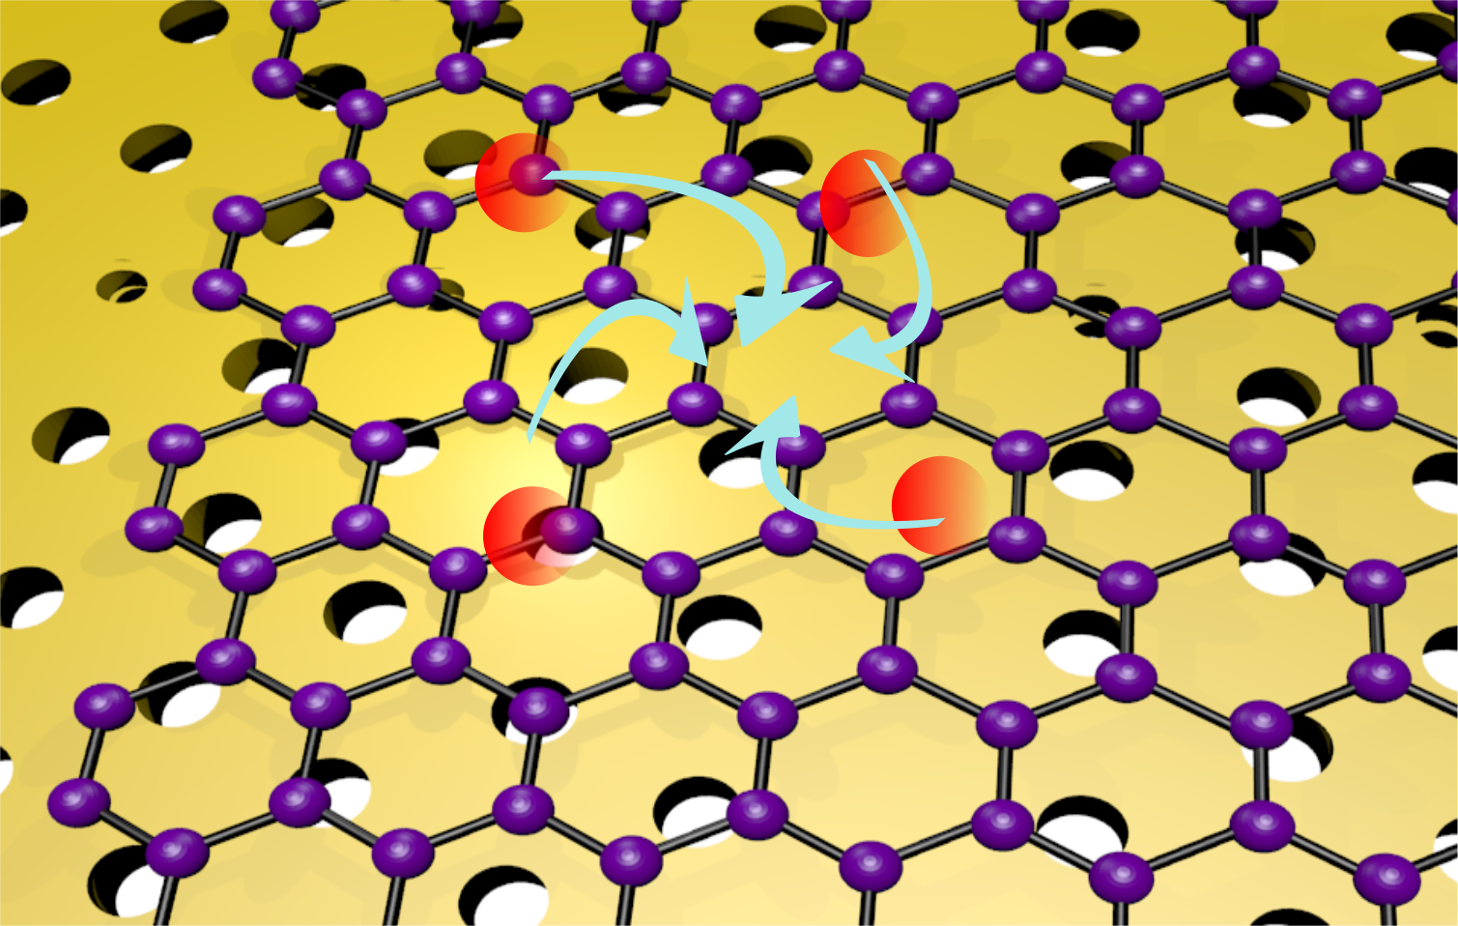
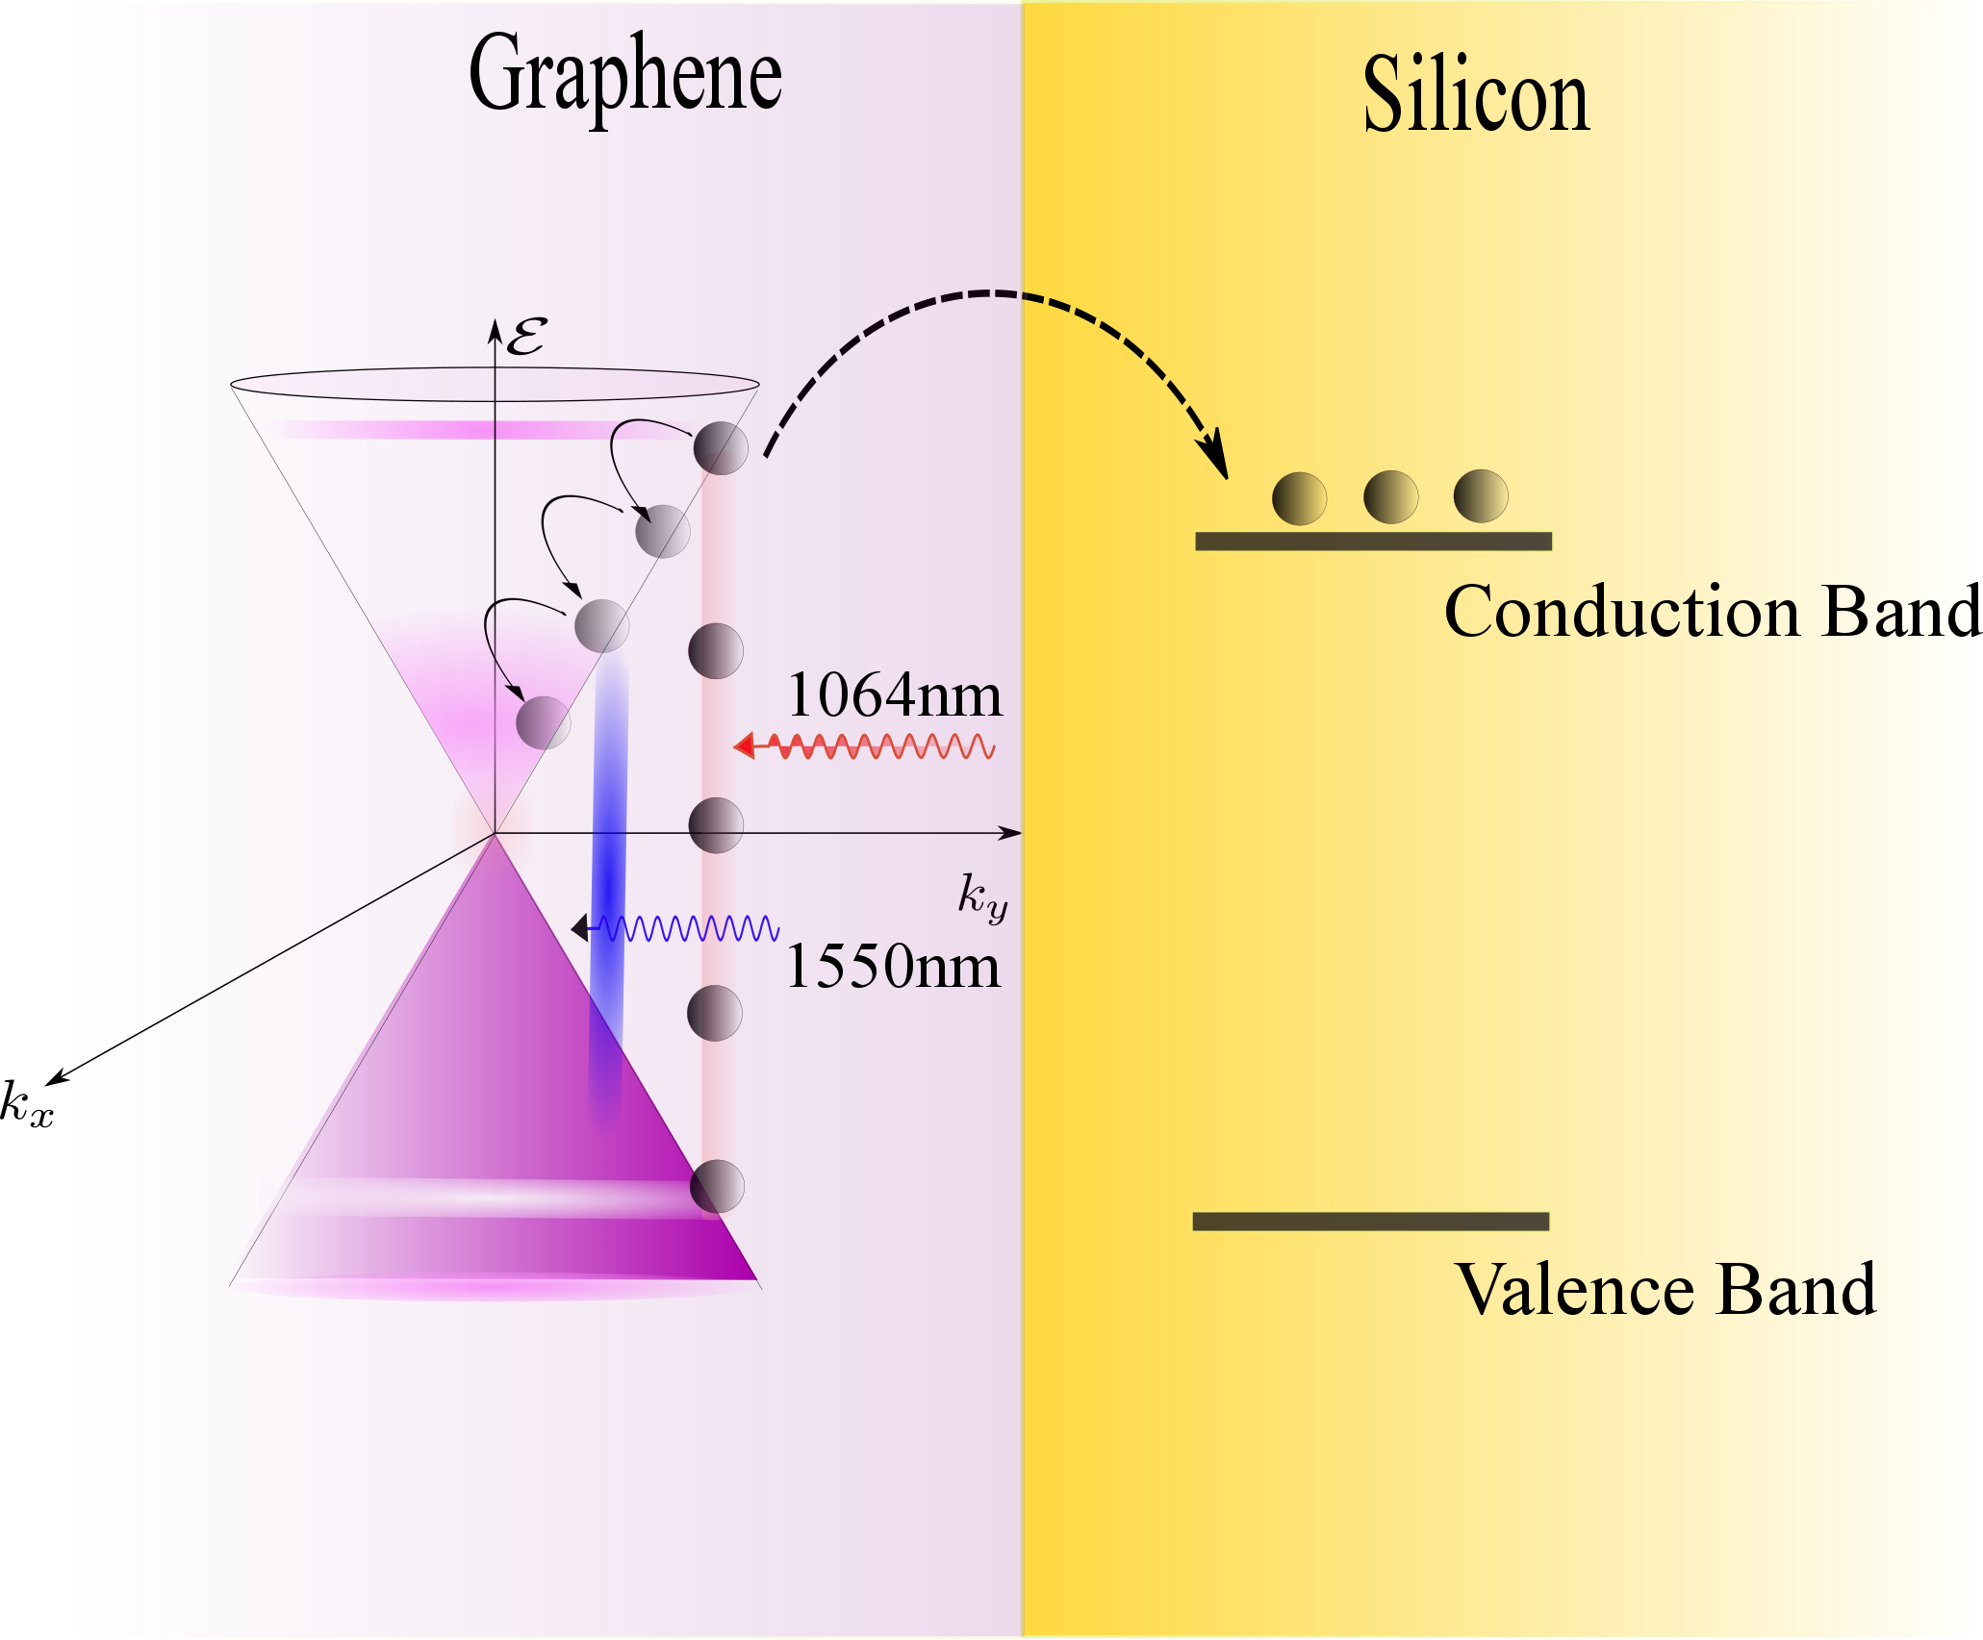
Hysteresis Modulation Pattern

Slide 29
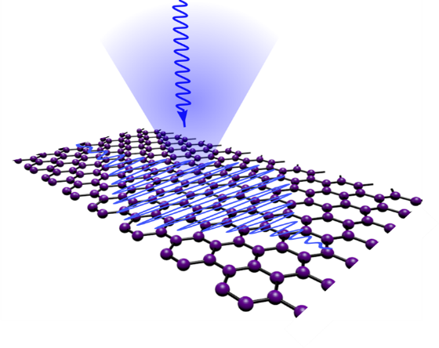
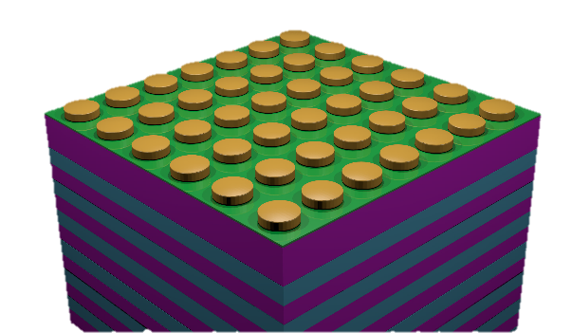
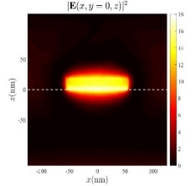
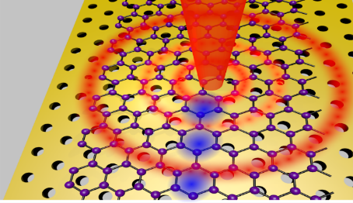
Summary
Quantum theory of nonlinear optical response of graphene
Theory of Spontaneous optical saturation in graphene.
Revisiting perturbative treatment of optical response of graphene
Theory
Experimental characterization of Kerr coefficient of graphene.
Measurement
Hybrid numerical technique.
Plasmon enhanced light-graphene interaction for harmonic generation
Design
Experimental demonstration of All-optical modulation.
Confocal cross-polarized reflectometry of PhC cavities.
100% modulation depth and Non memoryless modulation pattern
Experimental

Slide 30
Current & Future Research Work
Gated samples for Fermi level modulation, control at sample rather than the experimental set-up
Optical Nonlinearity in 2D Quantum Materials
Silicon/Graphene waveguides for nonlinear photonics
Quantum nonlinear optics (Single-Photon nonlinearity in 2D materials)
Ultrafast Carrier dynamics in Graphene probed by fs short pulses

Slide 31
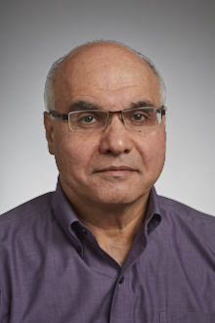







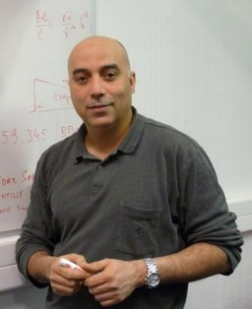
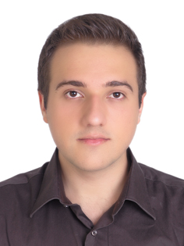
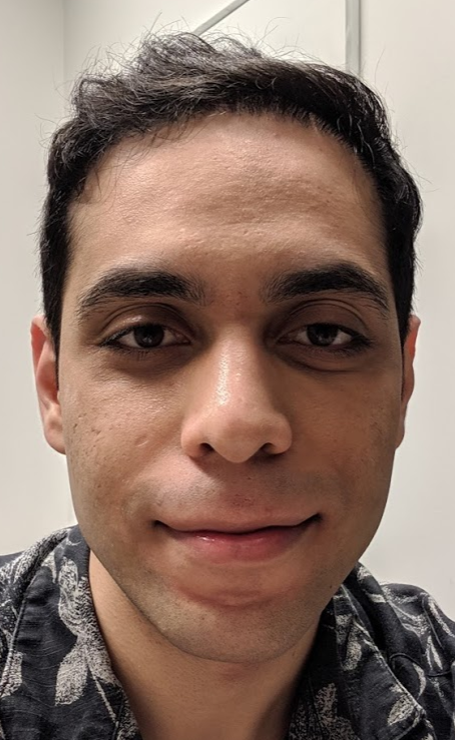
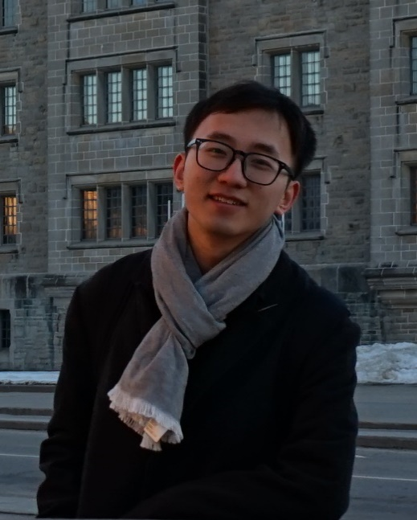
Team & Acknowledgement
Prof. S. Safavi-Neini
Prof. D. Strickland
Dr. Behrooz
Semnani (IQC)
Sidd Thakur
(UW/Bordeaux)
Prof. Brahim Lounis
LP2N Bordeaux
Dr. Milad Khoshnegar
(Nanosecurity, BC)
Amir HajBagheri
Sina Abedi
Mozhang Guo

Slide 32
Thank you!
Questions?

